Slide 1
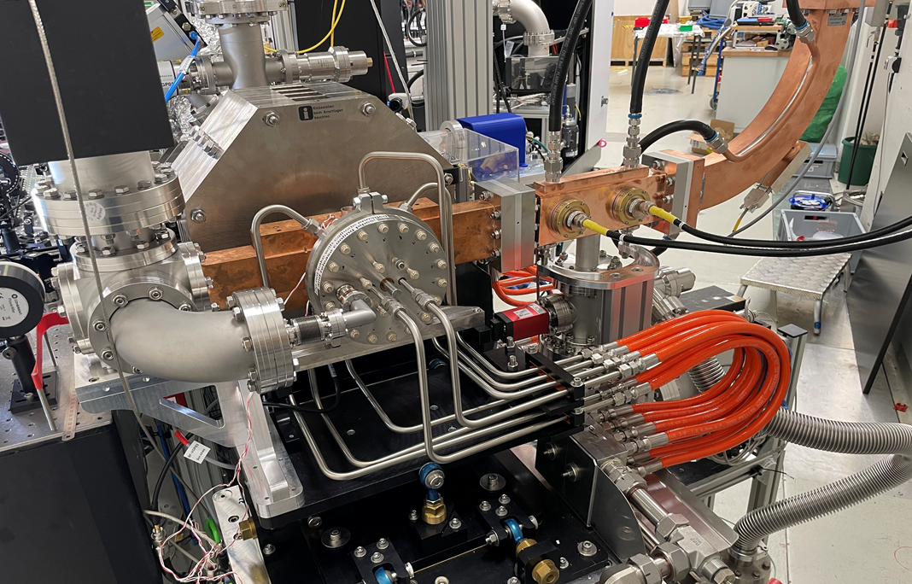
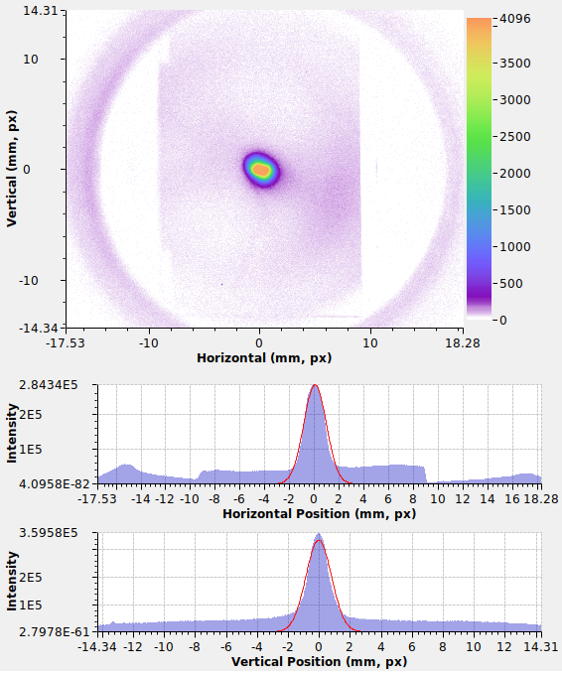
Compact linear accelerator FLUTE: status update
Dr. Anton Malygin on behalf of the FLUTE team
Notes:
Two different examples of electron accelerators will be presented

Slide 2

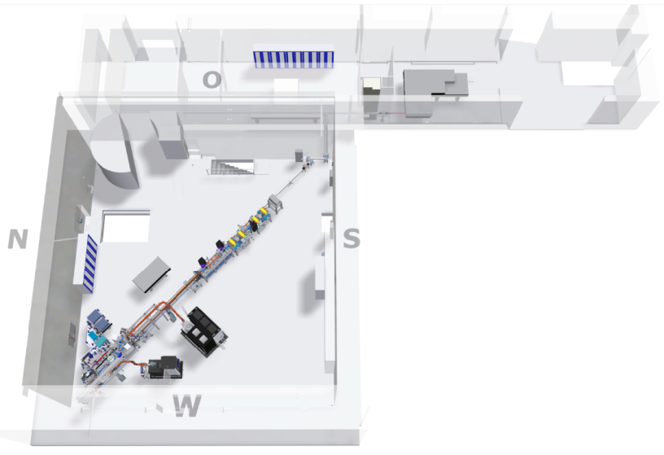




: Accelerator test facility at KIT
FLUTE (Ferninfrarot Linac- Und Test-Experiment)
  Linac-based test facility for accelerator physics
  Experiments with THz radiation
R&D topics
  Serve as a test bench for new beam
  diagnostic methods and tools
  Synchronization up to femtosecond level
  Systematic bunch compression
  and THz generation studies
  Compare different coherent
  THz radiation generation schemes
Final electron energy | ~ 41 | MeV
Electron bunch charge | 0.001 - 1 | nC
Electron bunch length | 1 - 300 | fs
Pulse repetition rate | 10 | Hz
THz E-Field strength | up to 1.2 | GV/m

Slide 3
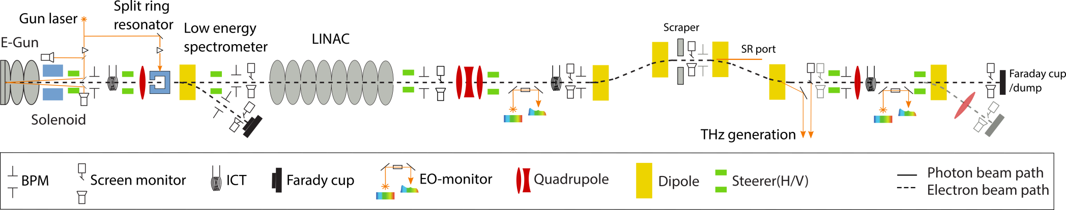
: Layout
5.5 MeV section
41 MeV section
Beam length: 0.5 – 2.5 ps
Buncher and THz section
Beam length: 3 fs – 500 fs

Slide 4
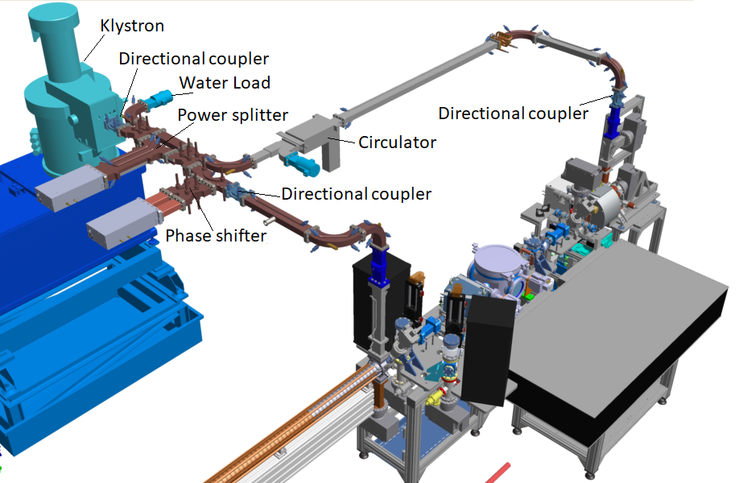
: Configuration of the first RF system
Main challenges of the first configuration of the RF system:
Limited repetition rate of 7 Hz due to the RF photo-injector design
High dark current produced by the RF photo-injector (above 1 nC)
Old modulator design with low stability and reliability
Total energy limited to 41 MeV
Waveguide configuration requires almost the full volume to be operated under SF₆ gas
Klystron:
45 MW
3 GHz
5 Hz
t_{pulse}= 4.5 µs
RF photo-injector:
E_{max}= 100 MV/m
E = 7 MeV
q = 1 pC – 1 nC
t_{beam}= 0.5 – 2.5 ps

Slide 5
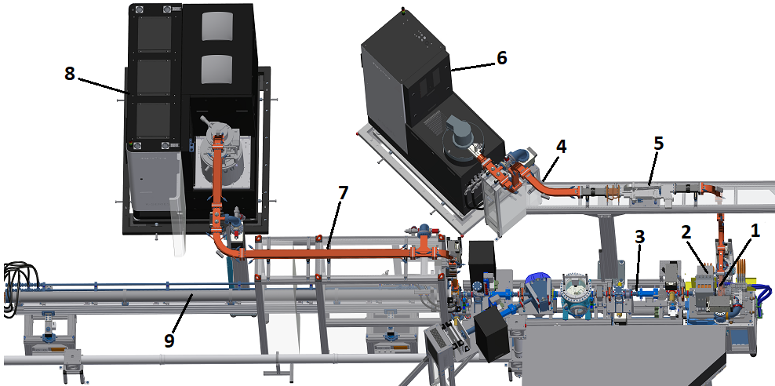
: New RF system
Main advantages of the new RF system
  Higher RF stability (up to 20 ppm)
  Higher energy (up to 90 MeV) and repetition rate (up to 50 Hz)
  Precise positioning for the new RF photo-injector (alignment stand)
  Fully vacuum waveguide system for the linac and smaller volume which requires SF6 gas (for circulator)
37 MW RF unit
3 GHz, 4.5 µs, 50 Hz
10 MW RF unit
3 GHz, 4.5 µs, 50 Hz
RF photo-injector
q = 1 pC – 1 nC
E = 5.5 MeV
t = 0.5 – 2.5 ps
50 Hz
Linac
Diagnostic section

Slide 6
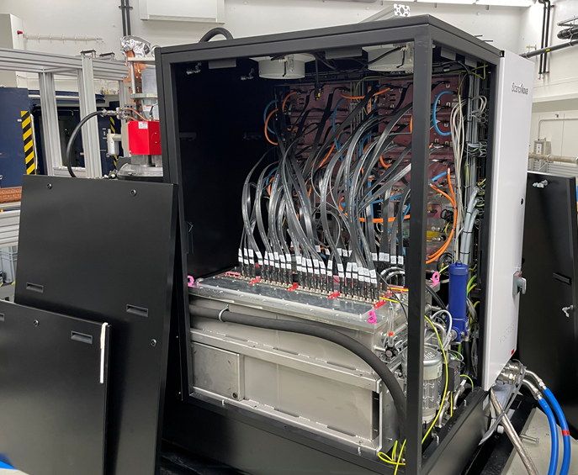
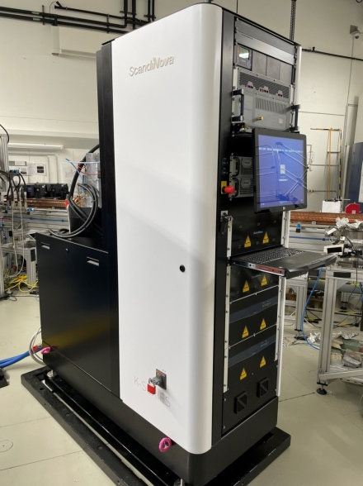
: 10 MW and 37 MW RF units
SAT results
10 MW RF unit – K100
37 MW RF unit – K300
Parameter | K100 | K300 | Unit
RF power | 10.6 | 37.3 | MW
Frequency | 2.997 | 3 | GHz
Output voltage | 177 | 287 | kV
Output current | 135 | 329 | A
RF pulse top flatness | 1% for 4 usec 2% for 5 usec | 1 | %
Repetition rate | 50 | 50 | Hz
Pulse to pulse voltage stability | 18 | 14 | ppm

Slide 7
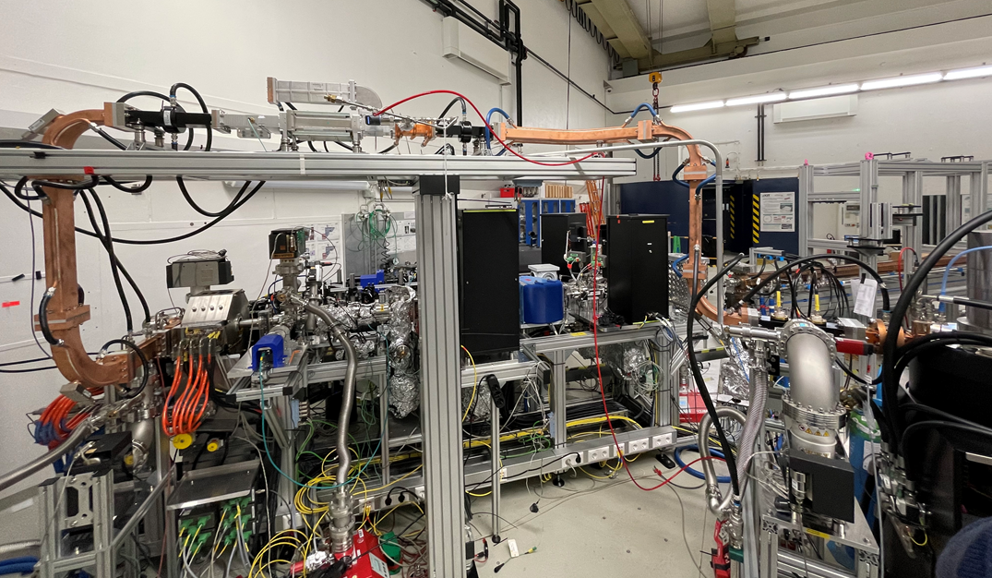
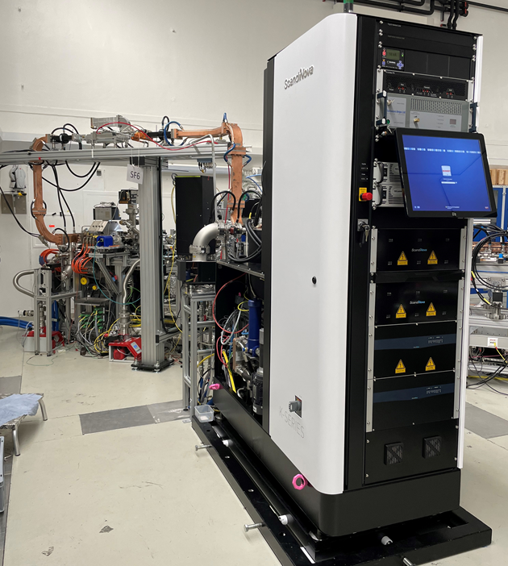
: 10 MW RF unit + waveguide system

Slide 8
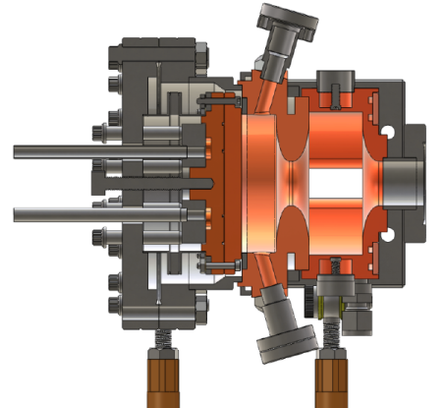
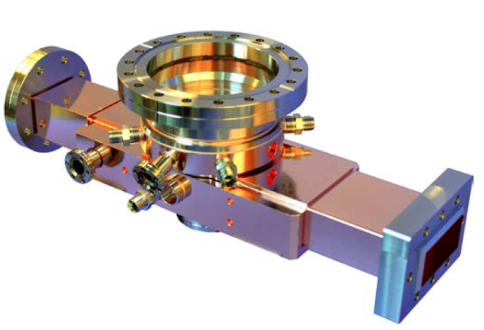
: New RF photo-injector
Cathode
Parameter | Value
Input RF power | 9 MW
Output Energy | 5.5 MeV
Operating Frequency | 2.997 GHz
Maximum repetition rate | 50 Hz
Peak surface field | 102 MV/m
Peak cathode field | 120 MV/m
Maximum bunch charge | Up to 1 nC
Cathode | Removable
Laser injection | On-axis
Dummy waveguide
(with pumping port)
Photo provided by RadiaBeam
RF probe
Input waveguide

Slide 9
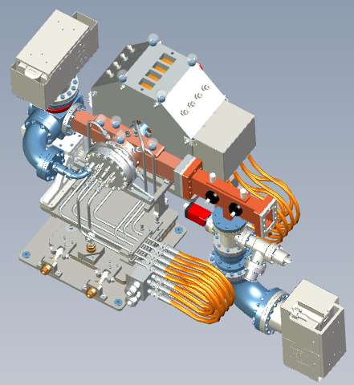
: New RF photo-injector
Parameter | Value
Input RF power | 9 MW
Output Energy | 5.5 MeV
Operating Frequency | 2.997 GHz
Maximum repetition rate | 50 Hz
Peak surface field | 102 MV/m
Peak cathode field | 120 MV/m
Maximum bunch charge | Up to 1 nC
Cathode | Removable
Laser injection | On-axis
RF power input

Slide 10
: New RF photo-injector

Slide 11
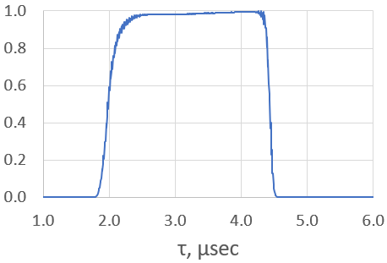
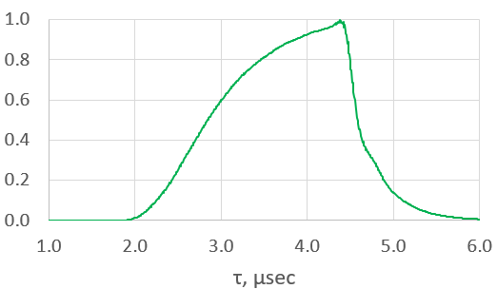
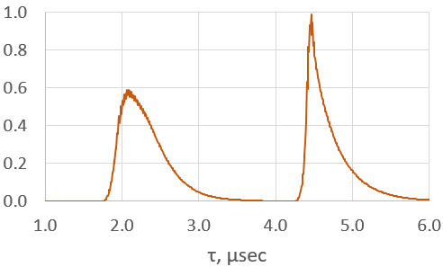

: Experimental results: RF signals
RF input power
RF probe (power inside the cavity)
Reflected RF power
RF probe
Input waveguide

Slide 12
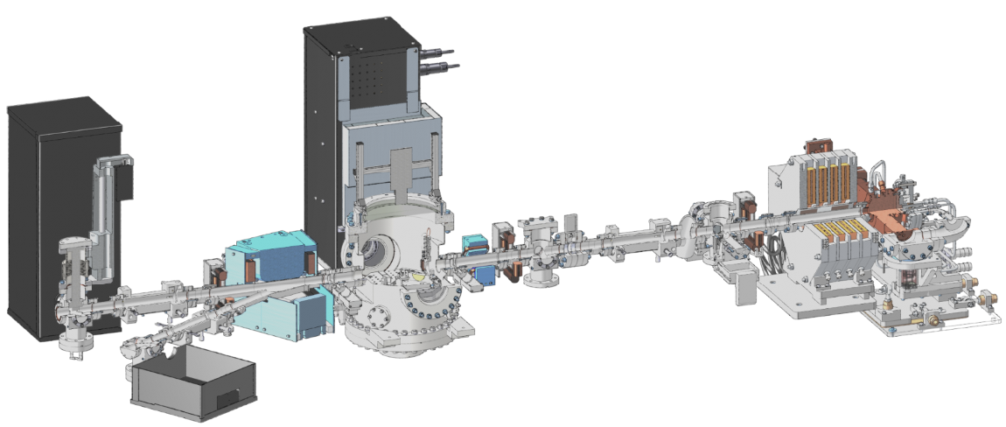
: Experimental results: electron beam
Parameter | Value
Input RF power | 8.9 MW
Output Energy | 5.9 MeV
Repetition rate | 50 Hz
Electron beam charge | 180 pC

Slide 13
: Summary
Installation of the FLUTE's new RF system for the low-energy section has been successfully completed.
Successful RF conditioning up to 50 Hz with RF power of 8.6 MW (with 3.5 µsec RF pulse)
Electron beam with the following parameters was achieved:
50 Hz, 5.9 MeV, 180 pC.

Slide 14

: Next steps for 2024
Further optimization of the laser parameters
Improving stability of the 10 MW klystron
Electron beam’s characterisation operating with the new RF system
  beam profile, electron energy, bunch charge
TÜV inspection of the personal safety system for continuation of the FLUTE operating license with the new RF system
Operation of FLUTE for the first users:
experiments for detector developments and medical applications
RF conditioning of the linac with the new 37 MW RF unit
Offering of FLUTE for international users within EU project’s EURO-LABS Transnational Access: https://web.infn.it/EURO-LABS/transnational-access/

Slide 15
Back-up slides

Slide 16
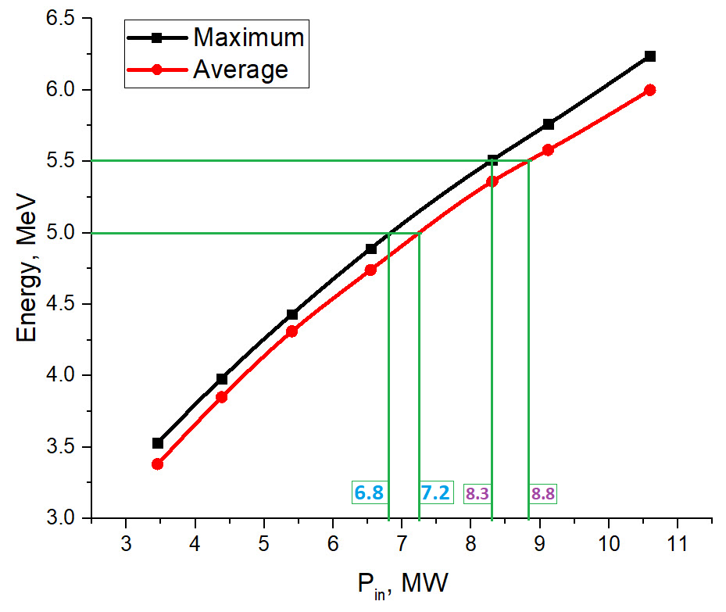
New RF photo-injector

Slide 17
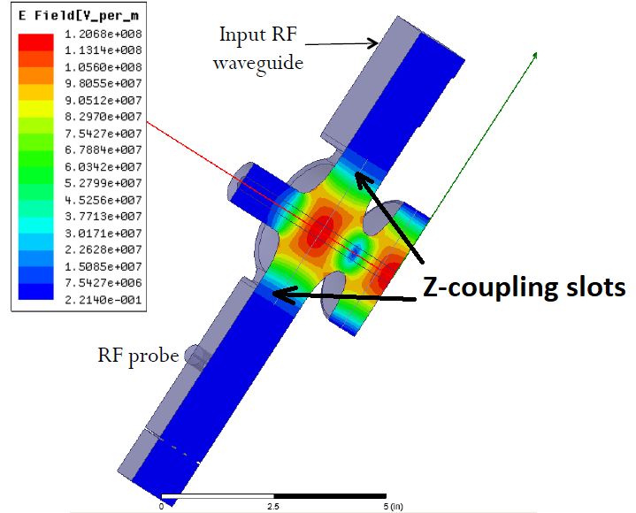
New RF photo-injector

Slide 18

RF photo-injector cross section
Bi-directional tuners
Cathode
Cooling pipes
Waveguide coupling port

Slide 19
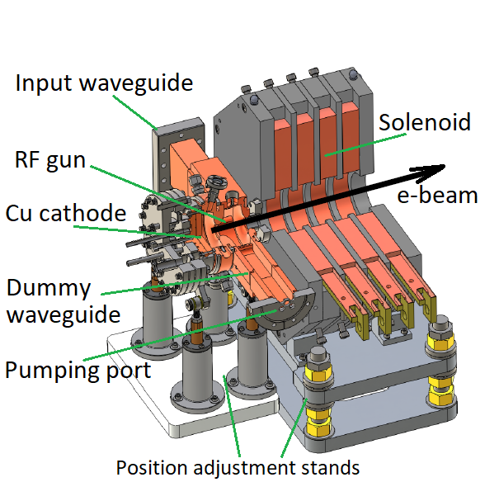
RF photo-injector cross section

