Slide 1
Toward SOLEIL Upgrade : Means, Resources and Strategy
Nicolas Béchu for SOLEIL II Project Team - Synchrotron SOLEIL

Slide 2
More Outlines than a Summary
Maybe need New Title
Toward SOLEIL Upgrade : Project Status and R&I Strategy
SOLEIL II in brief : a wide upgrade perimeter
  SOLEIL II ultralow emittance storage ring
    Still in lattice optimisation
    Impact of ID portfolios
    The collimation problem
  New low emittance booster and injection scheme
  Beam lines upgrades
  A work still in progress : R&D multiples initiatives
Removal and installation phasing strategy
The alignment requirements and consequences
Buildings for the preparation phase
Master planning toward a scheduled dark period
Actual scenario : Do what you know with available resources

Slide 3
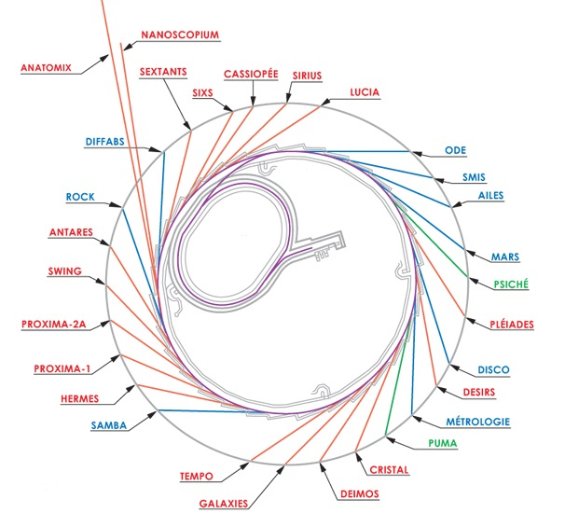
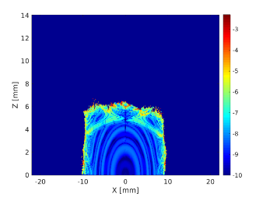

SOLEIL II perimeters : Many Upgrades
Upgrade of the LINAC @ 150 MeV
before end 2025 – beginning 2026 (before shutdown)
New low emittance booster (140 nm.rad →) 5.2 nm.rad (close to actual SOLEIL ST)
→ MBA with VC 12 mm x 22 mm and emittance exchange feature (tilted Qpole)
Strong work on optimization of dynamical aperture
New non-standard storage ring 12x 7BA - 8x 4BA
From 16 cells DBA → 20 cells with straight sections adapted to SOLEIL beam lines
Re-localization of 7 BL and require all other BL optimized to benefit from new source (realignment & modifications)
+ Upgrade of infrastructures : IT and services (cooling, air conditioning, power supply… not every things know at this time?)

Slide 4
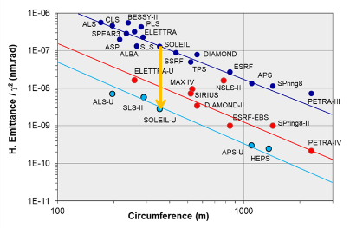
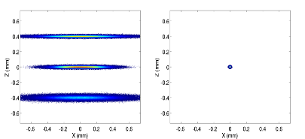
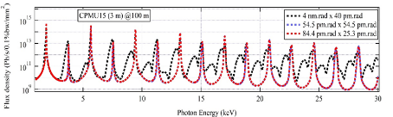
SOLEIL II Storage Ring in Brief : Main Parameters
SOLEIL II small circumference → best emittance normalized to energy, in its category, of 85 pm.rad
→ more risk based on SOLEIL’s expertise
Leads to a special geometry 12x 7BA + 8 x 4BA with the same circumference of 354 m and the same energy of 2.75 GeV
← Hope to offer the same current and the same spectral range
→ Higher field gradients : Qpole > 100 T/m, sextupole > 8000 T/m² with small bore radius of 16 mm
very small vacuum chambers with diameter down to 12 mm
+ NEG coating (almost 100 % cover compulsory)
R&D on PSD Vs. pumping balance (ok down to ø6 mm)
Compacity & miniaturisation : dipole & reverse bent with extensive use of permanent magnets
+ small Qpoles + strong sextupoles
→ Increase non-linearities → injection !
Accumulator (no) or work on dynamical aperture with off-axis injection → MIK
Power economy ++
10 µm round beam in both planes
Ultra-low emittance → narrow spectral peaks for BL
RMS size of the electrons beam
400 μm
10 μm
SOLEIL
SOLEIL II

Slide 5
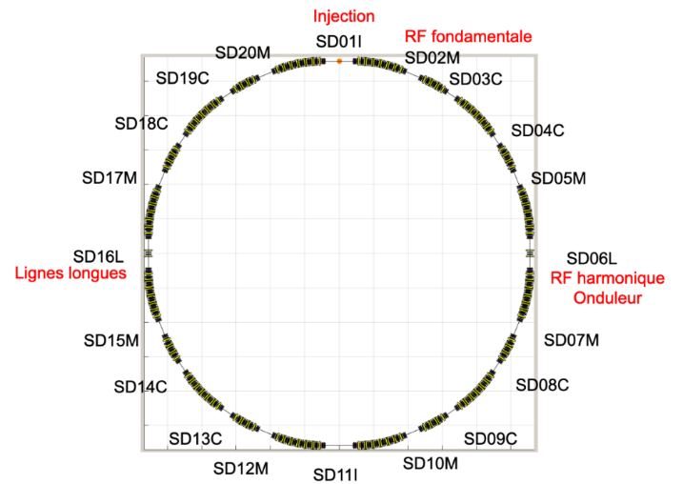
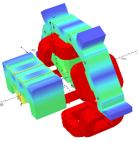
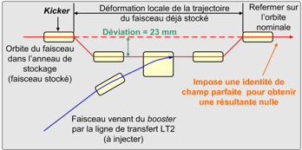
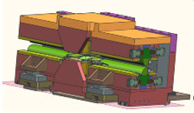
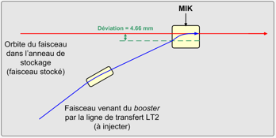
SOLEIL II New Lattice : a Work Still in Progress
New ST 12x 7BA - 8x 4BA with 20 Straight Sections
→ equivalent 22 SS with 7 ≠ length in order to keep most BL
A lot of accelerator physics optimization on beta functions
→ THE lattice (still not frozen)
Compactness → Qpole & sextupoles very close → crosstalk
Optimization of injection and beam dynamics
→ fist day injection with 4 kickers – future with MIK, and also harmonic cavity
10 µm alignment of matching sections to reduce dipolar correctors strength (else not possible)
Need to improve collimation (because of permanent magnet !)
Localized loss in dedicated area ! But VC so small → distributed loss !
still in reflexion / estimation of risks
Possibility of 8 super-bends @ 3T (middle of 7BA)
A lot of work on photons extraction and mechanical integration
(For now extraction still complicated for some BL)
Work in progress (well advanced) on lattice (maybe June 2024)
+ still problems with canted beam lines (keep actual 2 long beam lines with triplet in a shortened straight section !
Problem of bore radius Vs photon extraction (power management in VC to protect PM) : last problem
Standard 4 kickers Injection (SOLEIL)
New extra injection off-axis with MIK
Multi Injection Kickers (MAX-IV/SOLEIL)

Slide 6
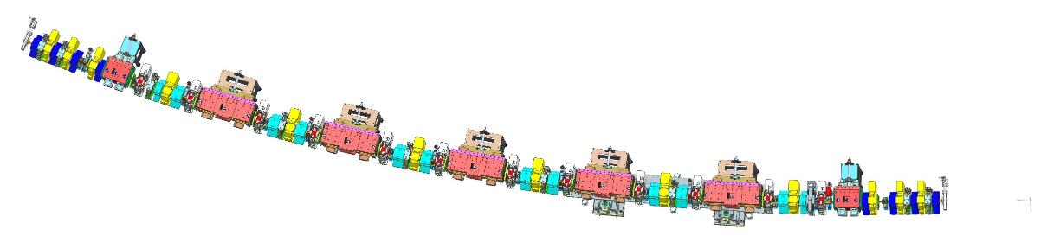
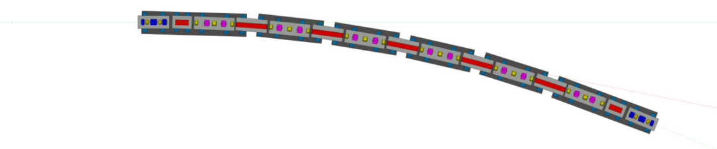
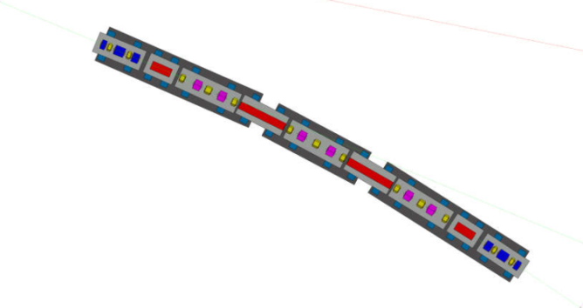
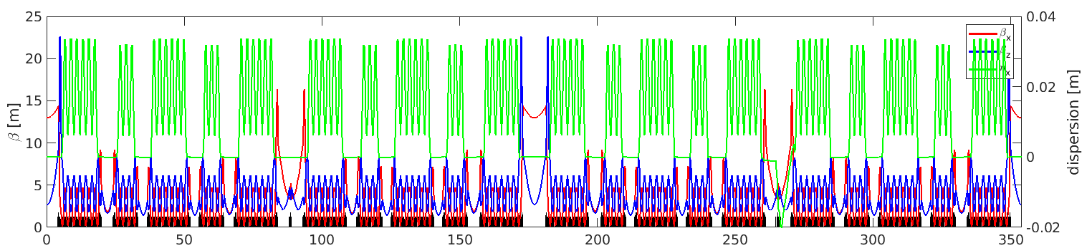
SOLEIL II New Storage Ring
An example of 7 bending achromat
Matching Section IN
Q & S skewer to be aligned down to 10 µm
Sextupoles
Reverse Bend
Quadrupoles
DNC1.01
Octupole (QP + QT)
DNL1.02
DNL1.03
7 BA
0°
DNL1.04
SDL
dipole
DNL1.05
MS OUT
DNL1.06
DNC1.07
SDM
SDC
7 BA
4 BA
0°
0°
SDC
4 BA
dipole
0°
Storage
Ring ¼
SDM
7 BA
Full storage ring optics with equivalent of 22 SS
0°
dipole
SDL

Slide 7
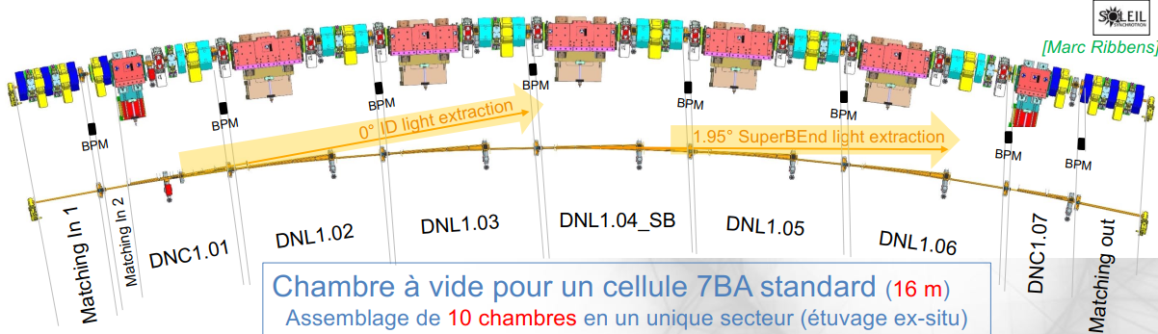
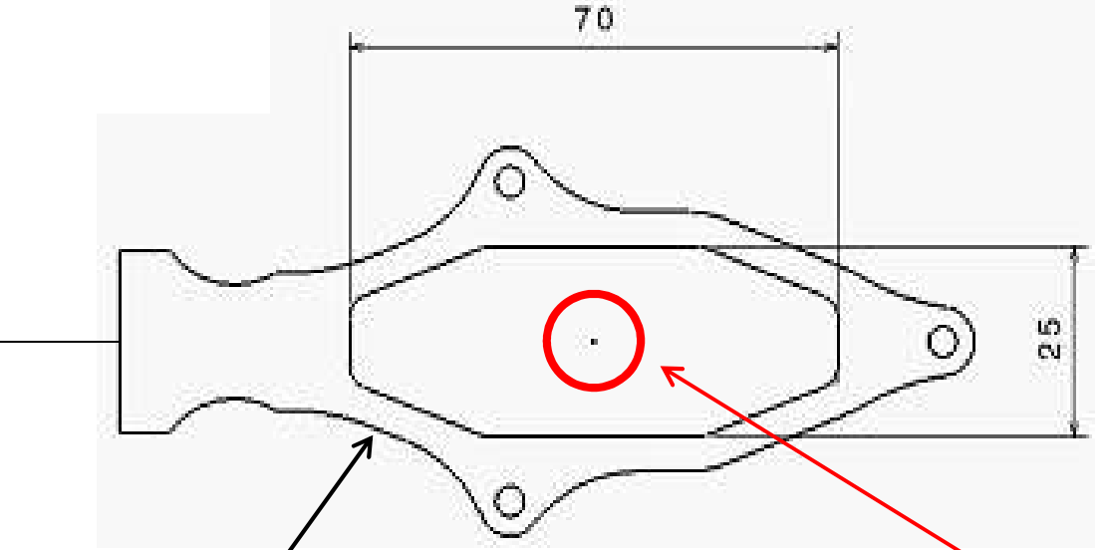
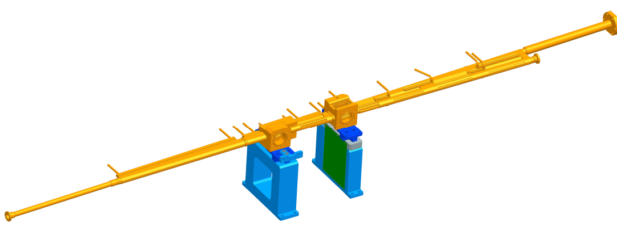
SOLEIL II Vacuum System
7 BA → Would be a unique sector “vacuum string”
between 2 RF shielded sector valves (specially developed).
Each 20 vacuum strings composed of 4 or 7 dipole vacuum chambers and 2 matching VC,
with combined getters and sputter ion pumps,
12 VS of 16 meters,
& 8 VS of 9 meters,
would be copper based (CuCr1Zr & OFS-Cu),
fully 0.5 µm NEG coated and activated ex-situ.
→ Still in conception
Actual SOLEIL (mm)
SOLEIL II DN12 mm

Slide 8
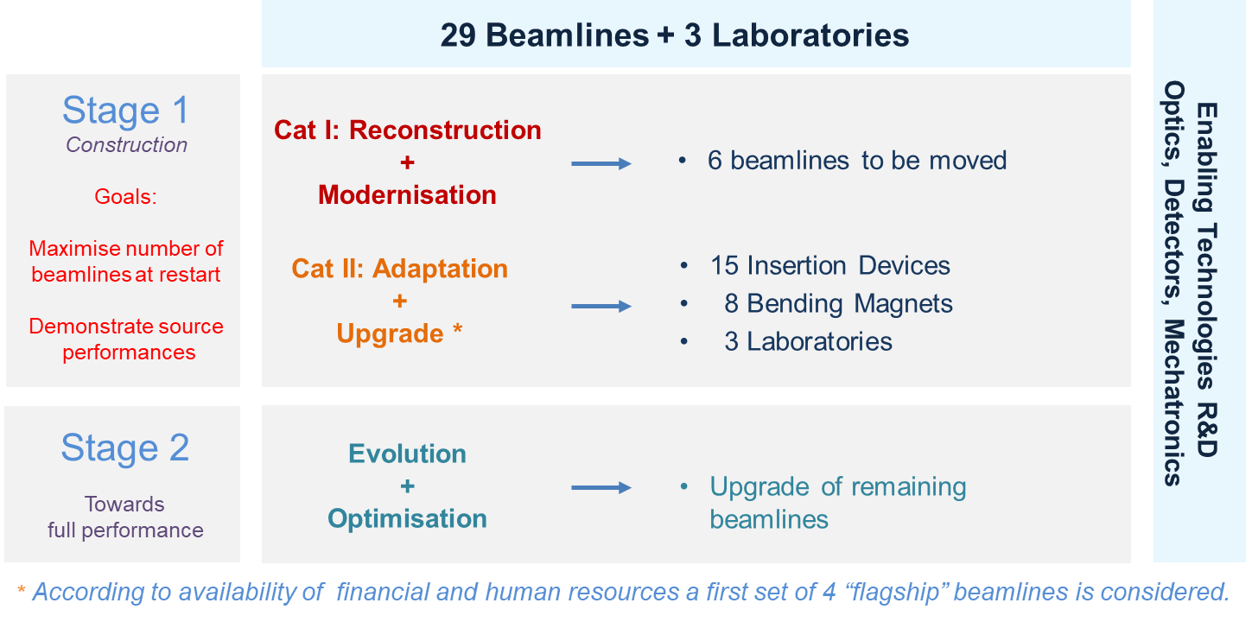
The BL² Program : BeamLines and Labs Upgrades
Category I BL : 7 to be moved
Cat. II BL : to be realigned #
2025
CASSIOPEE I15-M → SDM 20
ID: 14 BL
Pleiades
Puma
Cristal
Galaxies
Tempo
Hermes
Swing
Antares
Anatomix
Nanoscopium
Sextants
Sixs
Sirius
Psiche
BM: 7BL
Metrology
Samba
Rock
Diffabs
Ode
Mars
Smis
Disco
7
LUCIA I16-M → SDC 03
14
AILES I01-C → D6 20
2029
DEIMOS I07-M → SDL 06
→ SDL 11
2030
DESIRS I05-L → SDL 06 *
→ SDL 11
2034
PX1 I13-M → SB 3T
Compulsory movements because of source changes
→ 7 BL required reconstruction + a lot of realignments
+ Adaptation to benefit from new Machine performances
Each BL had its own TDR with upgrade propositions to be arbitrated
Program // to Machine upgrade with still a lot of questions about scopes, means and resources
BL² in needs of building for relocating existing labs + answer to new labs and new workshops demands
→ a work in progress, with the beginning of a relocation scenario, to be included in R&I…
PX2b I14-M → SDM 17
* No move
# no horizontal displacements of the source in the straight sections

Slide 9
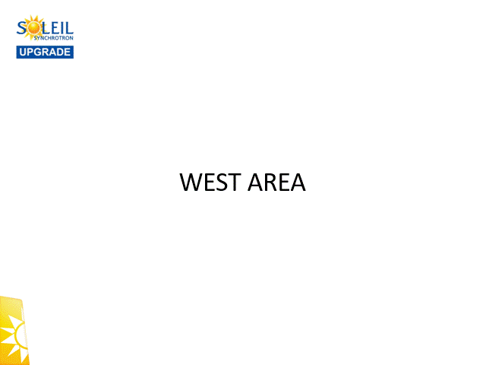
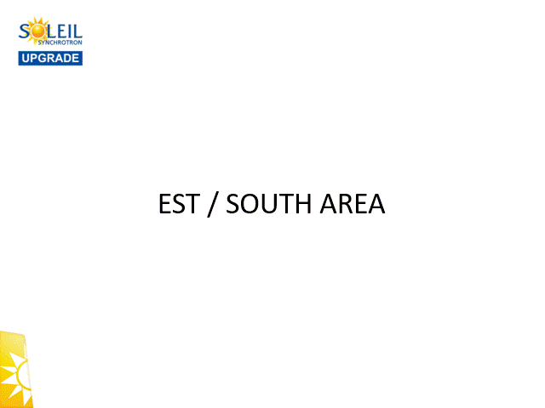
BL² Work Scenarios for Beamlines Relocation
First valse WEST: AILES / LUCIA / CASSIOPEE + SMIS
+µscope-SHG, Chem Lab annex, µ-fluid Lab annex
On WEST ear hypothesis (not validated)
SAMBA (1° correction) and METRO (split) reconstructions
→ Second valse EAST & SOUTH: DESIRS / DEIMOS
+ CRYO-TEM sensitive device working during shutdown
SOUTH ear → LN2 tank upgrade + 30 m SWING tunnel !

Slide 10
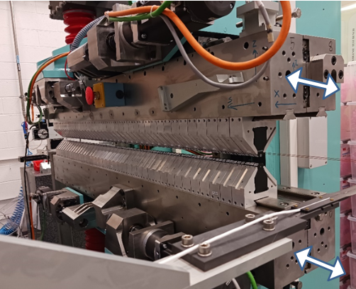
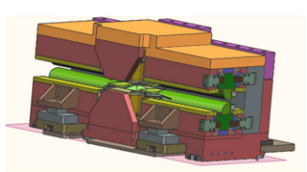
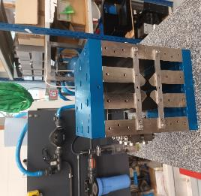
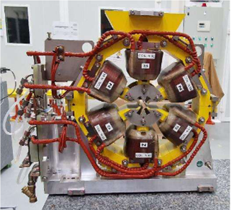
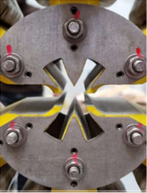
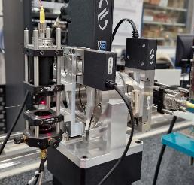
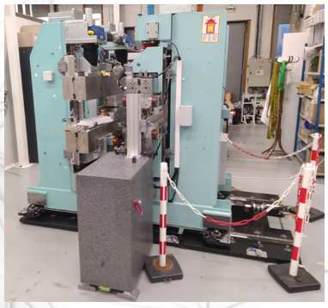
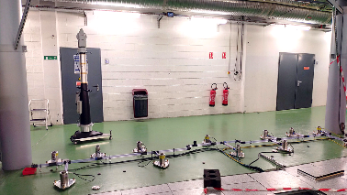
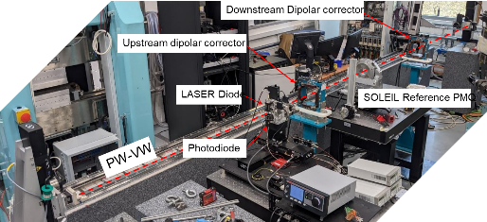
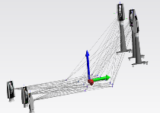
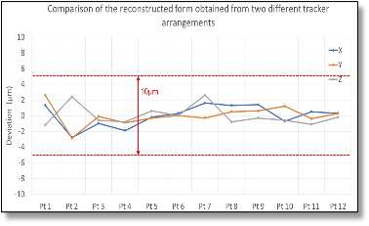
A Work in Progress and Many R&D Initiatives
Actual many prototyping on magnets (PM and electro) and IDs (biperiodic ID patent pending)
Development for alignment to 10 µm : correlated alignment & and vibrating wire

Slide 11
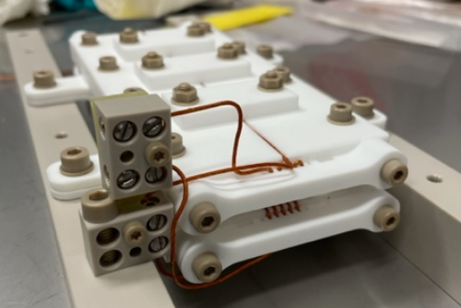
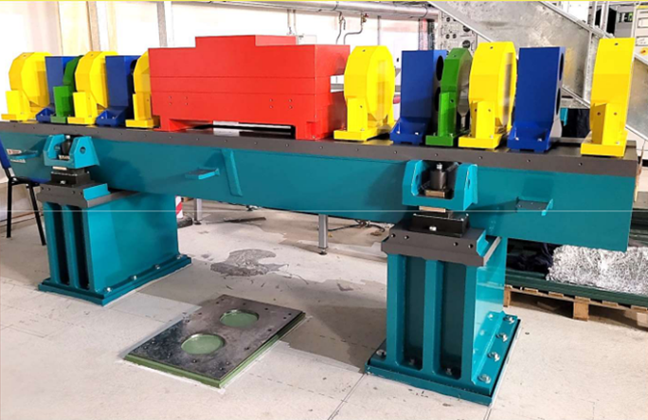
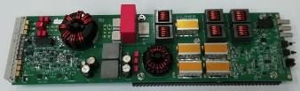
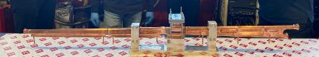
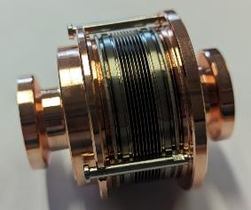
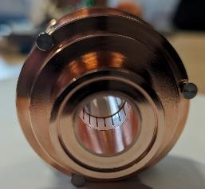
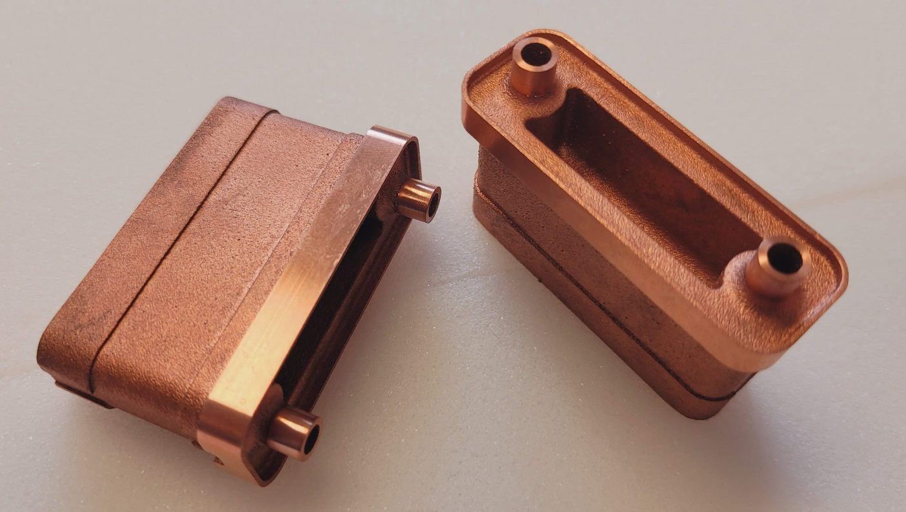
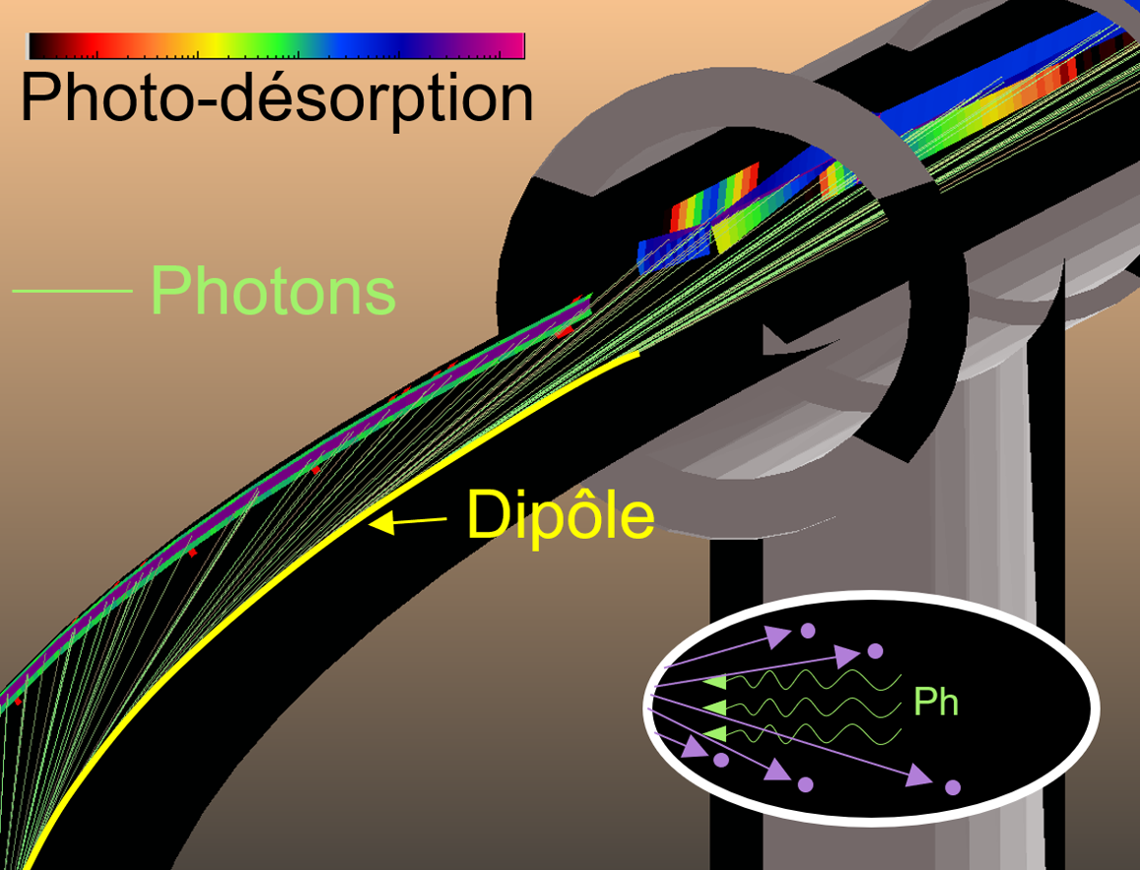
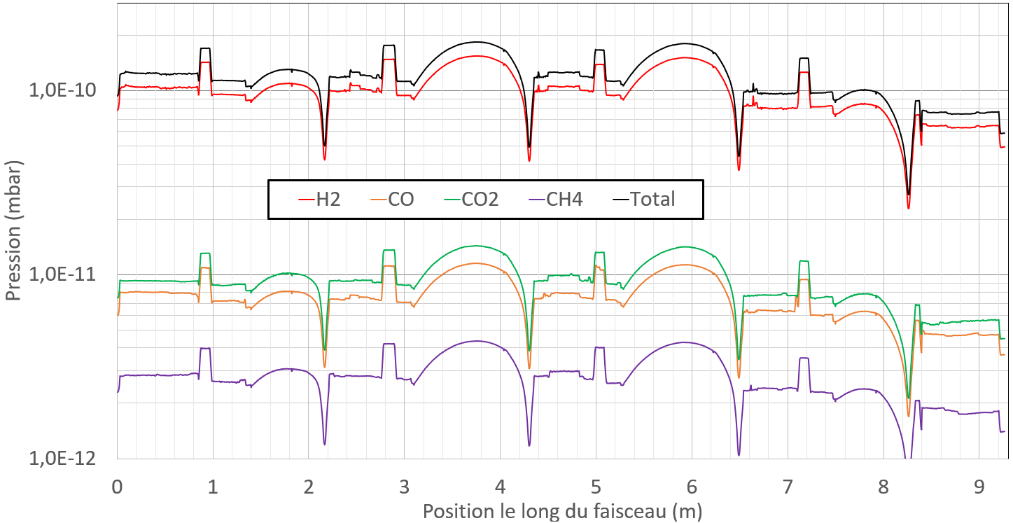
A Work in Progress and Many R&D Initiatives
In-vac MIK Girder design and vibration measurements
Power supplies (FGC CERN collaboration)
VC proof of concept for 16 m vacuum strings (ex-situ activation)
Additive manufacturing for crotches absorbers
Miniaturization of RF bellows
MOLFLOW & VacuumCOST simulations
for pressure profiles with NEG and PSD

Slide 12
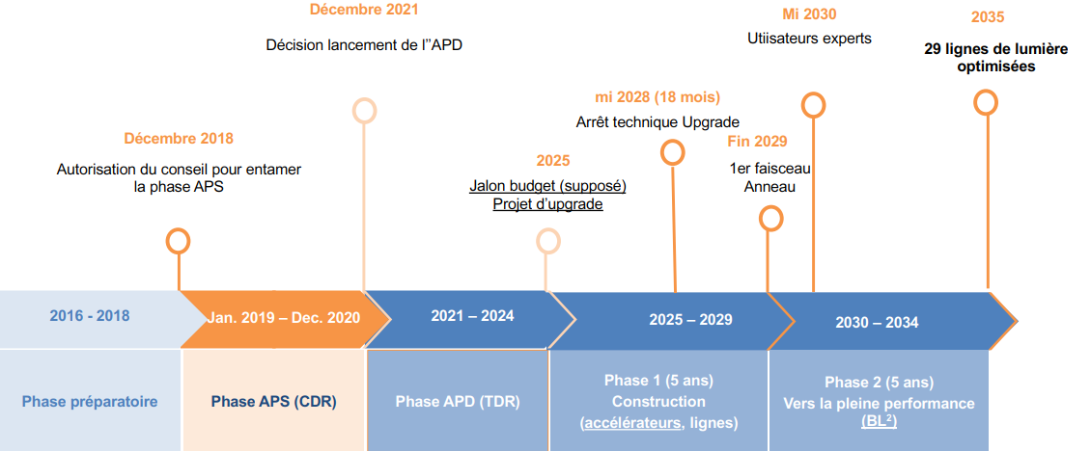
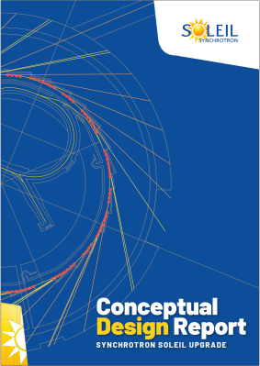
From Project to Buildings Strategy
SOLEIL II chronology
Original timeline in French, sorry
  CDR done → TDR till end 2025 → construction to come
→ shutdown for October 2028 / dark period of 18 months
Still in TDR phase with many prototyping
First budgets granted since beginning of the year :
38M€ for 2024-2025 French “Loi de Programmation de la Recherche” (Research Ministry)
After 2030 toward full performance on all beamlines
Actual project structuration // solving problems and freeze final lattice (October 2024)
Project organization beginning 2025 with consolidated resources
Now R&I hot topic → buildings for preparation phase need to be launch ASAP
Octobre 2028 (18 mois)

Slide 13
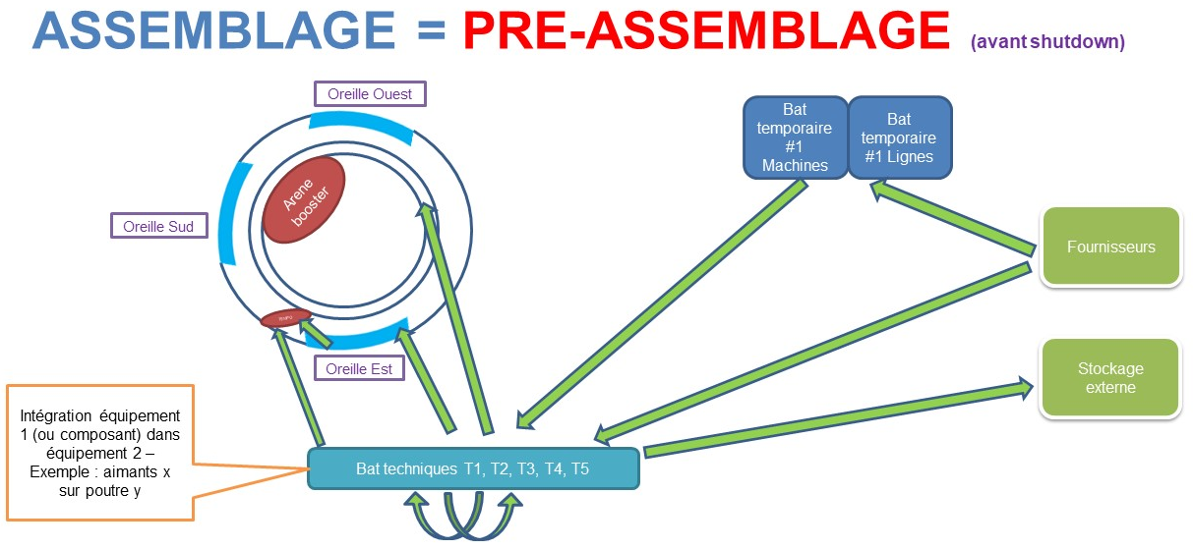
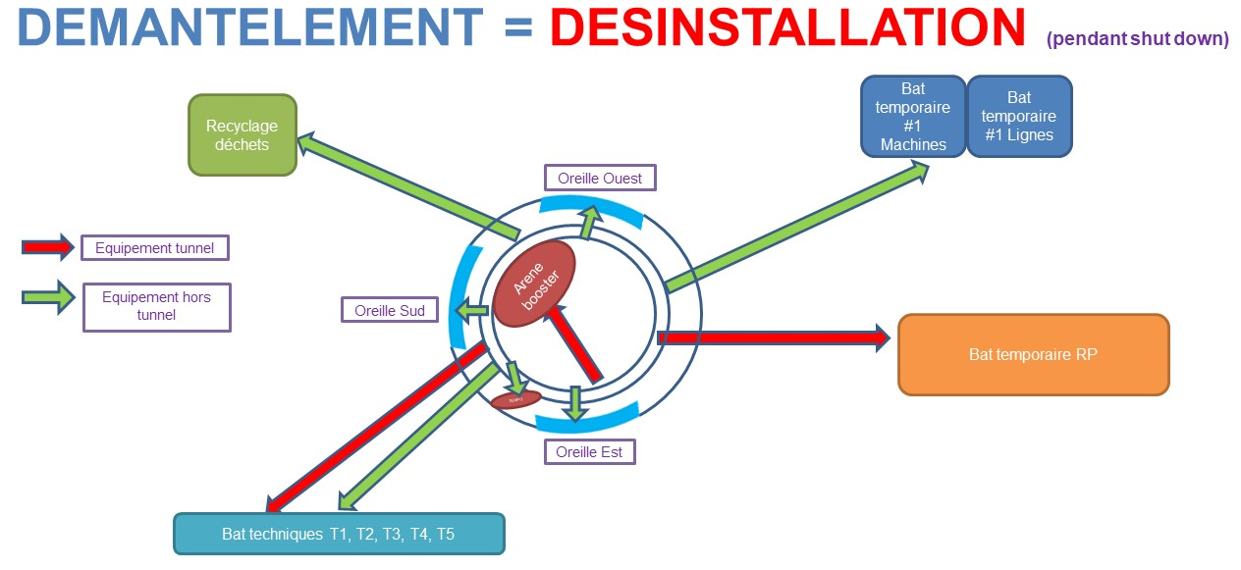
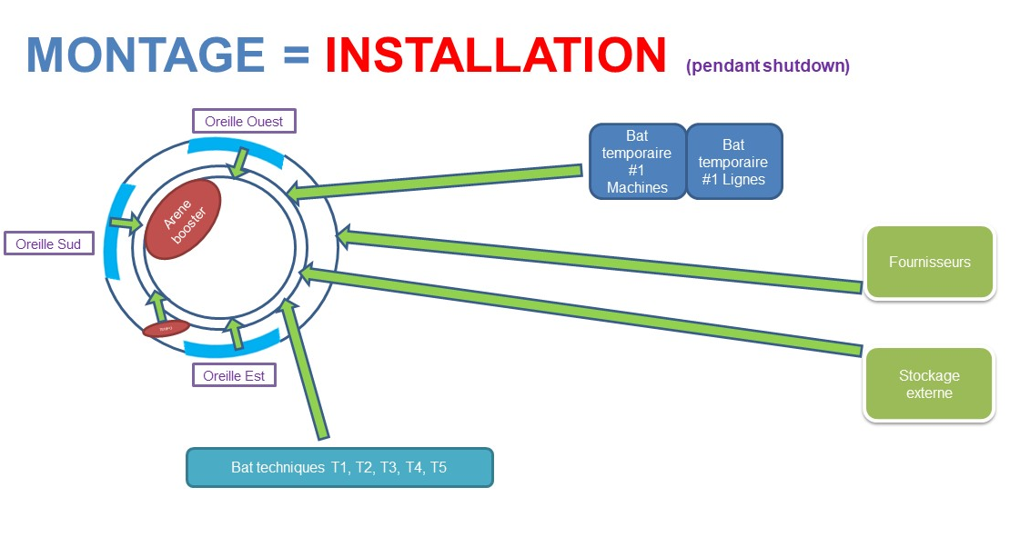
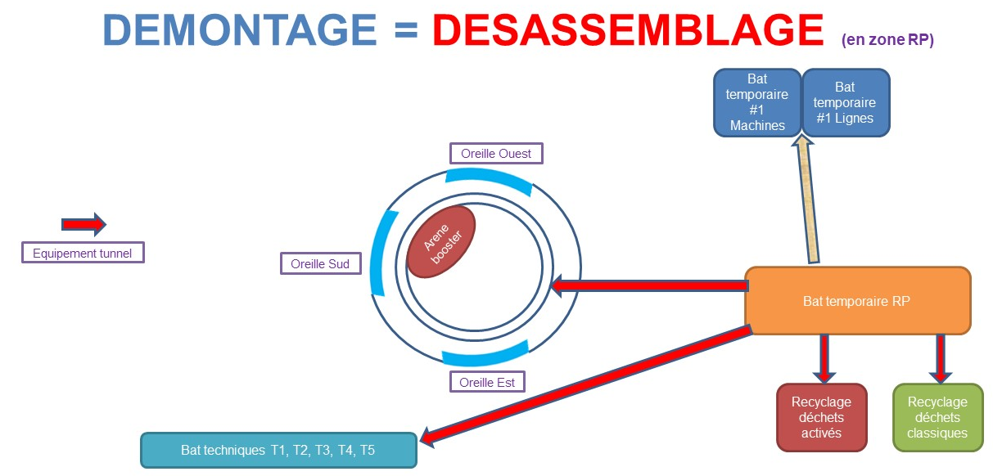

R&I Key Point : Phasing Operations
before shutdown
during operation
Assembly = Pre-mounting →
Dismantling = Removal → during shutdown
radiation safety
temporary zone for years…
Beforehand
Dismounting = Disassembly →
Mounting = Installation → during shutdown

Slide 14
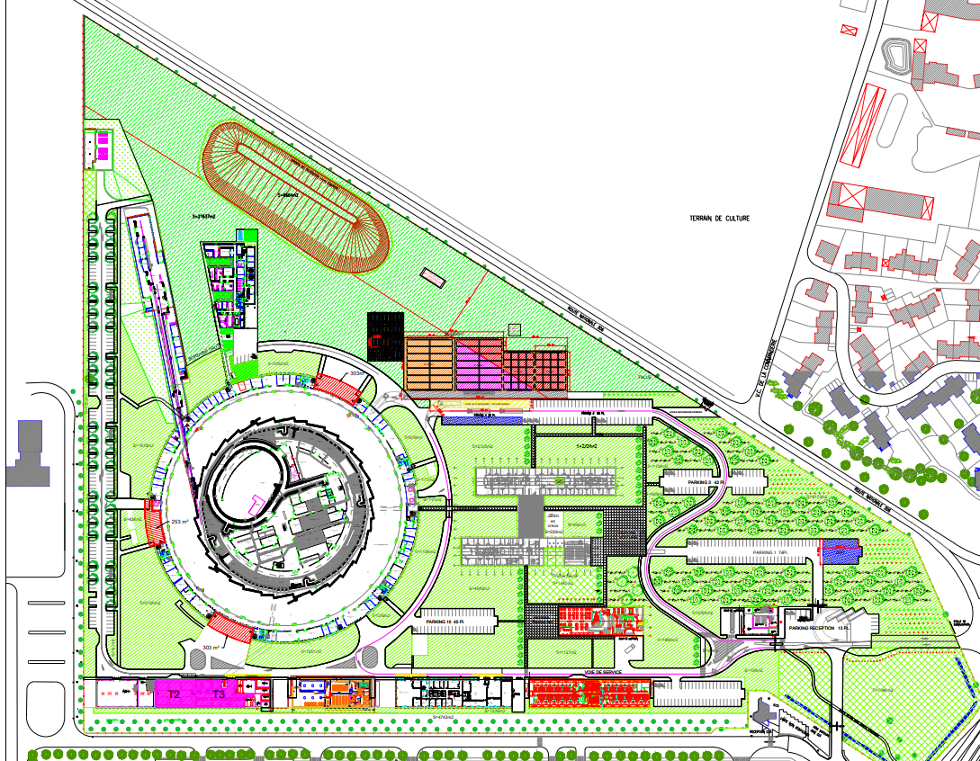
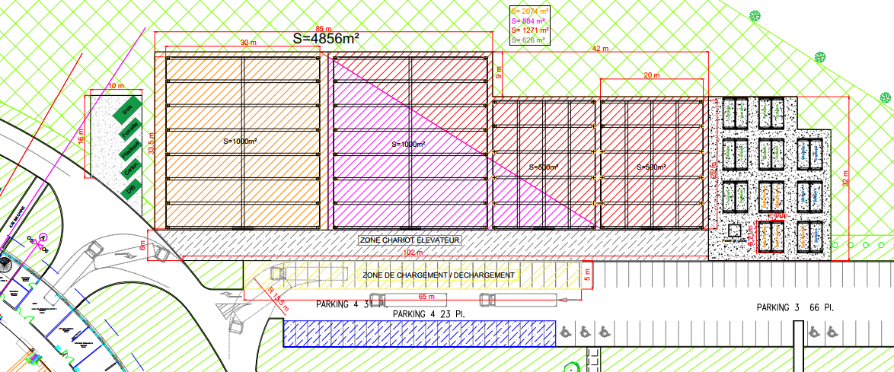
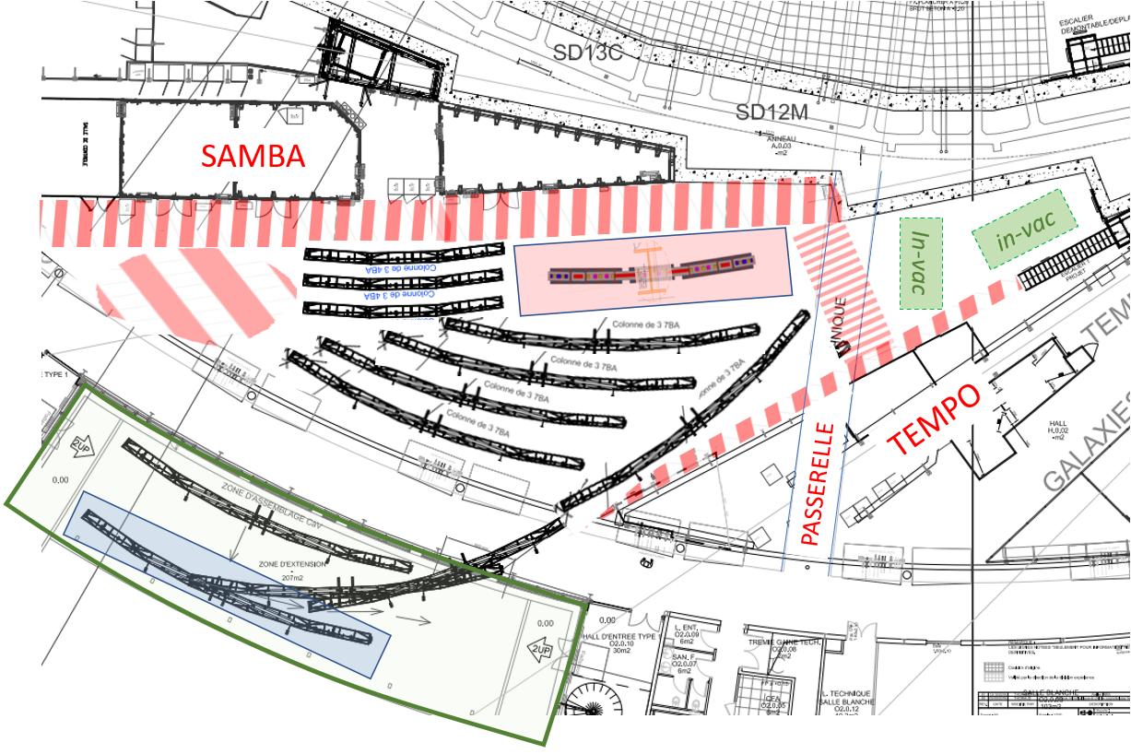
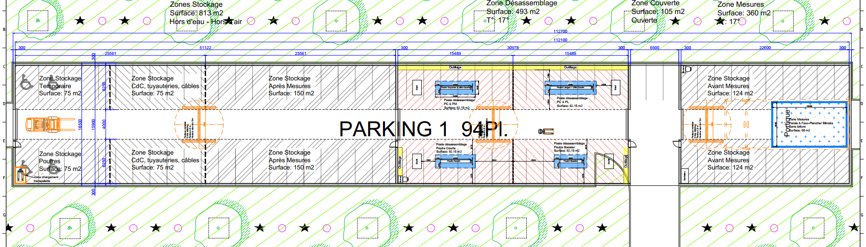



Inventory of “Considered Available” Space On-Site and Foreseen Destinations
Temporary buildings on meadow
Center of the Booster for racks and power supplies…
South Ear BL² storage
West Ear BL² labs
East Ear and “TEMPO” area for Vacuum strings and Mock-up
Radiation Safety temporary building
T3/T2 after T7 advent +T1 workshops or storage
T5
Buffers areas in
experimental hall during dismantling
Master plan

Slide 15


Vacuum Strings Activation & Storage in Synchrotron Building
new BL location
With minimum construction in EST ear associated to existing EXP zone :
Possible to mount, activate and store all the 20 vacuum strings within the synchrotron building (compulsory for handling)
Also possible to have Mock-up there until shutdown or later,
then temporary loading/unloading zone for R&I
May have to share the zone with BL constructions (SAMBA strong realignment & new BL location DESIR2 or DEIMOS)
And / or to set it free during shutdown

Slide 16

Beamlines Relocations All-over the Experimental Hall
Ph. Hollander, P. Prigent (12/oct/23) basics for BL²:
3 independent working areas
All beamlines work till shutdown
Chem & µFluid labs’ annex,
CRYO-TEM work during shutdown
Heavy optics kept on exp hall
Move away furniture to allow space
AILES2 optical hutch installed before shutdown
West & south ear area with 2nd floors (sharing ears OK)
DESIRS2 optical hutch installed before shutdown on TEMPO area
Sharing crane for optics during removal ?

Slide 17







Radiation Safety Temporary Area on Parking lot
Slope and ground quality management on parking P1!
→ towards Fenwick with central alley
Need more surface and radioprotection area sanctuarized
Whole parking surface (~1900 m²) could be used
Even partially before shutdown for bare girder storage
Limitation of 5/6 years → could be reduced afterwards
Before shutdown ~400 m²: bare girders storage → 2 identical superimposed with wooden supports or in stackable crates
Modularity = cost effective .
avoid “just-in-time” flux
After disassembly ~T0+6 months
→ reduce storage down to 900 m²
360 m²

Slide 18


The Preassembly Master Plan in Technical Building 5
Ideas : Minimal construction (± 1°C regulation only) + phasing with possible flexibility
In rehabilitated technical buildings T5 :
Phase 1 : Assembly & metrology of magnets
(PM & electro) 18 months
Phase 2 : Assembly & metrology of Matching sections to 10 µm
(± 0.1°C hutch) 42 weeks (critical path)
// Assembly & metrology of all other standard girders
Phase 3 : IDs mounting for years...
Transitory storage in other rehabilitated technical buildings T2 / T3 (magnets, girders…)
→ Then Off-site storage of ready-to-install girders before installation
PAU R&I3 - 18-20 March 2024 – Trieste 18

Slide 19

General Planning for Buildings with Possible Flexibility
At T₀ all girders assembled but keep Matching bench until end of the installation in case of bad survey
2026
2027
2028
PAU R&I3 - 18-20 March 2024 – Trieste 19

Slide 20




Uninstalling Scenario for Storage Ring Tunnel Removal
Objective: minimizing transport times with cranes!
straight sections
achromats
evacuation with crane
evacuation with trolley via exterior passageway
buffer unloading areas on exp hall
PAU R&I3 - 18-20 March 2024 – Trieste 20

Slide 21


Conclusion and perspectives
Trying to stick to my original title :
Toward SOLEIL Upgrade : Means, Resources and Strategy
We do go toward SOLEIL upgrade with some uncertainties
Means : not so much… everything is on-site, we do have ideas
Resources : some groups really in needs (only 2 people 100% dedicated) buildings ! (nothing validated for BL²)
Strategy : phasing, cutting, almost dissecting…
do what we know to do, just like during technical shutdowns
(many small slabs openings for R&I…)
→ Minimizing constructions, but need to start ASAP in 2024
Questions
For more on an almost complete uninstalling scenario,
→ Please see François Trias’ talk later on…
PAU R&I3 - 18-20 March 2024 – Trieste 21

