Slide 1
PIP-II Project – Linac Overview
Michael Geelhoed, Deputy L2 Manager LI&C
3rd Workshop on Particle Accelerator Upgrade - Removal and Installation
March 2024
FERMILAB-SLIDES-24-0046-AD-PIP2

Slide 2
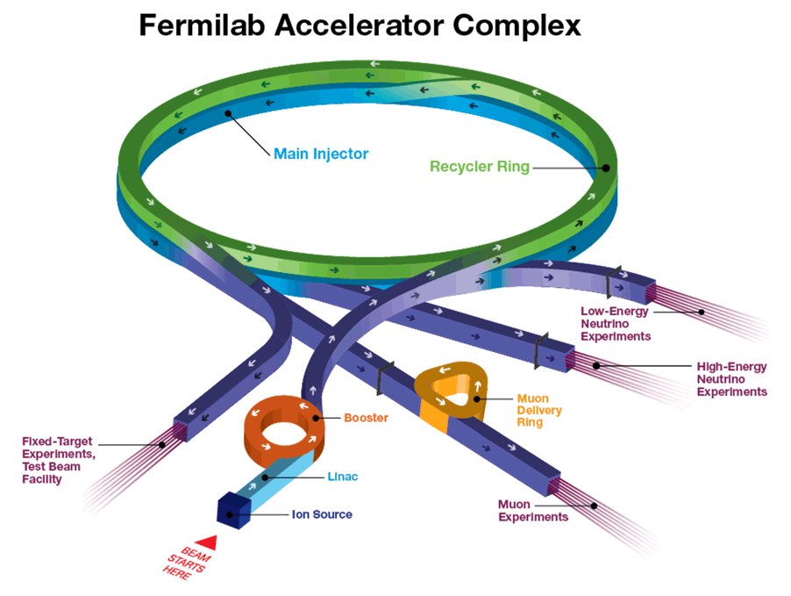
Outline
Complex & Mission
Linac Installation Scope
Hardware Process
Installation Planning & Coordination
Enclosure Configuration
1999
1970
1982
1970/1993
1970/2012

Slide 3
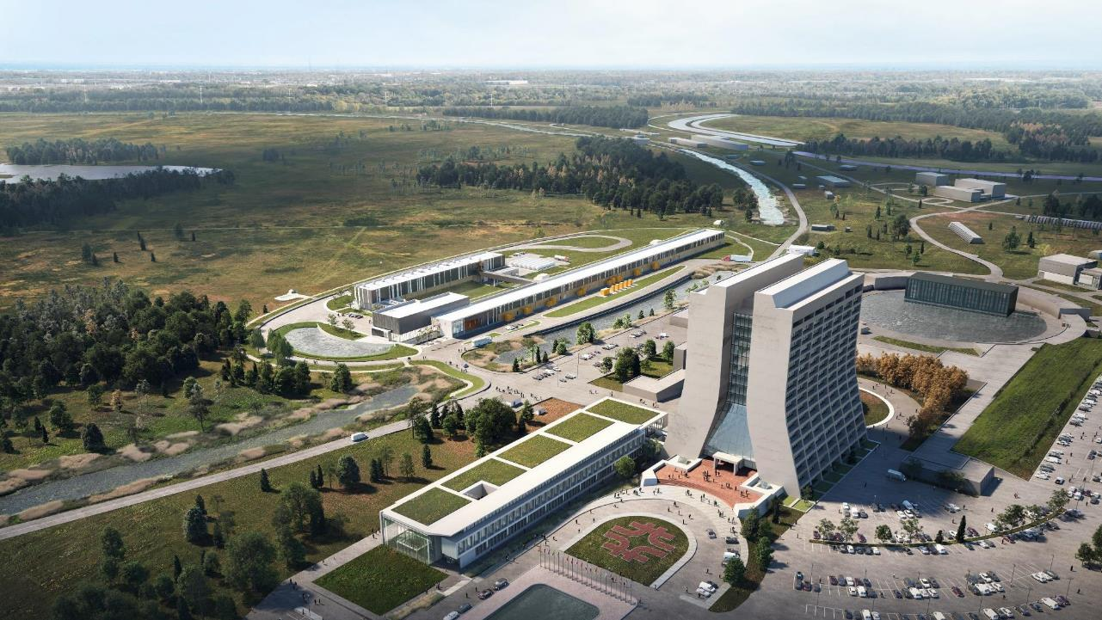
Main Injector
Transfer Line
PIP-II
SRF Linac
Booster
PIP-II will provide a highly capable, reliable, upgradeable and expandable scientific infrastructure with significant savings to DOE

Slide 4
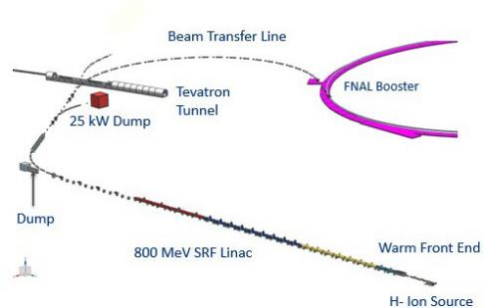
PIP-II Mission
PIP-II is an essential upgrade to Fermilab accelerator complex to enable the world’s most intense beam of neutrinos to LBNF/DUNE, and a broad physics research program for decades to come.
PIP-II Capabilities
Beam Power
PIP-II Scope
800 MeV H− SRF linac CW RF Operations
Linac-to-Booster transfer line Accelerator Complex Upgrades
Booster Recycler Main Injector
Conventional Facilities
Space reserved for two CMs for 1 GeV Upgrade
1.2 MW proton beam
Upgradeable to multi-MW
Flexibility, multi-user capability
CW-compatible
Customized beams
Multi-user delivery
Reliability
Modernizes Fermilab accel complex
The PIP-II scope enables the accelerator complex to reach 1.2 MW proton beam on LBNF target

Slide 5
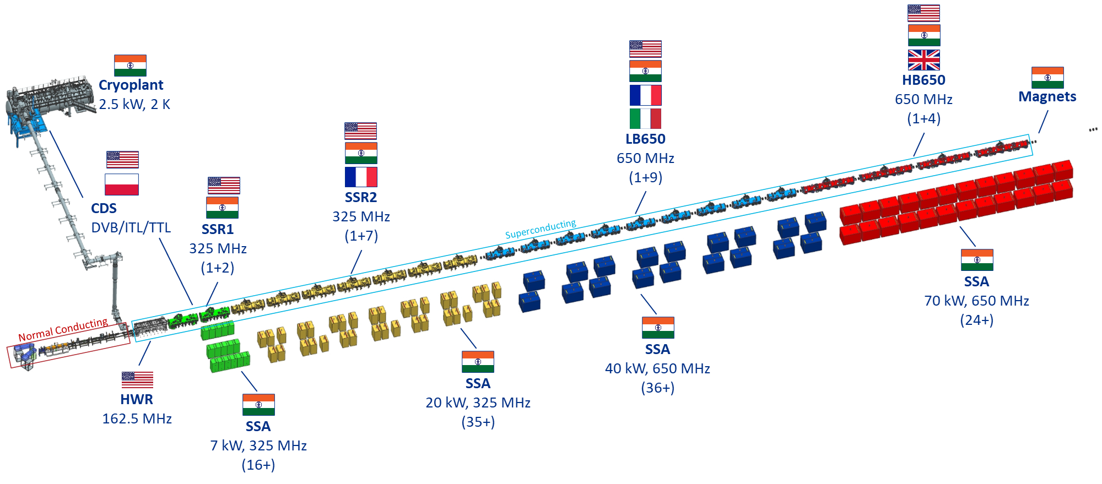
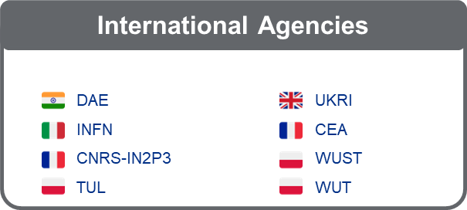
Superconducting Linac
Notes:
From Source to last HB 650 CM slot ~ 250 meters

Slide 6
Key Performance Parameters
# | Scope | Threshold KPPs | Objective KPPs
1 | Linac Beam Energy | Accelerate H- beam to 600 MeV | Accelerate H- beam to 700 MeV Linac systems required to accelerate beam to 800 MeV installed and tested
2 | Linac Beam Intensity | Beam delivered to Beam Dump at the end of Linac | Beam with intensity of 1.3E12 particles per pulse (H-) at 20 Hz delivered to Beam Line Dump
3 | Booster/ Recycler/ Main Injector upgrades | Booster, Recycler, and Main Injector Upgrades to support operations with beam power of 1.2 MW on the LBNF target are installed and tested without beam | Linac beam injected and circulated in Booster
Objective KPPs are aligned with the baseline project scope. However, the normal operating beam parameters:
800 MeV
20 Hz
<2 mA>
4.97E17 particles/hr 17.6 kW

Slide 7
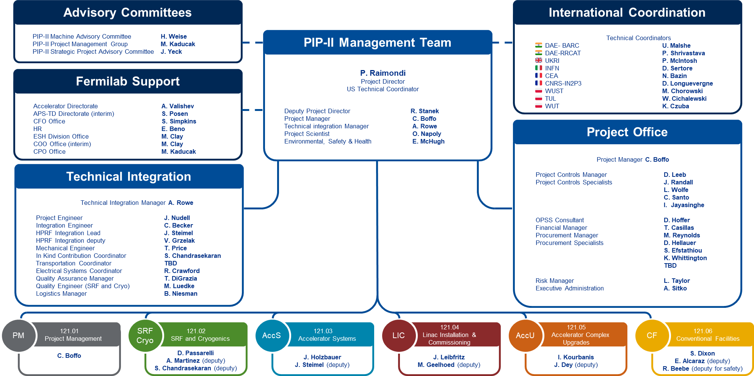
PIP-II Project Management and L2 Systems and Managers

Slide 8
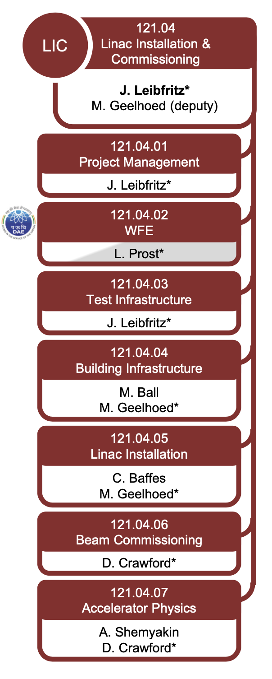
Linac Installation and Commissioning
121.04.05
Linac Installation
C. Baffes
M. Geelhoed*
Support Equipment
Installation Planning
Linac Installation
D
PIP2IT Disassembly, Cryomodule Storage
CAD
D
D. Lambert
Cryomodule Stands
T. Hamerla
R. Ridgway
Installation Traveler Development
CTTS
A. Bujak
C. Baffes
Warm Unit Integration
K. Kendziora
Warm Unit Structures
K. Kendziora
Installation Procurement Planning
M. Simon
WFE/SCL Installation Engineering Lead
C. Baffes
Installation Tools
K. Kendziora
Verification & Validation Lead
M. Geelhoed
WFE/SCL Installation Technical Lead
CDS Access Platform
D. Lambert
M. Simon
Alignment Network
HBB Shield Door
V. Bocean
K. Kendziora

Slide 9
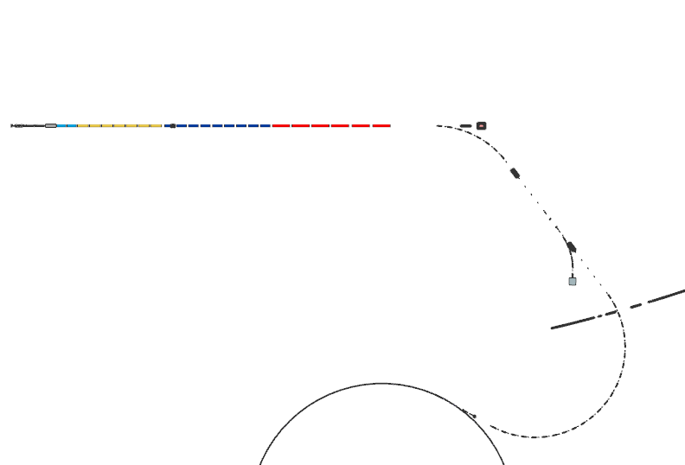
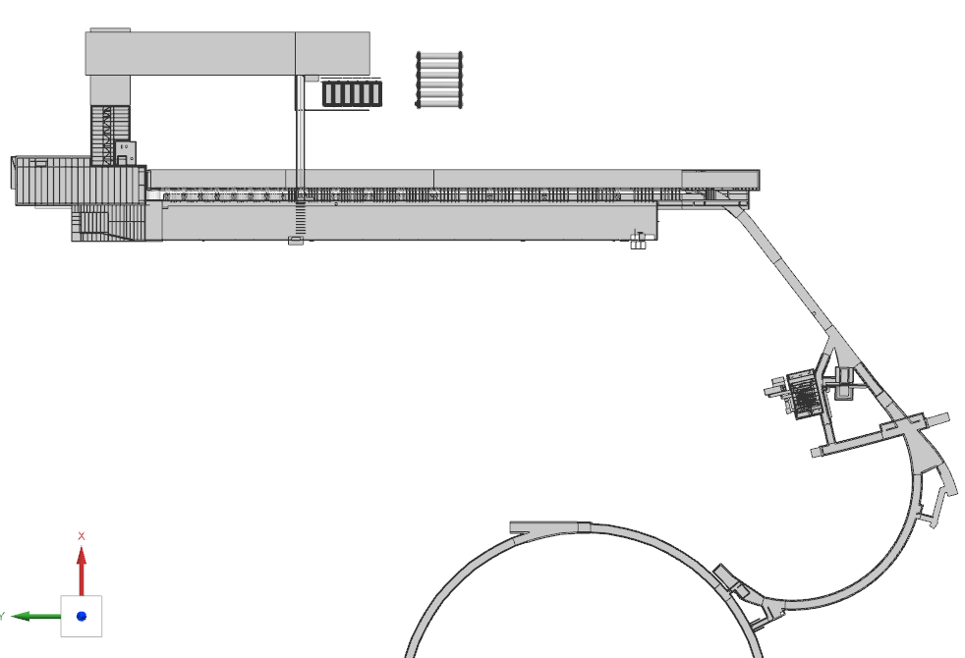
Linac Installation Scope
Cryoplant
Accelerator Upgrades Installation Geographic Scope
Linac Tunnel
HighBay Building (HBB)
Beam Transfer Line (BTL)
Linac Gallery
LI Team Installs Accelerator Equipment
F37 Service Building
Existing Main
Ring
LI Installation Scope
All Linac cryomodules
All Solid-State Amplifiers
Beamline Equipment
Power supplies
Instrumentation
Controls
Booster
BTL

Slide 10
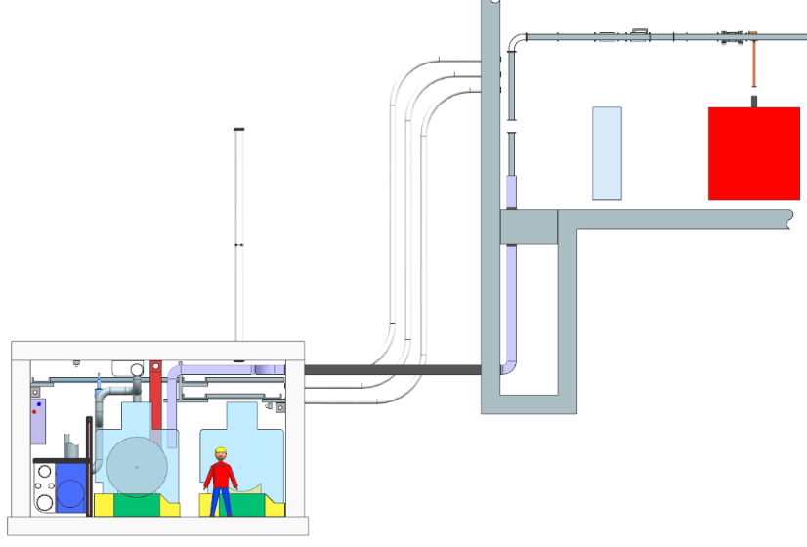
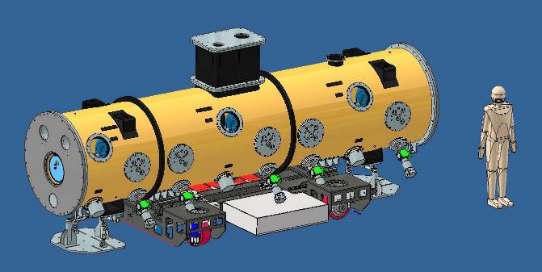
Linac Installation – 3D CAD Model
Integrated 3D CAD model being used to manage design for all of PIP-II
Not-to-exceed envelopes established as guidelines for system designs
Allows for parallel progress and interface verification between systems at different levels of design maturity

Slide 11
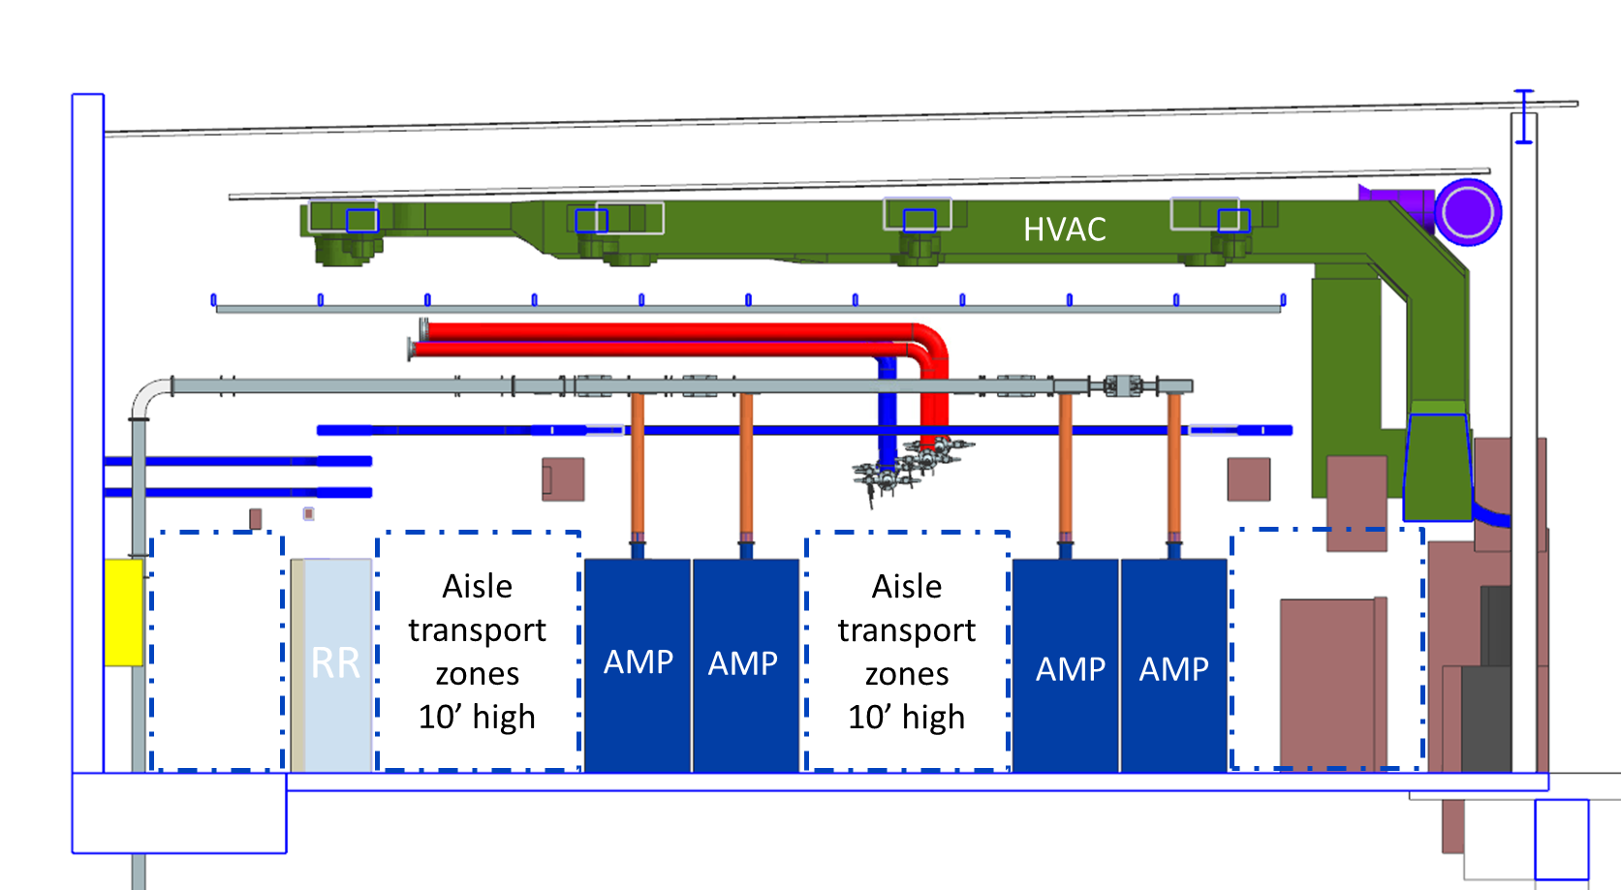
Linac Installation – 3D CAD Model
Integrated 3D CAD model being used to manage design for all of PIP-II
Not-to-exceed envelopes established as guidelines for system designs
Allows for parallel progress and interface verification between systems at different levels of design maturity
Final Linac Complex CF model has been integrated
Integrates design geometry from multiple sources
FNAL, Partners, CF/AE, lattice

Slide 12
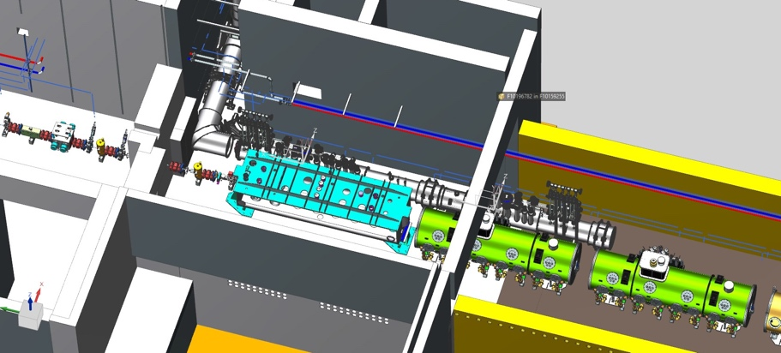
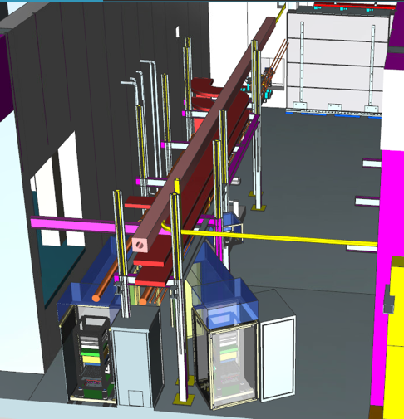
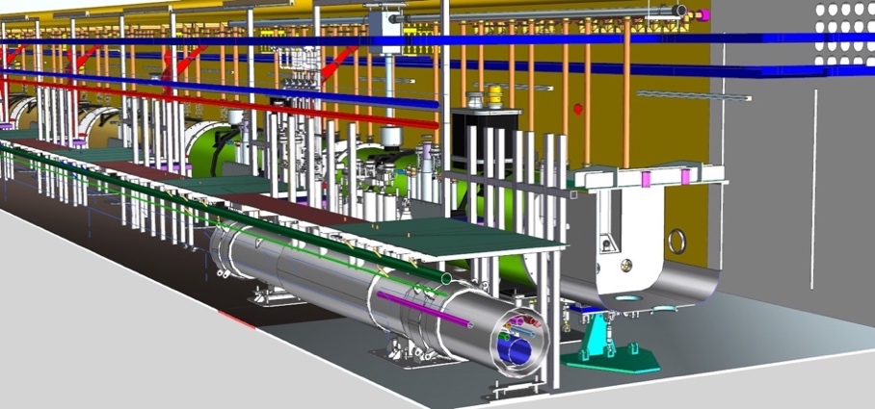
Linac Installation – 3D CAD Model
Integrated 3D CAD model being used to manage design for all of PIP-II
Not-to-exceed envelopes established as guidelines for system designs
Allows for parallel progress and interface verification between systems at different levels of design maturity
Final Linac Complex CF model has been integrated
Integrates design geometry from multiple sources
FNAL, Partners, CF/AE, lattice
Integrated detailed models

Slide 13
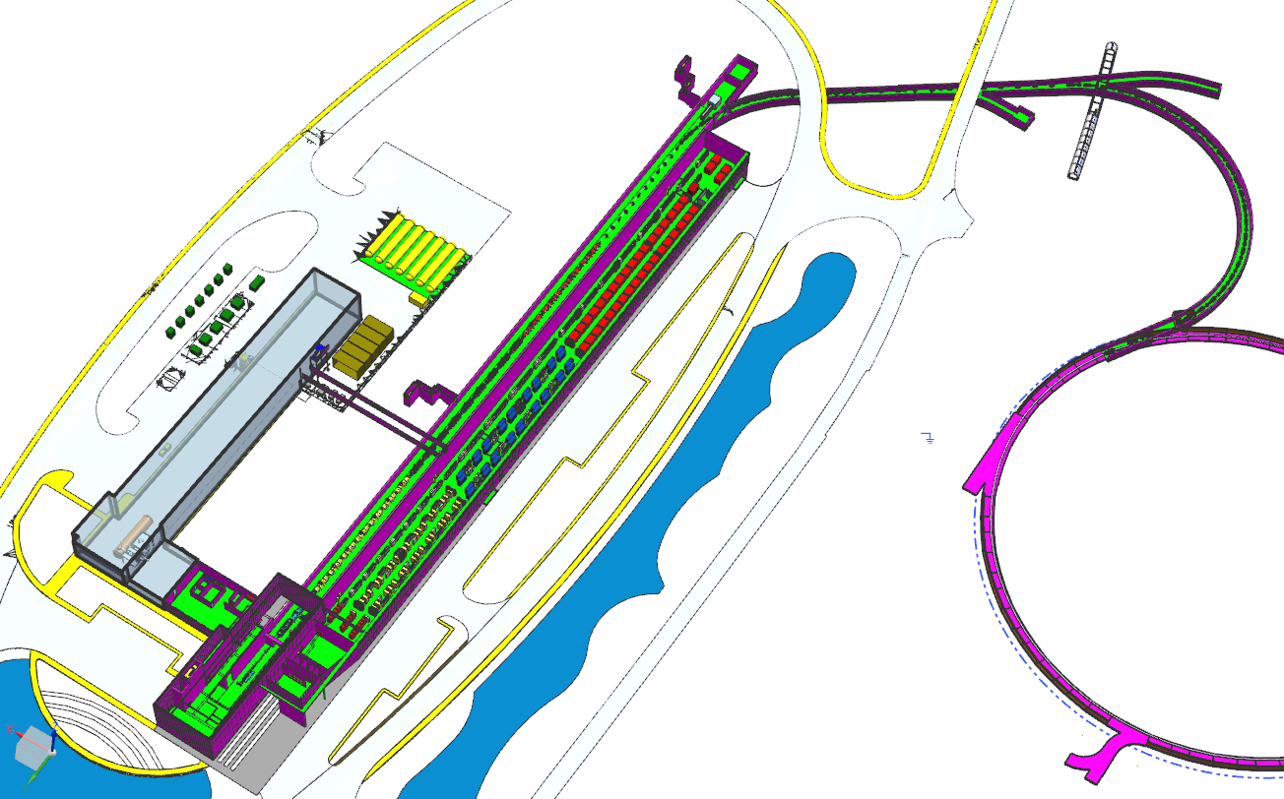
Linac Installation – 3D CAD Model
Integrated 3D CAD model being used to manage design for all of PIP-II
Not-to-exceed envelopes established as guidelines for system designs
Allows for parallel progress and interface verification between systems at different levels of design maturity
Final Linac Complex CF model has been integrated
Integrates design geometry from multiple sources
FNAL, Partners, CF/AE, lattice

Slide 14
Hardware Process
Installation Deliverable List Document
Hardware gets configured by L3 as agreed per Installation Deliverable List
Hardware gets configured shipment/delivery by L3
Handoff to installation WBS
Partner or vendor delivery
L3 Testing and QC
L3 acceptance of partner/vendor deliverable
per Acceptance Criteria Document and List
Installation Readiness Review, administered by Tech. Integration
Responsibility
Partner/Vendor Documentation (procedures, drawings, travelers, QC data, etc.)
Pass
Partner
L3-managed documentation stored in Fermilab systems (procedures, drawings, travelers, QC data, etc.)
L3
Tech. Int.
LI team input:
tensioned process
Fail
Installation

Slide 15
Hardware Process (cont)
Hardware gets configured shipment/delivery by L3
Handoff to installation WBS
Installation
Operational Readiness Clearance
Conditioning
Installation to Commissioning Handoff Review
Accelerator Readiness Review
Beam Commissioning
Transition to Operations
Responsibility
L3
Installation
Accelerator Complex Operations
Beam Comm
Acc Complex

Slide 16
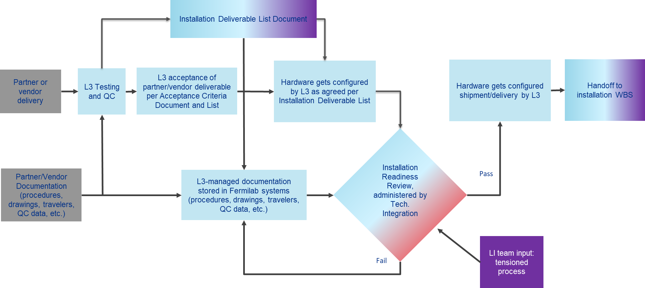
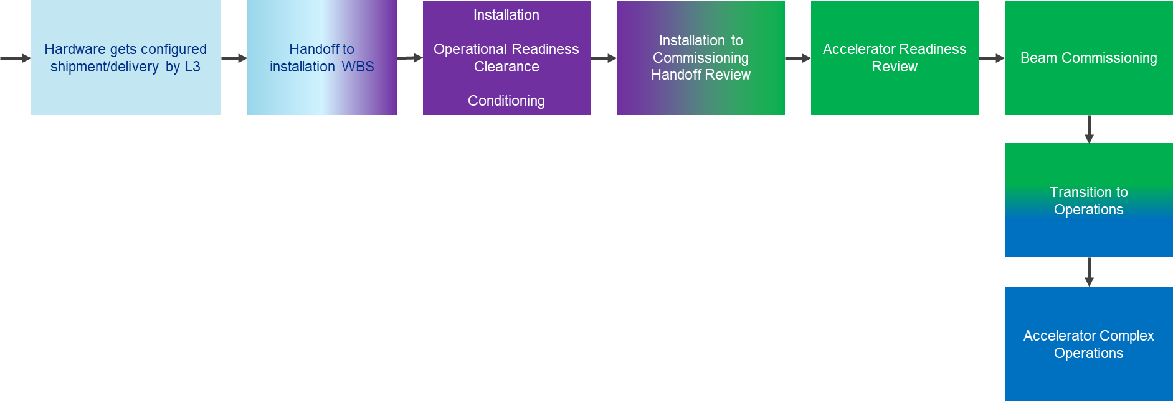
Hardware Process (cont)
Design, Fabrication, Production
Installation
Commission
Partner
L3 Manager
Tech Integration
Linac Installation
Beam Commissioning
Accelerator Complex

Slide 17
Installation Planning and Coordination
A. Bujak

Slide 18
Installation Planning and Coordination
FY
Linac Installation &

Slide 19
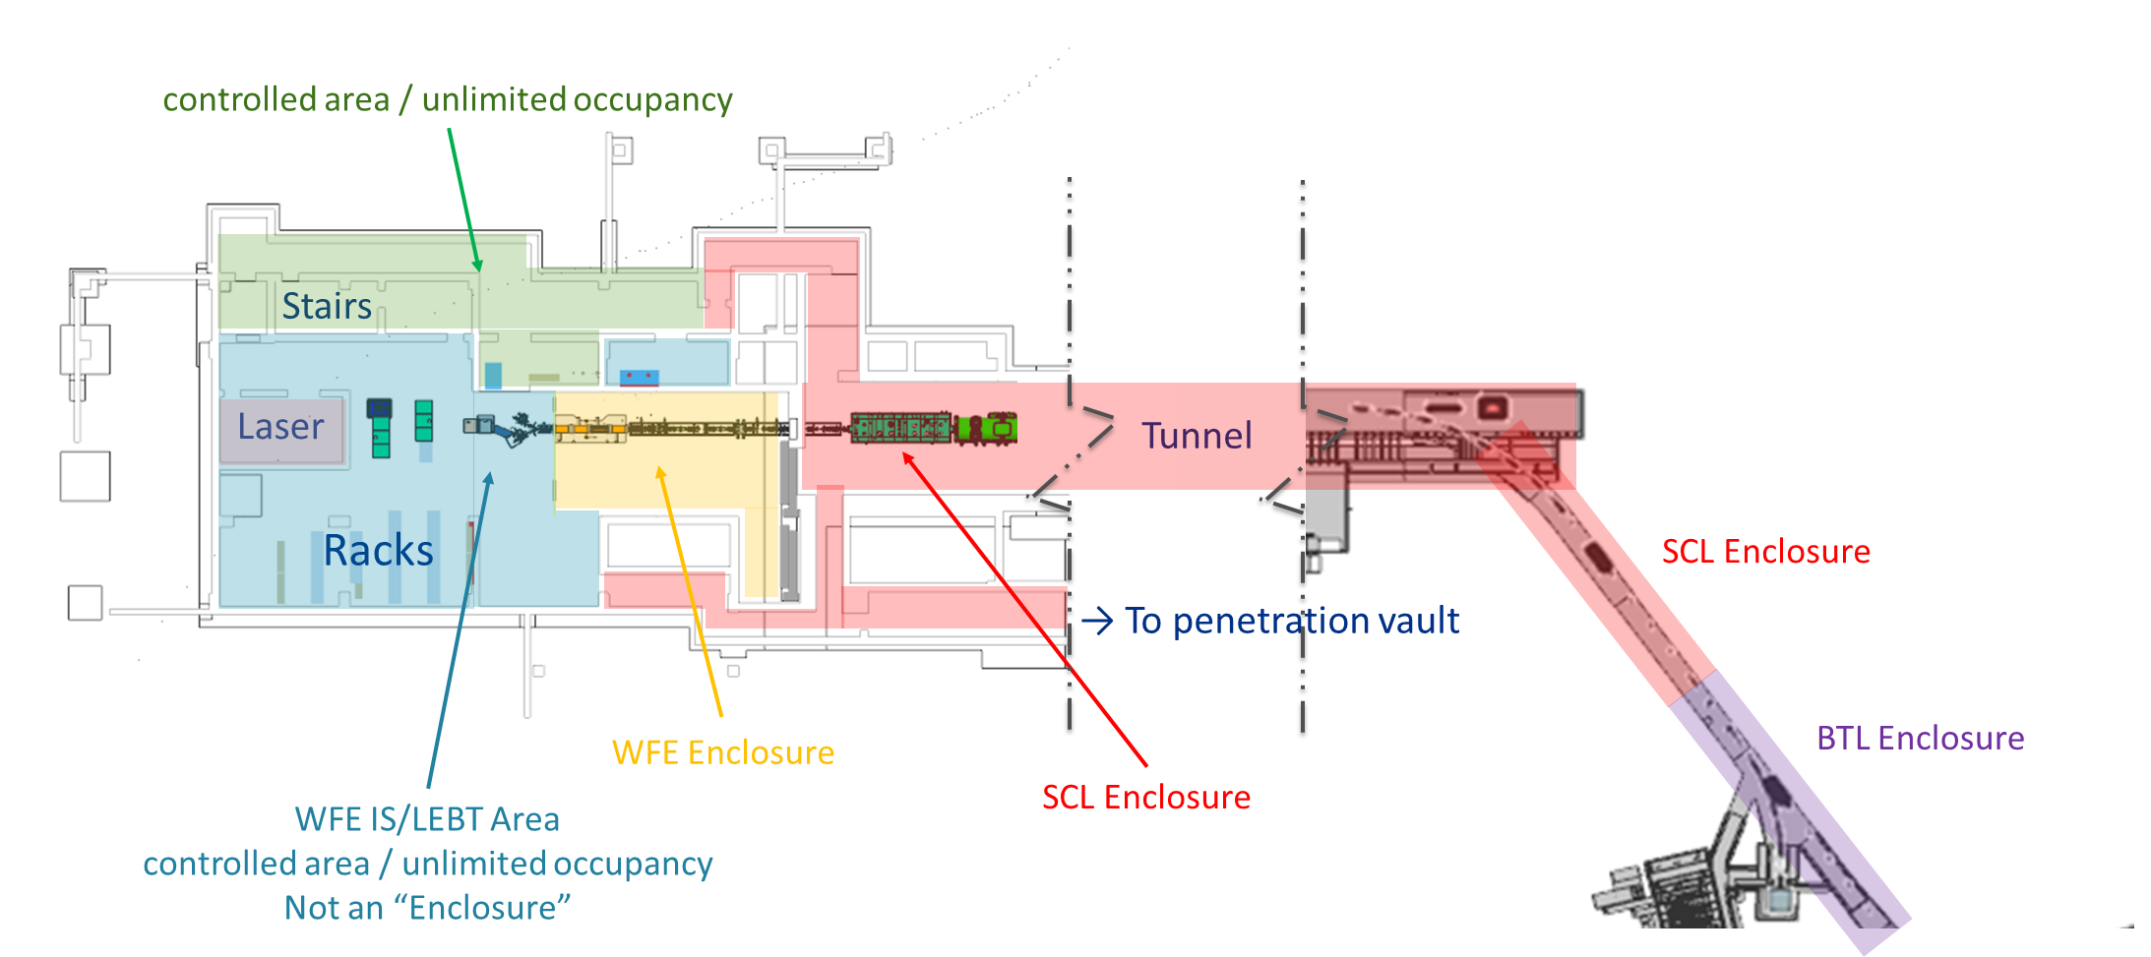
Installation Planning and Coordination

Slide 20
Enclosure Access Classifications
Open Access
Areas fully open to trained personnel
Only possible if residual radiation hazards are absent
Supervised Access
Interlocks dropped
Keys issued to each entrant
Power supplies are locked off
Access requires a clear, planned break in operations
Controlled Access
Interlocks remain active, specific access procedures required to keep them made up
Keys issued to each entrant
Power Supplies remain off
Allows for access coupled with operations

Slide 21
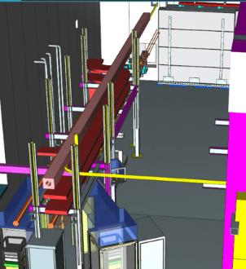
Enclosure Access Classifications
Oxygen Deficiency Hazard
ODH 0: Low hazard, few restrictions on entry
OHD 1: Training, qualification, and PPE required for entry
Supervised Access mode can be used to verify training and manage access
SCL Enclosure will be classified as ODH 1 after the Cryogenic Distribution System is charged
Other Enclosures have barriers and/or sufficient ventilation to maintain ODH 0 status at all times

Slide 22
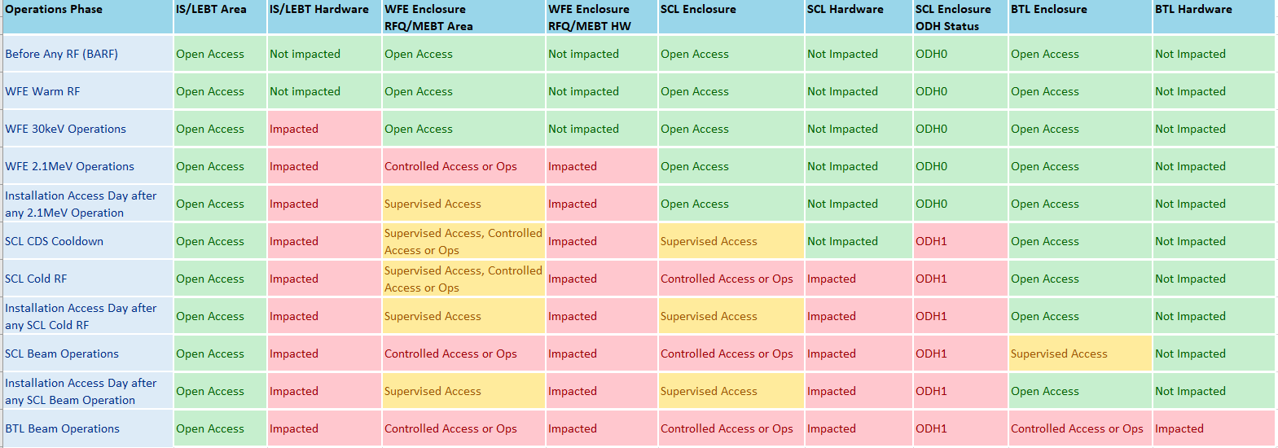
Enclosure Access Transitions
A. Bujak
3 CMs in
before transition
10 CMs in
before transition
6 CMs in
before transition
AUG-2027→
NOV - 2027→
JAN - 2028→

Slide 23
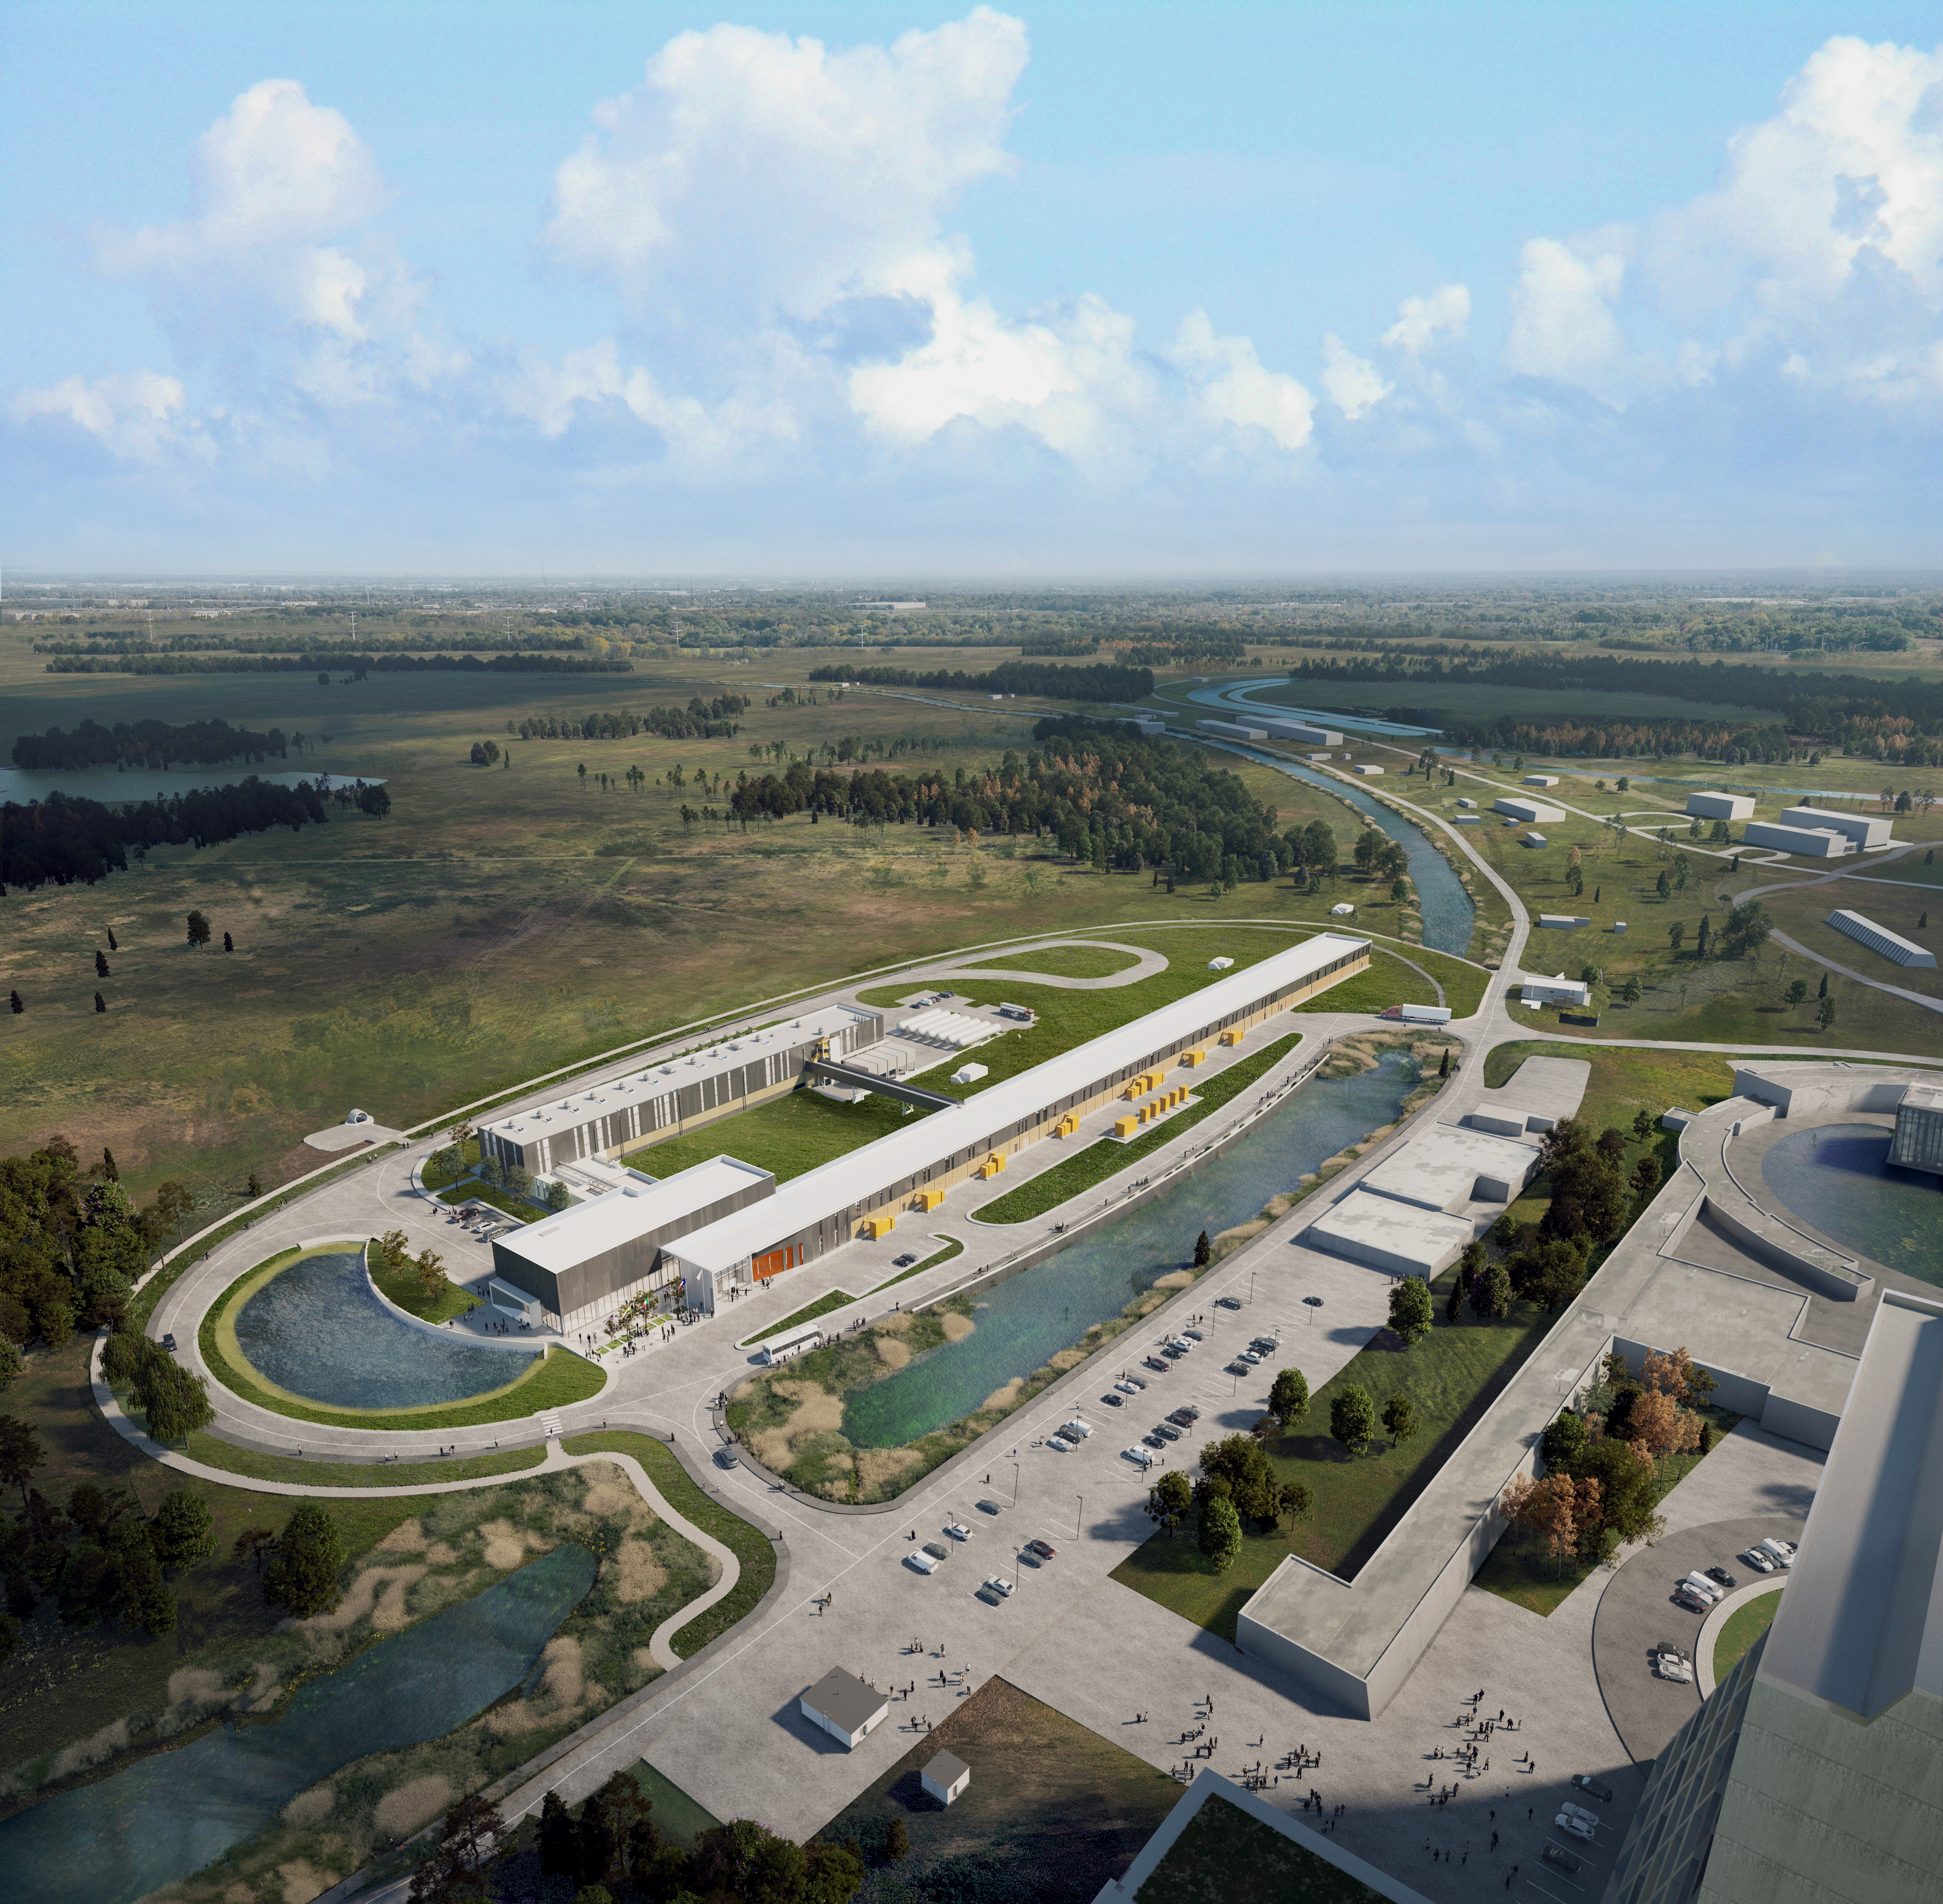
THE FUTURE OF FERMILAB
geelhoed@fnal.gov
Follow us:
http://pip2.fnal.gov/
@PIP2accelerator
/showcase/pip-ii/

