Slide 1
Relativistic Heavy Ion Collider (RHIC) operations transition to the installation of the Electron Ion Collider (EIC)
Marianna Albanese, PE
19 March 2024 11:30

Slide 2
My Role at BNL
Mechanical Engineer II
Facilities Experimental Support Group for the Collider Accelerator Department
Act as the liaison between science and the skilled trade workers to support science
Provide support through our trades: Carpentry, Rigging, Mechanical Technicians, Electricians, Electronic Services, and Survey.
Notes:
My role at BNL: My job title is Mechanical Engineer II. I am part of the Facilities Experimental Support Group for the Collider Accelerator Department. I act as the liaison between science and the skilled tradespeople that support the science. We provide support through our trades: Carpentry, Rigging, Mechanical Technicians, Electricians, Electronic Services, and Survey.

Slide 3
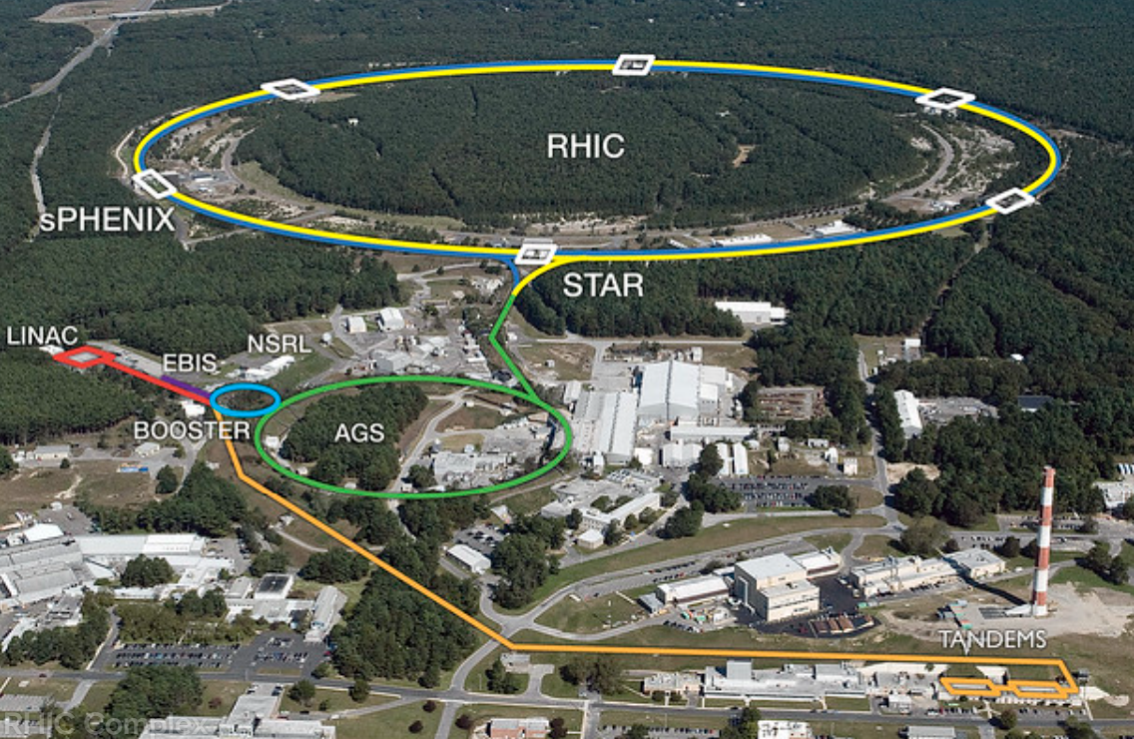
BNL Collider-Accelerator Complex
Notes:
Currently, the RHIC program is slated for completion by the end of the 2025 fiscal year, with the transition to install the Electron Ion Collider (EIC) to begin immediately. The transition plan encompasses the removal and repurposing of existing infrastructure, necessary alterations, installations, and the replacement of systems to accommodate EIC.

Slide 4
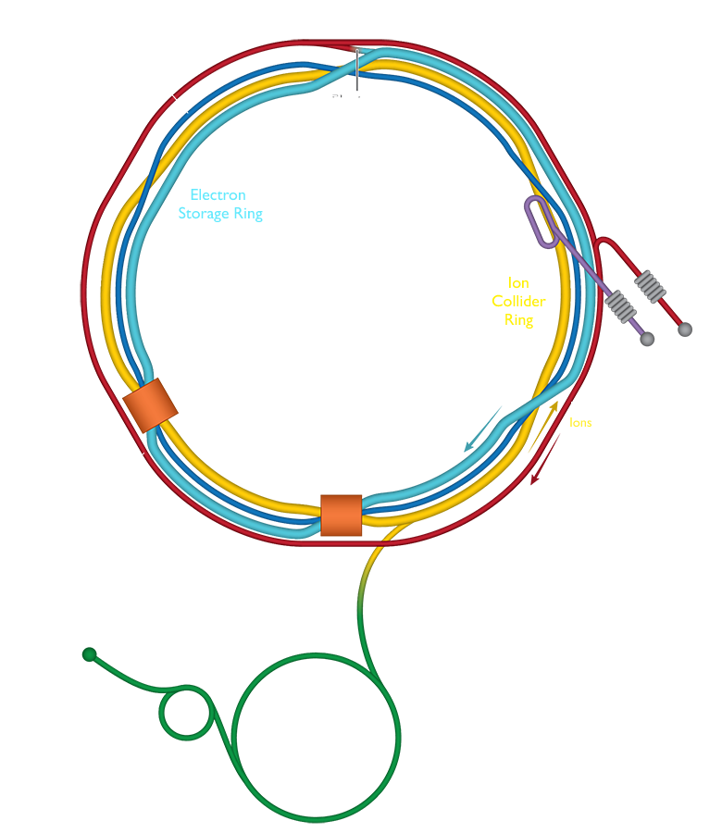
The Electron Ion Collider (EIC)
  The EIC will allow us to study the “strong nuclear force” and the role of gluons in the matter within and all around us. What we learn from the EIC could power the technologies of tomorrow.
Notes:
EIC will allow us to study the “strong nuclear force” and the role of gluons in the matter within and all around us. What we learn from EIC could power the technologies of tomorrow.
EIC will make use of existing components of RHIC, including its ion sources, pre-accelerator chain, and a superconducting magnet ion storage ring.

Slide 5
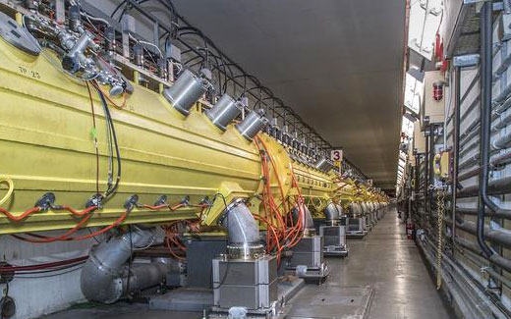
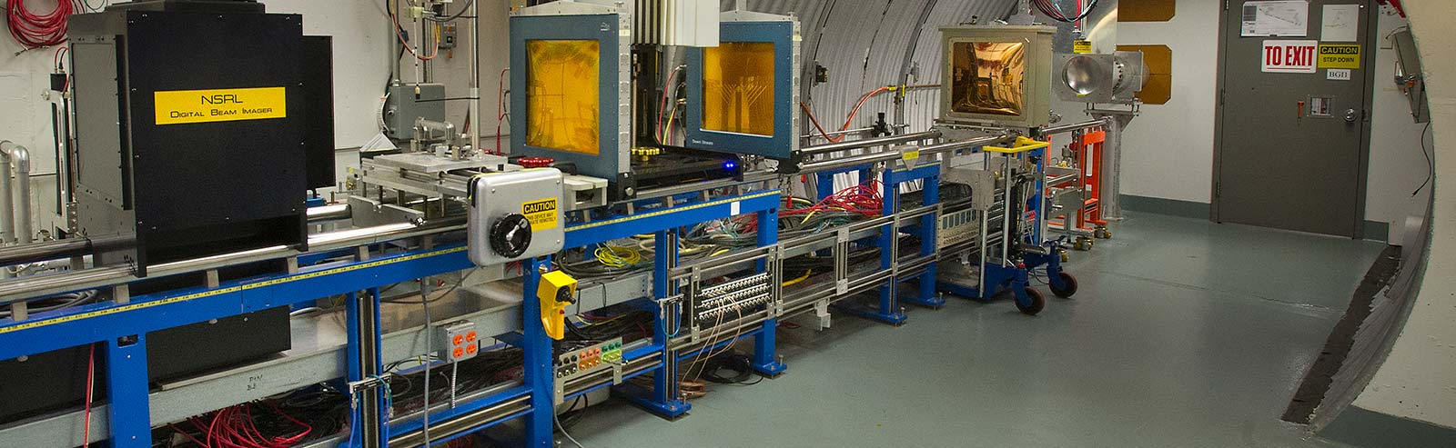
Continued Operations
Some scientific programs will continue to run without interruption.
  Brookhaven Linac Isotope Producer
  Radioisotopes for medical imaging and disease treatment
  NASA Space Radiation Laboratory (NSRL)
    A joint Brookhaven Lab/NASA facility to study the effects of cosmic radiation
Notes:
Following the conclusion of the last RHIC run and during this transitional period, our team will assume responsibilities for operations, decommissioning, and installations. Concurrently, we will maintain support for ongoing scientific endeavors, including the uninterrupted operation of the Brookhaven Linac Isotope Producer (BLIP) and the NASA Space Radiation Laboratory (NSRL) programs. BLIP serves to produce radioisotopes essential for medical imaging and disease treatment, while NSRL, a collaborative effort between Brookhaven Lab and NASA, investigates the impacts of cosmic radiation.

Slide 6
RHIC Tunnel Removals
The dismantling of the RHIC beam line and its accompanying support structures involves relocating accelerator systems and components for various purposes such as integration into the EIC, storage for potential future use, or disposal.
Notes:
The removal and repurpose work required is broken down into four parts.
The first part is the RHIC Tunnel Removals to allow for the addition of the new electron accelerator ring and electron storage ring inside the existing collider tunnel so that collisions can take place at points where the stored ion and electron beams cross.
The dismantling of the RHIC beam line and its accompanying support structures involves relocating accelerator systems and components for various purposes such as integration into the EIC, storage for potential future use, or disposal.

Slide 7
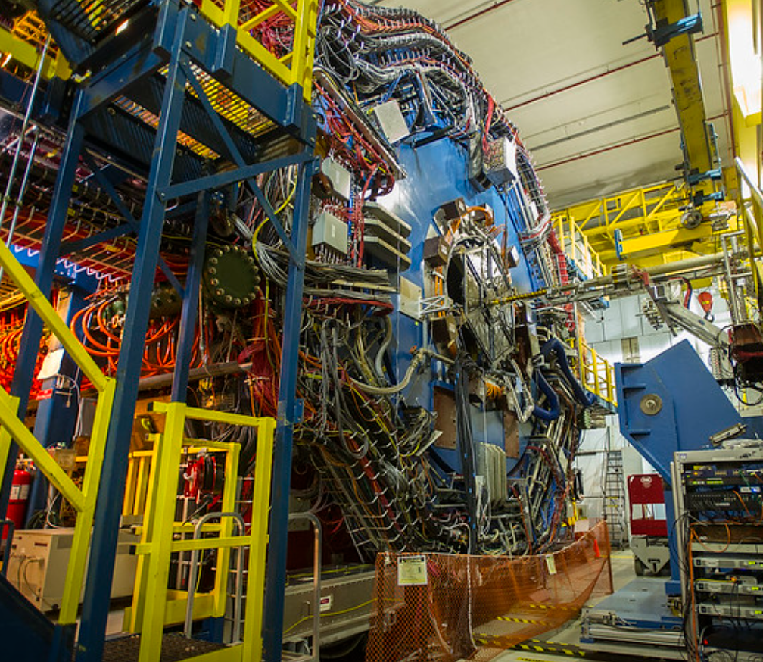
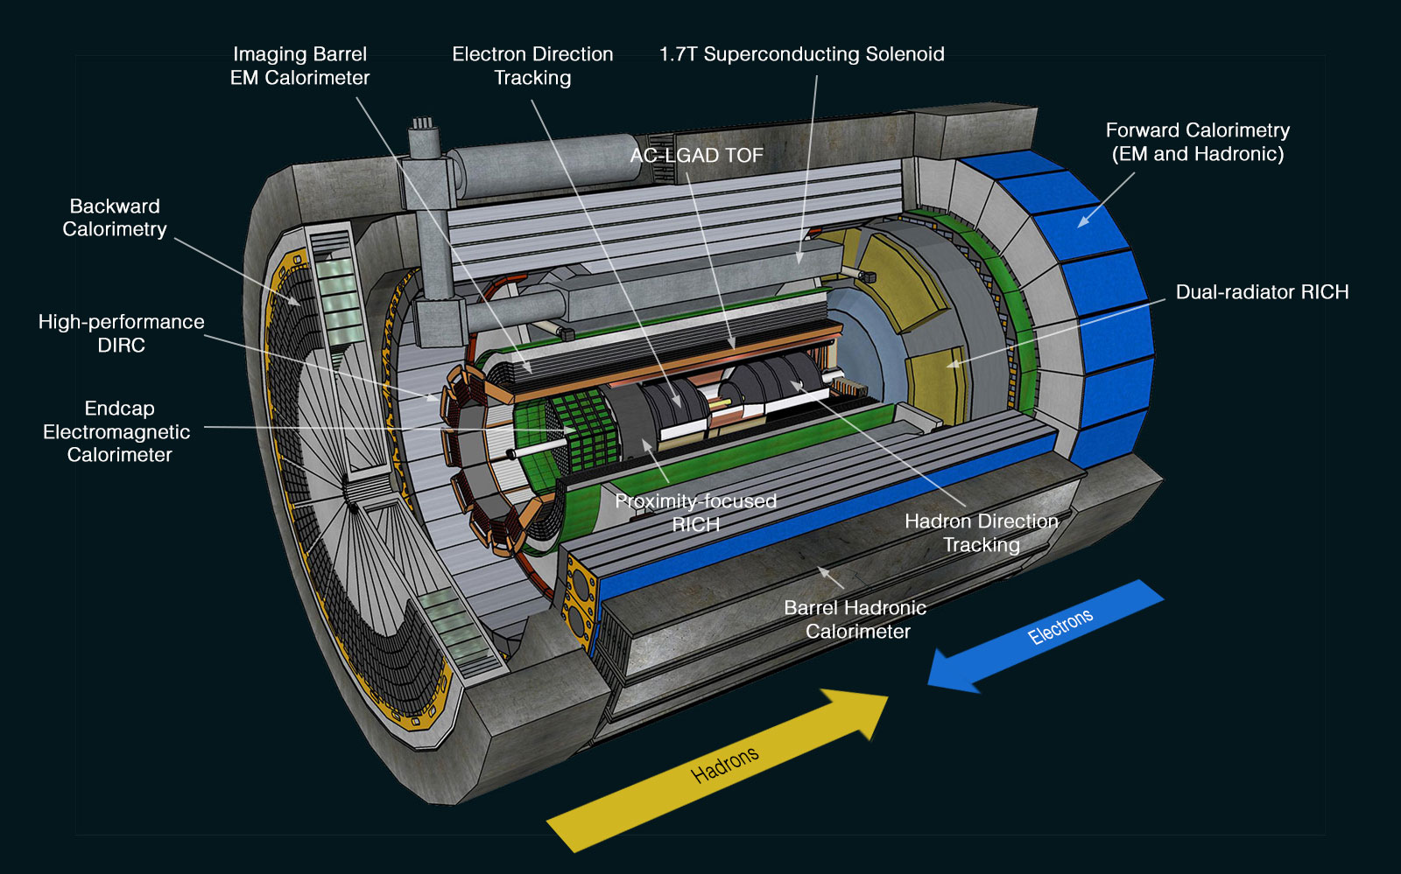
From STAR Detector
Building 1006 Interaction Region
To ePIC Detector
Notes:
The second part of the Removal and Repurpose work is the disassembly of the Solenoidal Tracker at RHIC (STAR) detector in the Building 1006 interaction region to allow for the installation of the Electron-Proton/Ion Collider detector for EIC (ePIC).

Slide 8
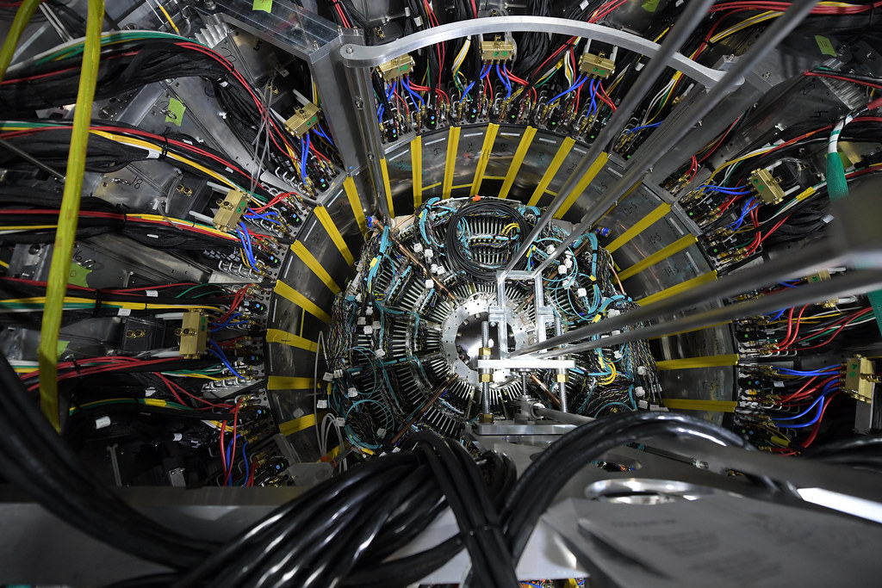
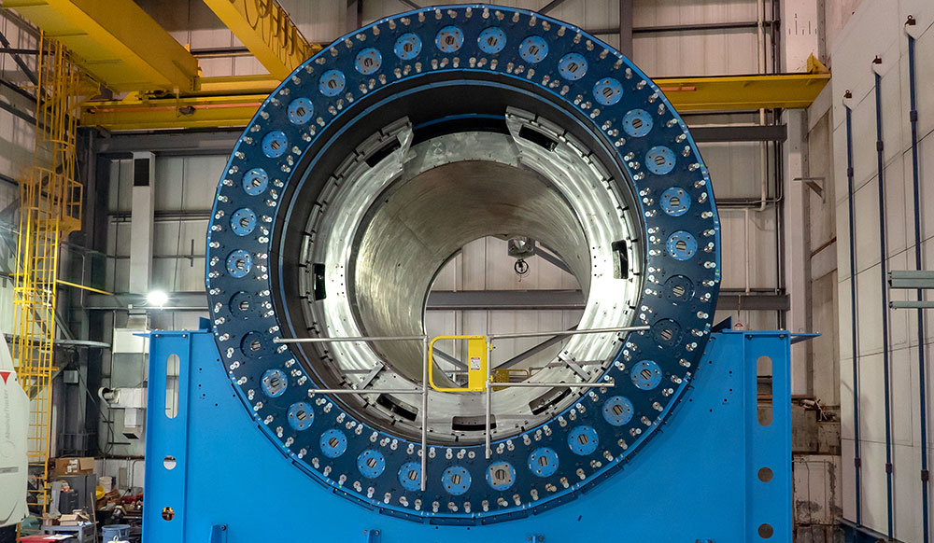
Building 1008 Interaction Region Detector: sPHENIX
Outer Hadronic Calorimeter
Notes:
The third part of the Removal and Repurpose work is the removal of the Super Pioneering High Energy Nuclear Interaction eXperiment detector (sPHENIX). We will harvest the Outer Hadronic Calorimeter steel frame to be repurposed in the ePIC detector.
All other equipment at both sPHENIX and STAR must be removed

Slide 9
MuID Steel Removal at Building 1008
Notes:
The fourth major activity with significant costs involves the removal of 30 Muon steel plates situated in the interaction region of building 1008, where sPHENIX is located. (describe the drawing). The plates were installed nearly three decades ago when the building was empty, predating the installation of the tracks used to move the detector. Initially serving the PHENIX experiment, these plates are now obsolete for both current and future operations. Their removal is essential to access the tunnel for extracting RHIC magnets and installing EIC magnets from both the north and south sides of the interaction region space.
Weighing in at over 1,800 metric tonnes, they must be cut into 9,000-kilogram sections to comply with the crane capacity requirements before disposal. To facilitate this, temporary supports and strapping will be welded onto the plates as each smaller section is removed and rigged out of the building for disposal. Due to the presence of flammable detectors between the plates, flame cutting is prohibited. However, we have acquired a water jet cutting tool capable of slicing through solid steel plates ranging from 10 to 20 centimeters in thickness. Nevertheless, this process will demand significant time and personnel resources.
The primary concern of my team revolves around the substantial volume of potentially activated wastewater that must be collected, stored, and properly disposed of. We will collaborate closely with our waste management team throughout the entire duration of this project.

Slide 10
Our Major Challenges
Transition Challenge:
  Managing task charges from RHIC to EIC budget
  Depleting RHIC budget while awaiting EIC funds
  Uncertainty from budget allocation changes
Staffing and Succession Planning:
  Key focus on smooth personnel transition
  Maintaining historical knowledge for efficiency
  Meticulous planning for project spanning 2025 to 2034
Storage and Workspace Considerations:
  Ensuring adequate storage for items including magnets
  Aim to preserve integrity by storing magnets indoors
  Resources not reused for EIC stored for potential future use
Delineation of work:
  Multiple groups manage different aspects of removals and installations, posing a coordination challenge.
  Ensuring overlap of work among the different divisions to prevent gaps.
  Transitioning staff from CAD to EIC may lead to ownership confusion over certain tasks.
Current Time Utilization:
  Fulfilling RHIC facility and experimental support needs
  Assisting EIC department with time and cost estimates
  Balancing responsibilities for seamless project coordination
Notes:
Our Major Challenges: As we approach the end of RHIC operations in 2025, a notable challenge emerges in how we handle task charges, transitioning from RHIC to the upcoming EIC budget. We need to navigate the depletion of the RHIC budget while awaiting EIC funds allocation. The uncertainty stems from budget allocation changes, with RHIC funding expected to decrease as EIC funding rises. This creates a transitional phase where accurate timing and decisions are vital to ensure a seamless financial shift without disrupting project flow or resource management.
As we navigate this transition, another critical aspect is staffing, succession planning, and the smooth transition of personnel. Maintaining historical knowledge throughout this period is paramount for continuity and efficiency. With the project spanning from 2025 to 2034, meticulous planning is essential for successful project sequencing and execution, ensuring that tasks are carried out in the most logical and effective order. This includes managing staffing transitions effectively to minimize disruptions and capitalize on the expertise of both existing and incoming team members.
Additionally, as we plan for the transition, we must consider storage and workspace requirements. Given that everything must be stored for a certain period, including over 400 superconducting magnets, it's essential to ensure adequate storage facilities are available. Specifically, we aim to store magnets indoors to preserve their integrity. Resources not earmarked for reuse in the EIC project must also be stored for a designated duration, allowing our collaboration the flexibility to potentially repurpose them before disposal. Proper storage solutions are integral to safeguarding valuable assets and maintaining organizational flexibility throughout the transition and beyond.
Currently, the bulk of my time is dedicated to fulfilling the RHIC facility and experimental support requirements. Concurrently, I extend support to the EIC department by assisting with time and cost estimates. This dual role allows me to effectively balance responsibilities between ongoing RHIC operations and preparatory work for the upcoming EIC project, ensuring smooth coordination and alignment of efforts across both initiatives.

Slide 11
Conclusion
The completion of the RHIC program by the end of 2025 marks the beginning of an exciting new chapter with the installation of the EIC.
Through meticulous planning and execution, we aim to overcome obstacles related to staffing, budget transitions, and infrastructure changes.
Storage and workspace considerations play a vital role in preserving valuable assets and maintaining organizational flexibility.
Our dedication to fulfilling RHIC and EIC support needs underscores our commitment to advancing scientific exploration and discovery.
Notes:
In conclusion: The completion of the RHIC program by the end of 2025 marks the beginning of an exciting new chapter with the installation of the Electron Ion Collider.
Through meticulous planning and execution, we aim to overcome obstacles related to staffing, budget transitions, and infrastructure changes.
Storage and workspace considerations play a vital role in preserving valuable assets and maintaining organizational flexibility.
Our dedication to fulfilling RHIC and EIC support needs underscores our commitment to advancing scientific exploration and discovery.

Slide 12
Contact Information
Marianna Albanese, PE
Title: Mechanical Engineer II
Department: Collider Accelerator Department
Group: Facilities Experimental Support Group
Email: malbanese@bnl.gov
Phone: 1 (631) 344-3839
Questions/Advice?

