Slide 1
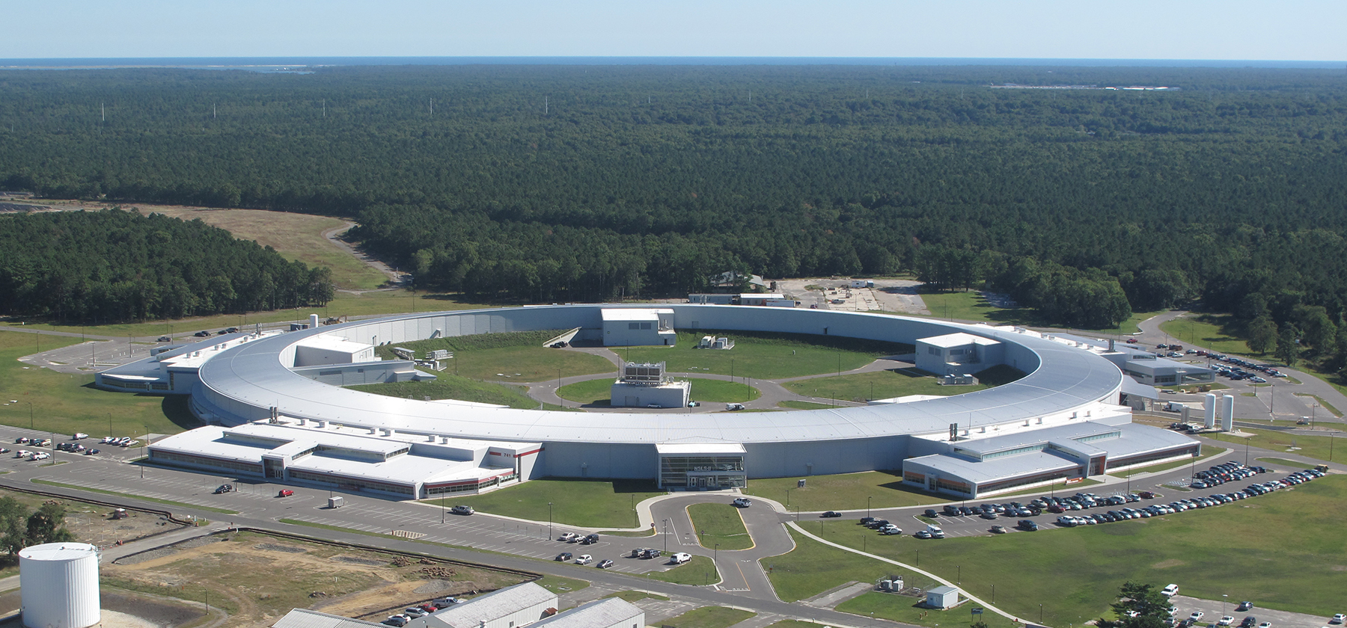
NSLS-II Accelerator Installation & Lessons Learned
Gregory Fries, BNL NSLS-II Accelerator Division
Removal & Installation Workshop
March 18-20, 2024

Slide 2
Outline
Design Features & Project Scope
Phasing of Installation
Production and Installation Approach
Review of Accelerator Installation
Project Performance
Critical Paths Identified
Lessons Learned
Labor Profile
Safety Topics
Challenges
Gregory Fries
NSLS-II Accelerator Division
Deputy Director for Projects
At NSLS-II for 15 years
Coordinated NSLS-II accelerator installation
CAM for accelerator infrastructure on all previous BLs
Manage accelerator staffing & budget
NSLS-II work control manager
CAM for ALS-U power supplies
CAM for NEXT-II Accelerator Infrastructure

Slide 3
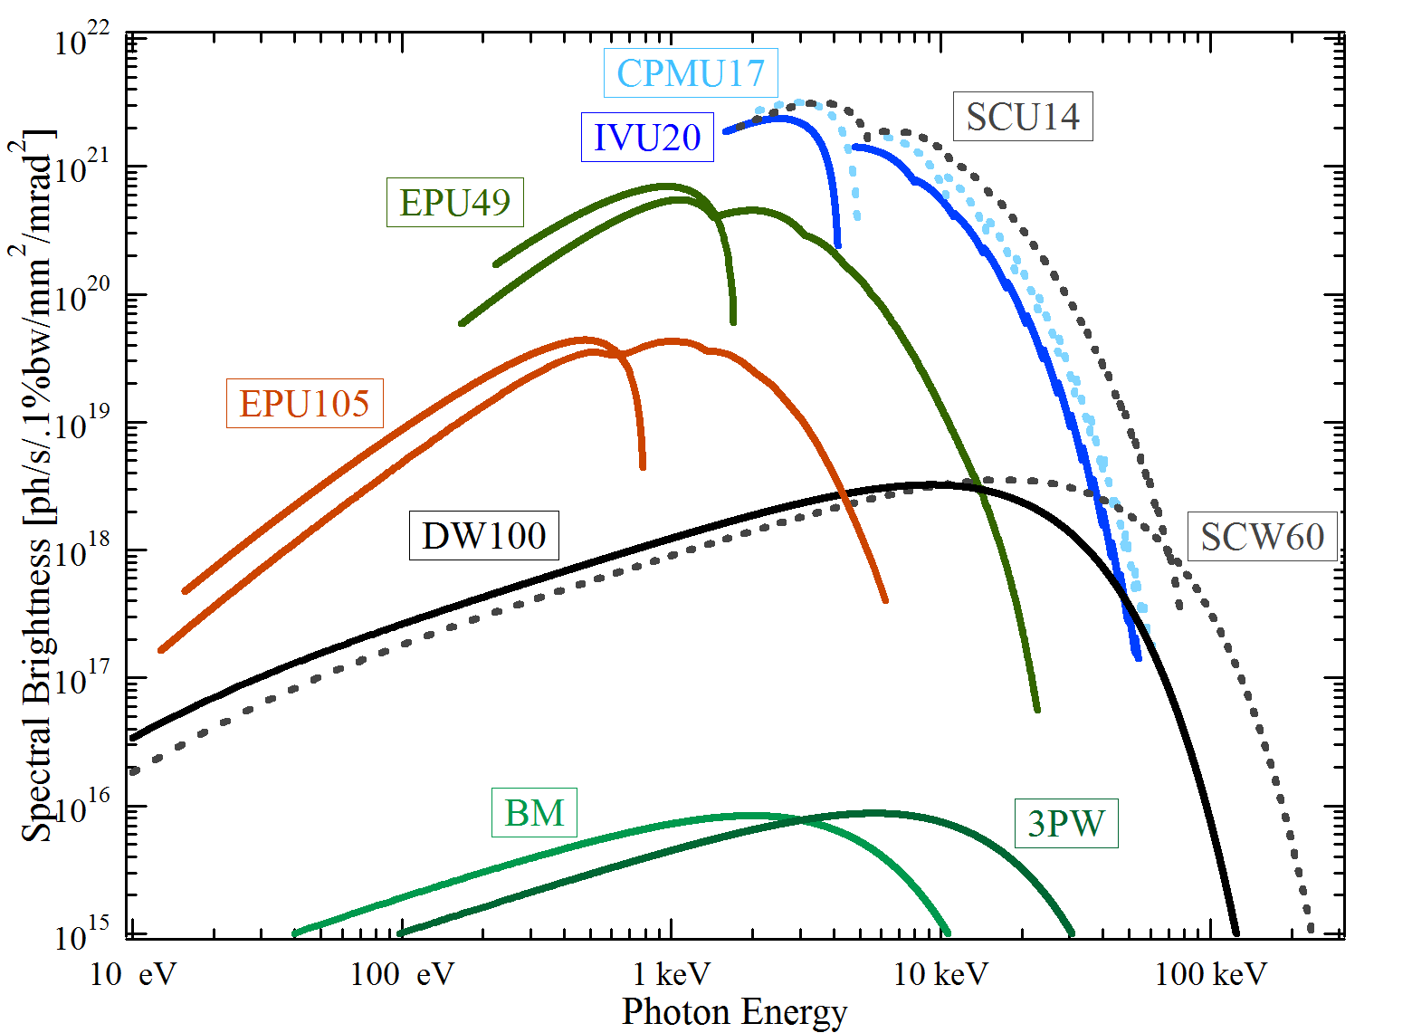
NSLS-II Design Features
Highly optimized x-ray synchrotron delivering:
Extremely high brightness and flux
Exceptional beam stability
Advanced instruments, optics, and detectors
Design Parameters
3 GeV, 500 mA, top-off injection system
Circumference 792 m
30 Cell, Double Bend Achromat Lattice
15 high-beta straights (9.3 m)
15 low-beta straights (6.6 m)
Novel design features:
Ultra-low emittance for high brightness and small source size
Damping wigglers
Soft bend magnets
Three pole wigglers
Large gap IR dipoles
Long beamlines
Ultra-high stability

Slide 4
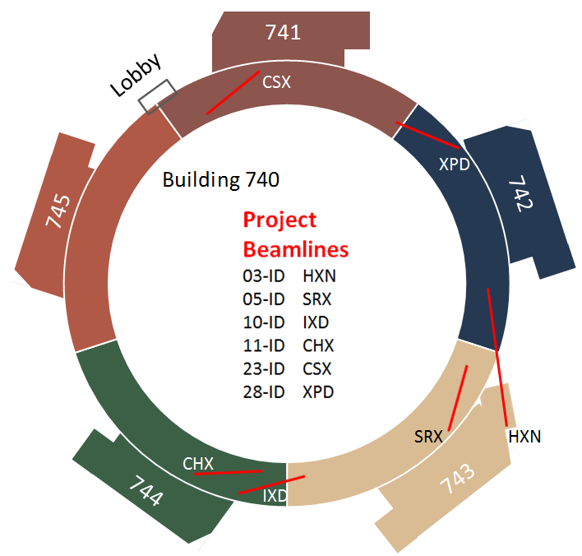
NSLS-II Project Scope
Accelerator Systems
Storage Ring – 792m circumference
Top-Off Injection System
Conventional Facilities
Ring Building and Service Bldgs (400,000 gsf)
5 Laboratory/Office Bldgs (190,000 gsf)
Experimental Facilities
Capable of hosting at least 58 beamlines
Research & Development
Advanced optics & accelerator components
Initial suite of 8 beamlines (two canted)
(XPD, SRX, CSX, HXN, CHX & IXS)
Total Project Cost $912M (Baseline)

Slide 5
Key Project Schedule Milestones
Aug 2005 CD-0, Approve Mission Need (Complete)
Jul 2007 CD-1, Approve Alternative Selection and Cost Range (Complete)
Jan 2008 CD-2, Approve Performance Baseline (Complete)
Jan 2009 CD-3, Approve Start of Construction (Complete)
Feb 2009 Contract Award for Ring Building (Complete)
Aug 2009 Contract Award for Storage Ring Magnets (Complete)
May 2010 Contract Award for Booster System (Complete)
Mar 2011 Begin Accelerator Installation (Complete)
Mar 2012 Start LINAC Commissioning (Complete)
Nov 2013 Start Booster Commissioning (Complete)
Mar 2014 Start Storage Ring Commissioning (Complete)
Sep 2014 DOE Approval to Start Routine Operations (Complete)
Oct 2014 Attainment of KPPs (Complete)
Dec 2014 NSLS-II Project Early Completion (Complete)
Jun 2015 CD-4, Approve Start of Operations (Complete)

Slide 6
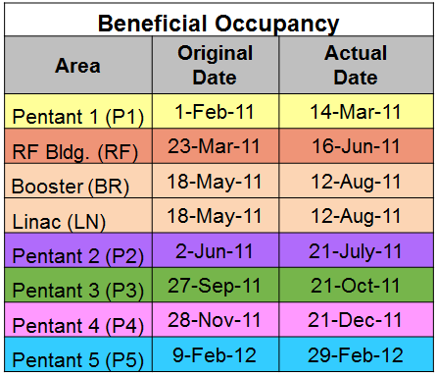
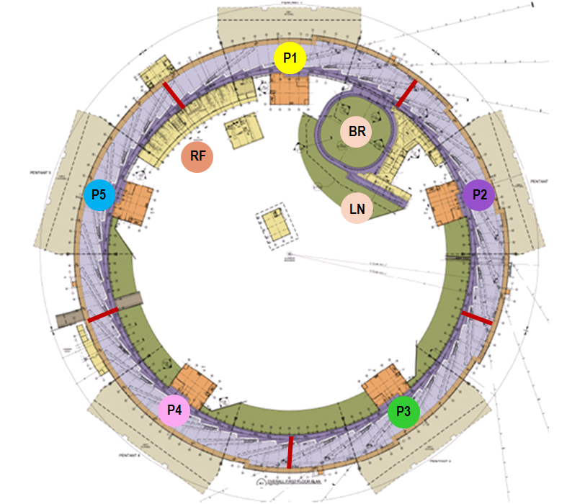
Phasing of Construction and Installation
Received building in stages; temporary walls constructed
Formal readiness evaluation before beneficial occupancy
After beneficial occupancy, space was no longer classified as “construction area”
Installation started as soon as occupancy was received
Construction “punch list” work continued after occupancy
Accelerator staff & contractors did not enter remaining construction area

Slide 7
Production and Installation Approach
Accelerator Production
BNL procured Injector sub-systems (Linac, Booster Ring)
BNL built and integrated Transfer Lines, Booster RF and SR components
Accelerator Installation
Linac Vendor w/ BNL oversight
Booster Ring Vendor using BNL technicians for all hands–on work w/ vendor oversight
Booster RF BNL
Transport Lines BNL
Storage Ring BNL
Storage Ring RF Combination of BNL & Vendors

Slide 8
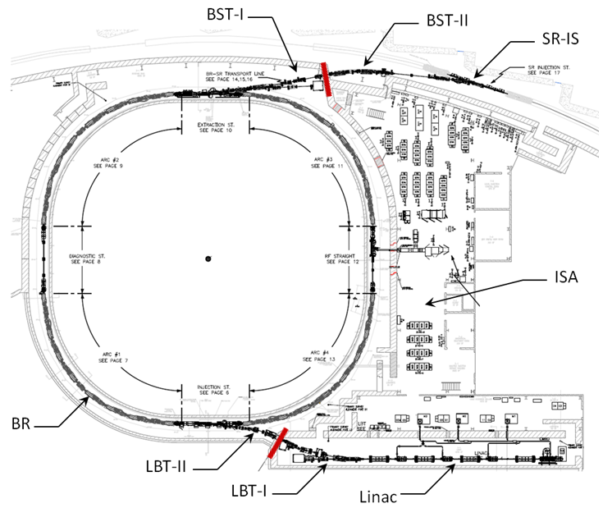
Injector
Linac
90 keV electron gun
Four accelerator sections that accelerate electron beam to 200 MeV before it reaches the LtB Transport Line
LtB Transport Line
Transports beam to the Booster
Two dump lines located in the Linac vault, which
provides opportunity to run just the Linac without
injecting into the Booster tunnel.
Booster (3GeV)
Accelerates electron beam from 200 MeV to 3 GeV
Four Arcs, each equipped with nine magnet girders
Four Straight sections (Injection, Extraction, Diagnostics & RF)
BtS Transport Line
Transports beam to the Storage Ring
One dump line located in the Booster tunnel, which provides opportunity to run just the Booster/Linac without injecting into the SR

Slide 9
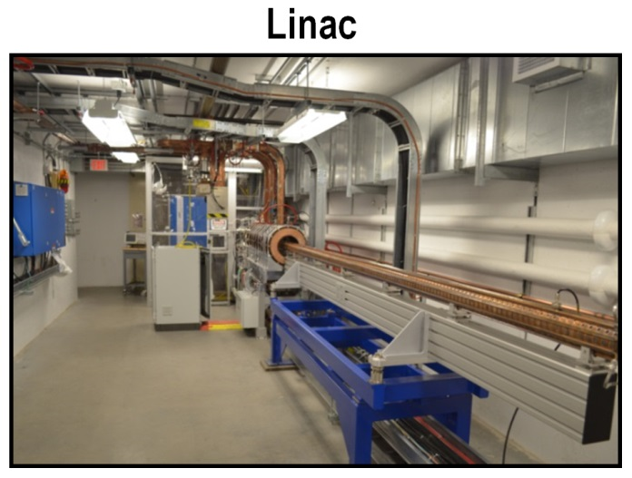
Linac & Transport Lines
Installation Milestone Timeframe
Linac Nov ‘11
LBT-I Jan ’12
LBT-II Dec ‘12
BST-I Feb ’13
BST-II Nov ’13
Note: 24 months includes time to close Linac mis-steering event corrective actions (~ 1 year)
24 Mo
Transport Lines – (LBT & BST)

Slide 10
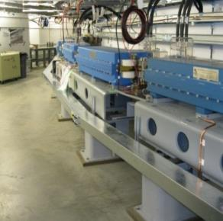
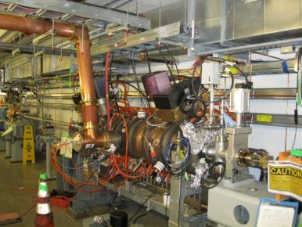
Booster Installation
Milestones Completed
Mechanical utilities installed Mar ‘12
First girder installed Feb ‘12
Last of 46 girders installed July ‘12
RF cavity installed and tested Jan ‘12
System integration Jan ‘13
Unit testing Mar ‘13
Integrated testing Mar ‘13
Supplemental Shielding July ‘13
PPS hardware installed July ‘13
Total duration – Approximately 16 months
10 Mo
Accelerator hardware

Slide 11
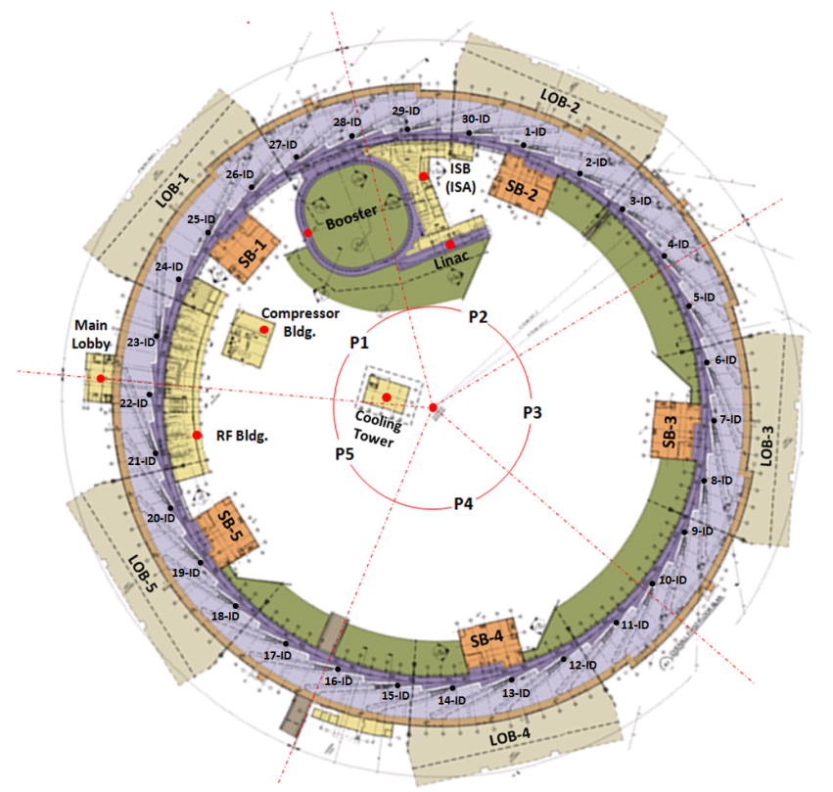
Storage Ring
SR tunnel is comprised of five “Pentants” with each “Pentant” having six cells
Each cell has one straight section and five Girders
Straight sections will be occupied by IDs except at Injection and in two RF Cavity Straights (27 Straights will be available for IDs)
Girders are equipped with magnets, vacuum components and advanced instrumentation
Double Bend Achromat Design

Slide 12
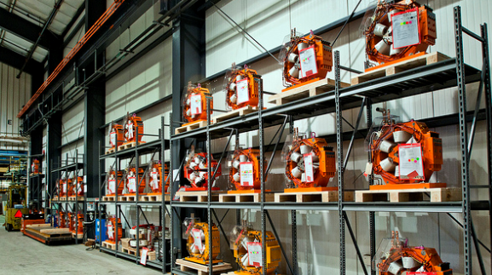
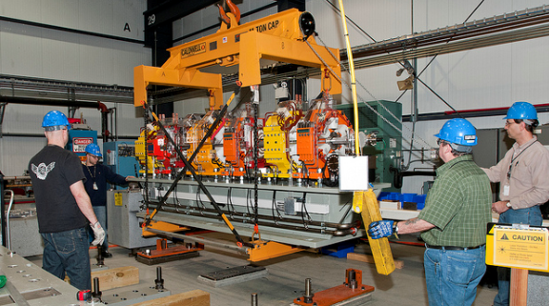
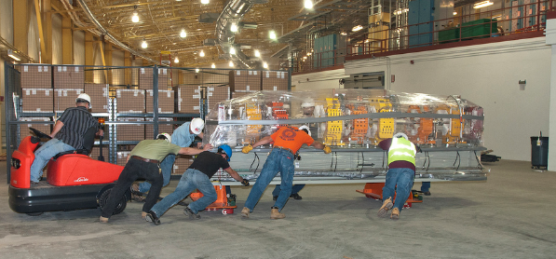
SR Girder/Magnet Installation
Dedicated Integration facility
Assembly and Integration including vacuum chambers and some instrumentation.
Magnet-magnet alignment (< 30um)
Dedicated magnetic measurement lab
Vibrating Wire
Rotating Coil
Hall probe
(150) Magnet Girders installed in tunnel
Girder-girder alignment in tunnel (< 100uM)
60 Dipoles
300 Quadrupoles
270 Sextupoles
270 Correctors
4 Bumps (Kickers)
1 Injection Septum
Over 900 Magnets
Installed

Slide 13
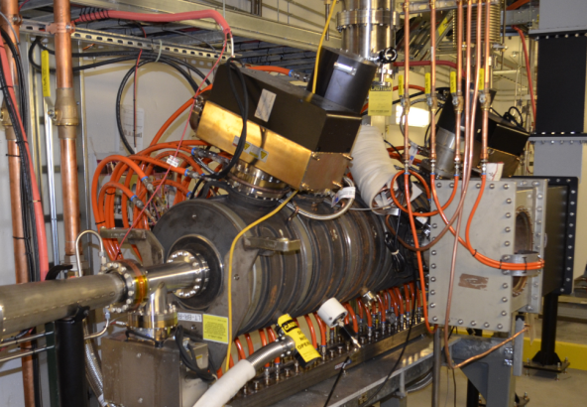
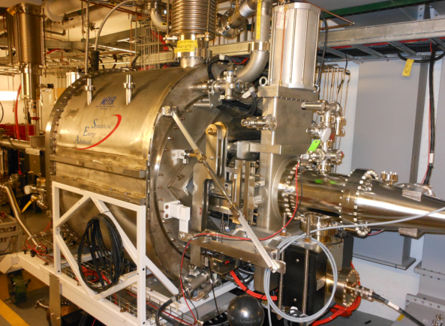
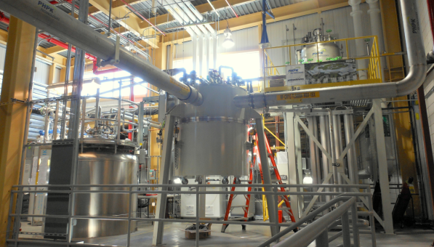
Storage Ring RF System
RF Transmitter (300KW)
RF Cavity
Phase I commissioning (mitigated SC Cavity delay)
7 Cell Copper Cavity (Booster spare)
Phase II Commissioning
500 MHz Superconducting RF Cavity is now installed and in operation
Cryo system
Closed loop LHe system
LN2 system to provide pre-cooling
RF Blockhouse
Used to test RF equipment prior to installation in the tunnel

Slide 14
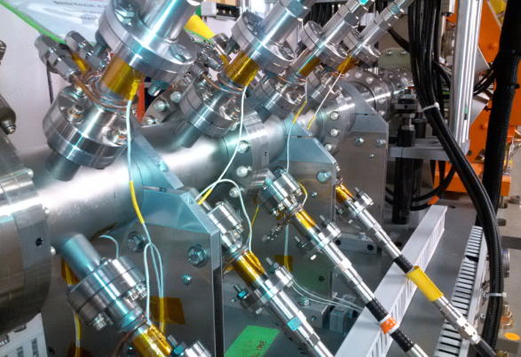
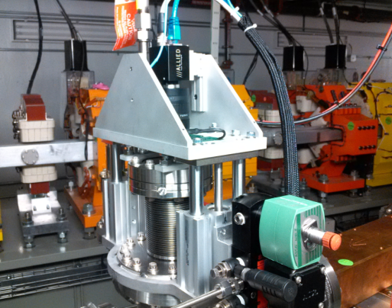
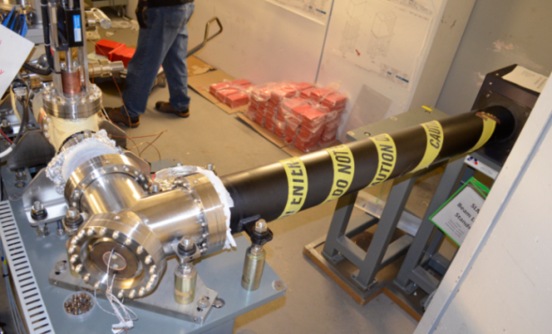
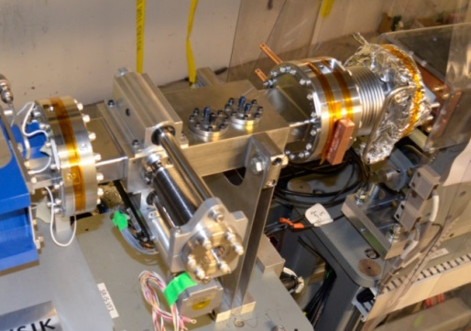
Storage Ring Instrumentation
(180) SR-RF BPMs
(18) SR-ID BPMs
(1) SR-XBPM
(1) DCCT
(1) SLM
(5) Beam Loss Monitors
Bunch-by-bunch feedback
(1) Tune Monitor System
(5) Scrapers - Horizontal/Vertical
One Storage Ring Flag located in the Injection Straight
Beam alignment Flags planned for all Front Ends (originally 6 installed)
Dedicated X-Ray diagnostic beamline with a pin-hole camera
Dedicated beamline with a 90º bend leading to SLM Hutch

Slide 15
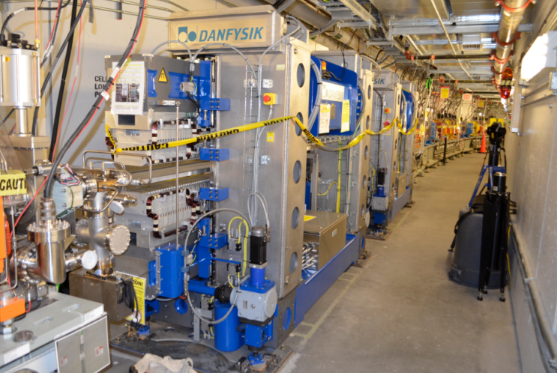
Insertion Devices
Insertion Devices originally installed:
(6) Damping Wigglers
(2) XPD
(4) Will be used on future beamlines
(1) 1.5m IVU21 (SRX)
(2) EPUs (CSX)
(2) 3m IVU20 (HXN & CHX)
(1) 3m IVU22 (IXS)
Time saving preparations:
Tunnel floor prepared & cable trays installed in advance
Rack installation & cable pulling is immediately performed after ID measurement are conducted
ID specific vacuum chambers are installed just prior to ID installation (IVUs not included)

Slide 16
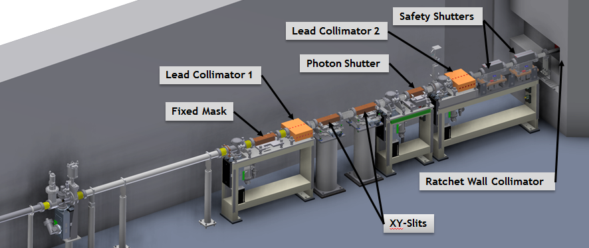
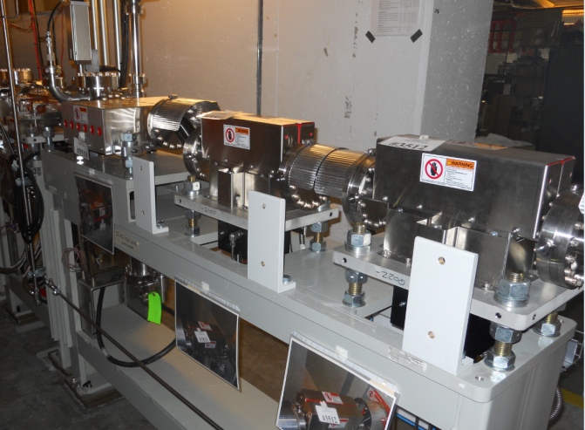
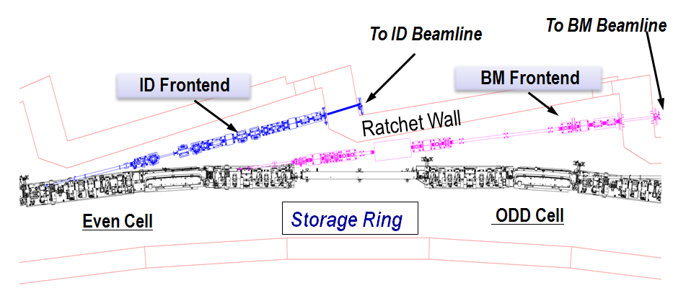
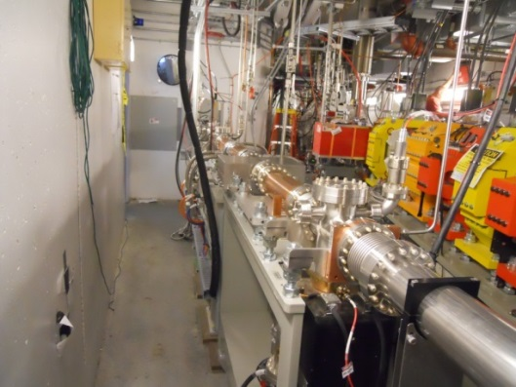
Front Ends
Six fully functional ID Front Ends originally installed: (XPD, SRX, CSX, HXN, CHX & IXS)

Slide 17
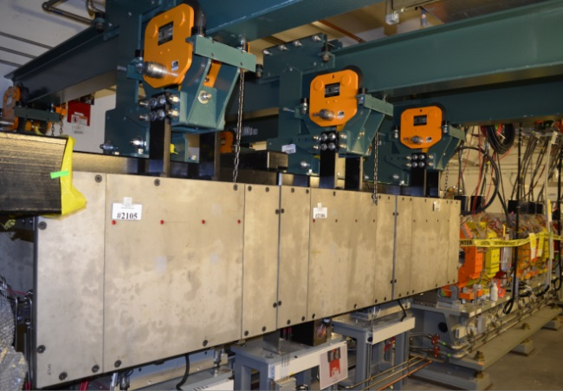
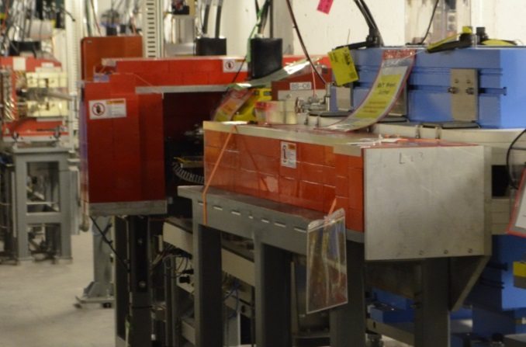
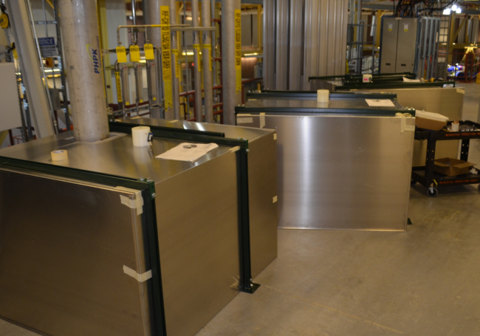
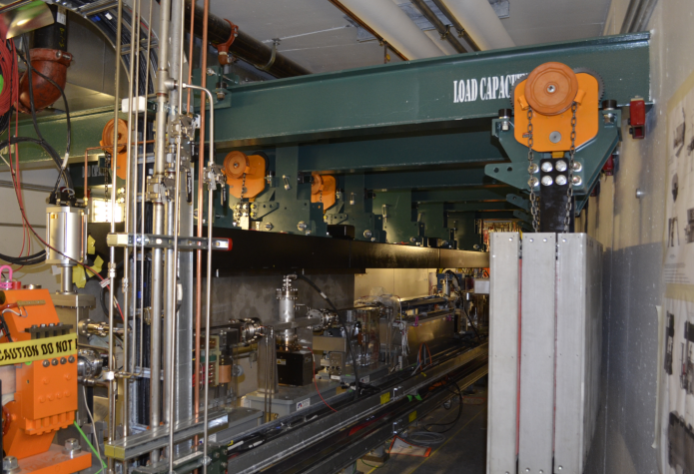
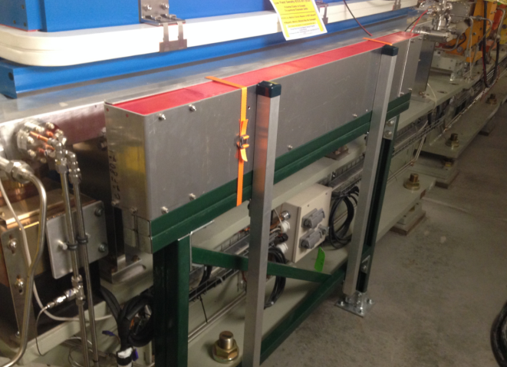
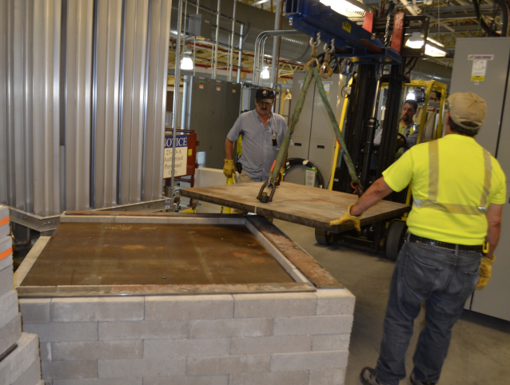
SR Supplemental Shielding
** Over 250 Supplemental Shields installed

Slide 18
NSLS-II Project Performance
Achieved excellent technical, cost & schedule performance
Installation and commissioning milestones met on October 2014
Cost Performance
Baseline Actual
Conventional Facilities $310M $311M
Accelerator Systems $295M $314M
Experimental Facilities $84M $93M
Pre-Ops $55M $56M
Project Management $68M $70M
R&D $61M $61M
$873M $905M
Baseline total with contingency = $912M

Slide 19
Critical Path Activities
SR & TL magnets (delivery and magnetic measurements)
SR power supplies (installation)
Pulsed magnets (design, fabrication and testing)
Area Radiation Monitors – (delivery and testing)
Supplemental Shielding (specification, design, fabrication & installation)
Insertion Devices (delivery and magnetic measurements)
Survey and Alignment (profiling of Girders in tunnel)
SR RF Cavity (delivery & testing - mitigated by warm cavity)
RF Cryo system (delivery and installation)
PPS (software development, testing and certification)
Readiness reviews (documentation for IRRs/ARRs)

Slide 20
Lessons Learned – Procurement Support
‘Liaison Engineer’ worked on of all specifications & statements of work (SOW)
Acted as Liaison among Cognizant Engineer/Scientist, Procurement, Quality & ESH (Environment, Safety, Health)
Many technical staff were not experienced with procurement documentation
Using specific, contractual language
Referencing appropriate codes & regulations
Omitting practical considerations related to shipping, testing, status reporting, installation, etc.
Including specifics of documentation deliverable (ex. contents of design reports)
Template was created for specs & SOWs
Each draft was reviewed by Liaison Engineer prior to circulation
Liaison engineer tracked procurement status & provided updates to management
Component delivery schedule was greatly helped by “up front” work
Installation was greatly aided by clearly stating the vendor deliverables
Process provided overview of all systems to become ‘Installation Coordinator’

Slide 21
Lessons Learned - Coordination
“Installation Coordinator” reported directly to the Division Director
Attended all Group Leader meetings; attended group meetings as necessary
Installation coordination started over a year before installation began
Identified “Work Control Coordinators” for each group
For work planning, safety, and field point of contact for group
Wrote work plans prior to work starting (beware of scope creep)
“Plan Of the Day” meetings held every morning on site
Plan of the day information updated daily with activities & safety warnings
Weekly installation coordination meetings for the Storage Ring and Injector were very effective
Weekly “coordination walk-throughs” were scheduled to identify and resolve hardware conflicts
Strong coordination with Conventional Facilities & Photon Division was essential
Space limitations in the Injector complex required detailed planning & coordination
In general, spreading groups throughout the facility was most effective

Slide 22
Lessons Learned - Labor
Learning curves & setup was longer than expected, which led to slow ramp-up
Installation “work profile” had a prolonged peak due to shifted work
Time associated with preparing for IRRs & ARRs was not planned
Competition for survey/alignment resources
Dedicated rigging team for project was essential
Underestimated labor for:
Shielding analysis & design
Electrical utilities & cable pulling
Mechanical utilities software effort
Rigging
Resource leveling & schedule analysis performed to determine impact of delayed work & developed plans to mitigate
Additional temporary labor added to keep schedule on track
Some activities strategically shifted
Schedule shifted from hardware driven to labor driven

Slide 23
Accelerator Installation Progress (Percent Complete)
Slower start relative to Baseline
“Catch-up” period
Actual
Includes SR, Injector, PPS & Insertion Device Installation WBSs

Slide 24
Accelerator Installation Work Profile (FTEs)
Slow ramp-up
(work performed)
Actual
Staff retained for longer than originally planned
Includes: SR, Injector, PPS & Insertion Device Installation WBSs

Slide 25
Lessons Learned - General
Importance of cable coordination & documentation
Documentation delaying install work (i.e. cable pull sheets)
Importance of subassembly travelers during install & test
Bi-weekly meetings with “project controls” staff was essential
Developed several different ‘schedule views’ to disseminate
Sent out simple installation status spreadsheet weekly
Changed order of installation due to component availability
Tracking small packages was difficult
Storage space considerations
Building delays required alternative storage solutions
Forklift usage limited to riggers only
Importance of barricades & signage
Enforcing PPE usage (i.e. safety glasses)
Shifted from “area based” approach to “job specific” approach toward the end

Slide 26
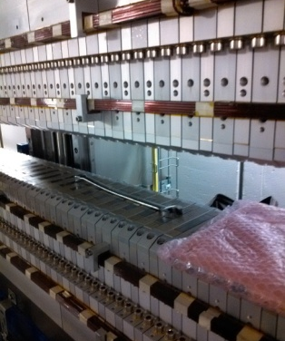
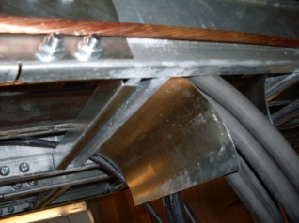
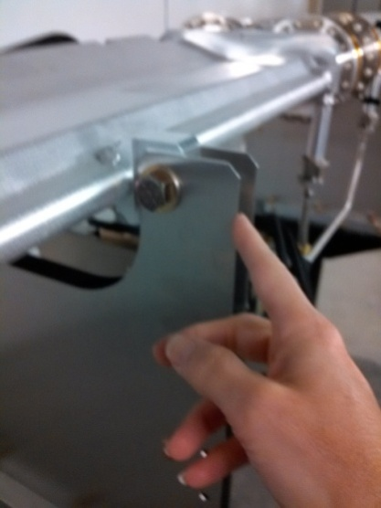
Safety Topics - Accelerator
Finger cuts from sharp edges (cable tray waterfalls, sheet metal stands)
Need for proper gloves
Pinched finger – wrench too close to permanent magnet
Trip down set of stairs
Proper ladder usage
Lead contamination of received parts
Changing hazards – rigging, high voltage, bakeout, magnetic fields, radiation
Importance of training (i.e. LOTO)

Slide 27
Challenges Experienced
Delayed “beneficial occupancy” of ring building
Extensive punch-list after receiving occupancy; ownership of space
Changes required to the building; updates to building as-builts
Coordinating multiple activities & teams during installation
Coordination to avoid interferences between systems
Performing installation, integrated testing and commissioning in parallel
example: Access to Pentants 1 & 2 limited during Booster commissioning
Limitations associated with having only one ID measurement lab
SR Supplemental Shielding design, construction and documentation (> 350 Shields)
Shortage of specialized installation labor
Component delays (i.e. magnets, RF cavity, etc.) required additional planning to balance activities and resources
Limited floor space for staging materials and performing secondary installation activities
Transportation of material during & after hutch installation is often difficult

Slide 28
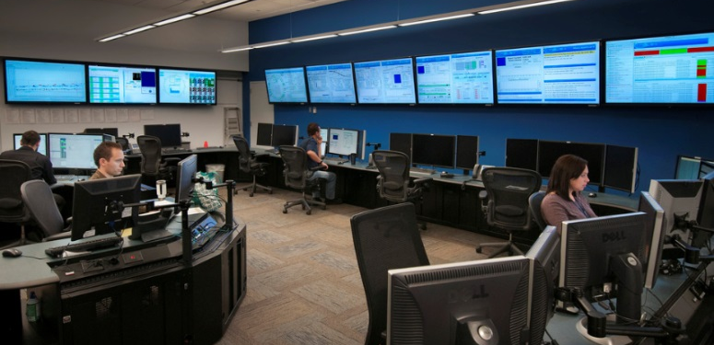
NSLS-II Project Success
Accelerator is in top-off operations at 400mA
8 Insertion Device “project” beamlines in operations
~20 additional beamlines have been built & are in operations
3 additional beamlines are in the process of being built (NEXT-II)
Expecting CD-1 this year to build an additional 10-12 beamlines (NEXT-III)
Proper planning, coordination, & communication have been the keys to success

