Slide 1
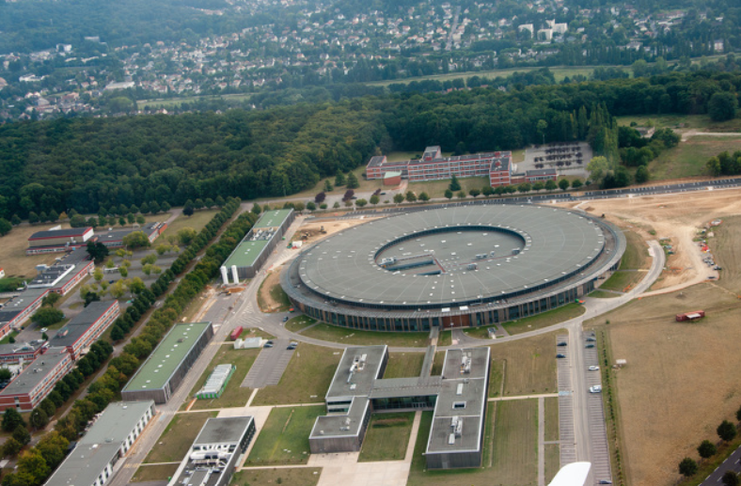
SOLEIL II : an almost complete dismantling scenario
François TRIAS on behalf of SOLEIL II Project team
PAU WS - Removal & Installation 18-20 March 2024 - Trieste

Slide 2
The dismantling & disassembling scenario
Summary :
Challenges and constraints
Traffic on site
Dismantling strategy (full Radiation Safety measurements)
Crane strategy: the sinews of war
Flying over working areas with safety (tunnel & exp hall)
Slabs handling management
Dismantling method (straight sections then arcs)
Dismantling planning
PAU WS - Removal & Installation 18-20 March 2024 - Trieste

Slide 3
Challenges and constraints
Dismantling of SR to be carried out as quickly as possible: work in 2 shifts in 2 different areas => 4 teams of authorized crane workers required/5 days a week
Handling with two cranes at the same time => coactivity management, evacuation on 5 unloading zones to streamline handling
Minimum 2 closed cells between 2 open cells
Obligation to process straight sections before arcs
No workers in adjacent closed cells during slabs handling
Handling heavy loads on slabs with specific protocol : safety reason
Evacuation of specific beamlines hutch when flown over by cranes
Permanent rotation of evacuations from the unloading areas to the disassembly building with forklift, trailers, etc.
Safe circulation on site with other users
  Critical path planning
  Just-in-time logistics
  Resources available
  Maximum safety
& the same items and timing with the booster equipments & 7 beamlines full Upgrade (location change) !!!
PAU WS - Removal & Installation 18-20 March 2024 - Trieste

Slide 4
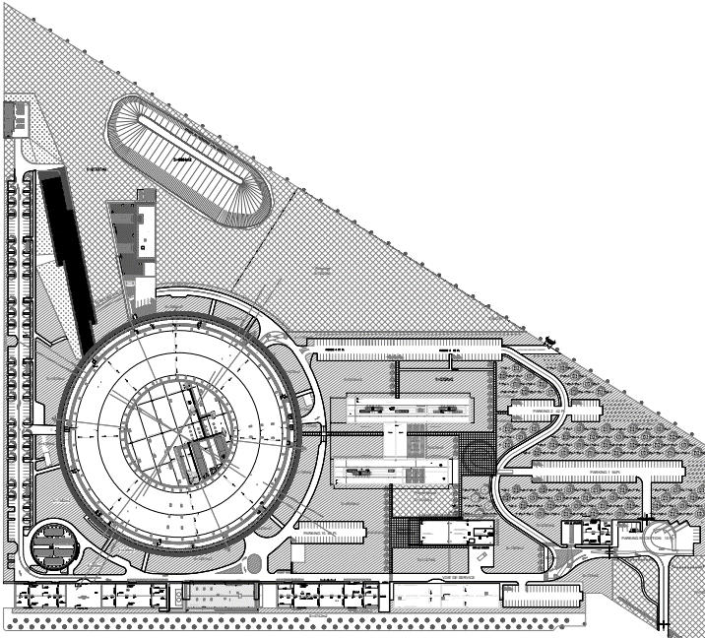
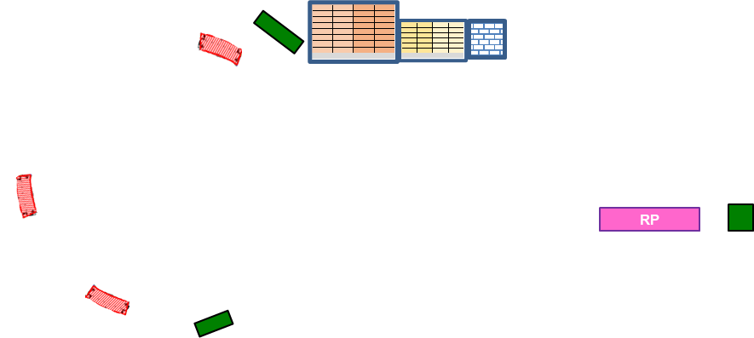


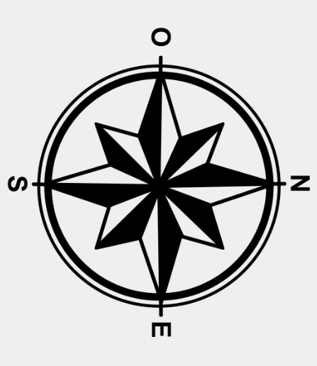


Road Traffic on Site – Removal SR & Booster during Shutdown
Traffic flow assumptions
Temporary building #1 :
- New machine equipments storages
- BL2 storages
Evaluation of the number of journeys with forklifts, trailers, to the different buildings: RS, Temporary storages, storages and modifications
Temporary building #2 :
1900 m2
- Radiation Safety : dismantling, measurements, storages
RS
To be completed by Beamlines movements.
Most will take place inside Synchrotron building
T1
T2
T3
T5
T4
PAU WS - Removal & Installation 18-20 March 2024 - Trieste

Slide 5
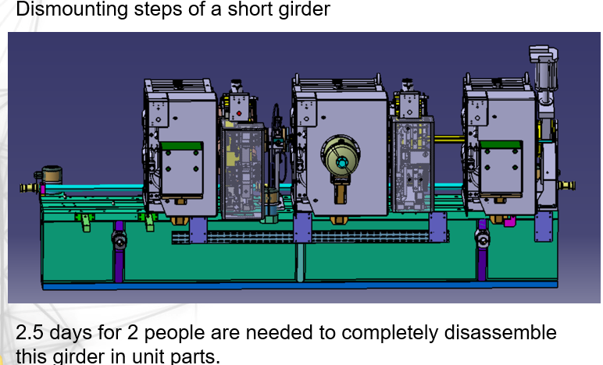
Dismantling strategy - full Radiation Safety control by requirements of ASN (Autorité de Sûreté Nucléaire /Nuclear Safety Authority) : a project IN the Upgrade project
The absolute rule : any equipment or accessory leaving the tunnels must be measured in RS
Estimated weight of tunnels equipment :
More than 650 tons (including cooling system) of various materials from SR
More than 150 tons of various materials from Booster
 | TOTAL SR
Weight (t) | 600,4
Steel | 495,1
Stainless Steel | 12,9
Al | 34,4
Copper | 36,2
Plexi | 0,6
Needs : procedures, methods, safety rules, available resources, logistics are necessary to succeed in this challenge !!
PAU WS - Removal & Installation 18-20 March 2024 - Trieste

Slide 6
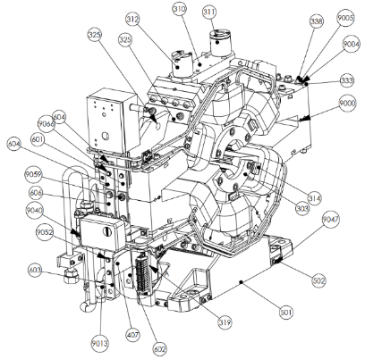
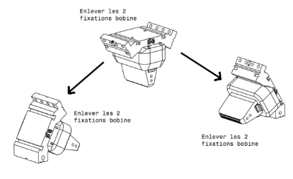
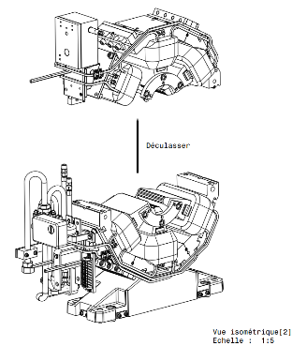
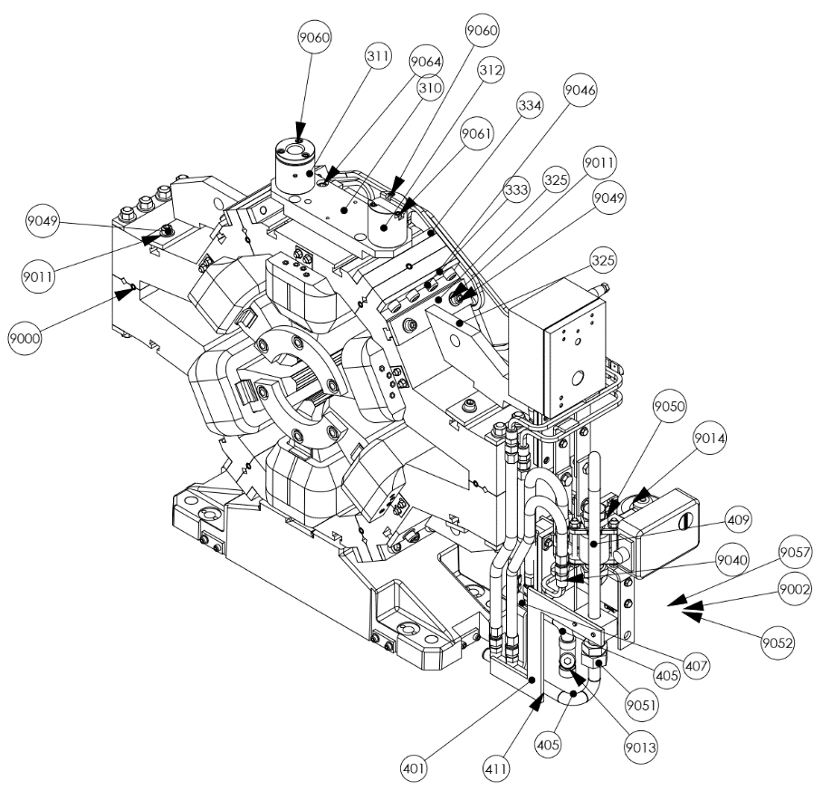
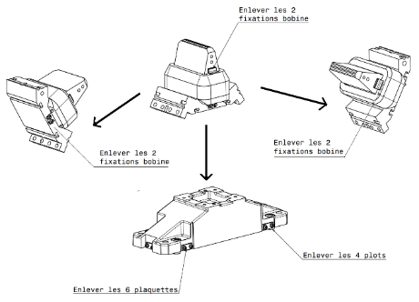
Disassembly down to the unique screw for the RS measurements.
Dismounting steps of a sextupôle magnet
The related BOM (Bill Of Material) specify the material of each component.
3 hours are needed for 1 person to completely disassemble a sextupole magnet.
PAU WS - Removal & Installation 18-20 March 2024 - Trieste

Slide 7
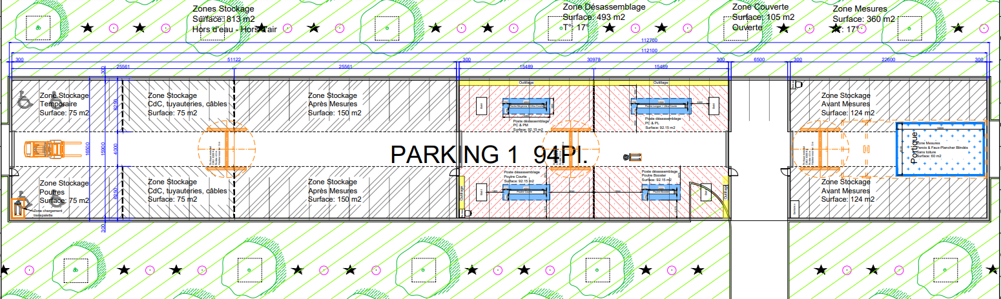
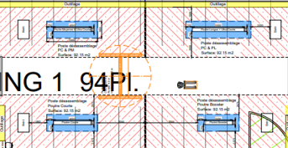
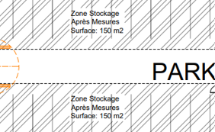
Disassembly at RS : a new building
Storage & Disassembly area
RS measures area
Zone stockage av et après mesures 150 m2
Project
Zone stockage av et après mesures 150 m2
Recycling area 3
Useful area : ~1700 m2 - Covered area to site exit : 105 m2
PAU WS - Removal & Installation 18-20 March 2024 - Trieste

Slide 8
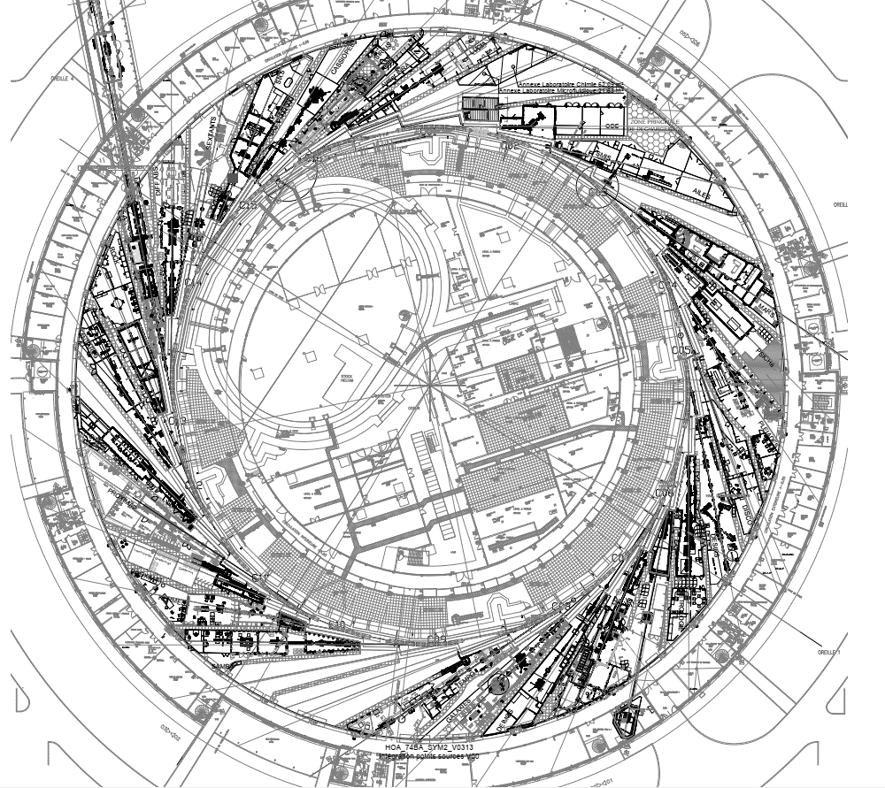
SR removal : Cranes strategy, the sinews of war
NW loading/unloading zone
Study of the pathways is almost complete.
We foresee to bring the larger and heavier equipment directly toward the two loading/unloading zones (named SAS, Synchrotron exits)
To shorten the crane time using and to facilitate the simultaneous use of the two cranes at the opposite sides of the ring, the girders will be moved passing above the passerelle E (bridges).
It will not be possible for the insertion devices because the available height over the bridge is not sufficient. Then we foresee to move them under the bridges thanks to motorized skates.
For the other equipment we foresee to have temporary storage areas close to the outer circulation area of the experimental hall (named passage way) and evacuate them with pallet truck or forklift.
C01
C16
C02
C03
C15
C14
C04
Passerelle N
C13
C05
C12
C06
C11
C07
C10
C08
C09
Passerelle E
NE loading/unloading zone
PAU WS - Removal & Installation 18-20 March 2024 - Trieste

Slide 9
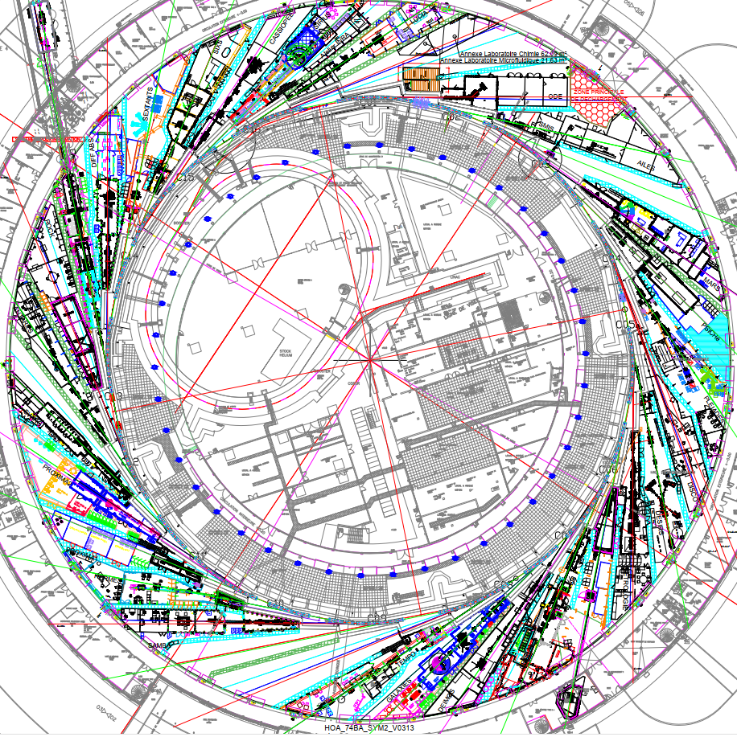

Uninstallation – Cranes fly over areas
Sextants
During the dismantling study, we found that the use of both cranes is the most important constraint :
The SD planning critical path is determined by the permanent use of cranes, their speed transport, number of equipment to be handled and the safety rules.
The slabs handling has been a specific focused point
A special cranes maintenance plan will be implemented before & during the shutdown to secure the cranes activity
West SAS
Fly over corridor between tunnel & loading/unoading areas
Crane area 1
Loading & unloading areas
Antares
Crane separation line
Crane area 2
SR fly over areas, SR exit doors & handling areas
Tempo
East SAS
PAU WS - Removal & Installation 18-20 March 2024 - Trieste

Slide 10
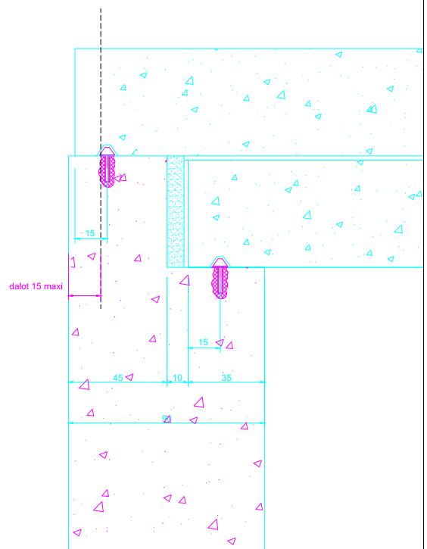

Circulation area for girders & ID’s above slabs
1 meter
Necessary conditions to allow inside tunnel work with circulations above slabs : OK safety group
around 40 cm
Visual device like string
- 20 cm above slabs
- 1 meter from railing
- visual device installed
Handling areas | Beam lines to be evacuated when cranes flying over
WEST LOADING ZONE | SMIS | AILES
EAST LOADING ZONE | DEIMOS * | CRISTAL | PUMA
TEMPO Temporary loading zone | SAMBA | (Futur DESIRS)
ANTARES Temporary loading zone | ANTARES | ROCK
SEXTANTS Temporary loading zone | SEXTANTS | SIXS
0,2 m
Upper slab
clearance between slabs
Lower slab
T3
Bat Infra
In case of accidental fall, the lower slab will not be damaged => no risk of injury for working people inside the tunnel
Inside tunnel
PAU WS - Removal & Installation 18-20 March 2024 - Trieste

Slide 11
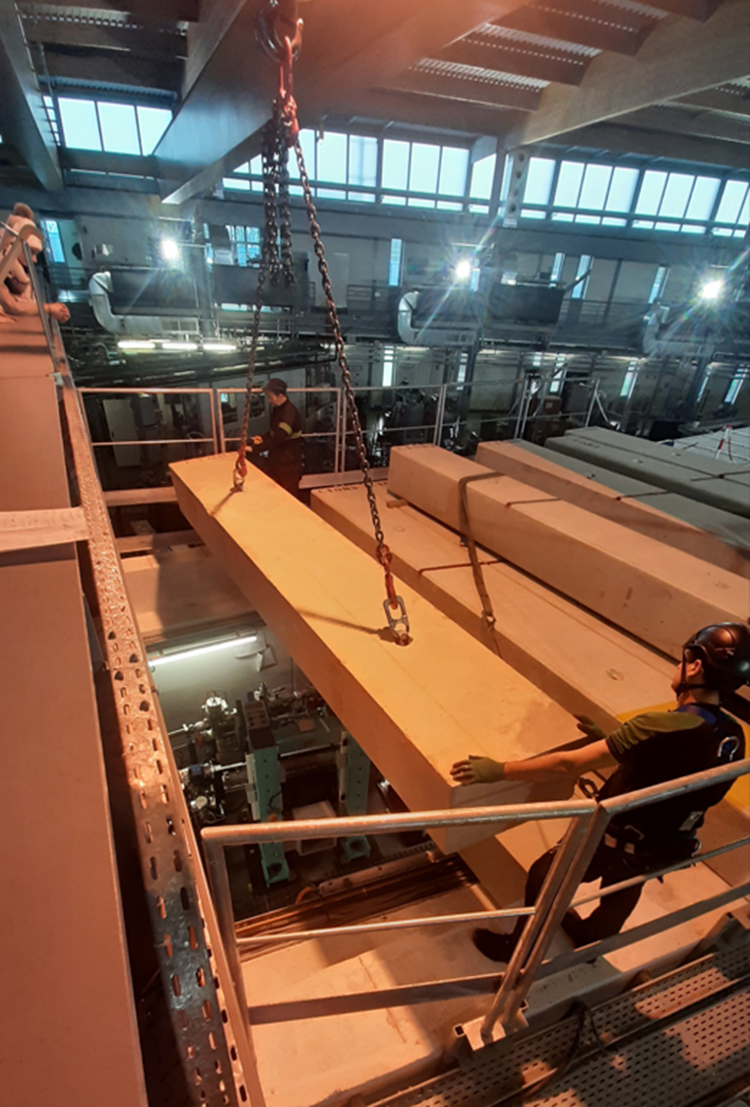
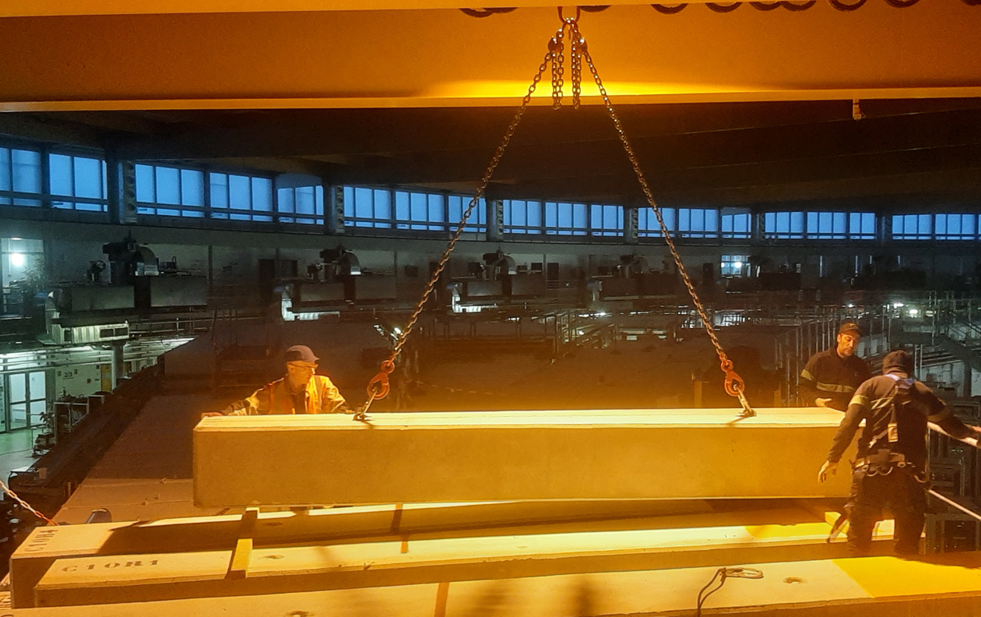
Remove – Focus on slabs handling
925 slabs to be handled twice (Remove/Installation), some of them several times (about 100)
=> Important safety & planning challenge
PAU WS - Removal & Installation 18-20 March 2024 - Trieste

Slide 12
Remove - Focus on timing evacuation & organization
Time table for evacuation of equipment for the complete Storage Ring
Estimated meantime for handling a slab : 10 to 14 minutes each.
5 hours for 22 slabs
216 hours or
31 shifts for all slabs
Crane 1 |  |  |  | Crane 2
Cell | Opened slabs Nber | Time in h | Total time | Cell | Opened slabs nber | Time in h | Total time
SDM 14 | 22 | 10,3 | 10,3 | SDM 06 | 17 | 7,9 | 7,9
SDM 15 | 21 | 9,8 | 20,1 | SDM 07 | 19 | 8,9 | 16,8
SDM 16 | 21 | 9,8 | 29,9 | SDM 08 | 19 | 8,9 | 25,7
SDL 01 | 46 | 21,5 | 51,3 | SDM 10 | 21 | 9,8 | 35,5
SDM 02 | 20 | 9,3 | 60,7 | SDM 11 | 21 | 9,8 | 45,3
SDM 03 | 26 | 12,1 | 72,8 | SDM 12 | 21 | 9,8 | 55,1
SDM 04 | 21 | 9,8 | 82,6 | SDL 13 | 29 | 13,5 | 68,6
SDL 05 | 29 | 13,5 | 96,1 | ARC 13 | 42 | 19,6 | 88,2
ARC 14 | 44 | 20,5 | 243,6 | ARC 12 | 39 | 18,2 | 106,4
ARC 15 | 44 | 20,5 | 223,1 | ARC 07 | 44 | 20,5 | 213,7
ARC 16 | 38 | 17,7 | 202,5 | ARC 06 | 49 | 22,9 | 236,6
ARC 01 | 55 | 25,7 | 184,8 | ARC 05 | 27 | 12,6 | 249,2
ARC 02 | 50 | 23,3 | 159,1 | ARC 11 | 46 | 21,5 | 127,9
ARC 03 | 48 | 22,4 | 135,8 | ARC 10 | 46 | 21,5 | 149,3
ARC 04 | 37 | 17,3 | 113,4 | ARC 09 + SDL 09 | 55 | 25,7 | 175,0
 |  |  |  | ARC 08 | 39 | 18,2 | 193,2
TOTAUX | 522 |  | 243,6 |  | 534 |  | 249,2
 |  | Shifts nber | 34,8 |  |  | Shifts nber | 35,6
With all logistics tools & staff as :
Chain slings (with spares)
Wooden blocks
Safety equipment
Area marking equipment
Free areas & paths to evacuate to RS building
Forklift & trailers
Plans & procedures
Authorized staff
Special safety staff
PAU WS - Removal & Installation 18-20 March 2024 - Trieste

Slide 13
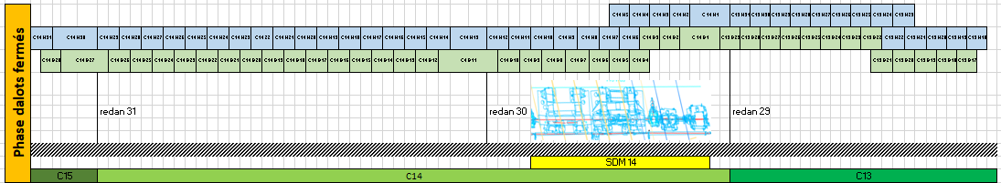
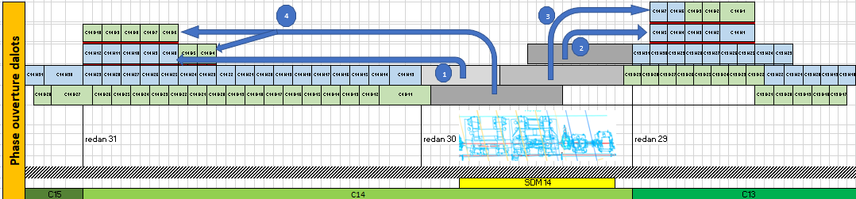
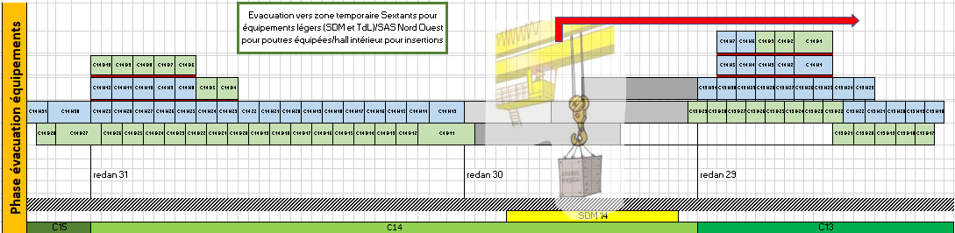
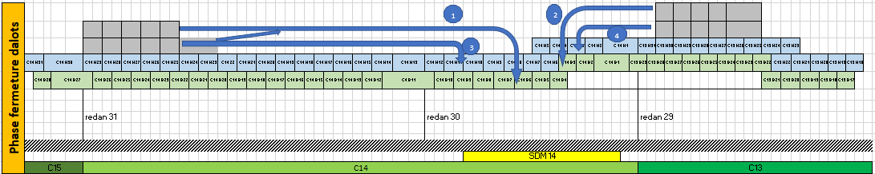
Dismantling - Equipment Evacuation Sequencing with O/C Slabs
Example for SS 14 : include 2 ID’S & 1 front end
Closed Tunnel
Specific defined area for slabs storage on both sides of aperture
Opening 22 slabs :
about 5h
Total time: opening, evacuation, closing :
about 20 hours or 3 shifts or 1.5 days
SS & FE Evacuation :
about 10 h
We are used to open/close slabs at every periodic shutdown
Closing 22 slabs :
about 5 h
« We do what we are familiar with »
PAU WS - Removal & Installation 18-20 March 2024 - Trieste

Slide 14

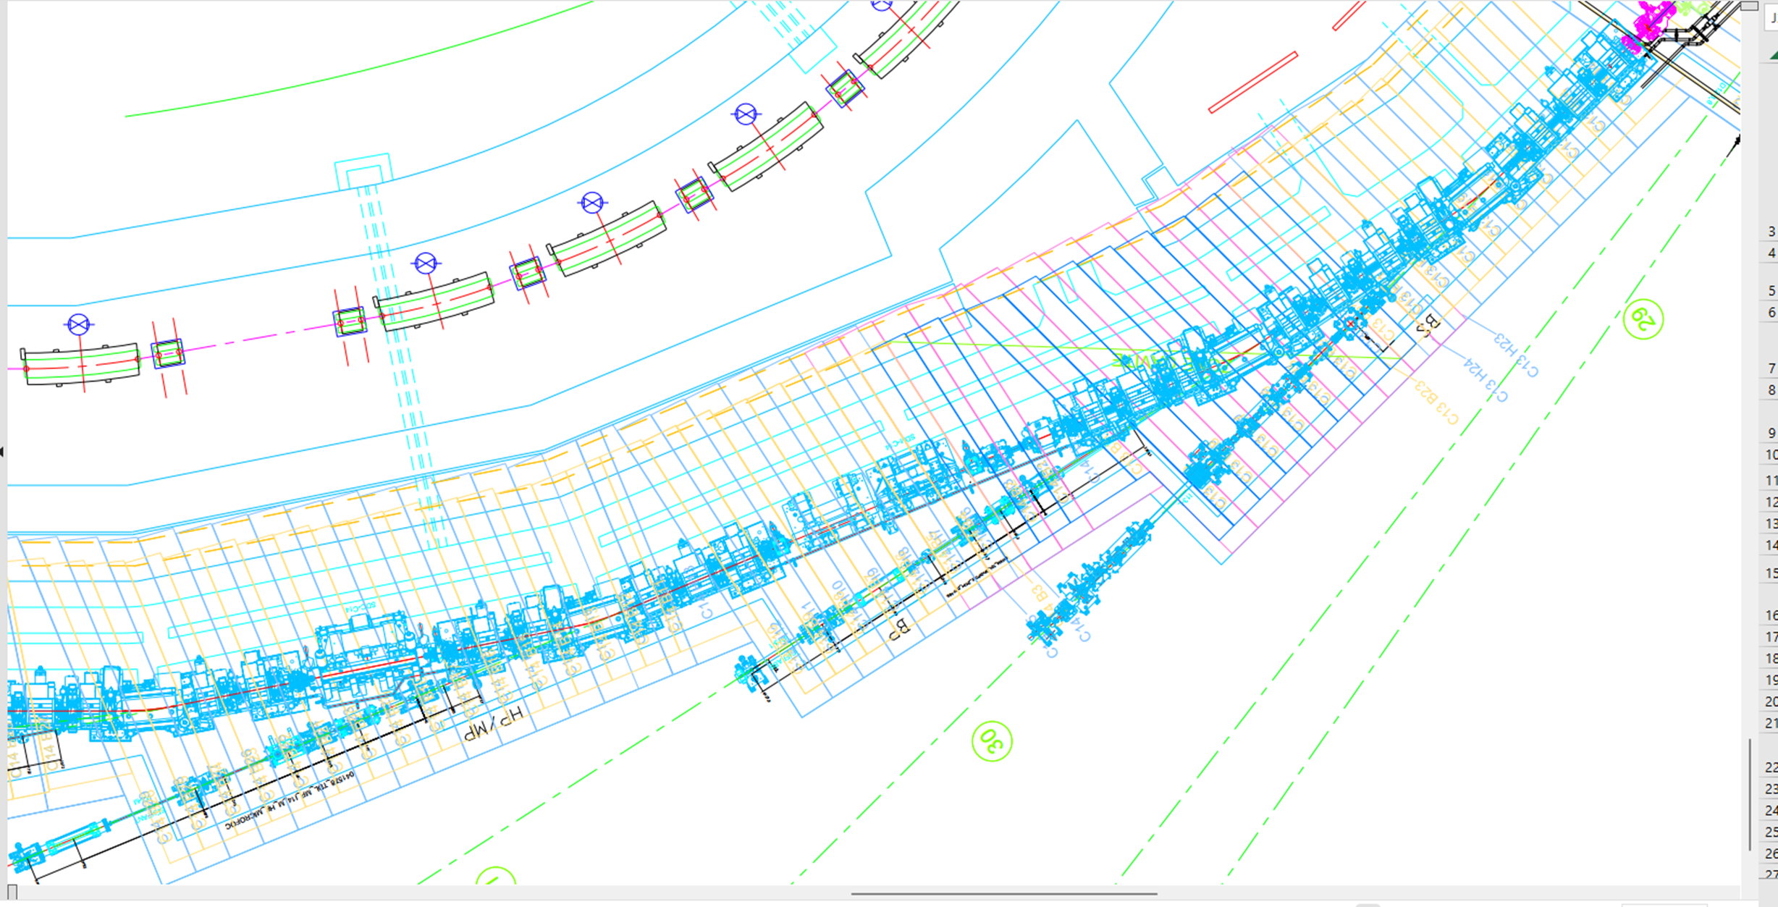

Dismantling – slabs removal SS 14 – Top view animation
Expansion : + 10 % of occuped area
Expansion : + 10 % of occuped area
11 slabs
11 slabs
C 13
C 14
SS 14
C 15
C 14
PAU WS - Removal & Installation 18-20 March 2024 - Trieste

Slide 15



Equipement removal SS14 – Simulation
C 13
C 14
Opened straight section 14
C 15
C 14
PAU WS - Removal & Installation 18-20 March 2024 - Trieste

Slide 16
Slabs re installation (closing SS14) – Simulation
11 slabs
11 slabs
SS 14
PAU WS - Removal & Installation 18-20 March 2024 - Trieste

Slide 17
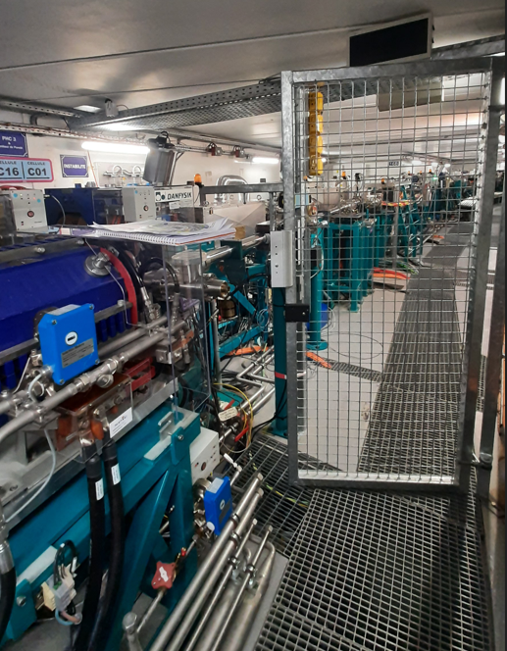
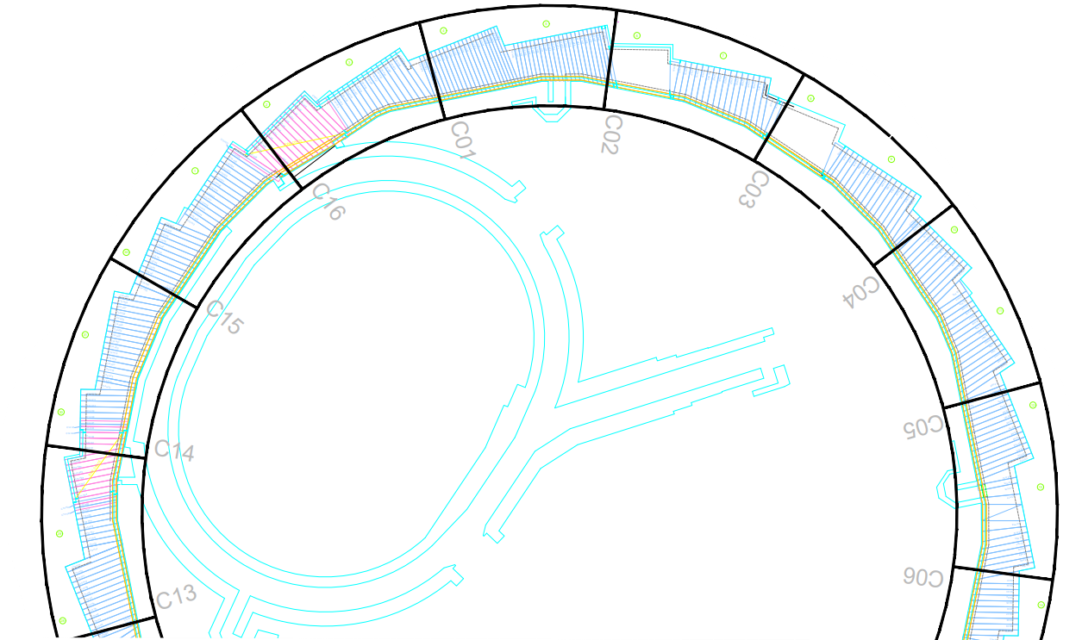




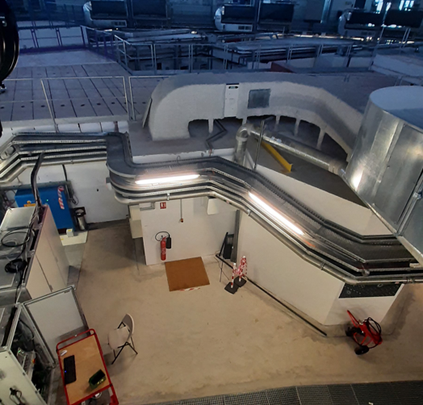
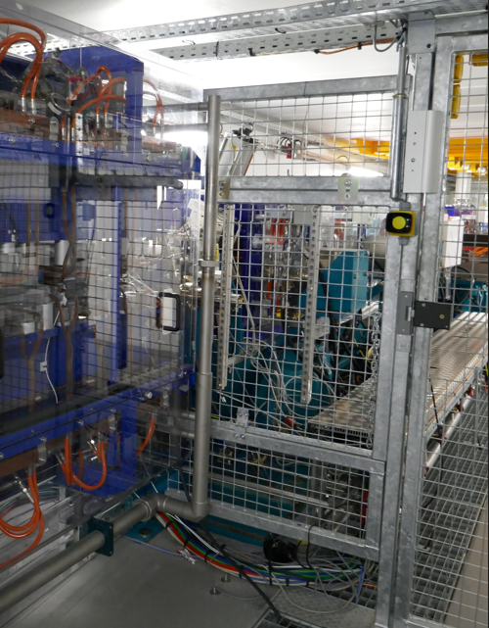
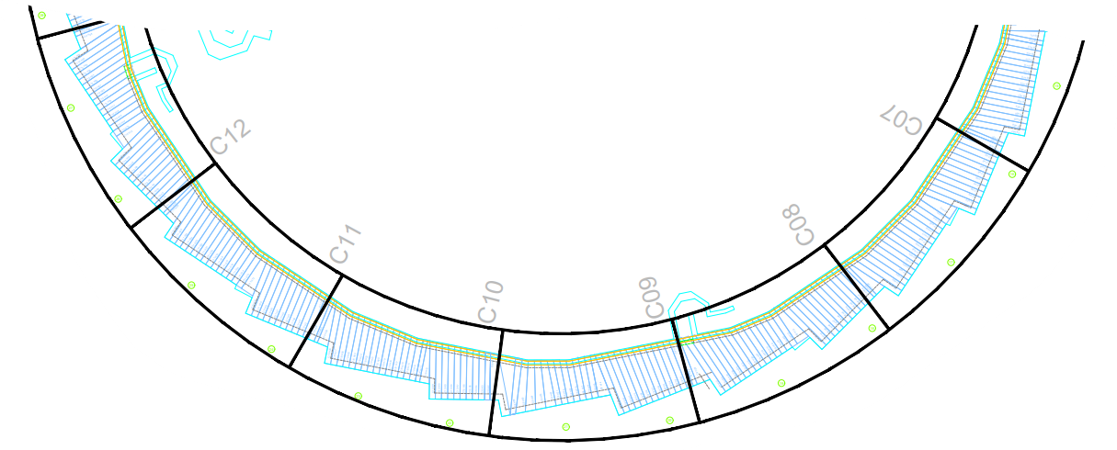

Dismantling – equipment evacuation areas when closed tunnel
Sextants
WEST SAS
For :
- Recovered equipments
- Cables, cable trays
- Piping
- Waste in crates
Safety screen gate
AS1
AS 2
West tunnel exit
Crane area 1
Tunnel exit
Antares
North tunnel exit
South tunnel exit
Crane area 2
East tunnel exit
Evacuation handling area by crane
AS 3
Achromats
EAST SAS
Straight sections
AS 4
Tempo
PAU WS - Removal & Installation 18-20 March 2024 - Trieste

Slide 18
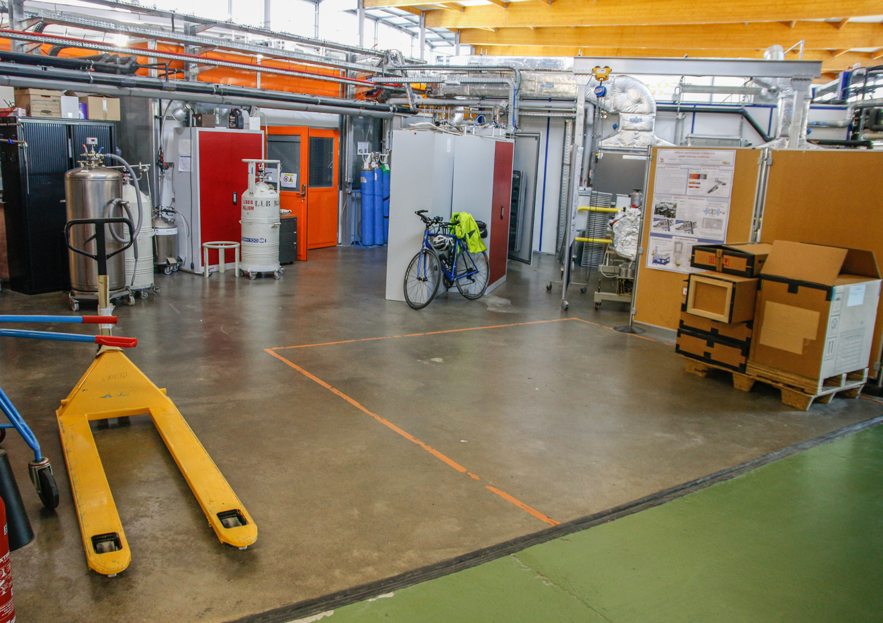
Dismantling – tunnel areas to be evacuated & passageway used
WEST SAS
Sextants
Handling with crane
Handling with forklift by passage way
Antatomix/ nanoscopium : crossing passageway beamlines
Antares
Crane separation line
GOAL : minimize time crane handling
EAST SAS
Tempo
PAU WS - Removal & Installation 18-20 March 2024 - Trieste

Slide 19
Dismantling – straight sections & arcs management
WEST SAS
Sextants
12 slabs to be evacuated by West SAS at SS02 & 03 => time to be added
SS & Arcs: Optimized management to release AS 1 area at first
AS1
Zone pont 1
AS 2
End AS1
End AS 2
Antares
Zone pont 2
EndAS 3
EndAS 4
AS 3
Achromats
EAST SAS
Straight sections
AS 4
Tempo
PAU WS - Removal & Installation 18-20 March 2024 - Trieste

Slide 20
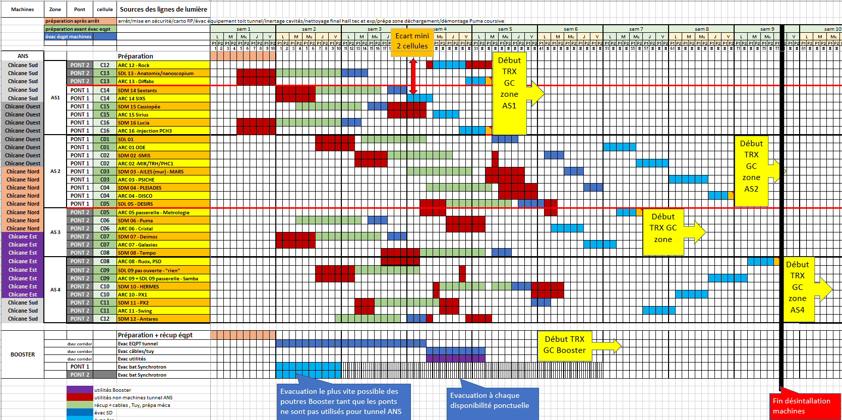
Dismantling machines – Estimated schedule
PAU WS - Removal & Installation 18-20 March 2024 - Trieste

Slide 21


Following works, & installation studies
To be completed :
More detailed works in technical zone removal
Strategy for non machines network as cooling system, safety system, communication system inside tunnel, etc,…
Civil works and then ….
Working on news machines (SR & booster) installation & BL2 Upgrade program
Our daily/weekly life !!!
Thank you very much for listening !!
Your questions are welcome !!!
PAU WS - Removal & Installation 18-20 March 2024 - Trieste

Slide 22


Optional slide : Buildings allocation
West ear : 250 m2
- BL2 Storages & Labs to be confirmed
Recycling area 1
Temporary building #1 :
2x1500 m2 => 3000 m2
- New machine equipments storages
- BL2 storages
Estimated areas (Existing, transformed, temporary) - m2 | 10 900 | on site | 9 900
 |  | off site | 1 000
Estimated area requirements - m2 | > 10 500 | Machine | 5 000
 |  | Beam lines | 3 500
 |  | RS | 1 500
 |  | Workers | 500
 |  | Cooling Cables Control Booster | ?
Booster & LINAC roof : 200 m2
- Power supplies construction
Workers accomodation
500 m2
Center of the Booster : 1500 m2
- Activated equipments storages
- New power supplies equipments
- Other storages
Temporary building #2 :
1900 m2
- RS : dismantling, measurements, storages
South ear : 250 m2
- BL2 storages to be confirmed
East ear : 250 m2
- Vacuum strings construction
T1 : 400 m2
- Front end vacuum construction
- Various storage
RP
Recycling area 3
T1
Experimental hall :
- Tempo area (450 m2) : Mock Up, strings vacuum storage, Id’s upgrade
- Inside passageway (150 m2)
- Internal technical area BL2 (380 m2)
T2 & T3: 460 m2
- Various Storage whose Matching assembly girders
T1
T2
T3
T5
T4
T5 : 430 m2
- Magnets & girders assembly & measurement
- ID’s construction
T4 : 230 m2
Magnets lab
ID’s construction
Recycling area 2
PAU WS - Removal & Installation 18-20 March 2024 - Trieste

