Slide 1
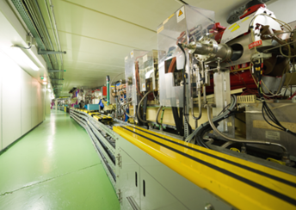
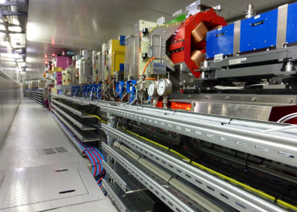


3rd Workshop on Particle Accelerator Upgrade
Removal and Installation (PAU-R&I3)
Trieste, 17-20 March 2024
ESRF-EBS TECHNICAL ZONE PREPARATION
&
CABLING
Old ESRF Storage Ring
ESRF-EBS
Benoit Joly

Slide 2
contents
Technical Zone preparation
Description & planning
New layout for the electronic cubicles
Improvements made to the electronic cubicles
Cabling A milestone task
Activities and contracts
Planning and progress
Main challenges
VDC distribution for the magnet power supply
Total figures

Slide 3
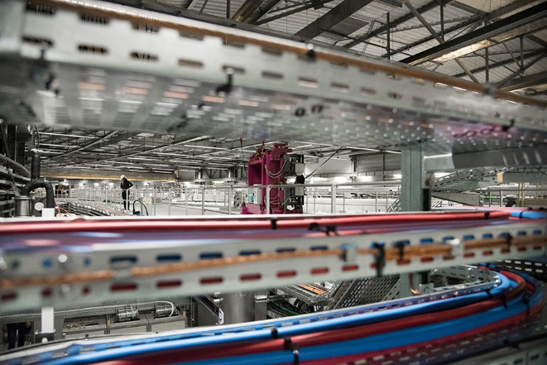
Description of the Technical Zone
“If the storage ring, with its innovative new lattice configuration, is the beating heart of the EBS, then the Technical Zone is the circulatory system of arterial cables and pipes that connects magnets, detectors and myriad other equipment from the storage ring to the brains of the operation – the Control Room”.
Metres of cables and pipes link the hardware in the storage ring to the software in the Control Room. Credit: A. JOLY & C. ARGOUD / ESRF.

Slide 4
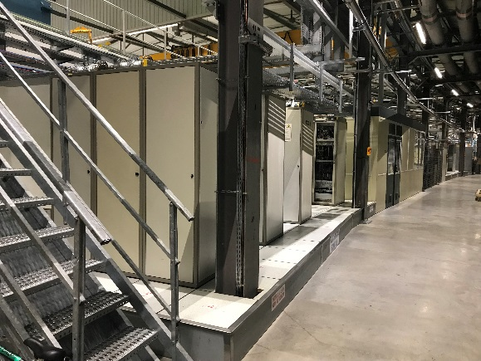
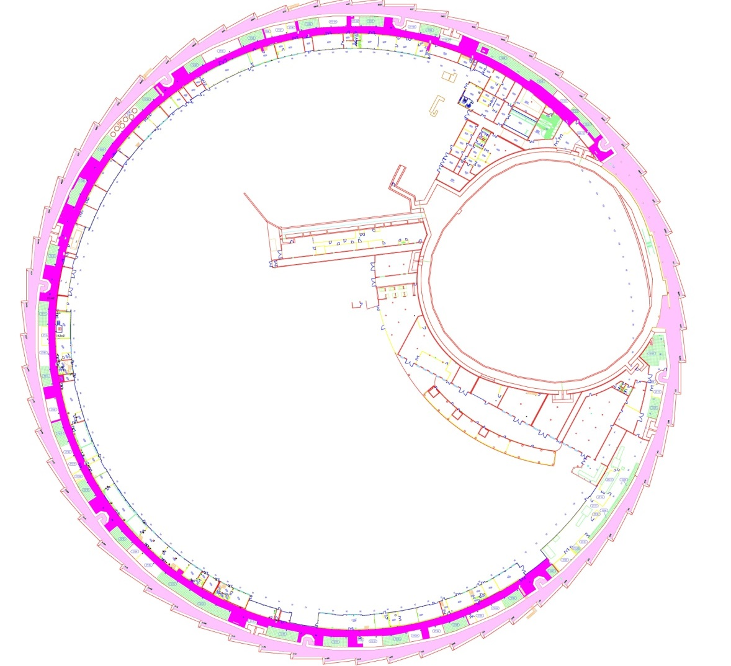
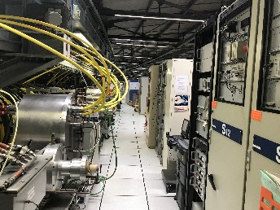
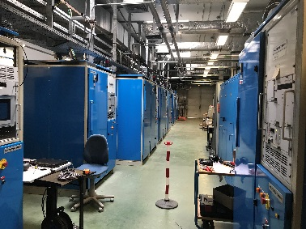
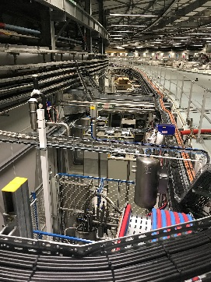
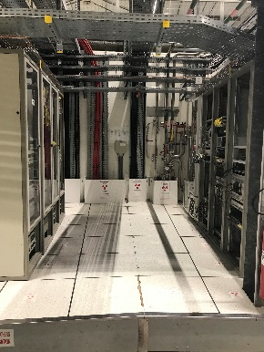
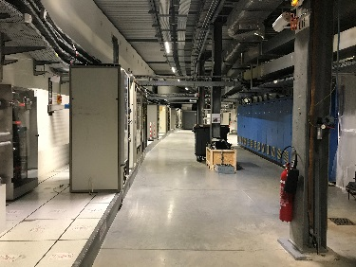
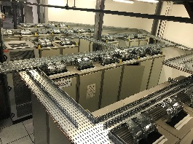
Description of the Technical Zone
Technical Areas
The Storage Ring Tunnel (3 670 m²)
The Technical Zone (5 300 m²)
SRRF 3
SY TU
InjExt Platform
LINAC
Technical
zones
(More than 500 elec. cubicles)
InjExt
- Freeway
- 32 x Electronic cubicle zones
- Storage areas and laboratories
- Liquid Nitrogen network
- …
SRDC
SRDC
SRRF 1&2
3xSRRF
SR TU

Slide 5
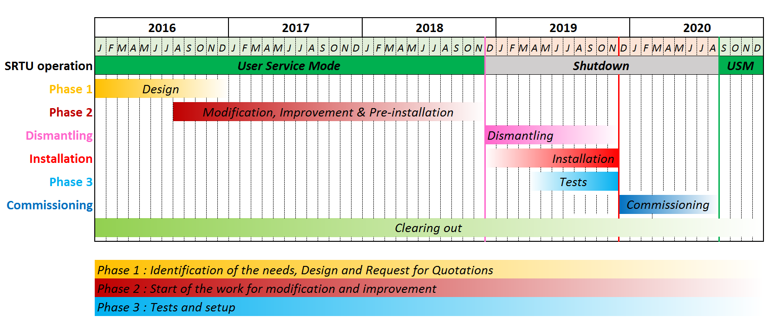
ESRF-EBS Planning

Slide 6
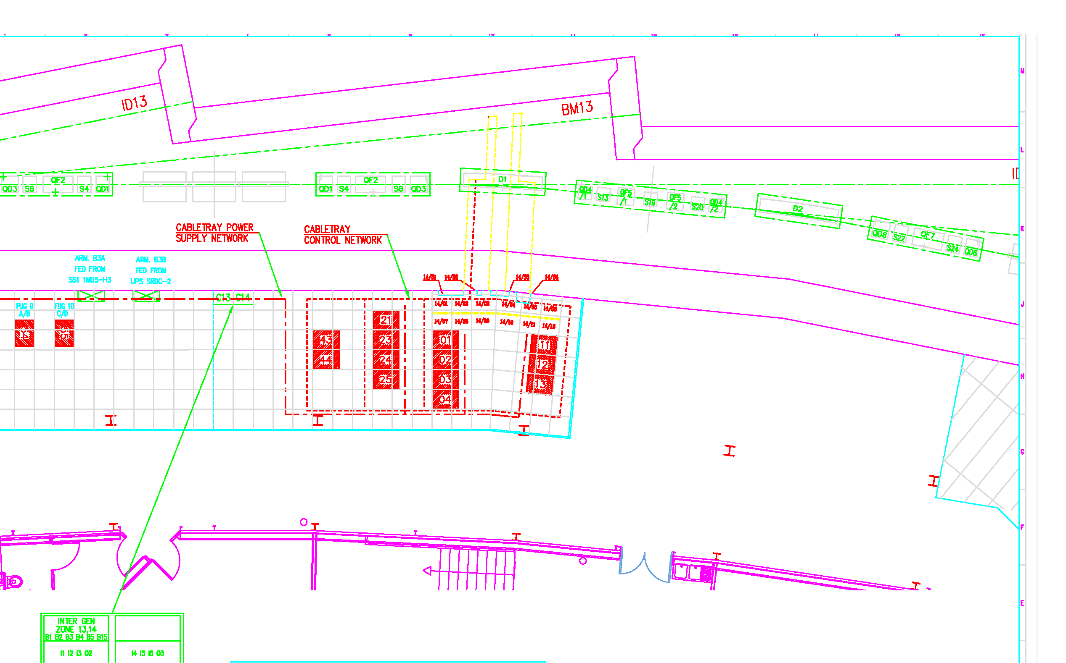
Old electronic cubicle layout

Slide 7
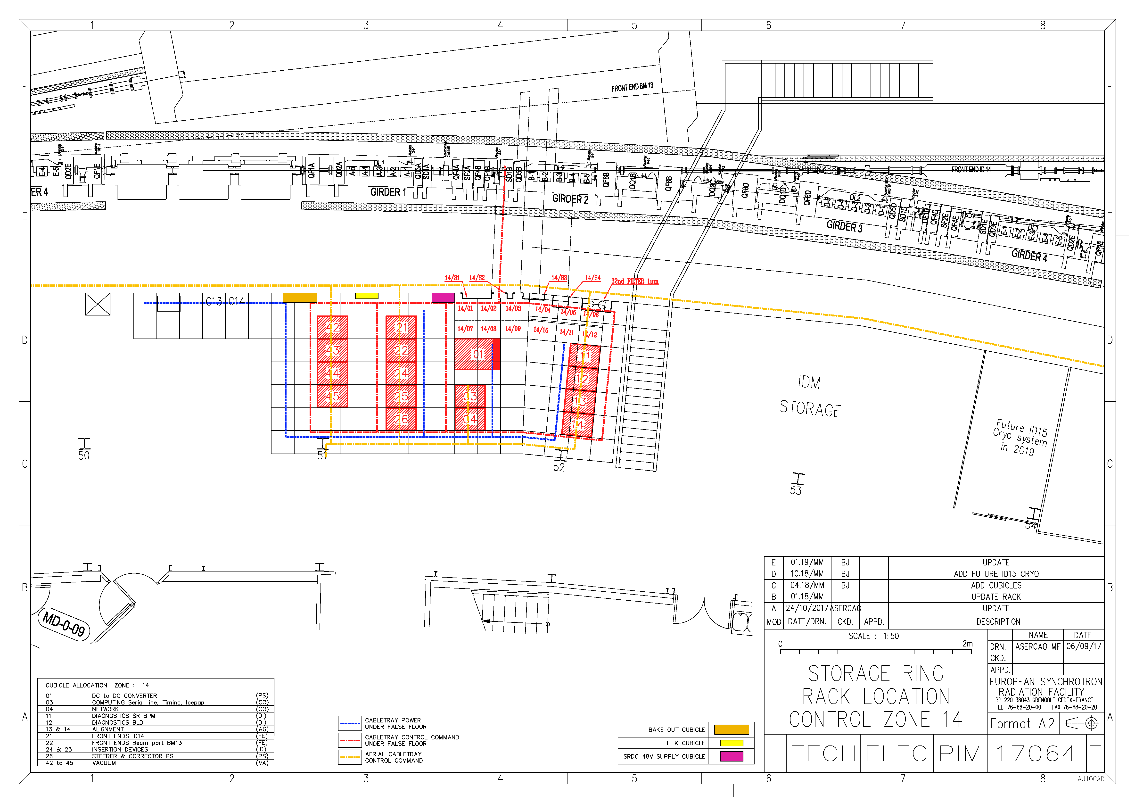
New electronic cubicle layout
ESCAPE ROUTE
DROP ZONE
STORAGE AREA
CRYO
SYSTEM
HOT SWAP Cubicle

Slide 8
Electronic cubicle Improvements
Mains distribution via the 230V power sockets
Replacement of the ageing power sockets with new power supply sockets fitted to 19” rack.
Improvement of the cable path inside the cubicle
Addition of a second cable tray in order not to have all the cables running on one side of the cubicle only.
Computing Network distribution in each cubicle
In the same way that the 230V power supply is distributed in each cubicle, Computing Network patch panels have been installed in each cubicle requiring a Network connection.
Low voltage DC distribution in the cubicles
24VDC : reliable and redundant power supply for the instrumentation (made from 230V).
48VDC : the Network switches stay ON in the event of a power failure (specific power supplies with battery).
Better routing of the low current cables
Installation of interconnected cable trays above the cubicles.

Slide 9

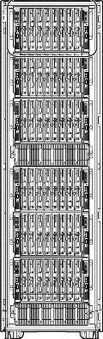
OLD cabling organisation
Low level signals
Optic fibers
Network cables
Serial lines
One row of
cubicles only…
Bottleneck!
SR Tunnel
TZ
Trench

Slide 10
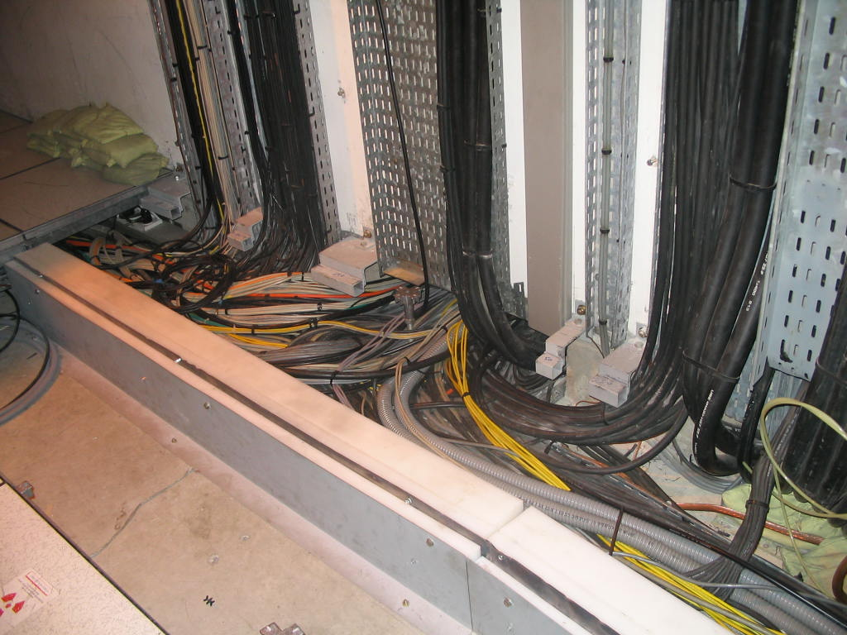

Slide 11
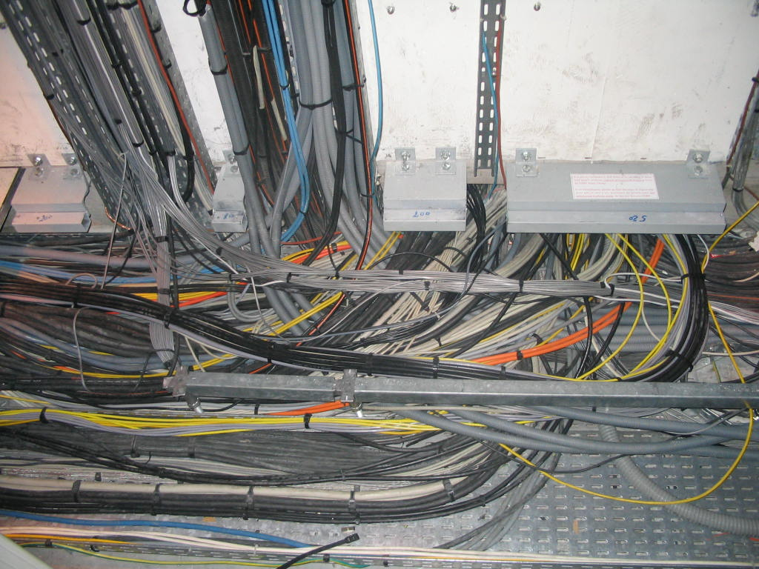

Slide 12
new cabling organisation
Low level signals
Optic fibers
Network cables
Cable trays above the cubicles
Serial lines
SR Tunnel
TZ
Trench

Slide 13
new cabling organisation
Low level signals
Optic fibers
Network cables
Serial lines
SR Tunnel
Trench

Slide 14
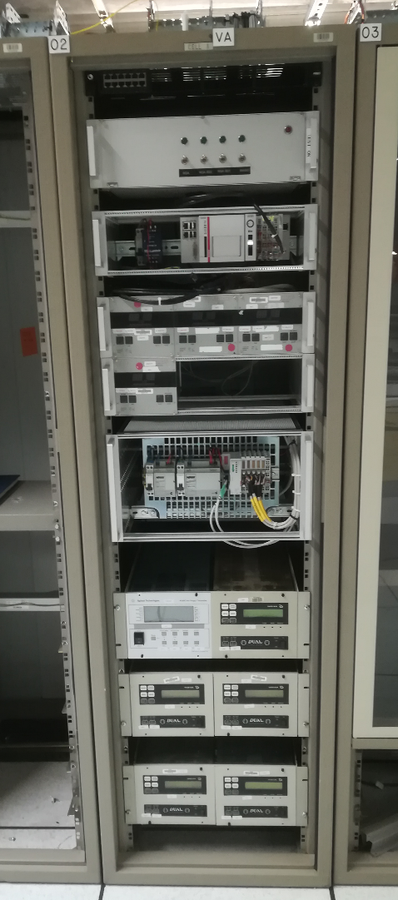
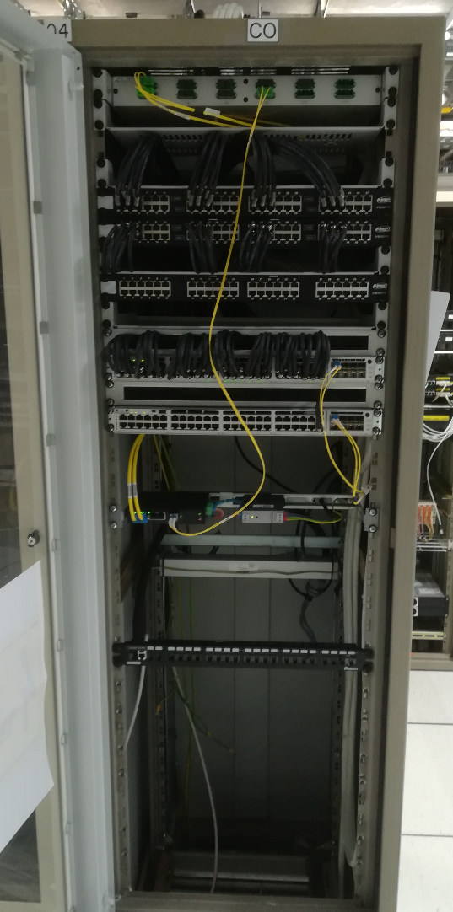
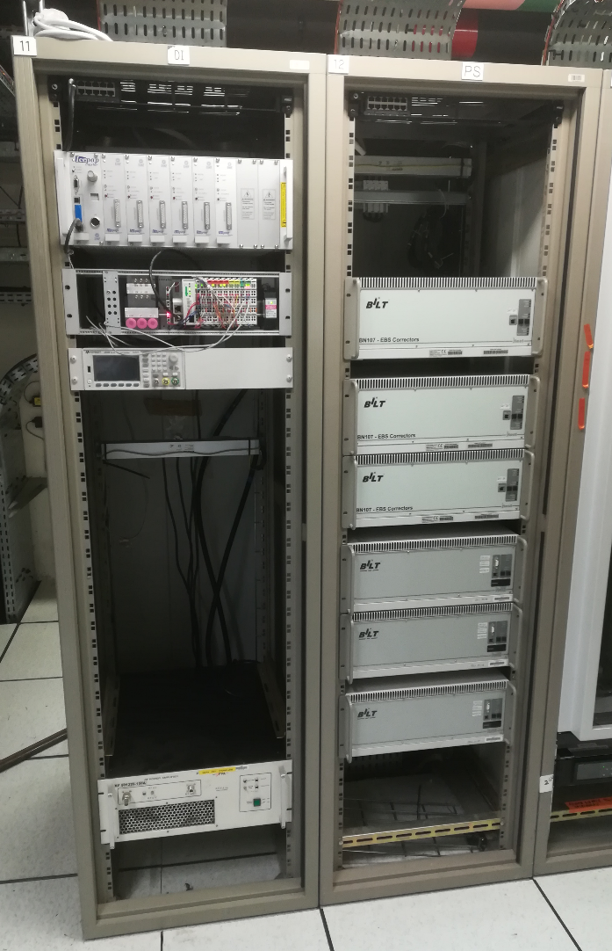
Control & instrumentation HARDWARE
VACUUM
NETWORK
DIAG
POWER
SUPPLY

Slide 15
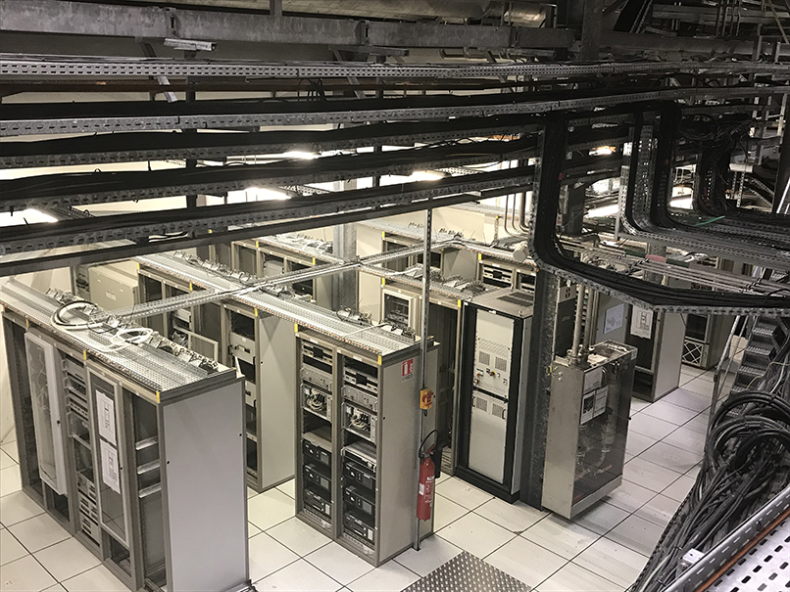
new layout organisation
Credit: C. ARGOUD / ESRF.

Slide 16
Cabling - a milestone task
Cabling was the link between SR installation, TZ installation and equipment tests
Work before cabling
Test of functionalities
(Local and remote control)
Test of each individual signal
(Supply, monitoring & interlocks)
Installation of remaining diagnostics & control equipment
Installation of equipment and service outside SR tunnel
(+ Remote control configuration)
Cabling in SR
Remaining connection of SR equipment
Reorganisation of cubicles
Preparation of new equipment
Refurbishment of reused equipment
Disconnection of cables
Dismantling old equipment
Work after cabling

Slide 17
Cabling - activities
A new cable database was fully updated with the new cubicle layout
It was used for any cabling requests
Electrical demands
Main electrical activities
Magnets
Accelerator engineering
Power supply and electrical engineering
Radio frequency
Control upgrade
Diagnostics
Injector upgrade
Vacuum
Transfert line 2
Management of the cable database
New cabling system from the technical zone (TZ)
Supply and installation of the cable trays and the grounding network inside the SRTU
Supply, installation, labelling and test of all the cables with connectors on both sides, i.e. from the electronic cubicles located in the TZ to the various equipment of the new accelerator inside the SRTU
Cable database

Slide 18
Cabling - contracts
Electrical cabling in
SRTU / TZ / SRDC
Batch 1: Cabling in the SRTU
CFT 2580 - SPIE
Batch 2: Cabling in the SRTU
CFT 2580 - ACTEMIUM
DC DC Distribution (main)
CFT 2503 - BONNAZZA
DC DC SRDC final connections to the grid
(WP4)
Move of electrical cubicles (baking)
RFQ 2731 - BOUYGUES
Dismantling of electrical cubicles
TZ01-08
RFQ2784 - BOUYGUES
48VDC + 24VDC electrical distribution for the computing network
CFT 2723 - INEO
Dismantling of cell 32, 01 & 02
RFQ 2789 - INEO
Dismantling of TL2
RFQ 2790 - BONNAZZA
Replacement of main electrical switch boards 1MD4-5-6 (WP4)
CFT 2774 - BONNAZZA
Notes:
The two main contractors had a different approach for the teams management. Contractor for one and temp agency for the other.
Actemium is a big group that used his national network. Spie was smaller and used local staff (smaller pool of technician).

Slide 19
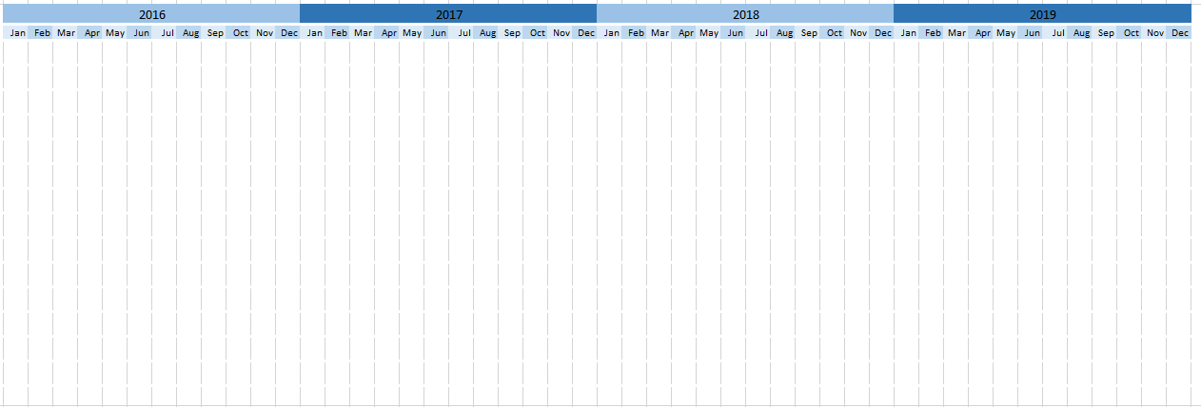
Cabling - planning and progress
ESRF-EBS SHUTDOWN
ADDITIONAL WORKS
ADDITIONAL CABLING REQUEST
Nbr of Cables
10 490
Nbr of Cables
13 400
Nbr of Cables
13 930
STUDIES
CFT EXERCICE
ESRF VALIDATION PROCESS
End of the cabling specifications writing
CONTRACTS
AMENDMENT 1
AMENDMENT 2
AMENDMENT 3
PREPARATION STUDIES & PROCUREMENT
Three months
Six months
PREASSEMBLY PHASE
CABLING WORKS
The technical specifications were done in September 2017 to launch the Call For Tender process beginning of 2018
Additional works arose during the dismantling phase and the cabling of the first cell
30% additional cables have been requested throughout the project
Three amendments have been done to update the contract with the increasing number of cables and the additional works (done only for the two main contractors ACTEMIUM and SPIE)
Increase of 13% of the initial budget
(quite low compared to the volume of works and the uncertainties)
Preassembly phase in the workshop prior to the shutdown to limit the installation time on site
Three years of preparation for six months of works

Slide 20
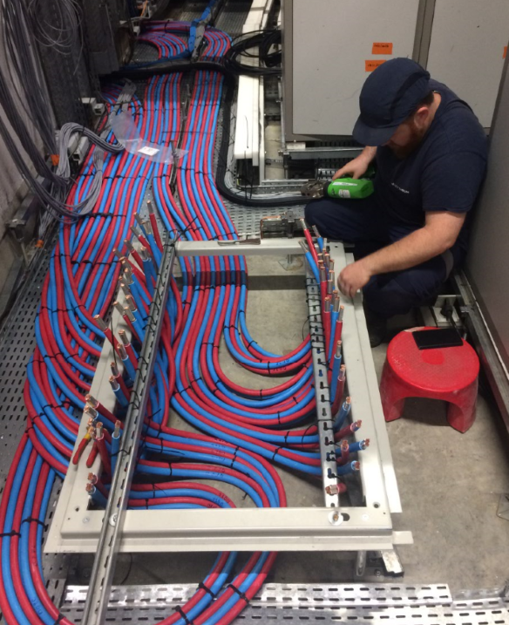
Cabling - Main challenges
To do:
32 cells to be wired with the same specifications regarding the installation of the cables, depending on their type and use.
Many of the 32 cells were different; they did not have exactly the same equipment and not exactly the same configuration.
Very short response time in the event of a problem (reaction and adaptation).
e.g. Only two weeks to wire eight cells in parallel (more than 100 electricians at the peak load).
RF cavities, collimators, diagnostic equipment
Proximity of transfer lines, different position and length of cable trenches, different layout of technical areas
How to:
We relied on experienced technicians and manager of the Electrical unit to do a close follow-up of the works
Technicians were assigned to each company, with the mission to:
monitor the progress of the work on a daily basis
deal with small problems and necessary adaptations in the field
point out the main difficulties and report
ensure compliance with initial specifications as well as adaptations decided following a change

Slide 21

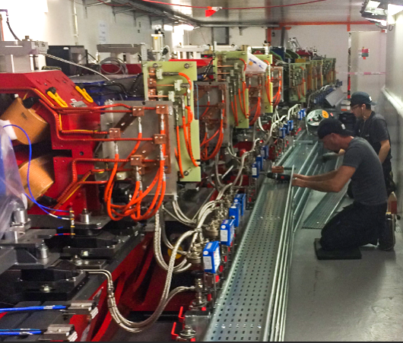
Cabling - Main challenges
To do:
Throughout the project, we received approximately 160 requests for additional cables, adaptations or changes to specifications.
How to keep track of these wiring tasks and account for each adjustment ?
How to:
We relied on the use of ticket trackers
Each requester had to send their request via email.
A ticket was created and saved automatically.
Thanks to JIRA ticket trackers, requests could be analysed, sorted and assigned to companies.
Then, the quotes according to the terms of the contract, were returned by the companies and the requests were validated via the ESRF change request process.
Finally, the new requests were included in the wiring workflow and their main steps recorded in the corresponding ticket.

Slide 22
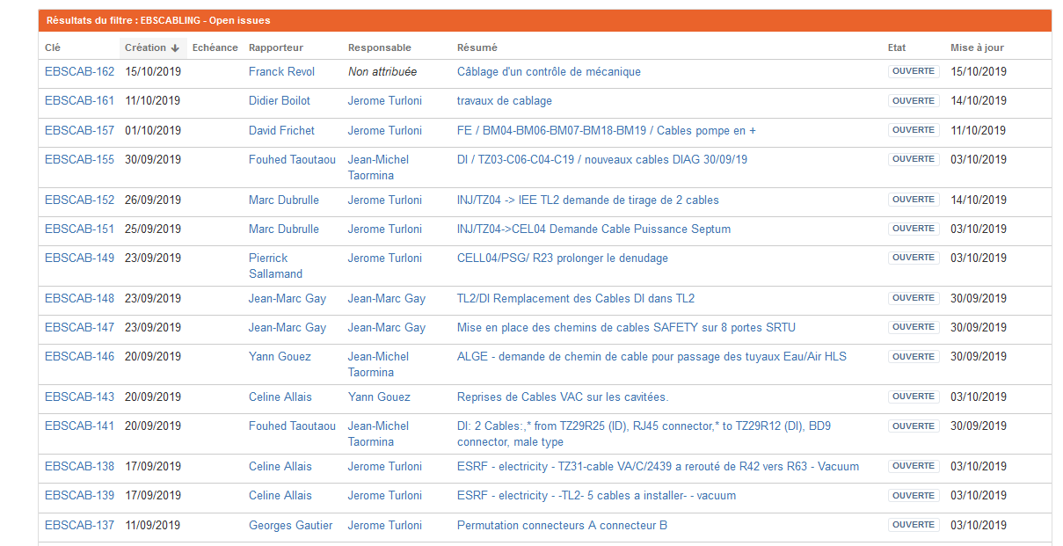

Cabling - Main challenges

Slide 23
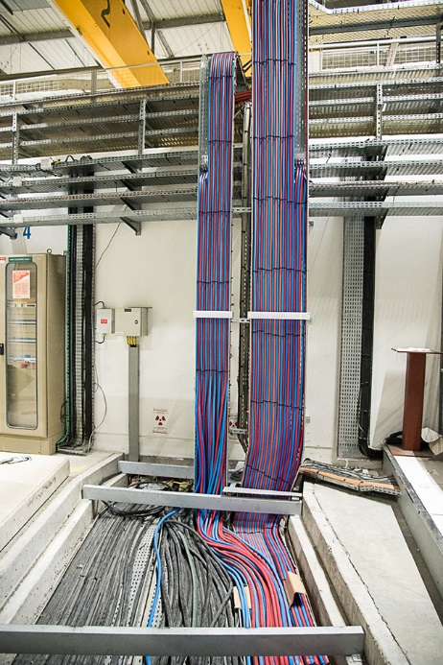
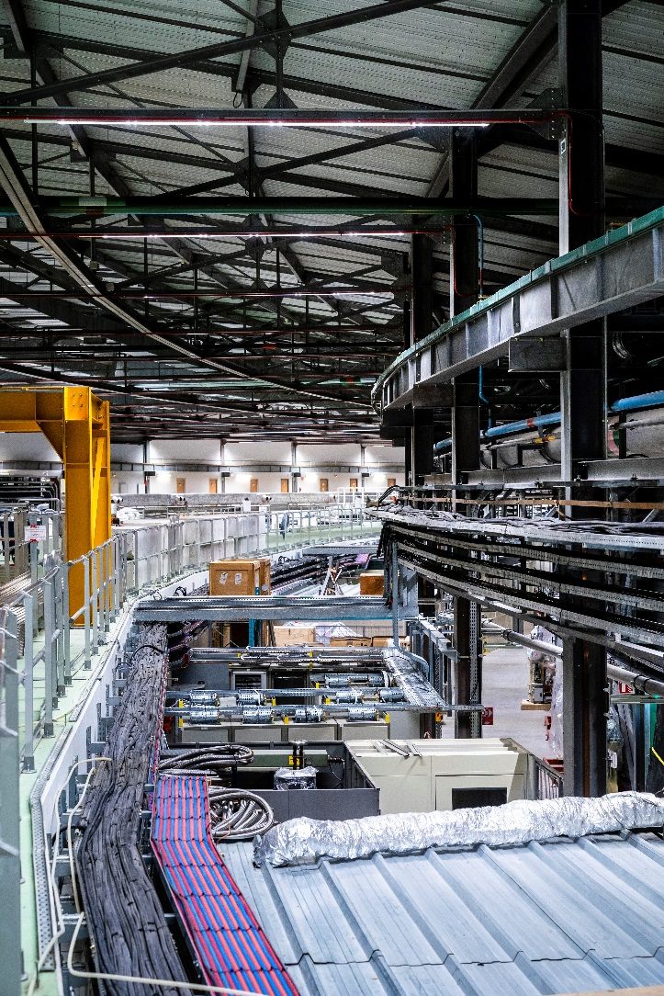
Installation of the VDC distribution for Power supply
Section 120 mm²
260 cables installed
Total length 24 870 m
Length of cable between 30 to 550 m
Installation done prior to long shutdown, during Machine shutdowns only (~12 weeks)
Credit: C. ARGOUD / ESRF.
Credit: S. CANDE

Slide 24
Cabling – total figures
3 years of preparation for 6 months of works
60 000 hours of works
220 electricians throughout the project
100 electricians at the peak load
14 000 cables installed
360 km of cables
15 500 connectors
Less than 100 faulty cables
Credit: C. ARGOUD / ESRF.
Credit: S. CANDE

Slide 25

Many thanks for your attention
Credit: VUEDICI.ORG / ESRF

Slide 26
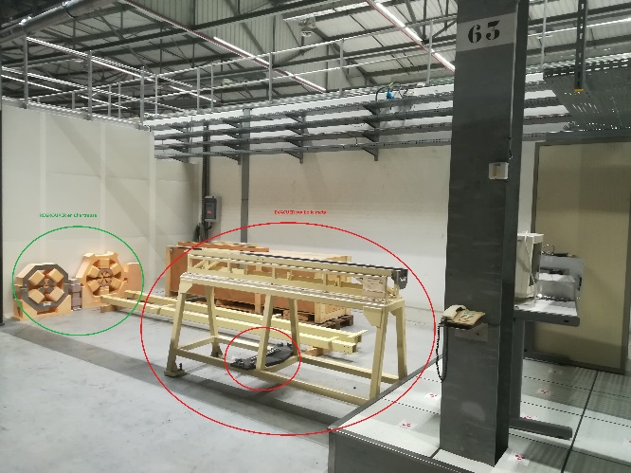
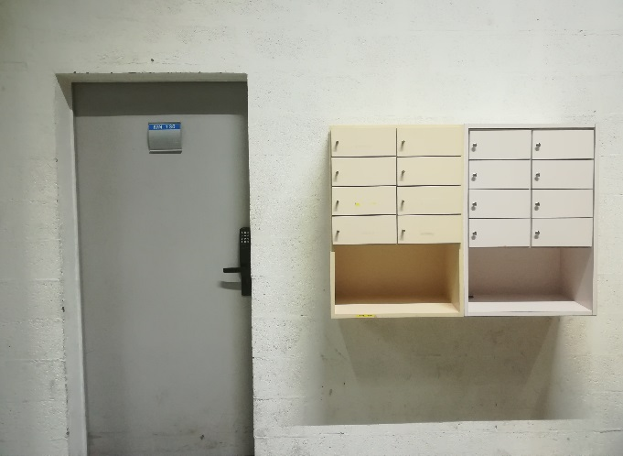
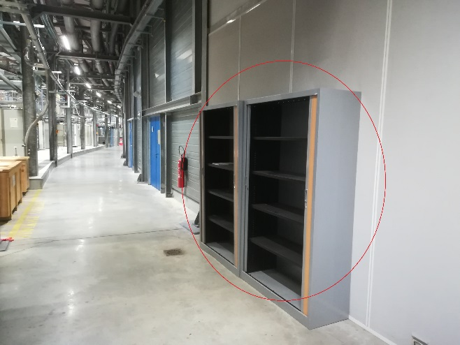
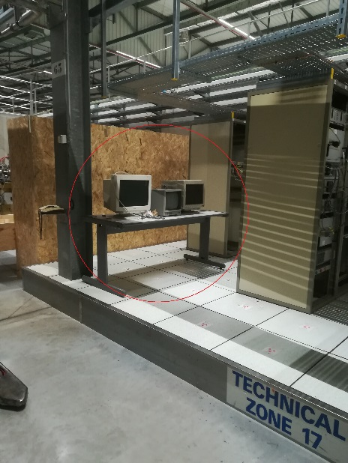
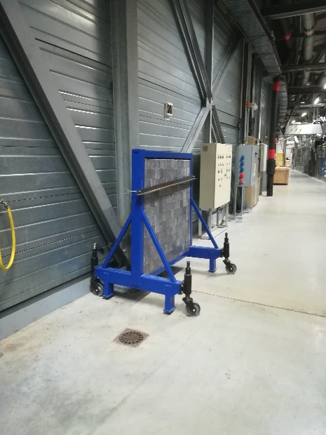
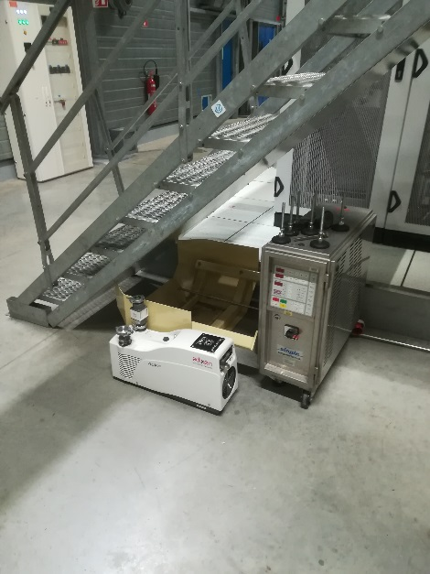
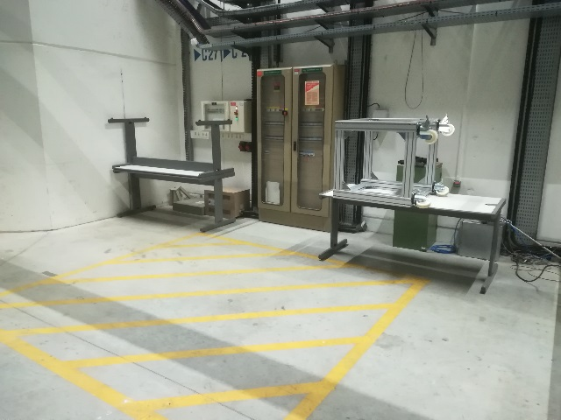
Clearing out

Slide 27
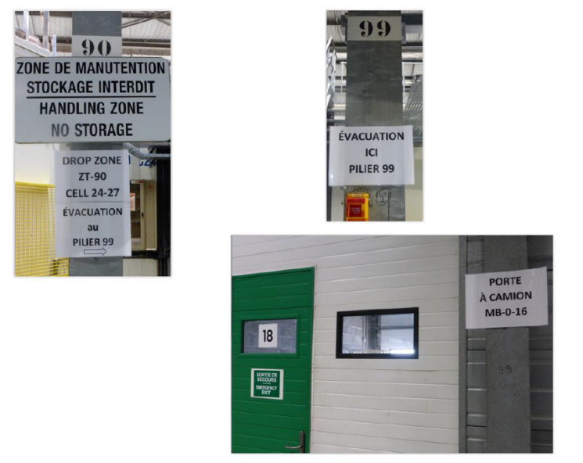


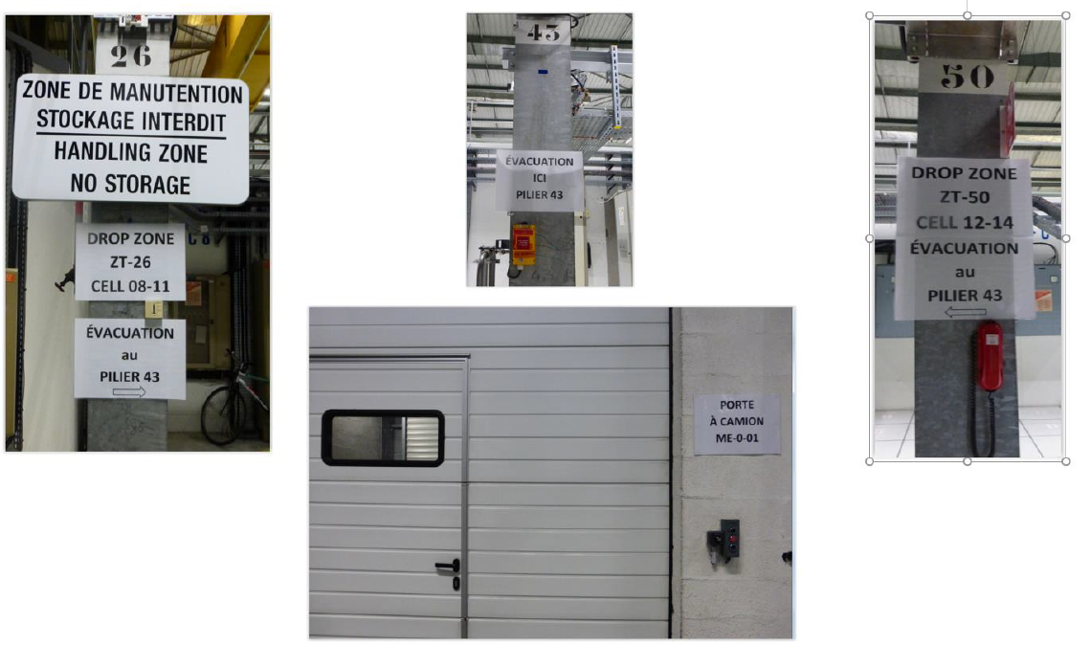
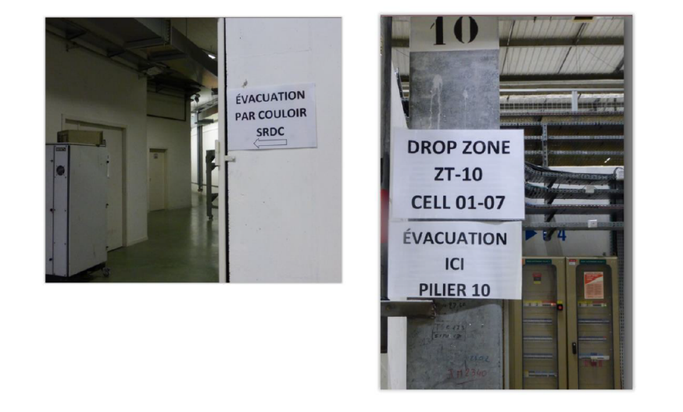

Mark out & sign post

Slide 28
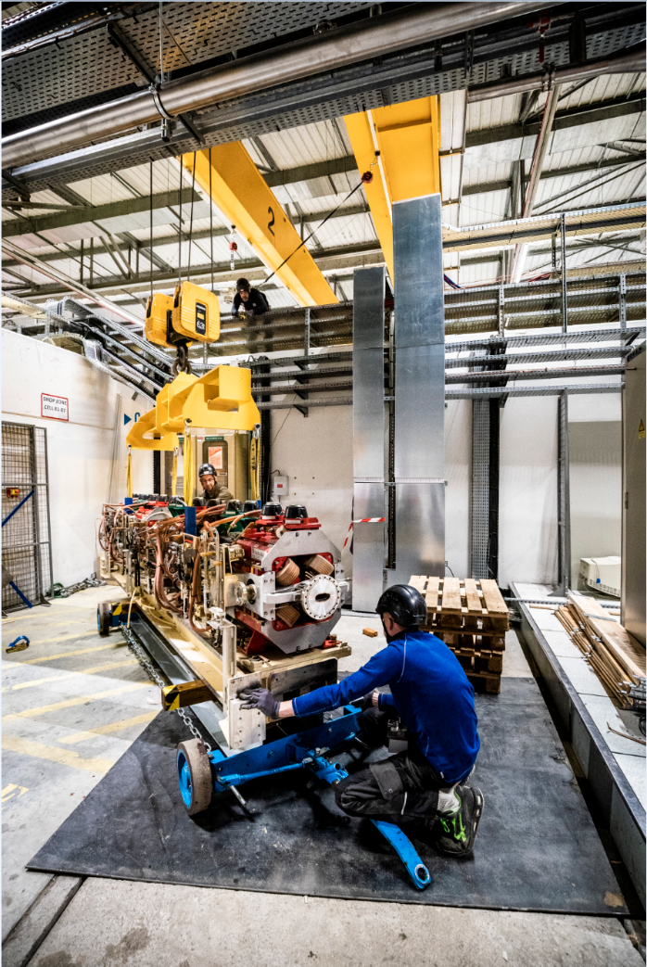
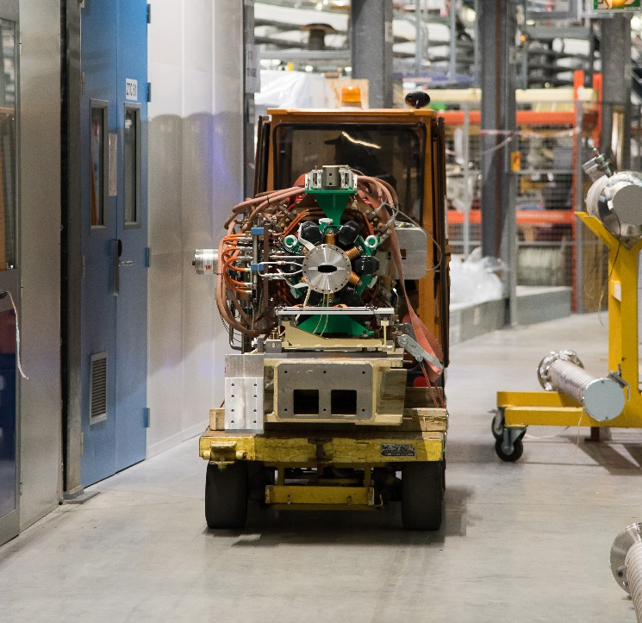
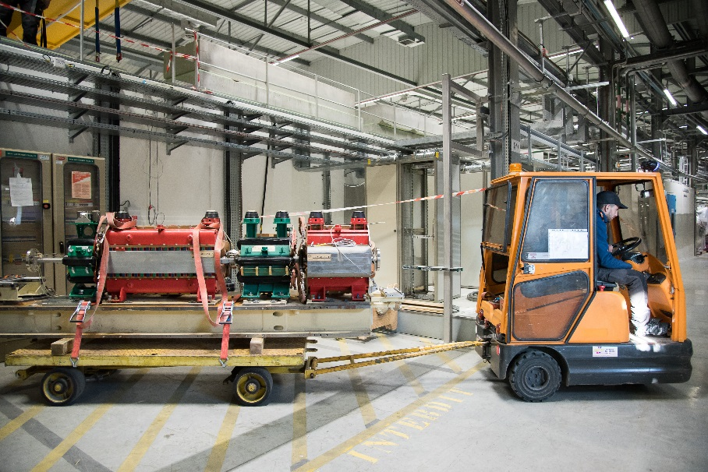
Drop zone for dismantling
Credit: C. ARGOUD / ESRF.
Credit: C. ARGOUD / ESRF.
Credit: S. CANDE

Slide 29
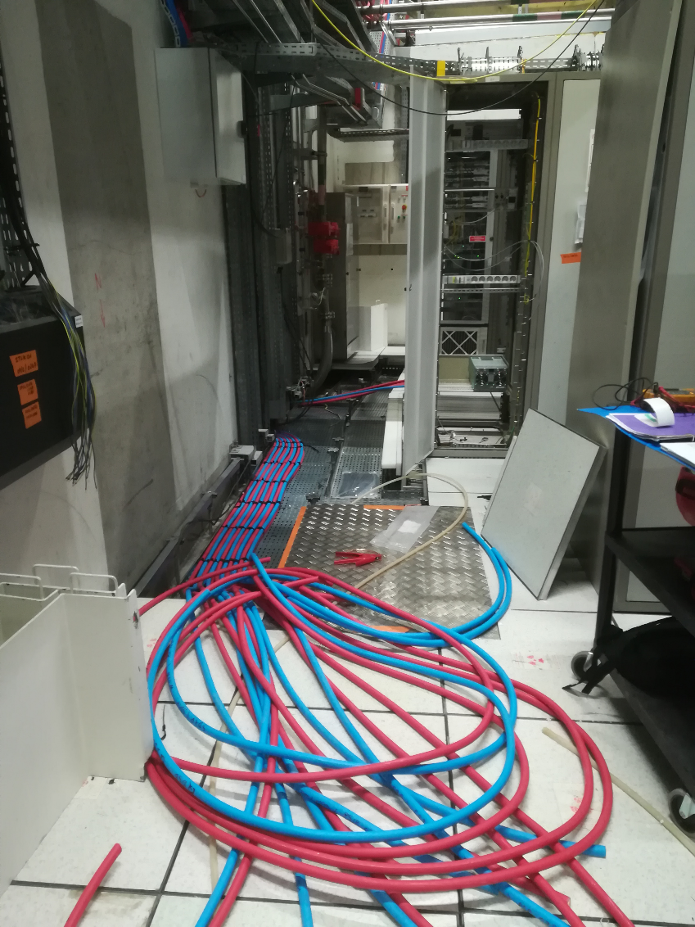
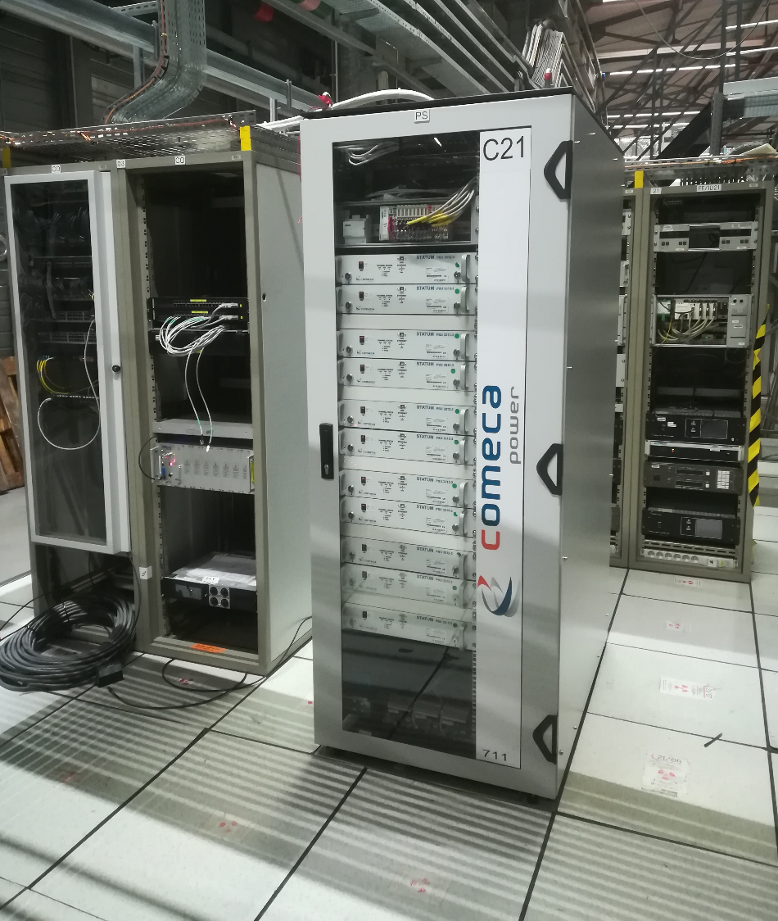
Hot Swap Cubicle cabling

Slide 30
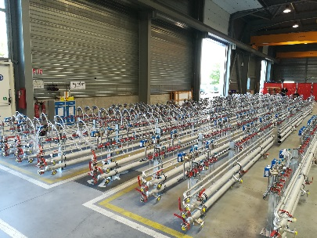
piping
Two main steps.
Pre-manufacturing :
80% of the added value
On site assembly :
20% of the added value

