Slide 1
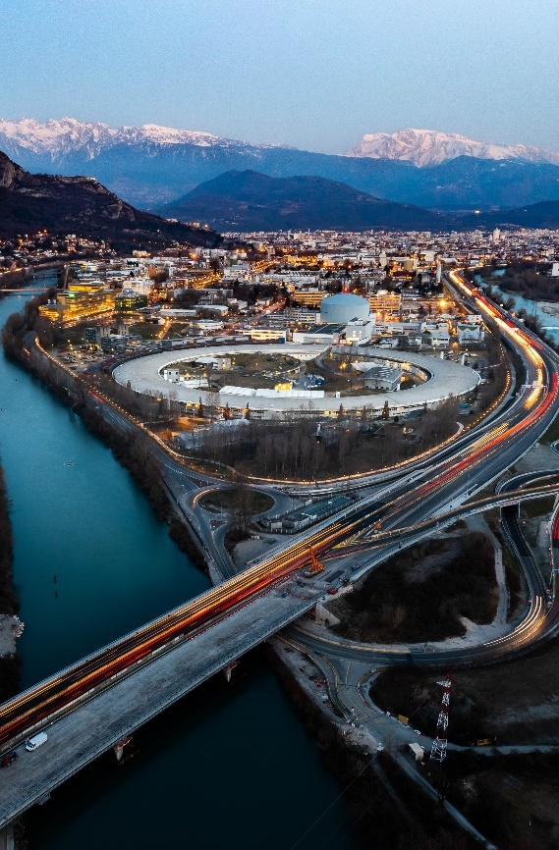
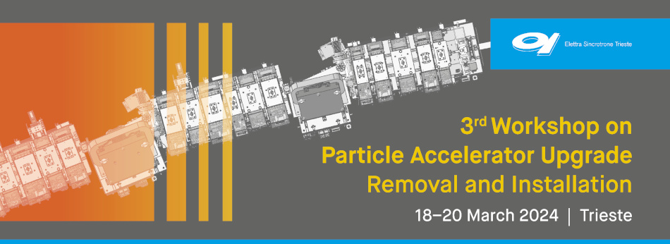
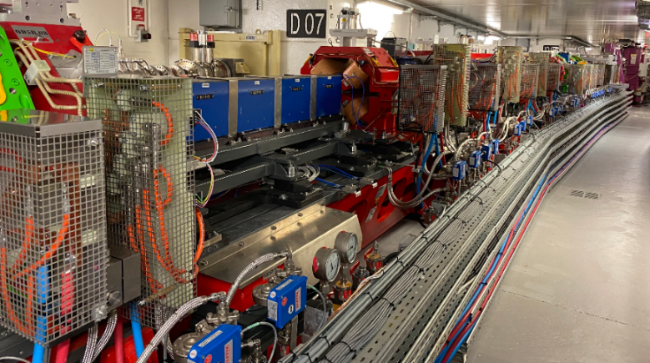

13-16 February 2024
CERN, Geneva
ESRF contribution
R&I 2024
18 Mars 2024
Jean-Luc Revol

Slide 2
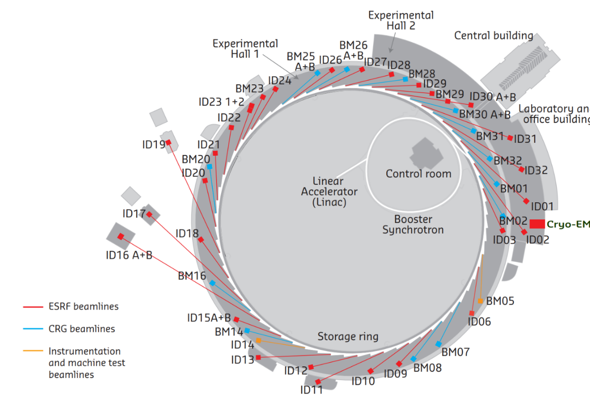
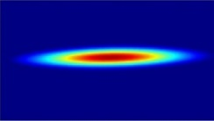
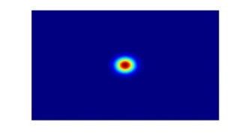
The ESRF: fact and figures
Ring-based Light source in operation since 1994, Grenoble, France
21 partner nations
  Budget: ~120 million euros/year, Staff: ~670
  5500 hours of beam delivery to users
  1500 experimental sessions
  44 beamlines (in 2023)
Upgrade programme 2009-2023 (2-phase):
  New beamlines
  Renew infrastructures and support facilities
  New storage ring (EBS)
E- Linac
200 MeV
Booster synchrotron
300m, 4Hz
The Extremely Brilliant Source (EBS) construction (2015-2020):
  Decrease the horizontal emittance
  Increase the source brilliance
  Increase the source coherence
  Keep as much as possible of the infrastructure & components
  Minimize operation costs, particularly wall-plug power
Storage Ring
6 GeV, 200 mA
844 m, 32 cells
4000 pm.rad
133 pm.rad

Slide 3
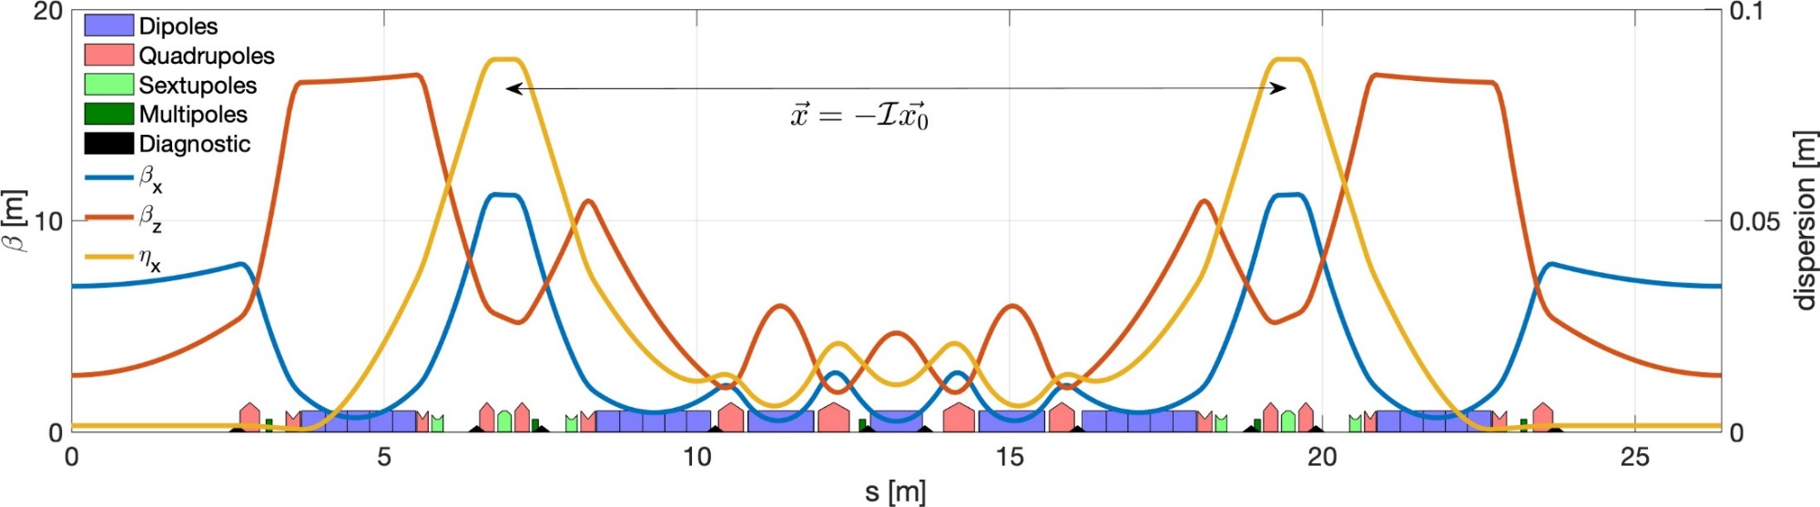
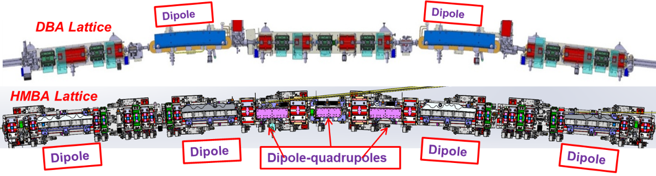
EBS upgrade lattice
Dipoles-quadrupoles
PM
PM
PM
PM
Dipole
Dipole
Dipole
Dipole
 | Units | ESRF | ESRF-EBS
Energy | GeV | 6 | 6
Circumference | m | 844.4 | 844
Lattice |  | DBA | HMBA
Current | mA | 200 | 200
Lifetime | h | 50 | 25
Emittance H | pm.rad | 4000 | 133
Emittance V | pm.rad | 4 | 10*
31 magnets per cell instead of 17
Free space between magnets (for one cell): 3.4m instead of 8m

Slide 4
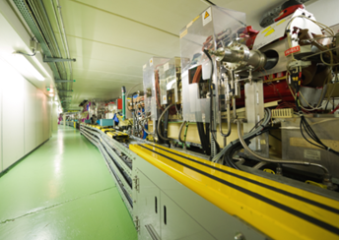
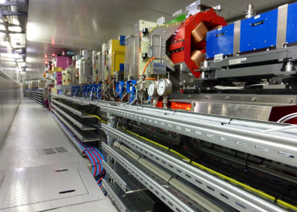
ESRF-EBS implementation (R&I 2021 talk)
Project approval: January 2015
First lockdown for COVID19 pandemic: 17/03/20
Mock-up (Summer 2017)
Old ESRF-Storage Ring
ESRF-EBS
October 2017 Start of girder assembly
10 December 2018 End USM, start shutdown
Dismantling
Installation
8 November 2019 Tunnel closed
Tests & Injector restart
28 November 2019 Accelerator commissioning
2 March 2020 Beamline commissioning
25 August 2020 Start User Mode Operation
Notes:
Update

Slide 5
Operation reliability and sustainability
Electrical power (KW) | ESRF (2018) | ESRF_EBS (2023)
Power supply | 2355 | 1070
Radiofrequency | 1300 | 900
Storage Ring (total) | 6350 | 4100
 | 2018 | 2021 | 2022 | 2023 (No compensation) | 2023
Availability (%) | 98.47 | 96.35 | 99.06 | 97.85 | 99.28
Number of failures* | 53 | 70 | 62 | 52 | 52
Mean Time Between Failures (hrs) | 104.30 | 66.4 | 88.5 | 105.6 | 107.1
Mean Duration per Failure (hrs) | 1.60 | 2.42 | 0.83 | 2.27 | 0.77
* Failures occurring in less than 1hour from another are grouped

Slide 6
List of contribution
Present at the workshop: Benoit Joly and Jean-Luc Revol
Poster 1: Upgrade and Operation of the ESRF-EBS Light Source
Poster2: Component data base
Talk on Wednesday (Benoit): Technical zone preparation and cabling
Past and available talks (Jl Revol):
R&I 2022: The ESRF-EBS Upgrade Experience
R&I 2023: Feedback from ESRF-EBS Upgrade
IPAC 2023: Sustainability in storage ring based light sources
LER 2024: Sustainability and energy efficiency at ESRF

