Slide 1
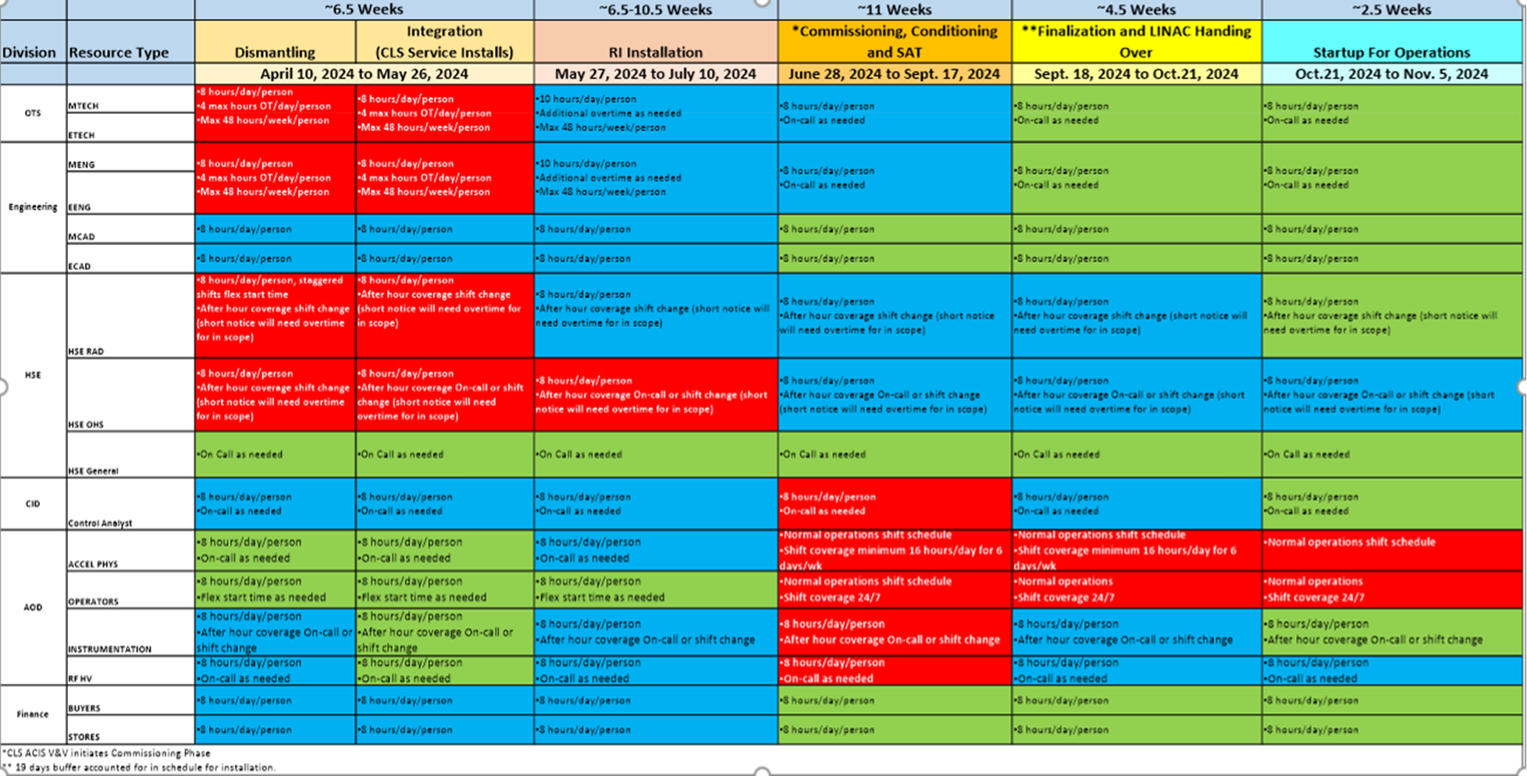
CFI-LINAC Project for CLS Stockage - Installation Ready to User Operation
Josh Erikson
F. Le Pimpec
2 Posters
6 months down time

Slide 2
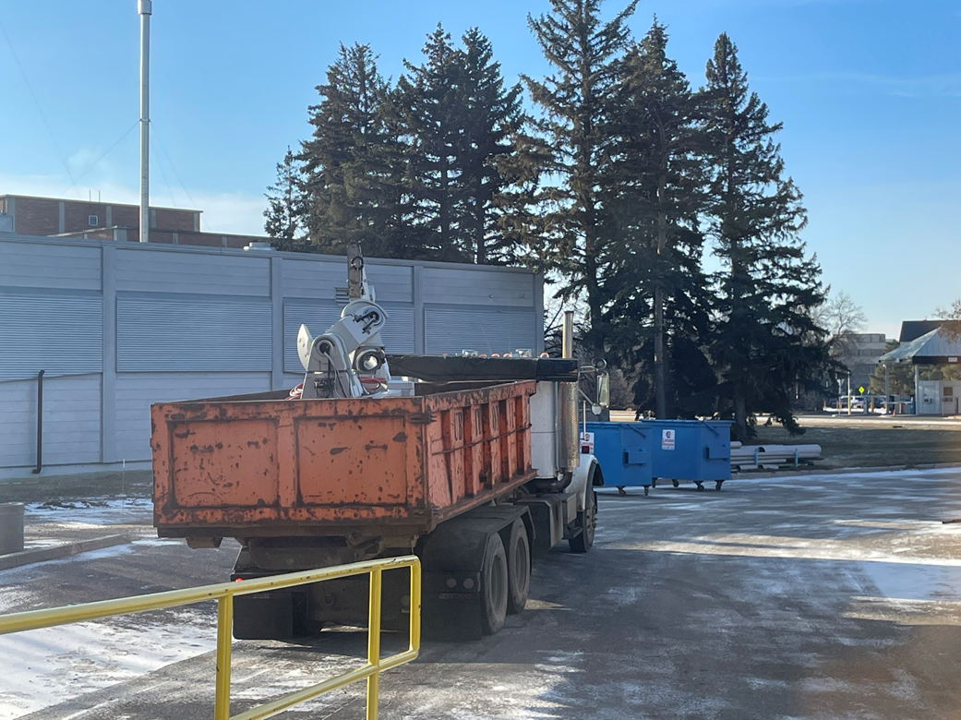
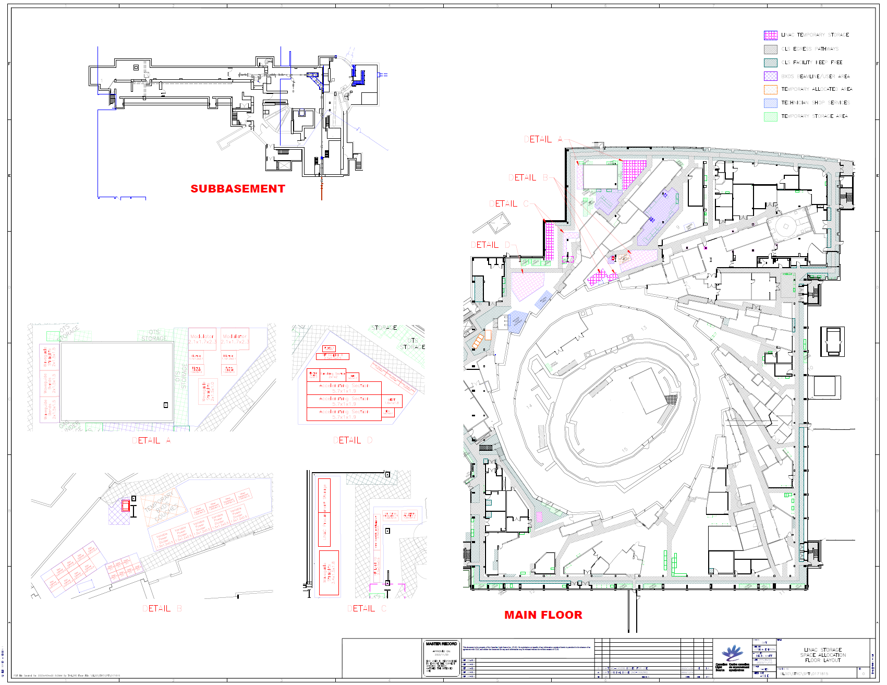
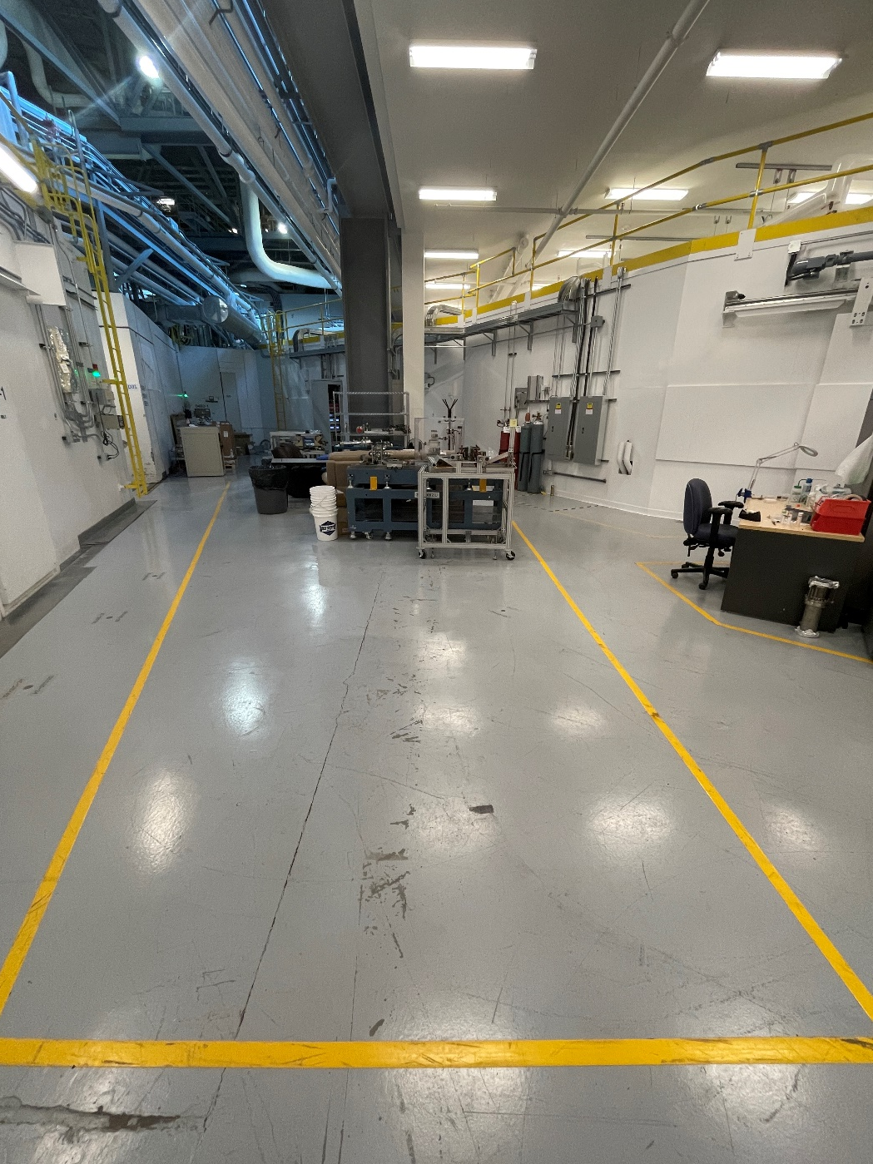
Warehousing
New & Old Linac Components
Plan
Reality
Garage Sale & Recycling
Josh

Slide 3
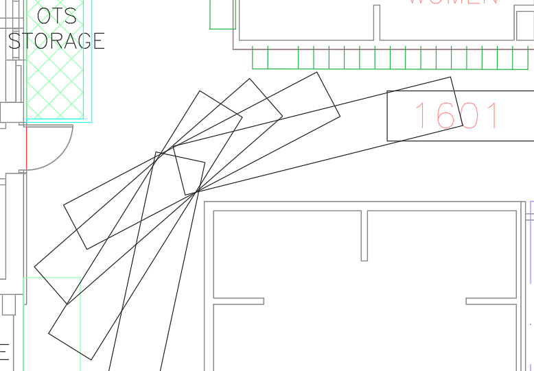
Moving the 5m long RF structures
Friends©
Clear the pathway ahead of time
Josh

Slide 4
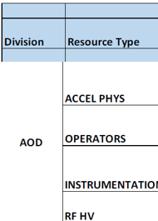
Commissioning to Startup to User Operation
Resource Loaded Schedule
Commissioning plan
W/O Beam
Interaction with the vendor
Dark Time - Competitive needs
Science Vs Machine
Why the users should come back?
Frédéric

Slide 5
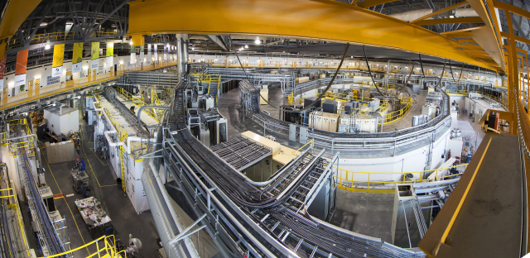
If you want to know more…
Behind a machine there is a Human adventure: admin to science
Thank you

