Slide 1
Flash Talk: Configuring Tunnel Space for EIC
Lauren Strange
3/18/24

Slide 2
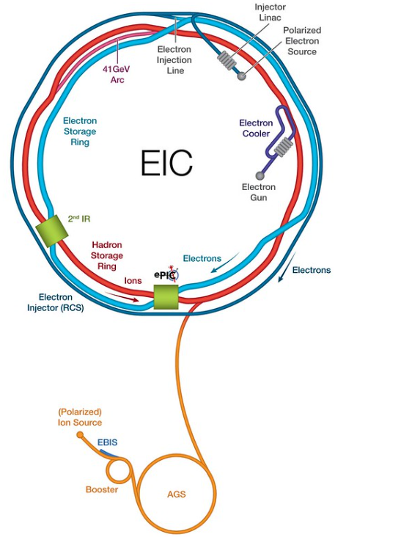
Introduction
Brookhaven National Laboratory (BNL) was recently awarded a contract to build the Election-Ion Collider (EIC)
EIC is comprised of two warm beamlines
Electron Injector (RCS)
Electron Storage Ring (ESR)
ESR electron beam will collide with the existing Relativistic Heavy Ion Collider (RHIC).
EIC will be built within the existing RHIC infrastructure
Space is limited! Both beamlines, power cables, and supporting utilities need to be accommodated

Slide 3
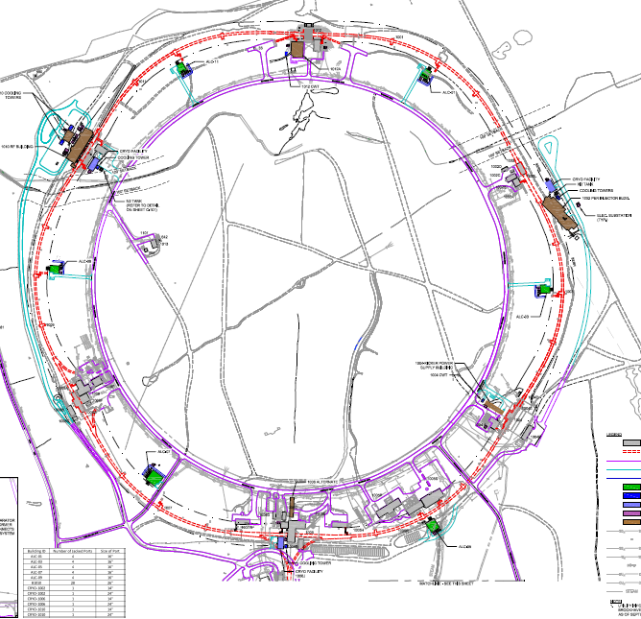
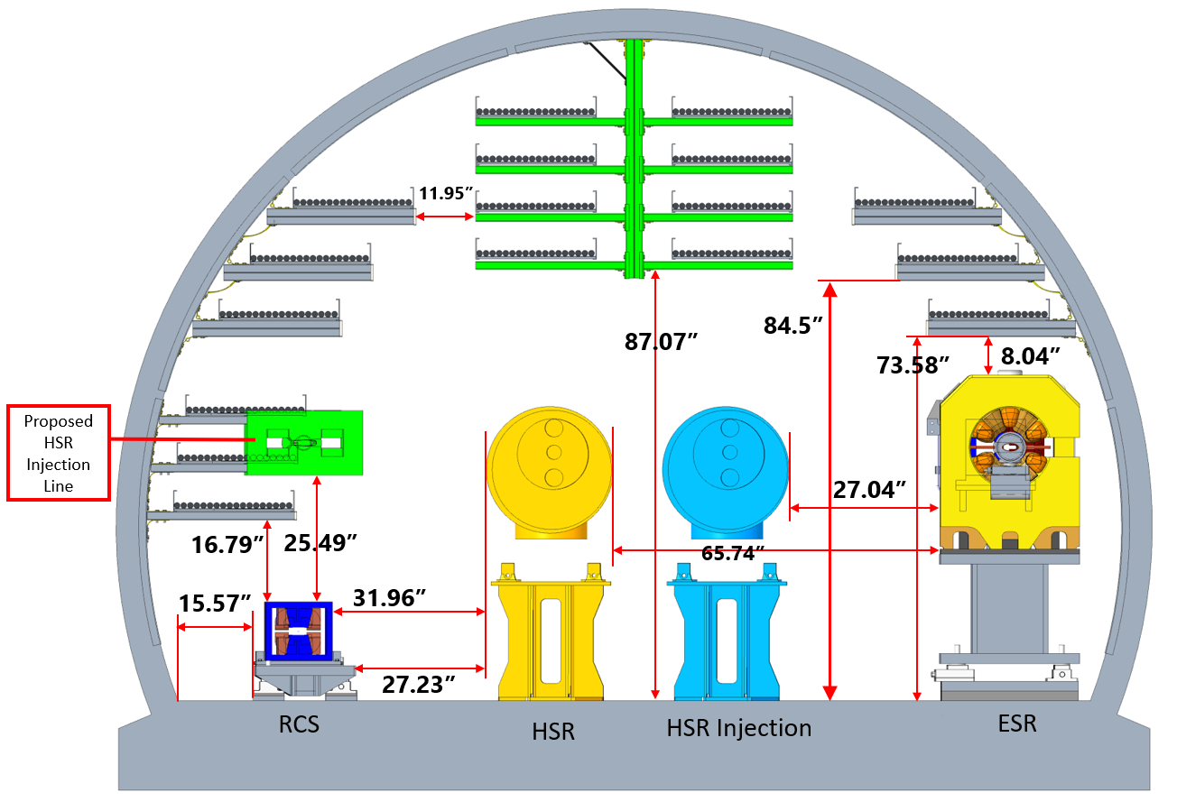
Design of EIC
The tunnel circumference is ~12,600ft
Infrastructure is designing equipment support buildings
8 new power supply buildings around the ring
Mechanical engineers are modeling the tunnel space
RHIC blue beam, RHIC yellow beam, EIC RCS, EIC ESR, EIC transfer lines in

Slide 4
Magnet Power Cables
Power supplies are assigned to buildings that provide the shortest cable path
Cables need to account for the magnet power requirements, conductor voltage drop, power per foot, heat dissipated, and current derating requirements
The cable selections are sent to both the infrastructure and mechanical engineering teams to design the cable support systems
Equipment Building | Count of PS | Sum of Magnet QTY | Sum of Cable QTY | Sum of Total L (ft)
1001A | 188 | 276 | 428 | 395,966.44
ESR | 74 | 162 | 200 | 224,914.44
RCS | 114 | 114 | 228 | 171,052.00
1003A | 213 | 284 | 488 | 420,657.27
ESR | 85 | 156 | 232 | 236,255.67
RCS | 128 | 128 | 256 | 184,401.60
1005T | 251 | 472 | 640 | 1,002,179.94
ESR | 104 | 178 | 334 | 312,602.58
RCS | 147 | 294 | 306 | 689,577.36
1007A | 248 | 326 | 682 | 580,479.49
ESR | 122 | 200 | 430 | 399,643.25
RCS | 126 | 126 | 252 | 180,836.24
1009A | 255 | 2454 | 688 | 1,709,192.00
ESR | 101 | 802 | 338 | 605,432.64
RCS | 154 | 1652 | 350 | 1,103,759.36
1011A | 202 | 315 | 462 | 418,352.87
ESR | 74 | 187 | 206 | 234,499.03
RCS | 128 | 128 | 256 | 183,853.84
Grand Total | 1,357.00 | 4,127.00 | 3,388.00 | 4,526,828.00
Cable Summary Table
Cable Type | Qty | Total CSA " | Total Tray Width" | Total lb/ft
8 AWG | 210 | 17.96 | 79.7 | 18.27
535.3 MCM | 74 | 83.69 | 102.12 | 142.45
444.4 MCM | 380 | 367.72 | 2.56 | 485.08
350 MCM | 1202 | 1,060.73 | 1,465.24 | 1,663.57
300 MCM | 68 | 53.41 | 78.2 | 81.26
10 AWG | 1690 | 82.96 | 485.88 | 94.64
Sum (in) |  | 2,696.20
Tray Width (in) |  | 2,700.00
Tray Width (ft) |  | 225
Total lb/ft |  | 2,621.11

Slide 5
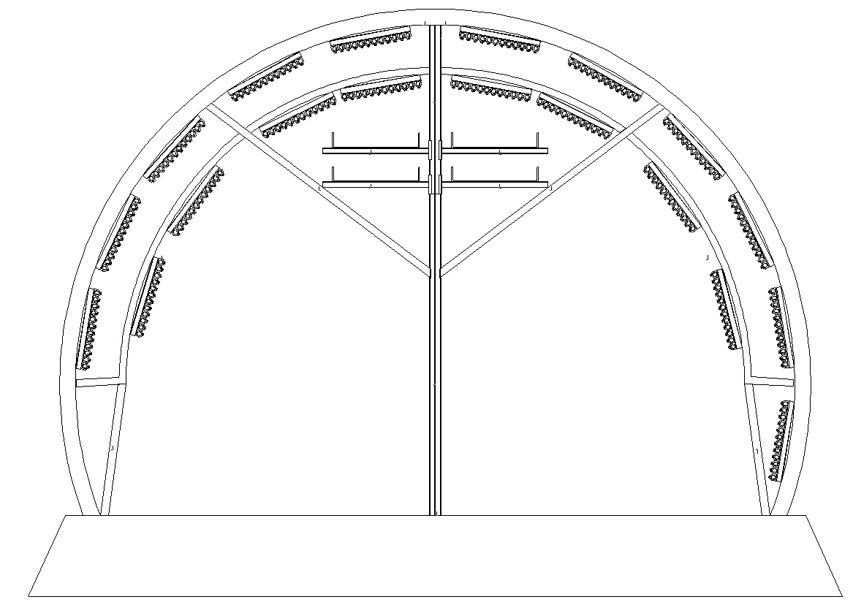
Discussion
The total cable tray required to power the beamlines cannot fit within the tunnel’s existing layout and penetrations.
Creative design solutions are required between all engineering disciplines to ensure a cost-effective solution
Mechanical: new building penetration points, tunnel support load
Infrastructure: building location, cable support from the buildings to the tunnel
Electrical: Reducing cable cross-section area
Systems: Tools to communicate needs, determining best areas for optimization between groups

