Slide 1
Notes:
Slide 1: Company Logo Full Page
Before you start editing the slides of your talk change to the Master Slide view:
Microsoft Office :Menu: View > Slide Master;
Macintosh – View > Master > Slide Master
Edit the following items:
On the Slide Master (first master slide) – lower area
a) On the left Delete the text and write the title of the event/Conference, Location
b) On the right delete the text and write the name and surname of the speaker and the date (day, month , year)
Close Master View

Slide 2
Shielding wall reconfiguration Floor flatness issue and rework
Notes:
Slide 2: Title of the Presentation
Before you start editing the slides of your talk change to the Master Slide view:
Microsoft Office :Menu: View > Slide Master;
Macintosh – View > Master > Slide Master
Edit the following items:
On the Slide Master (first master slide) – lower area
a) On the left Delete the text and write the title of the event/Conference, Location
b) On the right delete the text and write the name and surname of the speaker and the date (day, month , year)
Close Master View
To start adding slides insert a new slide and select a Layout:
For Title & Subtitle
For text with bullet points
For Text
For Picture, graphs, visuals
Two columns
Blank

Slide 3
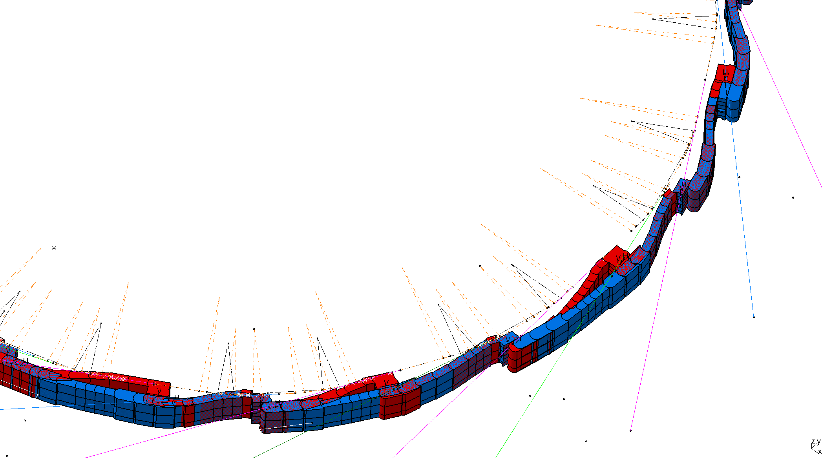
1. R&I Scenario and issue
Elettra
Elettra 2.0

Slide 4
1. R&I Scenario and issue
Unexpected pitch and roll deviation between concrete blocks
Operational slowdown
Gap between blocks
Concrete blocks inspection
Pitch and roll analysis
Off-line assembly tests
Floor investigation
Critical floor flatness rework

Slide 5
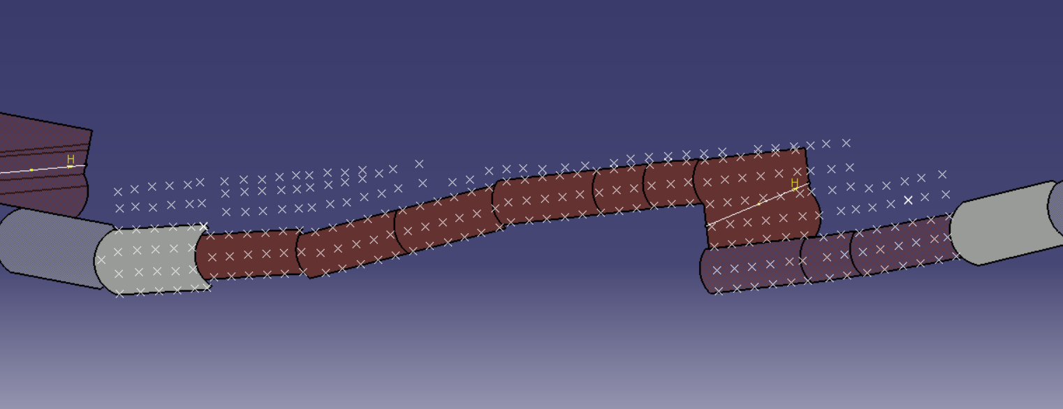
2. Root cause analysis
Case 12.1 beamline: Displacement survey (vertical direction)
Laser tracker measurement grid

Slide 6
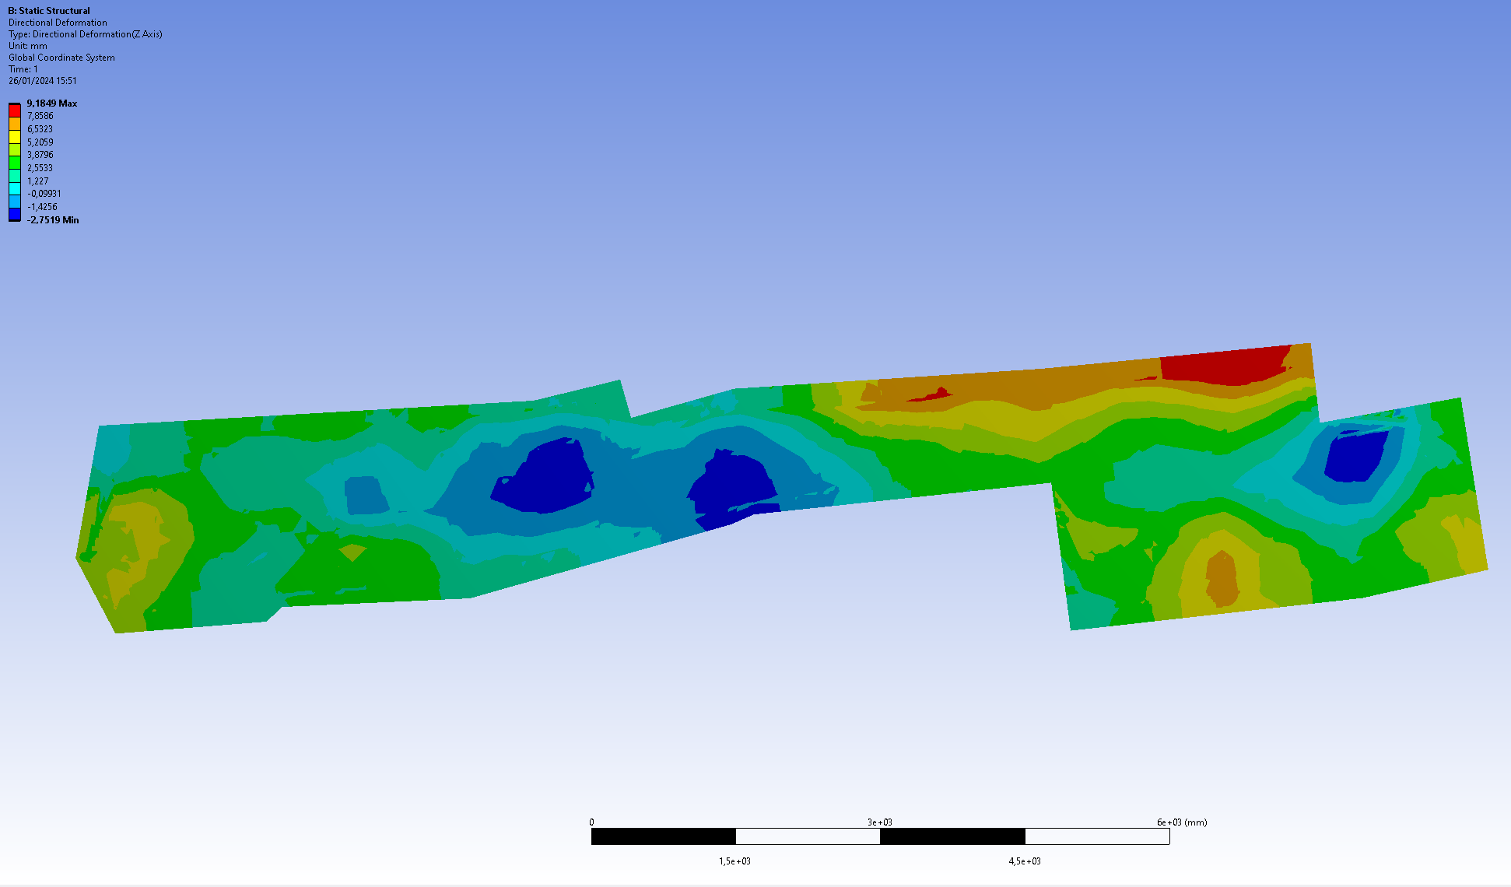
2. Root cause analysis
Case 12.1 beamline: Displacement survey
Storage Ring
Depressed area through the shielding wall
Flatness fluctuation up to 12mm
discontinuity on the floor
Depressed area through the wall
Exp. Hall
12.1 Beamline
Pitch discontinuity

Slide 7
3. Countermeasure development
Case 12.1 beamline: Rework hypothesis
Reference plane «A» in corrispondence with the lowest area
Flatness discretization by ~1 mm step
Concrete floor bush hammering and polishing
A
+2
+1
+0
+2
+1
+3
+3
Plane «A» → «zero plane» for rework

Slide 8
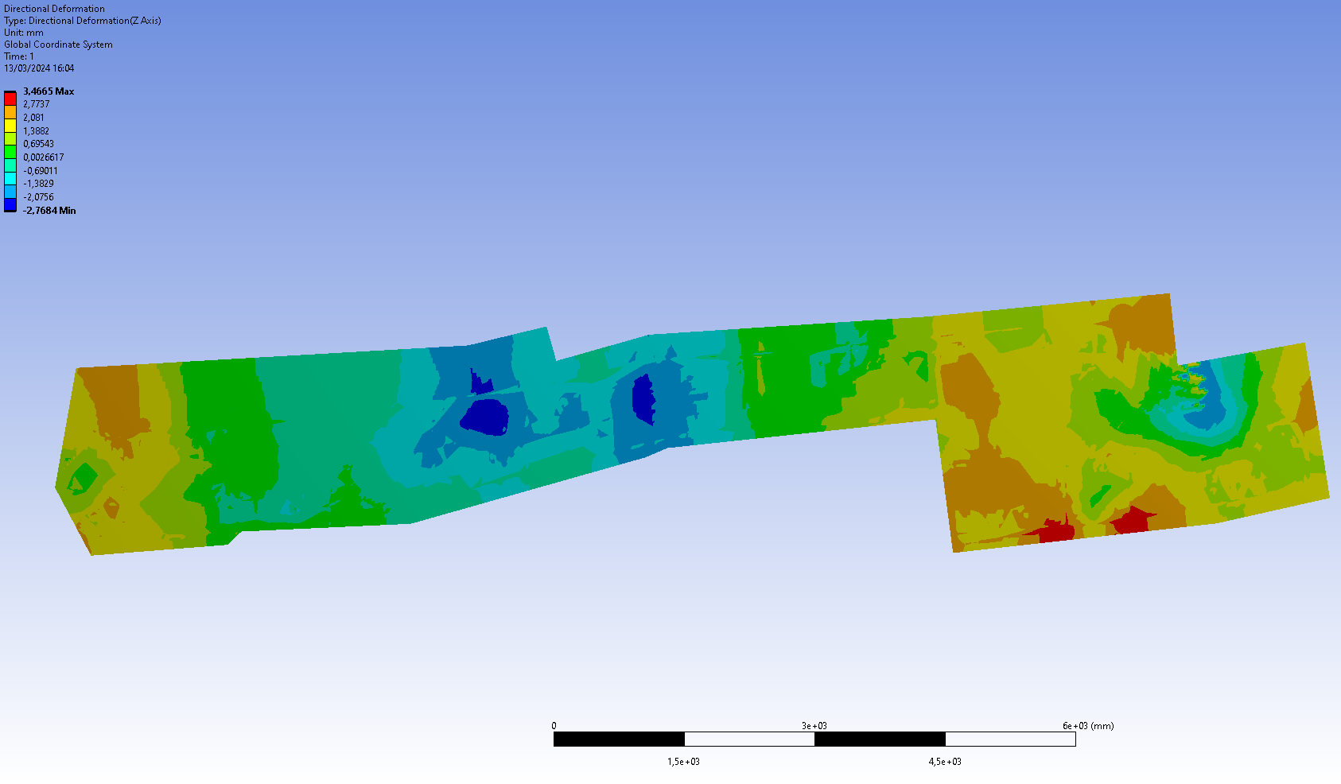
4. Conclusions
Case 12.1 beamline: Rework and final measurements
50% flatness reduction
No depressed areas through the shielding wall
Elimination of discontinuities
Final shielding wall reconfiguration without issues during assembly

Slide 9
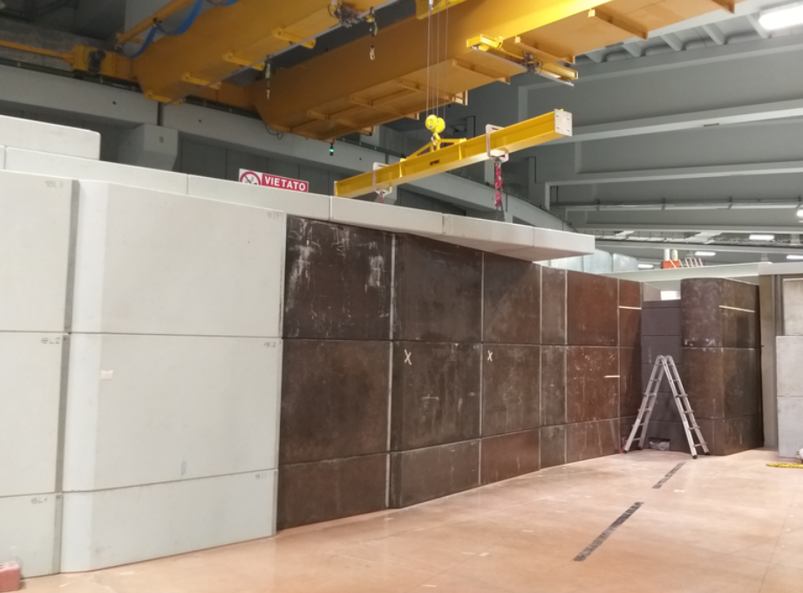
4. Conclusions

Slide 10
Girders Bases and Baseplates Towards Fast&Easy Installation
Notes:
Slide 2: Title of the Presentation
Before you start editing the slides of your talk change to the Master Slide view:
Microsoft Office :Menu: View > Slide Master;
Macintosh – View > Master > Slide Master
Edit the following items:
On the Slide Master (first master slide) – lower area
a) On the left Delete the text and write the title of the event/Conference, Location
b) On the right delete the text and write the name and surname of the speaker and the date (day, month , year)
Close Master View
To start adding slides insert a new slide and select a Layout:
For Title & Subtitle
For text with bullet points
For Text
For Picture, graphs, visuals
Two columns
Blank

Slide 11
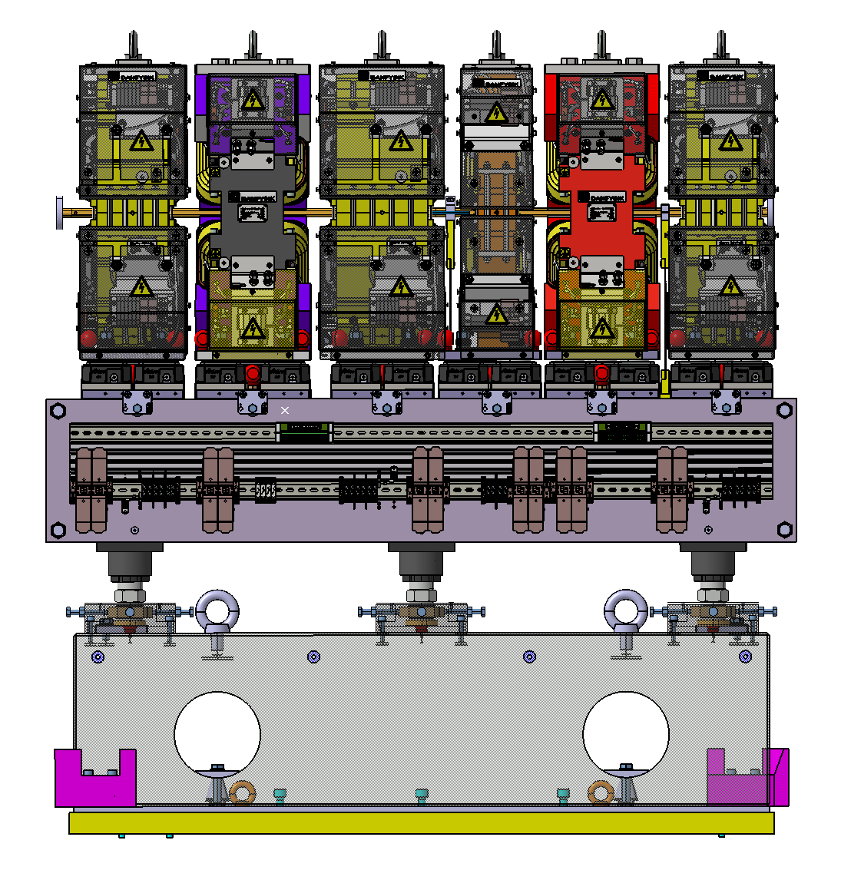
1. Set-up
2
3
4
5
6
7
1
8
2
3
4
5
1
6
Elettra 2.0 = 12 Achromats, 8 (multipoles)+ 6 (dipoles) girders each 168 girders
Each girder requires a stable base anchoring it to the floor
Challenge
Install 336 (grouted plate + base block) heavy components
…In the shortest time possible
…Using only two overhead cranes
…That most probably someone else needs using

Slide 12
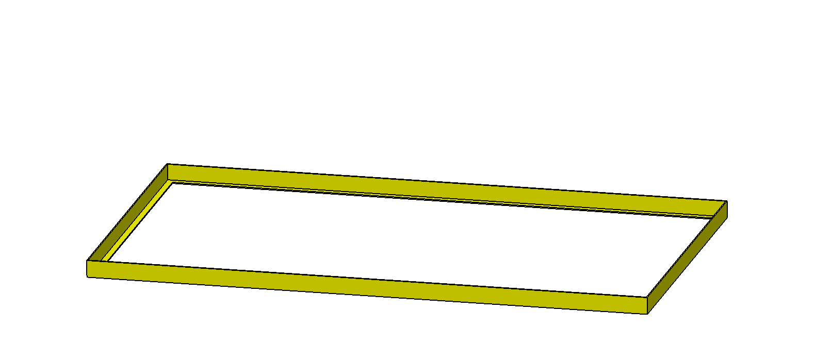
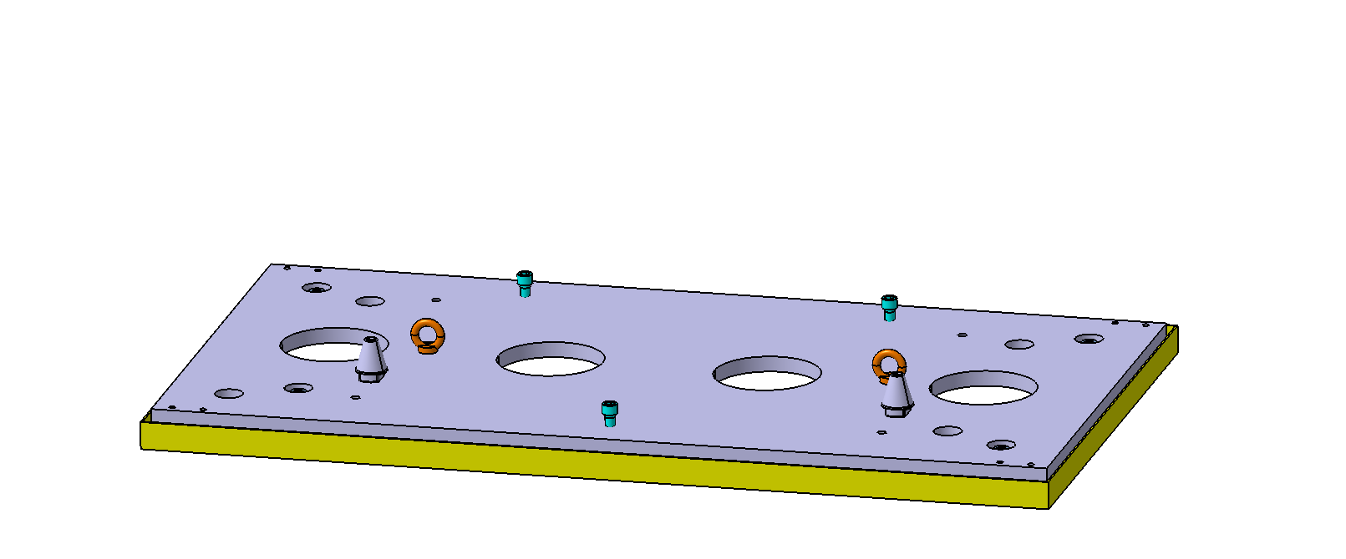
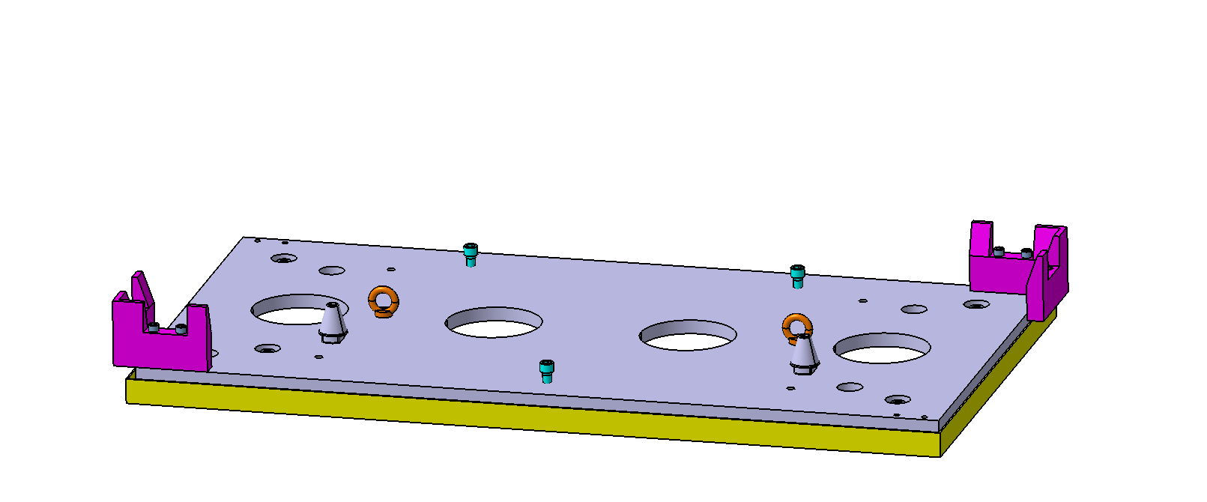
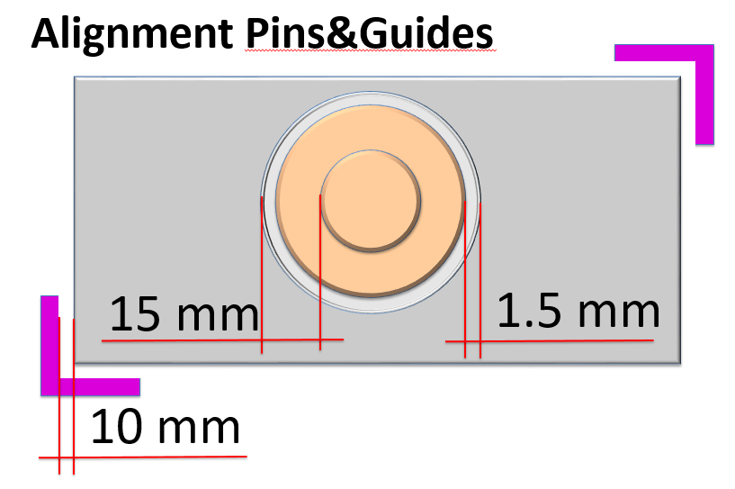
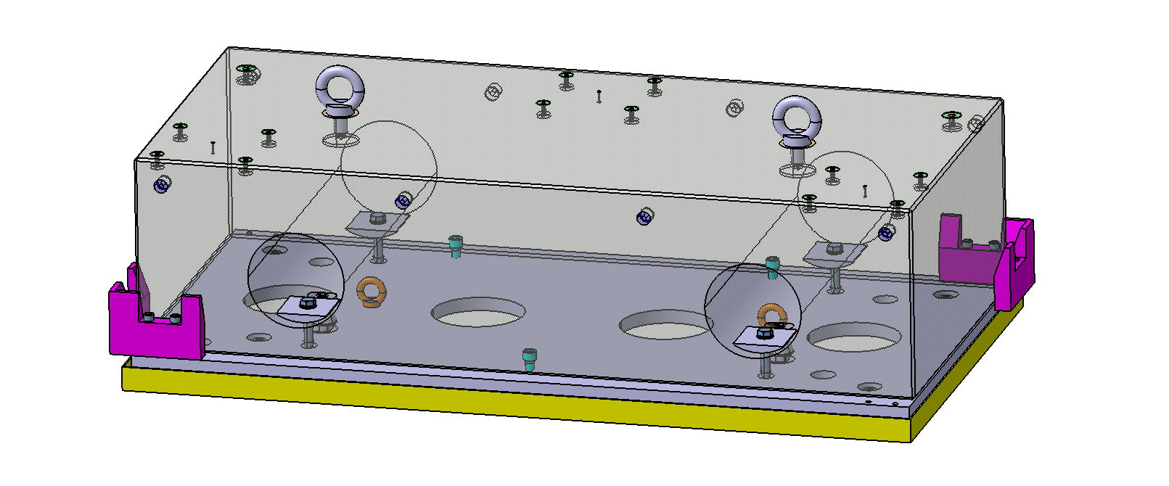
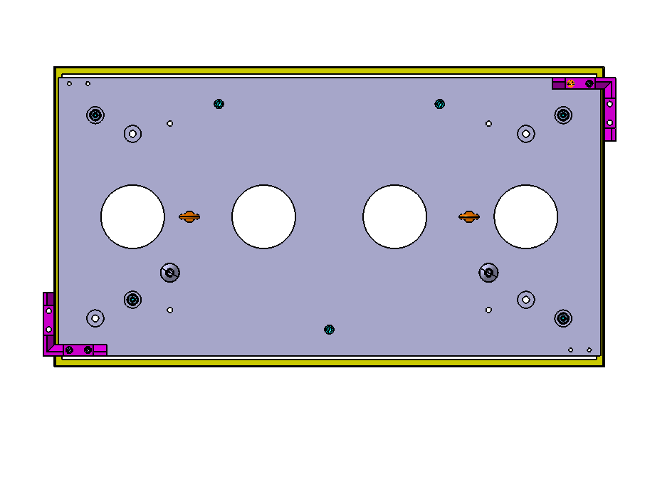
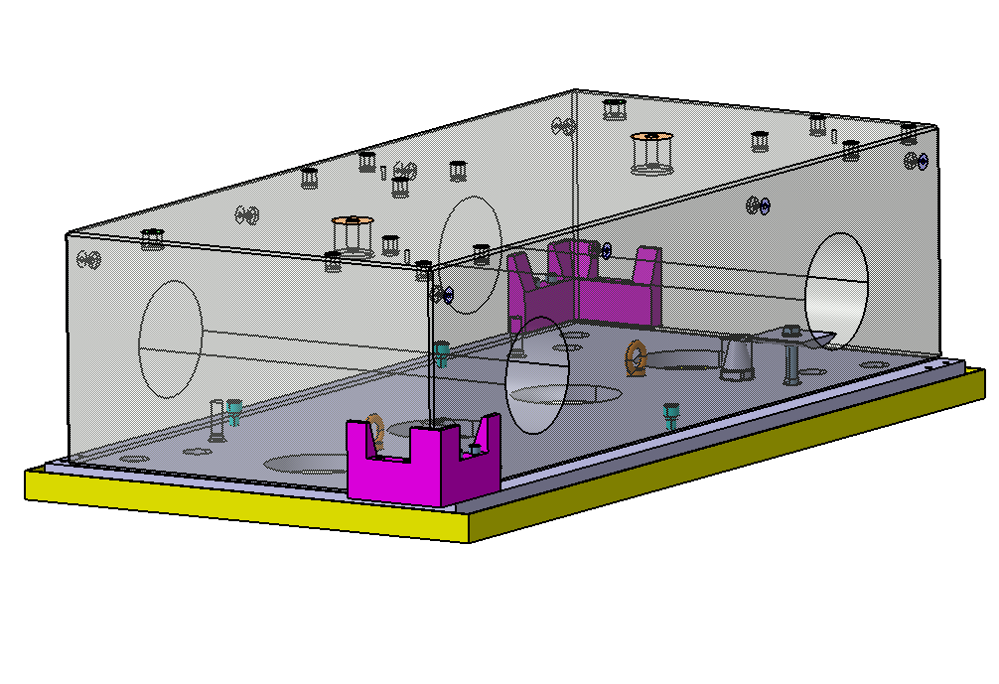
2. Solution
Design Approach:
Bespoke conical alignment pins
Align only “light” components (a.k.a. no crane needed), propagate alignment where possible (centering pins)
Prepare ahead of time what can be prepared (tracing jigs, plates, blocks, anchors, …)
Aim for ease of installation for deployment time reduction (redundant staggered holes, orientation-forcing design, external guides, …)
A two piece solution: a feature-rich baseplate and a precise granite block

Slide 13
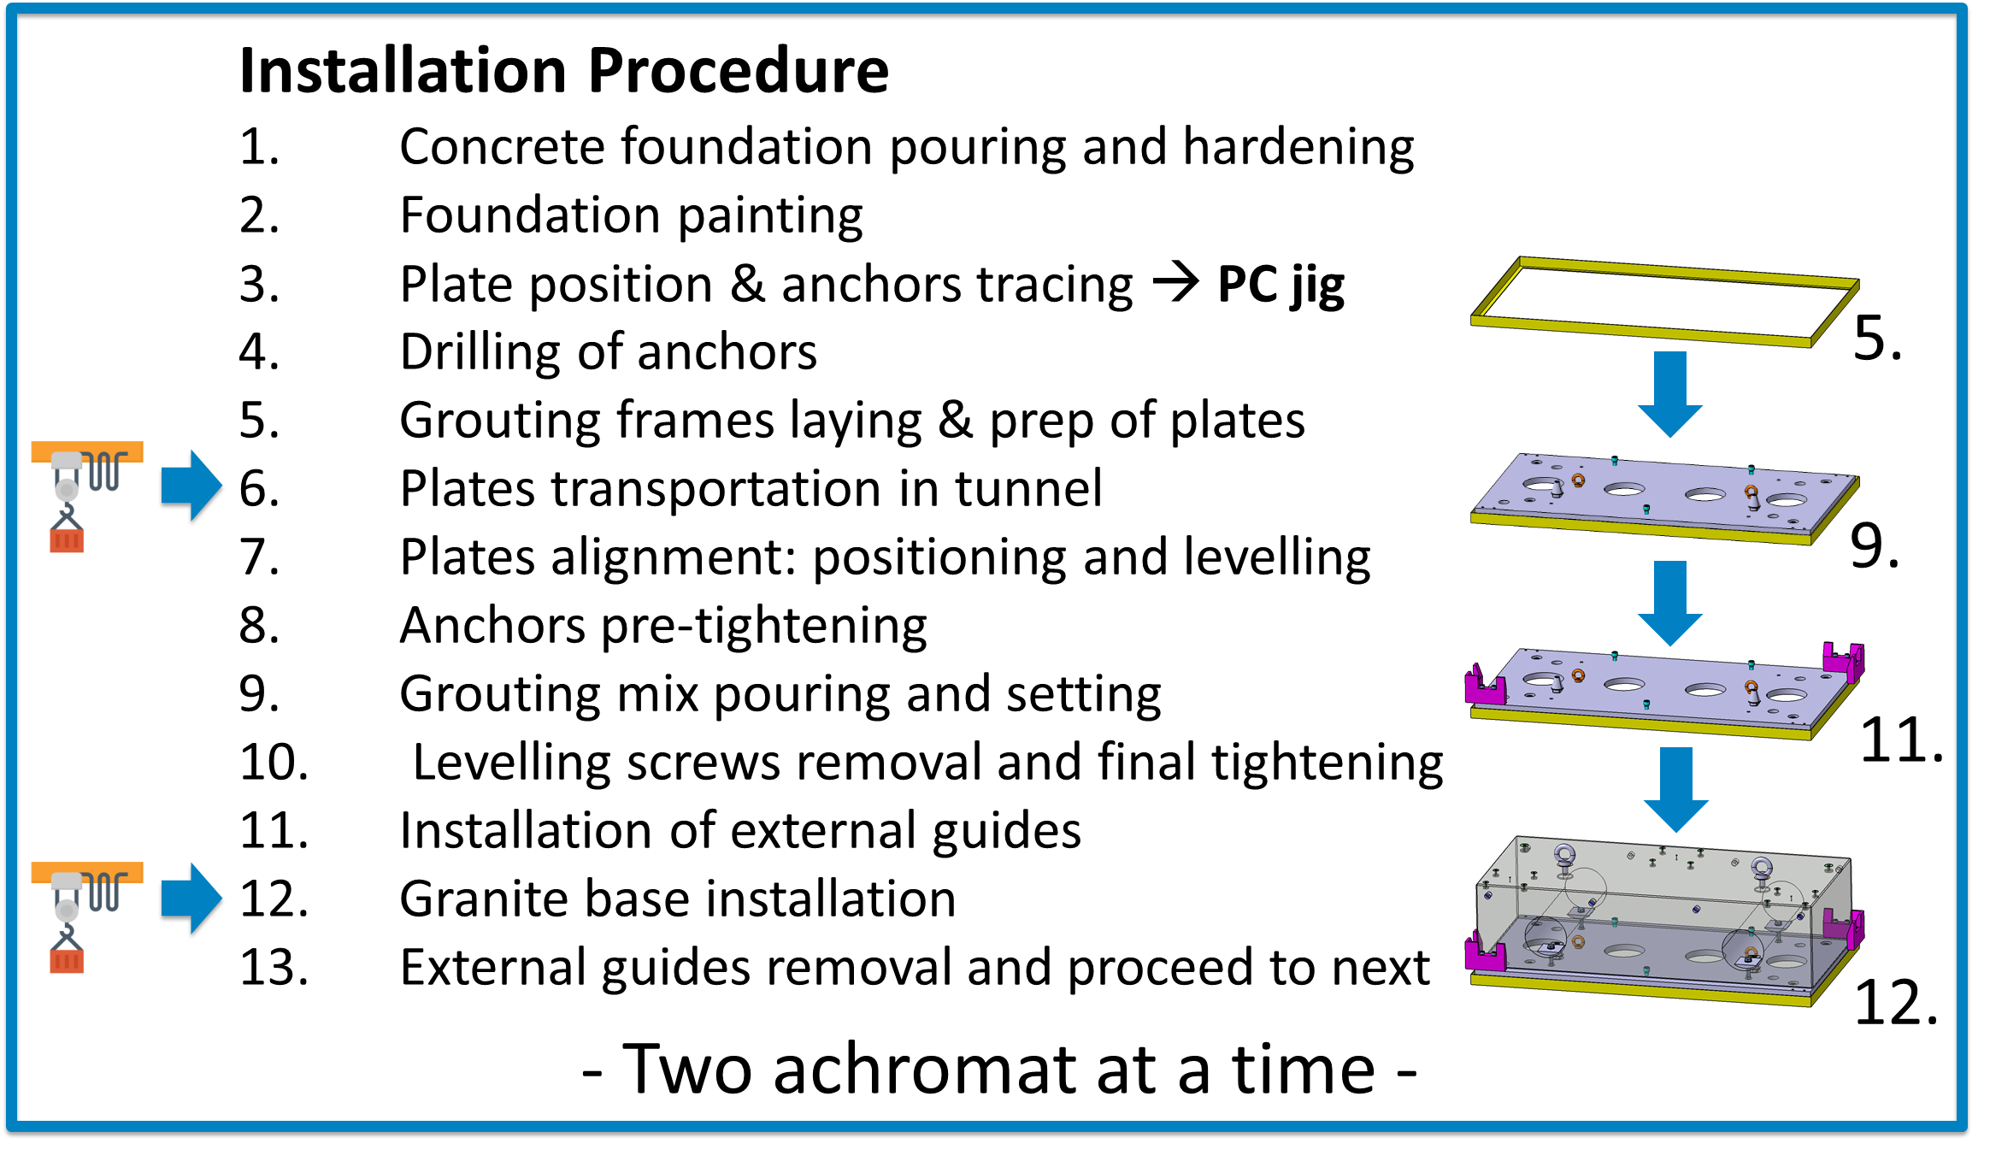
3. Conclusion
The proposed solution requires the crane usage just for transportation in the tunnel, with features to speed up the deployment of each block.

Slide 14
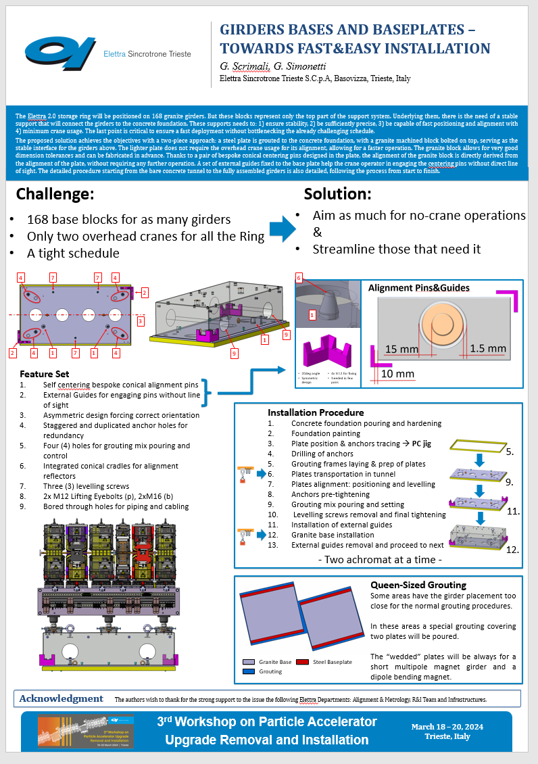
4. Let’s Talk!
Want to suggest any more streamlining or ask us something?
Come have a chat!

Slide 15
Notes:
Last Slide 1: Thanks to the audience

Slide 16
Notes:
Last Slide 2: Aerial Photo of Elettra

