Slide 1
Logistics
Storage & Pre-Sorting Plan
Kriel, Timon
WP 4.02 – Logistics and Storage
Trieste, 03/18/2024 – PAU-RI3

Slide 2
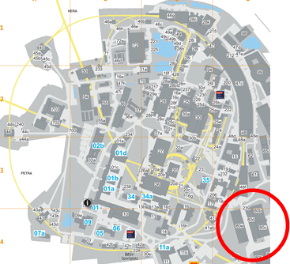
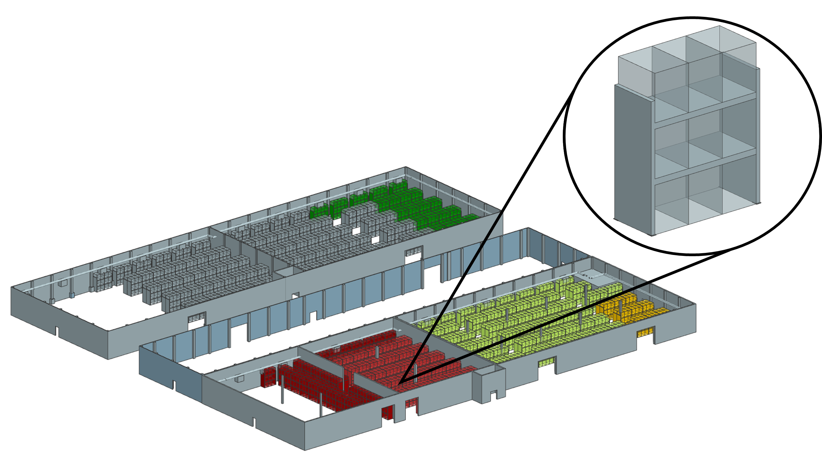
Reemtsma-Halls
Overview
We will use the Reemtsma-Halls to store
the radioactive materials from the old tunnels.
the new magnets for PETRA IV.
the Beam-Lines & Front-Ends.
the naked Girders.
Diagnostic components.
Vacuum components.
Also to store (but there is no space left in the Reemtsma-Halls)
Cable drums.
Schielding stones.
80d
80e
80b
80c

Slide 3
PETRA IV
Girders and magnets of a cell
PETRA IV cell
A PETRA IV cell consists of four girder types.
Each girder type needs individual magnet types in an individual order.
A lot of different resistive magnets.
Three types of dipole magnets.
→ To make sure that the required resistive magnets are prepared for the individual girders they will pre-sorted in the Reemtsma-Halls.
Alpha
Beta
Gamma
Alpha‘

Slide 4
Resistive Magnets
Pre-Sorting Concept
The resistive magnets for PETRA IV will be pre-sorted in the Reemtsma-Halls in order to
minimize errors.
→ The resistive magnets will be placed next to the girder they are needed for.
transport only the magnets that are currently required in the Girder Assembly Building (GAB).
→ In this way, the space in the GAB will be used most efficiently and transport capacity will be used most economically.
The pre-sorting works out.
→ Only one pallet will be left over, but it can be used directly for the next assembly process.
PQA
PQC
PQD
PSA
PBA
PQB
PQE
PQF
PQE
PSA
PSA
PQE
POF
PCXY

Slide 5
Permanent Dipole Magnets (DLQ)
No Pre-Sorting
The dipole magnets don’t need to be pre-sorted
The dipole magnets will be assembled after all resistive magnets have been assembled.
→ So the space next to a girder is free.
They can be stored individually.
They can be transported as required.
→ So they can be placed next to the girder they are needed for without any pre-sorting.
DLQ1
DLQ2
DLQ3

Slide 6
Thank you
T. Kriel
WP 4.02 – Logistics and Storage
timon.kriel@desy.de
+49 40 8998 3492

