Slide 1

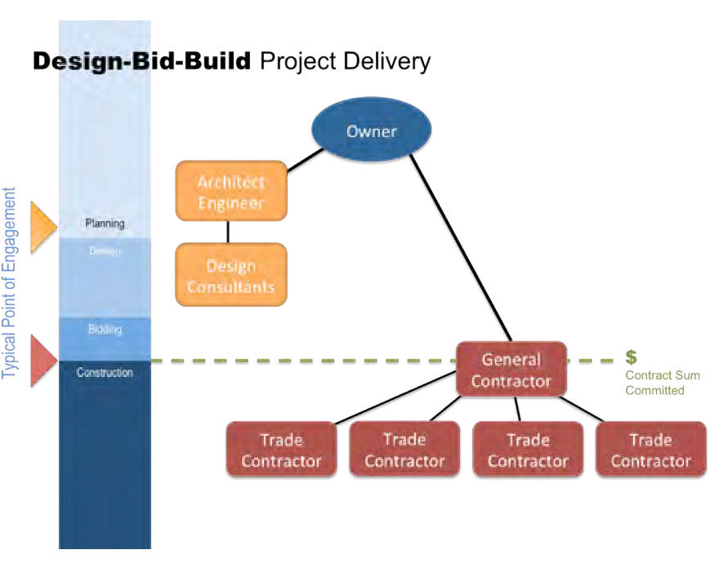
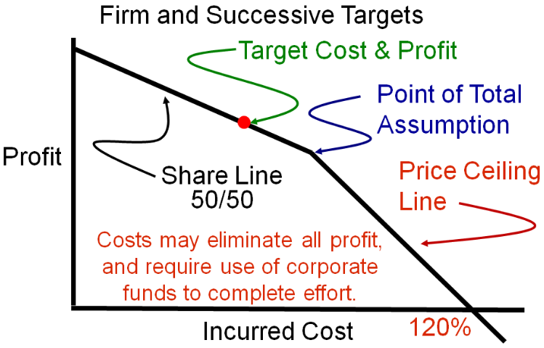
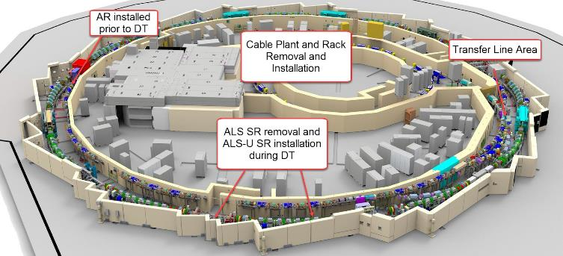
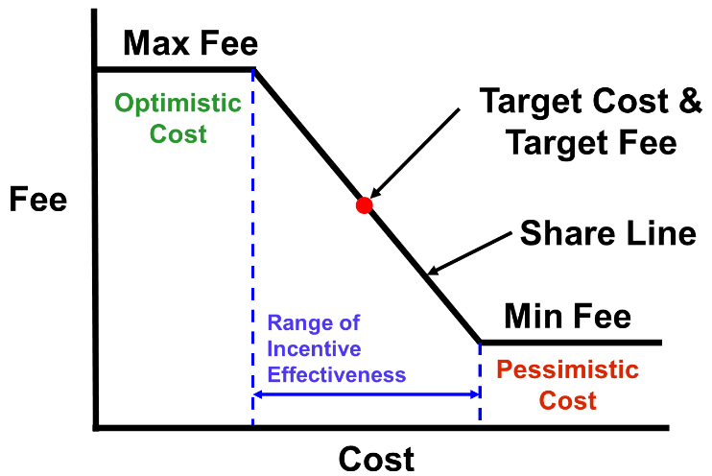
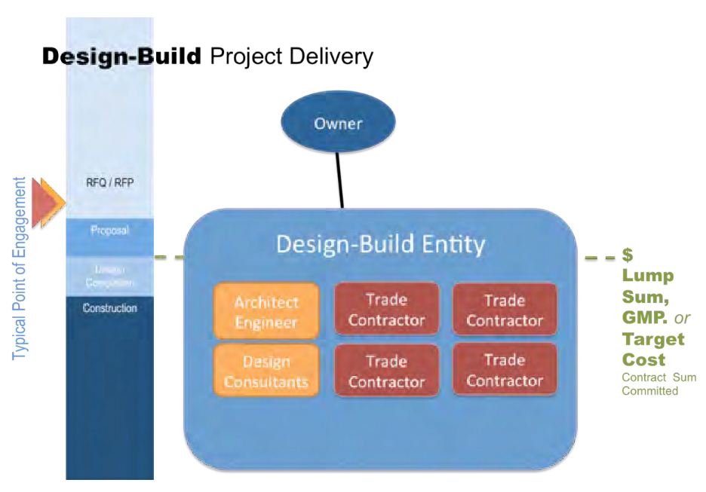

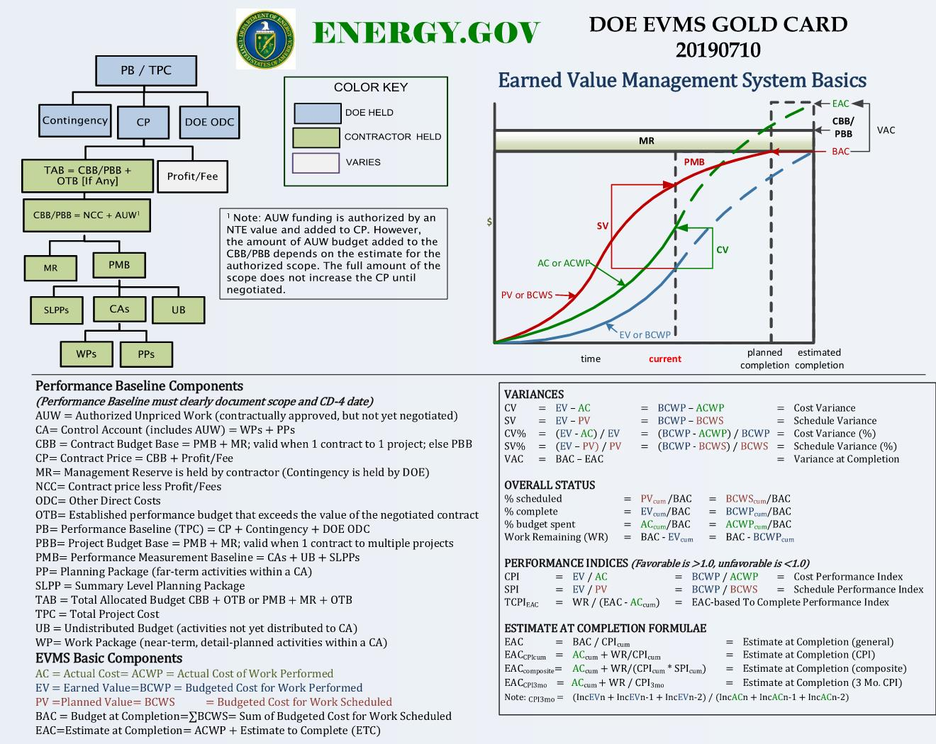
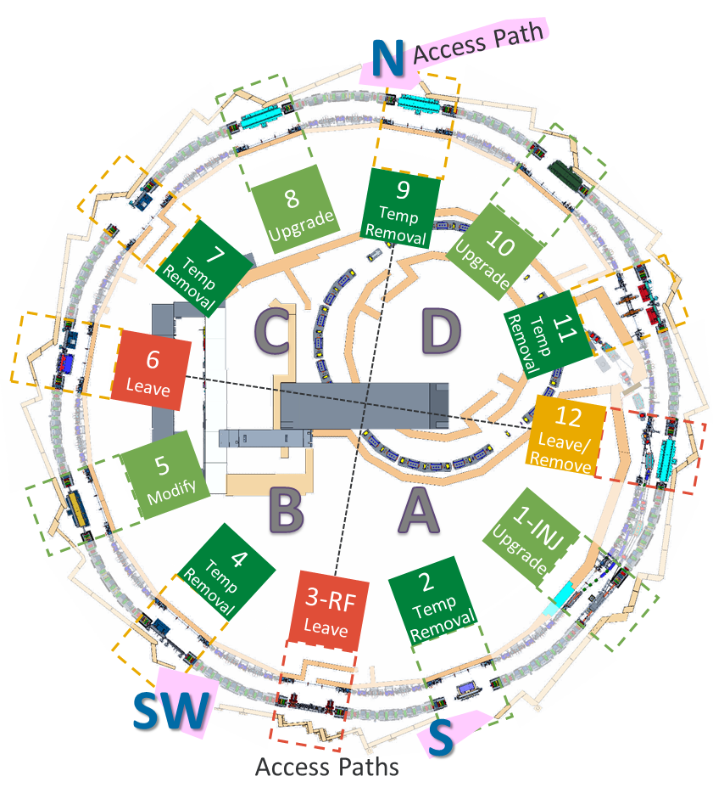
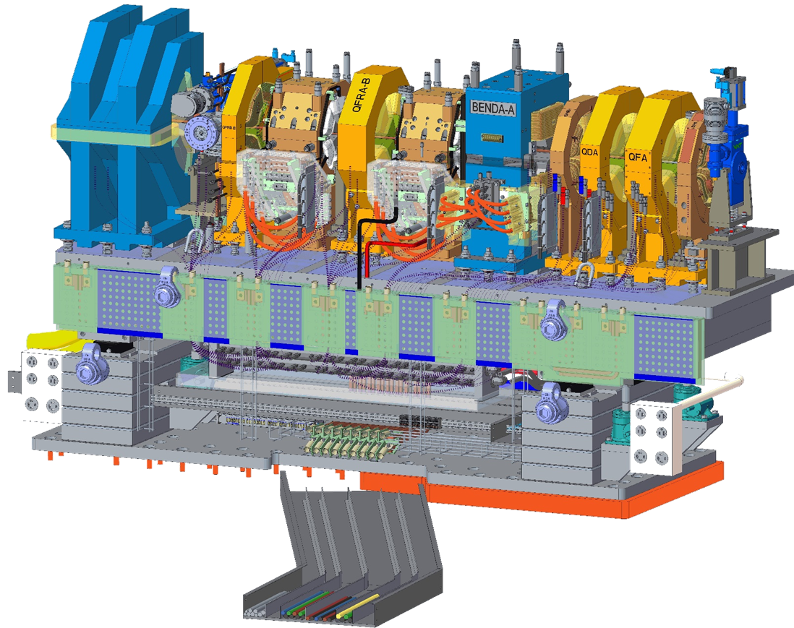
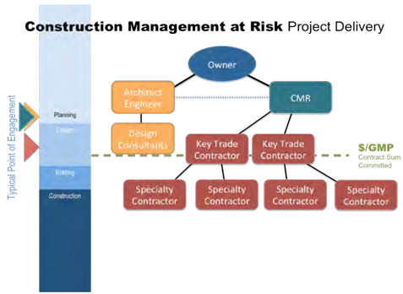
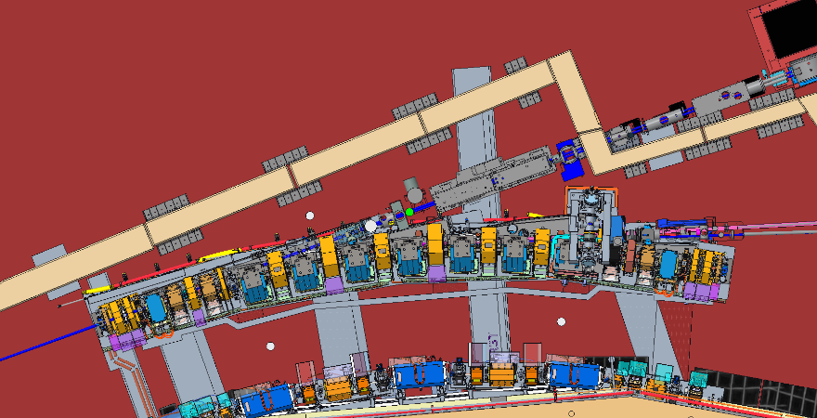
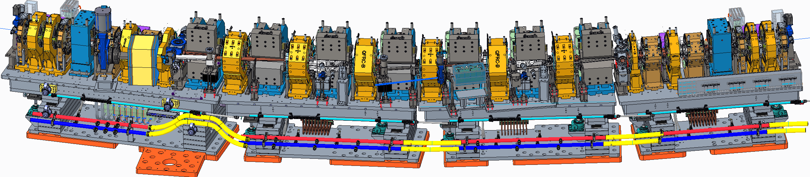
R&I vs. Traditional Construction: Contract Structure and SOW
J. Caddick, D. Leitner, A. Lodge, C. Bullock, E. Newman, L. Crosby, B. Muse
Lawrence Berkeley National Laboratory, Berkeley California, USA
Project Delivery Systems
Design-Bid-Build (DBB)
Most Common Commercially (2016-2023, 521 projects @ LBNL)
For simpler to moderate value jobs <$10-15M. Selection based most often on low price, at times best value when funding allows. Typically three project phases – design, where the design engineer of record completes a design as directed by the owner. Bid – where the owner then couples a contract and procurement method with the design and solicits pricing to execute the work outlined in the design. Build (construction) – where the project is built by an owner-selected 3rd party such as a construction firm.
Design-Build (DB)
Second Most Common Commercially (2016-2023, <30 projects @ LBNL)
One entity (design-builder) and a single contract with the owner to provide both architectural/engineering design services and construction. Moderate to complex, higher value jobs >$20M. Can be more cost effective and can alleviate some of the friction that can be present between designer and builder. Less ideal for products where the owner desires the engineer/architect to have more influence. Less change orders to the client due to design errors and omissions. Selection is typically based on best value.
Construction Management at Risk (CMAR)
3rd Most Common Commercially (2016-2023, 6 projects at LBNL)
Commitment by a construction or execution entity for construction performance to deliver the project within a defined schedule and price, either through a fixed price or a guaranteed maximum price (GMP). The construction or execution entity provides construction input to the owner during the design phase and becomes the general contractor during the construction phase. The ALS-U Storage Ring Removal and Installation (SR R&I) subcontract is analogous to a CMAR delivery system.
Procurement Methods
LESS RISK
  Fixed Price Contract
  A fixed price, agreed upon in advance, for a well-defined product, service, or result. Fixed price contracts included firm fixed price (FFP), fixed-price incentive fee (FPIF), and fixed price with economic price adjustment (FP-EPA). The ALS-U Storage Ring Removal and Installation (SR R&I) subcontract is FFP.
  Cost-Reimbursable Contract
  Payments to the seller for actual costs incurred for completing the work plus a fee representing seller profit. Used when scope is not well defined or frequent change. Cost-reimbursable contracts include cost plus award fee (CPAF), cost plus fixed fee (CPFF), and cost plus incentive fee (CPIF).
MORE RISK
Statement of Work (SOW)
Planning
ALS-U has awarded a contract in three segments: planning, removal, and installation. The planning scope is where the contractor validates proposed execution plans, demonstrates means and methods of executing (girder cutting and removal), and fully develops training, certification, lifting, and other pertinent plans required to successfully execute the work within an allotted 9 months time period. Staffing plans and resources are allocated and sub-tier contracts are arranged to support the contractor.
Removal
The removal period will begin after the facility Make Safe plan has been executed and the access paths have been established. Most Insertion Device/straights will be removed to improve ingress/egress space within the tunnel. The SR cables and wireways will then be removed to allow for technician access to the SR girder itself. After isolating the girder from the front ends and facility utilities, the girder will be translated into the aisle and cut into 3 segments. Each segment will then be removed individually. In cases where ground access is insufficient, the girder will be lifted out of position using the ALS annex crane, lowered into a safe area, then cut. Removal will begin in the furthest sectors from access points within each quadrant and progress towards the access point.
ALS Girder
Center Girder Segment with Ground Transportation Equipment
Installation
The installation phase begins in a quadrant when all sectors contained within it have completed their floor preparation stage. Installation will occur in sectors furthest from access points first, progressing towards the access point over time. Insertion device reinstallation will be performed after all other work is complete within the quadrant, allowing for technicians to access the front ends for reconfiguration.
Tracking Progress
Earned Value Management System
Integrated ALS-U Girder
ALS-U 9-bend Achromat Storage Ring
Notes:
Firm Fixed Price (FFP)
None or very little risk to the owner. Contractor assumes all cost risk unless it is an owner directed change or change order. Should be used when requirements are well defined. In the case of the SR R&I subcontract the risk was with design that was not yet mature for some aspects of the installation. Contractors should be experienced in FFP before entering into agreement with the owner. Market conditions should be stable, and financial risks are otherwise insignificant to ensure project success. Typically, a firm fixed-price is assigned for each deliverable (line item), resulting in a total sum or contract value. The contractor is obliged to provide an acceptable deliverable at the time, place and price specified in the contract. Generally not appropriate for R&D work.
Fixed-Price Incentive Firm (FPIF)
A fixed-price incentive contract is a fixed-price type contract with provisions for adjustment of profit. The final contract price is based on a comparison between the final negotiated total costs and the total target costs. A FPIF contract is appropriate when a firm fixed-price contract is not suitable, the nature of the supplies or services being acquired and other circumstances of the acquisition are such that the contractor's assumption of a degree of cost responsibility will provide a positive profit incentive for effective cost control and performance, the parties can negotiate (at the outset) a firm target cost/profit/profit adjustment formula that will provide a fair and reasonable incentive and a ceiling that provides for the contractor to assume an appropriate share of the risk. A FPIF should not be used if adequate cost or pricing information is available for establishing firm targets at the time of initial contract negotiation.
Cost-Plus-Incentive-Fee (CPIF)
A cost-plus-incentive-fee contract is appropriate for noncommercial service or development and test programs when the parties can negotiate a target cost and a fee adjustment formula that are likely to motivate the contractor to manage effectively and the contractor's accounting system is adequate for determining costs applicable to the contract. Appropriate owner surveillance during performance will provide reasonable assurance that efficient methods and effective cost controls are used. Note that the differences between the CPIF and FPIF pricing arrangements occur when contract costs are substantially above or below target cost. The CPIF contract pricing arrangement must include a minimum fee and a maximum fee that define the contract range of incentive effectiveness (RIE). When costs are above or below the RIE, the Government assumes full cost risk for each additional dollar spent within the funding or cost limits established in the contract. Consider the following final steps when developing a CPIF pricing arrangement.
Time and Materials (T&M) Contract
Contracts are used to acquire supplies or services on the basis of direct labor hours at specified fixed hourly rates that include wages, overhead, general and administrative expenses, and profit. Materials are priced at cost, including (if appropriate) material handling costs. A time and materials contract affords the contractor no positive profit incentive to control material or labor costs effectively. Yet this contract type is often the only effective one for repair, maintenance, or overhaul work to be performed in emergency situations. A time and materials contract may be used only after a determination that no other contract type is suitable. When the contract includes a ceiling price, its breach is at the contractor's risk. If the ceiling price is subsequently raised through a contract modification, the contract file documentation must justify the increase. Although the agreed upon hourly rate per direct labor hour is an important source selection factor, the contractor's technical and managerial skills are more important, to include his reputation for getting the job done. The contractor will get paid for hours and materials expended. Therefore, awarding to a marginal producer that charges a cheaper price per hour but expends more hours due to its ineffectiveness may not be the most beneficial solution.

