Slide 1

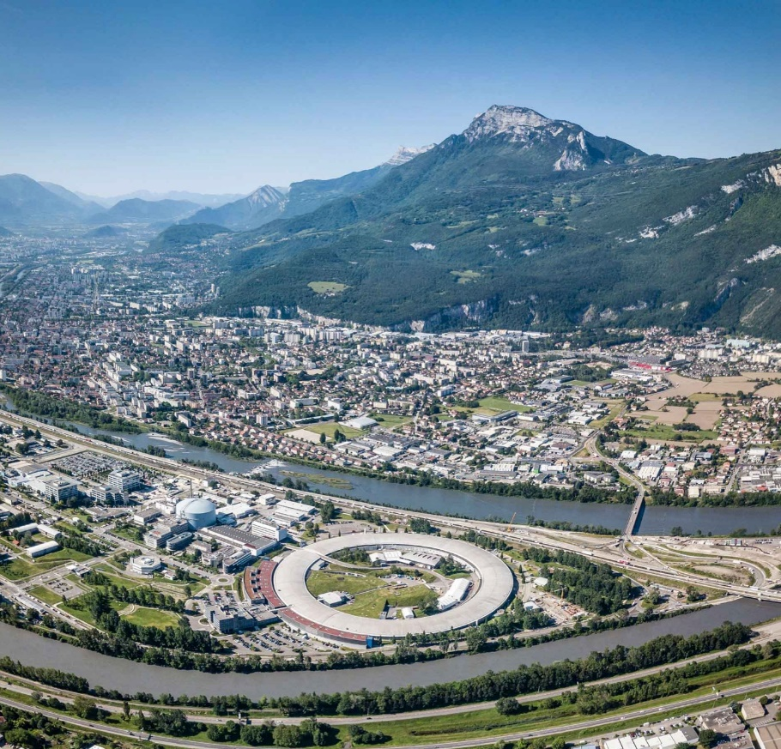






















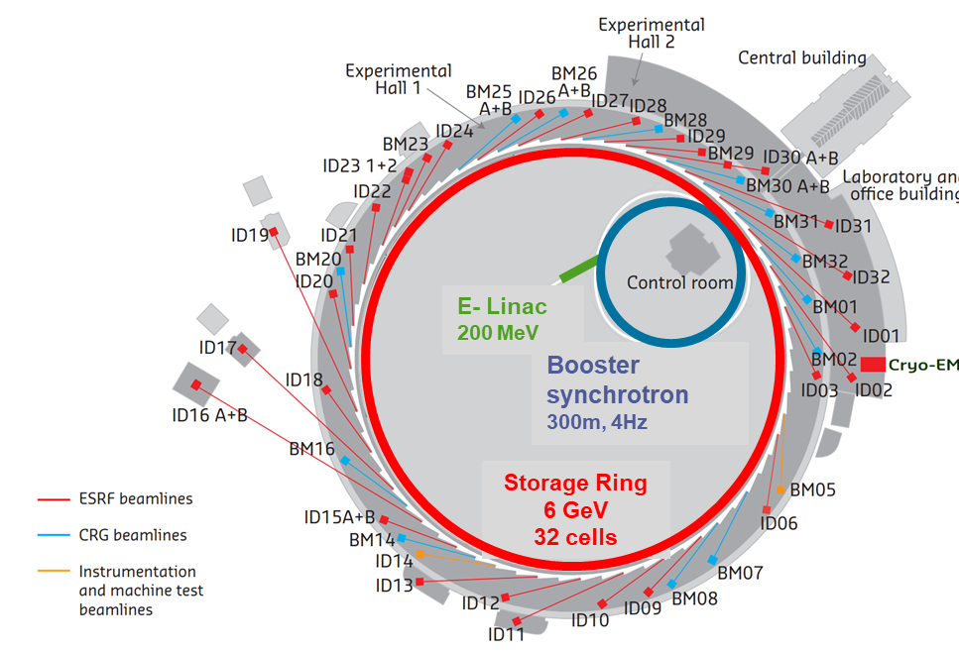
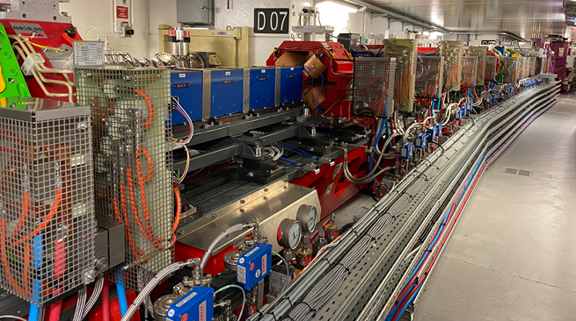
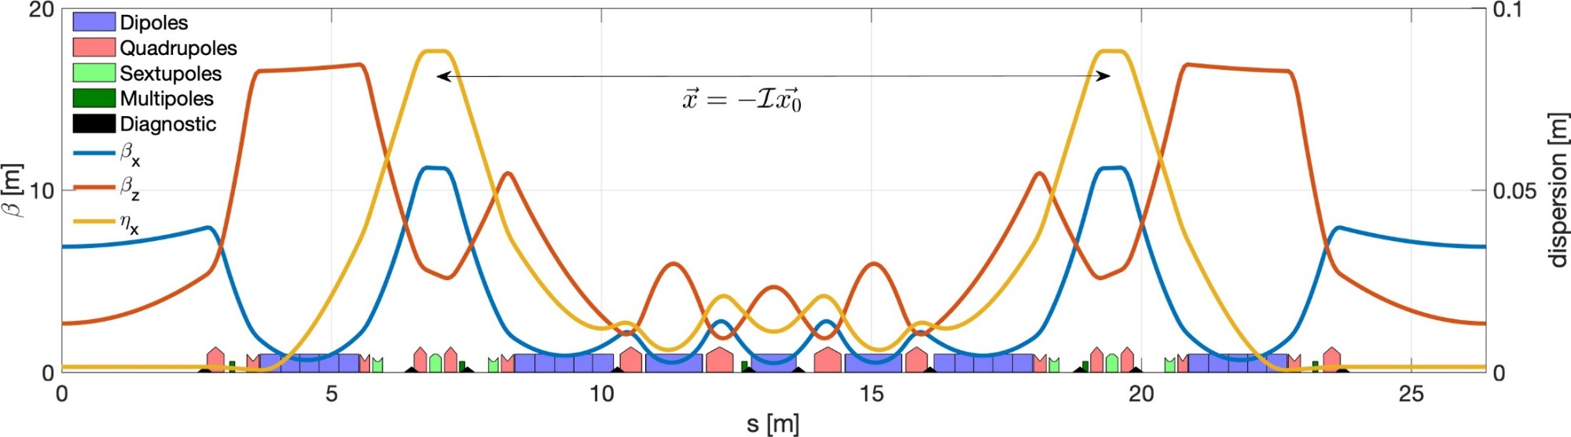
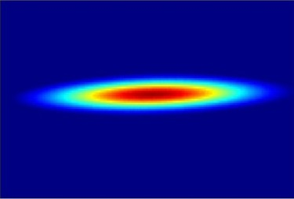
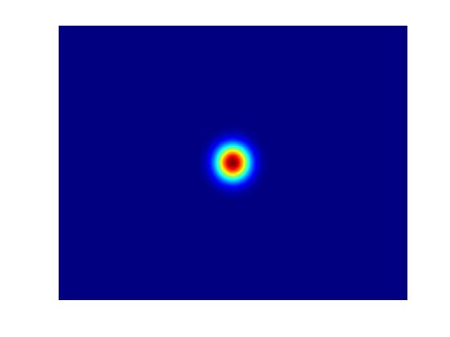
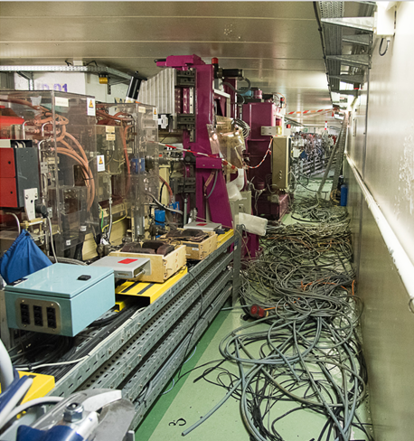
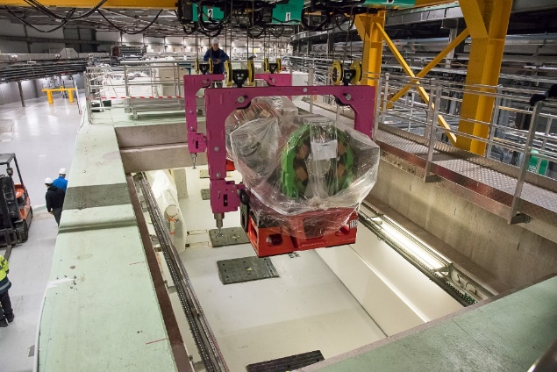
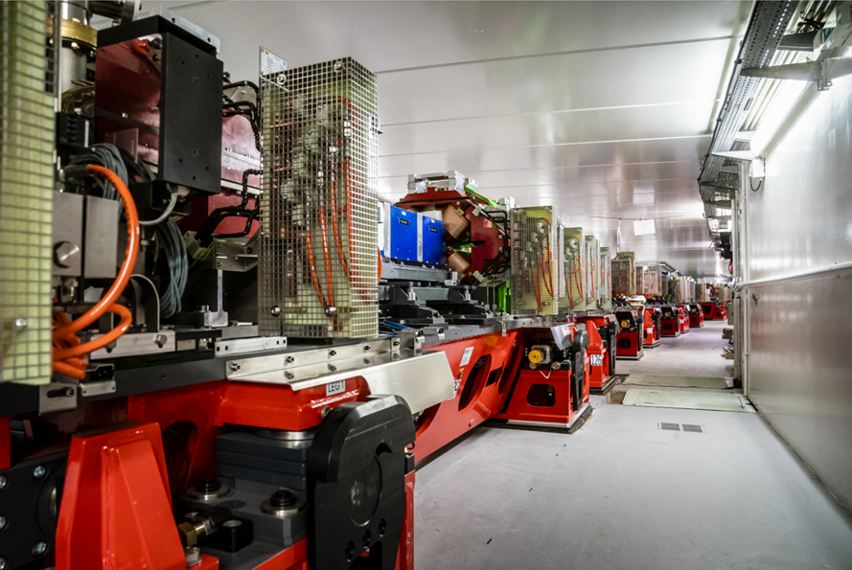
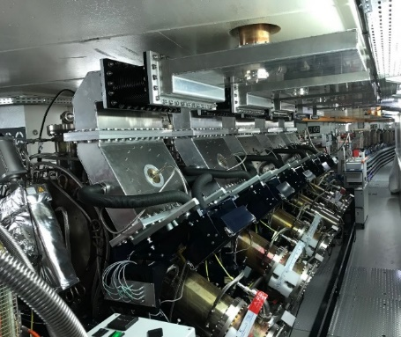
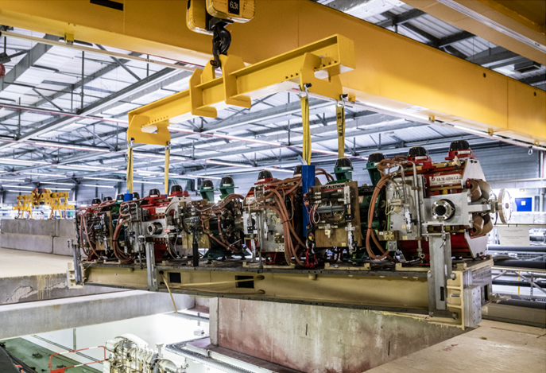
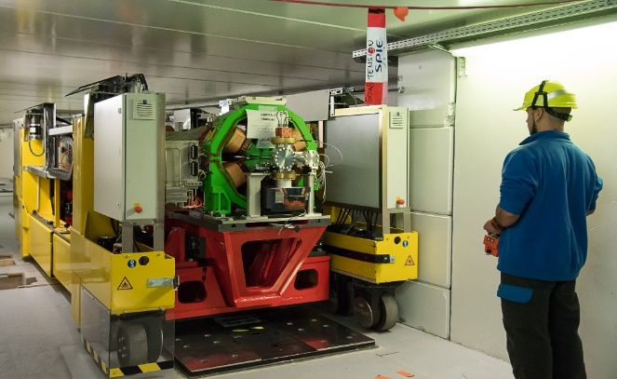
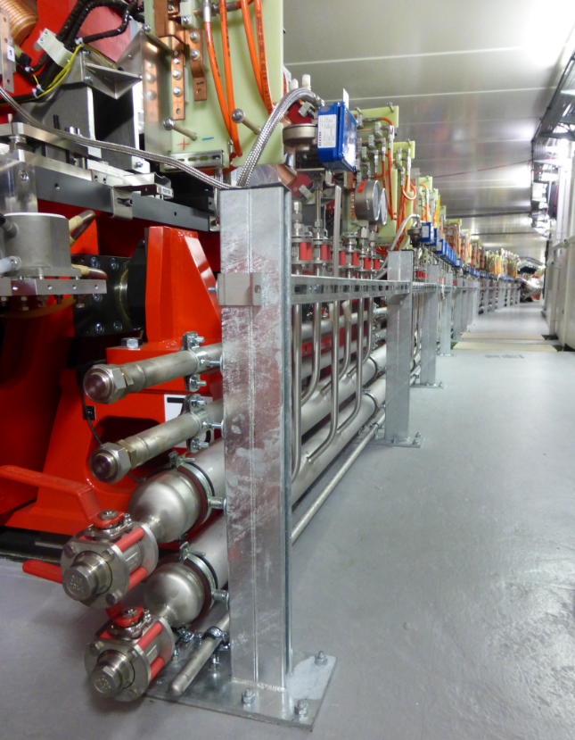
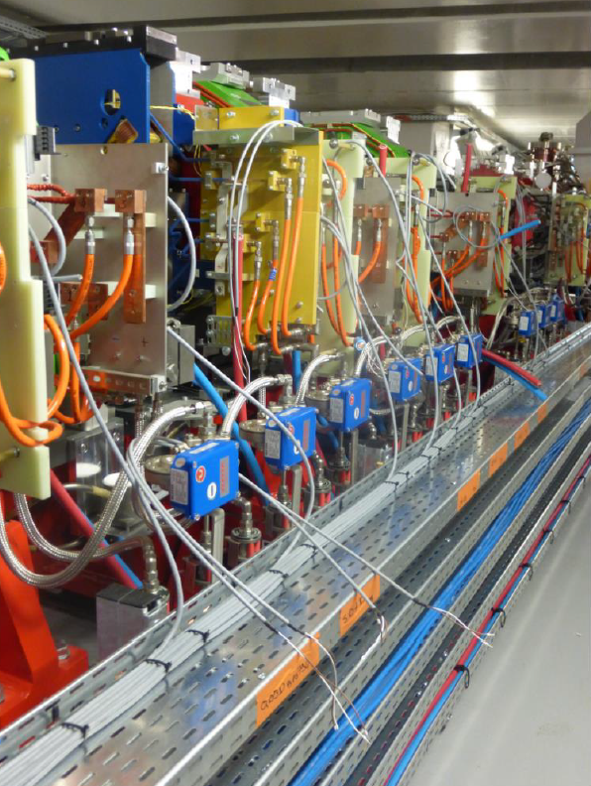
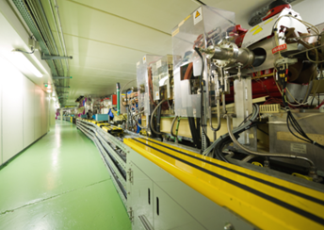
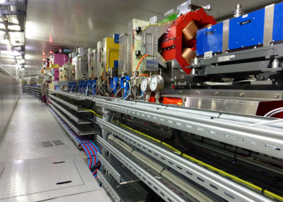
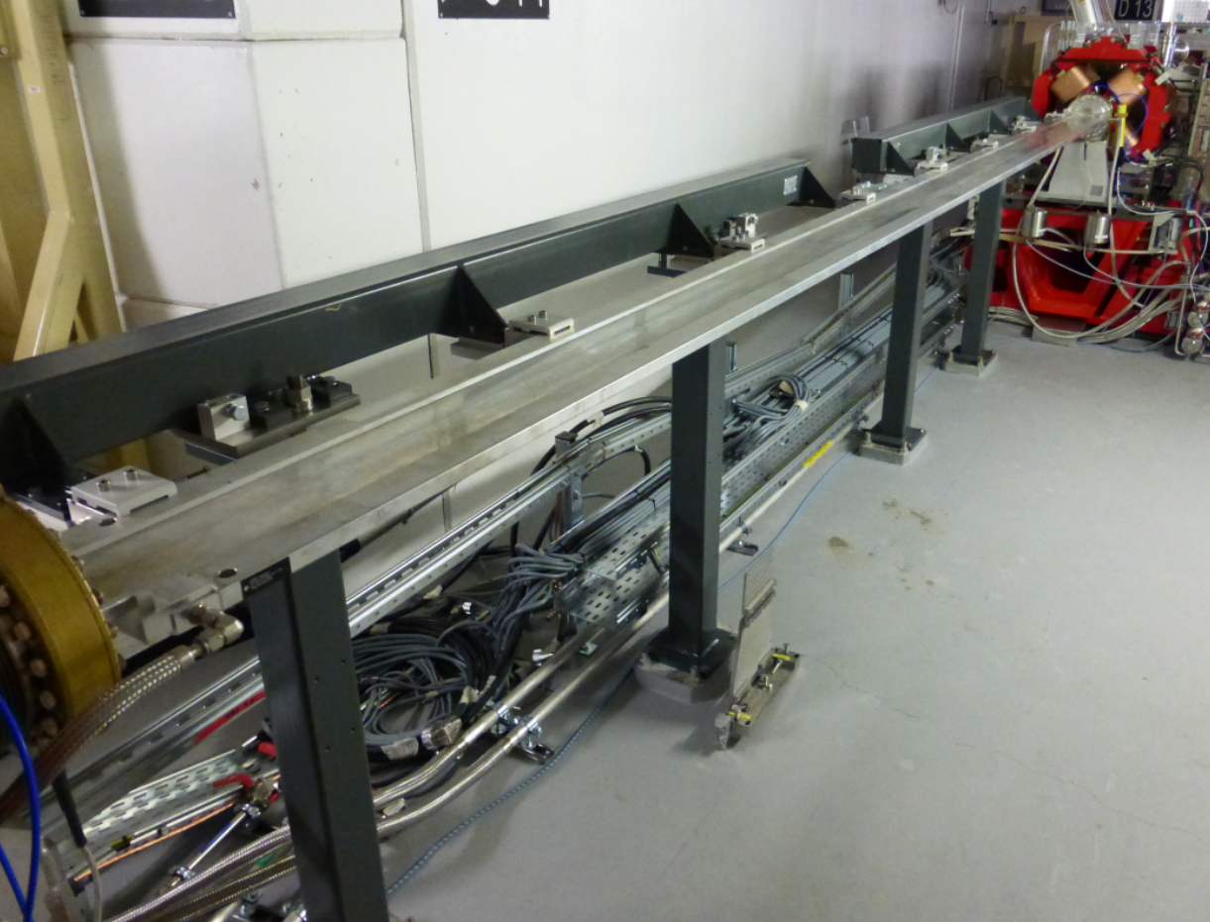
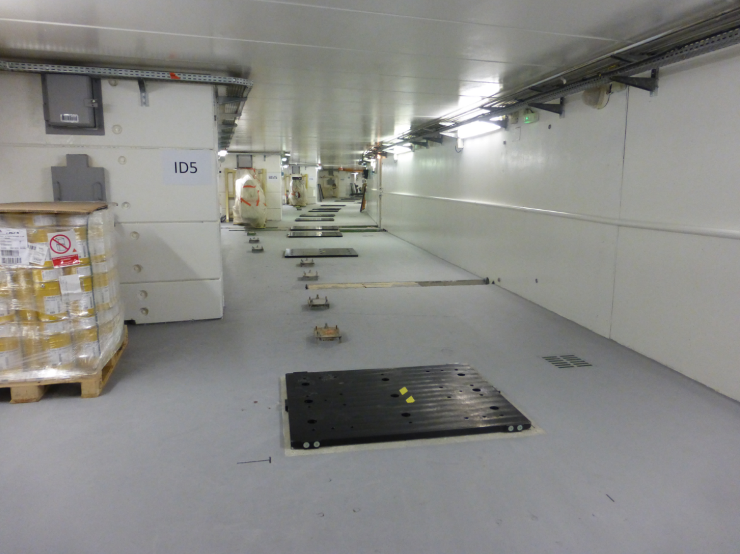
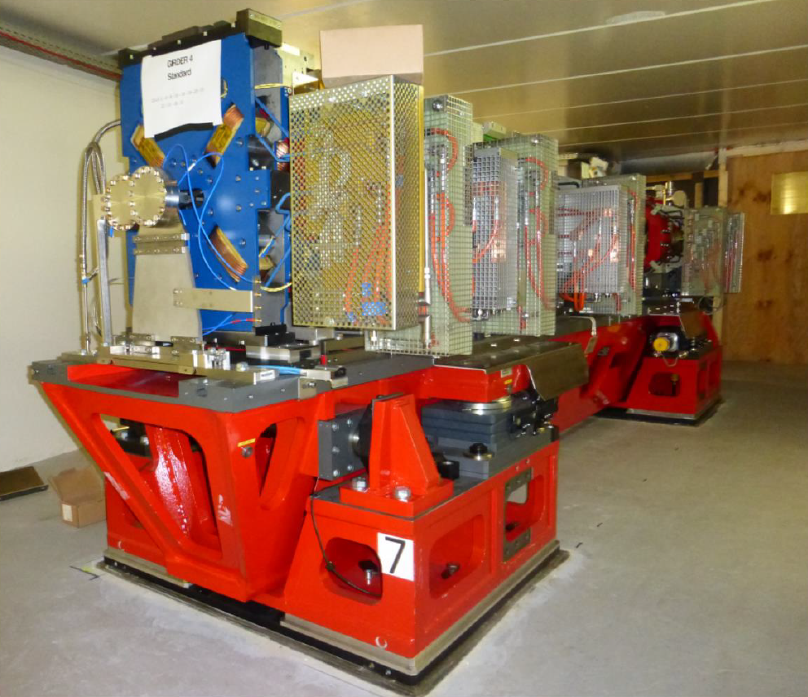
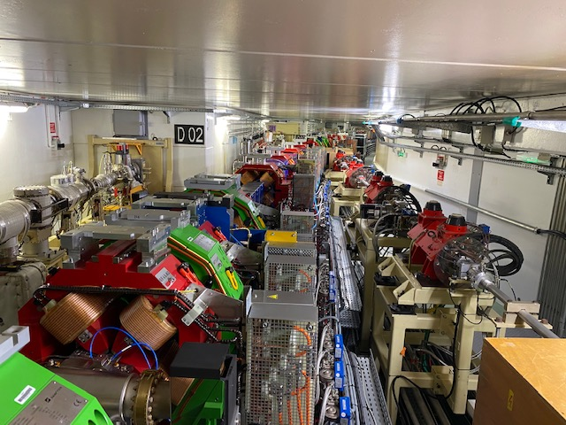
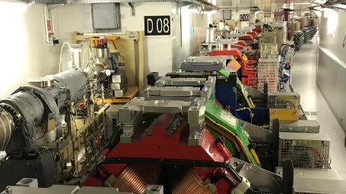
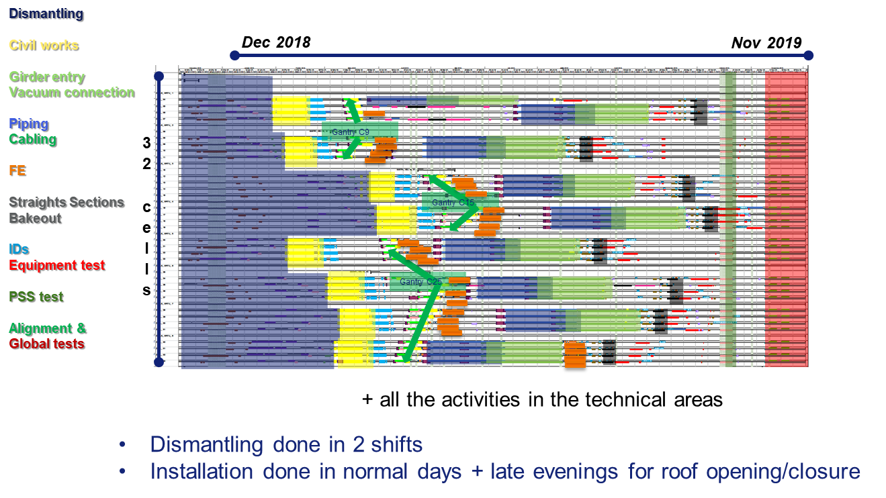
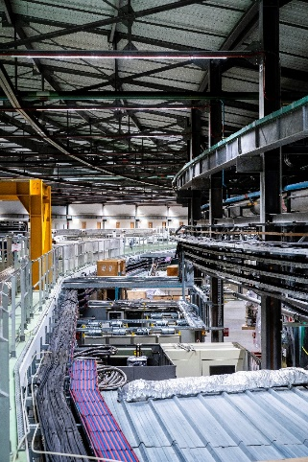
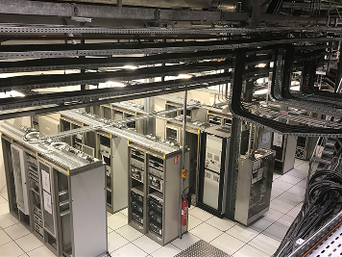
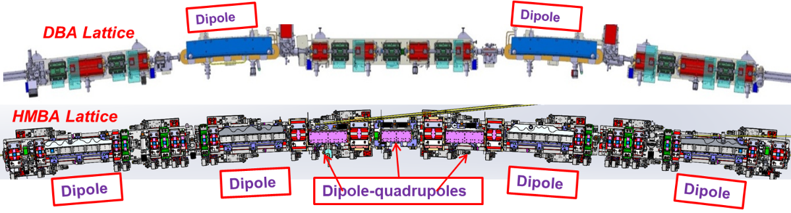
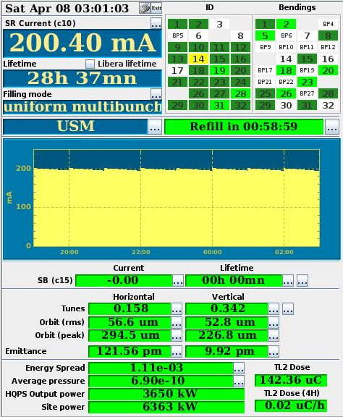
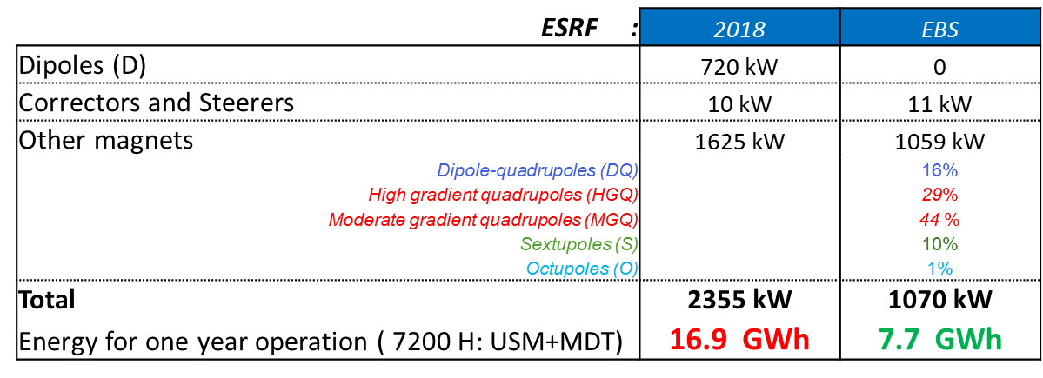

UPGRADE and OPERATION OF THE
ESRF-EBS LIGHT SOURCE
B. Joly, J-L Revol, .
On behalf of the Accelerator & Source Division
The European Synchrotron Radiation Facility - Extremely Brilliant Source (ESRF-EBS) is a facility upgrade allowing its scientific users to take advantage of the first high-energy 4th generation storage ring light source. In December 2018, after 30 years of operation, the beam stopped for a 12-month shutdown to dismantle the old storage ring and to install the new X-ray source. On 25th August 2020, the user programme restarted with beam parameters very close to nominal values. Since then beam is back for the users at full operation performance and with an excellent reliability.
This poster reports on the implementation of the upgrade and on the present operation performance of the source.
22 partner nations
Annual budget: 120 million euros
Staff: 670 people, 40 different nationalities
Legal status: Private civil company subject to French law
 | Units | ESRF | ESRF-EBS
Energy | GeV | 6 | 6
Circumference | m | 844.4 | 844
Lattice |  | DBA | HMBA
Current | mA | 200 | 200
Lifetime | h | 50 | 23
Emittance H | pm rad | 4000 | 133
Emittance V | pm rad | 4 | 10*
The Extremely Brilliant Source
upgrade :
Decrease the horizontal emittance
Increase the source brilliance
Increase the source coherence
ESRF
PM
PM
Dipoles-quadrupoles
PM
PM
Dipole
Dipole
Dipole
Dipole
ESRF_EBS
ESRF-EBS implementation
Interconnection &
alignment
Project approval: January 2015
First lockdown for COVID19 pandemic: 17/03/20
Dismantling
Entering girders
Radiofrequency
Mock-up (Summer 2017)
Old ESRF-Storage Ring
ESRF-EBS
Straight section for IDs
October 2017 Start of girder assembly
10 December 2018 End USM, start shutdown
Dismantling
Installation
8 November 2019 Tunnel closed
Tests & Injector restart
28 November 2019 Accelerator commissioning
2 March 2020 Beamline commissioning
25 August 2020 Start User Mode Operation
Dismantling
Moving girders
Piping
Cabling
Front ends
Civil work
Girder in place
Injection zone
The operation oriented development in progress:
New ceramic kickers chambers
Solid-State Amplifiers (SSA)
4Th Harmonic cavities
Injection upgrade, reduction injection perturbations
Mini-beta optics
Injector upgrade
Technical zone
 | 2018 | 2021 | 2022 | 2023 (No compensation) | 2023
Availability (%) | 98.47 | 96.35 | 99.06 | 97.85 | 99.28
Number of failures* | 53 | 70 | 62 | 52 | 52
Mean Time Between Failures (hrs) | 104.30 | 66.4 | 88.5 | 105.6 | 107.1
Mean Duration per Failure (hrs) | 1.60 | 2.42 | 0.83 | 2.27 | 0.77
Energy saving with ESRF-EBS: 12 GW/year
for a total electricity consumption of 50 GWh / year in 2023
Storage Ring Total RF power:
2018:
1300 kW RF Radiation loss 4.88 MeV/turn+ 0.5 (ID)
5 Five 5-cell, 2 single-cell cavities
9 MV total voltage
2023:
900 kW RF Radiation loss 2.5 MeV/turn + 0.5 (ID) 13 single-cell cavities
5.5 MV total voltage
Reliability and sustainability:
Reliability of the new accelerator comparable to the old machine
Power consumption reduced by 35%
‘Particle Accelerator Upgrade Removal and Installation’, Trieste, Italy , March, 2024
ESRF – The European Synchrotron – 71 Avenue des Martyrs, Grenoble, FRANCE - Tel +33 (0)4 76 88 20 00

