Slide 1
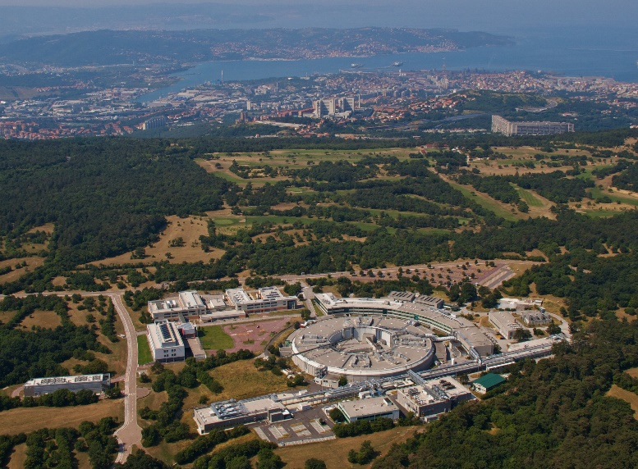
13-16 February 2024
CERN, Geneva
Wrap UP
R&I 2024
19 Mars 2024

Slide 2
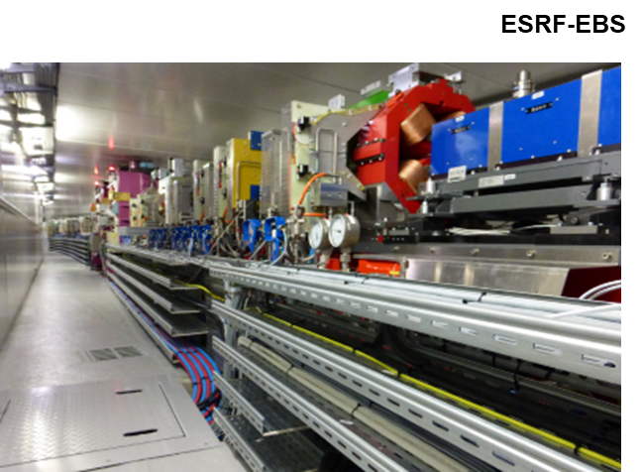
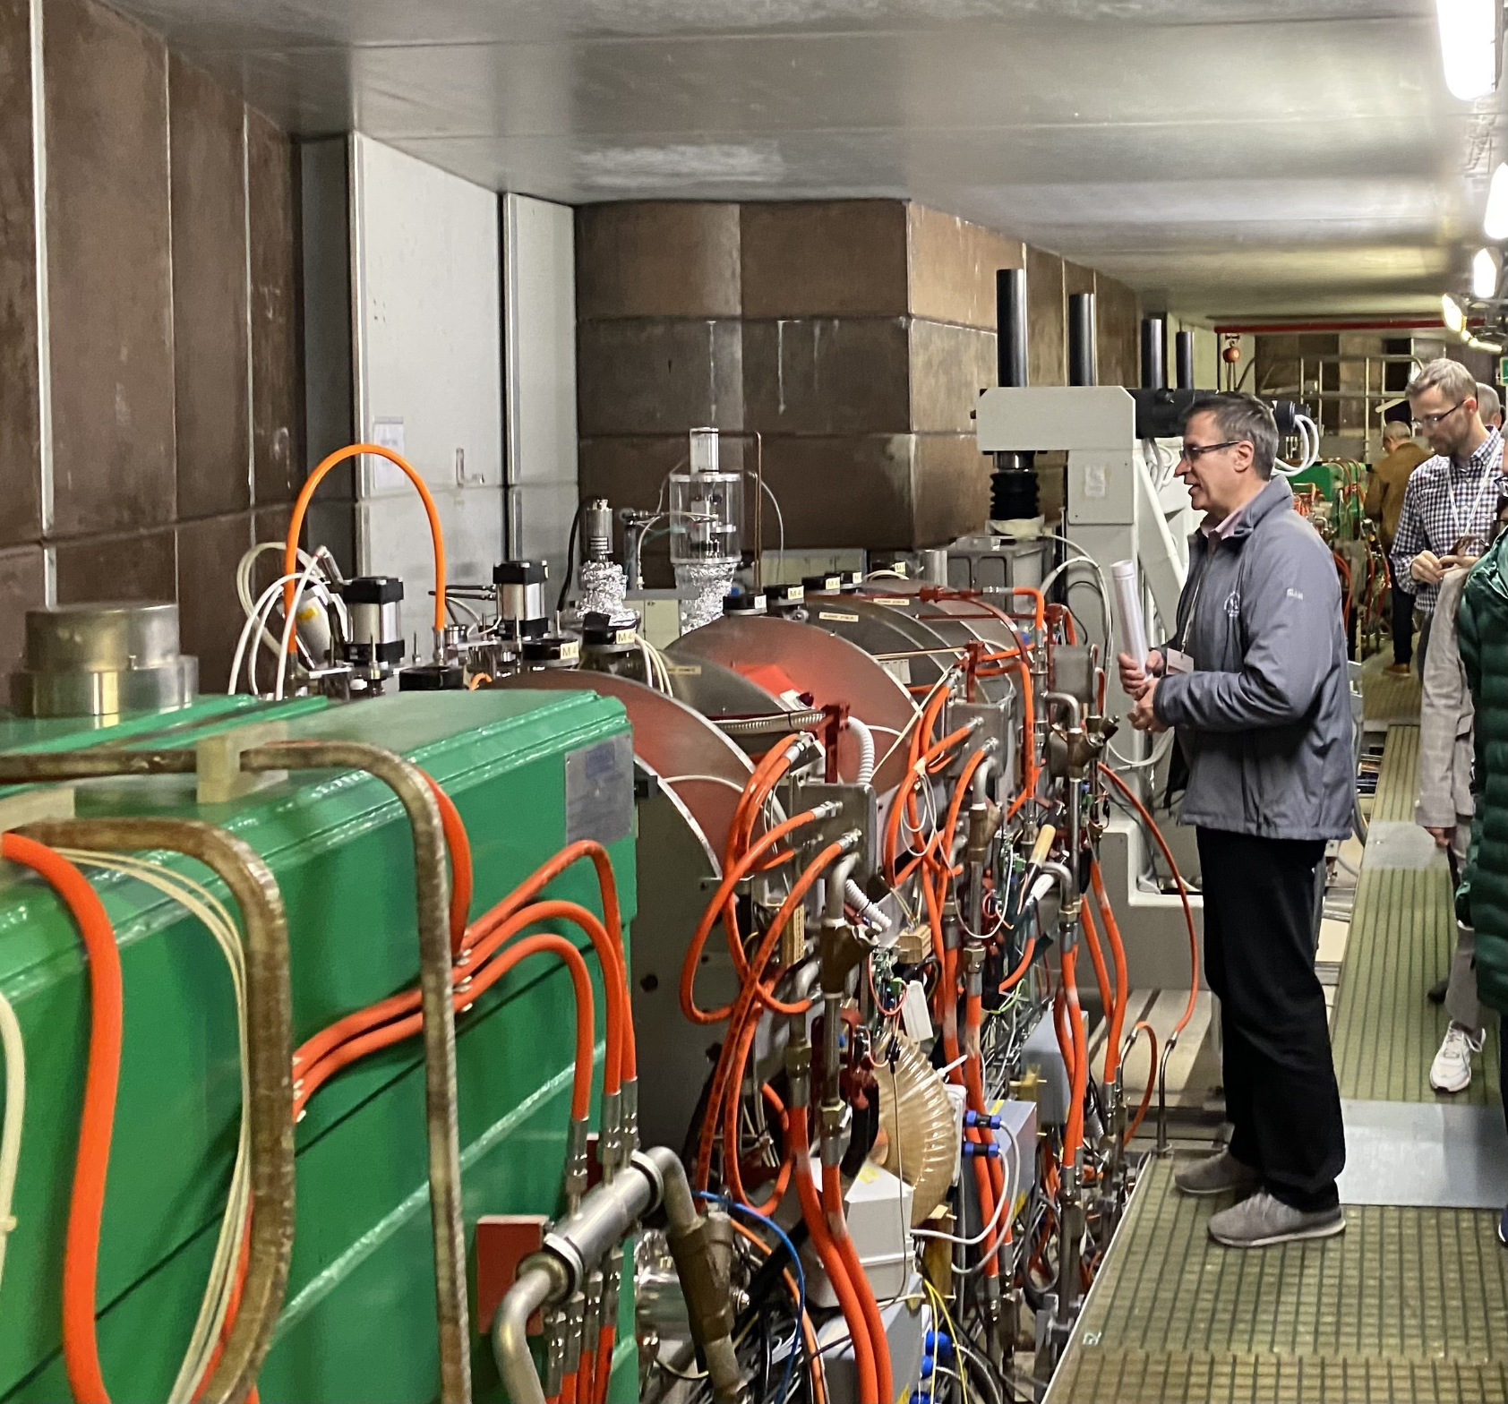
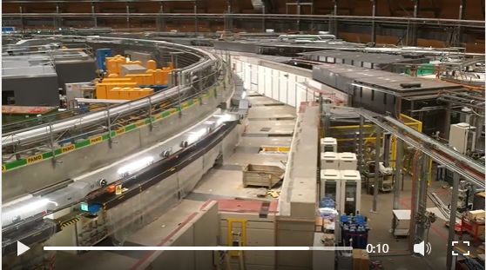
THE LIGHT SOURCE UPGRADES FAMILY
Done (ESRF)
Pantaleo initiate the games in 2012 and proved we could do it
ESRF always ready to share experience and feedbacks
New upgrade today are much better organized !!
In the dark …. Time (APS,SLS)
Dismantling are installation are running smoothly within planning
Next goal is commissioning and restart
Next to dive (ALS, Elettra, Diamond)
Facilities have clear plans and organisation
Preparation work is well progressing
Ready to go (Petra, Soleil, Alba)
Objectives and specificities are well identified
Plans and organization are progressing

Slide 3
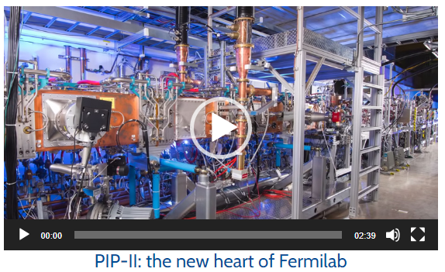
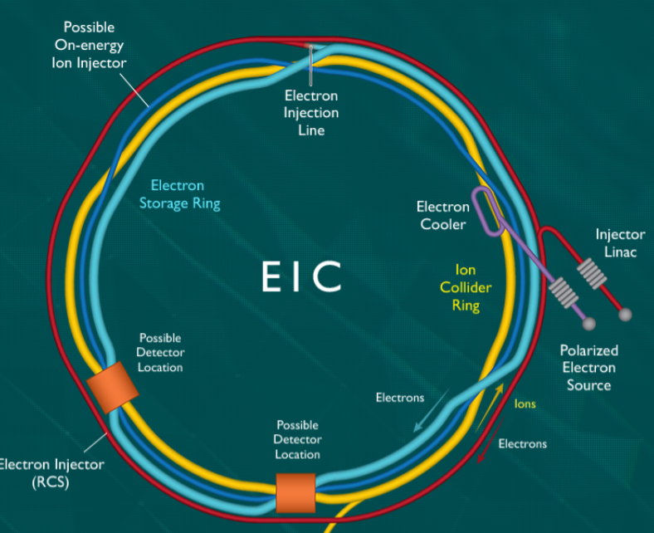
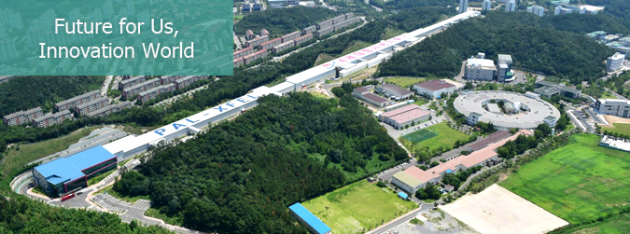
THE UPGRADE PROJECT COUSINS
Linac upgrade at CLS
Project is progressing well and close to installation
PIP II at Fermilab
A lot of in kind contribution
Preparation work and organisation are very well defined
Electron Ion Collider at BNL
A long shutdown in preparation for a large machine installation
Asian laboratories contribution to this workshop
Contribution of KEK and PLS were very well appreciated

Slide 4
A LOT OF COMMON TOPICS AND ISSUES between us
Duration of dark period
Organisation of dark period
Time constraints (strong pressure from users)
Subcontracting and use of internal resources
Radioprotection issues
Cabling issues (and cable data base)
Components follow-up data base
Preparatory work and preassembly
CAD and mock-up to prepare the work
Space space and space management
Packaging
Beamline and user support during dark period
Infrastructure upgrade
Alignement
Equipment start-up
Beam commissioning
….
Sustainability (lifecycle) and artificial intelligence were not mentioned
Q&A Sheet - linked on the website

Slide 5
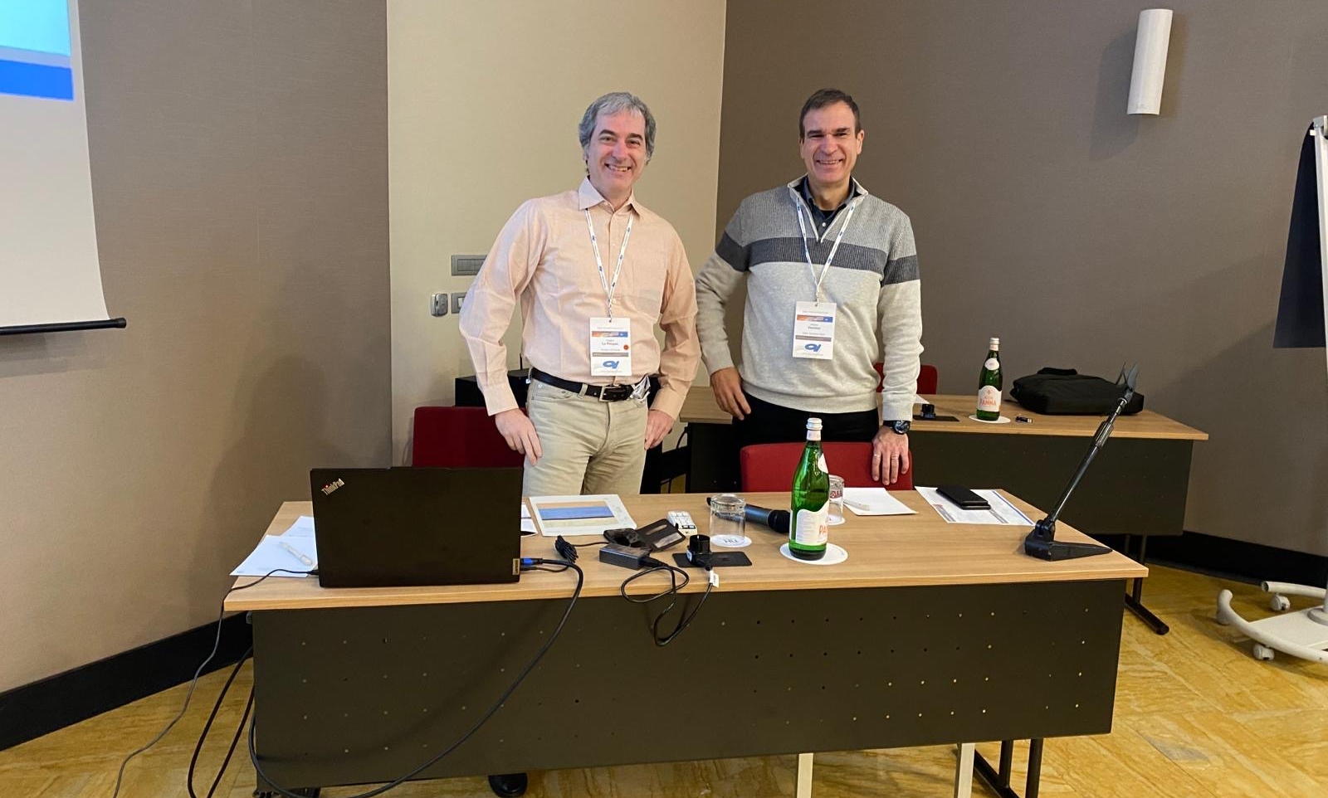
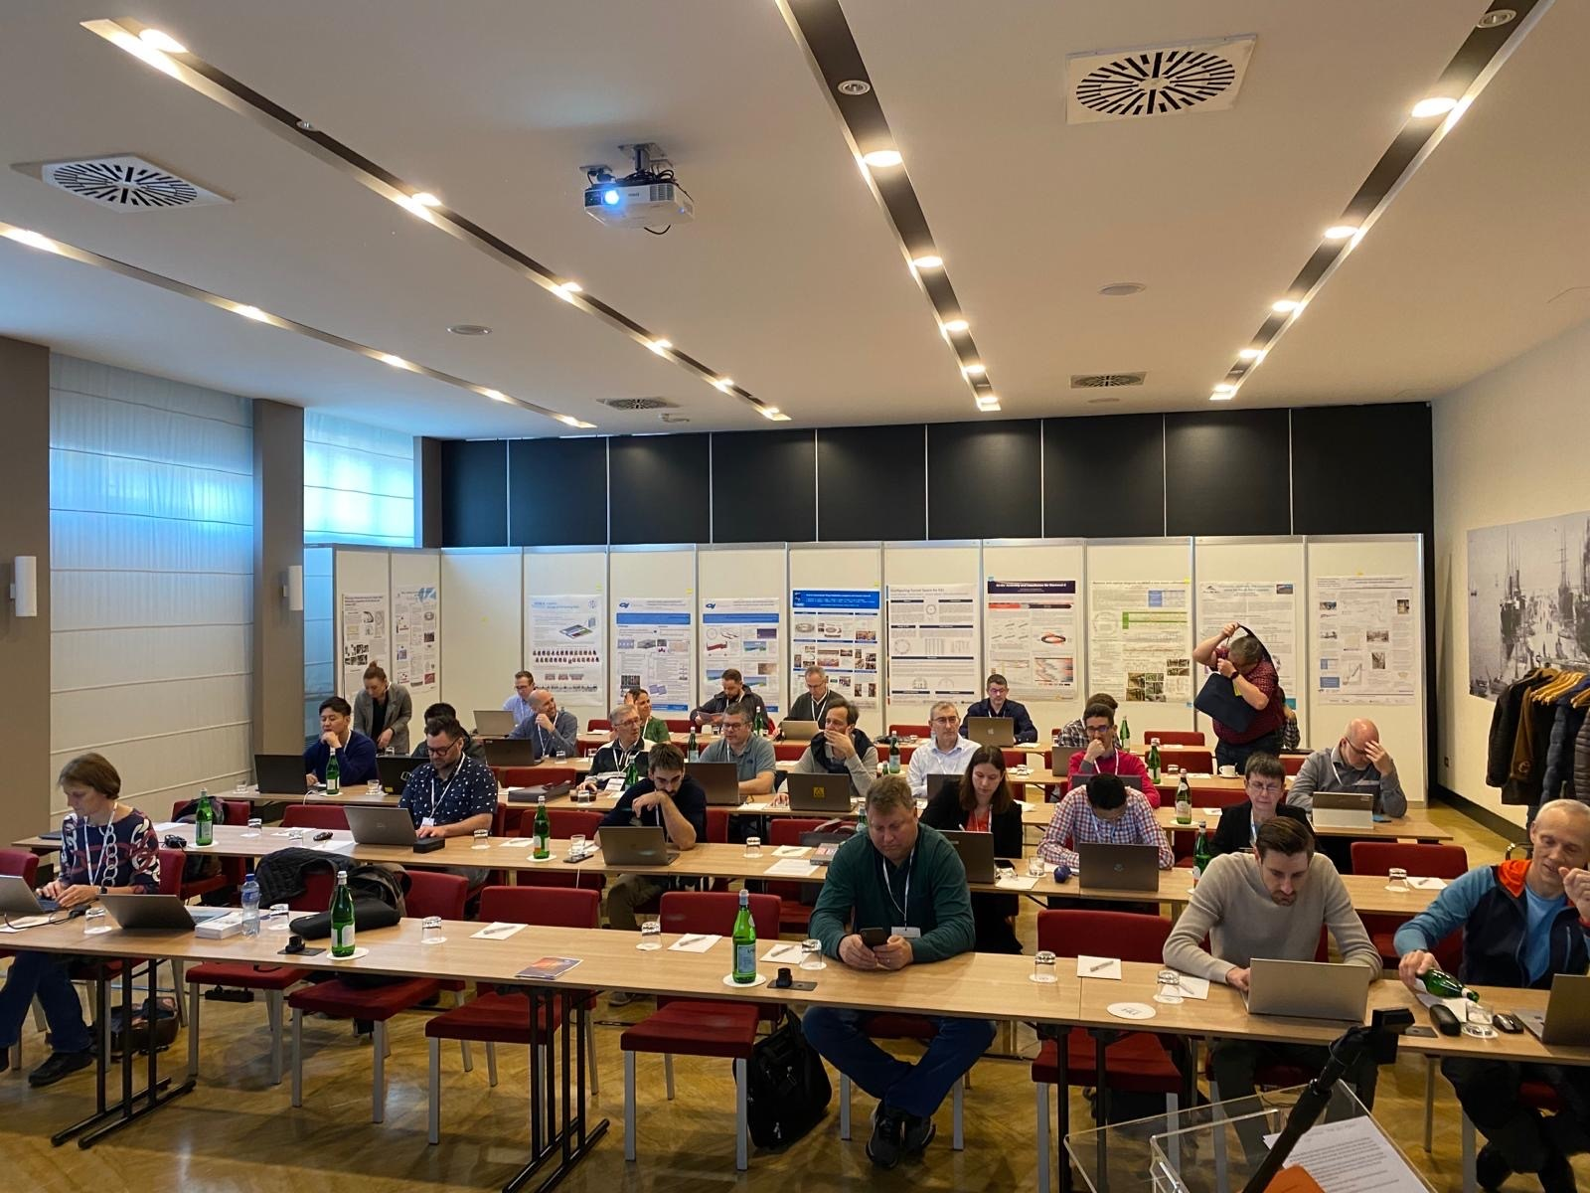
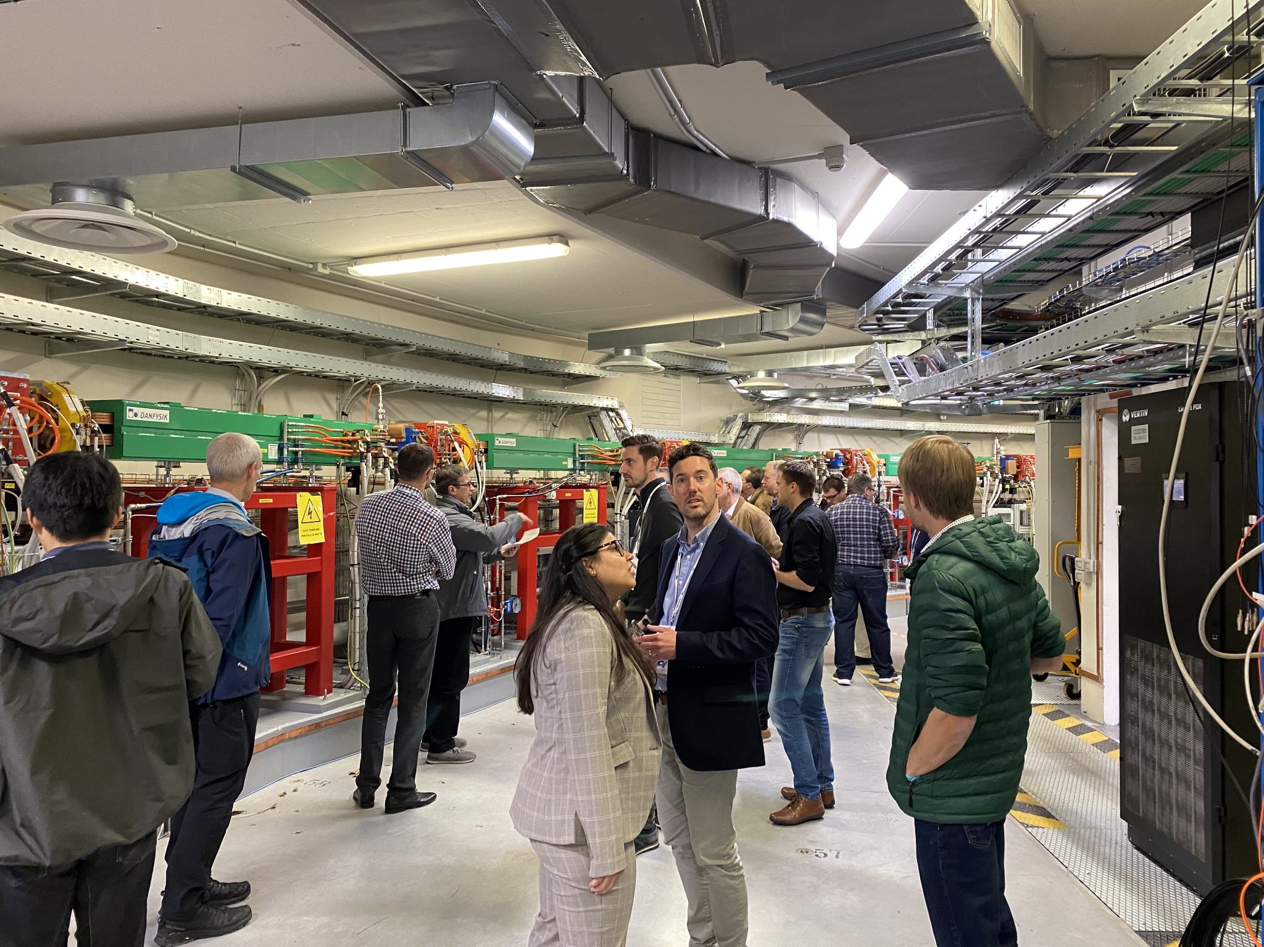
We had a great three working and pleasant days

Slide 6
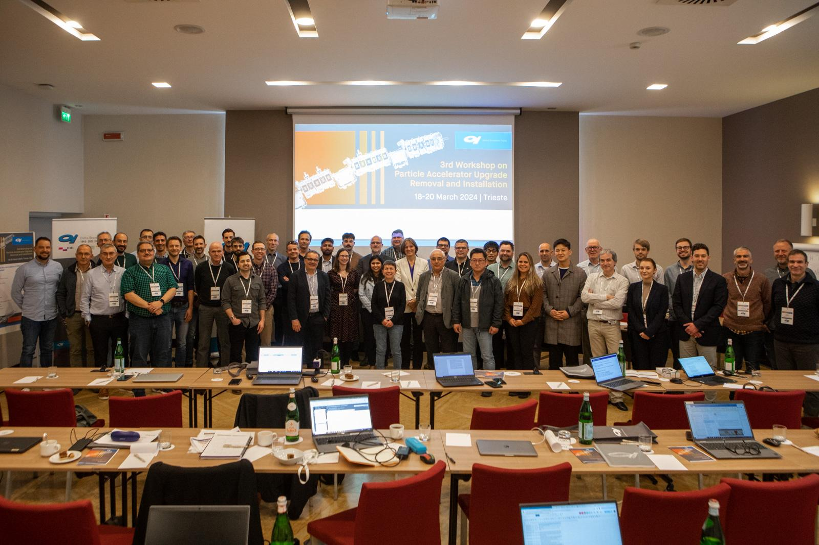
We had a great three working and pleasant days

Slide 7
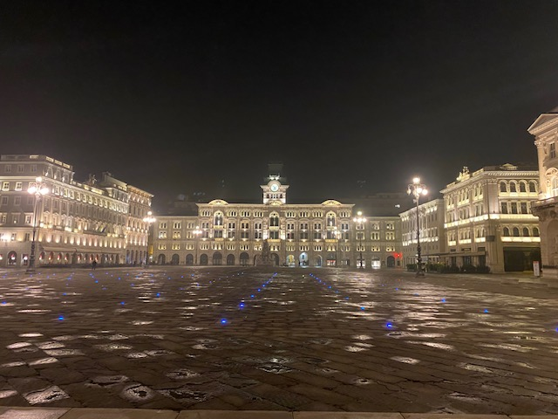
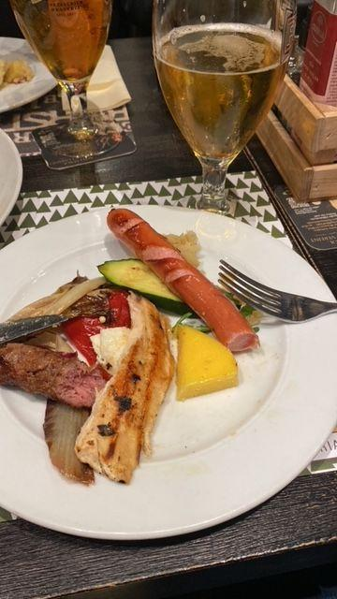
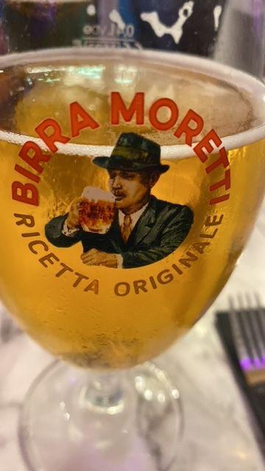
We had a great three working and pleasant days

Slide 8
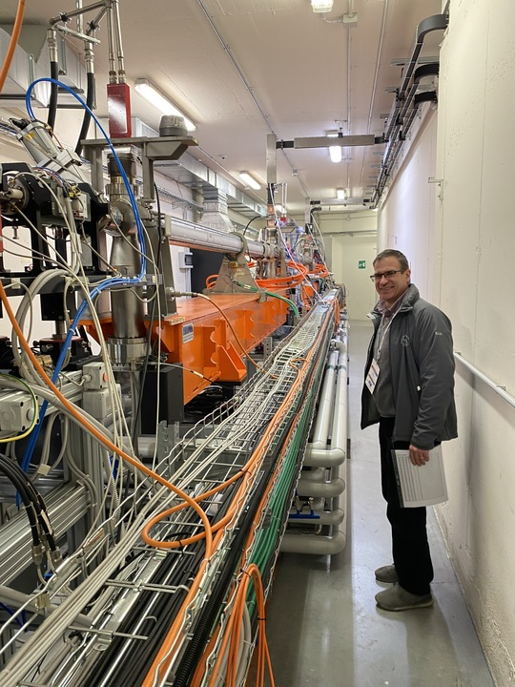
Thanks
Many thanks to the participants for their warm and active contribution
Many thanks to the speakers for the quality of the talks and posters
Many thanks to Roberto, Roberta and Elettra staff for your great work and support - it will be a hard act to follow!
Many thanks to Mark and APS for accepting to organize the next edition !
Talks and posters will be uploaded on the website!

