Slide 1
SOLEIL SciCAT Status
@ISPyB / MXCuBe meeting 2024/11/20
Majid OUNSY, Patrick Madela, Gwenaelle Abeille

Slide 2
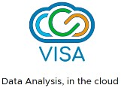
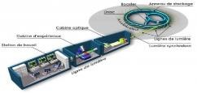
Context: SOLEIL Upgrade (Towards SOLEIL II)
Present
Future
Legacy: Solutions developed based on evolving needs, different silos
Deployment challenges: SciCAT, Sample Tracking, VISA, PUMA, DSW,…
Objective: Harmonized Application’s inter-communication processes, Mutualise Resources
PLUSS (Plateforme d’Urbanisation du Synchrotron SOLEIL)
A Platform for exchanging data between heterogeneous applications
Separation of Concerns: One Application Per Service
Integration: Inter-communication (APIs, Event Based
NO MORE SILOS

Slide 3
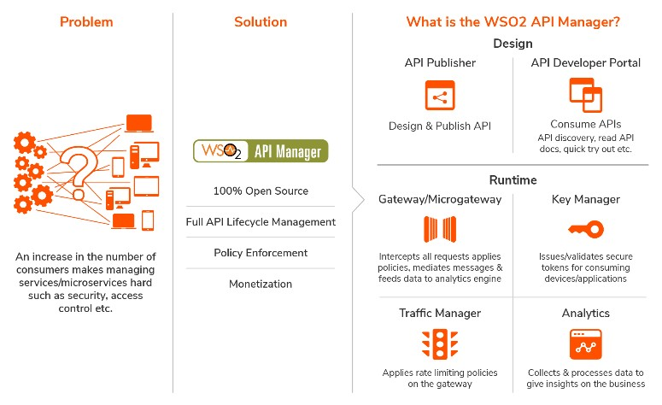
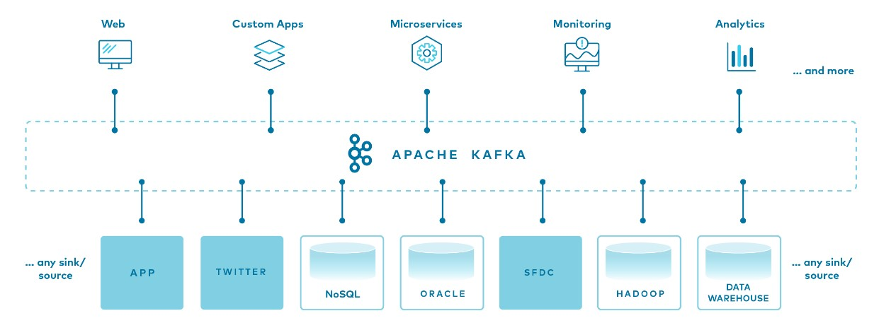
Architecture Base
WSO2 API Manager (Open Source)
Synchronos Communcations
WEB API Catalog (REST, GraphQL,..)
Controls Usage (security, quotas,..)
Apache KAFKA (Open Source)
Asynchronous
High throughput messaging
Many Existing Connectors
Secure

Slide 4
SciCAT:Ingestion of Proposals
Sun Set: SOLEIL DUO
REST API to query project’s information
Common Producer to publish DUO Events on a single KAFKA topic
Topic used by various applications: SciCAT and Sample Tracking Application
SciCAT Consumer
Ingests Proposal’s Metdata from DUO topic
Handles both Simple and BAG proposals

Slide 5
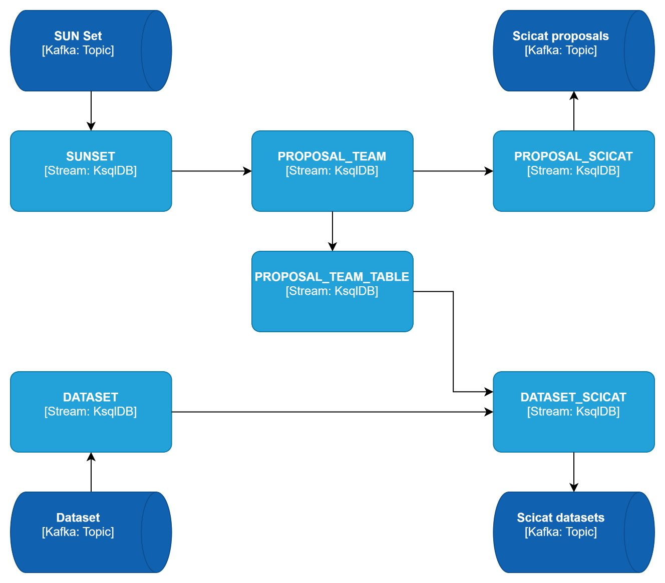
SciCAT:Ingestion of Datasets
Ongoing Work
Device Evaluation
Modifie Tango Control System Devices to Gather Metadata information directly
Kafka producer and consumer
Use of KsqlDB to integrate metadata from DUO topics

Slide 6
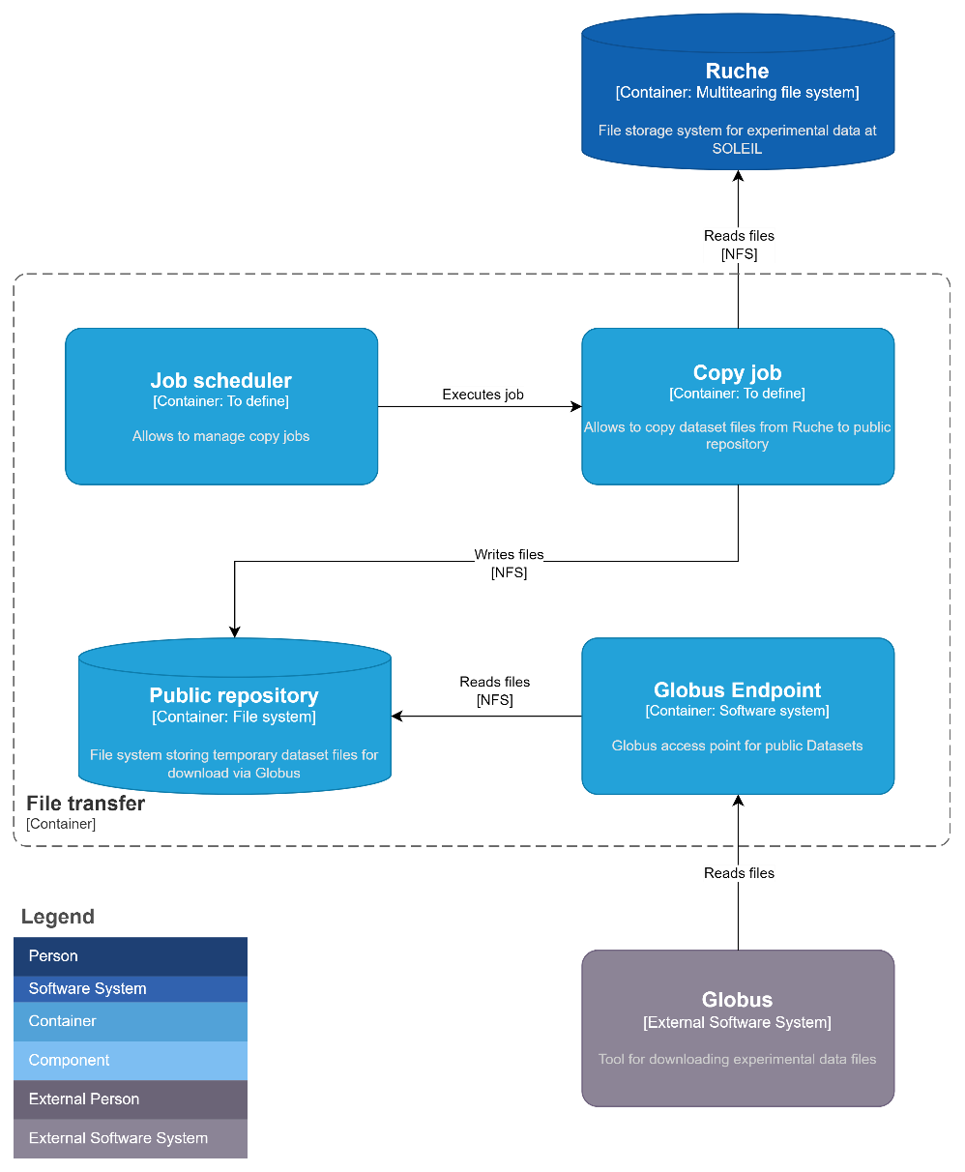
SciCAT:Dataset Access
Ongoing Work
Two options evaluated
Mirroring System:
Mirror experimental data storage for requested data
Archive creation:
Create an archive of requested data
Acess Method
Globus Public Endpoint

Slide 7
SciCAT:AAI
IAM with Keycloak
Implementing Keycloak based IAM based on DUO information
Evaluation of Autorisation solution
DUO’s REST API: Use of Endpoints
Database Integration: Direct Access to a DUO’s database view

Slide 8
SOLEIL flash report
@ISPyB / MXCuBe meeting 2024/11/20
Majid OUNSY, Tatiana ISABET, Idrissou CHADO

Slide 9
SOLEIL status report
Production status:
Two versions:
ISPyB 5.23 without Keycloak
EXI2 with Keycloak
Link to MXCube and SAXS measurements
pyISPyB status:
SOLEIL & MAXIV:
Full installation of pyISPyB (frontend & backend) under joint efforts
Some issues remain to be solved
Aim to share experience on functional & technical requirements
MX stuffs migration from ISPyB to pyISPyB is ongoing
Forseen :
SOLEIL expects to use pyISPyB’s CryoEM function on its new CryOEM installation
SOLEIL expects to add BioSAXS features into pyISPyB (in the long term)

Slide 10
Questions ?
?

