Slide 1
Diamond Update to ISPyB Collaboration Meeting
Martin Walsh
Eliot Hall
James Hall & Guilherme de Freitas
20th November 2024 @ Elettra

Slide 2
Summary
Resource availability has proved challenging
Replacement of ISPyB infrastructure
Focus on reliability
Three new MariaDB database cluster nodes and two MaxScale proxy servers
New back up and restore technology
Percona Monitoring and Management (PMM)
EM sample handling (more later)
Diamond-II and K04 (more later) will become focus of the team
Development of new SynchWeb technical framework in progress (more later)
Start survey of Diamond instruments and users for requirements for a future SynchWeb replacement
Summary page to consolidate processing results from multiple visits into a single view - to be released soon

Slide 4
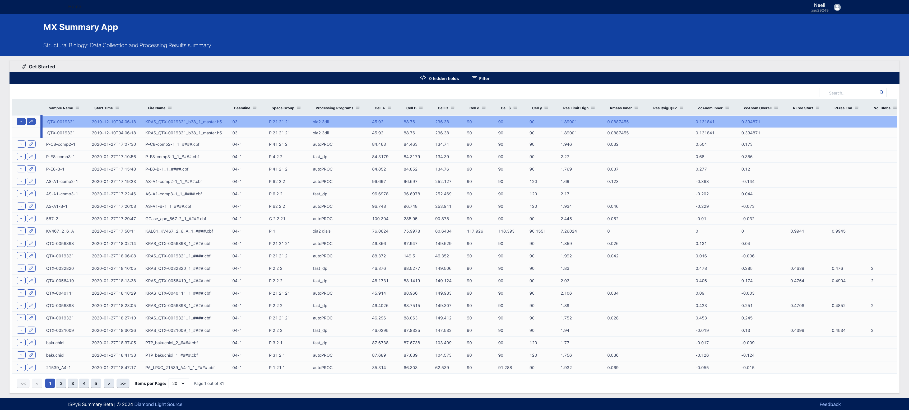

Slide 5
K04
One of three new beamlines designed to exploit the Diamond-II capabilities
2 Key Objectives
Automate existing XChem screening programme at Diamond
Increase throughput to 10,000 samples a day
Programme split into 4 projects (Optics, End Station, AXL Lab, Software)
Beamline automation, multi-sample pins, new acquisition software, and acceleration of analysis processing essential to achieving high throughput
ISPyB will remain central to data management
Sample registration
Data Acquisition
Data Processing
Publishing
SynchWeb will not cope with data throughput
Traditional mail-in experiments will remain part of the offering

Slide 6
SynchWeb Evolution
Typescript, FastAPI, NextJS, React (React being the new framework of choice for new applications at Diamond)
Monorepo structure – divided between science areas for separate deployments and compartmentalisation
Deployment as a Helm chart, rolling updates, near-zero downtime
Incremental replacement of SynchWeb functionality
Integration with other tools (sample shipping, sample handling...)

Slide 8
Thank you

