Slide 2
Reflective vs Reflectionless RF filters in BPM front ends
G. Brajnik, S. Cleva – Elettra Sincrotrone Trieste

Slide 3
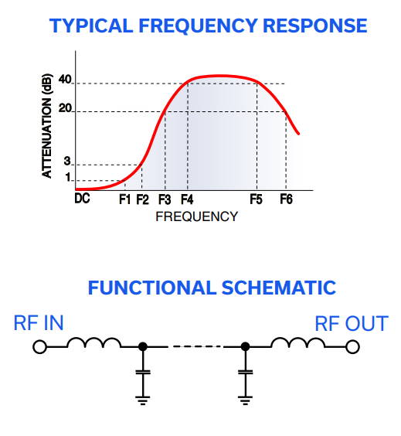
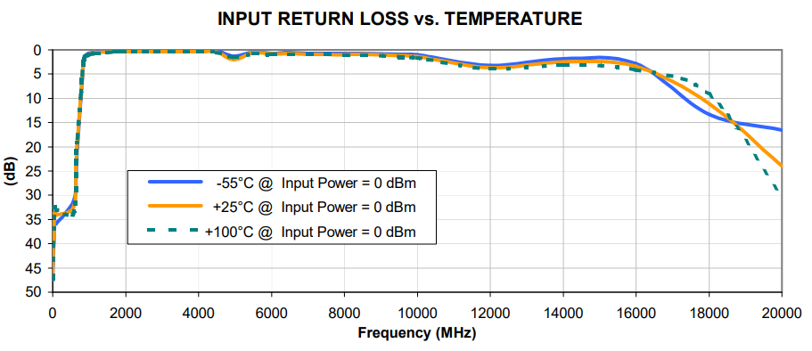
Traditional RF filters
Traditional filter designs employ circuits which reject undesired signals by reflecting them back to the source
Simple example: lowpass lumped LC filter
Stopband signals (above cutoff frequency) are sent back to the source: shunt capacitor is a short circuit
Different reflection coefficients (S11) for every frequency
There is no “dissipative” element
LF path
HF path

Slide 4
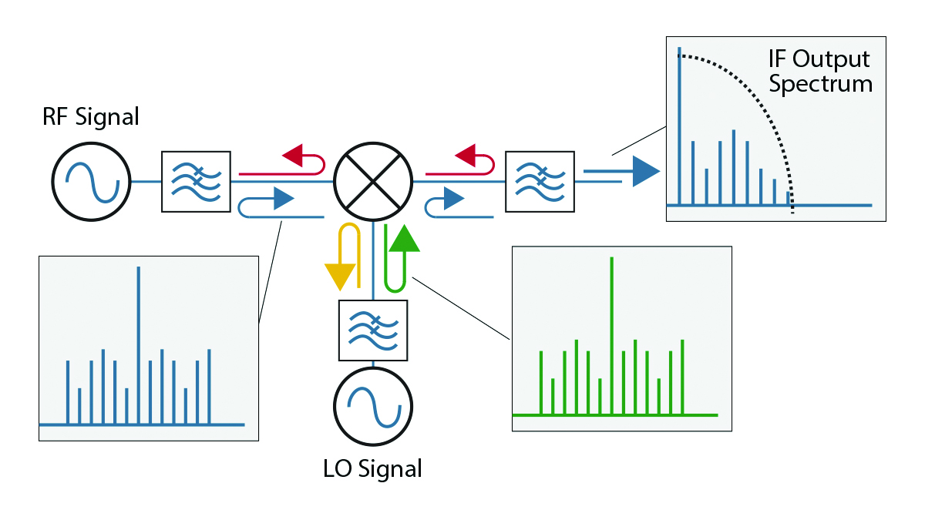
Traditional RF filters
Advantages:
Well-known design methodology
Reduced number of components
Disadvantages
Stopband energies are travelling back to the source
If the latter is an active component (amplifier, ADC) or a mixer, degradation of SFDR/IMD can occur

Slide 5
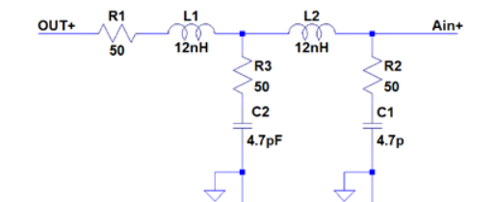
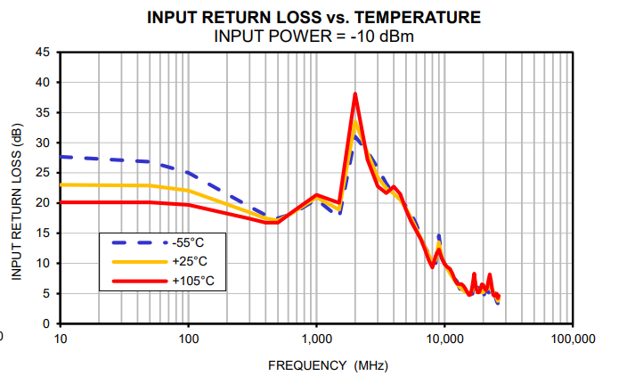
Reflectionless (absorptive) filters
Stopband signals are dissipated inside the filter itself
Different paths assure energy absorbing by resistors
Reduced reflection coefficients for unwanted frequencies
“flat” S11 parameter
LF path
HF path

Slide 6
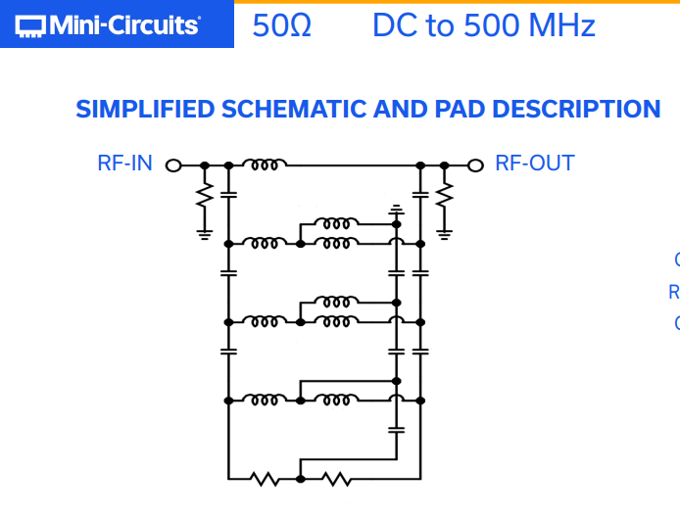
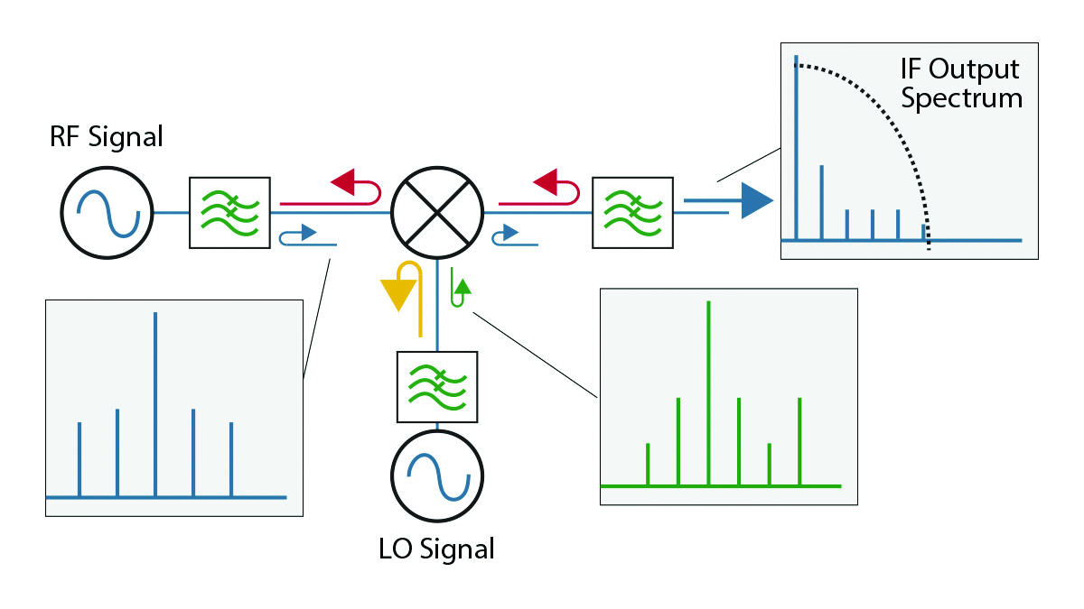
Reflectionless (absorptive) filters
Advantages:
SFDR / IMD increased, as well as linearity
Reduced power consumption for some amplifier classes
Disadvantages
More components involved
Complex design
Resistors can increase in-band noise

Slide 7
Applications
Telecomunications, digitizers
BPM electronics -> is a narrowband AM digital radio
Lowpass and bandpass filters inside analog front end / input stage
What happens to out of band energy?
Quick look to spectrum generated by the beam: slides from “Bunch length monitoring using a spectrum analyzer”, J. Banuelos et al., DEELS23

Slide 8
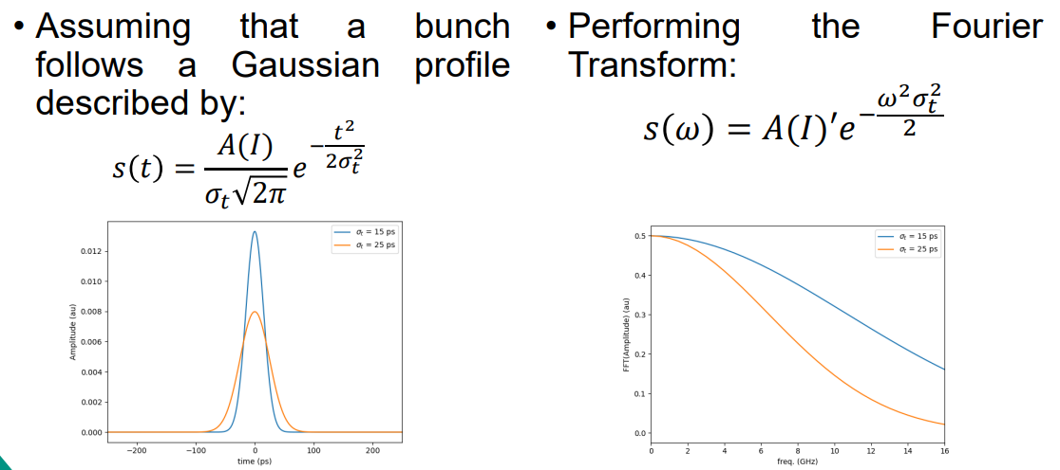
Generated spectrum
Generated spectrum:

Slide 9
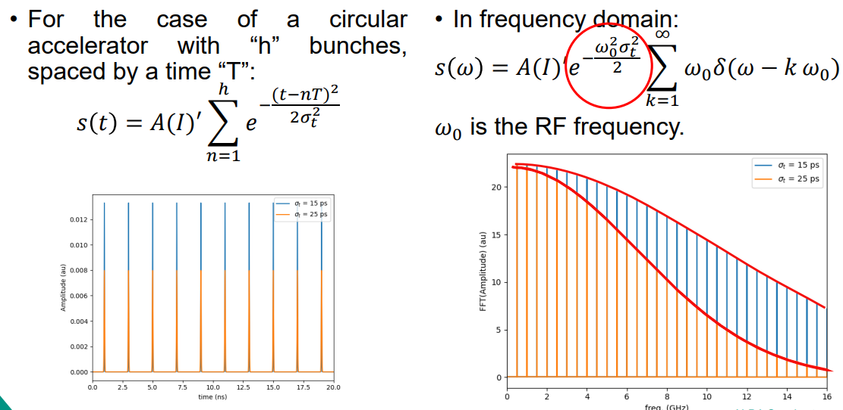
Generated spectrum
Generated spectrum:

Slide 10
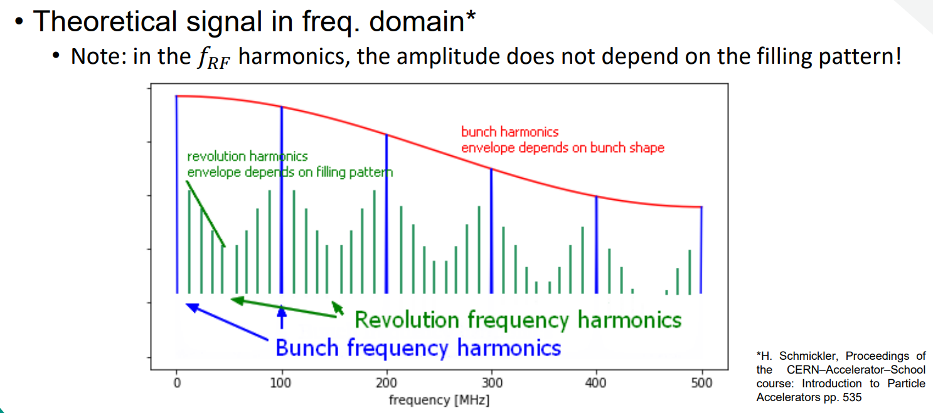
Generated spectrum
Generated spectrum:

Slide 11
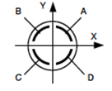
Topics
Upper frequency limit (cutoff) depends on bunch length
Pick-ups typically have a high pass characteristic
The reflected energy lies in the upper part of the spectrum and is going back to the pickup
Putting analog front ends nearer to the pickups can reduce the (beneficial?) attenuation of cables
“LF” path
CABLES
FILTERS
AMP
“HF” path

Slide 12
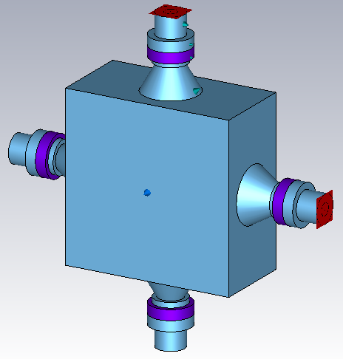
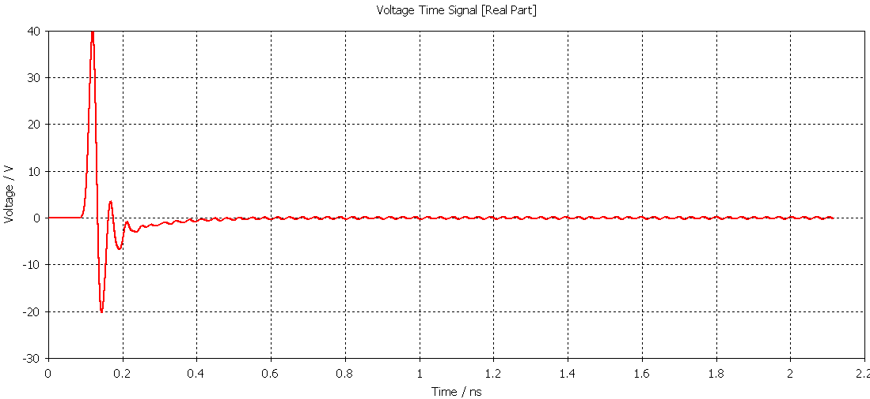
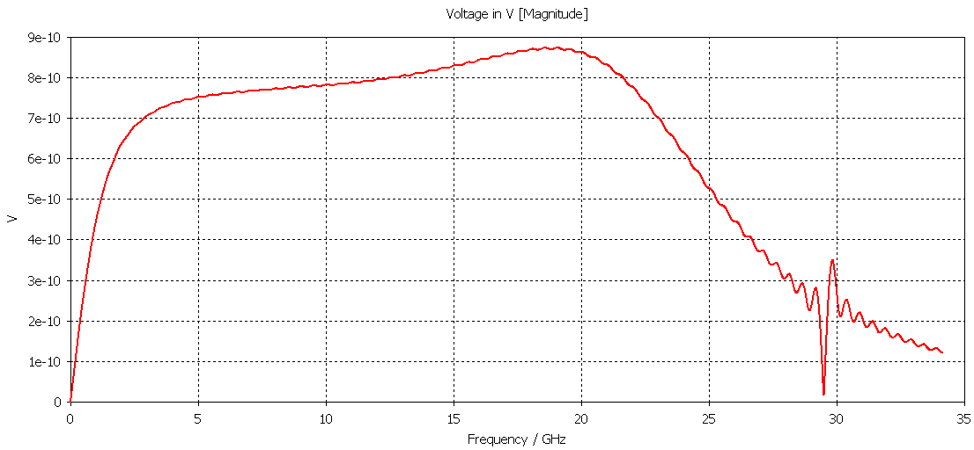
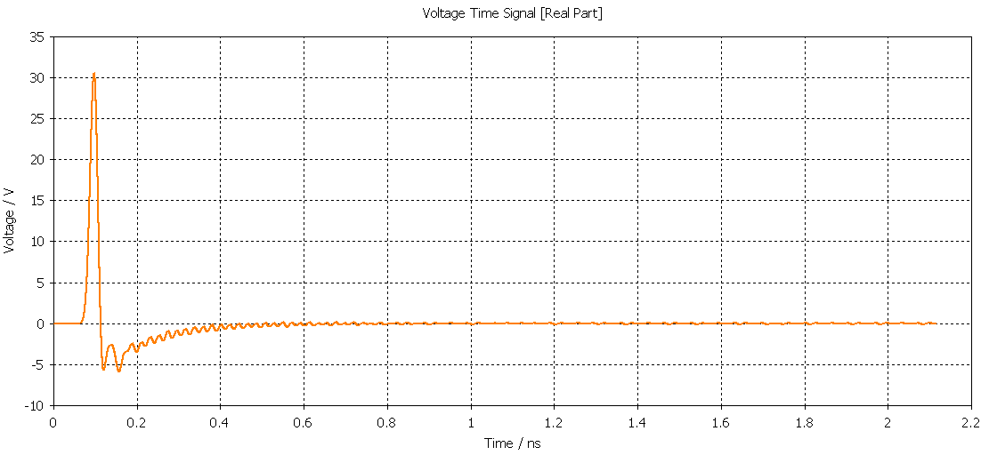
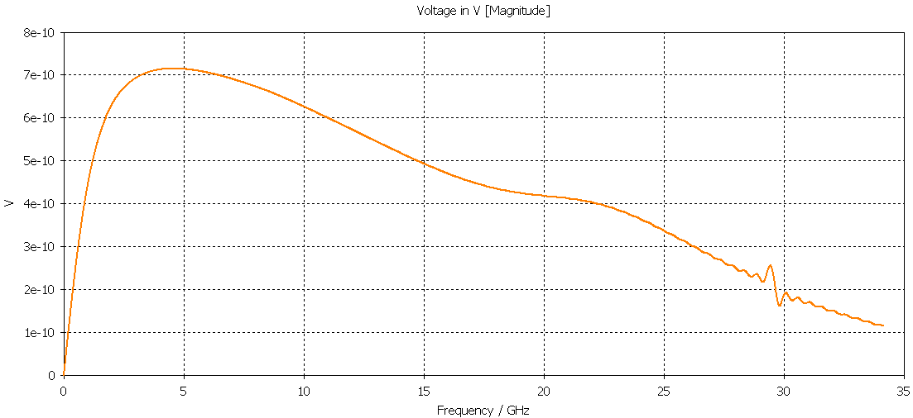
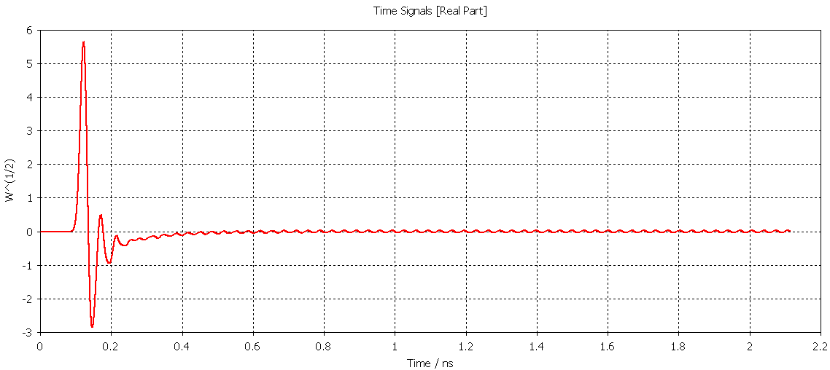
Electromagnetic simulations
Beam Coupling Impedance and Transfer Impedance are affected by pick-ups termination conditions
Nominal operation: RF ports are 50 Ohm terminated (short run)

Slide 13
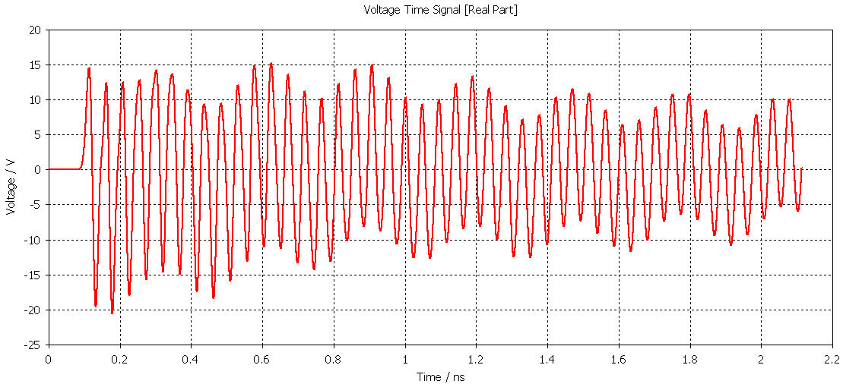
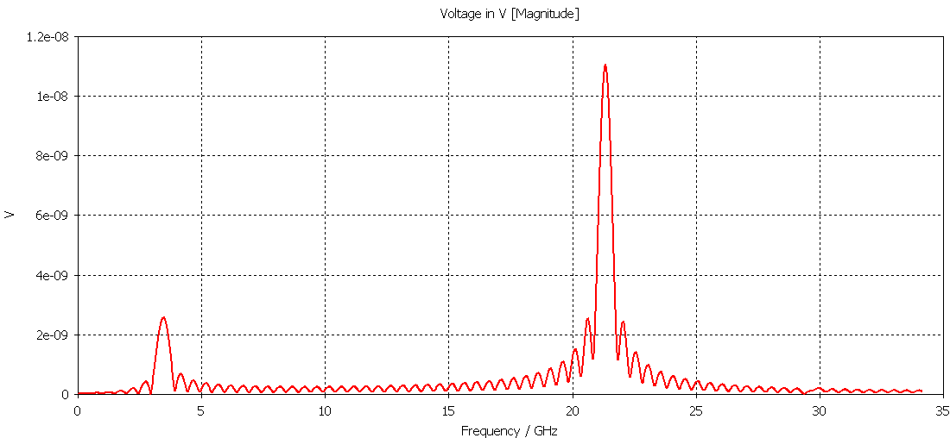
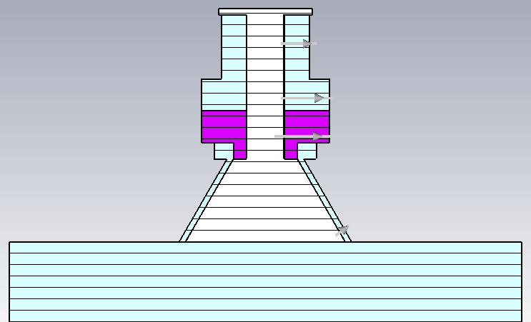
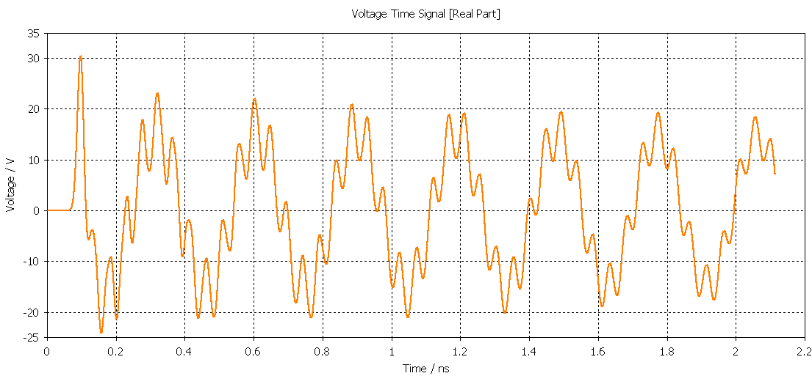
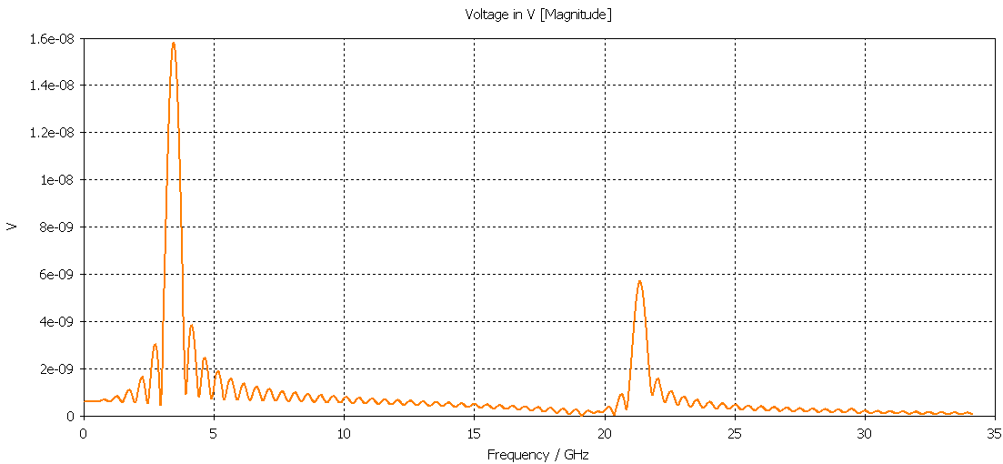
Electromagnetic simulations
RF ports are short circuited by conducting disks (short run)

Slide 14
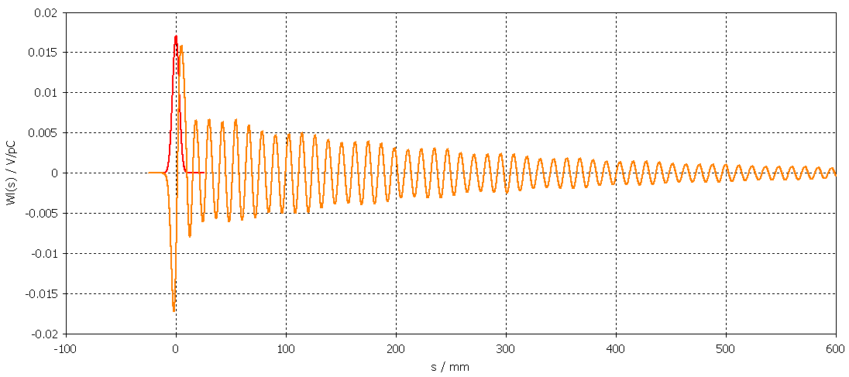
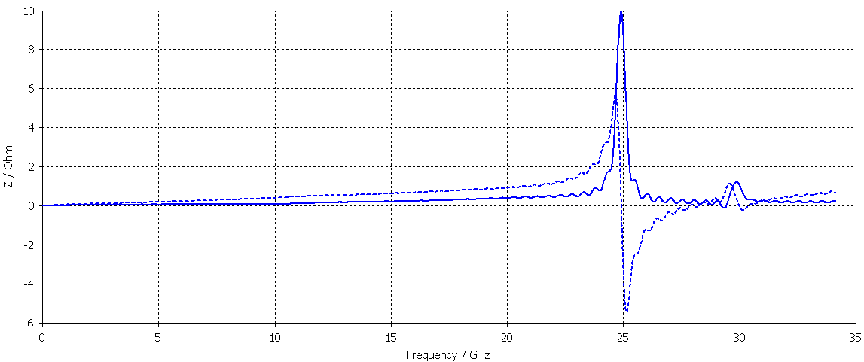
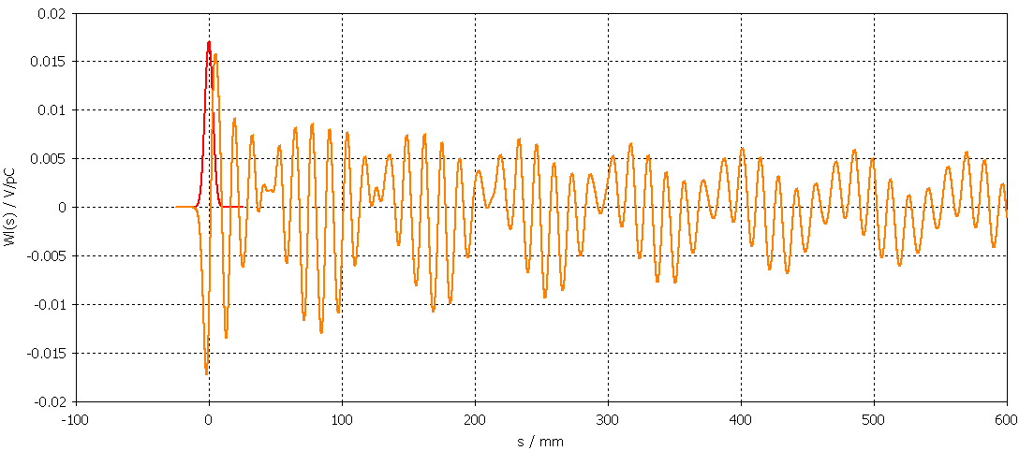
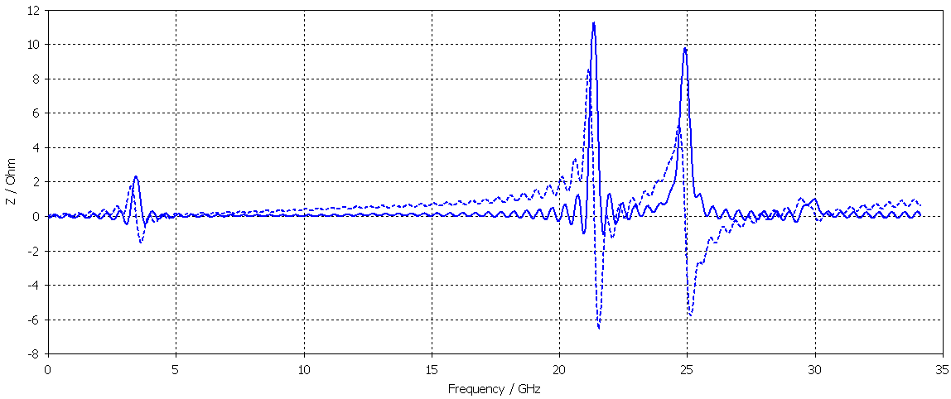
Electromagnetic simulations
Comparison between wake potential and coupling

Slide 15
Questions
Can we quantify the energy extracted and the reflected respectively by the pickup and the filter?
What could be the effect of the reflected energy?
Pickup heating?
Contamination of signal seen by BPMs electronics?
Is this something we need to be concerned about?

