Slide 2
Photon BPMs using SiC devices in photoconductive mode
Matija Colja, G. Brajnik, G. Cautero, D. Giuressi
Elettra Sincrotrone Trieste
Notes:
Good morning, everyone. I’m Matija Colja, I’m an electronic engineer of the Instrumentation and detectors laboratory from Elettra Sincrotrone Trieste and I will talk about “photon beam position monitors based on silicon carbide devices in photoconductive mode”.
I will start with a brief introduction on photon beam position monitors in general and then I will move to the description of the developed PBPM and preliminary results.

Slide 3
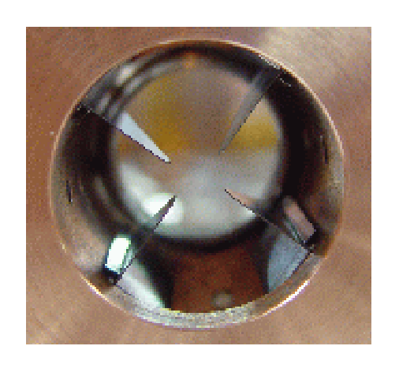
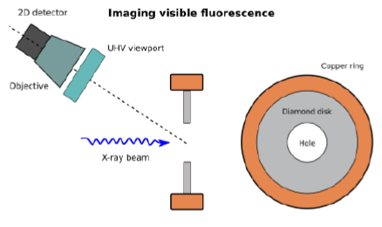
Introduction
PBPM types
metallic blades (photoemission)
photoconductivity, photodiodes (e-/h+ generation)
thin film, screen-based PBPM (fluorescence, scattering)
…
position estimation
4 sensors → center of mass/difference over sum
multiple detectors → imaging
[Krempaský, J., and M. Dehler. "Impact of noise floor and structure vibrations on the photon beam stability at the SIS beamline." (2002)]
Notes:
Photon Beam Position Monitors (PBPMs) are an important diagnostic tool used in scientific facilities to precisely measure and track the position of photon beams. The operation of these monitors relies on a variety of fundamental physical phenomena arising from the interaction of photons with matter, which differ depending on the type of beam and the specific technology employed.
For example, conventional BPMs use metallic blades that interact with the edges of the photon beam through the photoelectric effect and generate a current proportional to the amount of beam intercepted by each blade. By comparing the signals from multiple detectors arranged around the beam path, the precise center of the beam can be estimated.
However, achieving a precise and reliable measurement is not always straightforward.

Slide 4
PBPM challenges
distinguish between bending magnet (BM) and insertion device (ID) radiation
non-destructive operation (usable during user beamtime)
Additional complexities introduced by next-generation machines:
higher power dissipation
absence of beam “tails” to intercept
Notes:
Several factors can challenge the accurate determination of the photon beam's position
One significant concern is beam contamination from bending magnets and higher harmonics generated by the insertion devices itself which can introduce unwanted radiation that can overlap with the ID beam. For this reason there is the need to distinguish different radiation sources.
Secondly, an important requirement is non-destructive operation, allowing continuous monitoring without interrupting valuable user beamtime.
The latest generation of synchrotron sources introduces further complexities. The increased beam power leads to higher power dissipation issues within the PBPM itself. Effective cooling mechanisms and careful material selection are crucial to mitigate these problems. Furthermore, to safeguard downstream optics and experimental equipment from the intense radiation, collimators are typically placed immediately after the beam source. These collimators intercepts the outer portions of the beam removing the beam tails and allowing only the central core, to propagate. In these cases, traditional methods that relied on detecting the signals from the beam tails are no longer feasible
Addressing these challenges is an active area of research in synchrotron science and technology, driving the development of new materials and innovative designs.

Slide 5

Why SiC?
Property | Unit | Si | SiC (4H) | CVD diamond
Band gap | eV | 1.12 | 3.26 | 5.47
Resistivity | Ω cm | ≈10⁵ | ≈10¹⁰ | >10¹²
Electron mobility | cm² V⁻¹ s⁻¹ | 1500 | 800-1000 | 1800
Hole mobility | cm² V⁻¹ s⁻¹ | 500 | 115 | 1200
Saturation velocity | um ns⁻¹ | 100 | 200 | 270
Relative permittivity |  | 11.7 | 9.7 | 5.6
Energy to create electron-hole pair | eV | 3.6 | 5-8 | 13
Mass density | g cm⁻³ | 2.3 | 3.2 | 3.5
Breakdown electric field | MV cm⁻¹ | 0.3 | 3 | 10
Thermal conductivity | W cm⁻¹ K⁻¹ | 1.5 | 4.9 | 22
→ lower leakage current → better SNR
→ can handle higher photon fluxes
[Kimoto, Tsunenobu, and James A. Cooper. Fundamentals of silicon carbide technology: growth, characterization, devices and applications. John Wiley & Sons, 2014.]
Notes:
Among the most promising and studied materials are Silicon Carbide (SiC) and CVD diamond (C). While diamond exhibits superior properties in certain aspects, its fabrication processes are not as well-established as those for SiC. This translates to higher costs and also to limited availability of large-area wafers.
Instead, SiC carbide fabrication processes are more consolidated. Moreover, a nearby Austrian research center, the “Silicon Austian Labs”, specializes in its production and it is interested in scientific collaboration with us. For these practical reasons we decided to focus on SiC.
Compared to silicon, SiC offers still a compelling combination of properties that make it adequate photon beam position monitor applications.
Firstly, SiC has a wider bandgap than silicon. This results in a significantly lower thermally generated leakage current. This leads to a better signal-to-noise ratio and improved sensitivity of the pBPM.
Then, SiC exhibits higher thermal conductivity which allows SiC to handle higher photon beam power loads.
Furthermore, SiC is more radiation hard than silicon. This makes it more resilient to the radiation environment within synchrotron beamlines, leading to a longer operational lifetime and improved reliability of the detector.
SiC has also a very high resistivity, which makes it suitable for detection based on photoconductivity process.

Slide 6
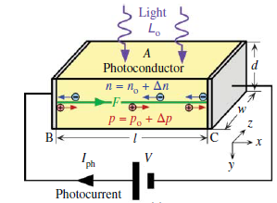
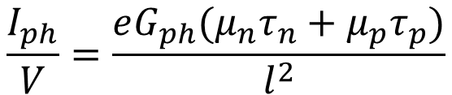
Photoconductivity
Photoconductivity = change in the conductivity of a semiconductor upon illumination
$$\frac{I_{ph}}{V}=\frac{eG_{ph}(μ_{n}τ_{n}+μ_{p}τ_{p})}{l^{2}}$$
[Kasap, Safa, ed. Photoconductivity and Photoconductive Materials: Fundamentals, Techniques and Applications. Wiley-Blackwell, 2022.]
Notes:
Photoconductivity is a phenomenon where the electrical conductivity of a material increases when it absorbs photons.
In particular, when photon beam strikes the sensor material, photons are absorbed, creating electron-hole pairs within the material. The generation of these charge carriers increases the electrical conductivity of the illuminated region of the sensor. In high resisitivty materials, like SiC, even a small increase in conductivity due to photogenerated carriers can result in a significant relative change, which translates in a higher sensitivity.
To use this effect for beam position monitoring, we apply a bias voltage across the sensor. The generated electron-hole pairs are drifted by the electric field, resulting in a measurable current. This current depends on the photo-generation rate, mean lifetime of carriers and applied voltage.

Slide 7
Developed PBPM
Notes:
We now proceed to describe our specific implementation

Slide 8

Detector
material: 4H-SiC
dimensions: 5 mm × 10 mm × 0.5 mm
electrode material: nickel
electrode thickness: 150 nm
supplied by Silicon Austria Labs
10 mm
5 mm
Notes:
As mentioned before, our PBPM design is based on silicon carbide, in particular on the sSiC-polytype 4H. This specific polytype of SiC, compared to other common polytypes (like 3C and 6H), has a higher bandgap and a higher thermal conductivity, which make it appealing for BPM applications. The detector has dimensions of 5 millimeters by 10 millimeters in area and a thickness of 0.5 millimeters.
Again, these highly pure and processed SiC detectors are supplied by the Silicon Austria Labs, with whom we maintain a technical-scientific collaboration to study this material in PBPM applications.

Slide 9
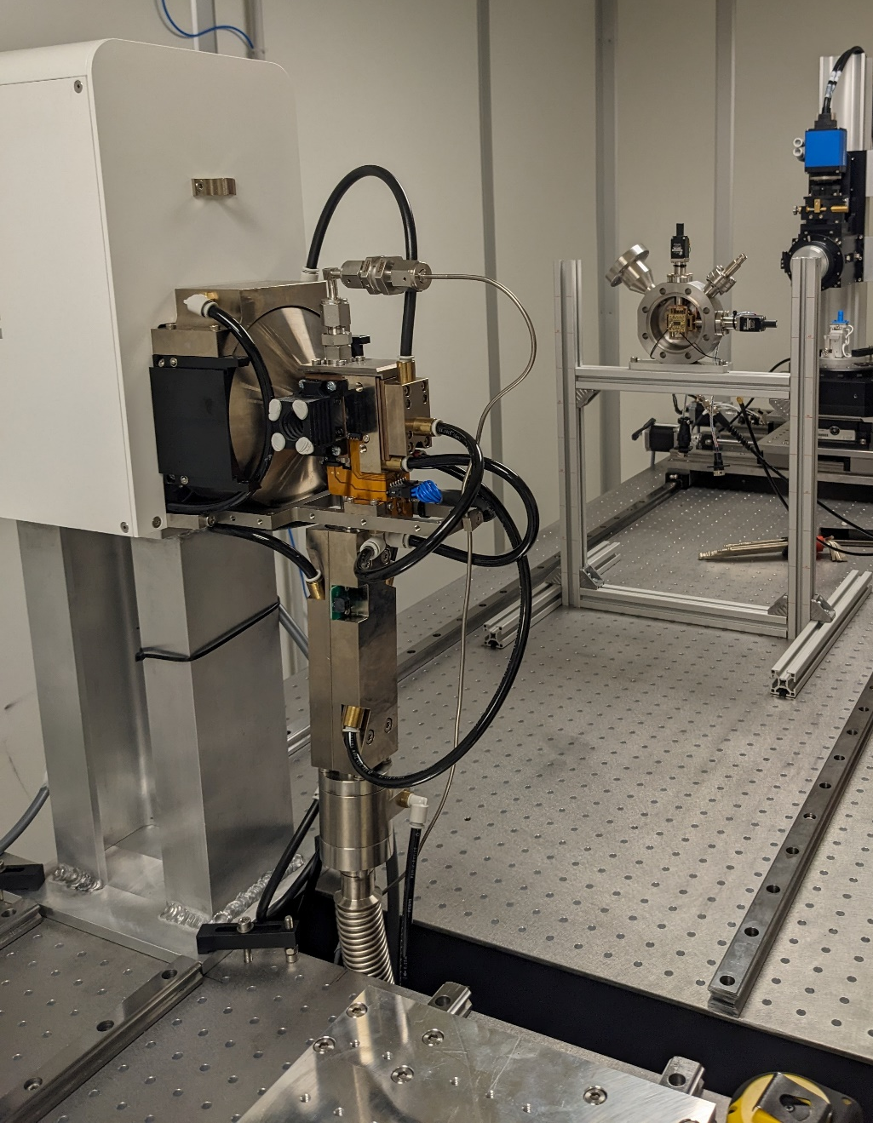
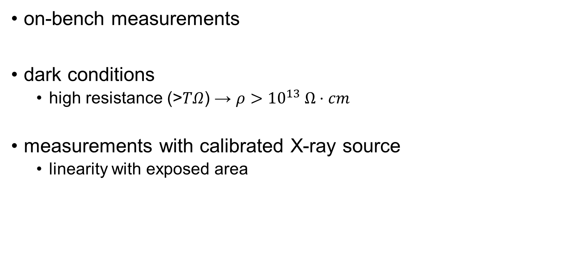
Detector characterization
on-bench measurements
dark conditions
high resistance (>$TΩ$) → $ρ>{10}^{13} Ω⋅cm$
measurements with calibrated X-ray source
linearity with exposed area
SiC
detector
X-ray source
Notes:
Before deploying our detectors in a synchrotron environment, we conducted laboratory and on-bench characterization to understand their fundamental electrical properties.
Our initial measurements revealed a very high resistivity in dark conditions. This confirms the wide bandgap characteristic, leading to minimal leakage current and a low noise floor, which is crucial for achieving high sensitivity.
We conducted also measurements with a calibrated X ray source, which demonstrated a strong linearity between the generated photocurrent and the exposed area of the detector. This linear response is essential for accurately determining the beam's size and position.
These initial laboratory results were highly encouraging and provide a strong foundation for the next stage of our work, which involves testing the detectors under real synchrotron beam conditions.

Slide 10
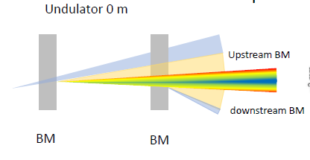
PBPM concept
goals:
discriminate BM and ID radiation
non-invasive measurement
multiple detectors
intercept beam tails only
4×2 detector matrix
BM downstream
ID
BM upstream
10
Notes:
To address the challenges of discriminating between different radiation sources and achieving non destructive operation, our concept is to use a detector matrix integrated with the initial collimator. This strategic placement allows us to intercept all photons from the various radiation sources before any beam shaping. By intercepting only the beam tails and exploiting the different spatial distribution of different radiation sources, we aim to effectively discriminate between these different sources.

Slide 11
PBPM concept
goals:
discriminate BM and ID radiation
non-invasive measurement
multiple detectors
intercept beam tails only
4×2 detector matrix
BM downstream
ID
BM upstream
measure only
downstream BM
measure only
upstream BM
11
measure
mainly
ID
Notes:
As illustrated here with a 4by 2 matrix, the outer detectors are specifically placed to exclusively intercept the contribution from the BM radiation. Conversely, the central detectors are positioned to be more sensitive to the core of the beam, which is dominated by the typically more focused radiation from the Insertion Device. By analyzing the relative signal intensities from the outer and central detectors, we can gain insights into the individual contributions.
Furthermore, our design has a non-invasive measurement approach. By positioning the detectors directly on the collimator to intercept only the edges of the beam, we minimize any perturbation to the main beam intended for the experiment. This ensures that our PBPM can operate continuously in real-time without affecting the downstream experimental data.

Slide 12
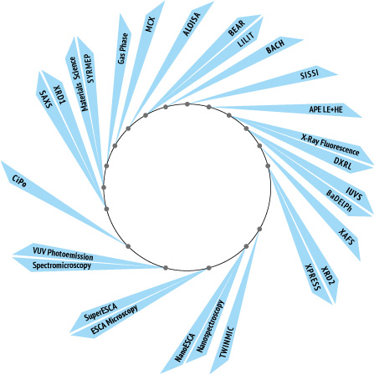
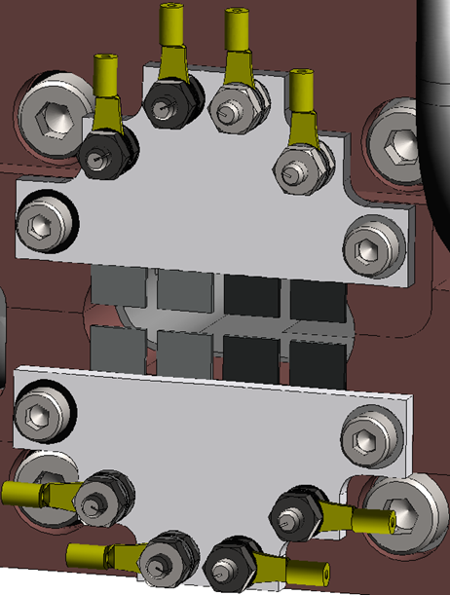
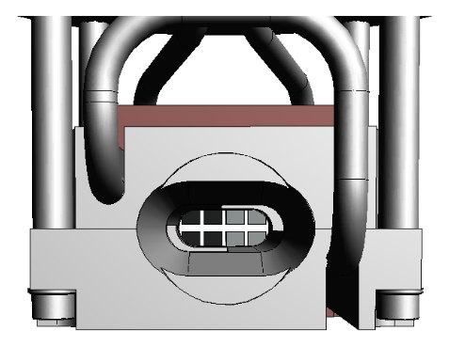
Installation
reuse existing PBPM holders in front-end 3.2
XY translation stage
limitations:
small area exposed
partially cooled
Elettra
beam
Notes:
To implement our 4x2 detector matrix, we chose to reuse existing PBPM holders already available at the synchrotron facility. These holders are equipped with precise XY translation stages, which provide the necessary mechanical flexibility for aligning and positioning our detectors within the beam path.
Reusing an existing infrastructure reduced the implementation time by avoiding a completely new mechanical design. However, this decision also introduced certain design constraints. The existing geometry required mounting our detectors on the back of the holder assembly. This mounting configuration, coupled with the need to maintain a non-invasive measurement, meant that we could only expose a small area of each detector to the edges of the photon beam.
Another important consequence of the back-mounting configuration is that the exposed detector area is not directly cooled and may experience high localized heat loads.

Slide 13
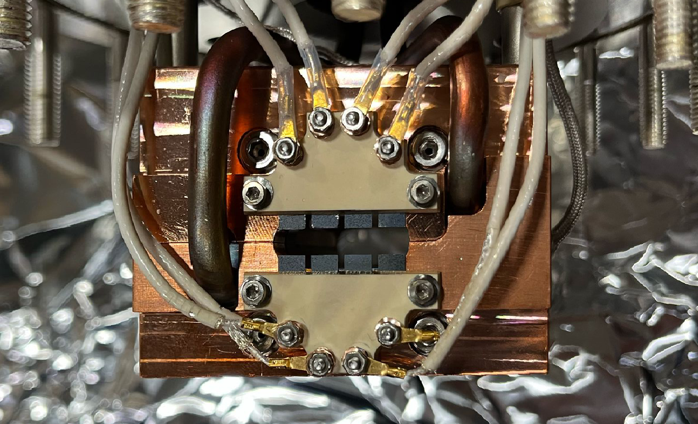
Developed PBPM
Notes:
This slide shows the actual prototype of our Photon Beam Position Monitor. You can see the 4x2 matrix of SiC detectors mounted on the existing PBPM holder, ready for installation and testing at the synchrotron beamline.

Slide 14
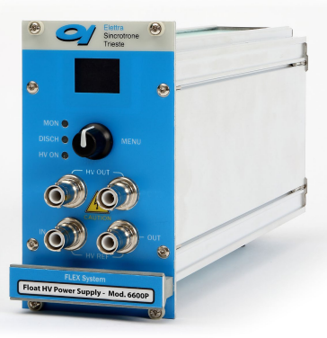
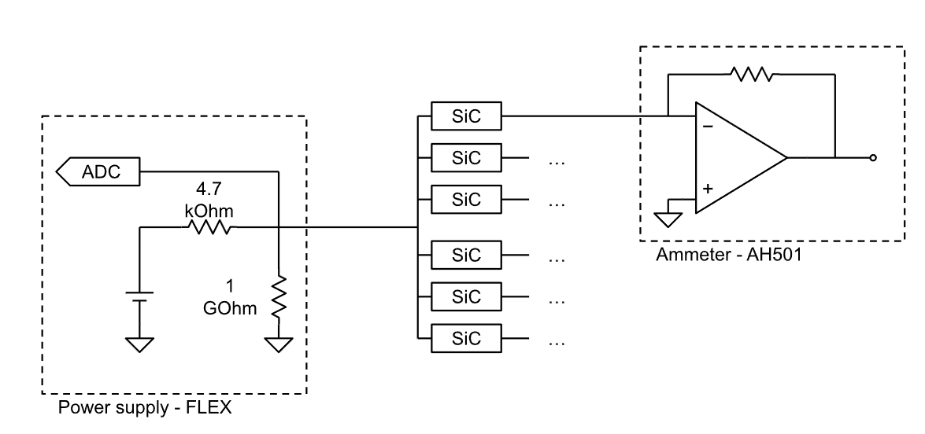
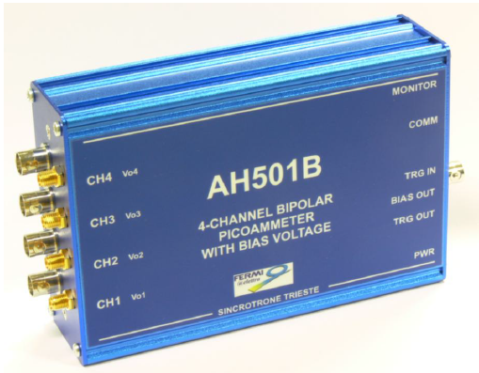
Readout electronics
Variable gain
Notes:
This schematic outlines the core of our readout electronics designed to precisely measure the photocurrent generated by each of the eight detectors.
As you can see, a stable power supply provides the necessary bias voltage across all the detectors. On the opposite side of each individual detector, we have inserted a dedicated transimpedance amplifier (TIA) that converts the currents generated by the photoconductive process into a measurable voltage signal.

Slide 15
Preliminary results
Notes:
Now, we move on to the preliminary results obtained from our initial measurement campaign at the synchrotron beamline.

Slide 16
Measurements overview
period of measurements: January 2025
Elettra parameters
energy: 2 GeV
storage ring current: 300 mA
filling pattern: multibunch (95%)
types of measurements
scans: i(x), i(y), i(x,y)
transients: i(t)
parameters
bias voltage
ID gap
ID tilt
Notes:
For completeness, this slide briefly outlines the experimental context. We report key machine parameters defining the beam conditions, the types of measurements we performed to evaluate our PBPM, and the parameters that were changed during these measurements. This background information provides essential context for understanding the results we'll now discuss.

Slide 17
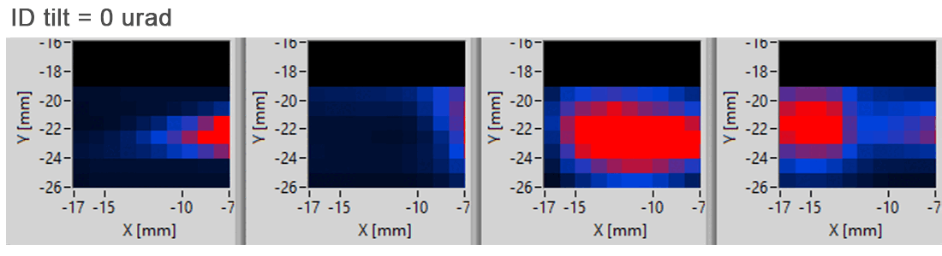
i(x,y) vs. ID tilt
V = 15 V
ID gap = 110 mm
ID tilt = {0 urad, 300 urad}
no significant changes
the spot moves upwards
Notes:
This slide presents bidimensional scans. For simplicity only the lower detectors are shown. These scans were performed with a fixed Insertion Device (ID) gap and a fixed bias voltage. We performed two measurements with two distinct ID tilt values: 0 microradians and +300 microradians.
As you can see in the animation below, a clear difference emerges in the detector responses. The detector positioned on the left exhibits a relatively stable signal. This behavior supports our hypothesis that these outer detectors are primarily sensitive to the Bending Magnet (BM) radiation, which is not affected by the changes in the ID tilt.
Conversely, the other three detectors show a more significant change in signal intensity and distribution as the tilt is applied. Specifically, the spot appears to move upward across these detectors. This demonstrates that the Insertion Device (ID) radiation is impinging on these detectors in a more localized manner and its position is directly influenced by the applied tilt.
With a better alignment of the beamline optics, we would be able to precisely direct the ID radiation on the two inner detectors.

Slide 18
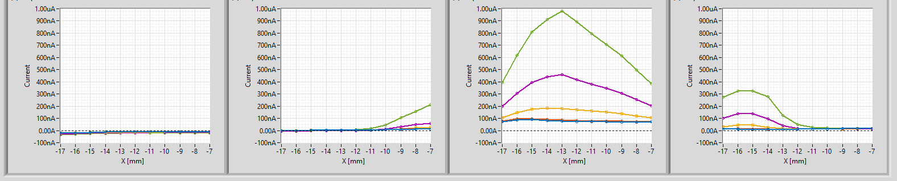
i(x) vs. ID gap
V = 15 V
ID tilt = 0 urad
ID gaps:
300 mm
200 mm
150 mm
125 mm
110 mm
Notes:
To further confirm our findings, we also performed measurements while varying the Insertion Device (ID) gap. In particular we performed horizonatal scans. These measurements consistently show that the ID radiation signal is predominantly detected by the inner detectors of our matrix. This confirms our understanding of the spatial separation and the potential for selective measurement of different radiation sources with our PBPM design.

Slide 19
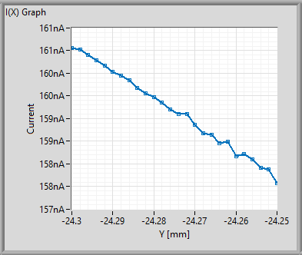
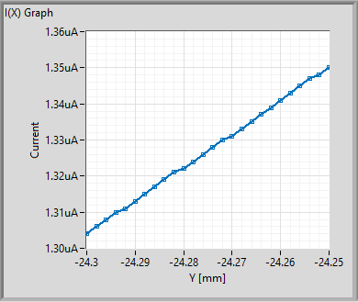
i(y)
V = 15 V
ID gap = 110 mm
ID tilt = 0 urad
movement
50 µm scan
2 µm steps
Notes:
We proceeded to evaluate the sensitivity of our PBPM to small beam displacements. To do this, we first carefully aligned the central core of the Insertion Device (ID) beam to the approximate center of our 4x2 detector matrix. Next, we performed precise small vertical scans of the PBPM across the beam. During these controlled movements, we measured the change in current by each of the eight detectors.
We observed a clear and consistent trend: when we moved the PBPM downwards, the upper sensors registered a corresponding decrease in the measured photocurrent. Conversely, the lower sensors detected a increase in current.
By analyzing the magnitude of the current change in relation to the known step size of our vertical scans, we were able to estimate the sensitivity of our PBPM. From these measurements, we obtained a promising preliminary sensitivity of approximately 2 microns.

Slide 20
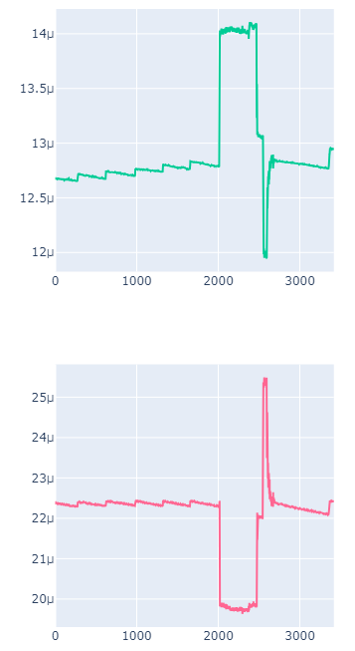
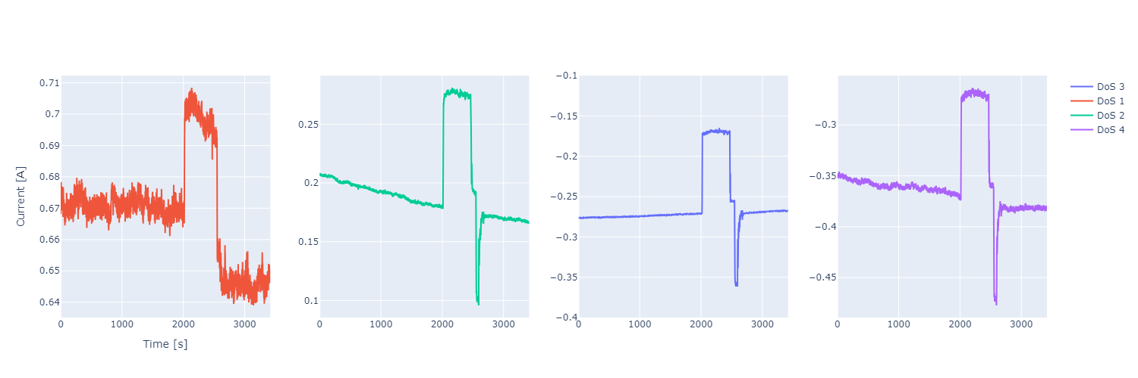
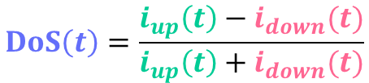
i(t) + DoS algorithm
orbit
correction
$$DoS\left(t\right)=\frac{i_{up}\left(t\right)−i_{down}(t)}{i_{up}\left(t\right)+i_{down}(t)}$$
Current [A]
top-ups
Time [s]
DoS [a.u.]
Current [A]
Time [s]
Notes:
This slide presents a time evolution of the signals recorded by our PBPM over a significant period, approximately one hour.
The two graphs on the left display the raw current measurements from two representative detectors. Notice the small, simultaneous increases in current visible in both signals. These correspond to "top-up" events (“ivènt”) , a common operation in synchrotron facilities where the electron beam current in the storage ring is replenished, leading to a slight increase in the emitted photon flux across the beamline. Importantly, these top-up events show correlated changes in both sensors, indicating a global intensity variation rather than a beam position shift.
Towards the end of this measurement period, you can observe a more significant change in the raw current signals. The current in one sensor increases while the current in the other decreases. This behavior indicates a real movement of the photon beam. This event corresponds to an orbit correction performed by the synchrotron operators to stabilize the beam's trajectory.
The right graph was obtained combing the two current measurements with the DoS method. This technique normalizes out common-mode fluctuations, and as you can see, the top-up signatures are significantly suppressed in this processed signal, demonstrating that the beam's position remained stable during these events.
However, the orbit correction performed at the end of the measurement is still clearly visible. This confirms that the change in raw currents at that time was indeed due to a beam displacement.
This analysis highlights the effectiveness of our PBPM and the signal processing techniques in distinguishing between intensity fluctuations and actual beam movements over extended periods."

Slide 21
Conclusions
further data analysis required
promising preliminary results
discrimination BM and ID radiation intercepting beam tails
good sensitivity
additional measurements on a differente beamline in the last Elettra run
Notes:
To fully confirm and provide more precise estimations of the system's performance, further data analysis is required. In any case, the preliminary results are encouraging and show that we are able to differentiate between ID and BM radiation by intercepting the beam tail only, obtaining a good sensitivity. Furthermore, this same system has been recently mounted on a different beamline for additional tests and will be tested in the last Elettra run.

Slide 24
Backup slides

Slide 25
Photoconductivity vs. photoemission
lower dependence on vacuum conditions
higher sensitivity to hard X-rays (higher e-/h+ generation cross section)
reduced sensitivity to low-energy background radiation [2021, M. Iabat]
higer currents compared to photoemission
Notes:
Photoconductivity-based PBPM offers several key advantages:
Firstly, vacuum is not strictly required for operation. Photoemission-based detectors typically require a vacuum environment for efficient electron emission and collection.. A photoconductive device can potentially operate in less demanding vacuum conditions simplifying the experimental setup and reducing complexity.
Secondly, photoconductivity can offer higher sensitivity to hard X-rays compared to the surface-sensitive photoemission process. This is because the absorption depth of hard X-rays is is high, leading to the generation of more electron-hole pairs within the active volume. This enhanced sensitivity can be particularly beneficial in reducing the influence of lower-energy.
Furthermore, Photoemission-based monitors are highly sensitive to low-energy photons, which can originate from sources like bending magnets and focusing optics. This background radiation can contaminate the position measurements, especially in undulator beamlines. Photoconductive detectors, are less sensitive to these lower energy photons, leading to more accurate measurements.
These benefits make this approach a compelling alternative to photoemission-based monitors in various synchrotron radiation applications.

Slide 26
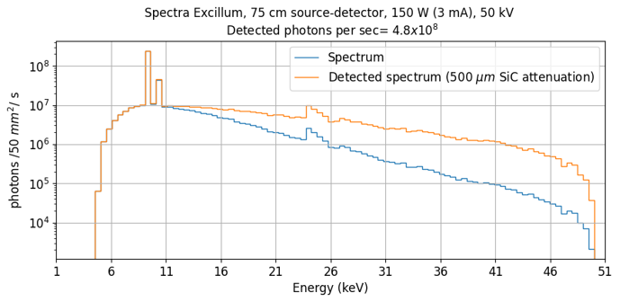
X-ray source specs
Excillum – MetalJet F
uses a liquid-metal jet anode instead of a solid-metal anode
primarily consisting of gallium, indium, and tin

Slide 27
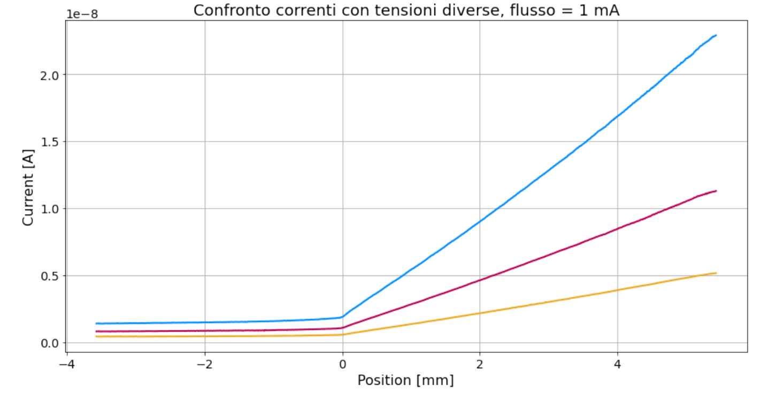
Notes:
The system was also tested with a minimum possible step size of 1 micron.
The measurements clearly indicate that the system is sensitive even to these small steps, suggesting that achieving sub-micrometer spatial resolutions may be feasible in the future.

