Slide 1
WP4 work plan presentation High repetition rate plasma structures
Angelo Biagioni | INFN | PACRI Kick off meeting
12 – 14 March Trieste

Slide 2
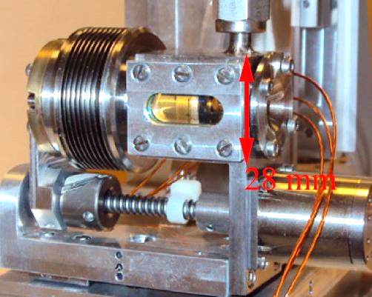
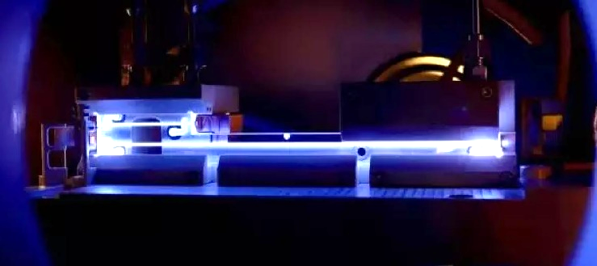
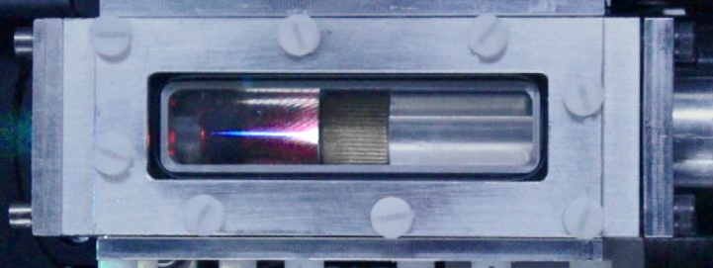
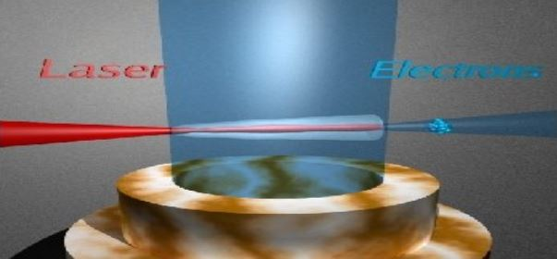
WP4 - High repetition rate plasma structures
Three key thematic areas have been selected for being addressed within PACRI
Plasma acceleration
RF normal conducting accelerator technology
High power, ultrashort pulse laser technology
Plasma acceleration
WP3 Plasma accelerator theory and simulations
WP4 High repetition rate plasma structures
WP5 Plasma Accelerator diagnostics and instrumentation
Discharge capillaries
Gas jets
HOFI Channels
Gas Cells

Slide 3
WP4 - High repetition rate plasma structures
We intend to explore the different target systems common in LWFAs and PWFAs: capillary discharges, gas jets, gas cells, and laser-induced plasma sources and address challenges for their development for high repetition rate and high average power operation.
This includes the vacuum and thermal management and the optimization of longevity (i.e., mitigate damage induced by lasers or beam drivers and discharges)
while optimizing the plasma structure for enhanced performance for high beam quality with dedicated MHD plasma codes developed in WP3.
Design and implementation of a plasma diagnostic to characterise the operation of plasma sources operating at high repetition
The development of plasma components requires access to specialized test benches and dedicated access to laser and accelerator facilities. In the proposal, this access is realized by fully leveraging in a concerted way significant past investments into infrastructures of the EuPRAXIA consortium and the know-how of specialized teams among the partner labs
Task 4.1: high-repetition rate Gas jet target development
Task 4.2: Development of a high-repetition rate gas cell structured target
Task 4.3 - Development of high-repetition rate plasma capillaries
Task 4.4 - Development of high-repetition rate advanced plasma sources

Slide 4
WP4 - Gas jet target
Task 4.1: high-repetition rate Gas jet target development (CNRS_loa-TL, UKRI, LMU, UOXF, ELI-ERIC)
The goal of this task is to develop gas jet-based plasma targets adapted to high-repetition rate operations. This includes:
Development, manufacturing and testing of nozzle geometries that provide structured longitudinal plasma profile for e.g., electron injection in shocks and downward ramps. The design will also be optimized in order to minimize the gas throughput in the chamber.
Development of the differential pumping scheme for high repetition rate operation. Tests on constant flow rate and investigation of high-repetition rate pulsed operation.
Tests on material wear when the plasma target is irradiated by a high repetition rate laser system

Slide 5
WP4 - Gas jet target
Gas targets for laser-plasma
accelerator at ELI Beamlines

Slide 6
WP4 - Gas cell structured target
Task 4.2: Development of a high-repetition rate gas cell structured target (CNRS-TL, IST, ELI-ERIC, DESY).
The aim of this Task is to develop a reliable beam line integrated gas cell target with tailored density profile and composition for ionization and down-ramp injection suitable for repetition rates from 10 Hz to 1kHz in the framework of high beam quality laser-plasma injectors for EuPRAXIA.
It includes test on 10Hz laser driver for electron acceleration and possibly kHz kW picosecond laser wear part resistance and thermal issue
A new type of gas cell with enhanced localized density step injection control aiming optimized operation for electron beams with high reproducibility, low energy dispersion, or high charge, will be developed and tested for 10 Hz laser drivers, this cell will also be redesigned for higher repetition rate operation.

Slide 7
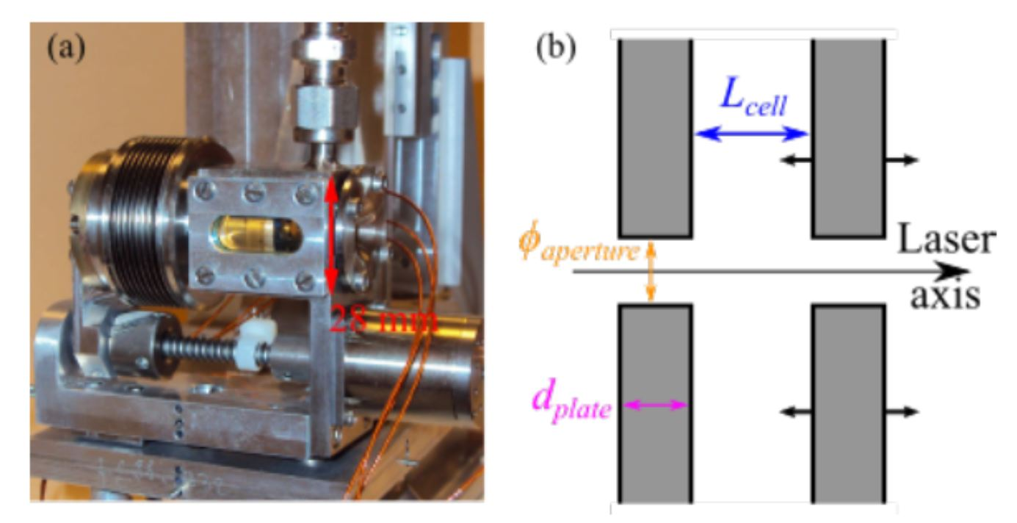
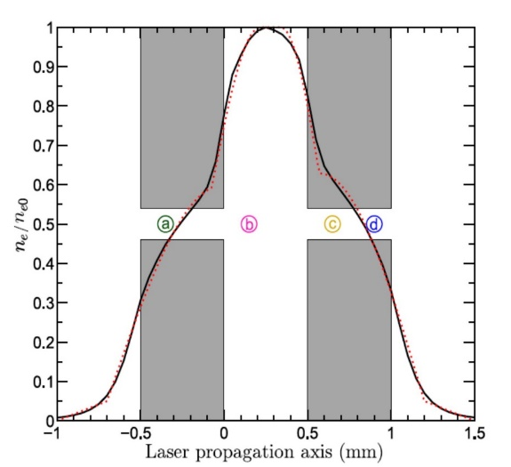
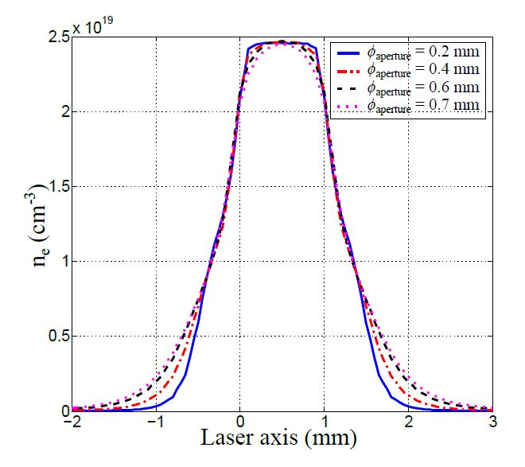
WP4 - Gas cell structured target
Steady-state-flow
Audet, T.L. et al. NIMA 909 (2018).

Slide 8
WP4 - Discharge capillaries
Task 4.3 - Development of high-repetition rate plasma capillaries (INFN-TL, DESY, UKRI, ELI-ERIC, UOXF, CLPU):
The goal of this Task is to develop discharge-based plasma capillaries capable to support their use as PWFA modules, LWFA waveguides, and active plasma lenses. It includes the construction of a plasma source optimized for EuPRAXIA applications including a full characterization of the spatial and temporal plasma density profile, and plasma temperature evolution while minimizing jitter of the system and maximizing longevity.
The realization of a segmented capillary for long (~40 cm) plasma channels will be investigated. Plasma sources utilizing segmented capillaries allow to obtain both m-scale dimensions and a plasma density modulation along the longitudinal coordinate. One focus of research will be to establish the synchronization between different sections.
The development and utilization of magnetohydrodynamic (MHD) simulations will be key to the optimization of key parameters in a high-repetition-rate plasma capillary e.g. inlet radius/shape/position/number, capillary radius, etc. Once an MHD-optimized capillary design exists, it will be tested with a to-be-developed solid-state discharge system.

Slide 9
WP4 - Discharge capillaries
Discharge capillaries for laser guiding at ELI Beamlines
Plasma
characterization

Slide 10
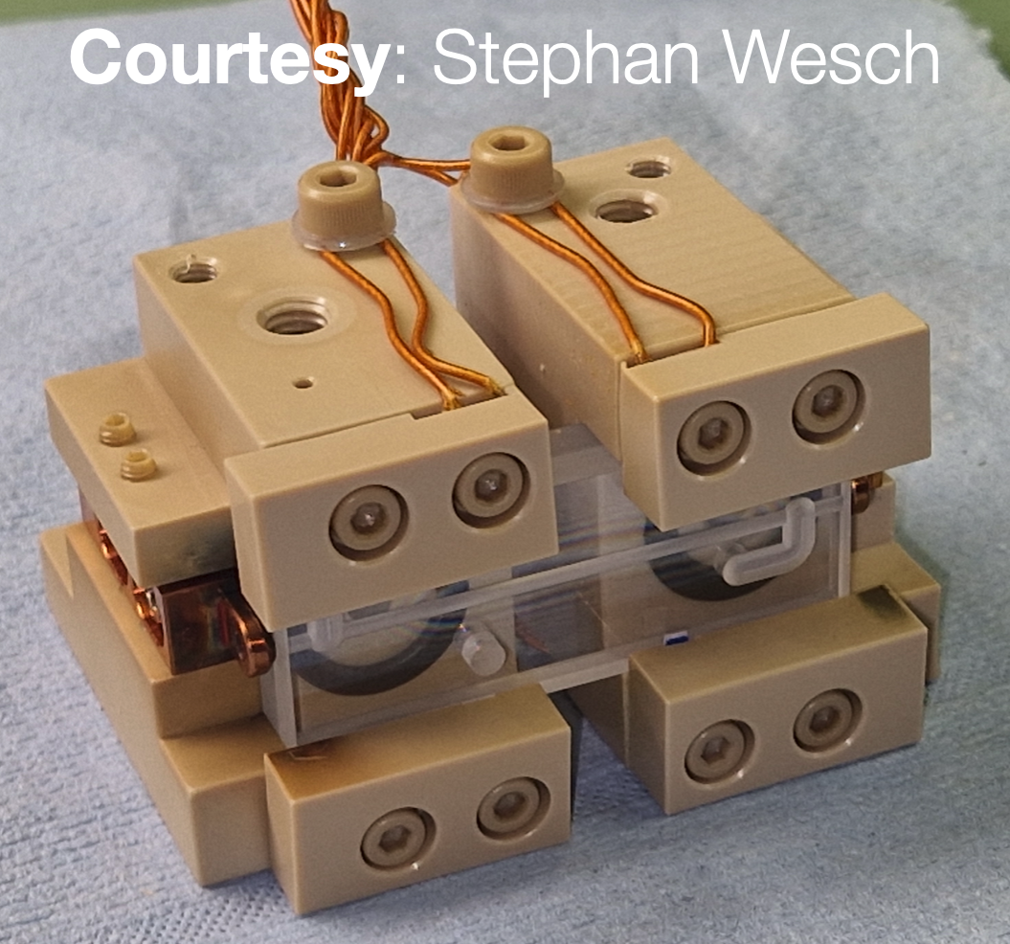
WP4 - Discharge capillaries
Goal: Oxford is developing novel diagnostics to measure the temperature evolution of the plasma and plasma source ➞ essential to understand the energy deposition from high repetition rate
150 Hz RepRate discharges at SPARC_LAB
x
x
Constraints: The principle is for all diagnostics to be all-optical for easy deployment at facilities e.g. EuPRAXIA
Next steps: Preliminary studies will be based around more conventional diagnostics e.g. thermocouples (see attached image) in collaboration with DESY
Spectral lines as a function of the longitudinal slices
x
x
Transverse Stark broadening method
to characterize non-transparent materials

Slide 11
WP4 - Advanced plasma sources
Task 4.4 - Development of high-repetition rate advanced plasma sources (UOXF-TL, INFN, UKRI, LMU, DESY):
The goal of this Task is to develop advanced-based plasma sources capable to support laser-induced plasma channels
Hydrodynamic Optical-Field-Ionized (HOFI) plasma waveguide (OPAL, CALA, CLF)
Plasma channel formation via filamentation (INF-LNF).
A plasma waveguide capable of operating at a repetition rate of 1 kHz will be developed
Long channels
Low wall interaction, long lifetime

Slide 12
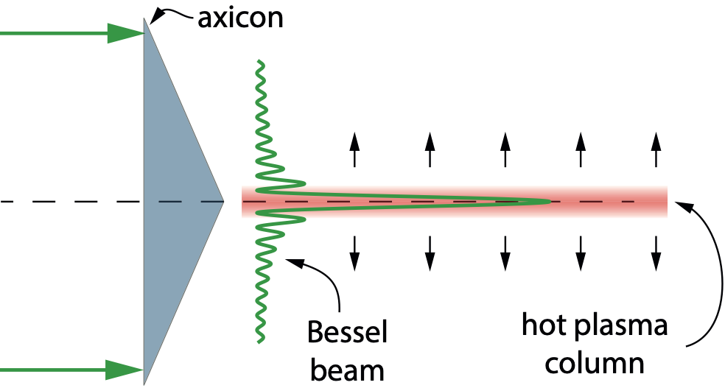
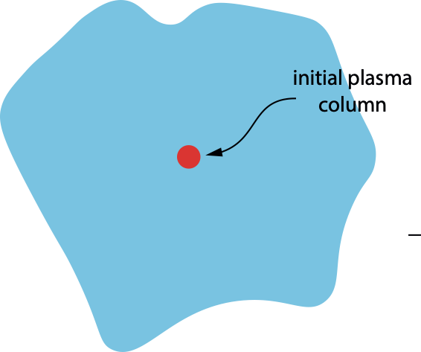
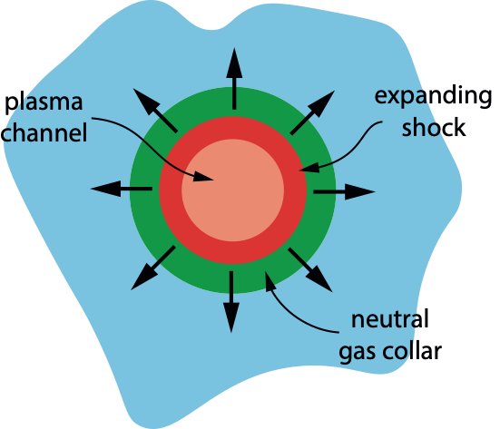
WP4 - Advanced plasma sources
HOFI Plasma channels
Long column of plasma generated by focusing pulse with axicon lens
Plasma column expands, driving shock wave & collar of neutral gas into surrounding gas.
Ionization of neutral collar by guided pulse creates deep, low-loss channel
Hydrodynamic optical-field-ionized (HOFI) plasma channels offer many benefits:
Long (> 100 mm) guiding structure
Low on-axis density ($∼{10}^{17}{cm}^{−3}$)
Free-standing: “indestructible” & capable of high rep. rate
Several key properties demonstrated:
Guiding > 100 mm
Picksley et al. Phys Rev Acc. Beams 23 081303 (2020)
Miao et al. Phys. Rev. Lett. 125 074801 (2020)
Feder et al. Phys Rev. Res. 2 043173 (2020)
Operation at kHz rep. rate (short channel)
Alejo et al. Phys Rev Acc. Beams 25 011301 (2022)
Down-ramp injection at channel entrance
Picksley et al. Phys. Rev. Lett. 131 245001 (2023)
Multi-GeV acceleration
Miao et al. Phys Rev X 12 031038 (2022)
Picksley et al. Phys. Rev. Lett. 133 255001 (2024)
Shallow
HOFI channel
Guided pulse
Deep, low-loss
plasma channel
Simon Hooker
University of Oxford
12

Slide 13
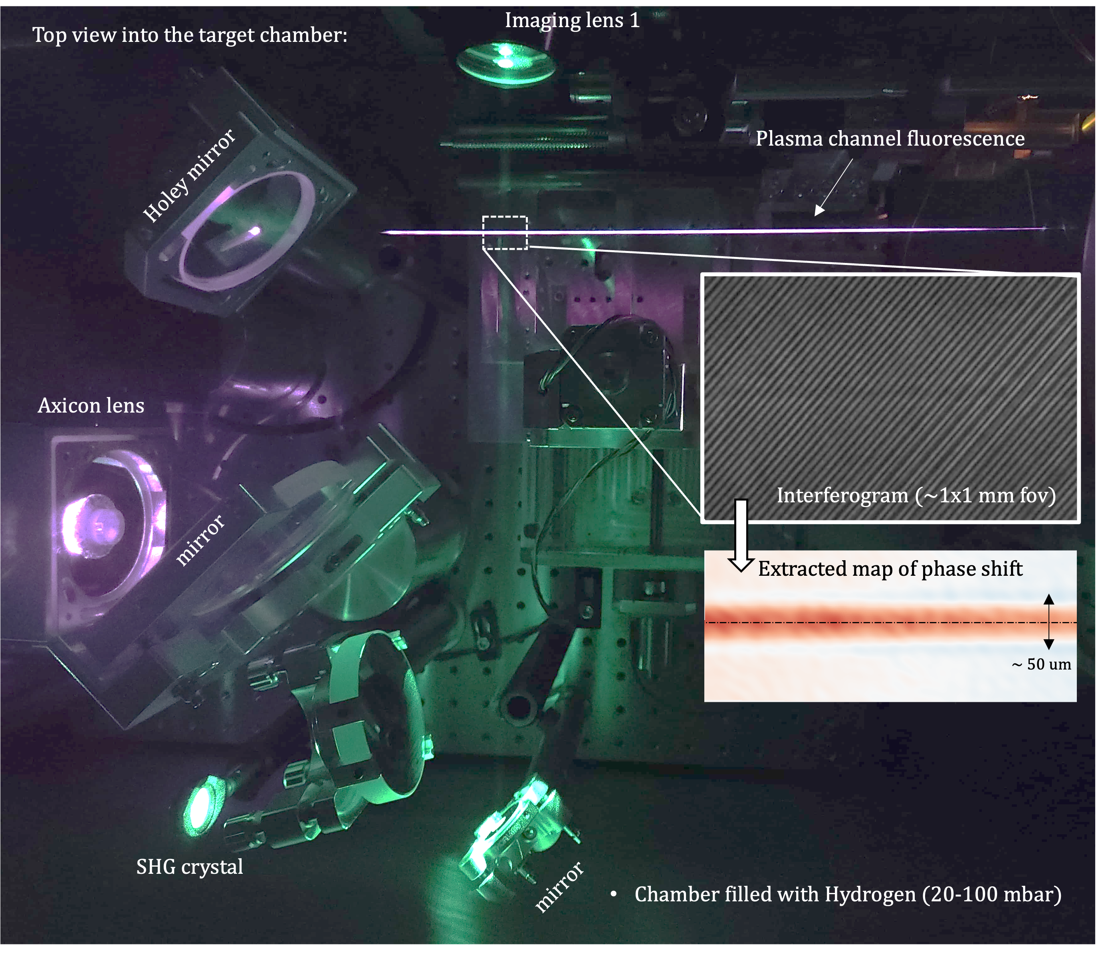
WP4 - Advanced plasma sources
HOFI Plasma channels 2/2
Developing long (> 100 mm) gas jets / gas cells for high-rep rate (> 10 Hz) operation
Reduced flow into surrounding vacuum chambers
Differential pumping designs to keep base pressure low
Minimize energy of channel-forming pulse
Investigate use of higher-order Bessel beams, axilenses etc
Investigate use of non-Ti:sapphire pulses to generate channels
Will investigate use of (~ 1 ps) thin-disk laser pulses at CALA
Demonstrate guiding of joule-scale thin-disk laser pulses
Guiding of single pulses and pulse trains (suitable for P-MoPA scheme) will be explored at CALA
60 mm long HOFI channels generated in hydrogen
Fluorescence from the channel is seen near the top of the image.
Also shown is an example interferogram & the extracted phase shift.
Simon Hooker
University of Oxford
13

Slide 14
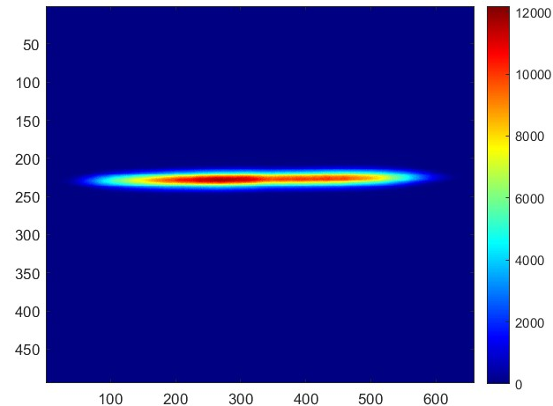
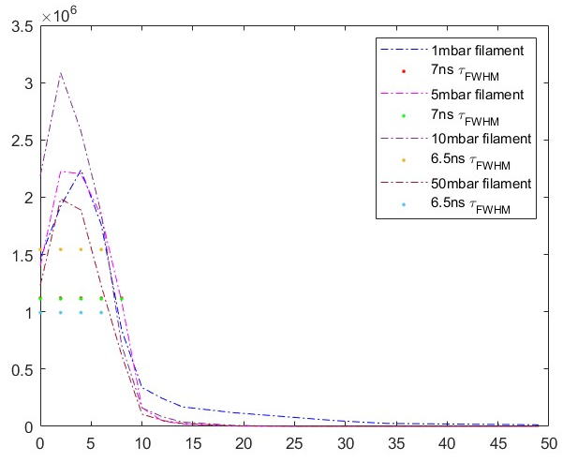
WP4 - Advanced plasma sources
Plasma filament by laser ionization
Tune laser energy, focal spot and gas pressure to change filament size and plasma density
Laser pulse: 15 mJ, 100 fs
N₂ 95% - H₂ 5%, 1-10 mbar
N_{e} = 10¹⁶ - 10¹⁷ cm⁻³
Intensity [a.u.]
7 ns Lifetime
1.2 mbar
L = 39.75 mm
d = 567.6 um
Time (ns)

Slide 15
WP4 – Work plan

Slide 16
WP4 – Work plan
M4.1.1 – Minimization of gas throughput and design of differential pumping for continuous gas jet operation adapted to high repetition rate. (M12)
M4.1.2 – Development, manufacturing and testing of nozzles with structured longitudinal plasma profile for e.g., electron injection in shocks, control of dephasing in upward density ramps (M24)
D4.1.1 - Demonstration of high repetition rate nozzles sustaining Joule level 100 Hz laser pulses
M4.2.1 - Studies of energy deposition and heating on apertures and wall exposed to high intensity and high power laser-driver beams (M30)
M4.2.2 - Studies of reducing gas leaks in the beam line and integration of active cooling on exposed parts at 50-1000W level driver average power (M40)
D4.2.1 - Optimized gas-cell target design for high quality beam laser-driven plasma source for high-repetition rate 10Hz-1kHz
D4.3.1 - Prototype of a high-repetition-rate discharge capillary system (10 – 400 Hz)
D4.3.2 - Segmentation of long (meter-scale) capillaries for EuPRAXIA relevant energy gains
M4.4.1 - Completion of design of a 0.1 - 1 kHz HOFI waveguide (M30)
M4.4.2 - Design of 1 kHz laser-induced plasma filaments (M24)
D4.4.1 - Completion of experimental tests of 0.1 – 1 kHz HOFI waveguide in burst mode operation
D4.4.2 - Completion of experimental tests of 1kHz laser-induced plasma filaments

Slide 17
WP4 – Risk managment
Risk management:
D4.1, D4.2
High repetition rate plasma module vacuum management fails (likelyhood: low, severity: medium)
Mitigation: Test at lower rep-rate and extrapolation of the results at higher rep-rate
D4.3.1, D4.3.2
High repetition rate plasma module heath load management fails (likelyhood: medium, severity: medium)
Mitigation: Testing at a lower repetition rate or lower discharge current and extrapolating the results to a higher repetition rate
D4.4.1, D4.4.2
Risk 1 “Properties of plasma channel degrade at high (> 10 Hz) repetition rates.” (Likelihood: Low, Severity: Medium) Mitigation: Flow gas to ensure that fresh gas available for each shot Risk 2 “Gas load too high for vacuum system at high (> 10 Hz) repetition rates.” (Likelihood: Medium, Severity: Medium) Mitigation: Design gas capture system to remove gas from main vacuum chamber

Slide 18
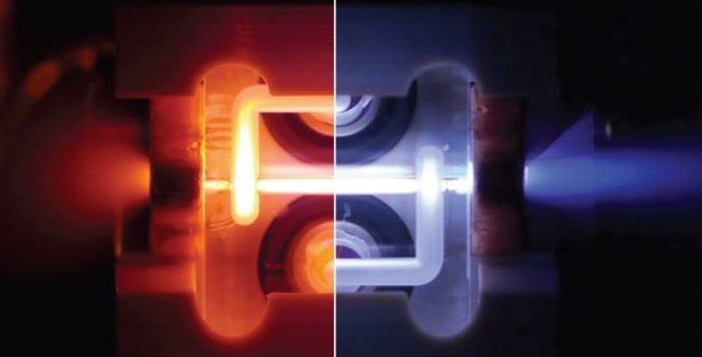
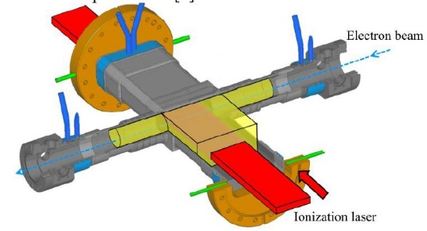
Thanks to all participants (INFN, UKRI, ELI-ERIC, CNRS, DESY, UOXF, LMU, IST, CLPU)
Thank you for your attention

Slide 20
Thank you for your attention
Thank you for your attention

Slide 21
WP4 - High repetition rate plasma structures
Three key thematic areas have been selected for being addressed within PACRI
Plasma acceleration
RF normal conducting accelerator technology
High power, ultrashort pulse laser technology
Promoting further developments on high-repetition-rate plasma modules, as the one foreseen by the EuPRAXIA project, extending its scientific domain to high average brightness radiation sources with possible future application also to high energy physics.
The work foreseen in PACRI plays a crucial role in complementing the EuPRAXIA construction project further developing the Plasma Accelerating Modules at high repetition rate (WP3 – WP4 - WP5)
Plasma acceleration
WP3 Plasma accelerator theory and simulations
WP4 High repetition rate plasma structures
WP5 Plasma Accelerator diagnostics and instrumentation
Discharge capillaries
Gas jets
HOFI Channels
Gas Cells

