Slide 1

WP 5: Diagnostics
Rasmus Ischebeck
Brigitte Cros
AI generated image:
Rasmus Ischebeck / Midjourney

Slide 2
Work package 5: Diagnostics
Members:
  Brigitte Cros, CNRS-LPGP
  Ralph Aßmann, GSI
  Alessandro Cianchi, Livio Verra, Univ. Tor Vergata / LNF
  Bernhard Hidding, Markus Büscher, Thomas Heinemann, HHU
  Rasmus Ischebeck, Evan Ericson, Elmar Thewes, PSI
  Thomas Pacey, Yuri Saveliev, Deepa Angal-Kalinin, UKRI, STFC ASTeC
  Carlos Salgado, Giancarlo Gatti, Mauricio Rico, CLPU
  Carsten Welsch, Univ. Liverpool
  Ilia Zymak, Gabriele Grittani, Alexander Molodozhentsev, ELI Beamlines

Slide 3
Work Package Tasks
Transverse diagnostics
  Wire scanners
  Pepper pot
  Beam position monitor
Longitudinal diagnostics
  Dielectric streaker
AI tools and virtual instrumentation
Charge and loss monitors

Slide 4



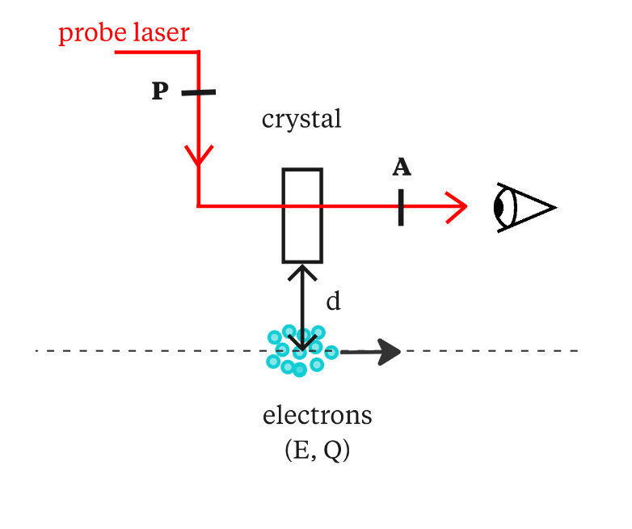
CNRS-LPGP : Develop electron beam diagnostic to characterize electron sources from Laser wakefield accelerators (LWFA)
B. Cros, F. Massimo, P. Desesquelles, O. Khomyshyn + PhD
Context: The characterization of LWFA electron source is challenging (short pulse, low charge, limited stability….), however its pulse duration and compactness are assets for multistage plasma acceleration
Challenges Improve the quality of the electron source and characterize its properties in single shot mode, without blocking the beam
Candidate for non perturbative single shot diagnostics:
Electro-Optical Sampling (time of arrival, duration, position)
Study combination of EOS, test advanced detection systems, compare to other techniques, couple modeling and experiments
LWFA Source
LWF Accelerator

Slide 5
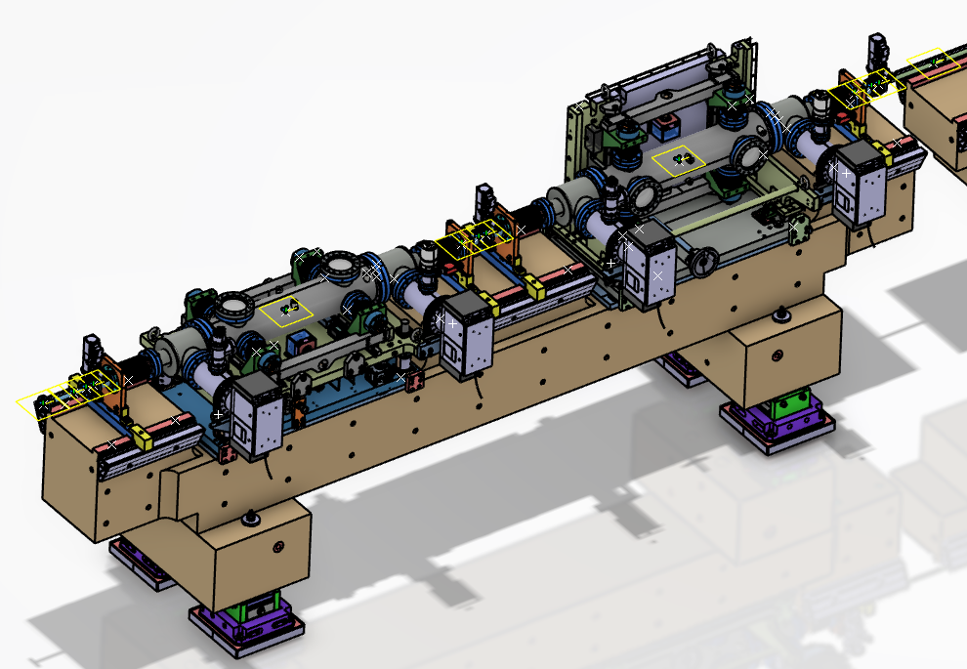
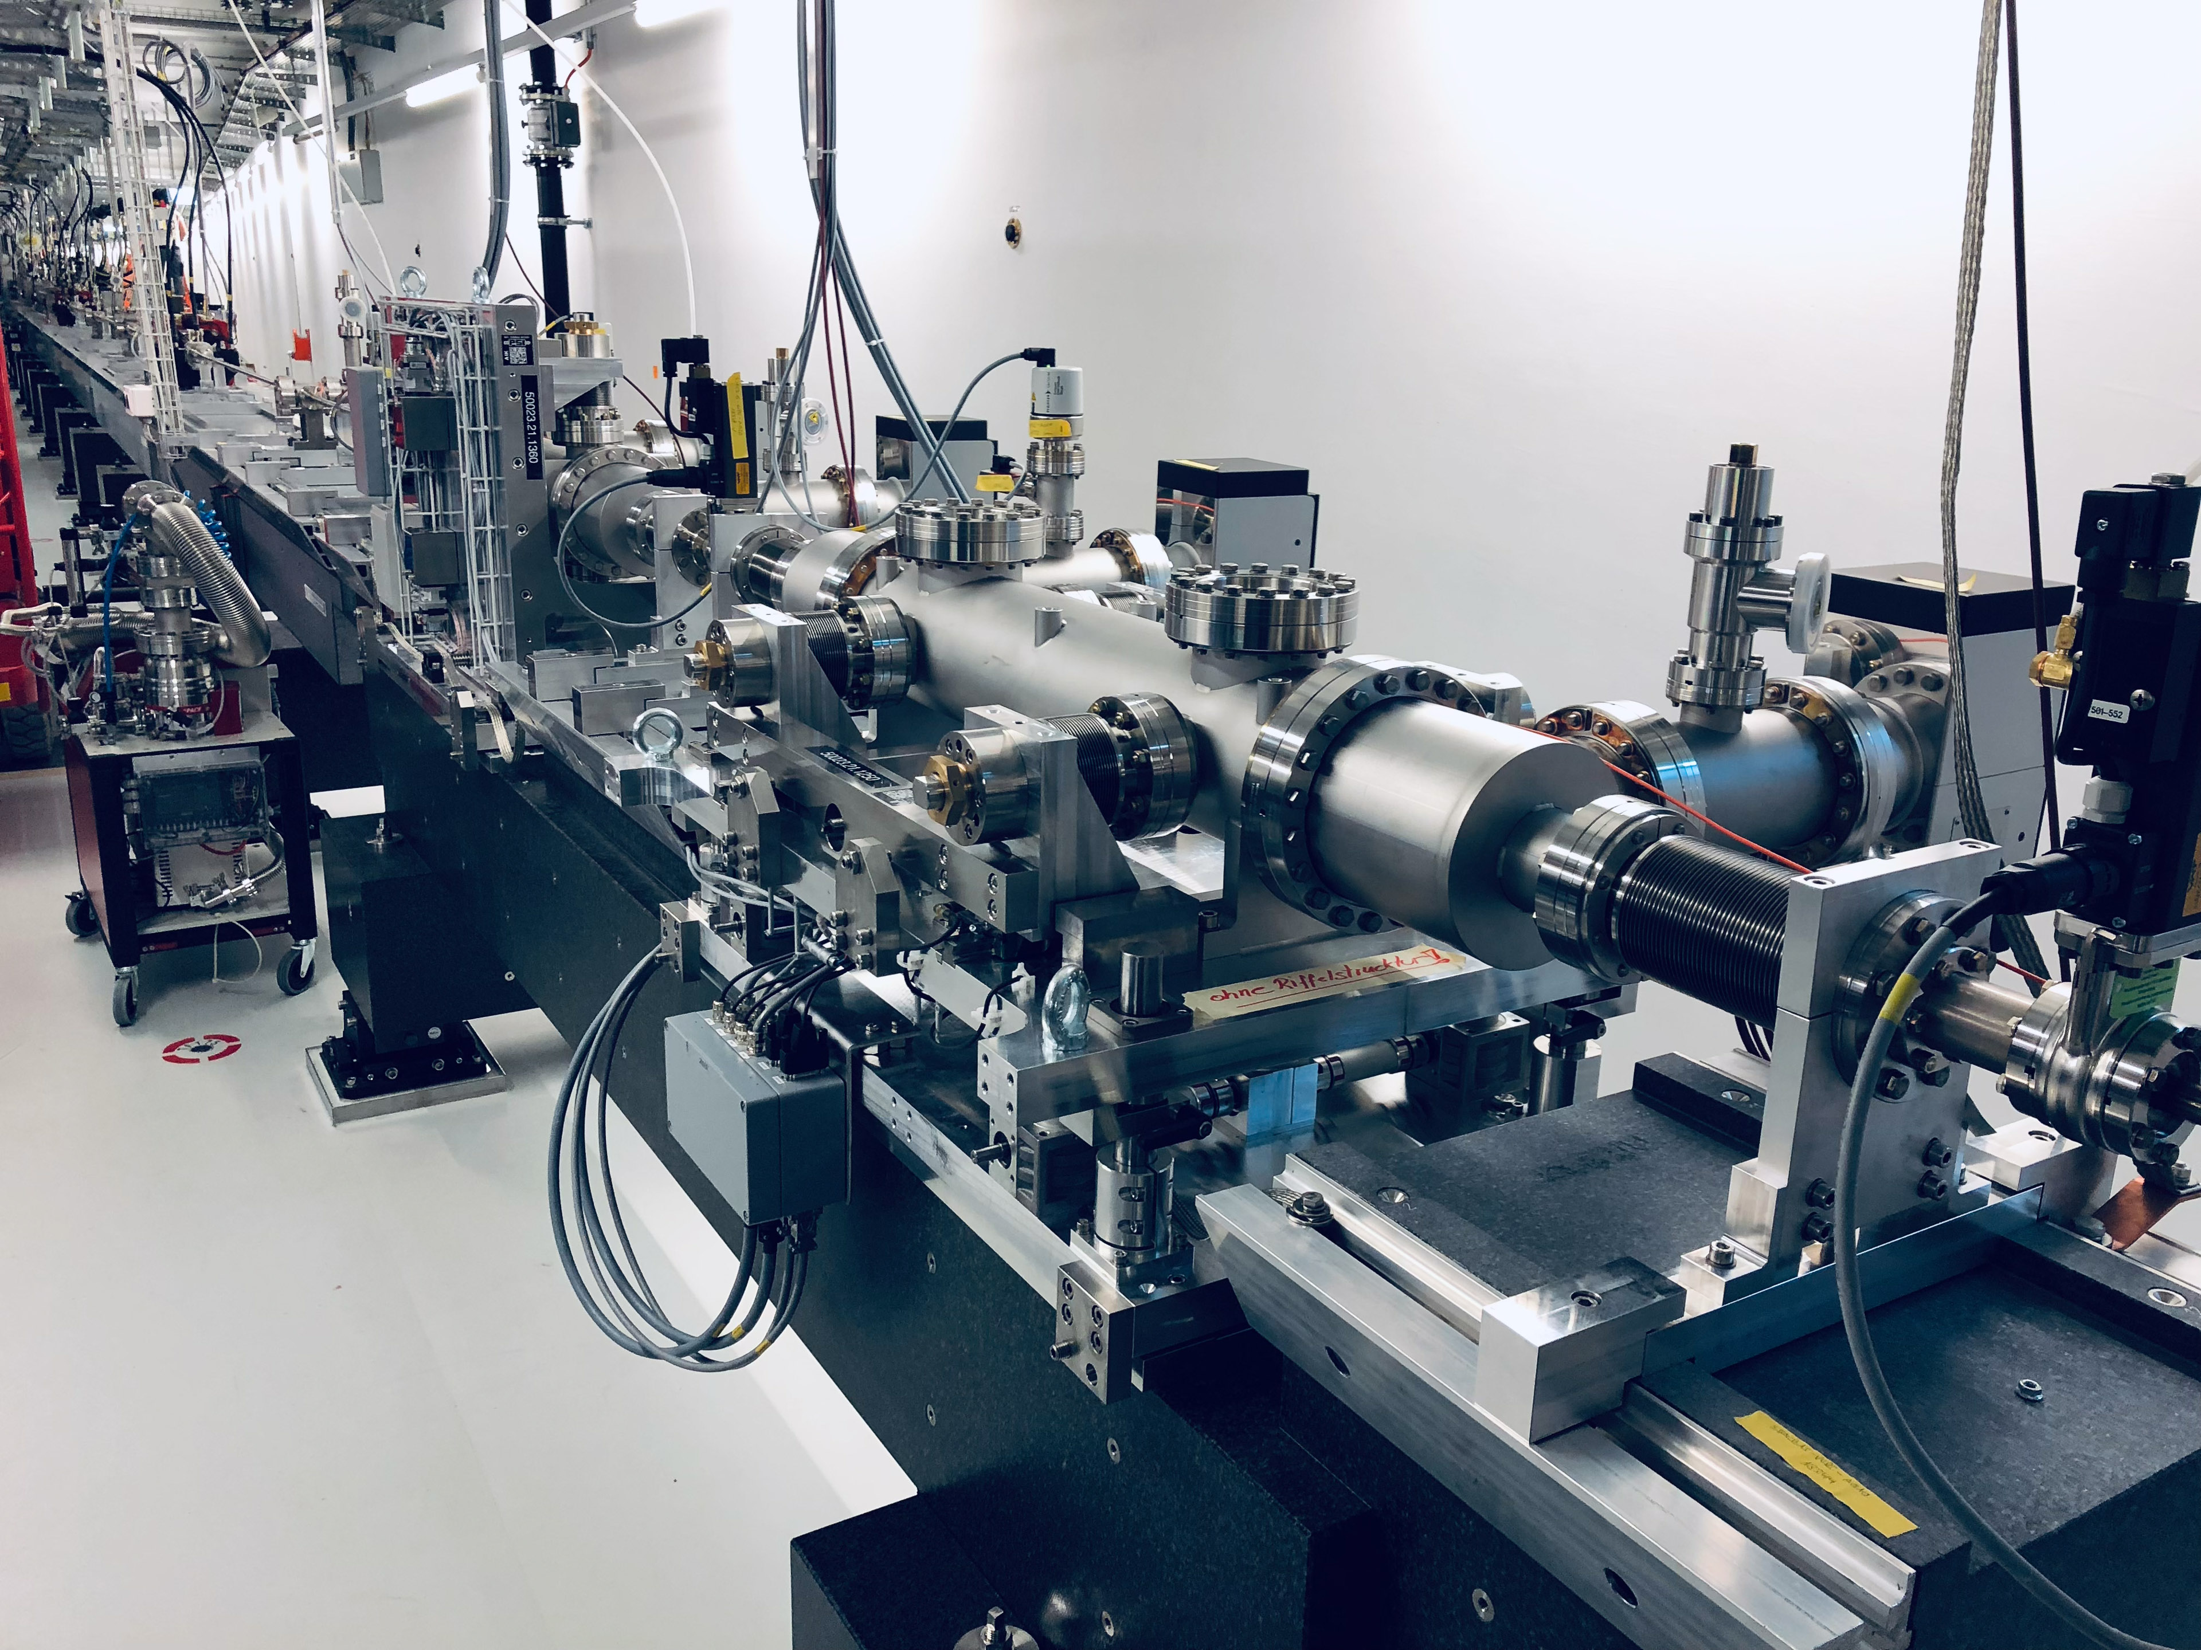
Possible PSI contributions
Dielectric streaker
In collaboration with UKRI

Slide 6
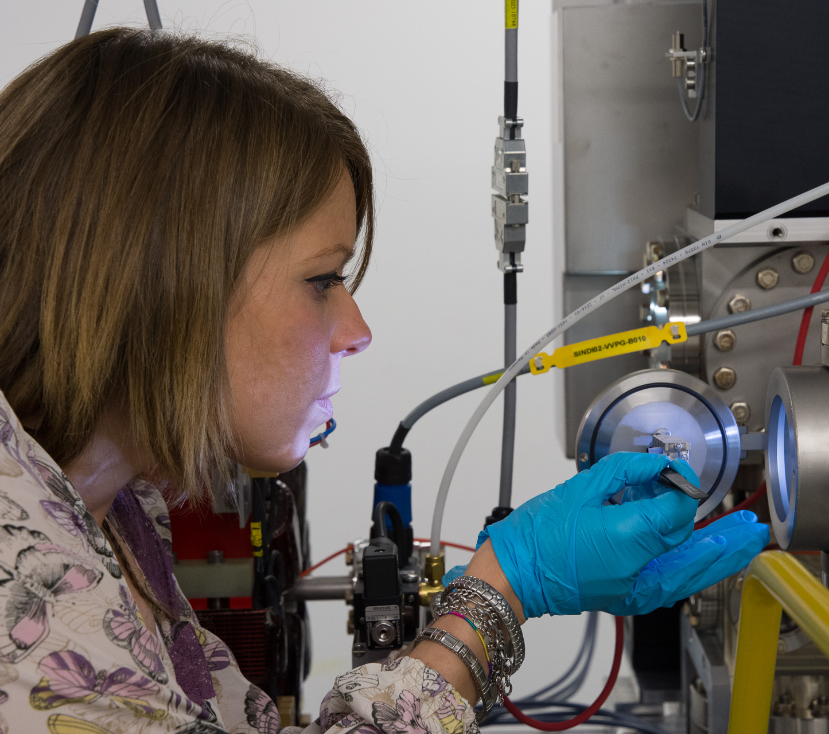
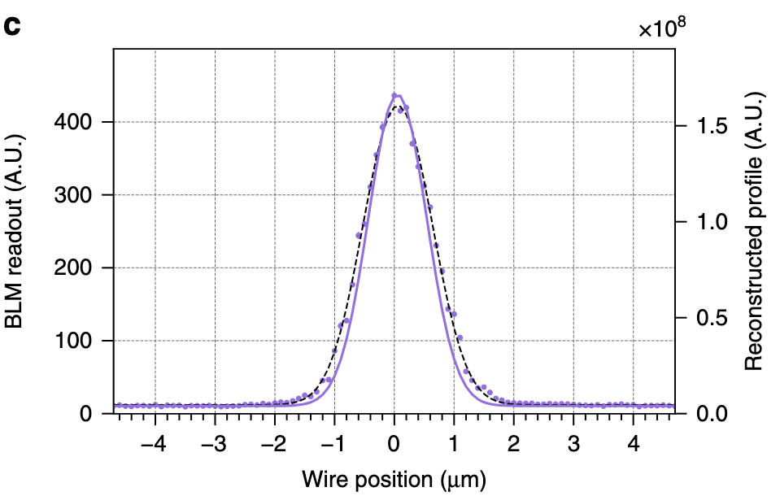
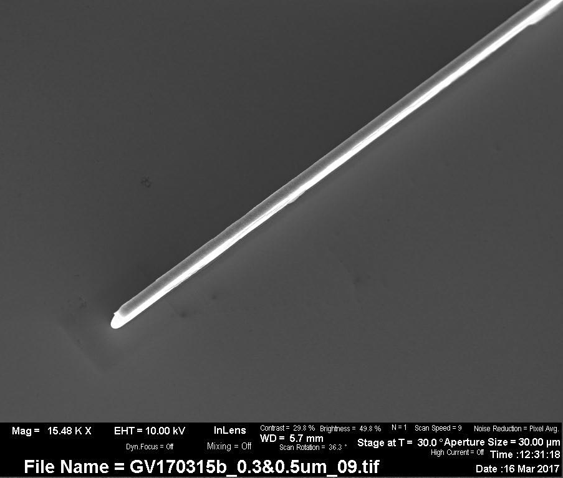
Possible PSI Contributions
Micro-wire scanner
In collaboration with Univ. Tor Vergata
σy= 491 nm

Slide 7
Plasma Entrance Diagnostics
The witness bunch in non-linear PWFA must be delivered at the plasma entrance with Twiss parameters:
$α_{m}=0$ (injected at waist)
$β_{m}=\sqrt{\frac{2m_{e}c^{2}ε_{0}}{n_{pe}q^{2}}γ}$ (matched to the ion column focusing force)
For EuPRAXIA@SPARC_LAB:
𝛽 = 3.3 mm, which corresponds to 𝜎 = 1.3 μm
➔ Need a diagnostics to measure the transverse beam size at the plasma entrance location with μm-resolution
Diagnostics position
x

Slide 8
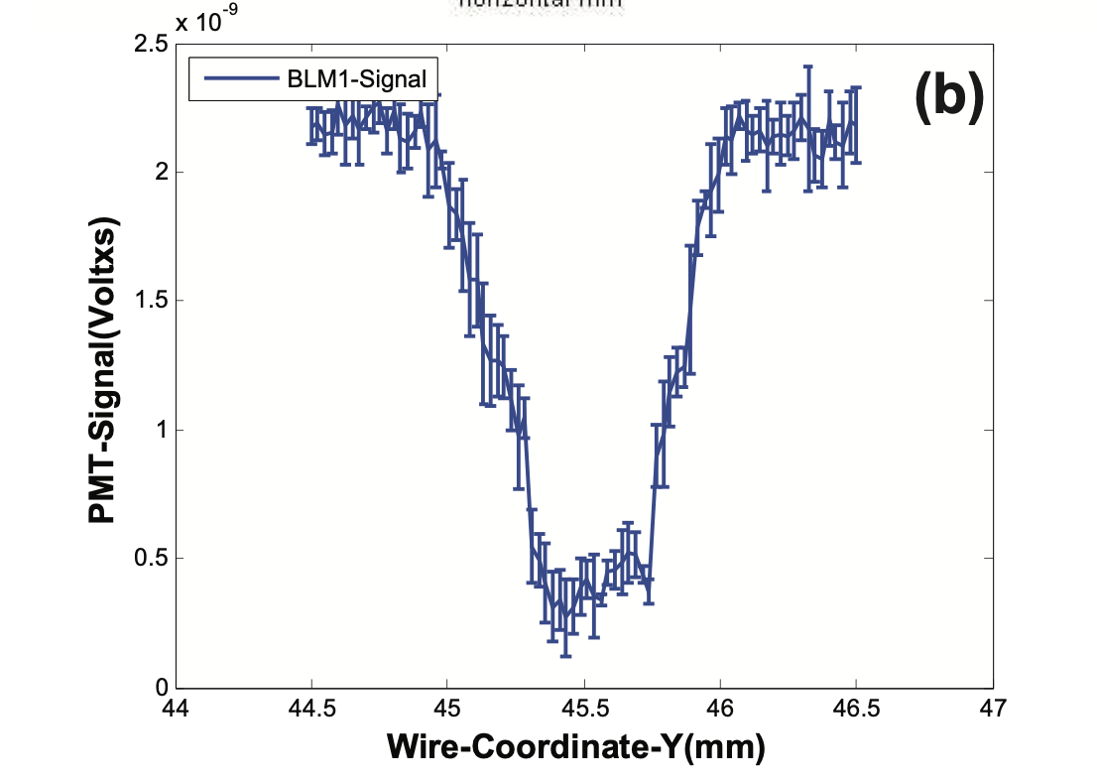
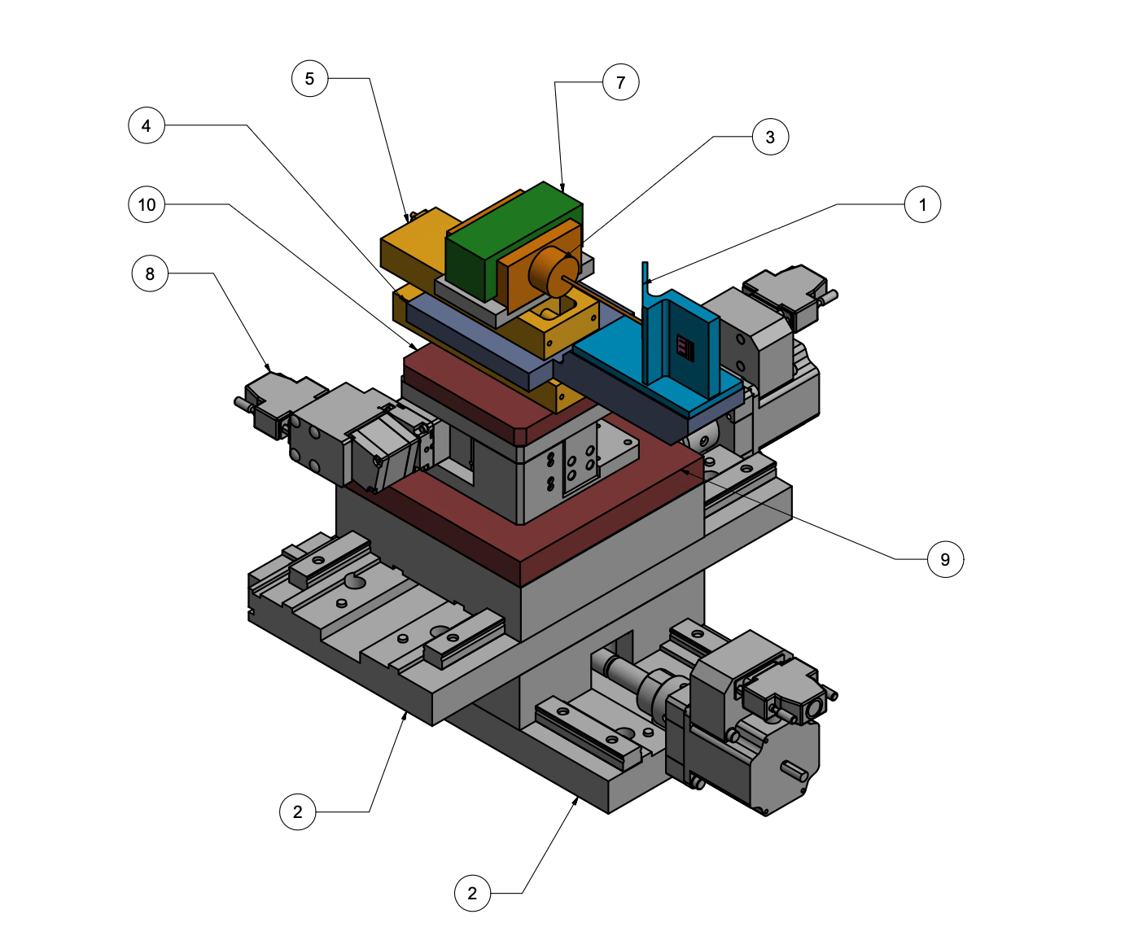
Microwire scanner
Intercepting the bunch with a μm-thick wire, secondary particles and scattered electrons can be detected with beam loss monitors
  [1] Orlandi et al., Proceedings of FEL2014
  [2] Orlandi et al., PRAB 19, 092802 (2016)
  [3] Borrelli et al., Comm. Phys. 1, 52 (2018)
  [4] FACET-II Technical Design Report, SLAC
By varying the position of the wire across the bunch with μm-resolution, and measuring losses:
info on transverse size and centroid position of the bunch
➔ Preliminary design of a device to measure the beam transverse size at different longitudinal positions to reconstruct the envelope around the waist
[1]
v_{b}
Wire holder
High-resolution translation stages
(x, y)
Longitudinal motion
(envelope reconstruction)

Slide 9
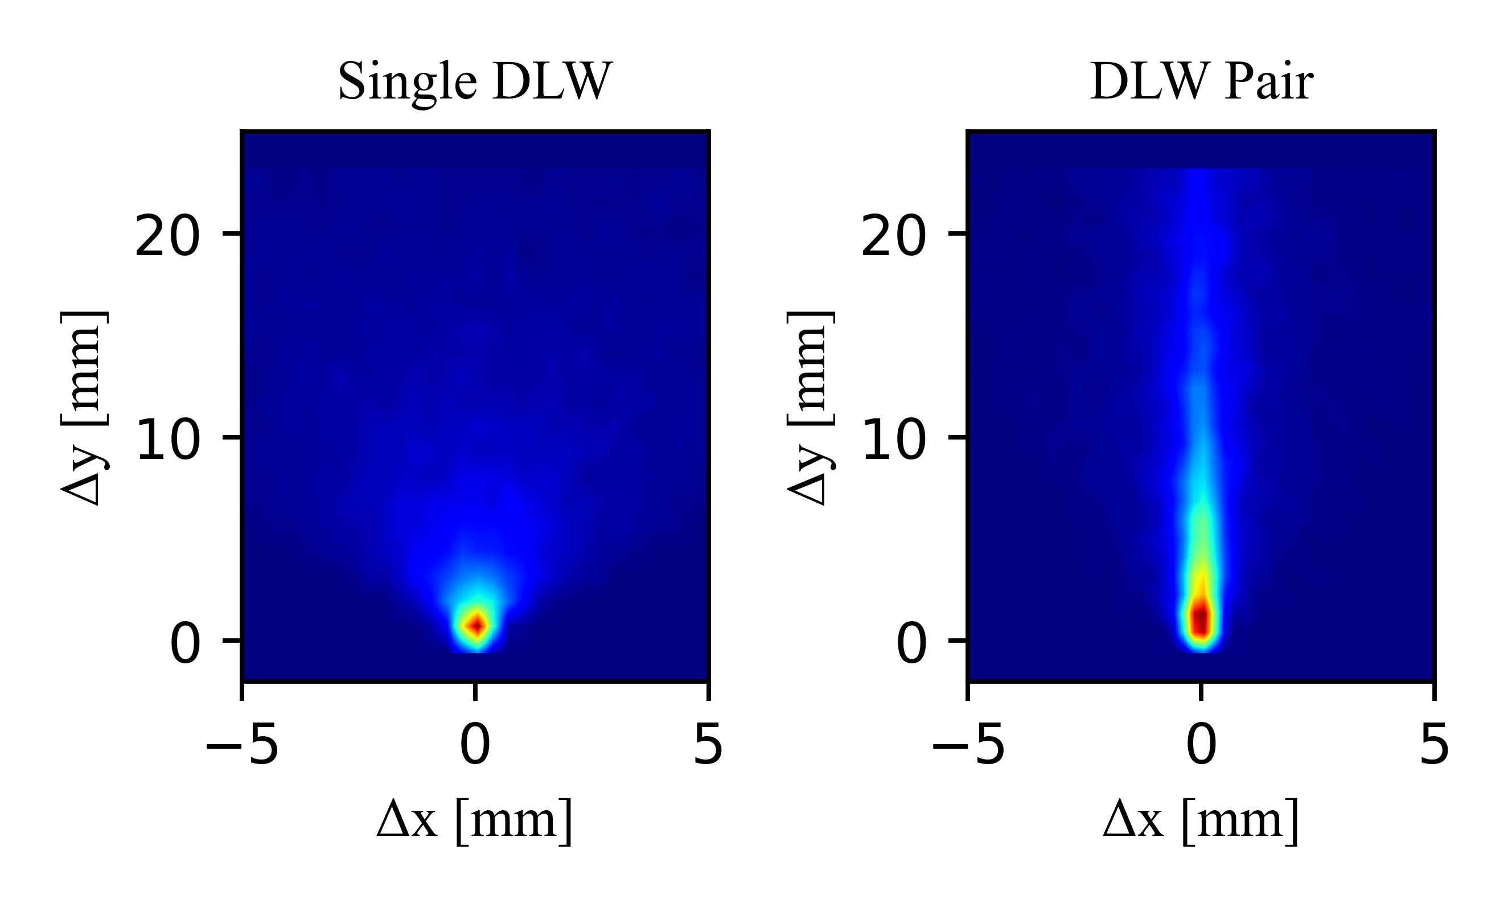
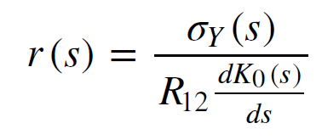
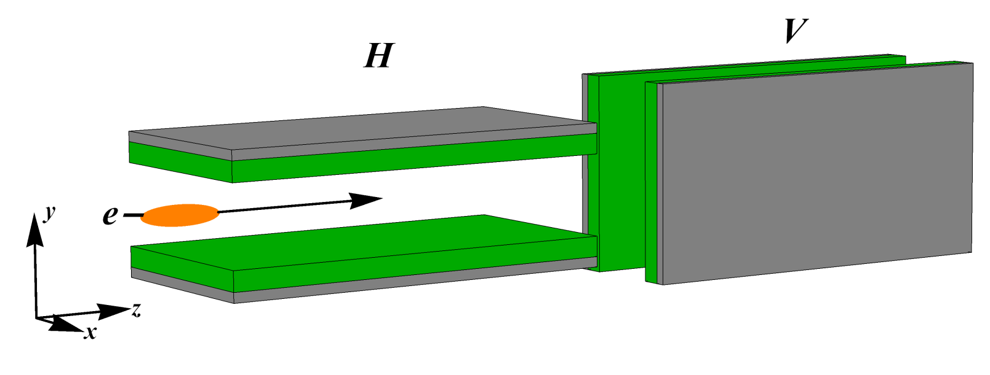

Longitudinal Diagnostics: Dielectric Streaker (1)
Wakefield based streaking provides a compact and cost effective measure for resolving short (<100fs) bunches produced by plasma accelerators
Technology proved at high energy FELs
  [1] Dijkstal et. al., PRR 2022
  [2] Dijkstal et. al., PRAB 2024
Resolution of measurements can be enhanced by using pairs of orthogonally orientated plates to cancel high order wakefields
Transverse beam size at s
Longitudinal variation in streak

Slide 10
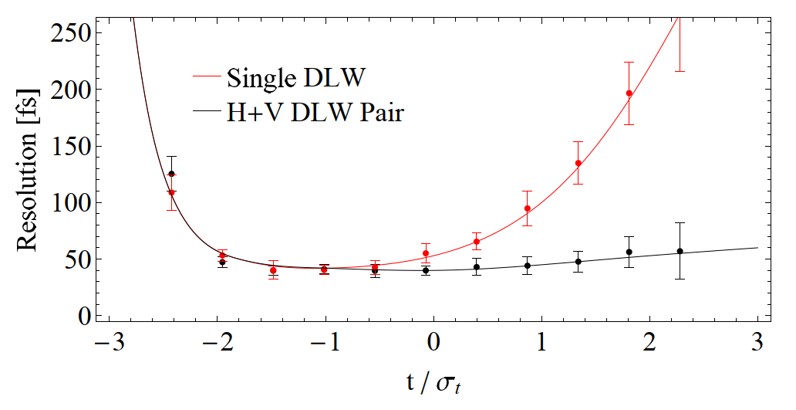
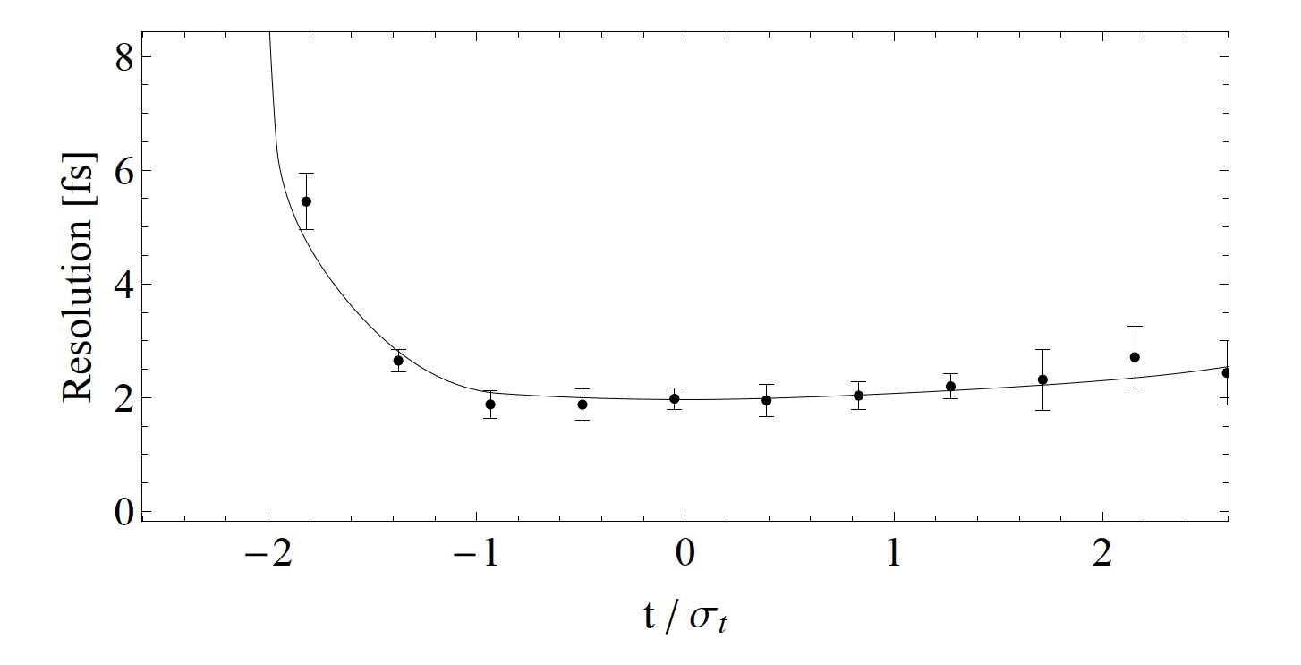
Longitudinal Diagnostics: Dielectric Streaker (2)
Research goals @ CLARA
  Proof of concept experiments at 35 MeV completed
    [3] Overton et. al., in Proc. IPAC24
    [4] Overton et. al., NIMA 2025
  At 250 MeV use our dielectric dechirper and TDC (for cross calibration) to prove our accuracy & precision; Q3 2025
  Commissioning dedicated streaker with the FEBE experiment hutch (Q1 2026) to study streaking from plasma accelerated electrons, Q4 2026
Research goals @ EPAC
  Perform low energy proof of concept experiments with Gemini laser facility; Q2 2025
  Perform full scale experiments at EPAC with GeV beams, late 2027
Simulated resolution for beam: σ_{t} = 200 fs, 250 MeV, 250 pC
Simulated resolution for beam: σ_{t} = 10 fs, 1 GeV, 250 pC

Slide 11

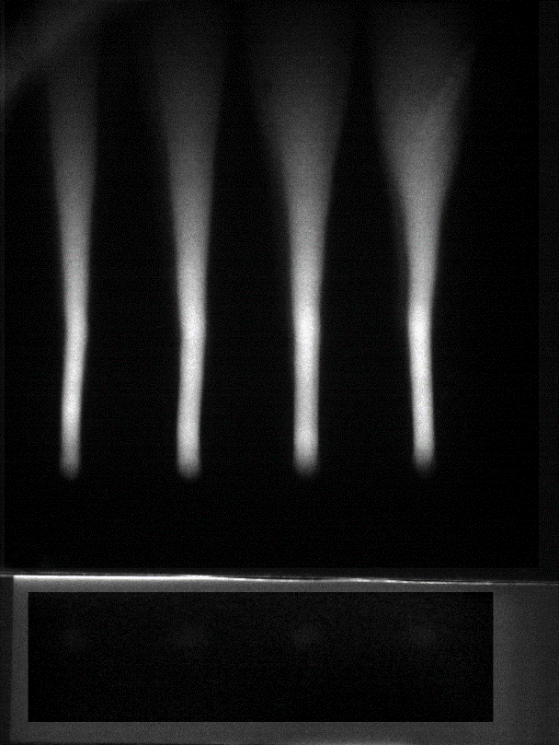

WP5: CLPU potential contribution
Study of feasibilty of two transverse diagnostics (taks 5.1):
Energy-resolved pepper-pot
Electro-Optical Beam Position Monitor (EO-BPM)
1D normalized emittance direct measurement
Accounts for beam energy spread
Destructive diagnostic
Towards overcoming restrictions for very small emittance values
Single shot 2D fast BPM
Beamline integration
No charge losses, non-destructive diagnostic
Requires proper dimensioning and limits awareness
$$E$$
$$x′(E_{i})$$
$$E_{i}$$
S
Pockels EO effect
$$γ$$
$$x$$
$$X$$
e⁻
N
x2 amplitude + timing field measurement in each crystal
Trace-space @ $E_{i}$
$$x′$$
Chirped laser pulses
C. M. S. Sears et al., Phys. Rev. ST Accel. Beams 13, 092803 (2010)
E. Brunetti et al., Phys. Rev. Lett. 105, 215007 (2010)
S. Fritzler et al., Phys. Rev. Lett. 92, 165006 (2004)
C. Salgado-López PhD thesis (2024).
C. Salgado-López et al., in preparation.
$$∆t= \frac{d}{γc}$$
B. Steffen et al., Rev. Sci. Instrum. 91, 045123 (2020)
K. Hunt-Stone et al., NIM-A 999, 165210 (2021)
Y. Okayasu et al., Phys. Rev. ST Accel. Beams 16, 052801 (2013)
$$x$$
Main contact: Carlos Salgado (csalgado@clpu.es)

Slide 12
Task 5.3 - Development of virtual instrumentation and AI-driven control systems
Capitalizing on extensive experience of instrumentation R&D and AI integration:
  Virtual diagnostics to characterize beam and plasma dynamics
  AI algorithms for real-time machine control and optimization
  Closely connected with wider R&D in WP5

Slide 13
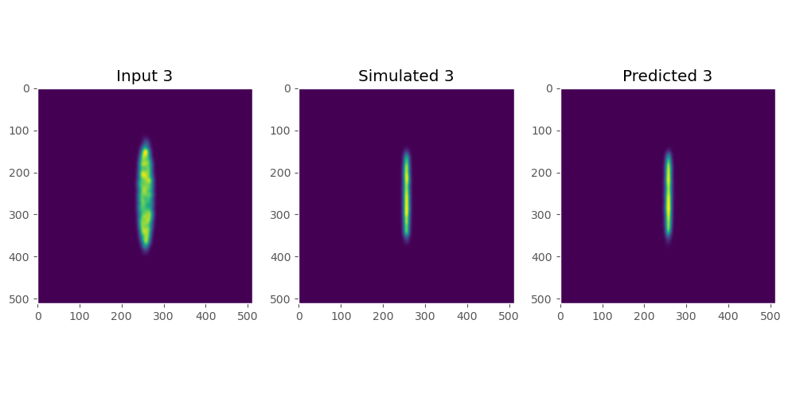

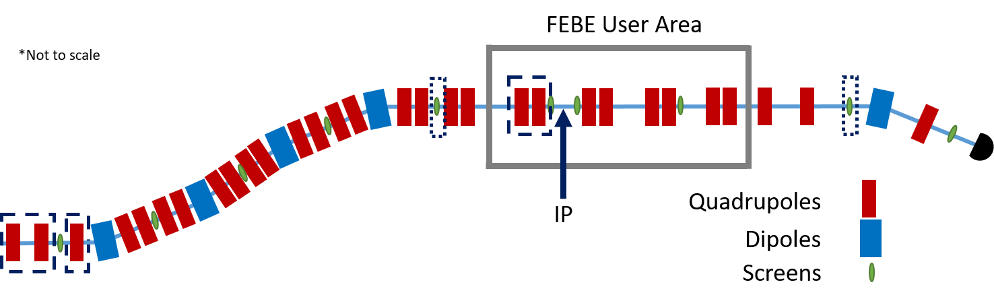
Virtual Diagnostics
A computational tool based on deep learning that can be used to predict a diagnostic output:
Non-invasive
Online monitoring
Measurement at an IP (e.g. plasma injection)
Simple measurement to complex output (e.g. profile to 4D emittance)

Slide 14
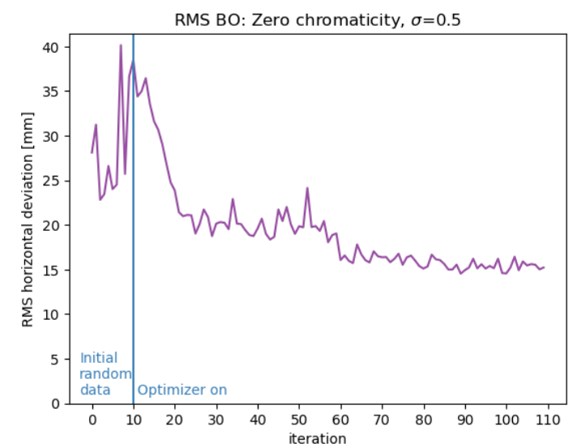
AI-driven control systems
Reinforcement learning agents are used frequently, trained to autonomously optimize accelerators:
Trained on single accelerator components
Real-time control and feedback
Integration of agent networks and “Agentic AI” as next step
D5.3: Report on virtual diagnostics suite for plasma accelerators
D5.4: Report on predictive algorithm, benchmarked through experiments
M31: Report on transverse diagnostic design.
M32: Report on longitudinal diagnostic design.

Slide 15
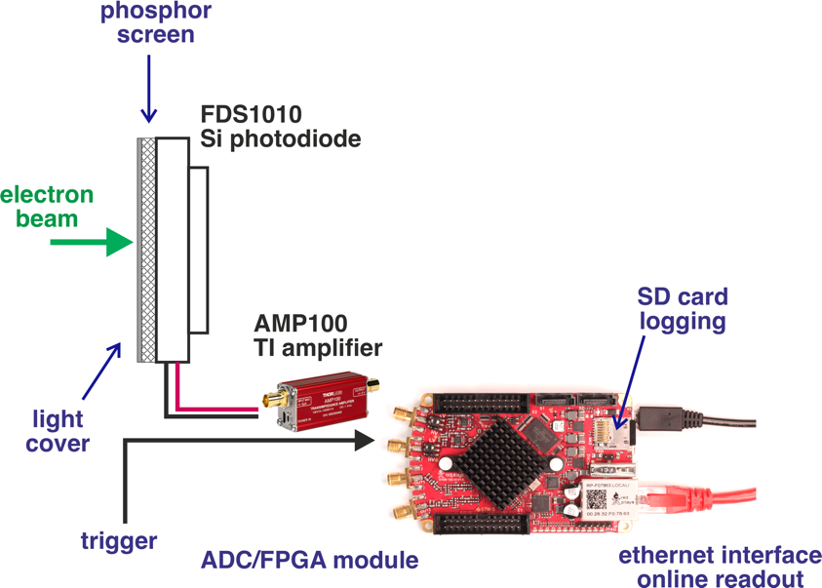
Charge Monitor

Slide 16
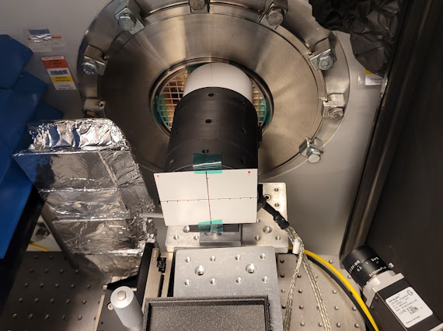
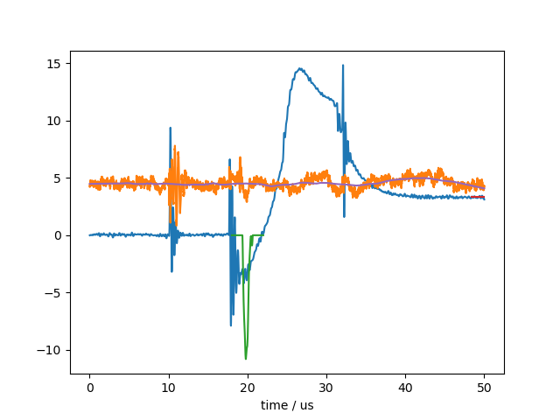
Charge Monitor

Slide 17
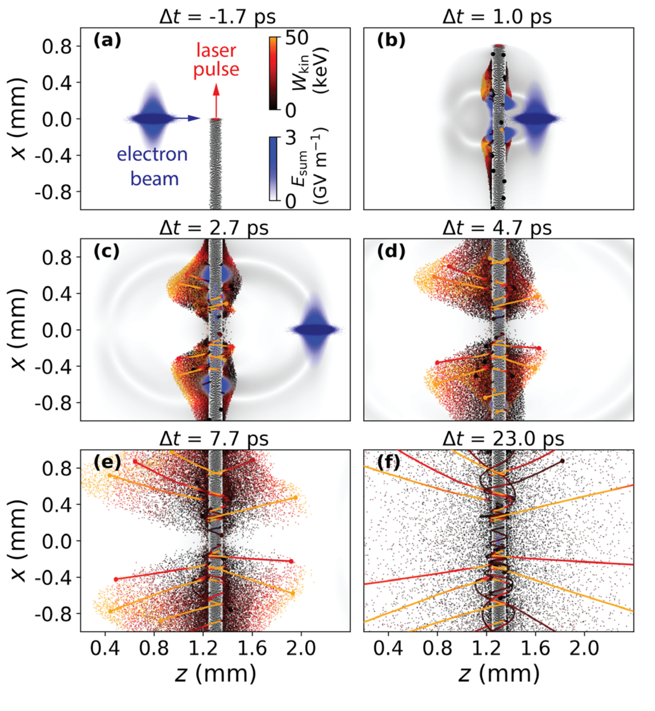
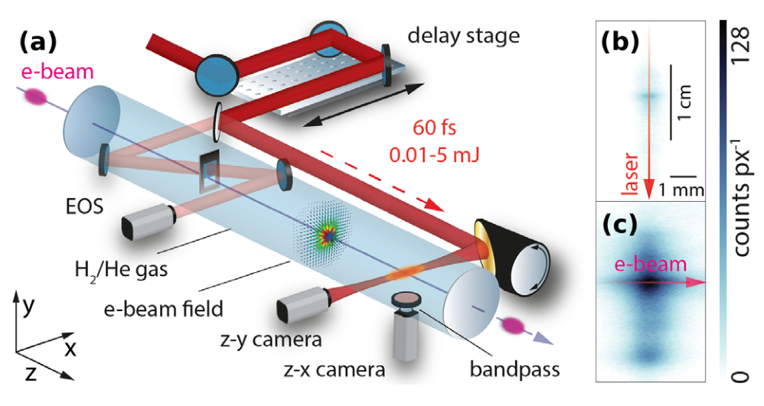

Plasma afterglow electron beam metrology
Electron bunch interacts with thin plasma filament
(generated, e.g. in a gas jet target via a low-power laser pulse)
Utilise recombination/relaxation “afterglow” radiation [1,2]
as diagnostics
Beam-plasma interaction enhances afterglow [3]
← laser only
← laser+ e-beam
[1] Oz et al., “Optical Diagnostics for Plasma Wakefield Accelerators”, https://doi.org/10.1063/1.1842612
[2] Lee et al., “Temporal evolution of the light emitted by a thin, laser-ionized plasma source”, https://doi.org/10.1063/5.0180416
[3] Scherkl et al., “Plasma photonic spatiotemporal synchronization of relativistic electron and laser beams”, https://doi.org/10.1103/PhysRevAccelBeams.25.052803

Slide 18
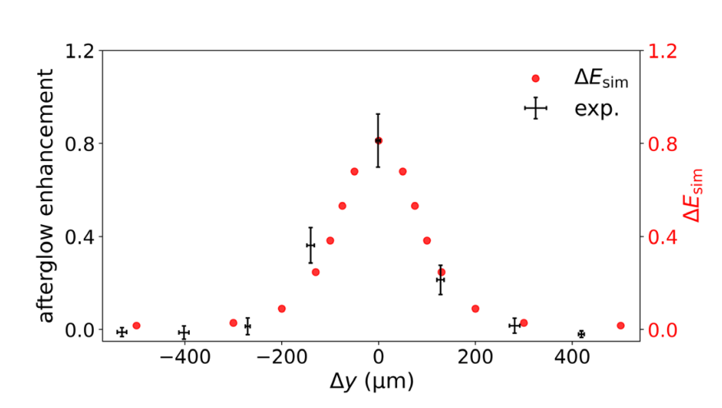
Plasma afterglow electron beam metrology
Afterglow enhancement highly sensitive on:
  electron beam dimensions
  spatio-temporal overlap with plasma filament
[3]
minimally intrusive beam positioning monitor & transverse size diagnostic
plasma-based approach resilient to intense beams for which conventional diagnostics may not be applicable
suitable for PWFA as well as LWFA EuPRAXIA scenarios
[3] Scherkl et al., “Plasma photonic spatiotemporal synchronization of relativistic electron and laser beams”, https://doi.org/10.1103/PhysRevAccelBeams.25.052803
[3] Scherkl et al., “Plasma photonic spatiotemporal synchronization of relativistic electron and laser beams”, https://doi.org/10.1103/PhysRevAccelBeams.25.052803

Slide 19
Next Action
WP meeting online to discuss proposed work and organise joint activities

Slide 20


Open Position

