Slide 1

WP8: X-Band RF pulse compressor (BOC)
David Alesini (INFN-LNF, Frascati, Rome, Italy)

Slide 2
WP8: Objectives and timeline
Objectives
The objective of WP8 is to design and fabricate an innovative X-band pulse compressor system, based on single high-order-mode RF cavity (clamped and not brazed), with a power multiplication factor ≥ 3, when operated with the klystron and modulator developed in WP6 and WP7.
Task 8.1: BOC design (M12). The Electromagnetic (EM) design and thermal analysis of the compressor will be done by INFN (BE3) and transferred into detailed constructive drawings by COMEB (BE8). Innovative solutions will be adopted for the mechanical structure of the BOC cavity, allowing for a completely clumped and braze-free system.
Task 8.2: BOC prototype production (M36). The construction of the BOC will be done by VDL (BE7). The manufacturing process will be pushed to very high precision and accuracy (in the micron range), which will then be verified by metrology. After construction of the parts, the RF compressor will be assembled and characterised on a microwave bench, to verify its performance.

Slide 3
EUPRAXIA X-band RF Module Layout
Mode converter
(INFN-SLAC design)
Power Source: Solid State Pulsed Modulator (K300) + 25 MW Klystron (Canon E37119)
BOC pulse compressor
Spiral RF LOADS
(CERN Design)
circular waveguide
Pumping units (INFN)
25 MW
1.5 us
100-400 Hz
140-70 MW
6 m
130 ns
Hybrid
(CERN design)
Transport line: Low loss Circular waveguide
X band structures
(INFN design)
70-35 MW
130 ns
DC
(CERN design)
Accelerating module
Pumping units (CERN design)
NEXTORR Pumps
(SAES)
2.3 m

Slide 4


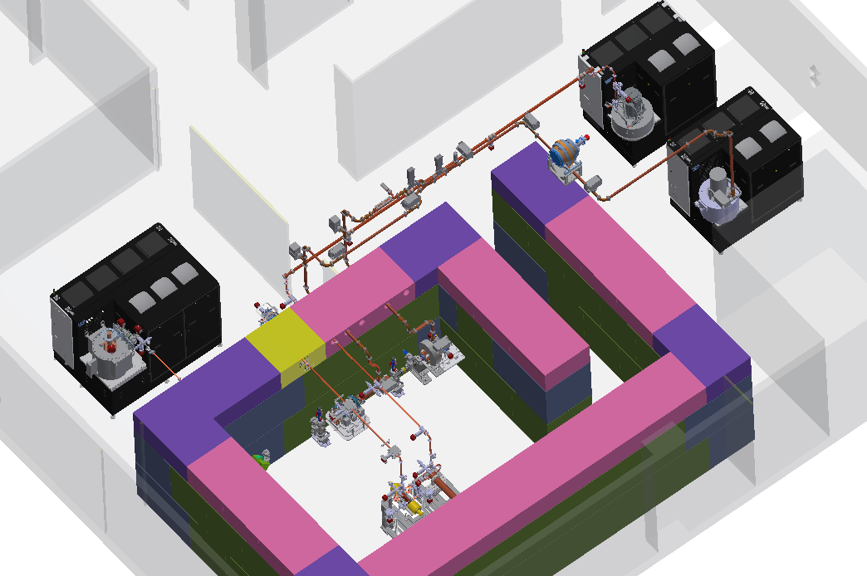
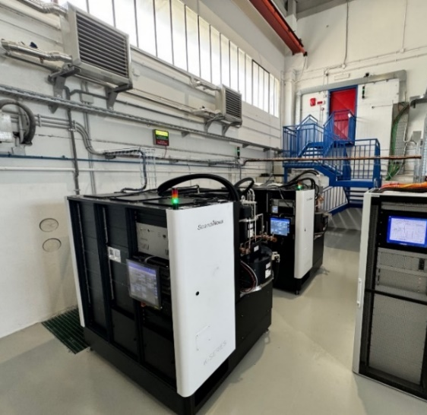
TEX Upgrade with new Power Sources
Currently, the test stand TEX is based on CPI VKX8311A Klystron on loan from CERN already commissioned and in operation.
Three other klystrons are being installed at TEX:
CANON X Band 25 MW, 400 Hz E37119
  Status:
    FAT of the klystron done @ CANON on a PFN modulator 11/2023, 25 MW, 10 Hz, t=1.5us
    FAT of the RF source @Scandinova 05/2024, full power in diode mode
    Modulator and klystron positioned at TEX
  CANON C Band E37217
  Status:
    FAT of the klystron done @ CANON on a PFN modulator 11/2023, 20 MW, 10 Hz, t=2.5us
    FAT of the RF source @Scandinova 05/2024, full power in diode mode
    Modulator and klystron positioned at TEX
CPI X Band 50 MW, 100 Hz High efficiency VKX8311HE
  Status:
  Tender has been done, realization phase (expected delivery from CPI Sept 2025)
Parameter | Unit | Canon E37119 | CPI VKX8311HE | CPI VKX8311 | Canon E37217
Frequency | MHz | 11994 |  |  | 5712
Vk beam voltage | kV | 312 | 415 | 420 | 280
Ik cathode current | A | 199 | 201 | 320 | 240
Peak RF output Power | MW | 25 | 50 | 50 | 20
Average RF output power | kW | 15 | 7,5 | 7,5 | 21
Modulator Average power | kW | 80 | 25 | 48 | 80
RF pulse length | μs | 1,5 |  |  | 2.5
Repetition Rate | Hz | 400 | 100 | 100 | 400
Gain | dB | 47 | 50 | 47 | 50
Efficiency | % | 40 | 55 | 38 | 40
Perveance | μp | 1.16 | 0.75 | 1.15 | 1
The commissioning of these sources and the waveguide networks is scheduled for January 2025, after the installation of the cooling and power systems that will serve these sources.
50MW, 50 Hz X-band Source
25 MW, 400 Hz X-band Source
20 MW, 400 Hz C-band Source

Slide 5
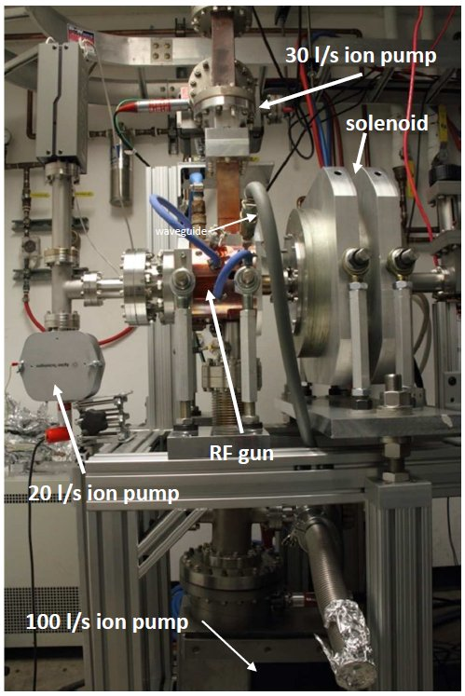
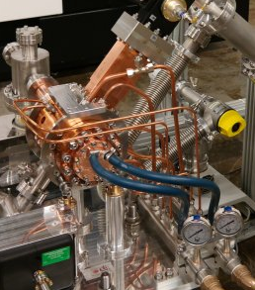
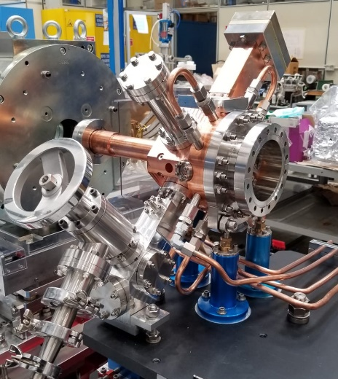
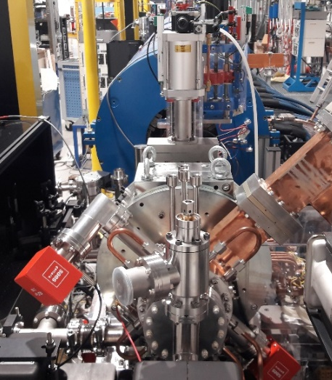
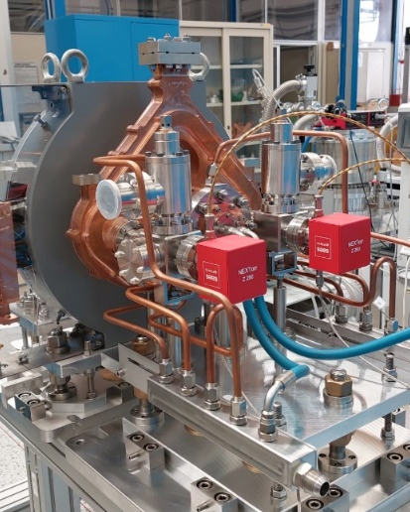
INFN Brazing free technology
In the last ∼10 years different RF photo-injectors have been fabricated, tested and put in operation @INFN (Frascati). All injector realizations are based on the new INFN technology w/o brazing
NEW SPARC_LAB
C BAND (I.FAST/TUAREG)
SPARC
ELI-NP
CLEAR (CERN)
D. Alesini et al., Phys. Rev. ST Accel. Beams 18, 092001 (2015)
D. Alesini et al., PHYS. REV. ACCEL. BEAMS 21, 112001 (2018)
Built and in operation @ CERN (2020)
V. Shpakov et al., et al 2022 JINST 17 P12022 (2022)
Successfully tested @ PSI
In operation
@SPARC_LAB
A. Giribono PRAB 26, 083402, 2023
In operation @UCLA
Tested at high power
S Band (3 GHz)
C Band (5.712 GHz)

Slide 6
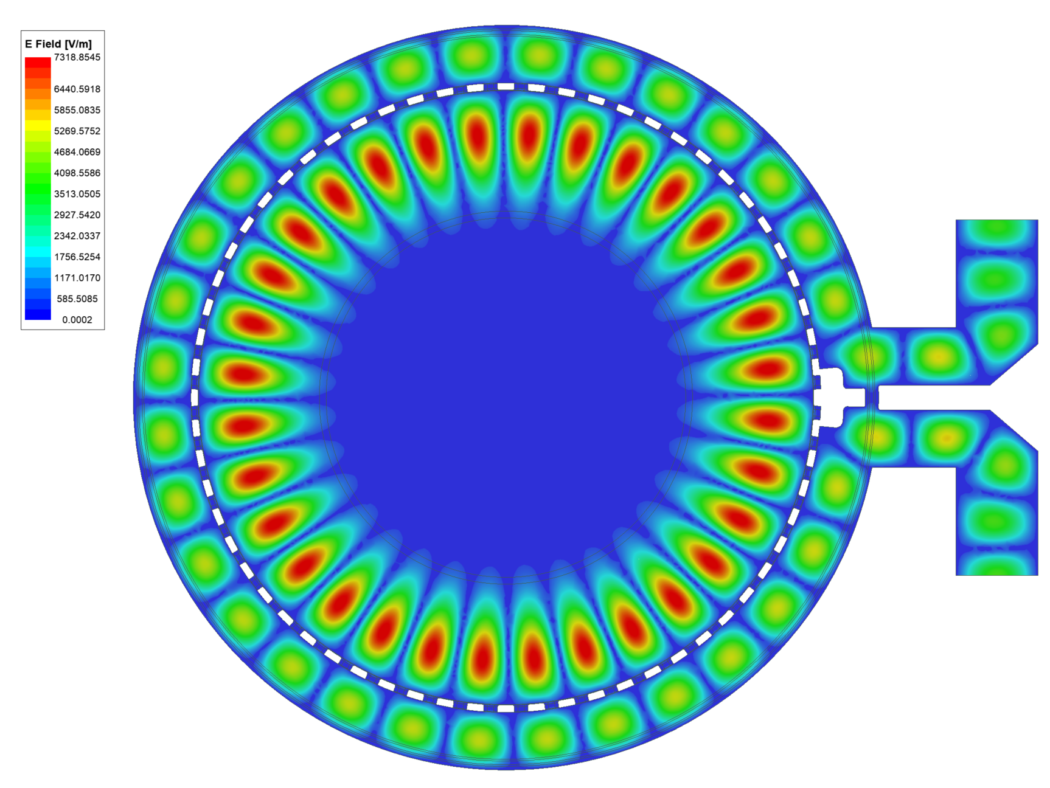
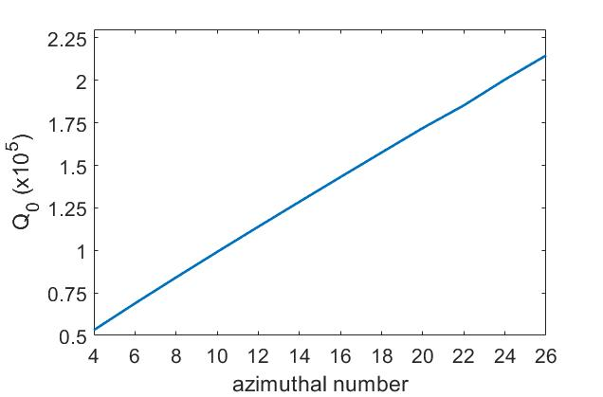
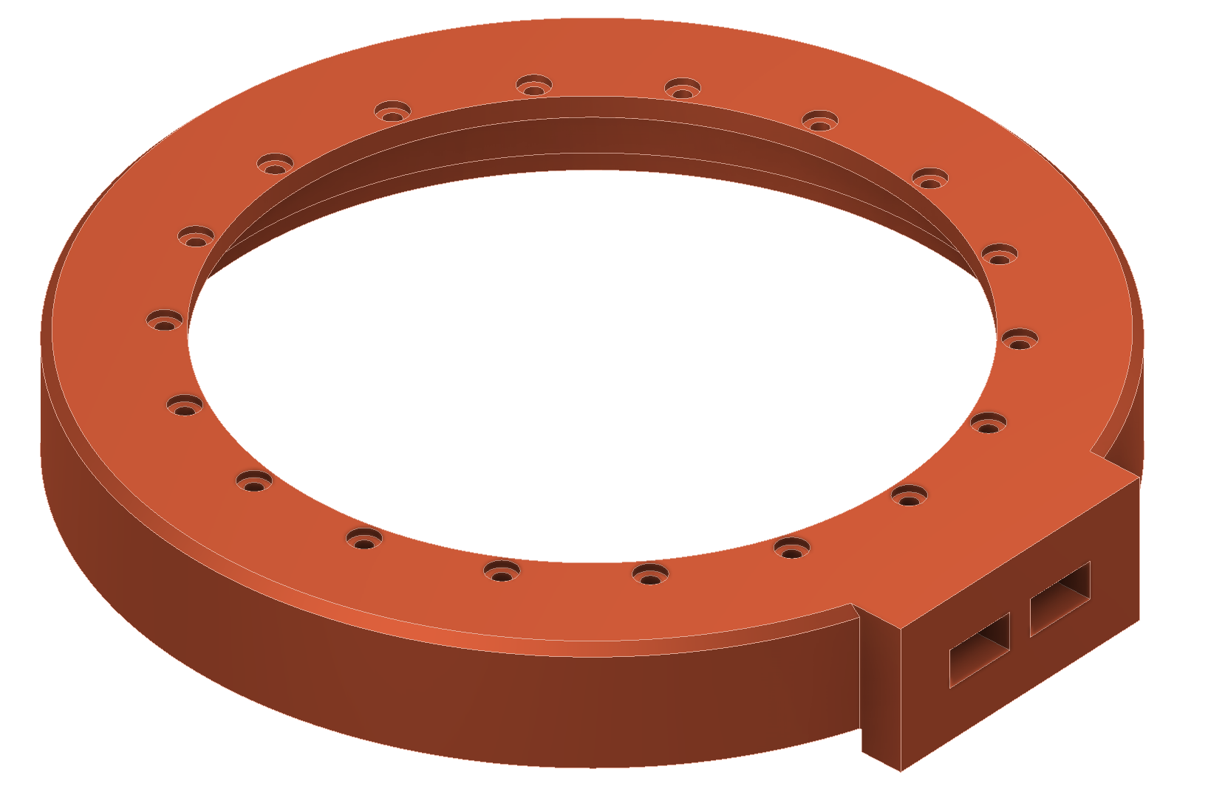
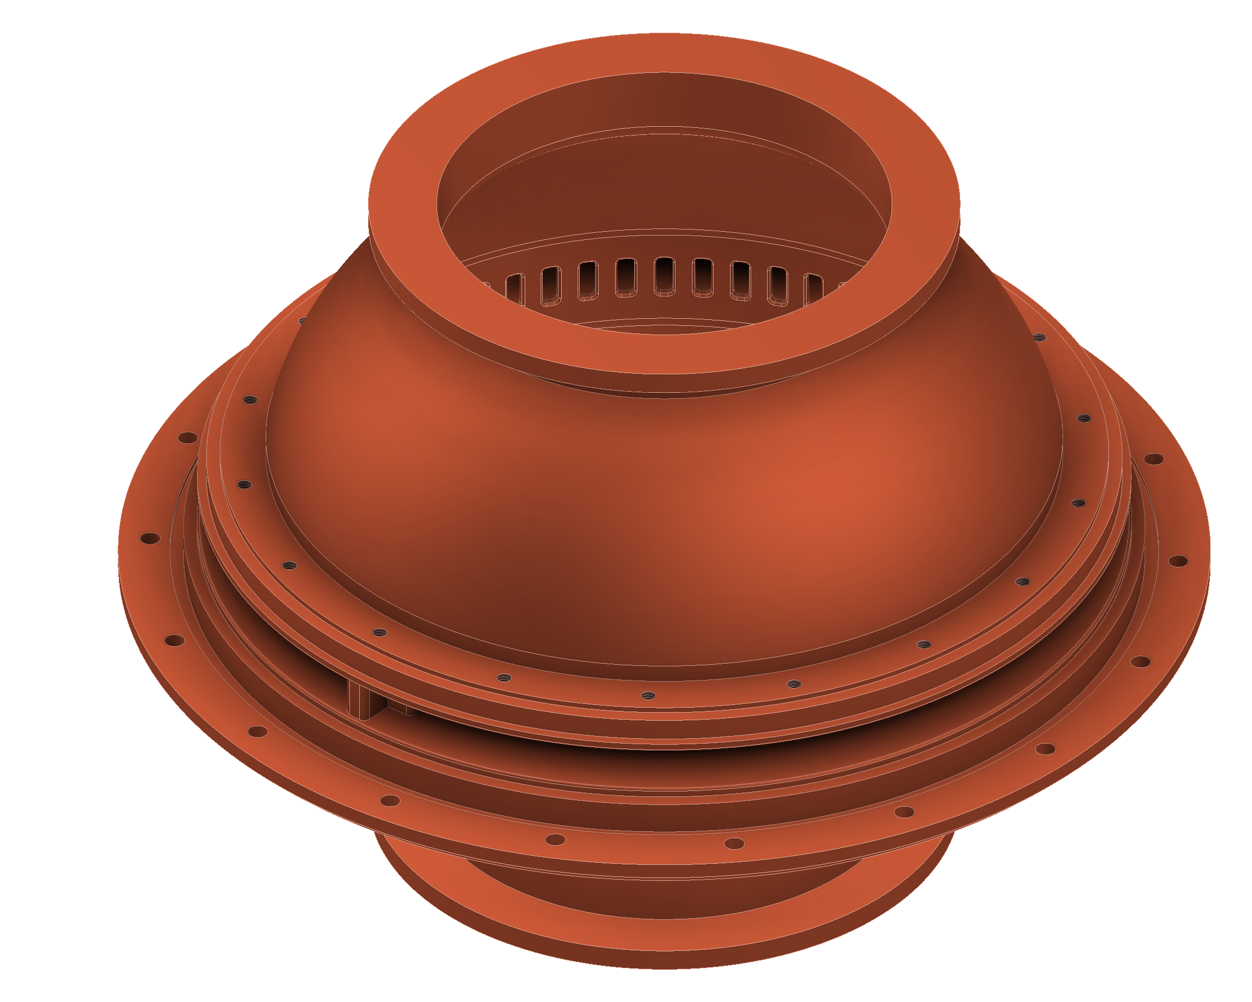
BOC MAIN PARAMETERS
BOC-type pulse compressors have been proposed and adopted at CERN (Syratchev et al…, S Band)
PSI developed C-band and X band pulse compressors brazed (SwissFeL): brazed
We are developing a new design for X-band BOC that implements the INFN-LNF brazing-free technology and allow operation at 400 Hz.
The brazing free or “clamping” technology is based on the use of special RF/vacuum gaskets
The choice of the mode to increase the Q₀ keeping the size of the BOC reasonable.
EM design has to be optimized
The mechanical design and cooling system design has to be done
Pulse Compressor | Parameter
Frequency | 11.994 GHz
Resonant Mode | TM_{16,1,1}
Diameter | 171 mm
Q₀ | 130000
Coupling factor β | 6.5
D. Alesini, et al., 13th Int. Particle Accelerator Conf. (IPAC22), Bangkok, Thailand, June 2022, paper MOPOMS019
D. Alesini, et al., 14th Int. Particle Accelerator Conf. (IPAC23), Venice, Italy, May 2023, paper TUPA009

Slide 7
CONCLUSIONS
WP8 main objective is to design, fabricated and test a new BOC-type pulse compressor
The technology we will adopt is the INFN-brazing free fabrication technique
INFN-COMEB-VLD are involved in this WP activity

