Slide 1
WP9:
N. Catalan Lasheras, Kick off meeting 12-14 March 2025

Slide 2
X-band facilities at CERN
50 MW, 1.5 ms
120 MW, 250 ns
50 Hz
Accurate phase
RF signals
Dark current
Spectrometer
E-beam capabilities
Connects to CTF3/CLEAR
50 MW, 1.5 ms
120 MW, 250 ns
50 Hz
Accurate phase
Input phase variation
Two DUTs fed with variable power splitting
RF signals
Dark current
Radiation monitors
6-10 MW, 5 ms
40-60 MW,100 ns
Up to 400 Hz (200 Hz/line)
Accurate phase
2 DUTs
RF signals
Dark current
Radiation monitors
XBOX1
XBOX2
XBOX3
01/20

Slide 3
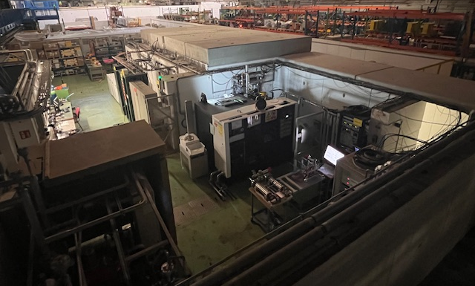
Current Xbox2
Testing needs for CLIC winding down
Available water station, electricity, infrastructure
Xbox2 klystron and modulator could be going to AWAKE in 2027
Good candidate for PACRI testing

Slide 4
WP9 Tasks
WP9: RF systems power tests and validation
T9.0 Specifications
In conjunction with Thales, Scandinova and INFN define system performance and testing reach
T9.1 Setup of the RF test area
Verification of power and cooling water availability.
Vacate the Xbox2 current area.
Procurement of waveguides and components
Procurement of LLRF system and control hardware
Development of control software
T9.2 RF systems power tests and validation
Full characterization of the modulator (in a load?)
Full characterization of the klystron
Performance for pulse compressor.

Slide 5
High level schedule

Slide 6
The work ahead of us
Design phase to be followed closely
Specifications important before placement can be decided
New systems for control and acquisition
Very tight schedule for testing.
No bult-in margin
What to do after PACRI?

Slide 7
Thanks

