Slide 1
WP12 High-rep rate pump sources for laser drivers
Tyler Green – ELI ERIC
Mariastefania de Vido – UKRI
Neysha Lobo Ploch, Paul Crump - FBH

Slide 2
WP12 Overview
High repetition rate pump sources for laser drivers
Focus on diode pumped Yb:YAG – based pump sources as applied to pumping 100 Hz short pulse laser systems
Suitable for pumping OPCPA or Ti:Sapphire
Key participants: ELI ERIC, UKRI, FBH
Task 12.1 Upgrade DUHA pump laser for increased average power operation (ELI ERIC)
Task 12.2 Evaluation of optical coatings for high average power, high repetition rate operation (ELI ERIC)
Task 12.3 Investigation of using DPSSL pumped OPCPA as a driver for LWFA (UKRI)
Task 12.4 Design report on diode pump units for 100 Hz DPSSL suitable for LWFA (FBH)

Slide 3
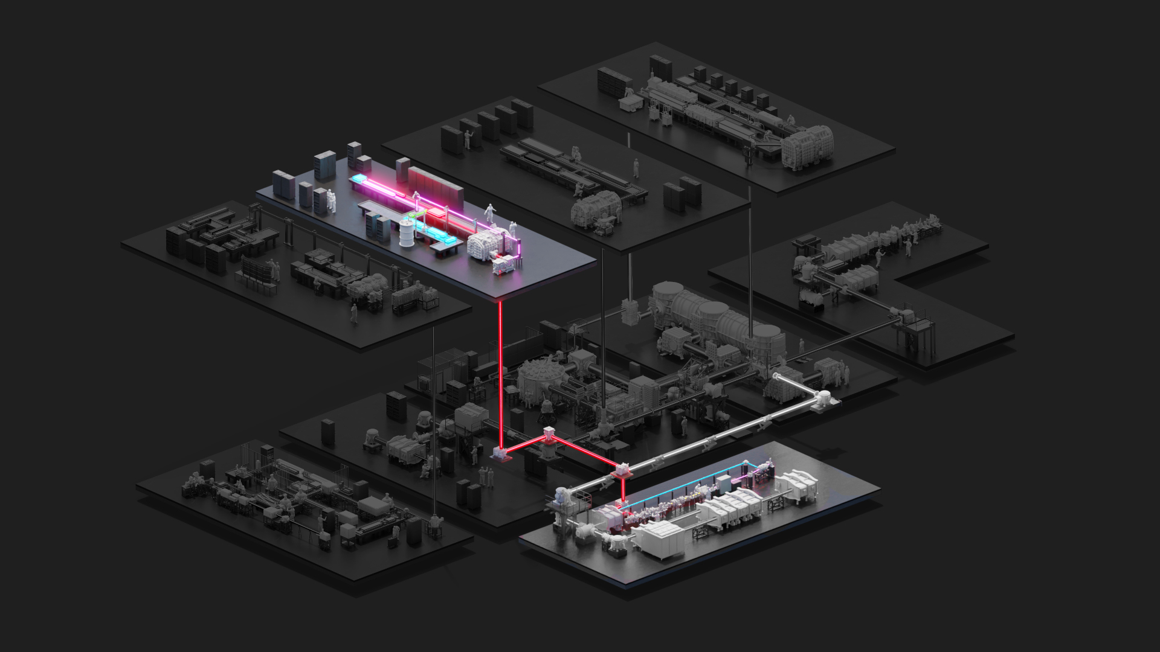
Task 12.1: Upgrade DUHA for increased power
L2-DUHA
3J, 20Hz, 25fs

Slide 4
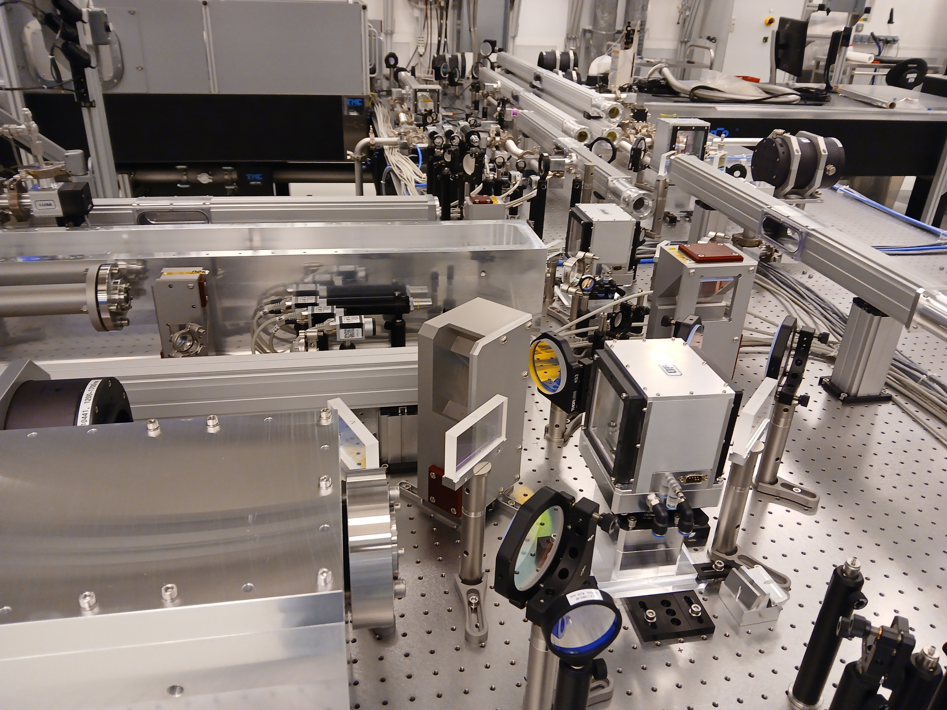
Task 12.1: Upgrade DUHA for increased power
L2-DUHA is based on OPCPA and has high requirements for pump laser quality and optical efficiency/durability.
Both addressed in WP12

Slide 5
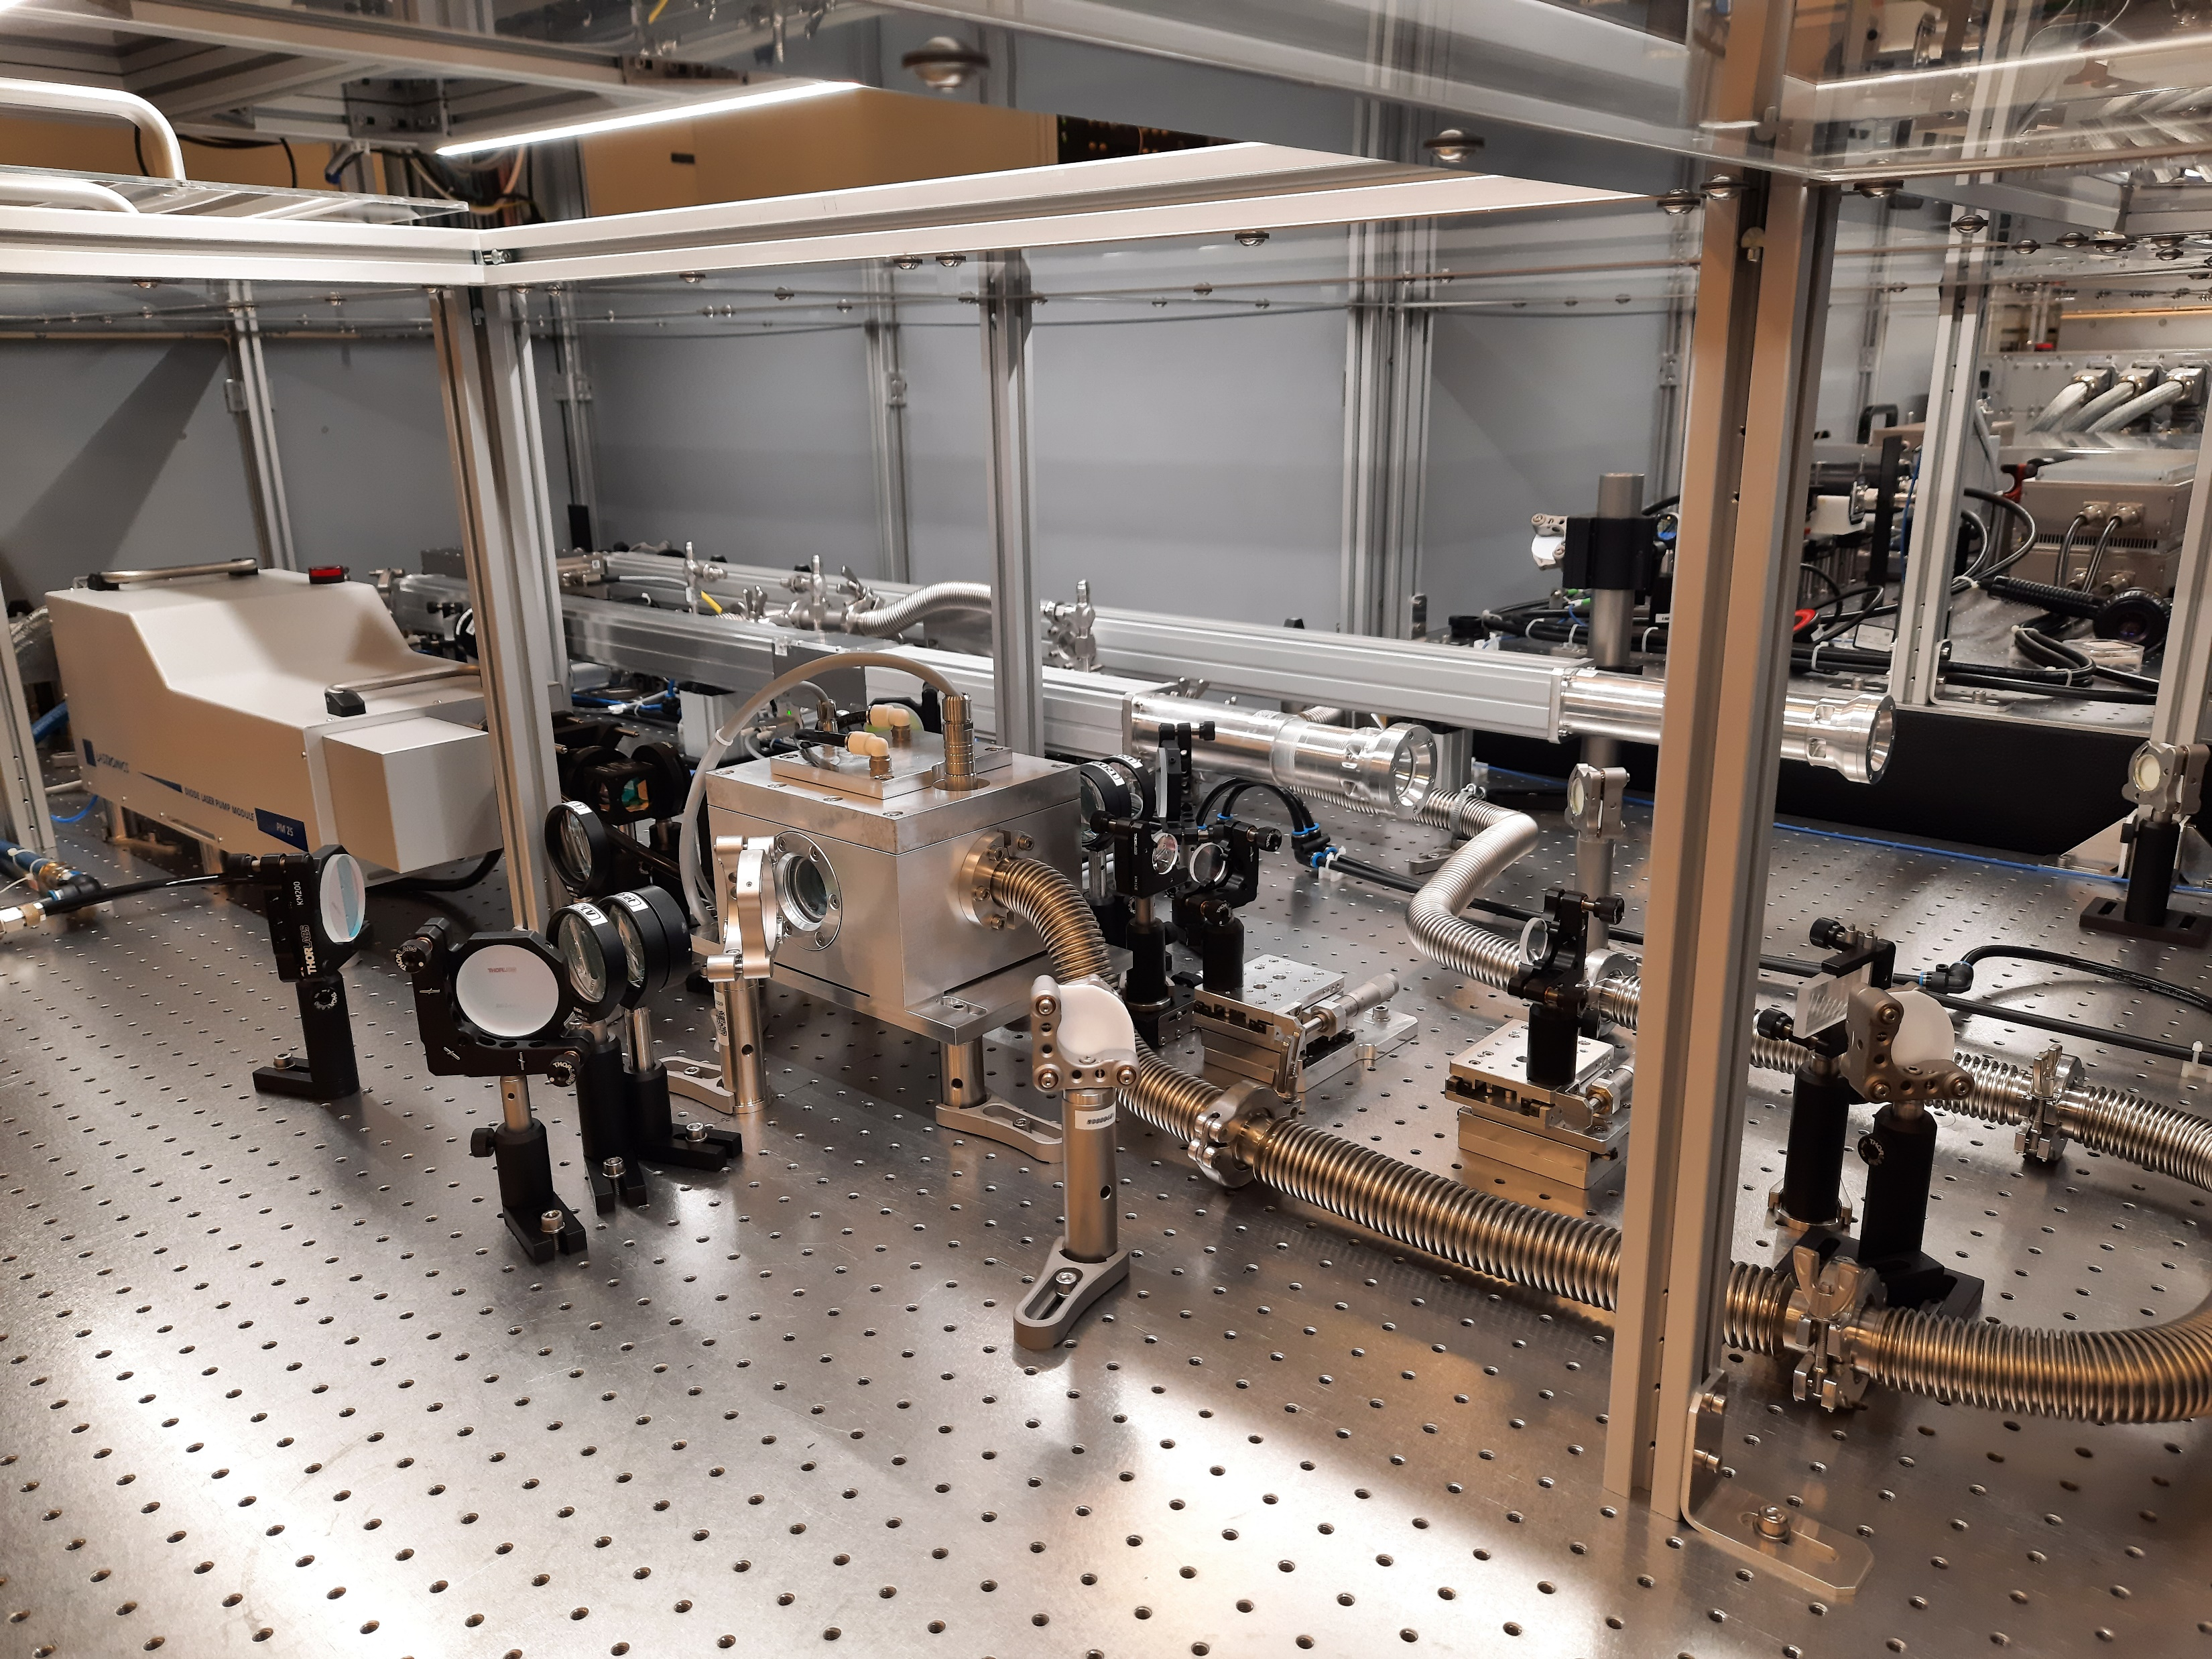
Task 12.1: Upgrade DUHA for increased power
Key goal is to improve profile and wavefront of pump laser for high average power operation
Key focus will be on booster pre-amplifier quality and energy
Mitigate deleterious effects such as depolarization or wavefront distortion at 20Hz and understand how to approach higher repetition rates.
Booster amplifier front end providing 250 mJ, shaped pulses to main amplifier. This will be a significant focus of the effort in Task 12.1.

Slide 6
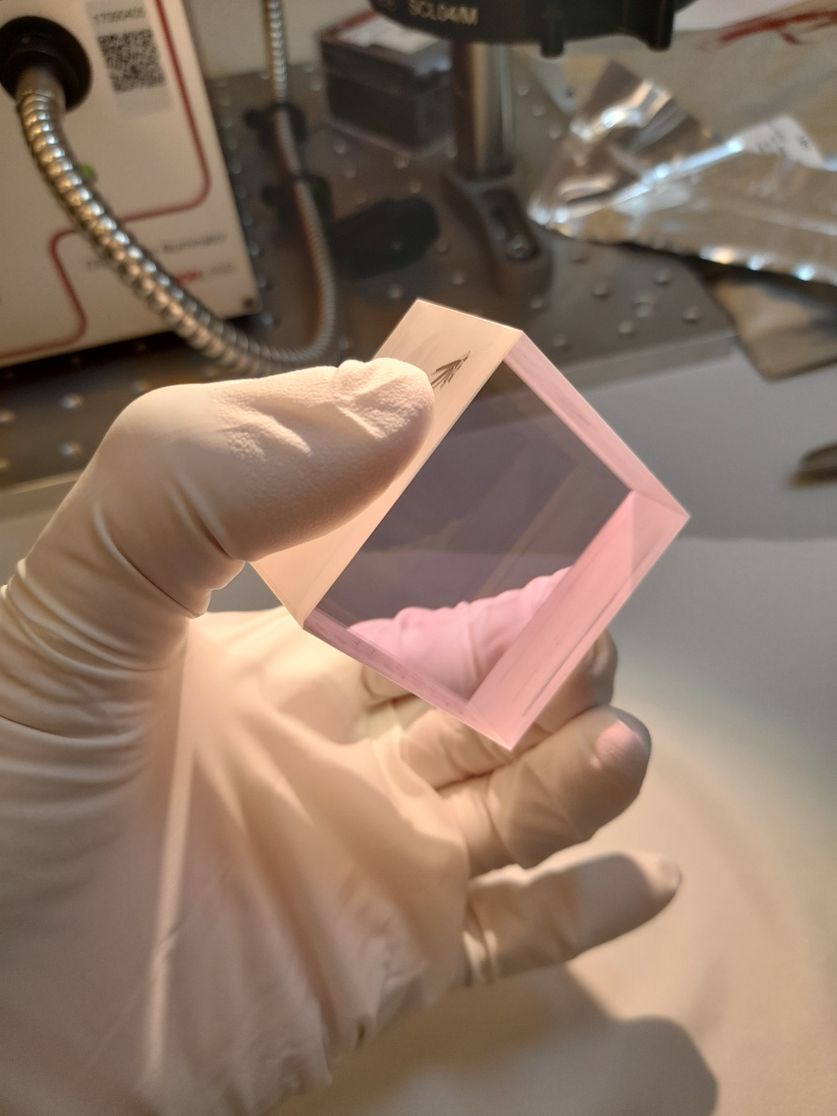
Task 12.2: Evaluation of optical coatings
Evaluate optical coatings in effort to find safe fluence ranges for nanosecond pulses at high average powers (up to 100 Hz)
Optimize balance of durability and efficiency evaluating e-beam and IBS coatings
Key tool for this effort with be KAZI laser (100Hz, 10J laser delivered to HiLase from UKRI) which is installed in L2 hall at ELI

Slide 7
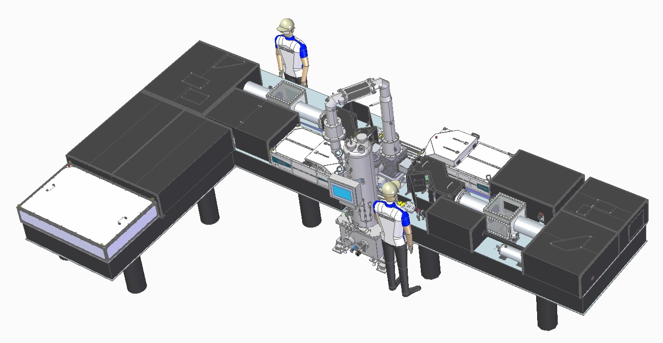
Task 12.3: OPCPA amplifier @ 100 Hz
UKRI will develop a frequency-doubled 100 Hz laser and characterise its output (task 10.1)
Based on the DiPOLE-100Hz concept, which demonstrated 10 J @ 100 Hz at 1030 nm [1]
Performance will be characterised and compared with OPCPA pump requirements calculated by ELI-ERIC.
M. De Vido et al., “Demonstration of stable, long-term operation of a kW-class nanosecond pulsed DPSSL operating at 10 J, 100 Hz,” Optics Express 32(7), 11907-11915 (2024).

Slide 8
Task 12.4: Design report for pump diodes
Direct preparation for EuPRAXIA Facility
Develop, in collaboration with industry (Subcontractor TRUMPF), diode laser pump unit design for 20…100 Hz implementation
Deliver design report on recommended configuration of diode laser pump units for second-site implementation
Efforts steered by results of ERDF co-funded HOTSTACK and internal studies at TRUMPF / FBH
Broad industrial input sought
Assumption: Second site clarified, RFQs released in ca. 24 months
Need clear solution and any tech transfer completed by that point

Slide 9
WP12 Conclusions
Key goals are to address the requirements for pump lasers for future LWFA drivers; specifically considering Yb:YAG based DPSSL architecture.
This work package considers:
How to address deleterious deformations to the high energy amplified pulses with final application of LWFA in mind.
How high repetition rate DPSSL lasers would perform in one of the most demanding roles of a pump laser (i.e. OPCPA pump)
What coatings and optics are suitable for long term reliable operation of such lasers
How to most effectively satisfy the diode requirements for pumping such lasers

Slide 10
WP12 Deliverables overview

Slide 11
Task 10.1: 20-100 Hz Yb:YAG pump laser
2nd generation DiPOLE-100Hz designed
Procurement at advanced state
Data from Amplitude FE?
FBH will be advising on diode pumps

