Slide 1
WP 13 – Prototype of high average power optical compressor
Olivier Chalus (Thales Las)
Kick off Meeting (13th March 2025)

Slide 2
WP 13 objective

Slide 3
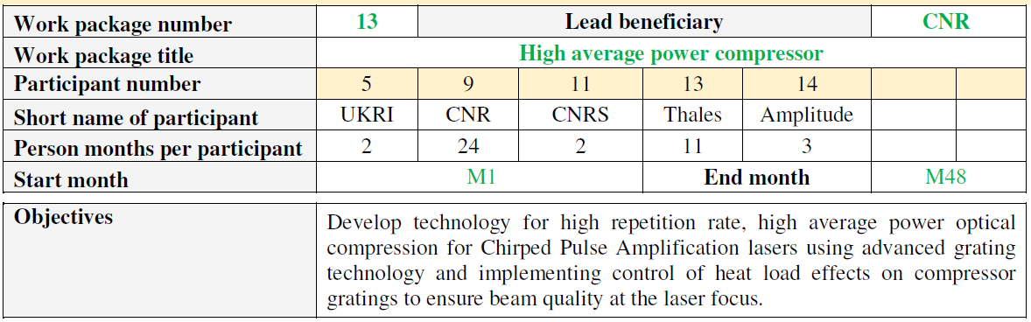
WP 13 – Man-months effort

Slide 4
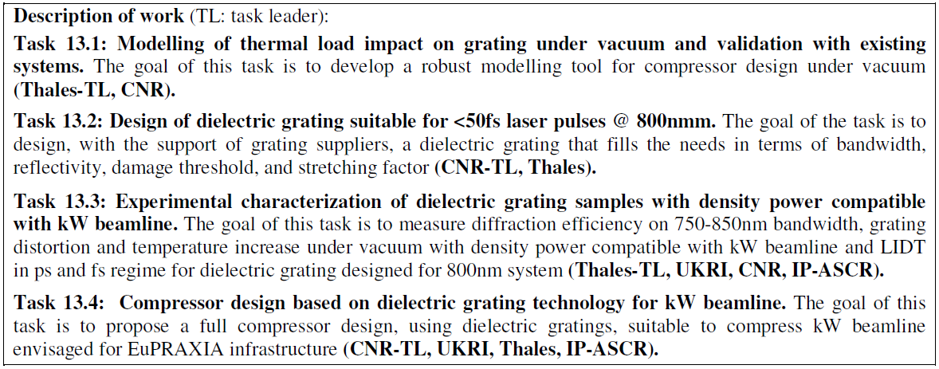
WP13 - Tasks

Slide 5
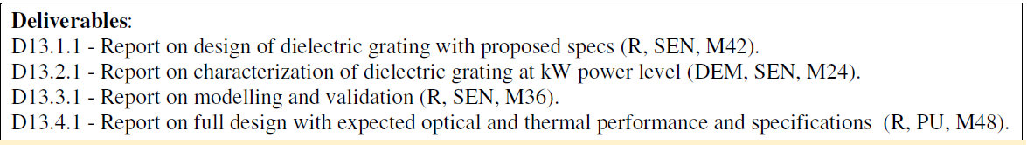
WP13 – Deliverables & Milestones
Milestones

Slide 6
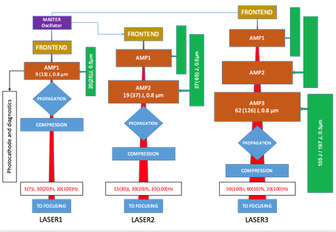
Starting point : Eupraxia-CDR Baseline
P0 (mandatory)
62 J – 20 Hz amplified
60 fs
1240 W average power on 1st grating
P1 (desirable)
126 J – 100 Hz amplified
50 fs
12600 W average power on 1st grating

Slide 7
State of the art of High Average Power TiSa CPA
Laser system as per Eupraxia-CDR baseline is a short pulse Titanium Sapphire based CPA
  1 kW average – 60 fs pulse for P0
  10 kW average – 50 fs pulse for P1
State of the art for measured performance of lasers in operation is below 100 W (highest average power: 86 W on ALEPH@CSU)
Ongoing projects (ramping up of facilities such as ELI BeamLines, ELI-ALPS - new developments such as 1J – 100 Hz of Thales) won’t exceed 300 W of average power (HAPLS once reaching full spec)
Therefore we need to design something substantially new to increase average power by 1 to 2 orders of magnitude

Slide 8
High average power compression – the rationale
TiSa based CPA exploit the broad amplification bandwidth of TiSa to produce very short pulses → typically 20-25 fs
To do so spectral transmission of all elements in the laser chain has to be maximised
Regarding compression gratings , the technology currently used is gold-coated reflective gratings who exhibit large spectral bandwidth
Unfortunately gold layer absorbs 3-4% of incident laser radiation
→ Heat load of grating surface + poor heat removal (grating in vacuum)

Slide 9
Potential solutions for high average power compression
Active cooling of gratings
Can efficiently remove heat and stabilize temperature
Still high heat load and potential surface deformation
Complex implementation
Use of MLD (Multi Layers Dielectric) gratings
Low heat load at the surface
Limited coating bandwidth leading to complex implementation (out of plane schemes)
Low LIDT due to complexity of coating
Combination of both → might be the only solution for Eupraxia P1

Slide 10
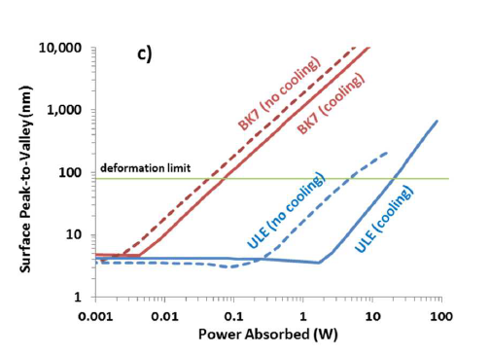
Average power scaling
Gold (1 kW incident)
Heat load of 30 W (3% absorption) → doesn’t work
MLD (1 kW incident)
Heat load of 1 W for 0.1% absorption
Head load of 3W for 0.3% absorption → needs cooling
MLD (10 kW incident)
Heat load of 10 W for 0.1% absorption→ needs cooling
Heat load of 30 W for 0.3% absorption→ doesn’t work
From Alessi, Optics Express 2016
For P0 , MLD coating specs can be relaxed if cooling
P1 is the most stringent: needs in the same time active cooling and low loss MLD coating

Slide 11
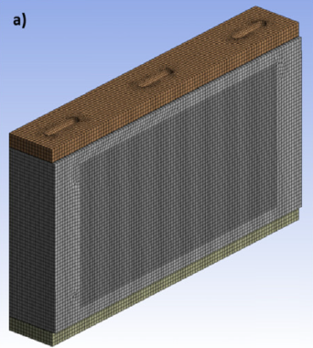
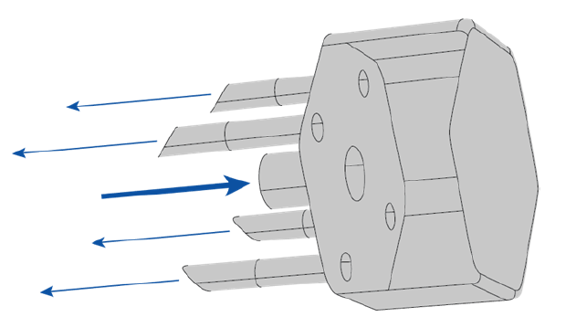
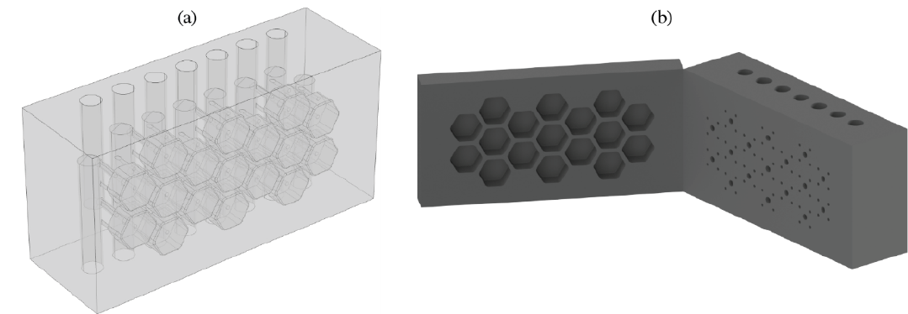
State of the art of active cooling
LLNL design (cooling bars at top and bottom)
(from Alessi & al, Optics Express 2016)
LLE concept of « flow-cell » active cooling for ceramic optics
(from Power & al, Optics Express 2022)
Also some ongoing work by STFC for EPAC and Thales …

Slide 12
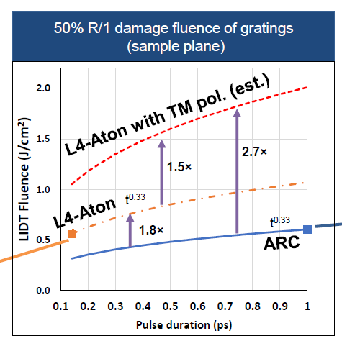
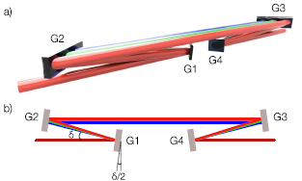
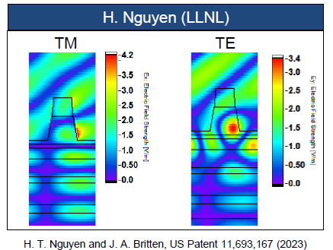
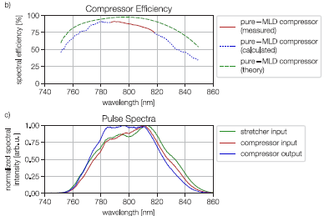
State of the art of MLD gratings
Recent breakthrough from LLNL: significant improvement of LIDT of MLD gratings when using TM polarisation (due to reduced e-field in the grating)
(from Alessi & al, ICUIL conference 2024)
Example of implementation of out-of-plane compressor with MLD gratings for TiSa CPA
(from Werle & al , Optics Express 2023)

Slide 13
Amplitude contribution to WP10-14
WP10.2 : Nd-based Diode-Pumped laser Development
WP10.3 : Conceptual design for TiSa PW amplifier @20Hz
WP11.2 : Post-compression of kHz ps pulses
WP13.3 : Compressor design based on dielectric gratings technology for kW beamline
WP14.1-2-3 : Laser driver system architecture, transport and engineering

Slide 14
WP13 : High average power laser Amplifier
  WP13.3 : Compressor design based on dielectric gratings
  Technology for kW beamline

Slide 15
WP13.3 : Prototype of kW-class PW compressor
  Strategic goal : Compress kW-class TiSa amplifiers
  Amplitude contribution :
    Evaluate MLD gratings performances (heating, bandwidth)
    Design a compressor based on MLD gratings
  Deliverable : Report on MLD compressor for kW beamline
  Due date : T0 + 48
  Planning :
    T0 to T0+24 : design and test MLD based compressor at low power
    T0+24 to T0+48 : extrapolate design for kW-class beamline

Slide 16

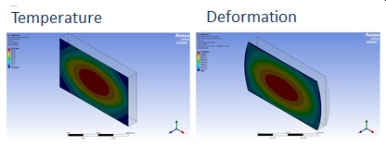
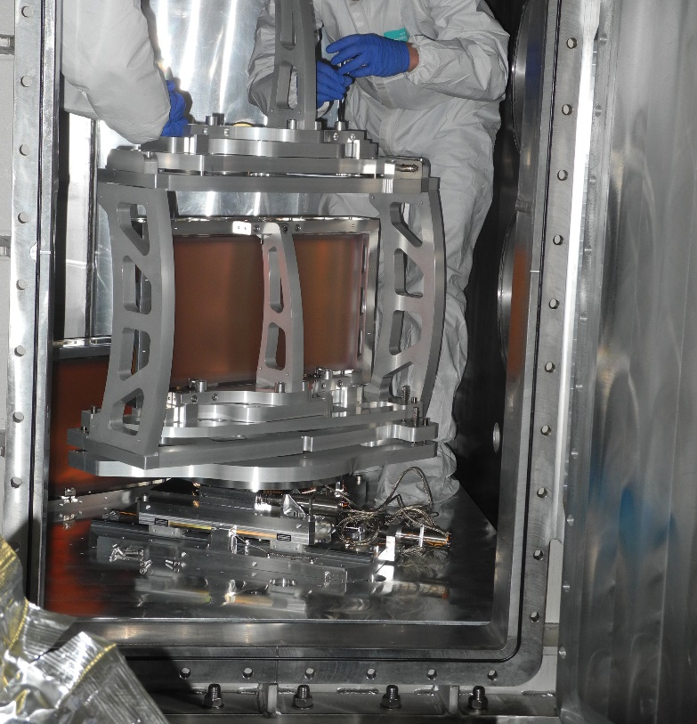

WP13 Prototype of high average power optical compressor
Simulations: gratings thermal behaviour
Model validation with experiments & Component testing
simulations of the behaviour of diffraction gratings under thermal loading induced by VEGA2 and VEGA3 operating at their nominal repetition rate (1-10 Hz).
Procurement of sensor elements for the diffraction gratings and sensor elements and data acquisition for the laboratory are foreseen.
Milestone: To compare the results of this data acquisition with the simulations performed.
VEGA 3 PW laser
optical compressor
Task 13.3: Compressor design based on dielectric grating technology for kW beamline. The goal of this task is to propose a full compressor design, using dielectric gratings, suitable to compress kW beamline envisaged for EuPRAXIA infrastructure
Task 13.1: Modelling of thermal load impact on grating under vacuum and validation with existing systems. The goal of this task is to develop a robust modelling tool for compressor design under vacuum

Slide 17


WP13 – Prototype of high average power optical compressor (UKRI contribution)
UKRI will contribute on the following activities within WP13:
Modelling of compressor gratings, including thermal load analysis
Development of candidate grating designs to inform grating manufacturer options
Validation of performance of prototype gratings
Contribute to design of overall compressor based on dielectric grating technology
Deliverable D13.1.1 – Report on characterisation of dielectric grating at kW power level
Deliverable D13.2.1 – Report on modelling and validation
Deliverable D13.3.1 – Report on design of dielectric gratings-based compressor for kW beamline

Slide 18
Short term tasks
Organize a technical workshop
Identify laser facilities (preferably among PACRI partners) to perform comparison of modelling results & experimental validations
Identify possible providers of MLD gratings and start connections with them

