Slide 1
WP14 : Laser driver system architecture, transport and engineering
L. Gizzi, K. Cassou, D. Papadopoulos
with Amplitude and Thales

Slide 2
Informations
Femtosecond multi-100 TW CPA laser driver operating at ≥ 20 Hz reaching 24/7 operation for user beam delivery with a correct uptime is a huge challenge
No current laser system complying

Slide 3
WP and tasks
Last minute change in the WP14 organisation, F. Mathieu left CNRS for new adventures.
Re-organisation of the WP14 has to be discussed between remaining partner in WP10 to WP14
CNRS/ LULI will only contribute to wavefront stabilisation R&D
System engineering in task14.1 is looking for a new coordinator.
IJClab will support more than initially plan in 14.2 supporting CNR-INO

Slide 4
Deliverables and Milestones
Milestone No | Milestone name | Related WP(s) | Due date (in month) | Means of verification
M14 | Team in place with all the employment done | 14 | 12 | Webpage
M18 | Review of subsystems at medium scale laser facilities completed (M18) | 14 | 18 | Int. report
M28 | Workshop on system engineering | 14 | 24 | Workshop report
Deliverable | DL name | Related WP(s) | Due date (in month) | Means of verification | Milestone No | Milestone name | Related WP(s)
14.3 | D14.2.2 | Report on overall laser architecture | 14 | CNRS | R | SEN | 40
14.4 | D14.3.1 | Report on subsystems for operation | 14 | CNRS | R | SEN | 43
14.5 | D14.3.2 | Report on architecture of a focal spot stabilisation system | 14 | CNRS | R | PU | 46

Slide 5
WP14.3 : Focal spot stabilisation
CNRS-TL, CNR, IP-ASCR, Thales, Amplitude

Slide 6
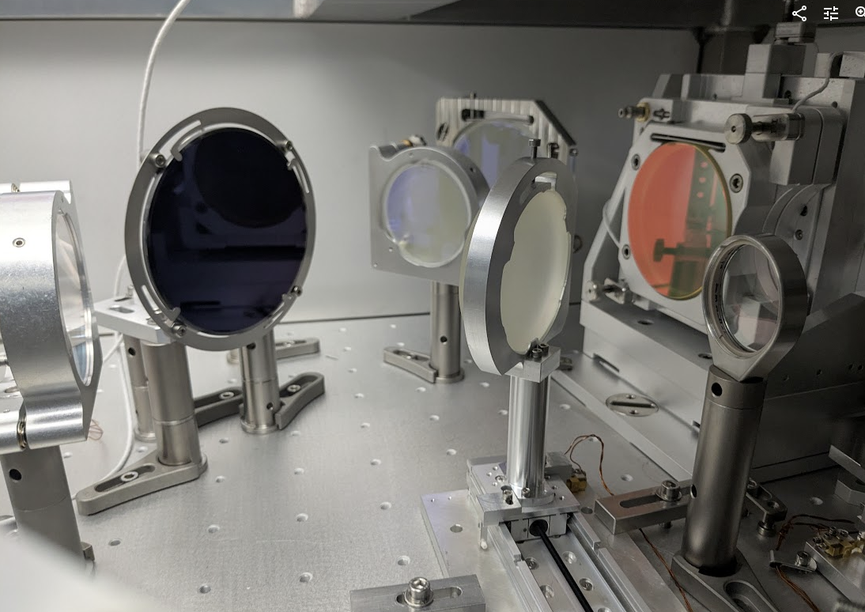
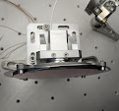
Focal spot stabilisation
It’s mandatory for optimal LPA operation to reach high beam pointing stability ≤ 1urad (RMS) level and wavefront stability (Strehl ratio, stable size)
Beam pointing stabilisation
Active stabilisation in key point of the laser system
Large aperture fast stabilisation optic and mount
Drift alignment compensation (PID vs Reinforcement Learning )
Passive stabilisation by system design optimisation ( linked to system engineering WP14.1 and other related WP)
Robert A Hardin et al. : Optics Express 19.4 (2011), pp. 2874– 2885.
Guillaume Genoud et al. : Review of Scientific Instruments 82.3 (2011), p. 033102
Fumika Isono et al. High Power Laser Science and Engineering 9 (2021), e25.
Curtis Berger et alPhysical Review Accelerators and Beams 26.3 (2023), p. 032801

Slide 7
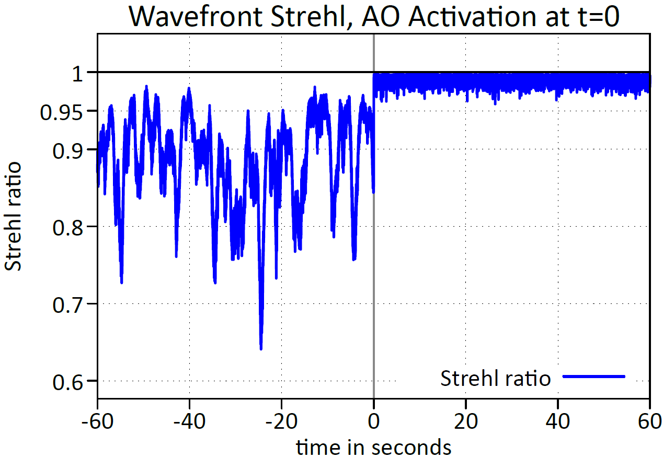
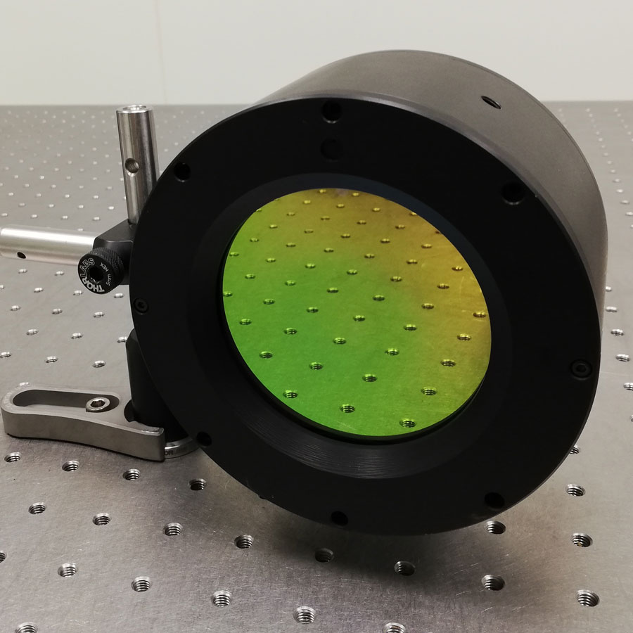
Wavefront stabilisation
Wavefront instabilities in large scale PW class laser facilities have a direct impact on the both on the intensity stability of the focused beam but also on the interaction of the beam over the whole volume of the gas target (beam caustic evolution)
Wavefront stabilisation in the Apollon laser
State of the art ultrafast Wavefront Sensor and Deformable Mirror technology in Apollon allows impressive improvement of the stability up to a >70 Hz cut-off frequency*.
The wavefront stabilisation loop is not sufficiently improving the pointing stability of the beam (only by 2-3x).
There is a real need to work on the combined operation pointing and wavefront stabilization loops and study in detail the potential cross talk effects between them.
*J. B. Ohland et al. “Apollon Real-Time Adaptive Optics (ARTAO) -- Astronomy-Inspired Wavefront Stabilization in Ultraintense Lasers,” accepted for publication in HPLSE, February 2025, (https://arxiv.org/abs/2412.08418)
Custom high-speed WFS
XIMEA PCIe camera, 7 kHz
Do evaluation on GPU
Bimorph DM by Dynamic Optics
60 mm aperture, 96 actuators
1.3 kHz, ca. 1 ms latency

