Slide 1
PACRI 1st General Assembly
G. D’Auria - Elettra Sincrotrone Trieste

Slide 2
1st GA - Agenda
Our aim for today:
# | CA article | Motion
1 | 6.2.2.3 – Sending the agenda | Approval of the agenda
2 | 6.2.1 – Representation in Meetings | Identify GA members (in presence / remote)
3 | 6.3.1 – General Assembly, 6.3.1.1.3 | Election of the Chair of the General Assembly
4 | 6.3.1.2 – Decisions | Appointment of the coordinators of the three pillars of the Project: (i) normal conducting RF accelerators (RF), ii) plasma acceleration (PA), iii) high power lasers (LA)
5 | 6.3.1.2 – Decisions | Approval of a list of names to be selected as External Expert Advisory Board Members: the (3) members of the Scientific Advisory Committee → SLIDO
6 | 6.3.2 – Executive Board | Give mandate to the Project Manager to appoint as Deputy PM the person selected from the call closed by Elettra on 04/03/2025
7 | 7.2 – Payments, 7.2.2 prepayment | Approval distribution as in article 7.2.2 before CA signed → SLIDO
8 | - | Approval of list of amended deliverables → for future amendment
9 | - | PACRI logo choice → SLIDO
10 | - | Choice of location for 1st Annual Meeting

Slide 3
Disambiguation
CA Article | Term in PACRI Consortium Agreement | Term in PACRI Proposal / Grant Agreement | NOTE
6.1 – General structure | General Assembly | Collaboration Board | We will use GA
 | Executive Board | Project Office | We will use EB
 | Coordinator | Coordinator | Meaning Elettra – Sincrotrone Trieste S.C.p.A.
 | External Expert Advisory Board | Scientific Advisory Committee | We will use SAC

Slide 4
General Assembly - Composition
1 representative per Beneficiary + 1 per Associated Partner + Proj Manager (w/o voting rights)
# | Short Name | GA delegate
1 | ELETTRA - 1 | G. D’Auria (C. Masciovecchio)
2 | CERN – 1&3 | N. Catalan-Lasheras
3 | INFN - 1 | M. Ferrario
4 | ULIV - 3 | C. Welsch
5 | THALES AVS - 3 | Y. Jaballi
6 | SCANDINOVA - 3 | M. Lindholm
7 | VDL ETG - 3 | M. Jansen
8 | COMEB - 1 | M. Machado
9 | UKRI - 3 | M.S. De Vido
10 | CNR - 1 | L. A. Gizzi
11 | ELI – 3 | A. Weeks
12 | CNRS - 3 | B. Cros
13 | THALES LAS - 1 | C. Simon-Boisson
# | Short Name | GA delegate
14 | AMPLITUDE - 1 | A. Courjaud
15 | CLPU - 3 | M. Rico (G. Gatti)
16 | FBH - 3 | N. Lobo Ploch
17 | IST - 3 | J. Vieira
18 | UROM - 1 | E. Chiadroni
19 | UDUS - 3 | T. Heinemann
20 | DESY - 1 | M. Thevenet
21 | UOXF | S. Hooker
22 | LMU | S. Karsch
23 | GSI - 1 | R. Assmann
24 | UTOV - 1 | A. Cianchi
25 | SOURCELAB - 1 | F. Sylla
26 | PSI - 1 | R. Ischebeck / M. Erat
from remote
absent

Slide 5
Voting rules - 1
Each Consortium Body shall not deliberate and decide validly in meetings unless two-thirds (2/3) of its Members are present or represented (quorum).
Each Member of a Consortium Body present or represented in the meeting shall have one vote. Associated Partners are excluded from certain decisions of the General Assembly according to Section 6.3.1.1.4 → see next slide
Decisions shall be taken by a majority of two-thirds (2/3) of the votes cast.
Notes:
6.2.3.1 [2nd half] If the quorum is not reached, the chairperson of the Consortium Body shall convene another ordinary meeting within 15 calendar days. If in this meeting the quorum is not reached once more, the chairperson shall convene an extraordinary meeting which shall be entitled to decide if one-half (1/2) of its Members is present or represented.

Slide 6
Voting rules - 2
The Associated Partner (PSI) is excluded from voting on and vetoing the following decisions of the General Assembly (6.3.1.2) and therefore are not counted towards any respective quorum:
Financial changes to the Consortium Plan
Distribution of EU contribution among the Beneficiaries
Proposals for changes to Annex 2 of the Grant Agreement to be agreed by the Granting Authority
Decisions related to Section 7.1.4 of this Consortium Agreement

Slide 7
Chair of the GA + Pillars
The Chair of the PACRI General Assembly is:
Appointment of the coordinators of the three pillars of the Project:
normal conducting RF accelerators (RF): Gerardo D’Auria
plasma acceleration (PA): Massimo Ferrario
high power lasers (LA): Leonida Antonio Gizzi

Slide 8
Scientific Advisory Board
List of names:
New name to be found for RF
Victor Malka (Weizmann Institute) – PA
Lukas Gruber (LEONARDO) – LA
GA members: suggest names before end of March 2025
Remote voting afterwards
Ranking

Slide 9
Executive Board - composition
The Executive Board shall consist of the Project Manager, the deputy Project Manager, appointed by the General Assembly, the Administrative Manager, appointed by the Coordinator, the Chair of the General Assembly and the coordinators of the RF, PA, and LA, pillars of the Project, appointed by the General Assembly.
Executive Board composition
Project Manager | G. D’Auria
Deputy Project Manager | to be appointed
Administrative Manager | R. Gioppo
Chair of the GA | L. A. Gizzi
Coordinator of RF Pillar | G. D’Auria
Deputy Coordinator RF | N. Catalan-Lasheras
Coordinator of the PA Pillar | M. Ferrario
Deputy Coordinator PA | B. Cros
Coordinator of the LA Pillar | L. A. Gizzi
Deputy Coordinator LA | M.S. De Vido
Deputy Coordinators added

Slide 10
Executive Board - DPM
The Coordinator (ELETTRA) opened a call for a PACRI Project Officer
Call closed 04/03
2 years 100% position
Selection starting soon
The Coordinator asks the GA to receive a mandate to appoint, as Deputy Project Manager, the person selected for this position.

Slide 11
Prepayment status
60 % | EU pre-financing on its receipt
20 % | EU pre-financing after the end of the first year of the Project, subject to the approval of the Coollaboration Board at the first Annual Meeting
20 % | EU pre-financing after the end of the second year of the Projects, upon submission of the First Periodic Report
Interim payments after the submission of each financial report in accordance with the reporting procedures
Exceptions: Beneficiaries with EC contribution < 150kEuro VDL ETG, COMEB, IST, UROM, UTOV
Prepayment received on March 7th 2025
Please send us your Financial Identification Forms

Slide 12
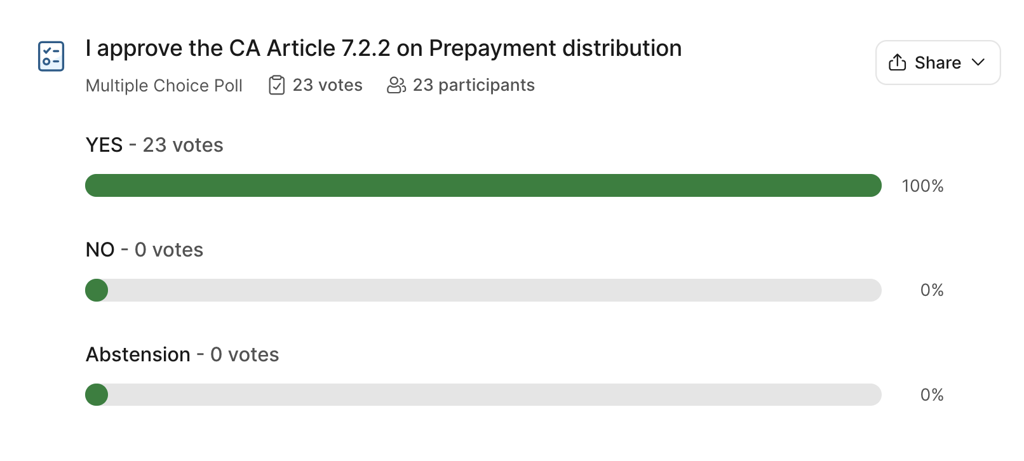
PSI not voting for budgetary issues → 23/23 votes → unanimity

Slide 13
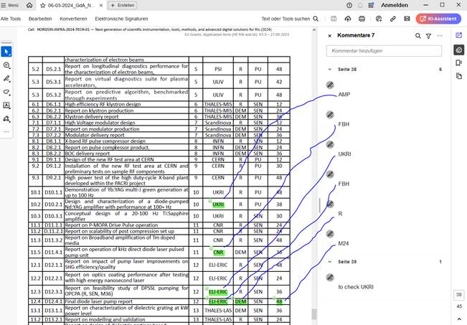
List of amended deliverables
Some Beneficiaries spotted some clerical errors in the Deliverables list, and some other requested changes.
We plan to ask for an amendment to correct them in the system and in the Grant Agreement
In particular:
D10.2.1: Amplitude instead of UKRI
D11.4.1: FBH instead of CNR
D12.3.1: UKRI instead of ELI-ERIC
D12.4.1.FBH instead of ELI-ERIC and “Report” instead of “Demonstrator” and M24 instead of M48
5. Move CLPU effort from Task 12.1 to Task 11.4 (tbc)
6. Move milestone M12 from T0+12 to T0+24
7. D11.2 move from M24 to M36 + different title
→ Please check by end of April 2025 and give feedback to us
More items
The Coordinator asks the to receive mandate to collect changes and prepare an amendment to be proposed to the PO.

Slide 14
PACRI Logo
2nd round vote: #1 or #3

Slide 15
PACRI Logo
# | PARTNER | 1 or 3
1 | ELETTRA | 1
2 | CERN – 1&3 | 1&3
3 | INFN | 1
4 | ULIV | 3
5 | THALES AVS | 3
6 | SCANDINOVA | 3
7 | VDL ETG | 3
8 | COMEB | 1
9 | UKRI | 3
10 | CNR | 1
11 | ELI | 3
12 | CNRS | 3
13 | THALES LAS | 1
# | PARTNER | 1 or 3
14 | AMPLITUDE | 1
15 | CLPU | 3
16 | FBH | 3
17 | IST | 3
18 | UROM | 1
19 | UDUS | 3
20 | DESY | 1
21 | UOXF | -
22 | LMU | -
23 | GSI | 1
24 | UTOV | 1
25 | SOURCELAB | 1
26 | PSI | 1
#1: 12 votes
#3: 11 votes
Logo #1 selected

Slide 16
Next Annual Meeting
Candidates for Next Annual Meeting ?
Location ?
Please send suggestions / proposals for the next Annual Meeting
Before end of April 2025
Date(s) ?
End of year 1 → February 2026

Slide 17
Trieste Kick-off meeting
Thank you!
PACRI – 101188004 – Funded by the European Union. Views and opinions expressed are however those of the author(s) only and do not necessarily reflect those of the European Union or the European Research Executive Agency (REA). Neither the European Union nor the granting authority can be held responsible for them.

Slide 18
https://indico.elettra.eu/event/52/
PACRI – 101188004 – Funded by the European Union. Views and opinions expressed are however those of the author(s) only and do not necessarily reflect those of the European Union or the European Research Executive Agency (REA). Neither the European Union nor the granting authority can be held responsible for them.

