Slide 1
PROJECT PACRI
Call topic HORIZON-INFRA-2024-TECH-01
Kick-off meeting 12-14/03/2025
Disclaimer: Information not legally binding
Sotirios Kakarantzas
European Research Executive Agency

Slide 2
Outline
I.Monitoring & Reporting
Technical Reporting
Financial Reporting
Audits
Amendments
II.Cross-cutting aspects
Impact
Communication, Dissemination & Exploitation
Open Science
Policy Feedback
Ethics
III.Extra Resources

Slide 3
Role Distribution
DG Research and Innovation
-> Definition of Policies
-> Drafting the Work Programme
European Research Executive Agency (REA)
‘Reforming European Research & Innovation and Research Infrastructures’, Unit C4
-> Implementation of calls for proposals
-> Grant Management
Coordinator
-> Monitor that the action is implemented properly
-> Act as the intermediary for all communications with REA
-> Distribution of payments

Slide 4
I. Monitoring and Reporting
Technical Reporting
Financial Reporting
Audits
Amendments

Slide 5
Monitoring Project Implementation
Technical: compliance with the Description of the Action
Financial: compliance with the cost eligibility rules
Other (non-financial) obligations: compliance with cross-cutting GA obligations
Notes:
The monitoring usually covers 3 aspects: technical, financial and non-financial.

Slide 6
Project reporting types
Beneficiaries must continuously report on the progress of the action (e.g. deliverables, milestones, outputs/outcomes, critical risks, indicators, etc), in the Portal Continuous Reporting Module and in accordance with the timing and conditions set out in the Grant Agreement
In addition, Beneficiaries must provide Periodic Reporting (= technical + financial reports) to request payments, in accordance with the schedule and modalities set out in the Grant Agreement
Notes:
Continuous reporting = activated at the start of the project and continuously open until the end of the period
Periodic reporting = activated at the end of reporting periods

Slide 7
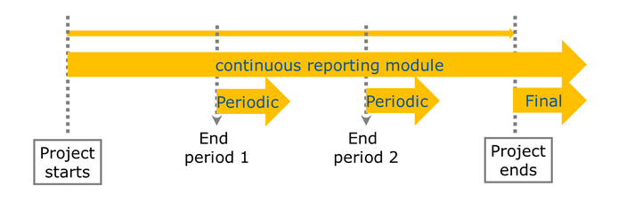
Project reporting types

Slide 8
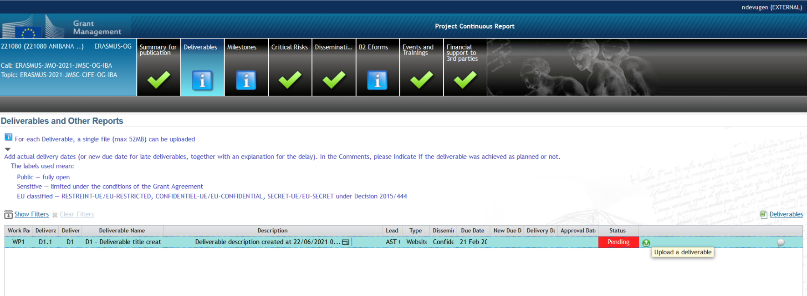
Continuous Reporting – Deliverables
Deliverables marked as Public will be automatically published in Cordis - Be particularly attentive to their quality and GDPR requirements
If deliverables will be delivered with delay - Contact REA PO

Slide 9
Periodic Reporting: Overview
WHEN
60 days after reporting period end
WHAT
Periodic Report
HOW
via Portal
(1) Technical report
By Coordinator with contributions from Consortium
Part A: structured tables with project information, generated automatically from Continuous Reporting
Part B: narrative description of the work carried out during the reporting period (uploaded as PDF)
(2) Financial report
Individual Financial Statement for each Beneficiary
Explanation of the Use of Resources and information on subcontracting
Certificates on the Financial Statements (CFS)*
(*) Requested EU contribution to costs ≥ EUR 430 000.
Special threshold for beneficiaries with a systems and process audit: requested EU contribution to costs ≥ EUR 725 000.00
Notes:
* What was done and achieved?
* Which problems were encountered?
* How can progress so far be assessed?
* Were there any deviations or corrective actions?
Periodic Reporting Module – Steps
Notification: all beneficiaries receive a notification
All beneficiaries
contribute to the Technical Part of the Periodic Report
complete their own Financial Statement and
e-sign (PFSIGN) and submit their Financial Statements to the Coordinator.
The Coordinator approves and submits the elements of the Periodic Report to the EU Services.
The EU Services review the submitted Periodic Report and accept or reject it.
Periodic Payment

Slide 10
Periodic Reporting: Reviews
Reviews planned at the end of each reporting period
(within 1 month after submission of reports) - GA article 25
Present the work carried out, main achievements and use of resources
Participation of Coordinator & WP leaders (minimum)
REA Project Officer assisted by external expert(s)
Notes:
1 month after submission of the report or 3 months after end of the reporting period

Slide 11
Periodic Reporting: Process
End of reporting period
Revisions and explanations
End of reporting and payment
Within 60 days
DELIVERABLES submitted
Periodic REPORT
submitted (technical and financial)
Submission of revised version of reports (technical and financial)
ALL documents received, correct and accepted
Comments from
Project Officer and Financial Officer – clarifications and modifications may be requested
Initiation payment
Review meeting*
Review report submitted
*A review meeting might not be necessary, to be decided with PO

Slide 12
Trans-National Access (TNA) activities 1/2
TNA available to external users:
User visits installation in-person,
Remote delivery of scientific services: sending reference materials or samples, RI staff performing tasks on behalf of users, etc.
Open calls to invite researchers to apply for access
Documentation needed to support/justify the amount of access reported
Records of the names, nationalities, and home institutions of the users, nature and quantity of access provided
Selection of researchers/research teams
Competitive evaluation and selection of proposals by experts, of which at least half independent from the consortium
Notes:
Specific rules for access to research infrastructure activities are in the GA – Annex 5 – Article 18.
in person (‘hands-on’), when the user visits the infrastructure to make use of equipment
remote scientific services, such as the provision of reference materials or samples, the remote access to a high-performance computing facility
The research infrastructures must promote equal opportunities in advertising the access and take into account gender issues when defining the support provided to visitors.
Regarding the Selection of researchers/research teams, the selection panels must be composed of international experts in the field, at least half of them independent from the consortium (unless otherwise specified in Annex 1).

Slide 13
Trans-National Access (TNA) activities 2/2
The user team, or its majority, must be affiliated to institutions in countries other than the country where the installation is located
Except when access provider is International Organisation, JRC, ERIC or similar entity
Third countries access permitted up to max cumulative access of 20% of the total amount of units of access
The EU financial support covers:
The access costs incurred by the access provider in providing access to the selected users,
The travel and subsistence costs incurred by the access provider to cover for the user’s visit to the installation (duration limited to 3 months)
Notes:
The duration of stay at a research infrastructure must normally be limited to three months, unless otherwise provided for in the proposal.
ESRF is considered a legal entity with international membership (for the exception to the rule about users working in countries other than the country where the installation is located).
Access for user groups with a majority of users not working in an EU Member State or Horizon Europe associated country is limited to 20% of the total amount of units of access provided under the grant (unless a higher percentage is foreseen in Annex 1)

Slide 14
Virtual Access (VA) activities
VA given to users according to RI’s access policy, no formal selection process (but authentication requirements are possible)
e.g. access to databases available via Internet, or data deposition
VA measured through units of access clearly defined in the GA and must be periodically assessed by an external board.
The EU financial support covers the access costs incurred by the infrastructure, including the technological and scientific support

Slide 15
Reporting: single submission & single rejection
‘One iteration only’ recommended, if correction of the submitted package is required.
Payment will be proceeded based on the information available after the 1st resubmission; in principle, no further opportunities to correct mistakes or provide additional information (i.e. corresponding costs will be rejected); except for final payment.

Slide 16
Financial Statement 1/2
HE C. Purchase costs
C.1 Travel and subsistence (column C1)
C.2 Equipment (column C2)
C.3 Other goods, works and services (column C3)
HE A. Personnel costs
A.1 Employees (or equivalent)
A.4 SME owners and natural person beneficiaries
A.3 Seconded persons
A. 2 Natural persons with direct contract
Simplified calculation
Daily rate x Nr of day-equivalents worked (to the nearest half day)
Daily rate = annual personnel costs for the person ÷ 215
Notes:
Simplified calculation from H2020: Daily rate x number of day-equivalents worked (to the nearest half day).
- Daily rate = annual personnel costs for the person ÷ 215

Slide 17
Financial Statements 2/2
D.1 Financial support to third parties
Specific cost categories:
D.5 PCP/PPI procurement costs
D.6 Euratom Cofund staff mobility costs
D.7 ERC additional funding
D.8 ERC additional funding (subcontracting, FSTP and internally invoiced goods and services)
HE D. Other cost categories
HE D. Other cost categories
D.2 Internally invoiced goods and services
D.3 Transnational access to research infrastructures unit costs
D.4 Virtual access to research infrastructures unit costs

Slide 18
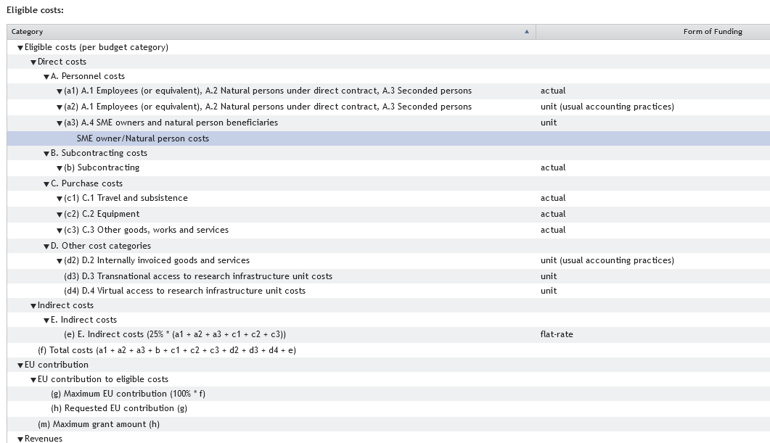
Financial Statement: online layout
Notes:
SME owners: unit costs at a daily fixed rate set out in Annex 2a
Cost explanations: i) mandatory explanation on adjustments (if applicable); ii) no more in-kind contributions against payment (free-of-charge only and described in Annex I) and no more separate column for “Costs of in-kind contributions not used on premises”;
New column “Revenues” in the FS to declare any income generated by the action (H2020 Receipts);
Grant reductions (art. 28 MGA) screen integrated in Sygma screens at final payment step;
Updated Financial Statement layout: changes in costs categories labelling and numbering.

Slide 19
Subcontracting vs. Contracting
Subcontracting - GA art.9.3
can be used to implement certain action tasks described in Annex 1
Contracting
can be used for purchasing goods, works and services which are necessary to implement the action tasks, but not directly linked to them.
may cover only a limited part of the action
if applicable, the tasks to be implemented and the estimated cost for each subcontract must be set out in Annex 1
if applicable, they should be set out in Annex 1
the total estimated costs of subcontracting per beneficiary must be set out in Annex 2
the total estimated costs for contracting should be declared in Annex 2

Slide 20
Financial reporting – eligibility of costs (art.6 GA)
ELIGIBLE COSTS
Actually incurred by the beneficiary
Incurred during the action
Connected to the action
Identifiable and verifiable - accounting
Compliant with national law
Reasonable financially sound
Tips:
Be transparent
Treat all costs according to your usual accounting practice
Check for exceptions beforehand!
Ask: PO, FO
INELIGIBLE COSTS
Identifiable taxes and duties
Deductible VAT
Interest owed / Bank charges
Possible future losses charges
Exchange
losses
Excessive / reckless expenditure
From other EU project
Tips:
Non-deductible VAT is an eligible cost
Ask: PO, FO
Notes:
Standard checks at interim and final payments (actual and unit costs)
Costs are reasonable, necessary, based on the work reported; the resources were used according to the DoA. Any significant deviation is explained in the narrative part;
Expenses are consistent with the principle of sound financial management (economy, efficiency and effectiveness);
In-kind contributions and names of third parties are clearly reported; foreseen in and in line with the DoA;
Subcontracted tasks are described with reference to the DoA (if not, simplified approval procedure can apply); costs budgeted and declared do not significantly differ; costs are satisfactorily explained;
Purchase costs are explained if >15% of personnel costs. Travel and subsistence are not major costs;
CFS are provided; their costs are claimed under purchase costs; the standard template is used; any exception is explained and the auditor has stated an amount (if not, ask to quantify an amount).

Slide 21
Use of Resources
Personnel - actual or unit costs
Number of PM broken down per WP
Amounts and description, if in-kind contribution from third parties
Subcontracting
Actual costs paid for subcontracts (usually in Annex 1) +Third parties (non-financial resources made available free of charge by third parties) + Art.9.2 of the GA
Breakdown of total + explanation + if foreseen in Annex 1
Details to be provided, if not foreseen
Explicit approval from PO during payment processing
Other direct costs
Actual costs incurred for: Travel & subsistence, Equipment, Costs of other goods and services, Costs of large research infrastructures
Explanation needed ONLY if amount > 15% of personnel costs
Cost, description, WP, if foreseen in Annex 1, explanation if not
Amounts and description, if in-kind contribution from third parties
Notes:
Personnel costs must be reported in line with the beneficiary's usual practices. Deviations on personnel per work package must be justified in the technical report. Justification is also necessary in case average personnel costs are significantly higher or lower than planned.
The nature of the subcontracted service (web creation, translation services, etc…), and the name of the subcontractor must be included in explanation provided. The beneficiary needs to confirm best value for money and absence of CoI (Article 9.3 of the GA). Unplanned subcontracting can be directly submitted, upon approval, at reporting stage .
Travel costs: specification of its nature (travel, meeting, conference, representation event), the number of people participating in it, the destination and date(s) of the reported costs. equipment costs: confirmation to be included that only depreciation costs were declared.

Slide 22
Certificates of the Financial Statements (CFS)
Only at the final reporting (or beneficiary termination) and if a beneficiary/affiliated entity requests a total of EUR 430 000 or more as reimbursement of actual costs and unit costs calculated according to its usual cost accounting practices
Scanned copy (PDF) together with Financial Statement submitted in the system; original remains at the beneficiary (might be audited!)
Costs declared for audited periods (if the audit letter of conclusion has been sent) are excluded from the EUR 430 000 threshold.
For beneficiaries with an approved System and Process Audit (SPA), the threshold is raised to EUR 725 000
CFS must be issued by a qualified external auditor (or public bodies by a competent independent public officer), using the CFS template on the EU Funding & Tenders Portal
Notes:
For beneficiaries with an approved System and Process Audit (SPA), the threshold is raised to EUR 725 000. For more details see article 24.4 of the GA.

Slide 23
Payments
Pre-financing
XX% of maximum grant amount
All Payments
Linked to the submission of complete and correct report, deliverables and financial statements
Limit to 90% of the maximum grant amount
Final payment
Interim payments
Final balance and release of contribution to MIM
5% Mutual Insurance Mechanism (MIM)
Paid within 90 days from receiving the full technical and financial report
Notes:
Pre-financing rates:
1 or 2 reporting periods: 80%
3 reporting periods: 53,33%

Slide 24
Financial management: some advice
Keep any adequate records and supporting documents to prove the eligibility of the costs declared
Apply usual accounting practices and internal control procedures
Any subcontracting?
If you need a subcontract which is not planned in the Description of Action, ask approval to the REA Project Officer beforehand, as this may require an amendment to the Grant Agreement
If one partner overspends, it is up to the Coordinator, in cooperation with the Consortium to decide internally how the EU contribution will be distributed (i.e. full amount if the over-spending is due to anticipated work, or only the budget share agreed for the reporting period)
Notes:
Record keeping and accounting practices: refer to Art. 20 of the HE Annotated Grant Agreement (p.193ff)
For meetings, collect participant’s signatures
Overspending: Refer to the Consortium Agreement which should set out the internal procedure

Slide 25
The unhappy path…
Article 28 – Reduction of the grant
Improper implementation/breach of obligations
May occur at payment of balance or after with pre-information letter
Article 30 — Suspension of payments
Suspicion of substantial errors, irregularities, fraud or serious breach of obligations
Contradictory procedure before suspending a payment
Article 31 — Suspension of implementation of the action
Costs not eligible during the time of suspension
Article 32 —Termination
Grant Agreement – effective date triggers final periodic reporting
Beneficiary – effective date triggers "termination report" + calculation of balance for beneficiary

Slide 26
Audits
Keeping records: keep a clear account of the project activities during the reporting period (GA article 20)
Beneficiaries must keep records and other supporting documentation up to 5 years in order to prove the proper implementation and the costs declared as eligible.
Can be carried out during the entire lifetime of the project, by the European Commission, not later than 2 years after the payment of the balance.
Types of audits: financial and/or technical audits

Slide 27
Amendments
Amendment needed if:
Change of the coordinator’s bank account for payments
Addition/removal of beneficiaries, affiliated entities or associated partners
Change of action’s title, acronym, duration, reporting periods
Change of Annex 1 (description of action)
Change of Annex 2 estimated budget
Change of coordinator or its legal status
Change of dissemination status of a deliverables (PU→SEN or SEN→PU)
Budget transfer is allowed between beneficiaries and among existing budget categories without an amendment (Art. 5.5)
Action to be implemented as described in Annex I
If the change is significant, an amendment to the GA is needed
TIP
Always contact the REA PO (Coordinator – PO) to discuss the typology and impact of change
Notes:
Cases where amendment IS NOT necessary:
No significant changes in the action (including budget transfers).With regard to budget transfers, beneficiaries can ask for an ex post approval by the granting authority to accept costs which have been incurred but where not planned in the estimated budget. For such an ex post approval, they must declare the costs in question in the periodic report, flag and justify them.
New subcontracts. New subcontracts can be introduced and approved at reporting stage, provided that related info is given to the Project Officer, flagging the change in the periodic report.
New in-kind contributions. New third parties providing in-kind contribution can be introduced and approved at reporting stage, provided that related info is given to the Project Officer, flagging the change in the periodic report.
Modifications of TNA unit costs. Beneficiaries are requested to report any changes for TNA unit costs via an email and to provide a comparative table of changes. TNA unit costs can be modified upon approval by the Project Officer.
Cases where amendment IS needed:
Duration of the project: extension are not accepted. The only exception being "force majeur" (e.g. natural catastrophes).
Change a beneficiary (partial takeover)
New cost category added requires an amendment. Not needed only if the costs categories were initially included in the Annex 2 to the GA.

Slide 28
II. Cross-cutting aspects
Impact
Communication, Dissemination & Exploitation
Open access
Policy Feedback
Ethics

Slide 29
HORIZON EUROPE : Impact-driven Framework Programme
IMPLEMENTATION
Strategic Plan
Work Programme
Proposal template
Project reporting
IMPACT TRACKING & EVALUATION
Monitoring Key Impact Pathways
Management & Implementation Data
Interim and ex-post evaluation
IMPACT DESIGN
Intervention logic
Clusters, destinations, missions

Slide 30
HORIZON EUROPE LEGISLATION: three types of impact, tracked with Key Impact Pathways
1. Creating high-quality new knowledge
Scientific
Impact
2. Strengthening human capital in R&I
3. Fostering diffusion of knowledge and Open Science
4. Addressing EU policy priorities & global challenges through R&I
Societal Impact
5. Delivering benefits & impact via R&I missions
6. Strengthening the uptake of R&I in society
Economic/
Technological
Impact
7. Generating innovation-based growth
8. Creating more and better jobs
9. Leveraging investments in R&I

Slide 31
Glossary of terms
LONG TERM
MEDIUM TERM
SHORT TERM
Notes:
The terms need to be properly used by applicants and experts need to check this:
3 main concepts with very different timing

Slide 32
Project’s pathway towards impact
Specific contribution that projects can make to the expected outcomes and impacts set out in the Work Programme
Project’s pathway towards impact
Project Results
WP EXPECTED OUTCOME (described in topic)
WP IMPACT
(described in Destination)
Effects
PROJECT’S CONTRIBUTION TO THE EXPECTED OUTCOME
PROJECT’S CONTRIBUTION TO THE EXPECTED IMPACT
…know-how, innovative solutions,
proof of feasibility, new business models, policy recommendations, guidelines, prototypes, demonstrators,
databases and datasets, networks, etc.
‘Intellectual Property’
Wider long-term effects on:
Society (including the environment)
Economy
Science
enabled by the outcomes of R&I investments.
…uptake, diffusion, deployment, and/or
use of project’s results
by direct target groups.
During project implementation
Shortly after the end of the project
Some time after the end of the project
Notes:
We define the Pathway to impact the Logical steps towards the achievement of the expected impacts of the project over time, in particular beyond the duration of a project.
A pathway begins with the projects’ results, that are shared through dissemination, exploitation and communication, then contributing to the expected outcomes in the work programme topic, and ultimately to the wider societal, economic and scientific impacts of the work programme destination.
Results are the outputs generated during the project which can be used and create impact,
The DoA includes a narrative explaining how the project’s results are expected to make a difference in terms of impact, beyond the immediate scope and duration of the project. The narrative normally includes the following components:
The unique contribution that the project results would make towards (1) the outcomes expected in the topic, and (2) the wider impacts, in the longer term, expected in the respective destination to which the project was submitted.
An indication of the scale and significance of the project’s contribution to the expected outcomes and impacts, should the project be successful.
Requirements and potential barriers - arising from factors beyond the scope and duration of the project - that may determine whether the desired outcomes and impacts are achieved (e.g. other R&I work within and beyond Horizon Europe; regulatory environment; targeted markets; user behaviour).
In the periodic report participants describe the progress of the project towards delivering scientific impact, based on its objectives and towards delivering impact in any of the following fields (if applicable): scientific, economic, societal or industrial production or processes. They also report on changes to the expected impacts presented in the DoA (if any) and the effects on the project/need for adaptations.

Slide 33
Results
Research Communities
MS, EU Policymakers
Result = any tangible or intangible effect of the action, such as data, know-how, whatever its form or nature, whether or not it can be protected, as well as any rights attached to it, including intellectual property rights
Research Roadmaps
Data
Policy Recommendations
Publications
Reports
Project Results
Software
Platforms (Collaboration)
Key results are the outputs generated during the project which can be used and create impact, either by the project partners or by other stakeholders.
Prototypes
Skills and Knowledge
Project results can be reusable and exploitable (e.g. inventions, prototypes, services) as such, or elements (knowledge, technology, processes, networks) that have potential to contribute to further R&I.
Pre-Standards
Educational Materials
Codes of Conduct
Industry, Innovators
Civic Society, Citizens
Notes:
RESULTS
…know-how, innovative solutions, proof of feasibility, new business models, policy recommendations, guidelines, prototypes, demonstrators,
databases and datasets, networks, etc. ‘Intellectual Property’ may be protected by formal IPR

Slide 34
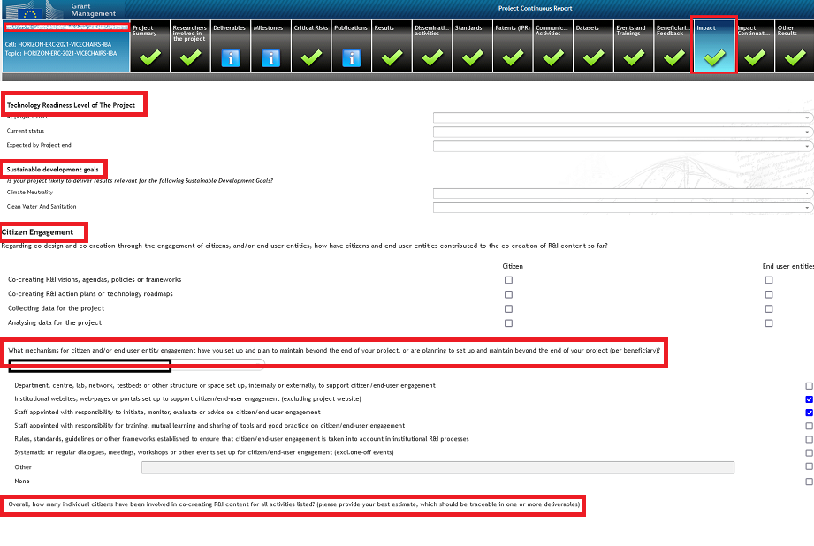
Reporting on Impact: Impact questionnaire (1/2)
Impact reporting: questionnaire to be used for the monitoring and evaluation of HE Programme performance + indication on progress of the project
Included in different tabs on the Portal (Continuous Reporting Module)
Impact
Impact Continuation
Important: quality of the data
For each beneficiary

Slide 35
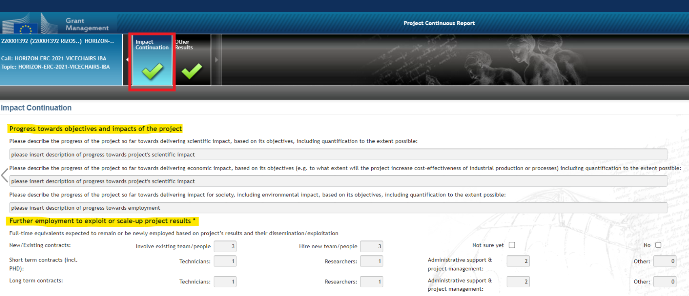
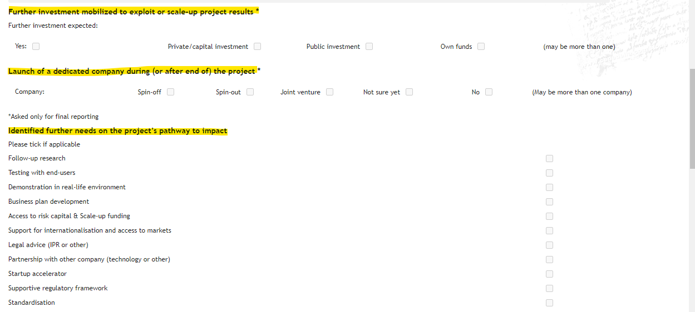
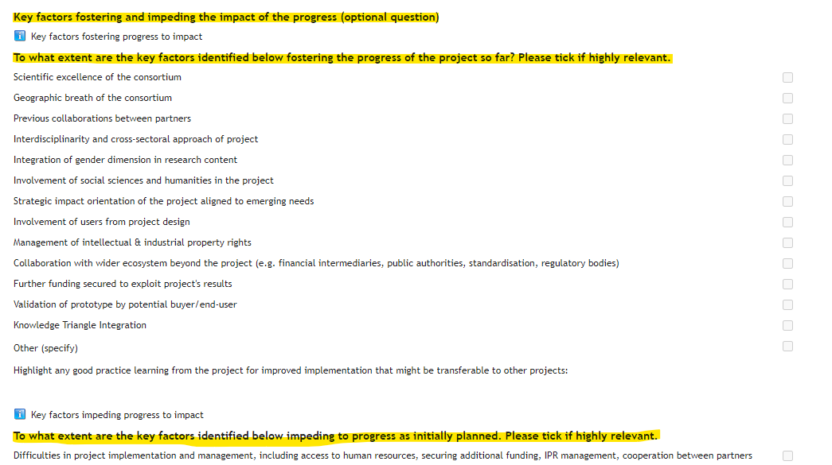
Reporting on Impact: Impact questionnaire (2/2)

Slide 36
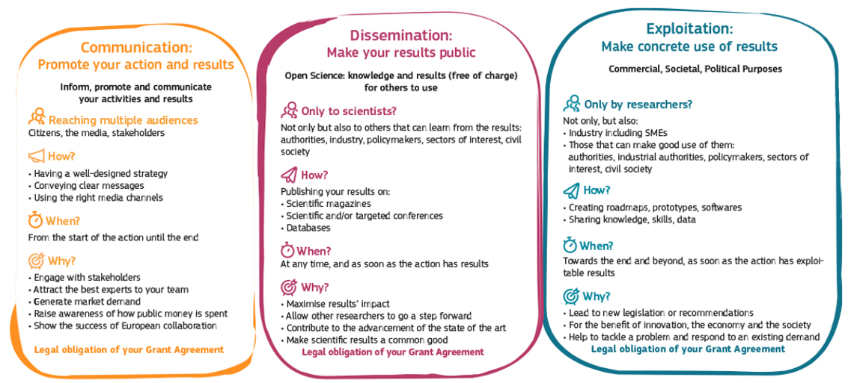
Communication, dissemination & exploitation: an obligation (art. 17 AGA) and an opportunity
Notes:
Communication, dissemination and exploitation activities are an integral part of Horizon projects to help maximise the impacts of EU research & innovation funding
D&E plan is a mandatory deliverable
Note that further rules will come on the use of X/Twitter by consortium and paid content –to be updated

Slide 37
Communicating with impact
Communication
Article 17 of the HE grant agreement = BEN must promote the action and its results by providing targeted information to multiple audiences in a strategic and effective manner (including to the public)
CDE Plan = mandatory deliverable, due in M6 and to be regularly updated
Inform your Project Officer and National Contact Point if your project has won an award, made a ground-breaking discovery or was featured in the press
Tag our social media channels so that we can highlight and promote your news and results
Enhance your visibility by
Defining your audience: Who do you want to reach?
Carefully crafting messages to tell a compelling story
Building a communication plan where you detail your outreach activities
Using the appropriate communication channels: web, social media & press
Developing a network
Evaluating the impact of your communication activities
https://rea.ec.europa.eu/communicating-about-your-eu-funded-project_en

Slide 38
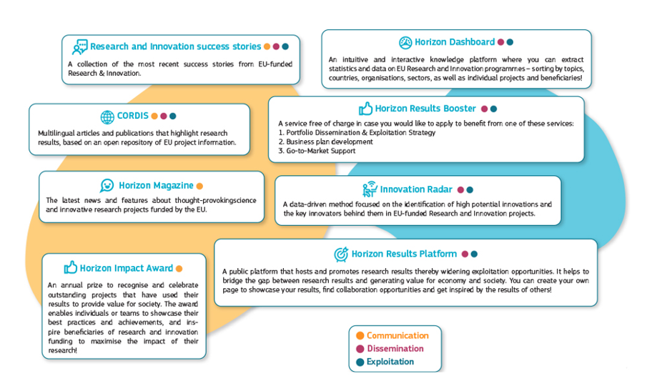
Free-of-charge European Commission dissemination tools
Communication
Dissemination
Exploitation

Slide 39
Acknowledgement of EU Funding
Use the European flag (emblem), not the European Commission logo
Disclaimer (GA art .17.3) must be added in any publication/output
”Funded by the European Union. Views and opinions expressed are however those of the author(s) only and do not necessarily reflect those of the European Union or the Agency. Neither the European Union nor the granting authority can be held responsible for them.”
Notes:
As specified on
Communicating your project — Acknowledgement of EU funding - Online Manual - Funding Tenders Opportunities (europa.eu)
Acknowledgement of EU funding
Beneficiaries of EU funding must display the EU flag and funding statement ("Funded by the European Union" or "Co-funded by the European Union") in all their communication and dissemination activities and any infrastructure, equipment, vehicles, supplies or major result results funded by the grant.
The EU flag and funding statement must be displayed in a way that is easily visible for the public and with sufficient prominence.
EU funding must moreover be acknowledged in all types of public outputs (including patent applications, EU standardisation of results), media contacts and other public statements.

Slide 40
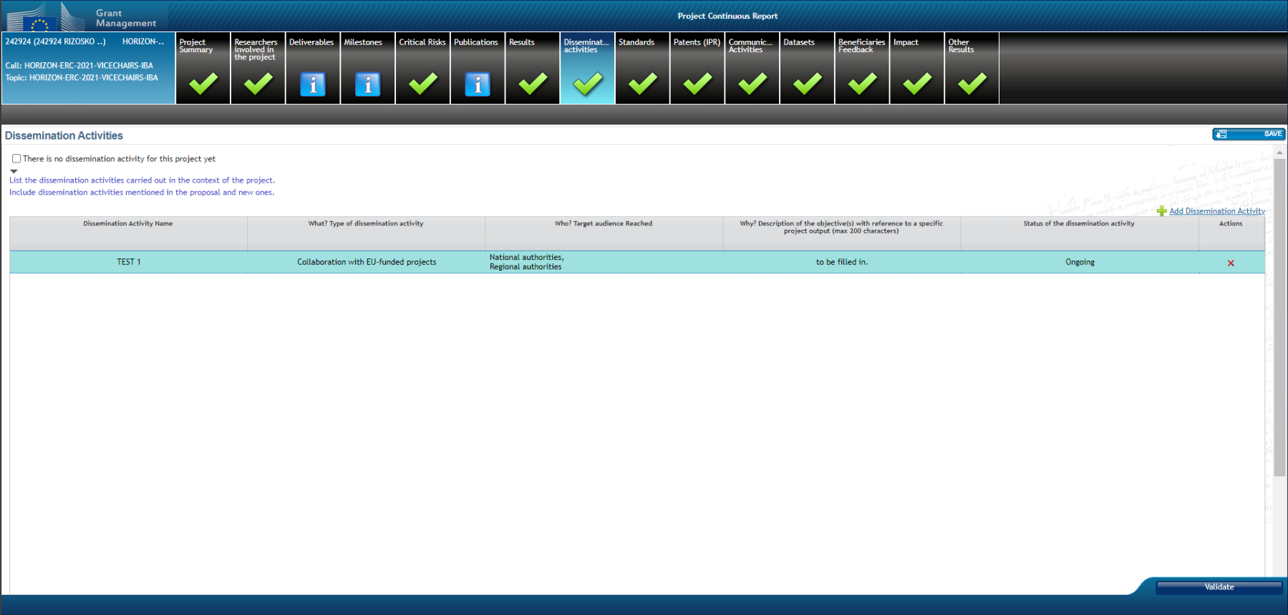
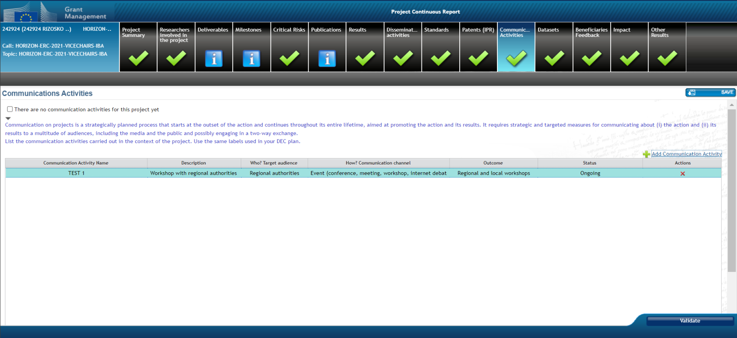
Reporting on communication, dissemination and exploitation
Part of the Key Impact Pathway to demonstrate the contribution to the impact on society
Qualitative rather than quantitative approach on reporting communication, dissemination and exploitation activities
Describing the activities, their purpose, the target audience and their status (pending, completed etc).
List main communication, dissemination and exploitation activities; especially the ones for which costs are charged to the project
Notes:
A first version of the ‘plan for the dissemination and exploitation including communication activities’ is included in the DoA (normally section 2.2).
A more detailed ‘plan for dissemination and exploitation including communication activities’ must be provided as a mandatory project deliverable within 6 months after signature date. This plan shall be periodically updated in alignment with the project’s progress.
In addition, participants must report all dissemination and communication activities (those mentioned in the DoA and new ones) carried out in the context of the project via the CRM (Dissemination activities and Communication activities sections respectively). In addition, they also need to report on the IPRs that result from the project (via the CRM IPR section).
What we check:
Whether the participants have disseminated project results (foreground) and have communicated project activities and results as planned in the DoA (e.g. through publications, a page for the project on social media, press-releases, a website, video/film, etc.).
Whether they have included a reference to EU funding.
Whether the plan for the exploitation and dissemination of the results has been updated and implemented as described in the DoA, in particular as regards intellectual property rights.
The effectiveness of the measures planned.
When the plan for exploitation and dissemination provides for exploitation primarily in non-associated third countries, whether the participants have explained how that exploitation is still in the EU interest and if it is acceptable.

Slide 41
IPR and Background
Background: any tangible or intangible input — from data to know-how, information or rights — that exists before the grant is signed and that is needed to implement the action or to exploit its results (e.g. database rights, patents, prototypes, cell lines, etc.).
Participants must give each other mutual access to the background that is necessary for the project implementation
Beneficiaries are advised to agree in writing on background before the grant is signed, to ensure that they have access rights to what is needed for implementing the action, including exploiting its results.

Slide 42
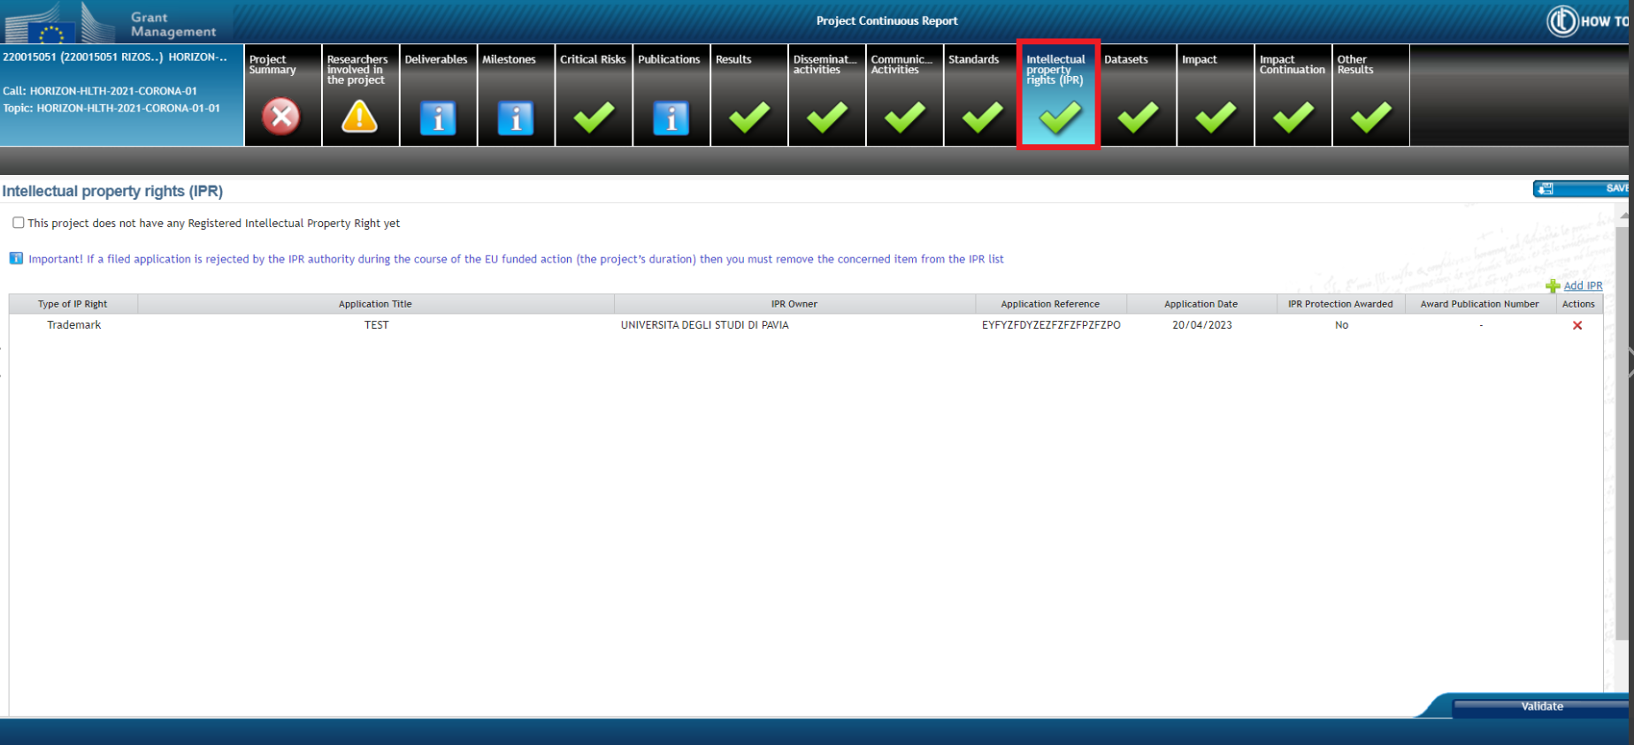
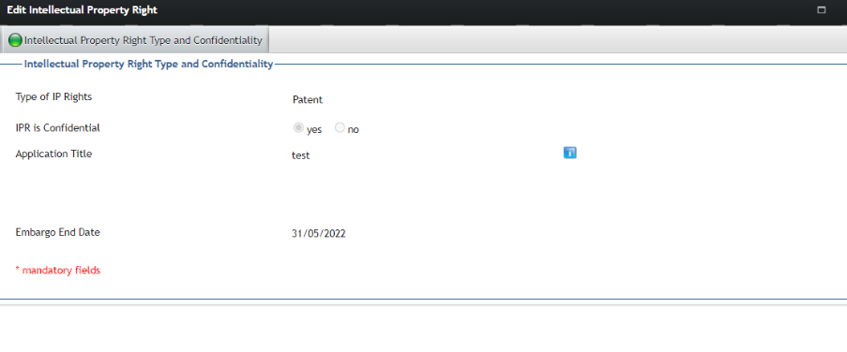
‘Intellectual Property Rights’ (IPR) tab
For European Patent Office, data are automatically fetched by encoding the reference

Slide 43
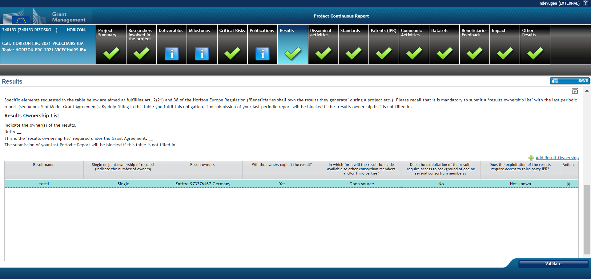
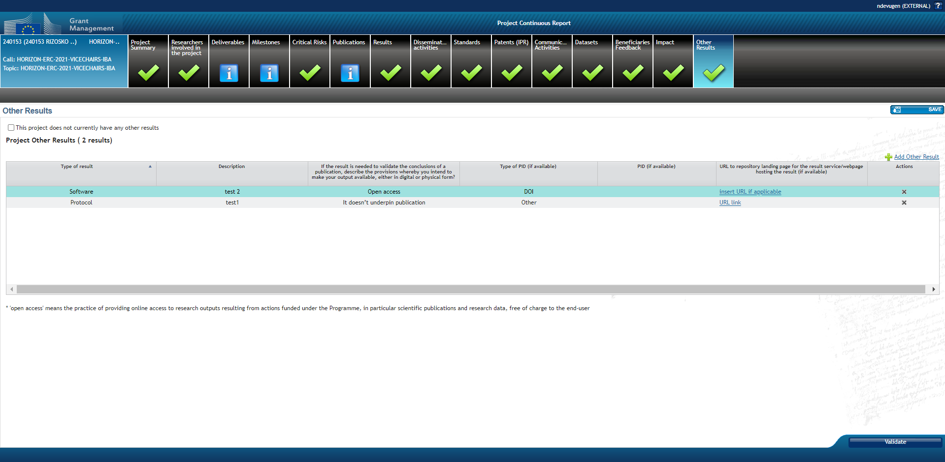
Reporting on project results
Obligation to report on project Results (content focused)
Name and type of the results + if they are Key Exploitable Results (KER) + audience or target group, steps undertaken towards exploitation and market maturity..
For Key Exploitable Results: use of Horizon Results Platform is mandatory in cases the beneficiary has not been able to exploit them within a year after the end of project (obligation may be waived –if justified- by granting authority upon request of beneficiary)
Elements of the Results Ownership List (ROL) (Art. 2(18) and 34 of the Horizon Europe Regulation - ‘Beneficiaries shall own the results they generate’ during a project etc.). Mandatory with the last periodic report.
Notes:
The Results table is the place where participants report on their results, focused on their content, for example discoveries and theories, products, services, methods etc.
These results may also produce publications, intellectual property rights, datasets, software, algorithms, protocols etc. that are encoded in separate tables, i.e. Publications, Datasets, IPR, Standards, Other results (for Software, Workflows, Prototypes, Protocols), which are part of the ‘open science artefacts’, if relevant.

Slide 44
‘Results’ and ‘Other results’ tab
Examples:
The project developed a new medical device, which is described in two publications and later patented. Instructions: participants list the medical device in the results table (as ‘PROD: Product’) and add publications to this product in dedicated sections. When participants have information about the patent application, they add it in a dedicated section.
The project developed a new scientific theory which is described in several publications. Instructions: participants list the name and potential of the theory in the results table (as ‘SCI: Scientific discovery, model, theory’) and add publications to this model in publications section.
The project develops a high potential industrial process and is currently at the stage of prototyping. Instructions: participants list the industrial process n the results table (as ‘PROC: Industrial process’) and indicate the prototyping stage under ‘Steps undertaken towards exploitation’. If the there is a registered prototype, they add the registered prototype in the IPR section.
The project mainly focused on activities such as conferences, staff exchanges, or on investments in infrastructures. Instructions: participants list these as results and their potential in the results table.
The Results table is the place where participants report on their results, focused on their content, for example discoveries and theories, products, services, methods etc.
These results may also produce publications, intellectual property rights, datasets, software, algorithms, protocols etc. that are encoded in separate tables, i.e. Publications, Datasets, IPR, Standards, Other results (for Software, Workflows, Prototypes, Protocols), which are part of the ‘open science artefacts’, if relevant.

Slide 45
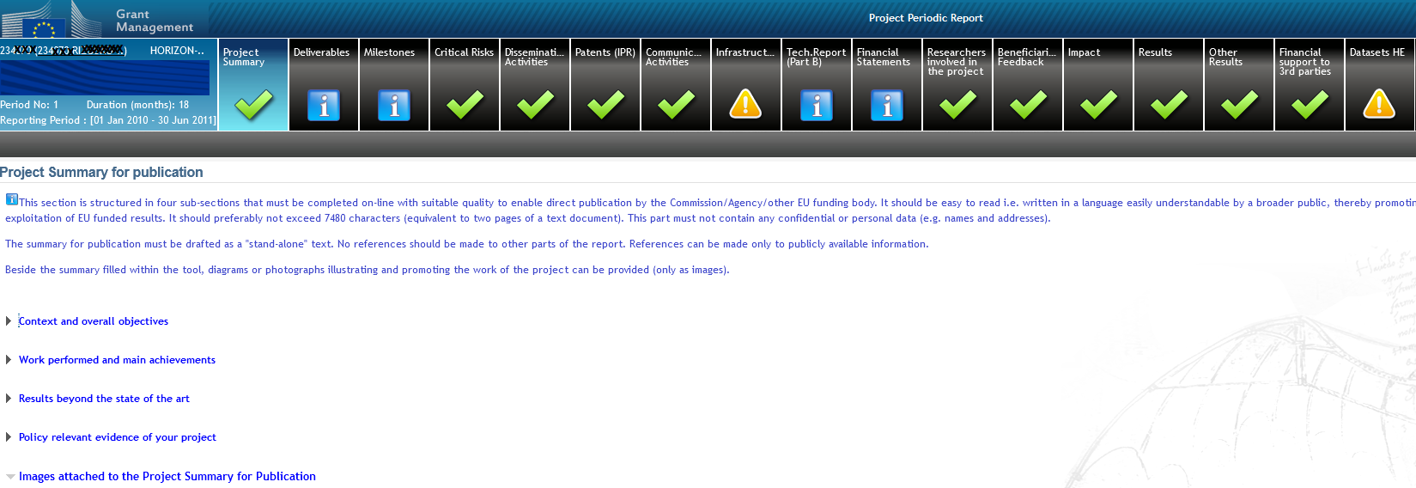
‘Project Summary’ tab
This summary is automatically published in CORDIS and it is prefilled with proposal abstract
Participants should adapt it as the project produces results (always with PUBLIC information)
Check the text is in simple language, understandable to externals (not a copy of some technical paper or a list of publications).
The fields 'work performed' and 'results beyond state of art' should also contain short descriptions intended for wider audience.
Question on the 'policy relevance': this text is intended to indicate the relevance of project to the policy objectives of the call (policy feedback to DGs).

Slide 46
‘Researchers’ tab
Include the list of researchers involved in their project at proposal stage.
List of researchers can be updated in real time in Grant Management Services of the F&T Portal
Indicator on follow-up of the researchers' careers for the evaluation of HE Programme
Only researchers as defined in the Frascati manual should be encoded + those whose salary is covered by other sources, but still contributing to project’s activities
Justification needed if researcher(s) not participating or removed (especially if considered crucial at the time of the evaluation of the proposal)
Notes:
For associated partners: the coordinator should add the respective information (APs do not have access to our tools). Same for affiliated entities, it is the linked beneficiary that should provide the information.

Slide 47
Open Science in Horizon Europe
Open Access to Scientific Publications
Beneficiaries must ensure open access to peer-reviewed scientific publications relating to their results
Research Data Management
Beneficiaries must manage the digital research data generated in the action (‘data’) responsibly, in line with the FAIR principles
Additional practices
Where the HE work programme/call conditions provide for additional obligations regarding open science practices, those obligations must also be complied with
Open Science requirements are listed in detail in Annex 5 of the Grant Agreement
Notes:
Horizon Europe Annotated Model Grant Agreement (Annex 5, section 2 -pg 154)

Slide 48
Open Research Europe
Why Open Research Europe?
Support our open access policy and beneficiary capacity to adhere to it and also enables publishing post-grant
Leading by example in operationalising open science principles within scientific publishing and enabling the European Research Area
Contribute to transparency and cost-effectiveness and explore sustainable open access publishing business models
What is Open Research Europe?
A peer-reviewed publishing platform. Not a repository. Post-publication peer-review model. First you publish, then review takes place. Publication and review reports open access under CC BY licenses. Optional service for our beneficiaries at no cost to them.
More on Open Research Europe

Slide 49
Ethics and research integrity
Art. 14 GA – Ethics and values
Annex 5 GA – Ethics
The action must be carried out in line with the highest ethical standards and the applicable EU, international and national law on ethical principles. No funding can be granted, within or outside the EU, for activities that are prohibited in all Member States.
Respect the fundamental principle of research integrity - as set out in the European Code of Conduct for Research Integrity.
Ensure compliance with the GDPR - General Data Protection Regulation (Regulation (EU) 2016/679).
Ethics deliverables must be submitted according to Grant Agreement. Necessary authorisations need to be obtained prior to start of the activity.
Consult PO if there are unforeseen research activities or whenever activities with potential ethical issues are modified during the project implementation (e.g.; collection or processing of “personal data”, involving volunteers, data exchange between EU – non-EU countries).
Notes:
Guidance to facilitate the implementation of targets to promote gender equality in research and innovation
http://ec.europa.eu/research/swafs/pdf/pub_gender_equality/KI-07-17-199-EN-N.pdf
European Charter & Code for Researchers
https://euraxess.ec.europa.eu/jobs/charter

Slide 50
Implementing ethics: Ethics Check/Review requested (ethics issues cleared)
Ethics Check/Review might be requested:
In the Ethics Summary Report as result of the ethics screening/assessment done;
During the project implementation (only for ethics checks) when it is important to reassess the global situation or specific ethics issues.
Information to be provided by the Consortium to comply with the ethics Check/Review:
The consortium should refer to the Ethics Work Package and the Deliverables set by the PO during the GAP;
If Ethics check is requested during project implementation, instructions on the needed documents/certificates/approvals will be provided accordingly by the PO.

Slide 51
Implementing ethics: Ethics Advisor or Board requested (ethics issues conditionally cleared)
Appointment of an external, independent ethics Advisor / Board
When: It is necessary for the project to be advised by one or more ethics experts.
Where: In the Ethics WP which includes a deliverable for the appointment of the ethics Advisor/Board and for each of the regular reports to be provided.
The Advisor/Board members must be totally independent and free from any conflict of interest.
The Advisor/Board members get paid for their services (via e.g. a service contract).
The Coordinator must grant access to the Advisor/Board members to the relevant documents needed to perform their duties. It is recommended to build a collaborative relationship with ethics Advisor/Board members (see section 9.2 of How to complete ethics self assessment).
The name/s and the ethics and research integrity expertise of the appointed Ethics Advisor/Board members must be submitted as a deliverable.
Each report prepared by the Advisor/Board must be submitted to the REA as a deliverable at the month set by the PO during GAP. The template for Reporting must be requested to the PO!

Slide 52
External Independent Ethics Advisor vs Ethics Mentor
Ethics Advisor
Totally independent and free from any conflict of interest.
The Ethics Advisor is usually paid for this service (via e.g. a service contract).
Obligation to provide the REA with independent report(s).
Ethics Mentor
Not independent of the consortium - can be a member of the same department or institution. The EM advises, shares experience and knowledge on how to properly identify and address ethics issues.
Paid as a regular staff.
Not obliged to independently report to the REA, although it is recommended to keep on file a report of the activities performed.

Slide 53
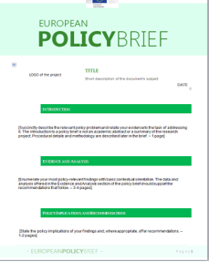
Policy feedback
It is a mechanism through which your project results feed into current and/or future policy-making:
It gives you the opportunity to inform evidence-based policy-making, to interact with similar projects, to create synergies with other communities and to promote your project.
It allows the EU to monitor the achievement of policy objectives and the impact of existing policies/legislation as well as to identify gaps, opportunities or potential synergies.
To be provided throughout the whole project lifecycle in form of:
policy briefings as a mandatory deliverable at each reporting period;
ad-hoc contributions from the project at the initiative of the COO or upon request;
participation in cluster events, etc.
Focus on how the project contributes to advancing the EU’s policy objectives, using quantitative and/or qualitative indicators, and develop potential recommendations/best practices.
Notes:
Policy briefings:
Policy brief deliverable to be submitted at each reporting period. Templates available for RIs and for EOSC – the PO will share them with you and provide some guidance.
Policy briefings should not be a summary of project achievements (we find them in periodic report!).
What happens: Policy briefs will be collected and analysed periodically by RTD colleagues. They are the first document to look at in case of specific requests.

Slide 54
To sum up, some good practice…
Communicate/disseminate (Annotated Grant Agreement, art. 17)
The more publicity you are giving to the results, the more impact you have…
Cite the grant in articles, presentations, etc..
Changes in the work plan / budget
Inform the PO and report them in the deviation section of the technical report
Deliverables/reports on time (art. 21)
TNA – special section in reporting
Financial reporting – keep all records (art. 20)
Grants are, as a rule, not extended

Slide 55
III. Extra Resources

Slide 56
Policy framework
Horizon Europe – Funding Programme for Research and Innovation
Factsheet ‘Open Science in Horizon Europe’
Communication on ‘A new ERA for Research and Innovation’
Pact for Research and Innovation in Europe
ERA Policy Platform
European Research Infrastructures
ESFRI Landscape Analysis 2024
Notes:
ERA Policy Platform:
Provides up-to-date information about the state of implementation of the ERA Policy Agenda and its joint actions;
Gives insights into EU-wide activities contributing to make progress on the ERA;
Features all the elements of the ERA monitoring mechanism, including interactive graphs showing the progress on ERA priorities as reported in the ERA Scoreboard and the ERA Dashboard;
Offers a repository of key ERA-related documents and reports available to the public;
Serves as a central space for communicating between all actors interested in advancing the ERA objectives.
Covers Action 8 on Research Infrastructure

Slide 57
Useful resources
Horizon Europe Annotated Model Grant Agreement
Guidance on communicating about your EU-funded project
Guidance on social media for EU funded R&I projects
CORDIS – EU research results
Horizon Results Booster
E-Translation – European Commission’s machine translation system
Notes:
eTranslation is a free web-based tool that allows you to translate online from and into any official EU language and other languages.
Prior registration required.
Free of use for EU institutions, public administrations, universities, EU freelance translators, SMEs, European NGOs and projects financed by the Digital Europe Programme, located in an EU country, Iceland, Norway, Liechtenstein or Ukraine.
It produces raw machine translations. Use it to get the gist of a text or as the starting point for a human-quality translation. If you need a perfectly accurate, high-quality translation, the text still needs to be revised by a skilled professional translator.
Projects can use it to translate their document(s), such as project deliverables, prior to an upload on the Grant Management System or CORDIS.

Slide 58
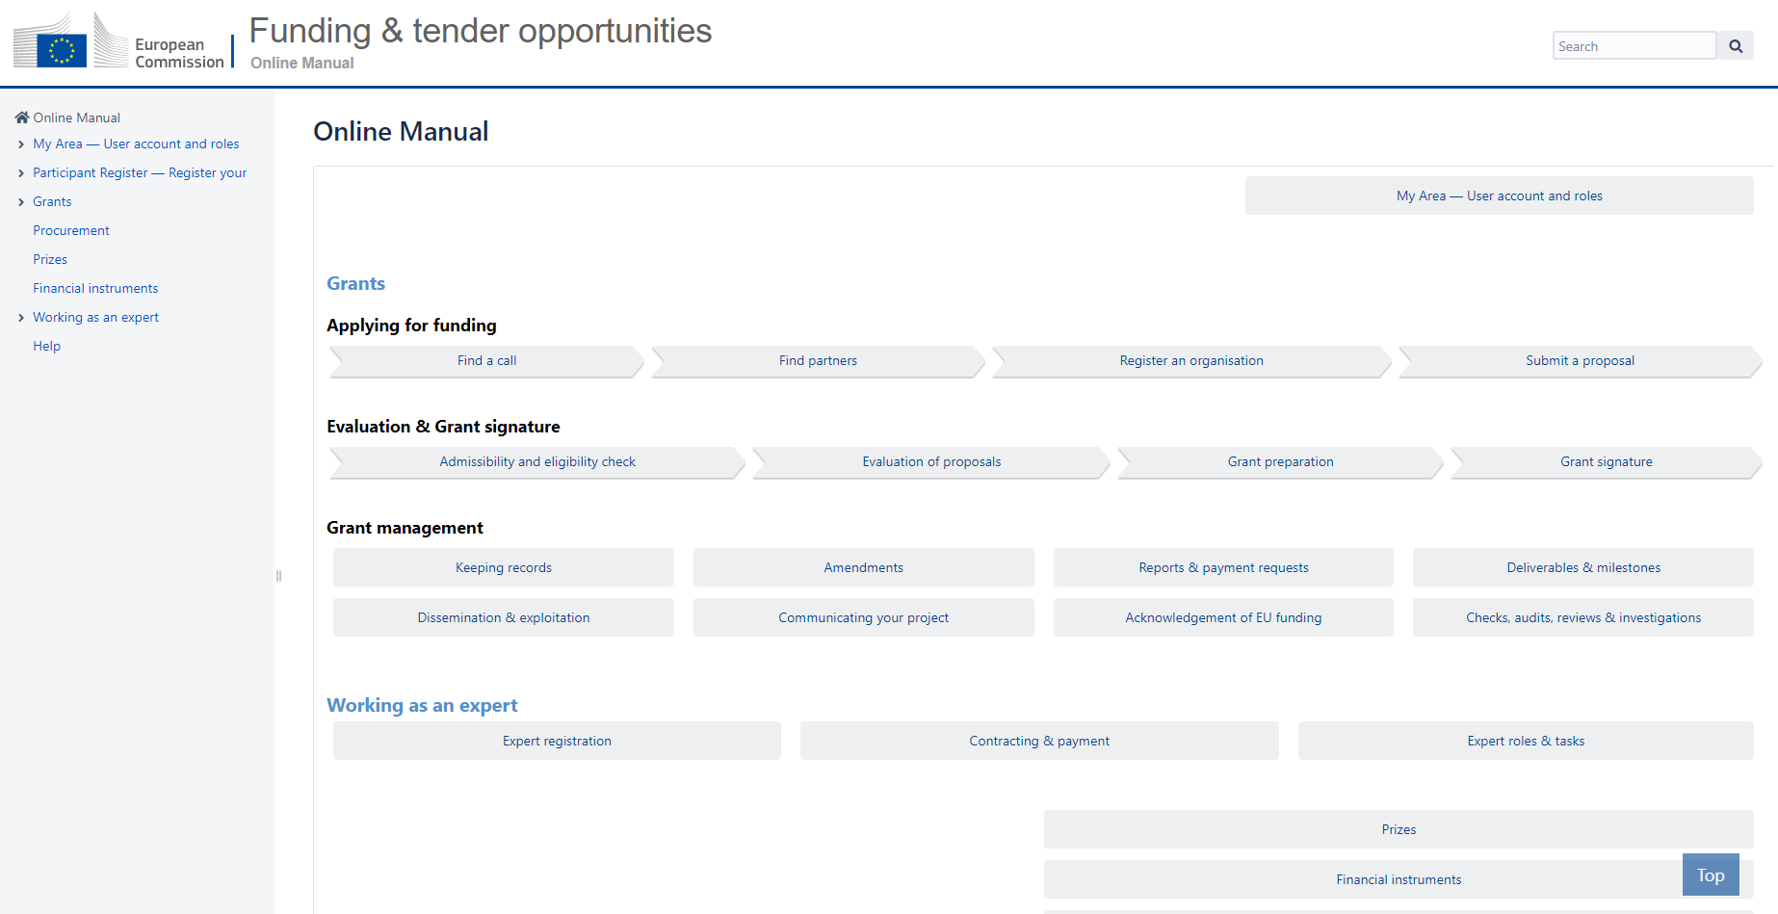
HE Online Manual
https://webgate.ec.europa.eu/funding-tenders-opportunities/display/OM/Online+Manual

Slide 59
Experts needed!
We need experts for:
Assessing applications for EU funding (including prizes and tenders)
Monitoring or EU-funded projects and contracts
Giving your advice on specific issues
Experts are expected to:
have a high level of expertise in their field(s)
be available for occasional, short-term assignments
Find out more about expert work and registration here.
We welcome experts from all gender identities and backgrounds.

Slide 60
Open Science
Open science (OS) is an approach based on open cooperative work and systematic sharing of knowledge and tools as early and widely as possible in the process, including active engagement of society.
Open science practices include:
Early and open sharing of research (for example through preregistration, registered reports, pre-prints, or crowd-sourcing)
Research output management including research data management (RDM)
Measures to ensure reproducibility of research outputs
Providing open access to research outputs (e.g. publications, data, software, models, algorithms, and workflows) through deposition in trusted repositories
Participation in open peer review
Involving all relevant knowledge actors including citizens, civil society and end users in the co-creation of R&I agendas and contents (such as citizen science)

Slide 61
Open access to publications (1/2)
Beneficiaries must ensure open access to peer-reviewed scientific publications relating to their results. In particular, they must ensure:
at the latest upon publication, deposition of the Author Accepted Manuscript or Version of Record in a trusted repository + immediate open access via the repository under a Creative Commons Attribution license (CC BY) or equivalent (Creative Commons Attribution Non Commercial/Non Derivatives licenses or equivalent are allowed for long-text formats)
No embargo periods are accepted (for green open access)
information via the repository about any research output/tools/instruments needed to validate the conclusions of the scientific publication
Metadata must be open under a Creative Commons Public Domain Dedication (CC 0) or equivalent, in line with the FAIR principles and provide information about the licensing terms and persistent identifiers, amongst others.

Slide 62
Open access to publications (2/2)
Beneficiaries (or authors) must retain sufficient intellectual property rights to comply with the open access requirements
Publication in venue of your choice but publication fees are reimbursable only if publishing venue is full open access (publication fees in hybrid venues are not reimbursed, even if some of the articles are open access)
Do not place the journal's DOI in the field of the repository (even if gold access); double check the provided links (including the repositories)
Login to OpenAIRE and verify your project publications; it provides also an interface to immediately upload a copy to Zenodo repository
Acknowledgement of EU funding must be present
Consider the option to publish at no costs in Open Research Europe, the European Commission open access publishing platform

Slide 63
Trusted repositories under Horizon Europe
Trusted repositories are either certified repositories (e.g. CoreTrustSeal, nestor Seal DIN31644, ISO16363) and/or disciplinary/domain repositories that are commonly used/endorsed by the research communities (e.g. ELIXIR deposition databases).
General-purpose repositories and institutional repositories are, in general, also acceptable.
Trusted repositories share essential properties:
Mechanisms to ensure integrity and authenticity of contents.
Offer clear information about their policies/services.
Provide broad, and ideally open access to content (consistent with legal and ethical constraints).
Assign PIDs, ask for detailed metadata in a standardized (e.g. Dublin Core) and machine-readable way.
Ensure mid- and long-term preservation of contents, expert curation, quality assurance.
Meet national and/or international security criteria

Slide 64
Research data management (1/2)
Beneficiaries must manage the digital research data generated in the action responsibly, in line with the FAIR (“Findable”, “Accessible”, “Interoperable”, Reusable”) principles and:
establish + regularly update a data management plan (‘DMP’) for generated (and/or collected) data
as soon as possible and within the deadlines set out in the DMP, deposit the data in a trusted repository (federated in the EOSC if required in the call conditions) + ensure open access under CC BY, CC 0 or equivalent, following the principle ‘as open as possible as closed as necessary’
provide information via the repository about any research output/tools/instruments needed to re-use or validate the data
Metadata must be open under CC 0 or equivalent (to the extent legitimate interests or constraints are safeguarded), in line with the FAIR principles and provide information about the licensing terms and persistent identifiers, amongst others.
Notes:
Proper Research Data Management (RDM) is mandatory for any Horizon Europe project generating or reusing research data, as a key part of Horizon Europe's open science requirements.

Slide 65
Research data management (2/2)
Exceptions to open access to research data. Data may be kept closed if:
providing open access is against the beneficiary’s legitimate interests, including regarding commercial exploitation;
it is contrary to any other constraints, such as data protection rules, privacy, confidentiality, trade secrets, Union competitive interests, security rules, intellectual property rights or would be against other obligations under the Grant Agreement.

Slide 66
Keep in touch
ec.europa.eu/info/research-and-innovation_en
europeancommission
rea.ec.europa.eu
@EuropeanCommission
@REA_research
EUTube
European Research Executive Agency (REA)
EU Spotify

Slide 67
Thank you
© European Union 2020
Unless otherwise noted the reuse of this presentation is authorised under the CC BY 4.0 license. For any use or reproduction of elements that are not owned by the EU, permission may need to be sought directly from the respective right holders.
Notes:
Update/add/delete parts of the copy right notice where appropriate.
More information: https://myintracomm.ec.europa.eu/corp/intellectual-property/Documents/2019_Reuse-guidelines%28CC-BY%29.pdf

