Slide 1
WP2 - Scientific and Industrial Exploitation
Carsten P Welsch, University of Liverpool

Slide 2
WP2 – Scientific and Industrial Exploitation
Work Package 2 promotes the scientific + industrial exploitation of PACRI technologies, gender equality and diversity, and the participation of early-stage researchers.
Task 2.1 – Technology transfer strategy & networking:
Identify and implement an efficient exploitation strategy of the project results.
Task 2.2 – Dissemination:
Coordinate and monitor the scientific dissemination activities and public events.
Task 2.3 – Industrial Exploitation:
Provide information for future implementation of the technological results, including cost-benefit analysis.
Task 2.4 – Gender & early-stage researchers:
Collect and analyze project data on (1) education & training activities for early-stage researchers and (2) gender equality
Propose measures to promote gender equality
Conduct awareness raising activities for different stakeholders.

Slide 3
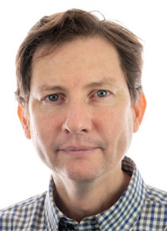
Communication - Contact point at ULIV
Dr Ricardo Torres
Senior Project Manager in the QUASAR Group at the University of Liverpool (ULIV), working closely with Elettra colleagues and in charge of:
PACRI Dissemination & Communication
Event Organisation
Outreach and Science Engagement
ricardo.torres@cockcroft.ac.uk
Please send Ricardo your press office details for future communication purposes

Slide 4
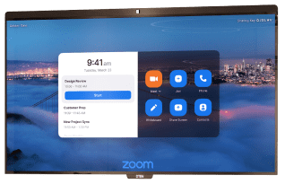
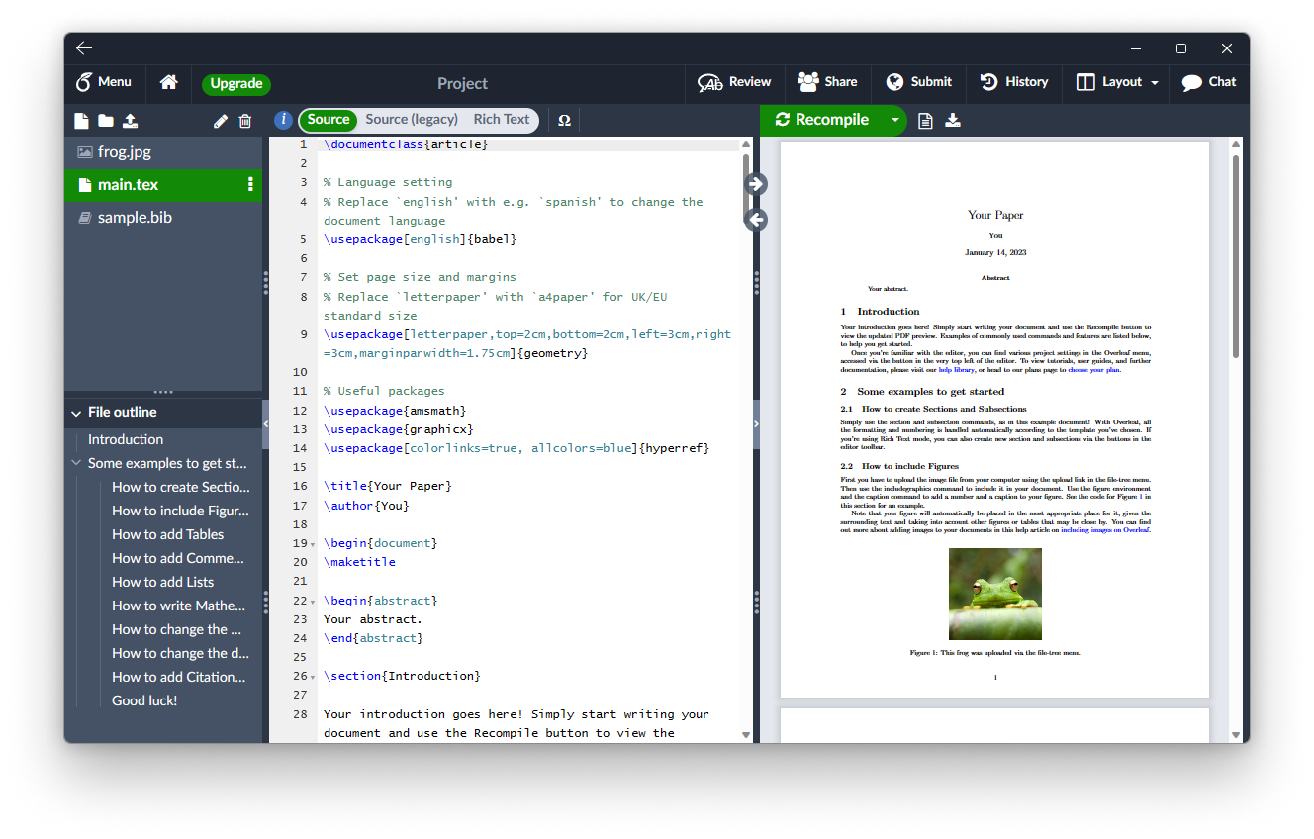
Internal Communication
Central contact directory (made accessible to all project members)
Zoom as primary communication tool (with dedicated virtual rooms for each WP)
Event organization with Indico
Collaborative documentation via Overleaf
SharePoint for secure sharing
LinkedIn presence for continuous updates
Quarterly WP meetings
Project events for enhanced interaction
Up-to-date project web page

Slide 5
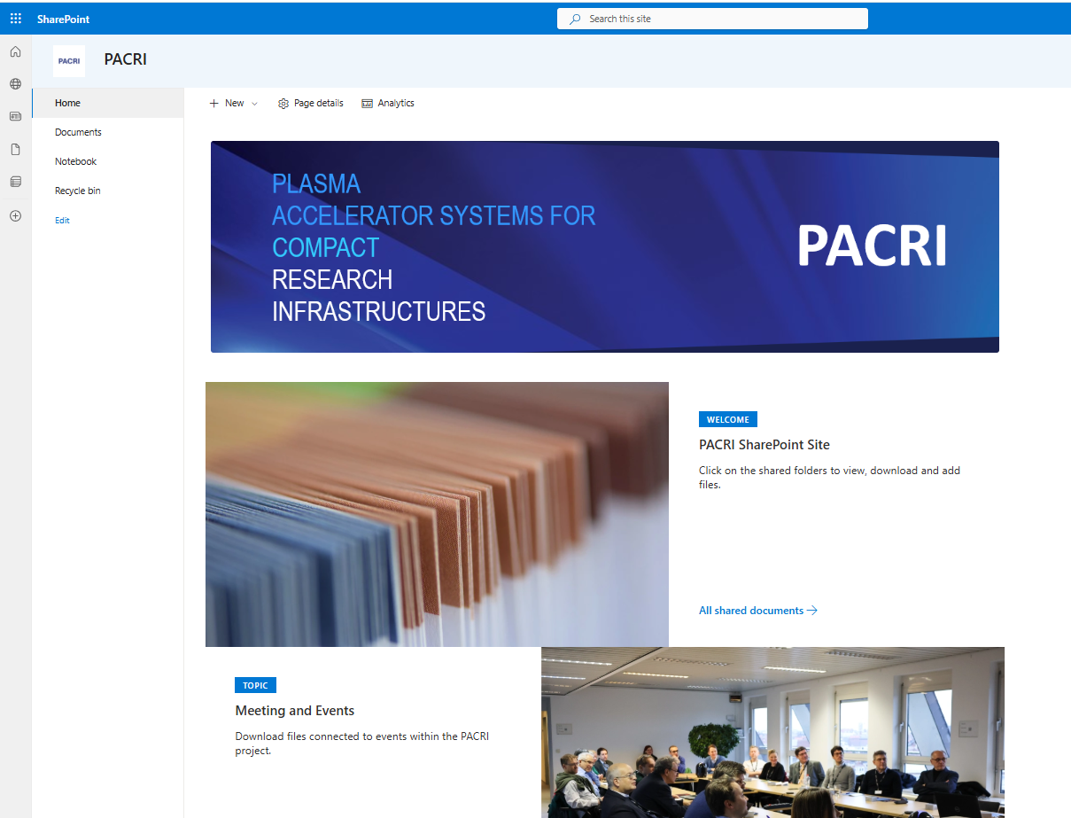
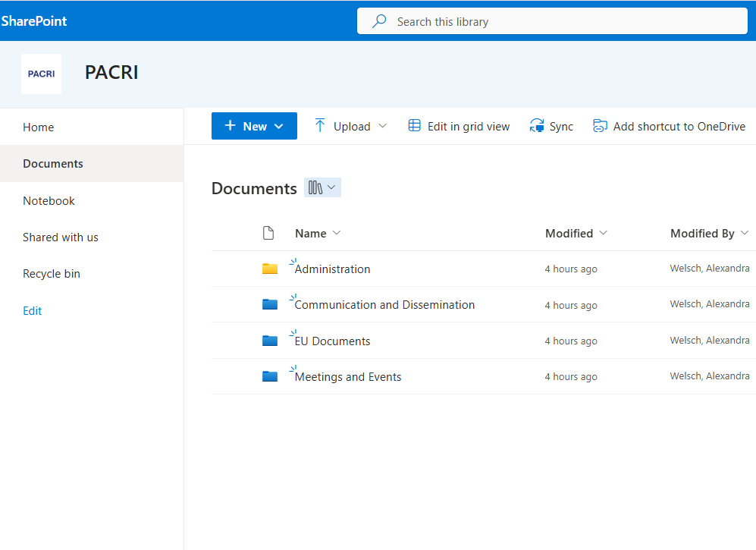
SharePoint
A secure SharePoint platform at ULIV will act as central repository for sharing information and archiving project materials safely.
Requires:
Microsoft email account
Two-factor authentication
Please send an email to Ricardo to get access and further instructions
https://theuniversityofliverpool.sharepoint.com/sites/PACRI/

Slide 6
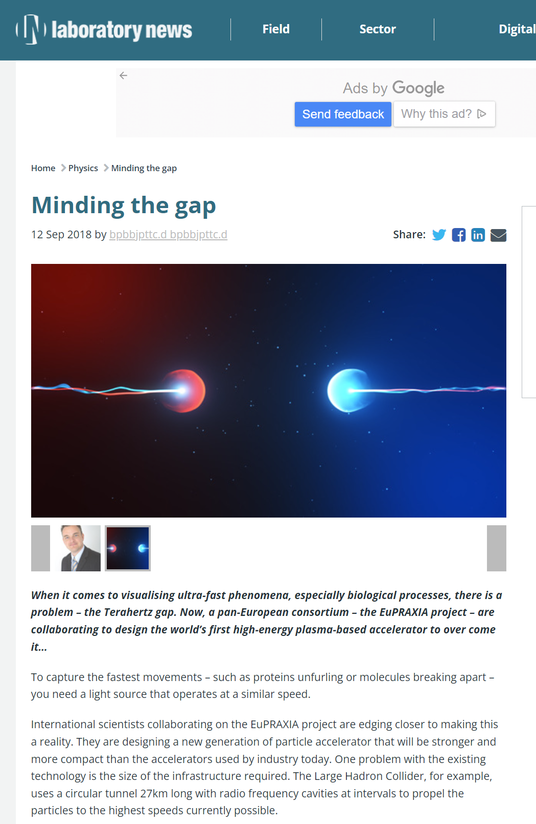
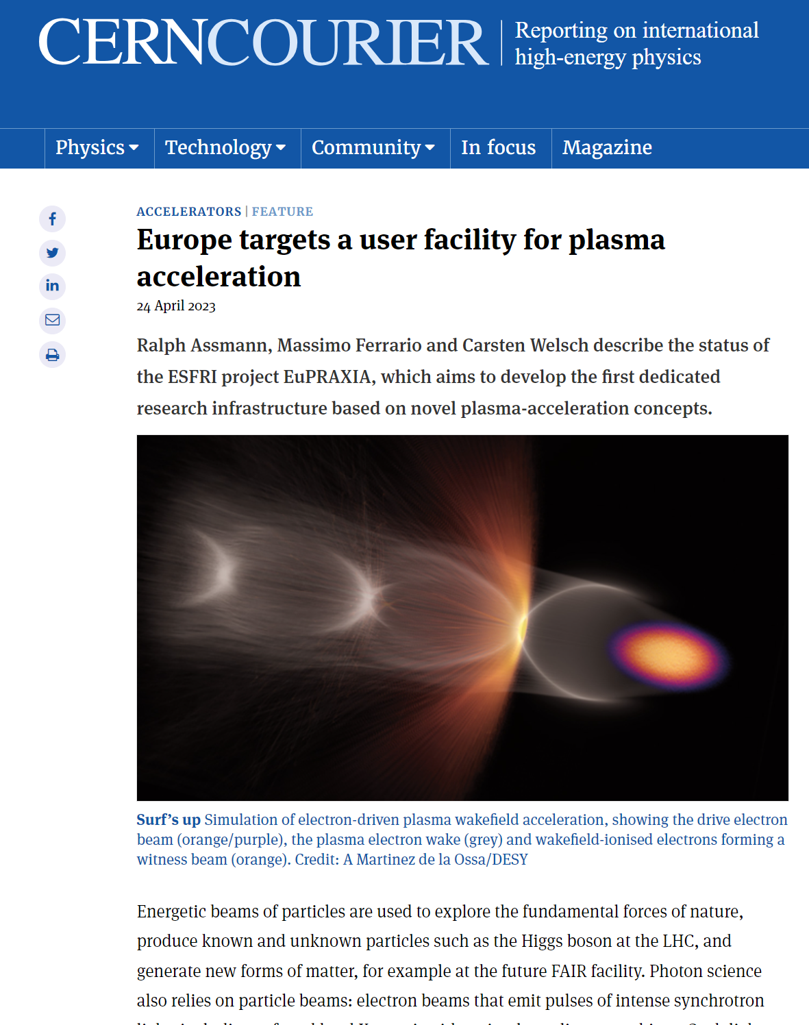
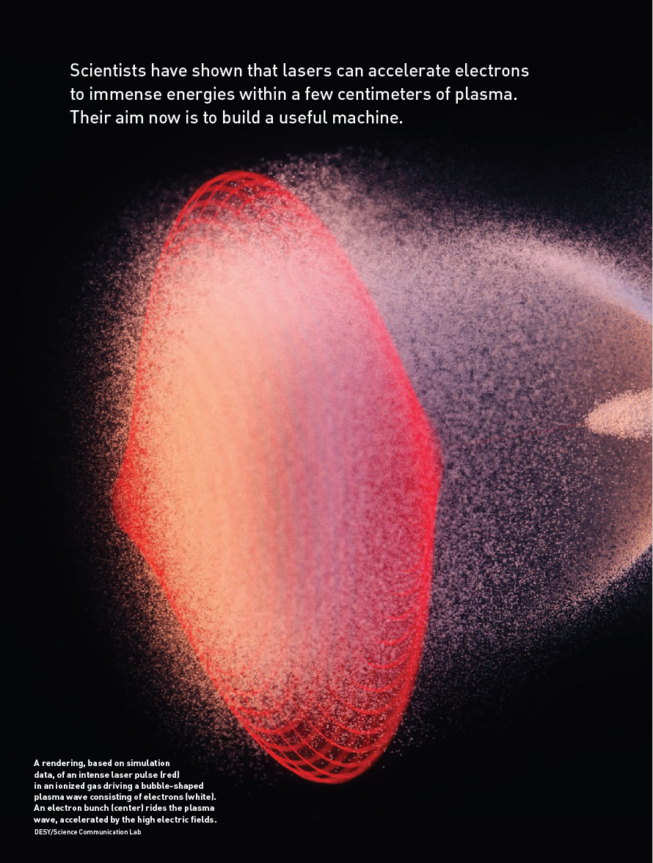
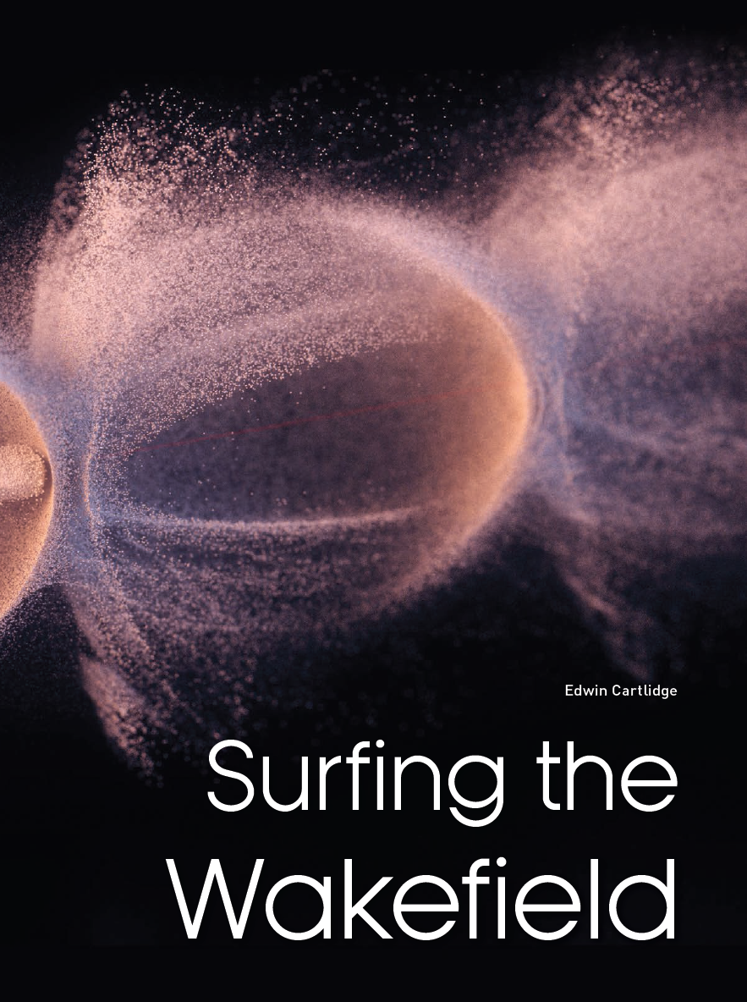
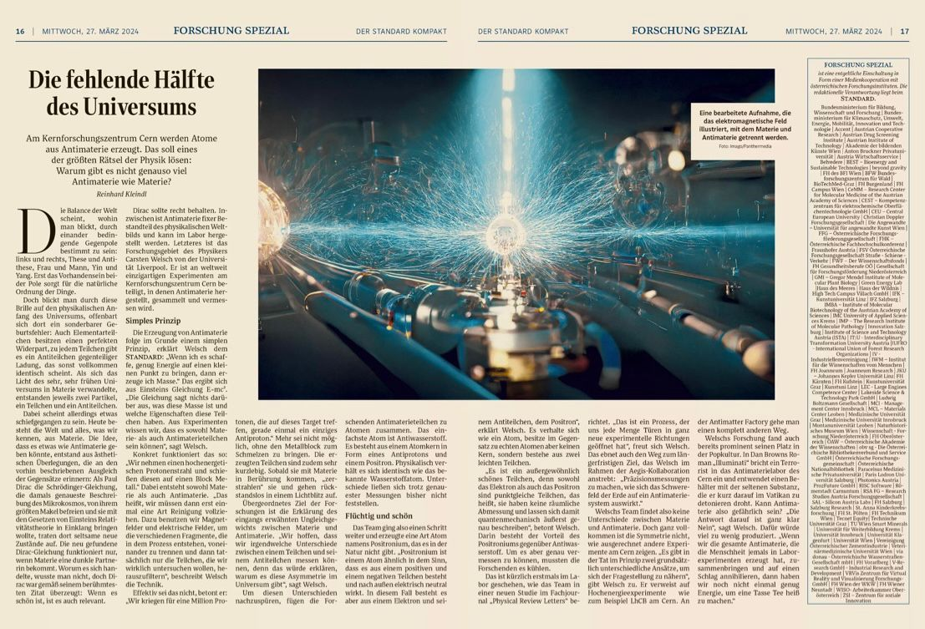
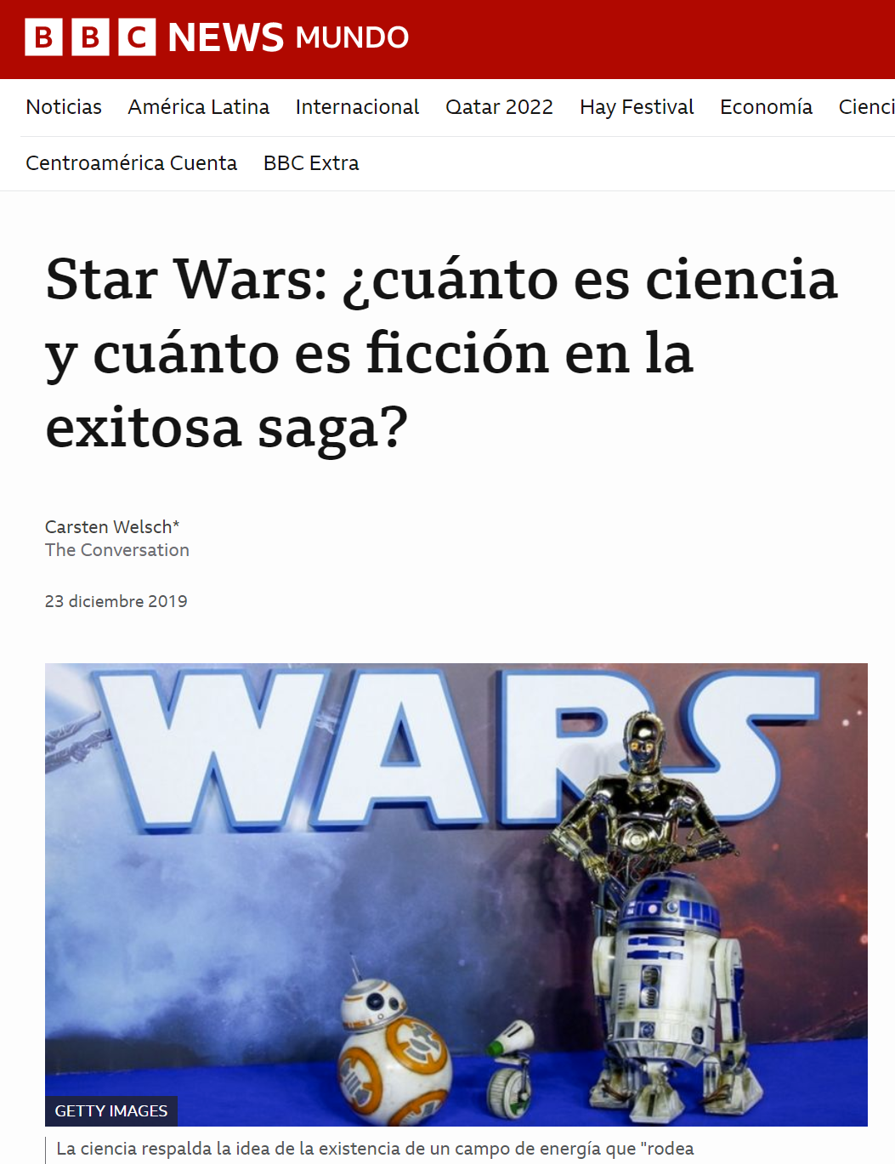
External Communication - Press
Working with inter/national press
General public (online and print articles, social media, general media, events)
Policy makers (media, targeted publications, leaflets)
School children (school visits, open days, placements)
Wider scientific community (seminar series, established newsletters, social media)

Slide 7
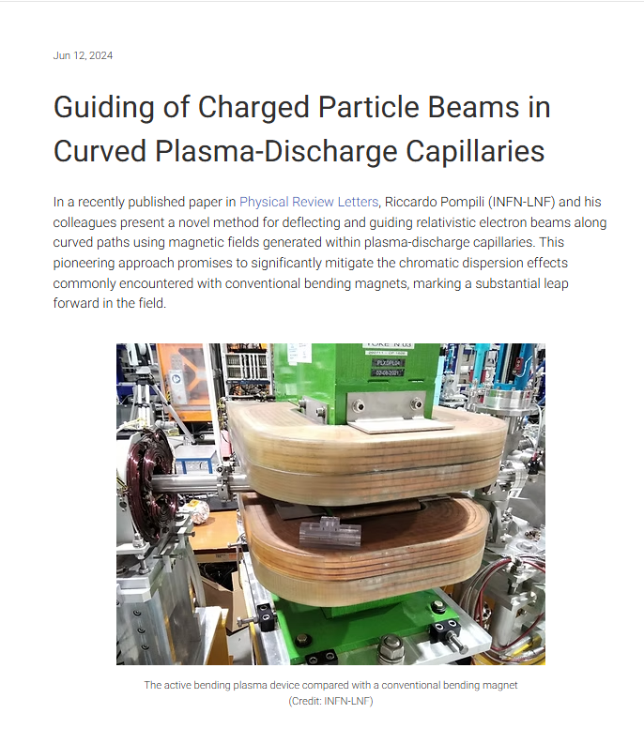
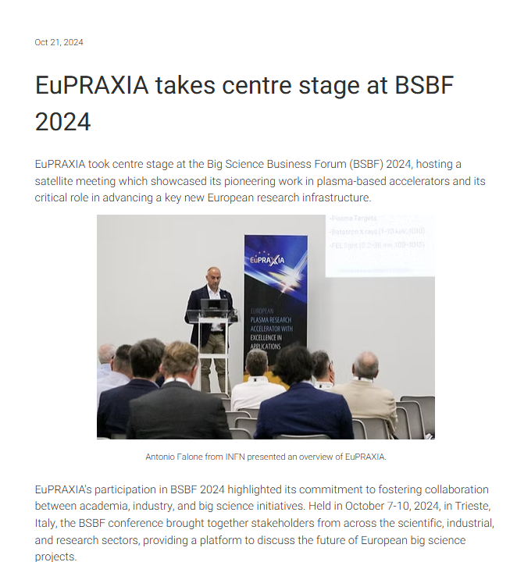
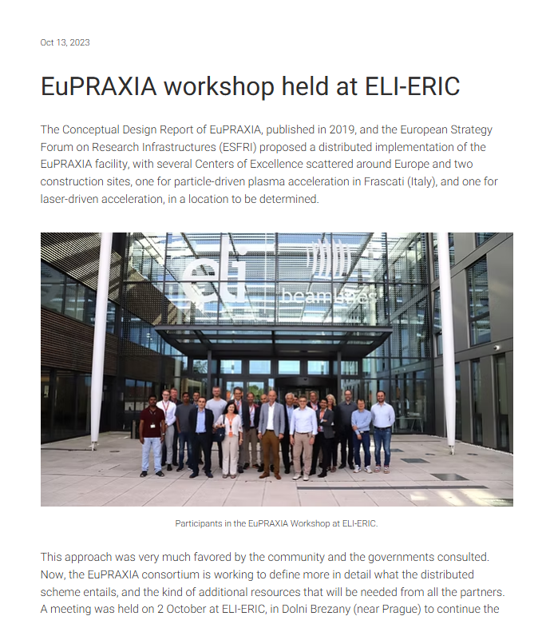
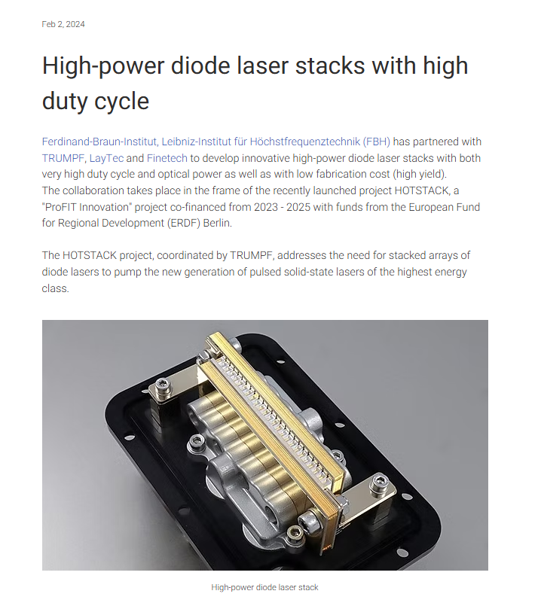
External Communication - Website
PACRI publishes regular news about:
Scientific results
Events
Network news
Partner news
ULIV can you help with:
Drafting press release
Posting on online outlets
Promotion through social media
Please send us (regularly!):
R&D highlights, events, prizes etc
Catchy title and draft text
1-2 images (with caption, credits and permissions)

Slide 8
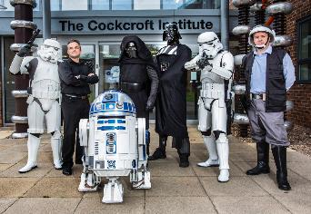
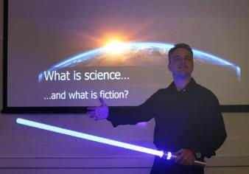
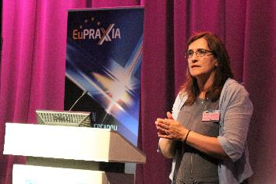
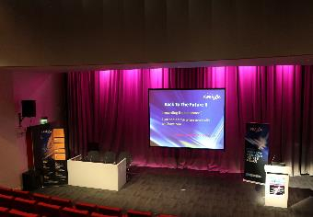
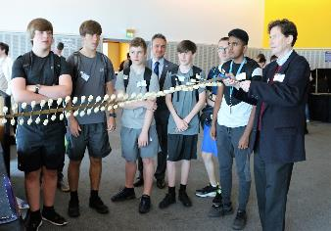
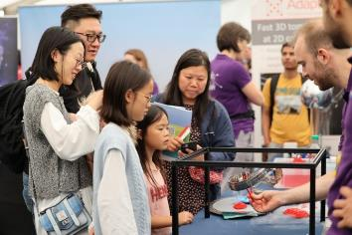
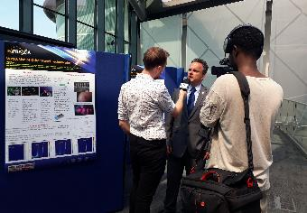
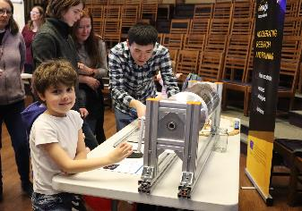
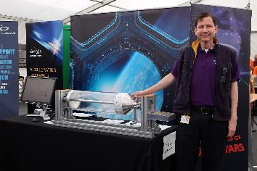
Outreach and Public Engagement
ULIV is a recognized leader in the communication of accelerator science R&D to public audiences through innovative activities, events, and media coverage:
Physics of Star Wars
EuPRAXIA Symposium
Shining a light on particle accelerators
Pint of Science
Daresbury Open Week
Surfatron
etc.

Slide 9
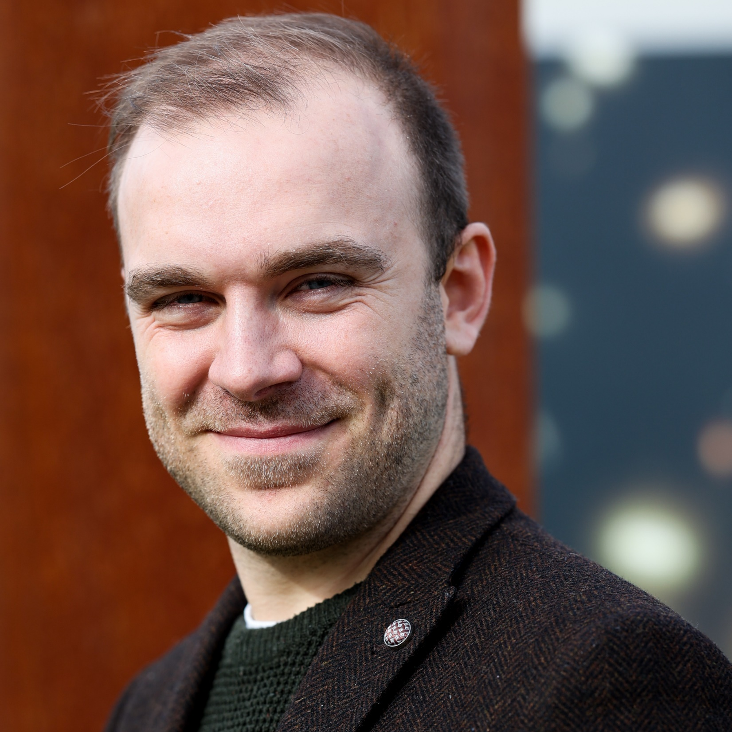
Knowledge Transfer - Contact point at ULIV
Dr Joseph Wolfenden
Joseph.Wolfenden@cockcroft.ac.uk
https://www.liverpool.ac.uk/quasar/the-quasars/joseph_wolfenden/
Research focuses on the development of novel beam diagnostics
Experienced in collaborative research through e.g. AWAKE, EuPRAXIA-DN and PERLE
Experimental programmes at many international facilities
Director of the beam instrumentation company D-Beam Ltd, UK
Lead on Equality and Diversity in Liverpool's Centre for Doctoral Training LIV.INNO

Slide 10
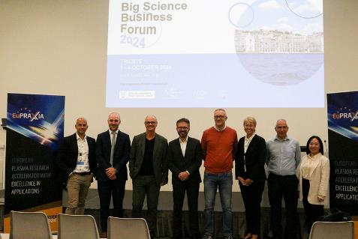
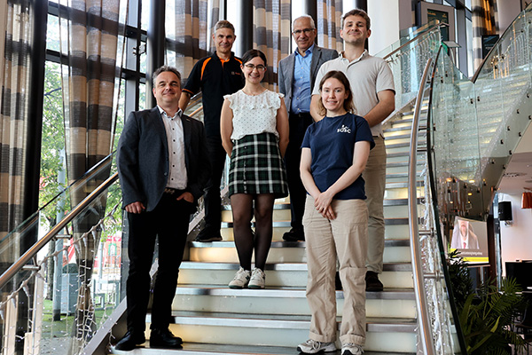
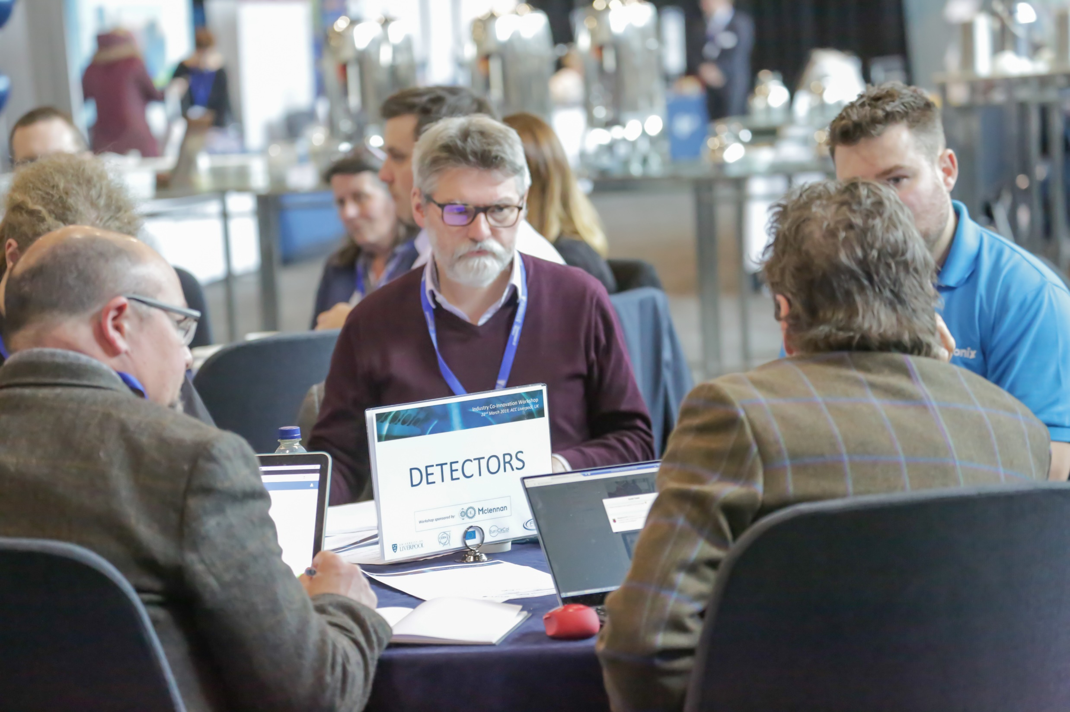
Exploitation of Research Outputs
Strategic exploitation plan ensures innovations deliver economic and societal value:
Identify exploitable outcomes and IP
IPR management
Market analysis and validation
Development of business models
Engagement with industry and stakeholders
Support for PACRI start-ups and spin-offs
Activities supported by ULIV Research, Partnerships and Innovation Directorate.
Please send Joe your knowledge transfer office details so we can establish a contact network.

Slide 11
Example Impact Cases (1)
Positron annihilation lifetime spectroscopy (PALS):
Non-destructive
Sub-surface volumetric inspection of materials
Plasma accelerators could be perfect sources for PALS:
High-flux
Short
Mildly relativistic
(Credit: POSH-PALS

Slide 12
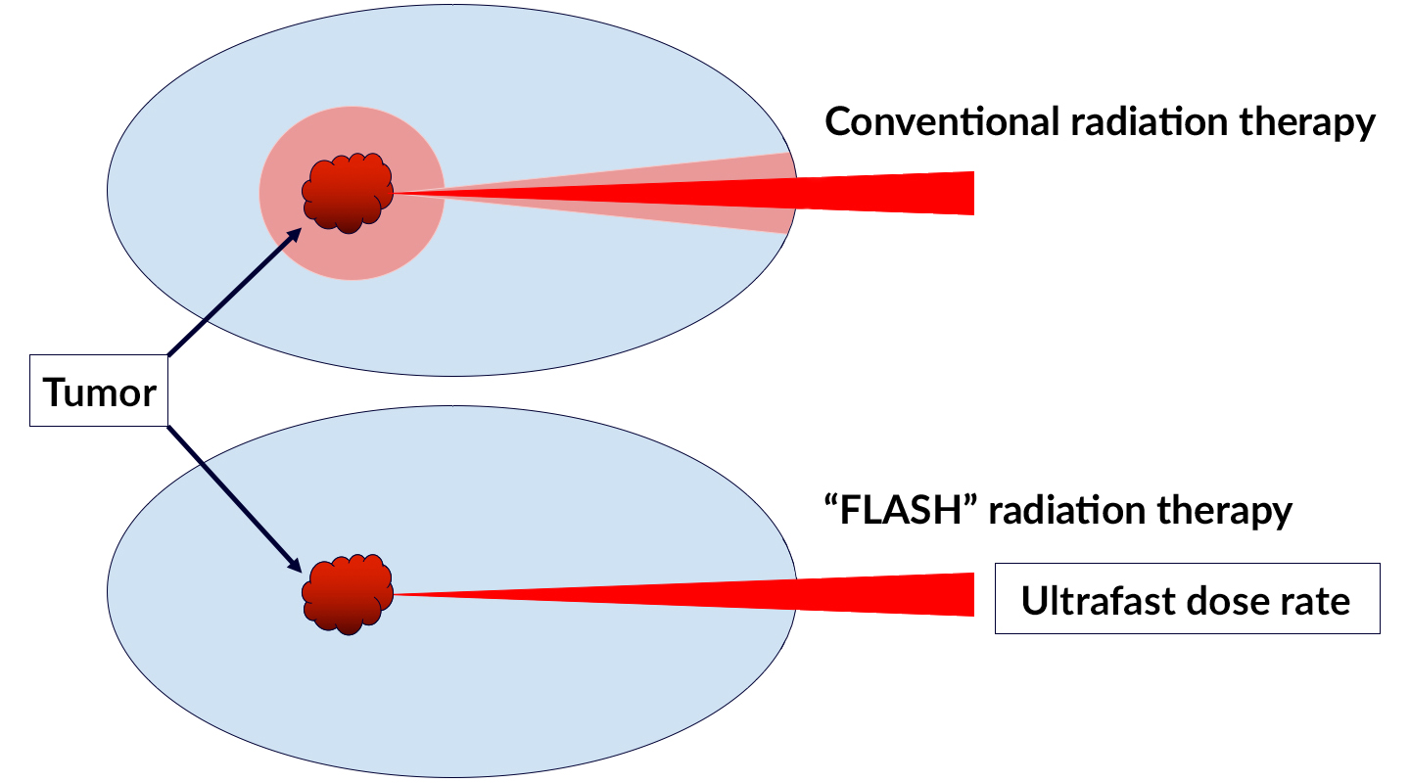
Example Impact Cases (2)
Inverse Compton Scattering (ICS) source:
operating frequency up to kHz
small footprint
low operational and maintenance expenses
price tag below 10 MEUR
FLASH Radiotherapy:
a novel cancer therapy method – very high dose rates compared with conventional
could be adapted for plasma accelerator-driven ICS sources
(Credit: C. Ralston, Berkeley Lab)

Slide 13
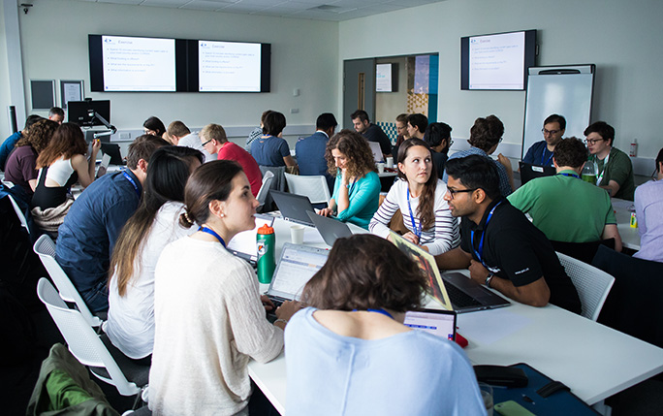
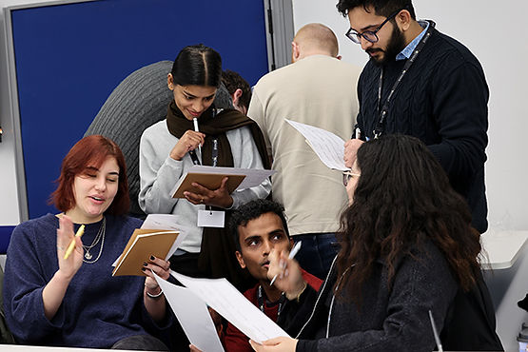
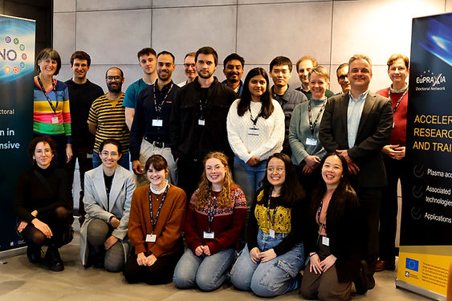
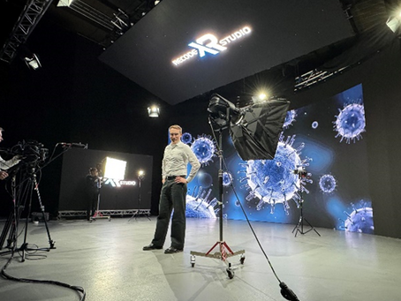
Education & Training
Through PACRI research >10 early-stage researchers are expected to benefit from an enhanced training.
ULIV team is considered a European reference in the training of ESRs, having coordinated 6 Marie Curie Training Networks and 2 CDTs
Education and training activities across PACRI consortium will be collected, analyzed and used for strategic planning and dissemination.

Slide 14
Gender Studies
EC’s “SHE Figures 2021” confirms that gender imbalance is still a serious issue in R&D:
Task 2.4 dedicated to address this, “Gender and Young Researchers”
Raise awareness within the project, community, and early career researchers
Collect data on gender distribution at all career levels and roles within PACRI
Information about related experiences and perception of the situation
Results will be widely disseminated

Slide 15
Deliverables & Milestones
Month
1 | 2 | 3 | 4 | 5 | 6 | 7 | 8 | 9 | 10 | 11 | 12 | 13 | 14 | 15 | 16 | 17 | 18 | 19 | 20 | 21 | 22 | 23 | 24 | 25 | 26 | 27 | 28 | 29 | 30 | 31 | 32 | 33 | 34 | 35 | 36 | 37 | 38 | 39 | 40 | 41 | 42 | 43 | 44 | 45 | 46 | 47 | 48
D1.6
 |  |  |  |  | D2.3 |  |  |  |  |  | D2.4 |  |  | D2.1 | D2.6 |  |  |  |  |  |  |  |  |  |  |  |  |  | D2.8 |  |  |  |  |  |  |  |  |  |  |  |  |  |  |  | D2.7 |  | D2.5D2.2
 |  |  |  |  |  |  |  |  |  |  |  |  |  |  |  |  |  |  |  |  |  |  |  |  |  |  |  |  |  |  |  |  |  |  |  |  |  |  |  |  | D5.3 |  |  |  |  |  | D5.4
 |  |  |  |  |  |  |  |  |  |  | M2 |  |  | M15 |  |  |  |  |  |  |  |  |  |  |  |  |  |  | M31M32 |  |  |  |  |  |  |  |  |  |  |  |  |  |  |  |  |  | M40
D1.6 – D1.4.1: Project Website with project information for different stakeholder groups.
D2.1 – D2.1.1: Evaluation of PACRI technology transfer strategy.
D2.2 – D2.1.2: PACRI technology transfer report.
D2.3 – D2.2.1: PACRI - Dissemination and exploitation plan including communication Activities – Initial
D2.4 – D2.3.1: PACRI industrial outreach & exploitation plan.
D2.5 – D2.4.1: Young researchers & gender report.
D2.6 – D2.2.3: Policy briefing report 1.
D2.7 – D2.2.5: Policy briefing report 2.
D2.8 – D2.2.2: PACRI - Dissemination and exploitation plan including communication Activities – Update

Slide 16
Deliverables & Milestones
Month
1 | 2 | 3 | 4 | 5 | 6 | 7 | 8 | 9 | 10 | 11 | 12 | 13 | 14 | 15 | 16 | 17 | 18 | 19 | 20 | 21 | 22 | 23 | 24 | 25 | 26 | 27 | 28 | 29 | 30 | 31 | 32 | 33 | 34 | 35 | 36 | 37 | 38 | 39 | 40 | 41 | 42 | 43 | 44 | 45 | 46 | 47 | 48
D1.6
 |  |  |  |  | D2.3 |  |  |  |  |  | D2.4 |  |  | D2.1 | D2.6 |  |  |  |  |  |  |  |  |  |  |  |  |  | D2.8 |  |  |  |  |  |  |  |  |  |  |  |  |  |  |  | D2.7 |  | D2.5D2.2
 |  |  |  |  |  |  |  |  |  |  |  |  |  |  |  |  |  |  |  |  |  |  |  |  |  |  |  |  |  |  |  |  |  |  |  |  |  |  |  |  | D5.3 |  |  |  |  |  | D5.4
 |  |  |  |  |  |  |  |  |  |  | M2 |  |  | M15 |  |  |  |  |  |  |  |  |  |  |  |  |  |  | M31M32 |  |  |  |  |  |  |  |  |  |  |  |  |  |  |  |  |  | M40
M2: PACRI dissemination plan.
M15: PACRI technology transfer strategy ready.
M40: PACRI technology transfer plan ready.

Slide 17
Summary
By working together closely, we will maximize PACRI’s impact across several parallel pathways.
We will take a multifaceted approach to ensure the transition of innovations into applications that deliver economic and societal value.
Our detailed communication plan, based on previous experience, will guarantee effective communication of all project results.
We will expose the next generation of researchers and the general public to PACRI science through an international outreach and communication program, connecting with EuPRAXIA, ELI and others.

