Slide 1


Twin Echo-Enabled Harmonic Generation for Enhanced Coherent Bunching at Short Wavelength
Eugenio Ferrari
25.09.2025

Slide 2
Outline and contents
Echo Enabled Harmonic Generation (EEHG) for FEL external seeding at short wavelengths
Fresh bunch technique for further extend seeding
Performance and limitations of two cascaded EEHG stages

Slide 3
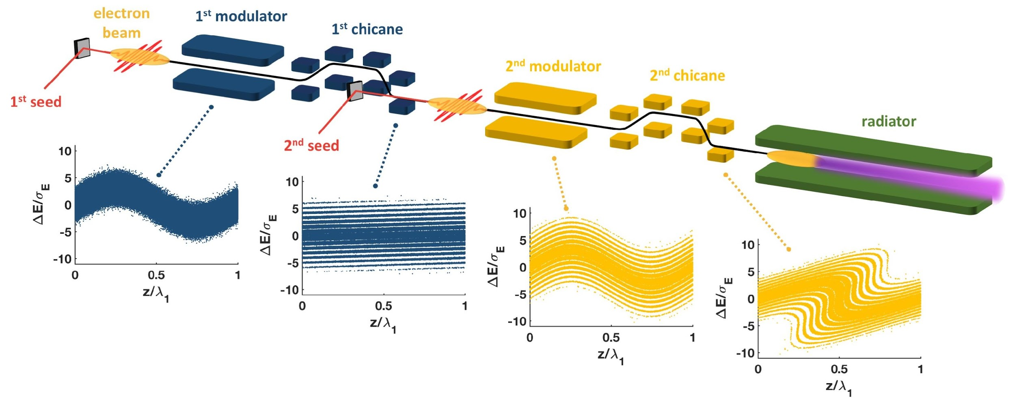
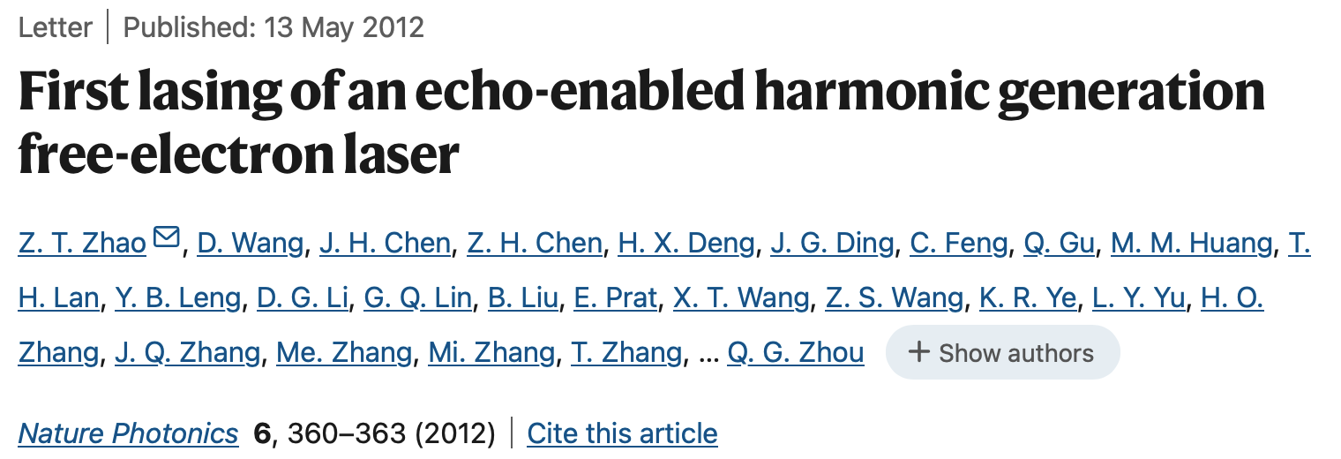
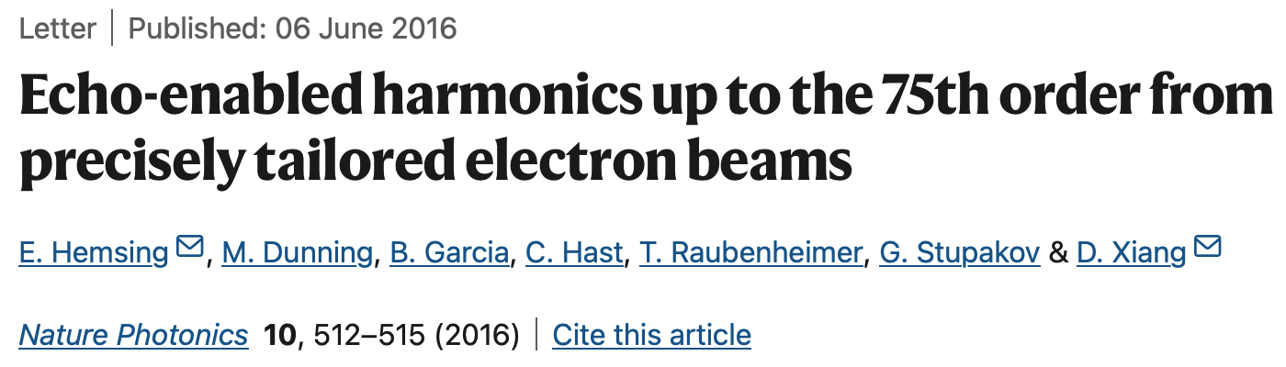
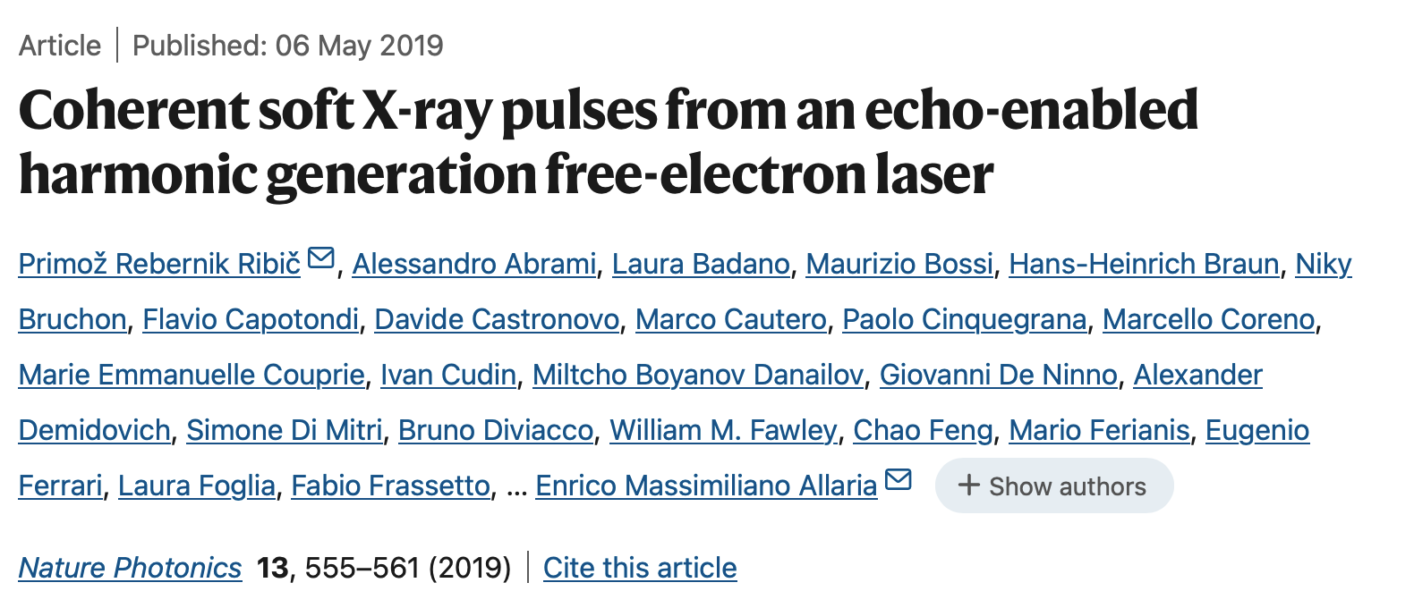
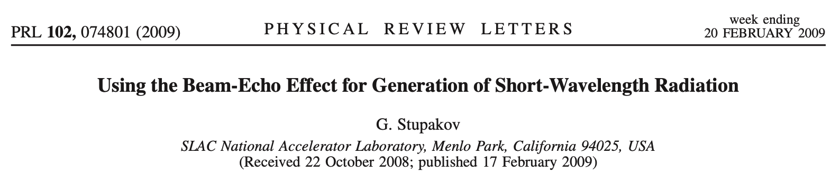
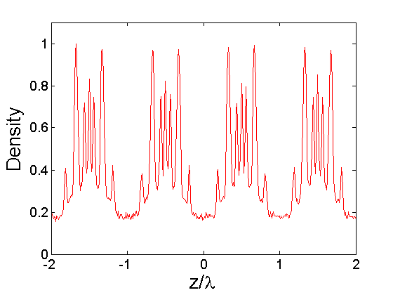

Echo Enabled Harmonic Generation
Increasing harmonic content to generate short FEL wavelengths
A first laser generates an energy modulation in electron beam.
A strong chicane creates stripes in the longitudinal phase space.
A second laser imprints an energy modulation.
The second chicane converts the energy modulation into harmonic density modulation.
Image from P.R.R. et al., Nature Photonics 13, 555-561 (2019)
B₁
A₁
B₂
A₂

Slide 4
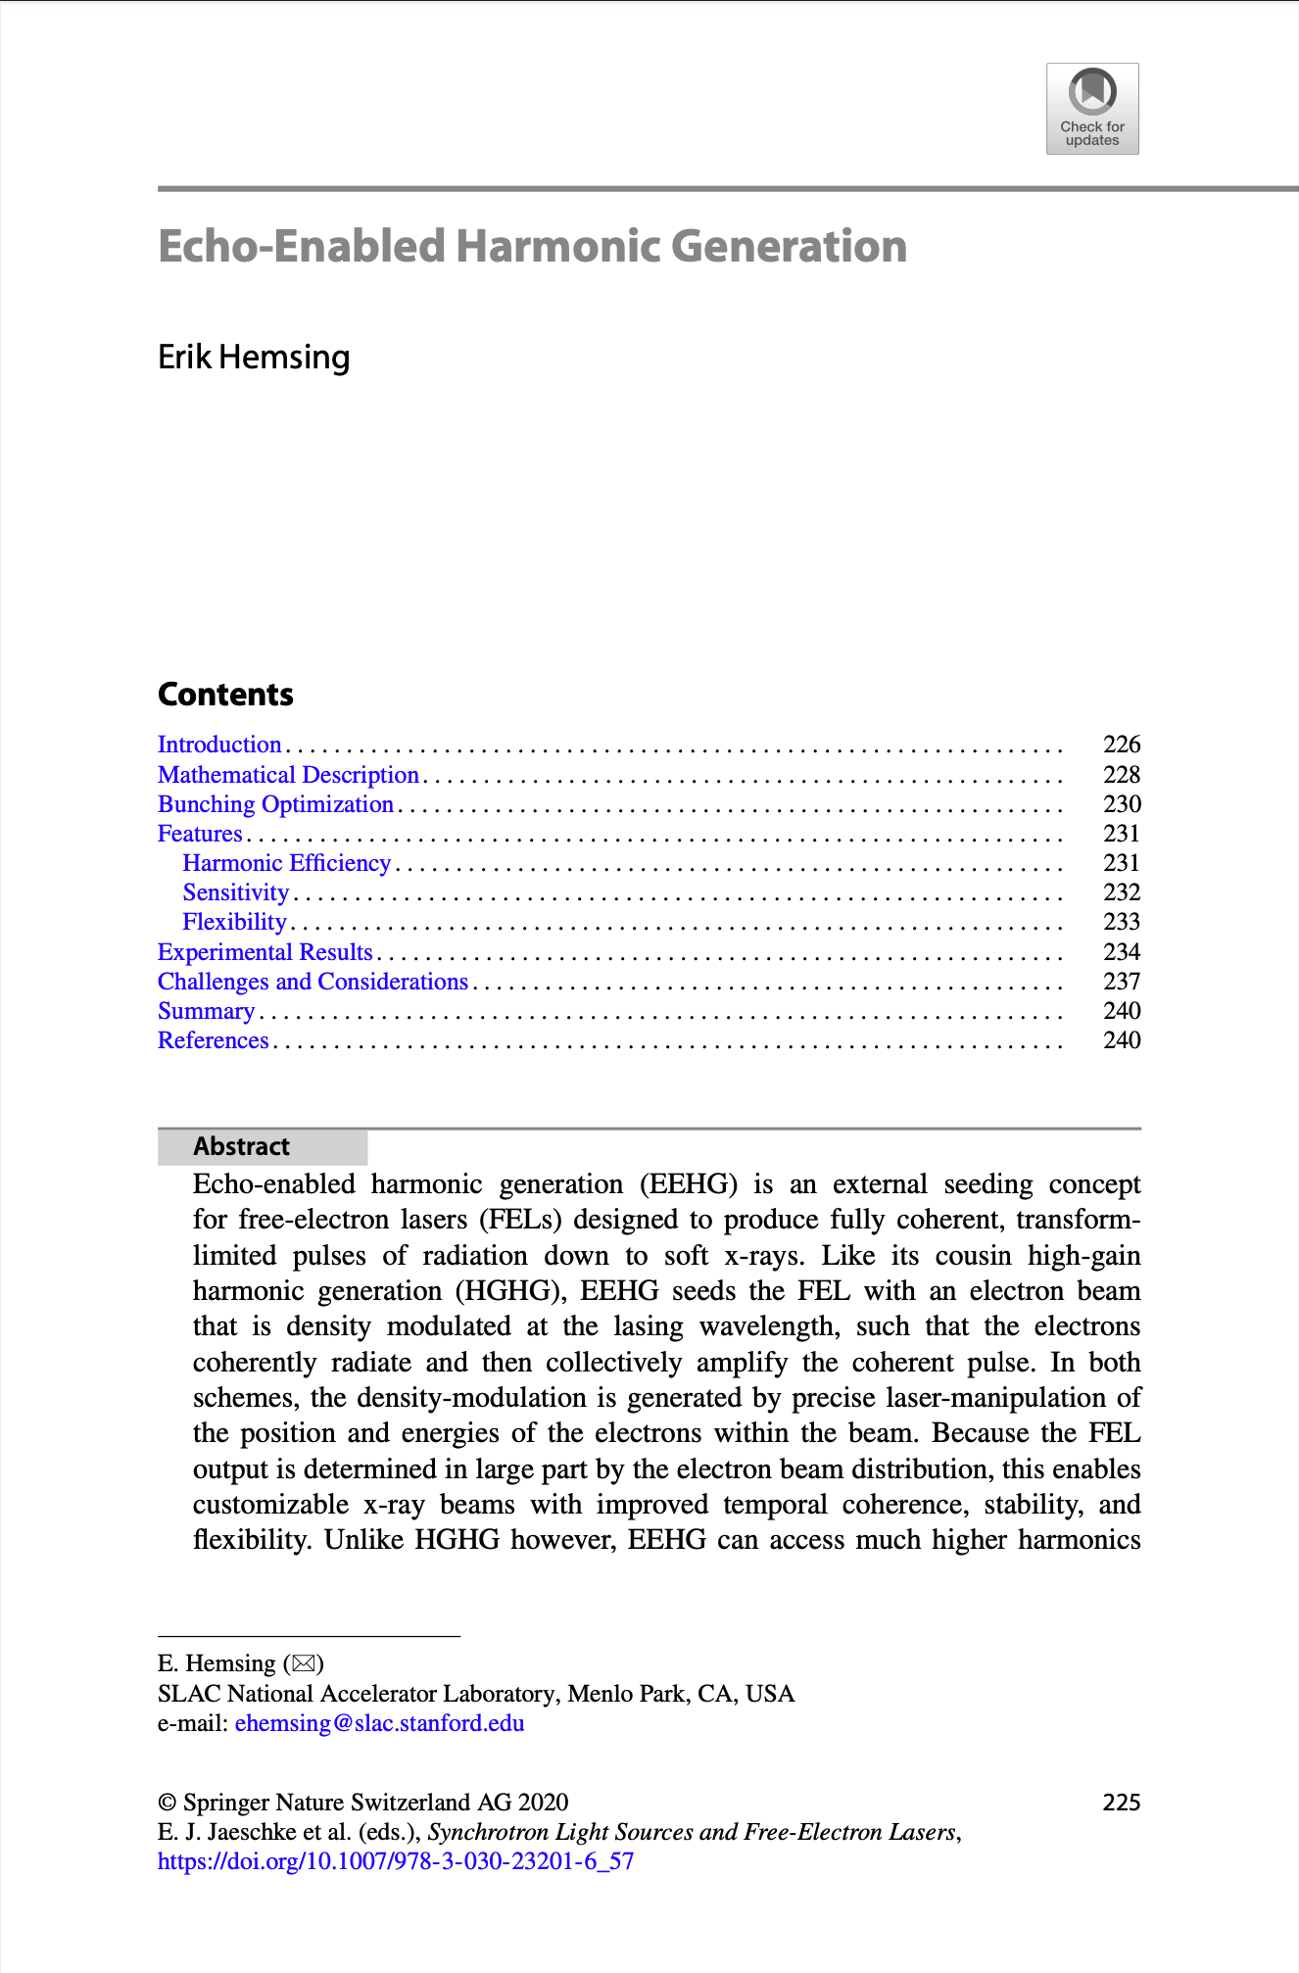

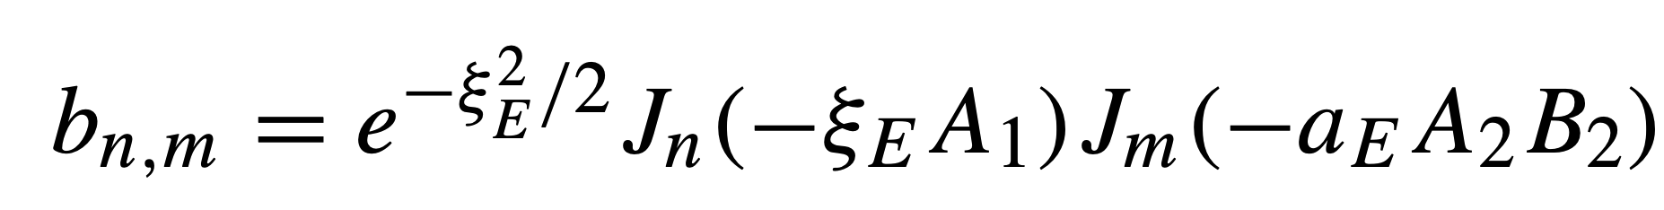
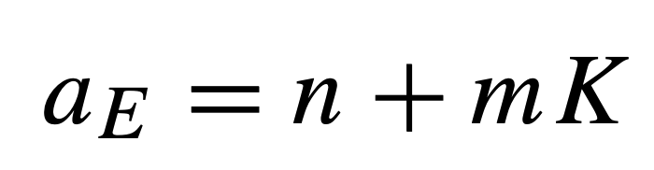
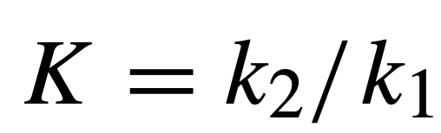
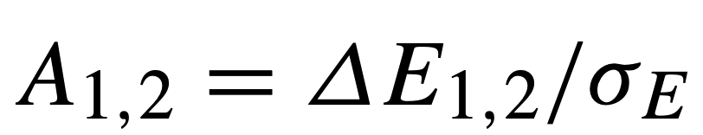
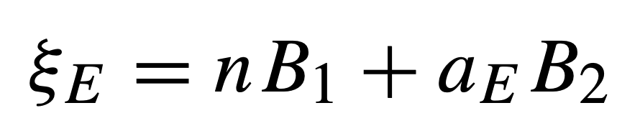
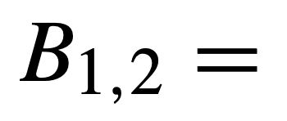
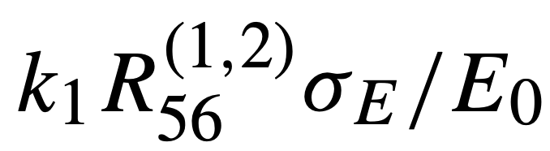

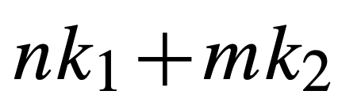
EEHG bunching equation
Dependence on seeding parameters
B₁
EEHG harmonic number
A₁
B₂
A₂
Modulation amplitude
EEHG scaling
Chicane strength
EEHG wavenumber

Slide 5
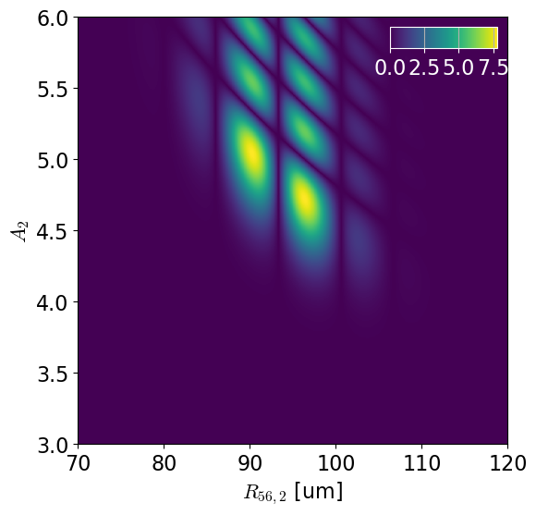
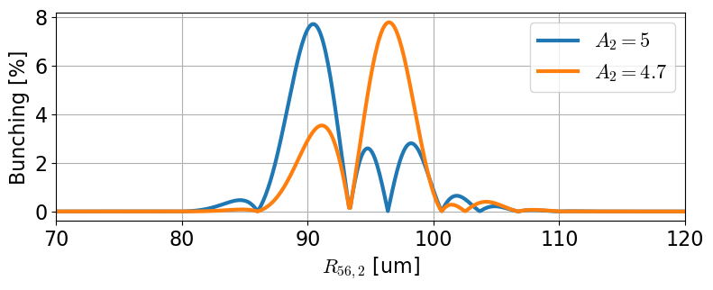
How to deal with multi-parameter EEHG bunching
Solving the bunching equation numerically with fixed first seeding stage parameters
One possible approach:
  A₁ = 3
  R₅₆⁽¹⁾ = 7 mm
  n = -1, m = (a_{E} - n) / K
  Plot b_{n,m} vs. A₂, R₅₆⁽²⁾
Bunching islands
Modulation amplitude
Example: FLASH-1 at 4 nm
Very high harmonic up-conversion efficiency
Chicane strength

Slide 6
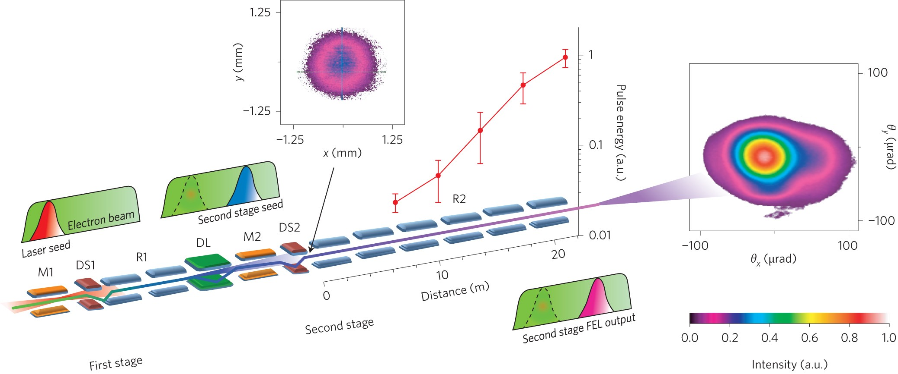
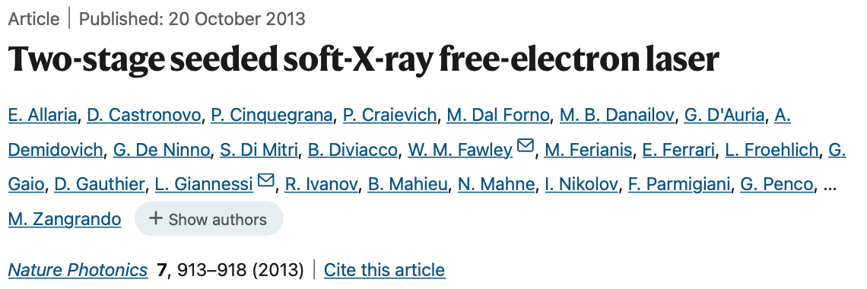
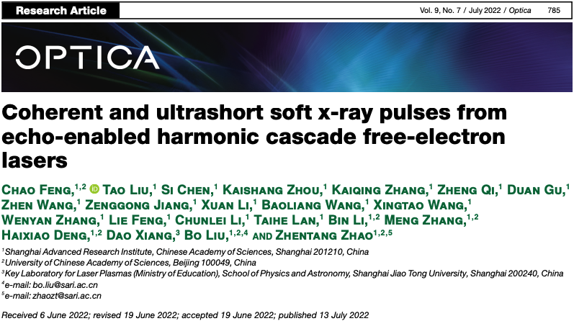
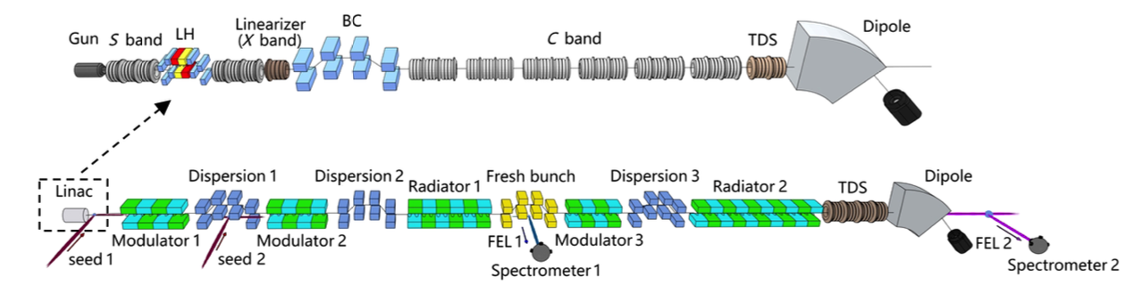
Fresh bunch approach
HGHG seeding HGHG
An FEL seeding another FEL
EEHG seeding HGHG

Slide 7
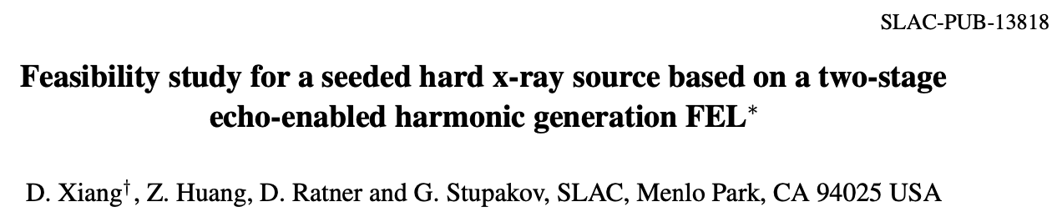
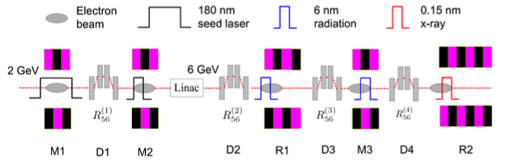

Two cascaded ECHO stages
EEHG till hard X-rays?
a_{E}(final) = 1199
Notes:
TEEHG is in a sense similar to the scheme reported in this paper, where the authors were considering EEHG to the hard-x-rays
But we consider instead very small echo numbers
In out case, we saw that the main degradation effect is the finite size of the seed laser

Slide 8
Two cascaded ECHO stages
EEHG seeding EEHG
*Seed 1
Seed 2
ECHO-1
Fresh bunch
MOD1
MOD2
RAD1
DL
MOD3
RAD2
T
H
DS1
DS2
DS3
e-beam
*Seed1 pulse length is comparable to the e-beam to reduce the effects of temporal jitter
Notes:
Now let’s together follow the journey through the setup shown above of two electron beam slices with length of one seed laser wavelength, located towards the tail and towards the head of the bunch
Shown is the longitudinal phase space (E, phase)

Slide 9

Two cascaded ECHO stages
EEHG seeding EEHG
*Seed 1
Seed 2
ECHO-1
Seed 3
ECHO-2
Fresh bunch
MOD1
MOD2
RAD1
DL
MOD3
RAD2
T
H
DS1
DS2
DS3
e-beam
Twice EEHG? TEEHG!
*Seed1 pulse length is comparable to the e-beam to reduce the effects of temporal jitter
Notes:
After ECHO-2 appears:
And what better achronim? Twice EEHG: TEEHG!

Slide 10
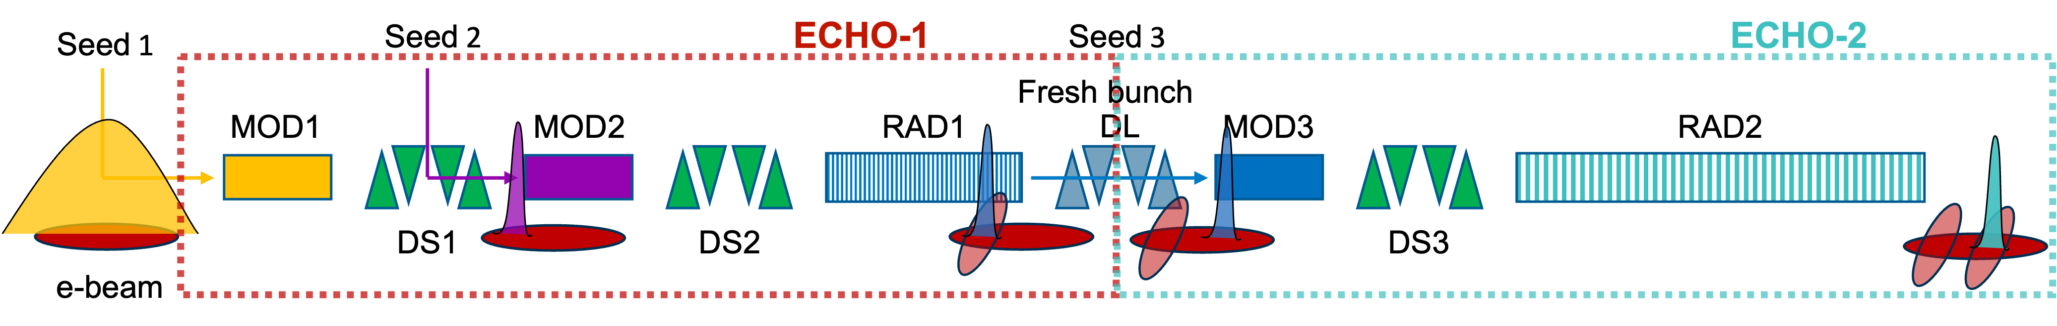
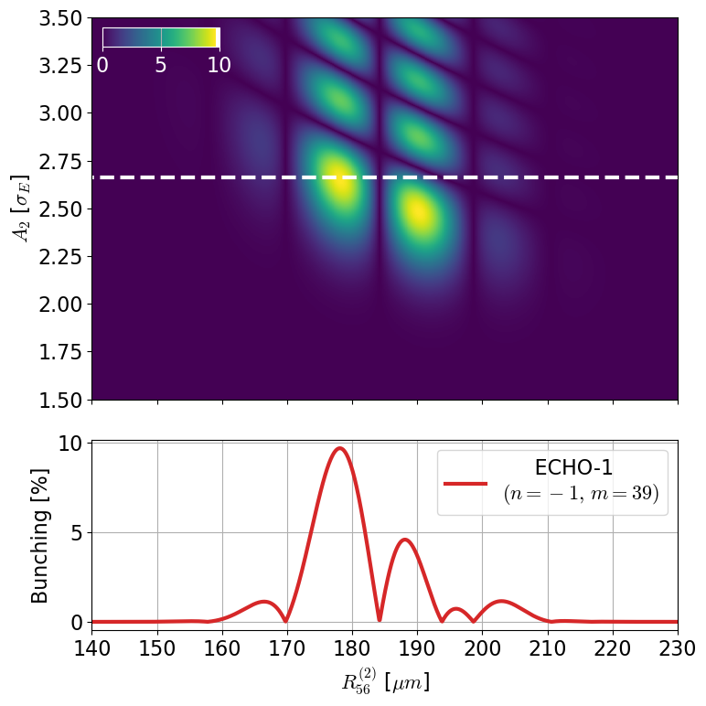
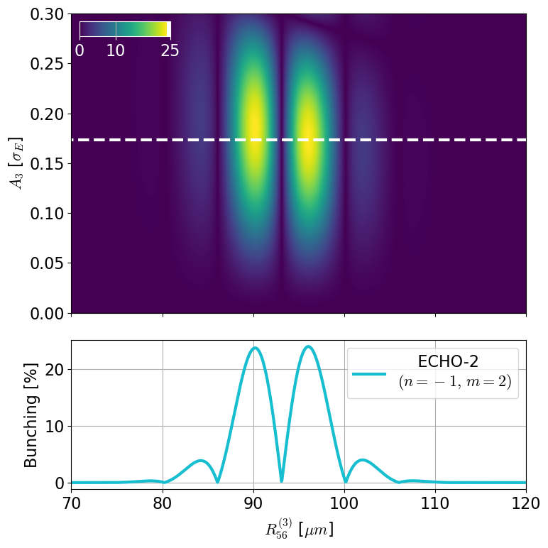
Two cascaded ECHO stages
Bunching maps, harmonic up-conversion (i.e., shorter wavelengths)
ECHO-1 (λ_{FEL} = 7.89 nm)
a_{E1} = 38 (n = -1, m = 39, λ₁ = λ₂ = 300 nm)
ECHO-2 (λ_{FEL} = 4 nm)
a_{E2} = 75 (n = -1, m = 2, λ₁ = 300 nm, λ₂ = 7.89 nm)
Optimum for A₂ ~ 2.7
Max. bunching ~ 10%
En. Spread ~ 0.44 MeV
λ_{FEL} = 7.89 nm
Optimum for A₃ ~ 0.17
Max. bunching ~ 24%
En. Spread ~ 0.33 MeV
λ_{FEL} = 4 nm
Notes:
Now we have two bunching equations to be optimized.
We fix the final wavelength to 4 nm and here are the possible solutions to achieve that

Slide 11
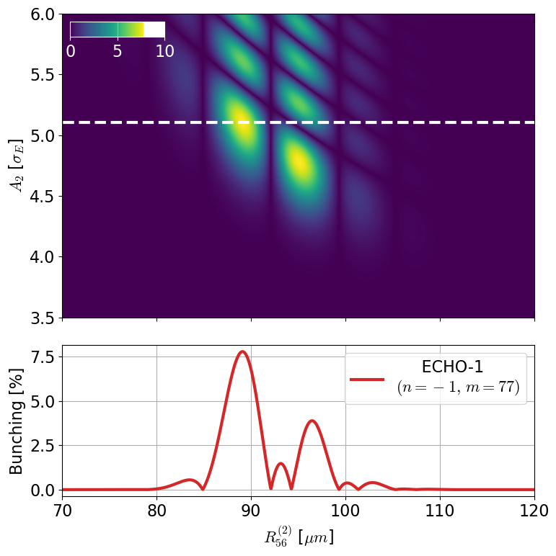
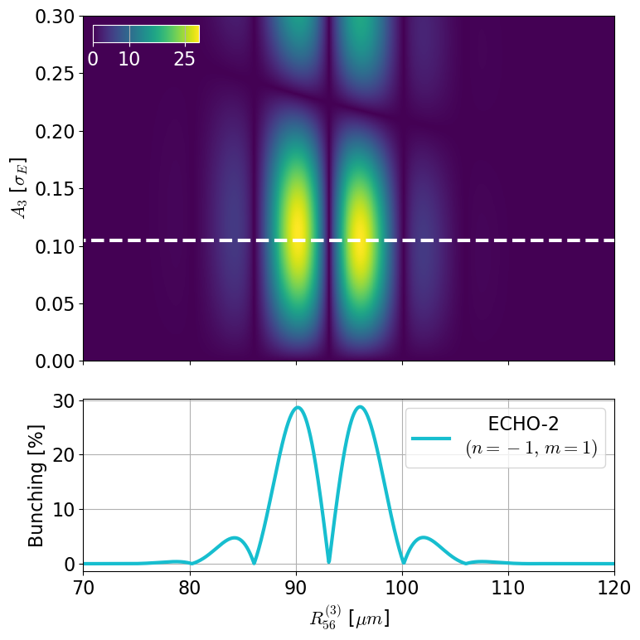
Two cascaded ECHO stages
Bunching maps, harmonic down-conversion (i.e., longer wavelengths)
ECHO-1 (λ_{FEL} = 3.96 nm)
a_{E1} = 76 (n = -1, m = 77, λ₁ = λ₂ = 300 nm)
ECHO-2 (λ_{FEL} = 4 nm)
a_{E2} = 75 (n = -1, m = 1, λ₁ = 300 nm, λ₂ = 3.96 nm)
Optimum for A₂ ~ 5.1
Max. bunching ~ 7%
En. Spread ~ 0.64 MeV
λ_{FEL} = 3.96 nm
Optimum for A₃ ~ 0.1
Max. bunching ~ 29%
En. Spread ~ 0.33 MeV
λ_{FEL} = 4 nm

Slide 12
Two cascaded ECHO stages
Bunching maps, harmonic down-conversion (i.e., longer wavelengths)
ECHO-1 (λ_{FEL} = 3.96 nm)
a_{E1} = 76 (n = -1, m = 77, λ₁ = λ₂ = 300 nm)
ECHO-2 (λ_{FEL} = 4 nm)
a_{E2} = 75 (n = -1, m = 1, λ₁ = 300 nm, λ₂ = 3.96 nm)
Notes:
The two ECHOs are very different:
Energy spread
Entrance bunching
Modulation amplitude

Slide 13
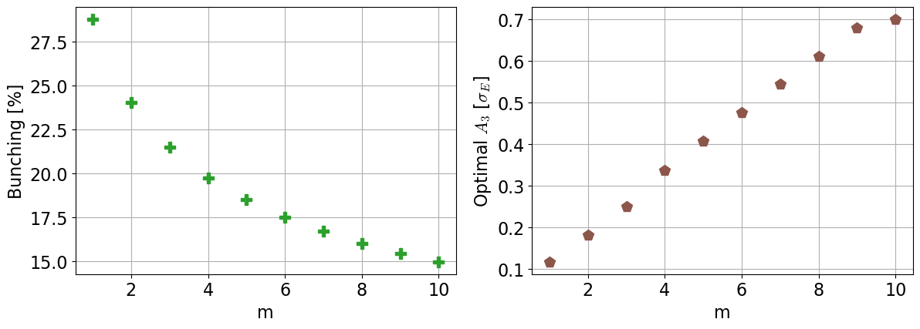
Two cascaded ECHO stages
Comparison between harmonic up- and down-conversion
ECHO-2 (λ_{FEL} = 4 nm)
up-conversion
a_{E1} = 75
n = -1, m = 2,
λ₁ = 300 nm, λ₂ = 7.89 nm
Optimum for A₃ ~ 0.17
Max. bunching ~ 24%
In both cases:
Very high bunching at 4 nm (>20%)
With tiny modulation amplitude A₃
Minute seed3 power requirements:
  Few 10⁴ W peak power*
  ~nJ pulse energy
  Emitted by a single radiator module (and even requiring attenuation)
  RAD1 can be very compact
Small induced energy spread at RAD2
  Practically only determined by A₁
Harmonic down-conversion provides the best performance
Achievable bunching is independent on the final wavelength if sufficient seed3 power is available
ECHO-2 (λ_{FEL} = 4 nm)
down-conversion
a_{E2} = 75
n = -1, m = 1,
λ₁ = 300 nm, λ₂ = 3.96 nm
Optimum for A₃ ~ 0.1
Max. bunching ~ 29%
λ_{FEL} = 4 nm
λ_{FEL} = 4 nm
*For the presented parameters
Notes:
And the simple explanation on why m = 1 is more efficient than m = 2

Slide 14
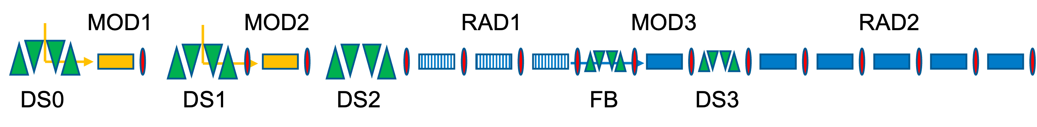
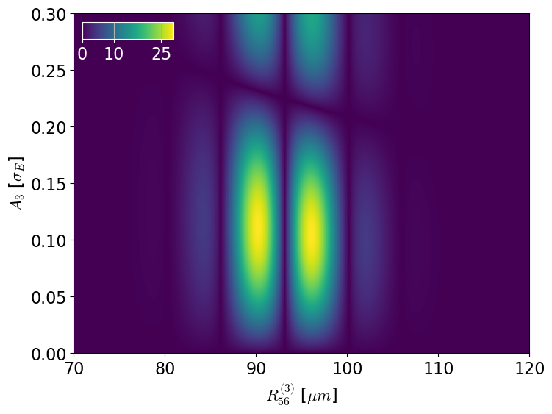

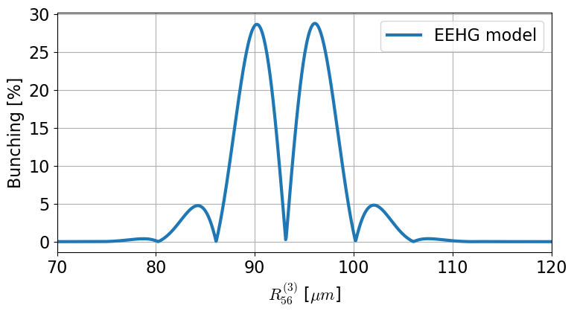
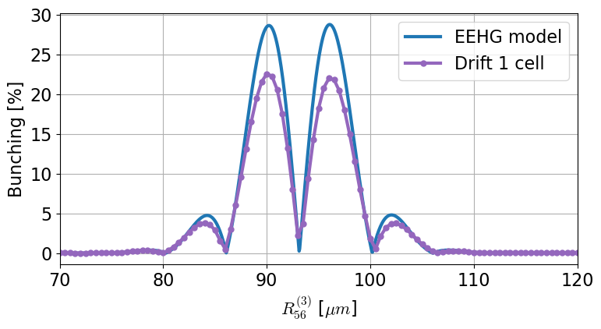
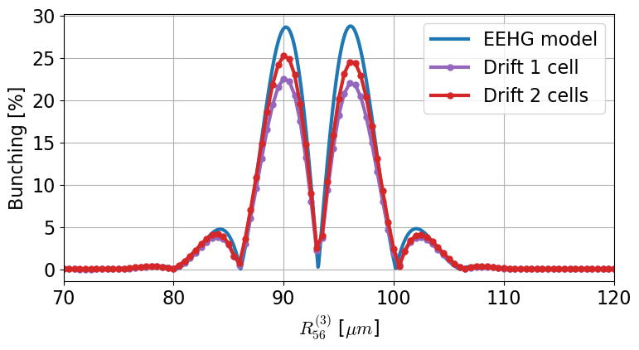
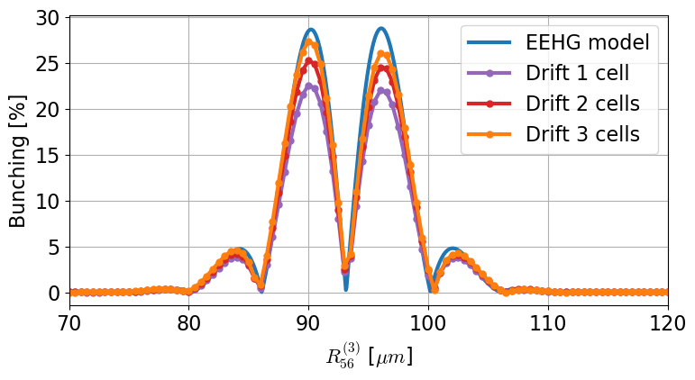

Two cascaded ECHO stages
Simulations, down-conversion
Genesis1.3v4 time-independent
ECHO-2 (λ_{FEL} = 4 nm)
a_{E2} = 75 (n = -1, m = 1, λ₁ = 300 nm, λ₂ = 3.96 nm)
λ_{FEL} = 4 nm
Consequence of the “finite size” of seed3
Can be mitigated:
by longer drift
appropriate e-beam optics
Using small A!
Notes:
Let’s focus now on the comparison between the model and time independent Genesis simulations
Same number of undulators as source, but different source position (and attenuation to always have A3 = 0.1)

Slide 15
Two cascaded ECHO stages
Performance comparison
Genesis1.3v4 time-dependent
(λ_{FEL} = 4 nm)
* best case scenario: ECHO-1 on 500 A slice, FB on 500 A
** worst case scenario: seed3 from one cell with one cell drift only
Notes:
Full fledged time dependent Genesis simulations at 4 nm

Slide 16

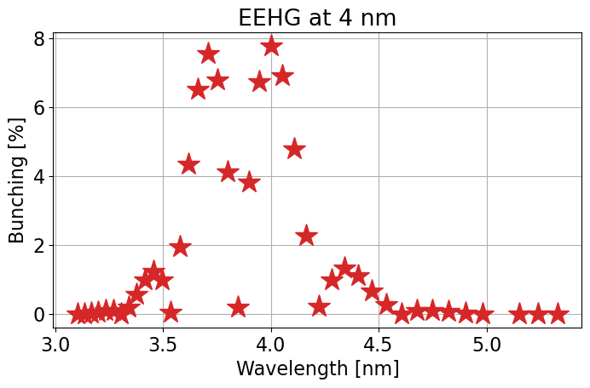
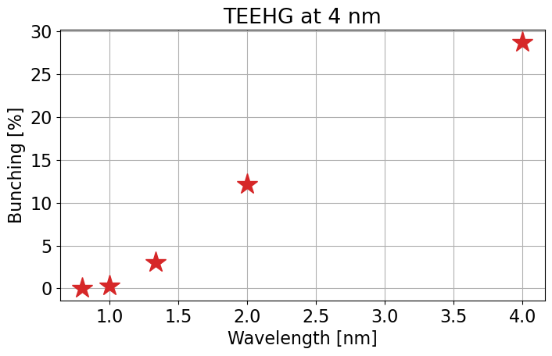
Harmonic social distancing
Cascaded schemes “reset” the harmonic separation
Both setups optimized for 4 nm
The bunching spectrum is show, without altering the tuning

Slide 17
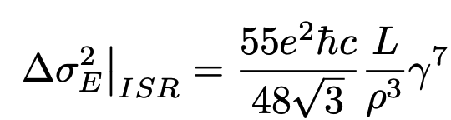
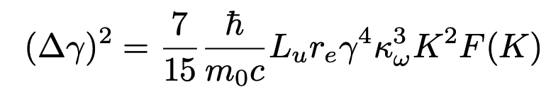
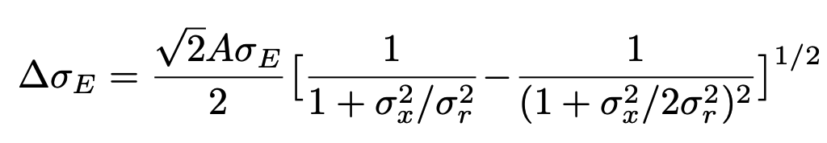
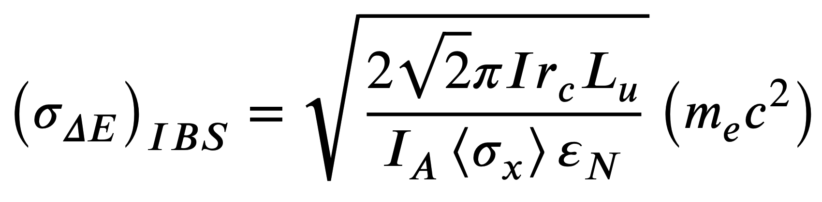
Two cascaded ECHO stages
Limiting effects:
EEHG till hard X-rays?
ISR in bending
a_{E}(final) = 1199
SR in undulators
Finite size of the laser
IBS
Notes:
TEEHG is in a sense similar to the scheme reported in this paper, where the authors were considering EEHG to the hard-x-rays
But we consider instead very small echo numbers
In out case, we saw that the main degradation effect is the finite size of the seed laser

Slide 18
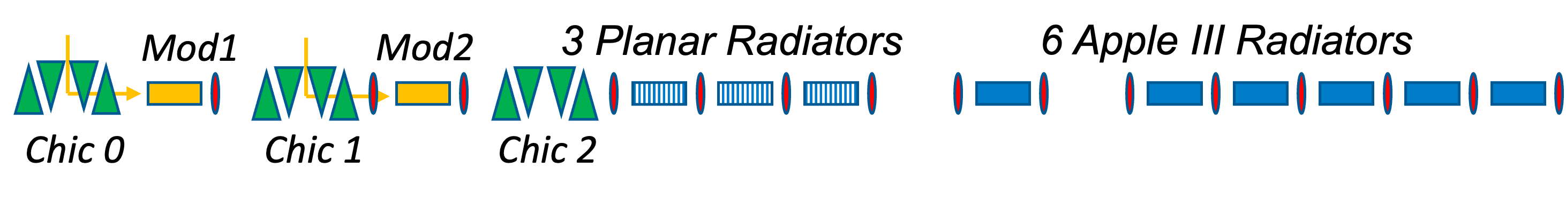
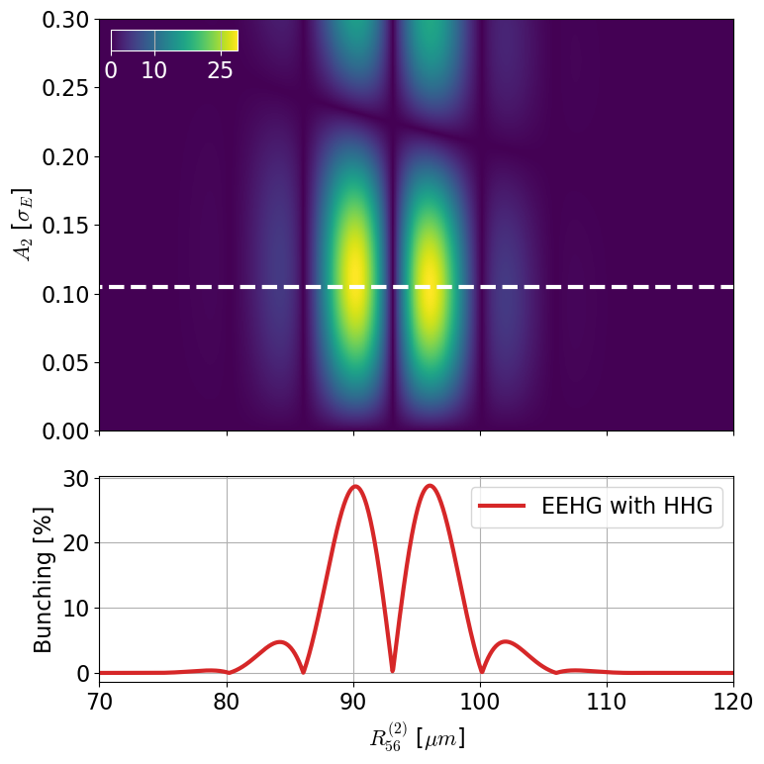
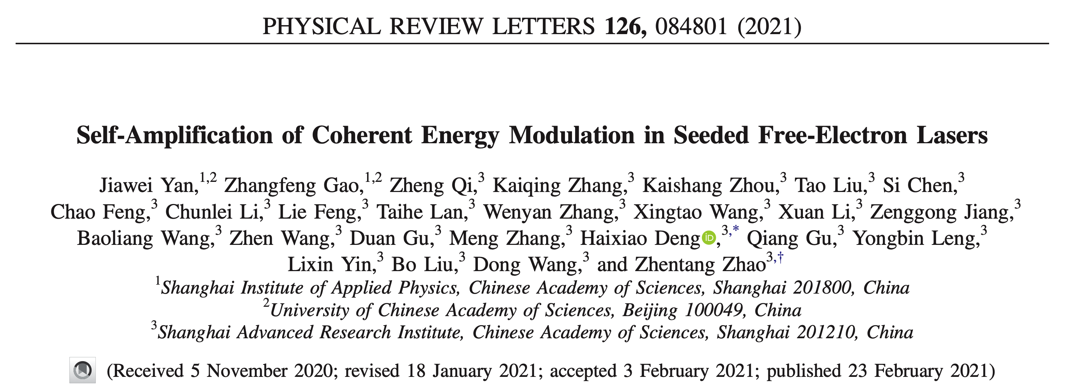
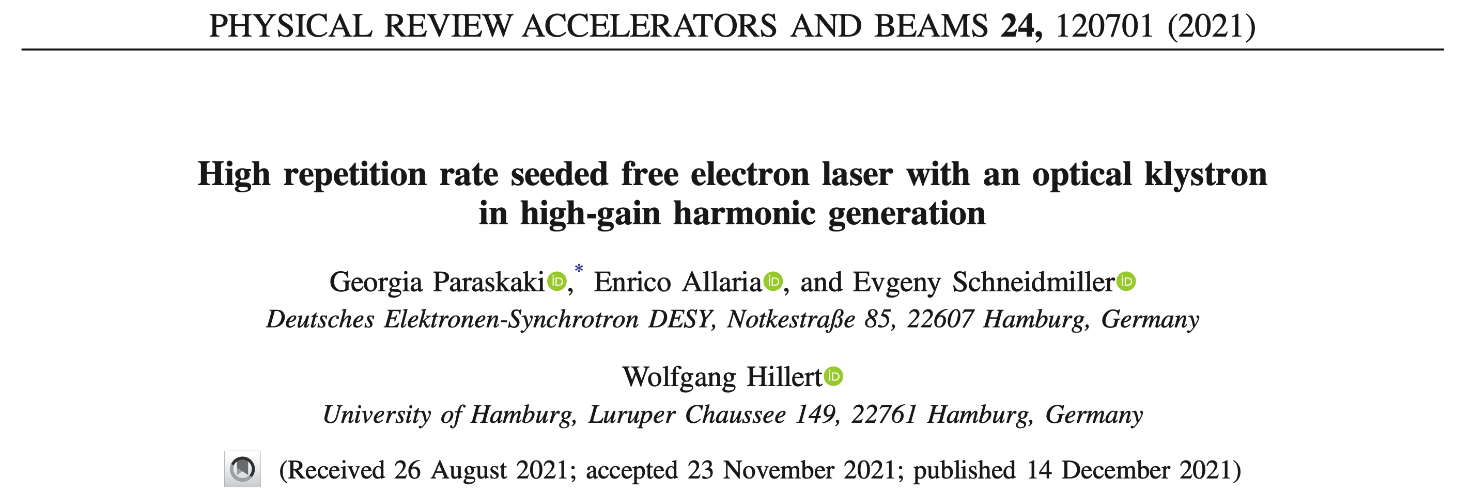
Amplification of small signals
HHG as seed for EEHG
  Few 10⁴ W peak power*
  ~nJ pulse energy
Seed laser
A₁ = 3
HHG source
A₂ ~ 0.1
(n = -1, m = 1)
An alternative to self-modulation, with the reduced sensitivity to e-beam parameters of EEHG
*For our parameters
Notes:
A somewhat simplified similar to the one shown could be then considered to amplify instead small signals
Like the harmonics in gas

Slide 19
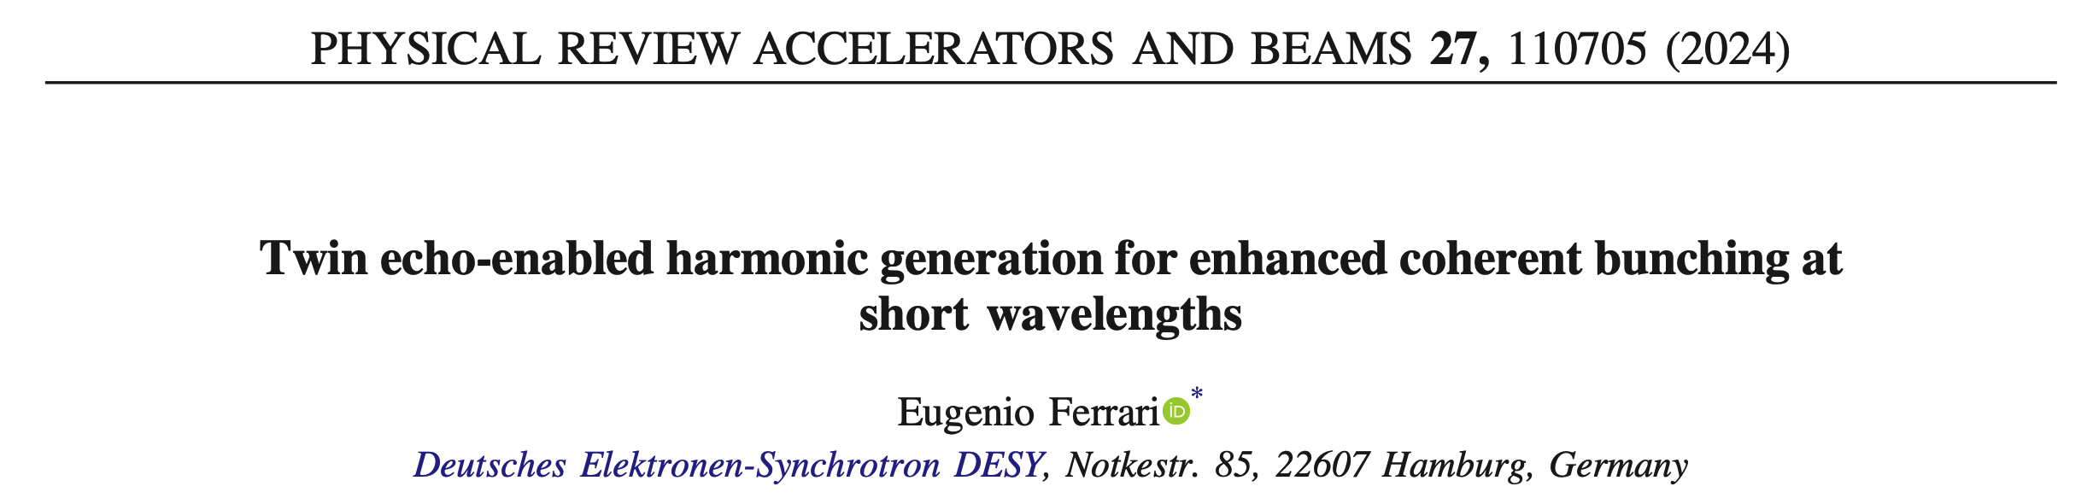

Summary
EEHG is a well-established external seeding technique for reaching short wavelengths in a single stage
The fresh bunch technique can be used in stages to further extend external seeding
TEEHG is a promising approach to reach high bunching at very short wavelengths
We plan to test the setup soon

Slide 20
Thank you!

Slide 21
Eugenio Ferrari
MPY
eugenio.ferrari@desy.de

Slide 22
Backup

Slide 23
Dependence on EEHG paramerters

Slide 24
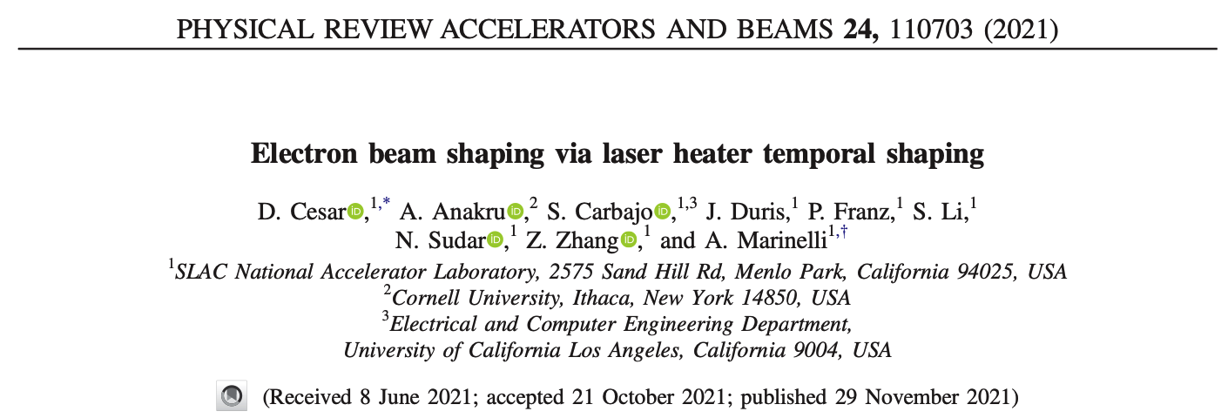
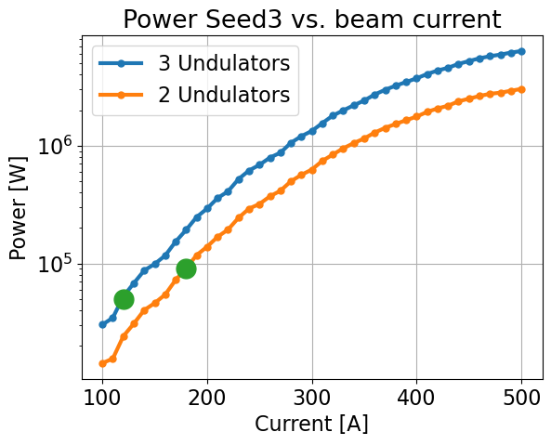
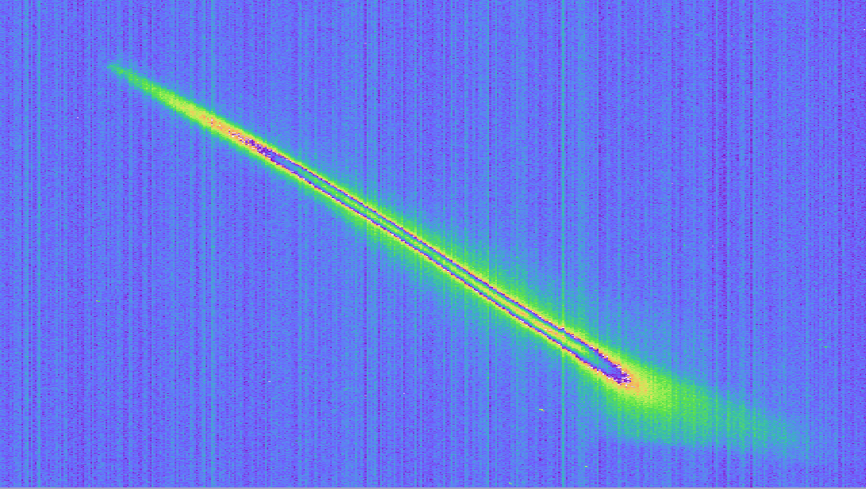
Controlling seed3 power (A₃)
Attenuate ECHO-1 output
Laser heater shaping
Detune of RAD1 or MOD3, tune of ECHO-1 parameters
Solid or gas attenuator for RAD1 emission
  Or a mono?
Current distribution of the beam
  Naturally present
  Conveniently located for FB
Energy
Time

Slide 25
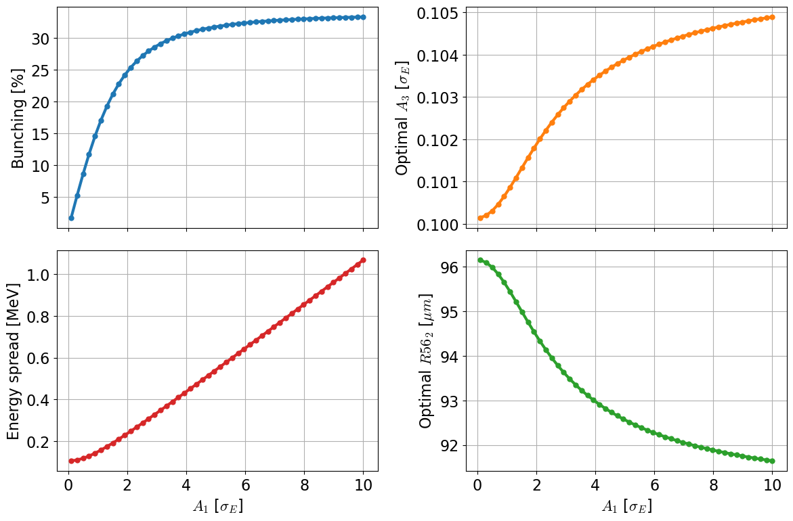
Dependency on A₁
For ECHO-2, fixed R_{56,1}
Even larger bunching is possible, but at the cost of increasing the energy spread.
Next step: optimization of A₁ for best performance

Slide 26
Dependency on m
Higher harmonics

Slide 27
How to use two empty cells

Slide 28


Two empty cells
Mod1
Mod2
3 Planar Radiators
6 Apple III Radiators
Space for two chicanes!
Chic 0
Chic 1
Chic 2
Shift of the source point towards the users
  This can be critical at long wavelengths
  Transport only an energy modulation to avoid
    space charge effects
Reduce the pulse duration using superradiance
Notes:
Shift of the source position
Superradiant cascades

Slide 29


Two empty cells
Mod1
Mod2
3 Planar Radiators
6 Apple III Radiators
Space for two chicanes!
Chic 0
Chic 1
Chic 2
Militarize* multicolor emission in EEHG:
  One or multiple pulses from from seed2
  Tweak EEHG optimum using the chicanes
Color 1: 6 nm
(n = -1, m = 51, a_{E} = 50)
Color 2: ~8 nm
(n = -1, m = 38, a_{E} = 37)
*but still, #makelovenotwar
Notes:
And finally chicanes can enable cascaded schemes

Slide 30
FERMI

Slide 31





FERMI-FEL2
TEEHG:
ECHO-1 at 1.98 nm with a_{E1} = 134 (n = -1, m = 135, λ₁ = λ₂ = 266 nm)
ECHO-2 at 2 nm with a_{E2} = 133 (n = -1, m = 1, λ₁ = 266 nm, λ₂ = 1.98 nm)
Optimum for A₃ = 0.093 with bunching ~28%
Preliminary Genesis1.3 simulations with mock-up lattice
TEEHG for the upgrade of FERMI
Parameter | Value
Energy | 1.8 GeV
Energy spread | 200 keV
Emittance | 0.8 mm mrad
Current | 1 kA
Average beta | 10 m
Radiator | 6 x 2.4 m (λ_{u}=29 mm)
Seed λ | 266 nm
*with cubic taper
Notes:
I explored what could be the TEEHG performance for the parameters of FERMI FEL-2 upgrade, taken from the CDR
With a mock-up setup, to generate 2 nm radiation in upconversion
Bunching spectrum shown for 1 nm too

Slide 32
Small signals

Slide 33




HHG for seeding
Direct amplification and CHG with HHG
Notes:
Finally, let’s step back and consider seeding with harmonics in Gas.
This has been demonstrated at long wavelengths, around 160 nm in direct seeding
And at FLASH in CHG mode at 38 and 19 nm
The performance were limited by the amount of power at the harmonics, as this needed to be larger than the energy spread of the electrons (A~1)

Slide 34
Amplification of small signals
HHG as seed for EEHG
  Few 10⁴ W peak power*
  ~nJ pulse energy
Seed laser
A₁ = 3
HHG source
A₂ ~ 0.1
(n = -1, m = 1)
An alternative to self-modulation, with the reduced sensitivity to e-beam parameters of EEHG
*For our parameters
Notes:
A somewhat simplified similar to the one shown could be then considered to amplify instead small signals
Like the harmonics in gas

Slide 35
Older stuff

Slide 36


Two cascaded ECHO stages
Performance comparison
Genesis1.3v4 time-dependent
(λ_{FEL} = 4 nm)
Conditions for high extraction efficiency could be satisfied
very high bunching
(possibly) high seed
Taper is critical
For now, only quadratic
Next steps:
detailed taper optimization
Notes:
The high extraction efficiency could provide energy extraction up to %-level of the beam power

Slide 37
Foreword
Once upon a time…
there was an FEL facility going through an upgrade for realizing seeding at high repetition rates.
A dangerous dragon called “Budget Constraints” threatened to filibuster the project.
And this is how the story begins…

Slide 38
Seeding FLASH1
Modifications to FLASH facility for external seeding
RF Stations
Accelerating Structures
FLASH1
TDS
THz
Pump-Probe Lasers
Seeding
RF Gun
Laser Heater
FLASH2
Photon Diag.
Bunch Compressors
Albert Einstein
Lasers
Seed Laser
5 MeV
150 MeV
550 MeV
1350 MeV
FF Laser
FLASHForward
Kai Siegbahn
FEL Experiments
Parameter | Value
Energy | 1.35 GeV
Energy spread | 150 keV
Emittance | 0.6 mm mrad
Current | 500 A
Average beta | 10 m
Seed λ | 343 nm / 297 - 317 nm 300 nm*
Typical phase space for seeding:
500 pC / 1 ps / 500 A Gaussian
 | Seeded FLASH1
Wavelength (nm) | 4 – 60
Photon energy (eV) | 310 – 20.6
Rel. fwhm bandwidth (%) | 0.05 – 0.4
Pulse energy (μJ) | < 20
Pulse energy stability (%) | < 10
Pulse length (fs) | 12 - 40
Pulses per second | < 5000
Polarization | Variable (linear to circular)
Energy
Time

Slide 39




Seeding FLASH1
The “infinite money approximation” doesn’t hold
Mod1
Mod2
11 Radiators
Chic 0
Chic 1
Chic 2
Reduce performance
Maintain upgrade capability
Upgrade to full version when budget becomes available
Mod1
Mod2
3 Planar Radiators
6 Apple III Radiators
Chic 0
Chic 1
Chic 2
But there are still two empty radiator cells
← Output power reduced
by a factor of 5
← Polarization contrast
reduced to about 50
SASE saturation
11x Apple III
6x Apple III
→ SASE is no fallback
option
→ 24/7 operation of seed
laser!
Notes:
E = 1350 MeV
I = 2 kA
Espread = 600 keV (150 keV@500 A)
Av. Beam size = 50 um
Norm. Emittance = 0.6 mm mrad
Average beta function = 10 m

Slide 40
Better a chicane today than an undulator tomorrow?
(Almost) anything is better than a drift*
Chicanes are great for flexibility
  Adapt the source position
  Multicolor pulses, pulse shortening, cascades
  and for thinking outside the box
  and they are cheaper
Undulators are better for (increased) output power
TEEHG is a promising approach to reach unprecedented bunching at very short wavelengths
Can we have both?
Notes:
Maybe a clever design, similar to what presented yesterday by Shaukat, where an undulator could be quickly swapped into a chicane

