Slide 1
Nanoscale polarization transient gratings

Slide 2
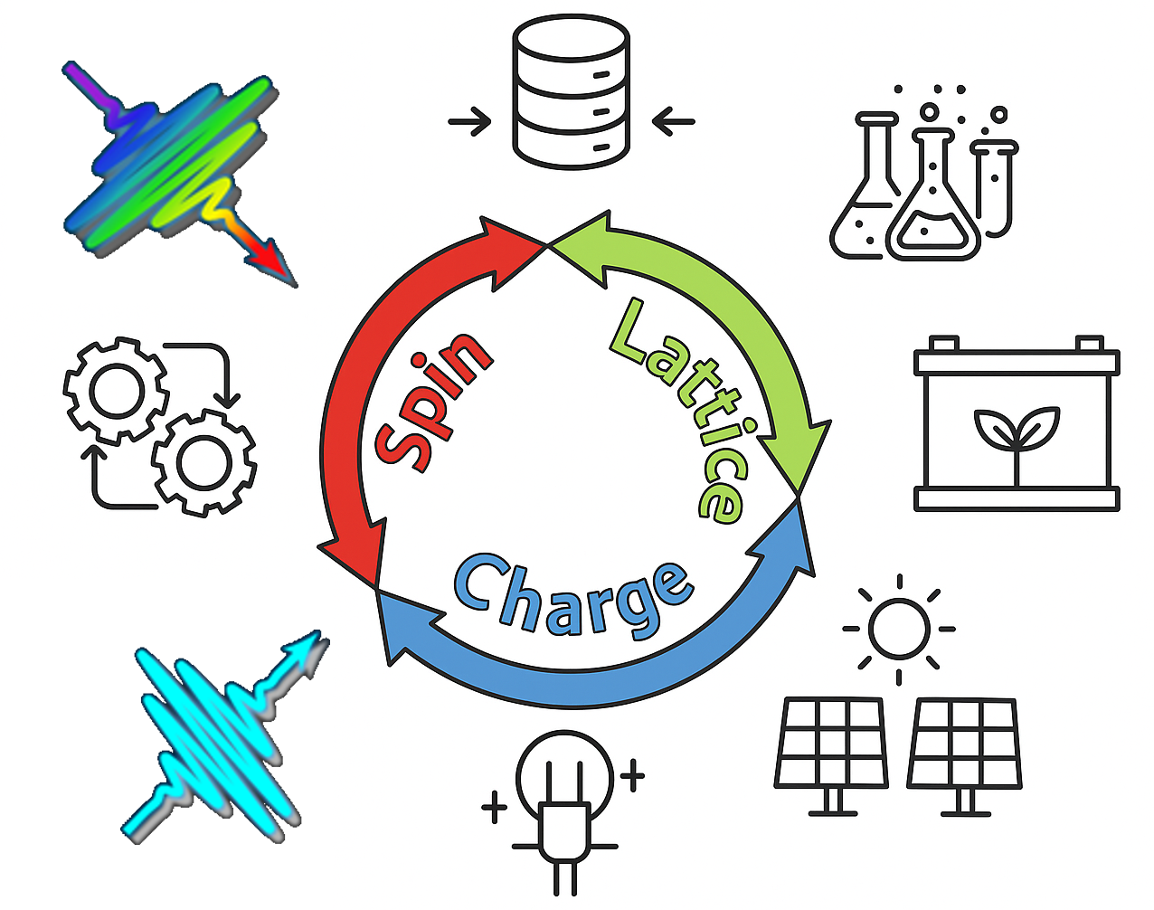
Research challenges
Introduction Transient Grating Polarization Grating Outlook
●○○○○ ○○○○○○ ○○○○○○ ○○○
Interplay of charge, spin and lattice subsystems:
Properties ad functionality of solids, molecules and hybrid compounds
Transport phenomena
Collective excitations
Exotic nonequilibrium states & phase transitions
Selectively investigate the time evolution of the different degrees of freedom via pump-probe techniques.
Extension to the XUV and X-ray regime:
chemical specificity
access to larger exchanged momentum and smaller length-scales.

Slide 3
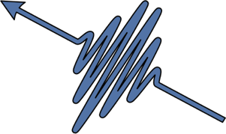
TG: a tool for probing collective dynamics
Introduction Transient Grating Polarization Grating Outlook
●●○○○ ○○○○○○ ○○○○○○ ○○○
Elastic waves
(via thermal expansion)
Plasmons, polarons, excitons, etc.
“Magneto-elastic” coupling
Molecular vibrations
Intensity grating
(Electronic excitations )
Thermal grating
(heat diffusion)
Structural relaxations,
Heat waves, etc.
Sample
Phonons, magnons, etc.
Elastic waves
(via electrostriction)
Circular Dichroism
Strain grating (field-driven)
Polarization grating
2θ
“pump 1” (k_{1,}λ_{FEL})
“pump 2” (k_{2,}λ_{FEL})
This excitation is associated to a selected wavector $Q=k_{1}−k_{2}$, $|Q|=(4π sin⁡θ)/λ_{pump} =2π/Λ_{TG}$

Slide 4
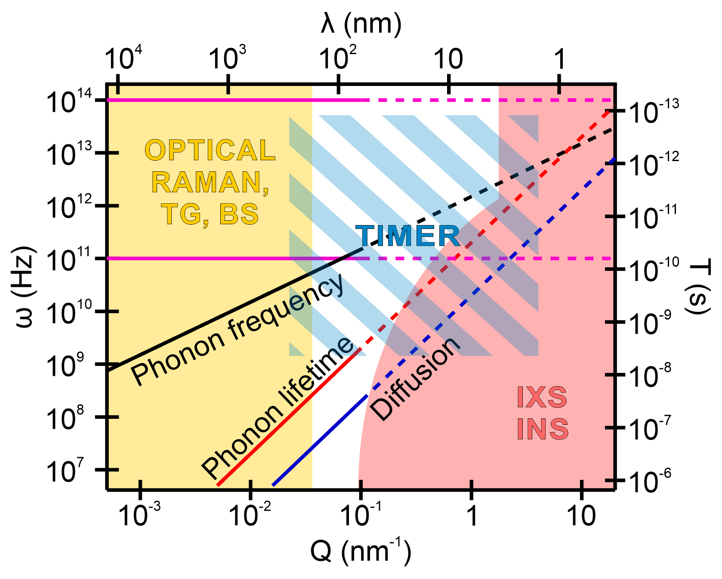
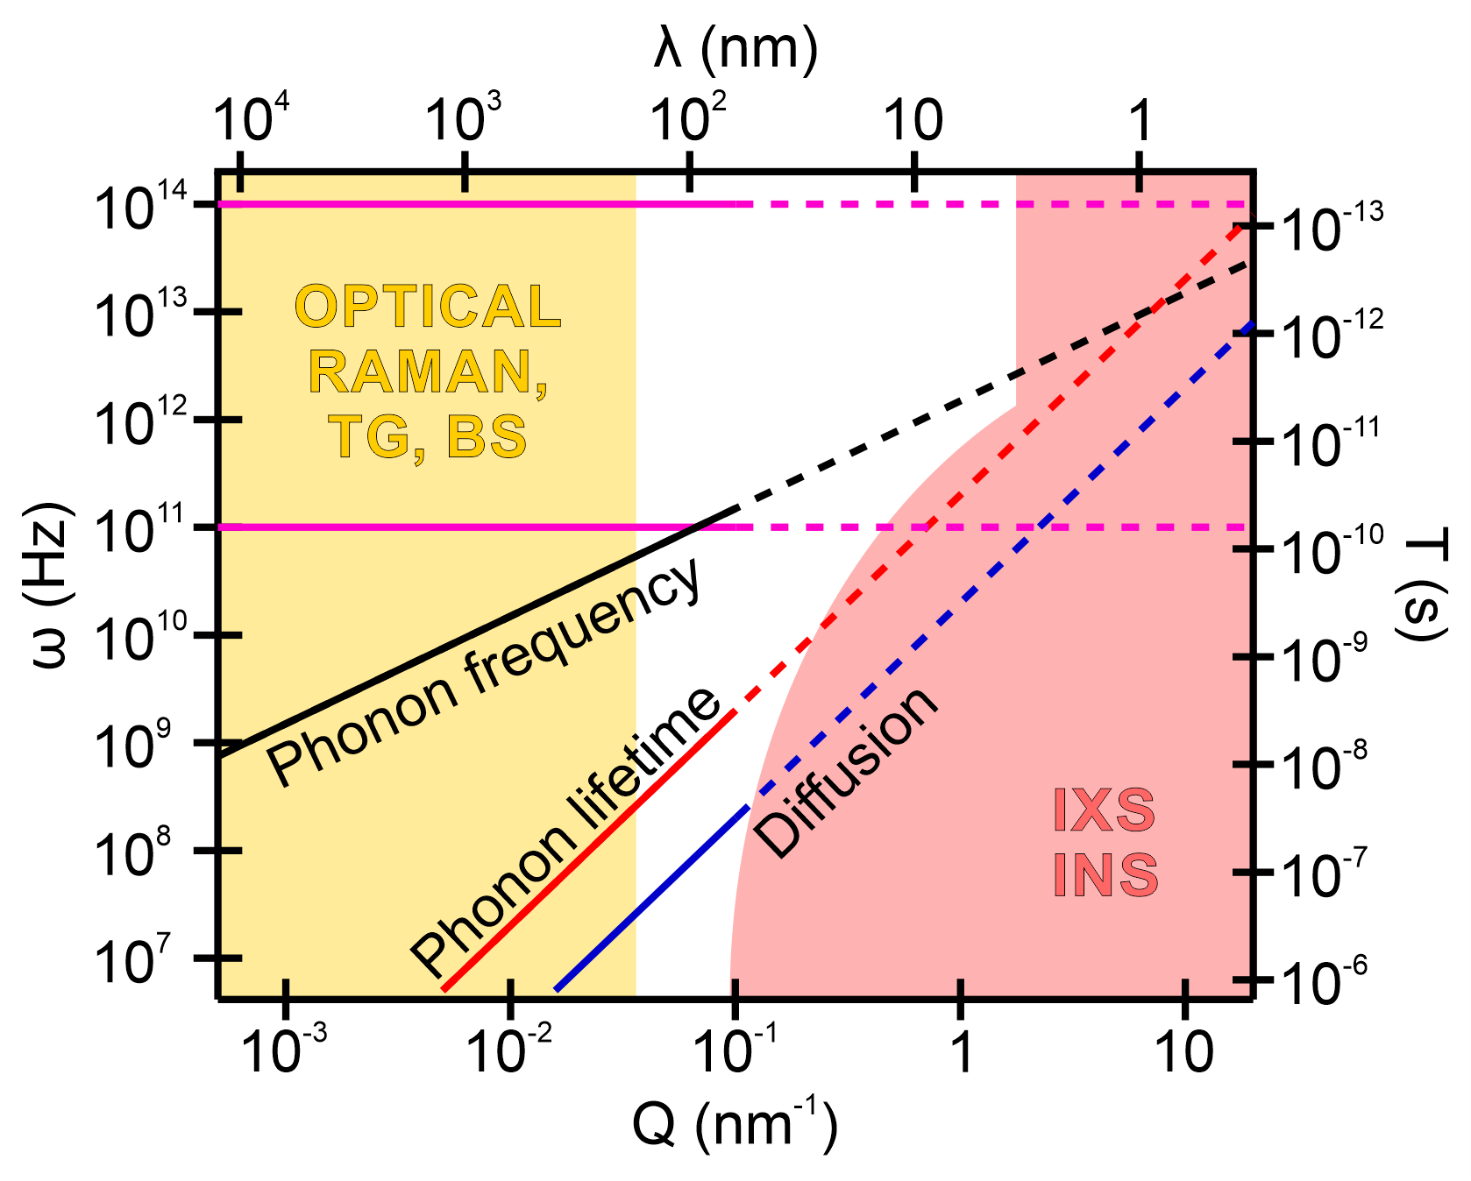


Extreme ultraviolet transient gratings
Introduction Transient Grating Polarization Grating Outlook
●●●○○ ○○○○○○ ○○○○○○ ○○○
XUV probe
K_{out}
K_{FEL1}
|Q|=4πsin(θ) / λ_{FEL}= 2π/Λ_{TG}
K_{FEL2}
Q
K_{EUV}
gap
q ~ 0.1-1 nm⁻¹
EIS-TIMER beamline:
θ = 9.2º – 52.7º
λ > 60 – 4 nm
λ_{pr} = λ/3
Δt_{F-F} ≈ -1.7-7 ps (@52.7º)
|Q| ≈ 0.03-2.5 nm⁻¹
ω up to ≈ 10 THz
The TIMER beamline is designed for a specific technique: EUV TG
Pro: Well defined scope and unique instrument worldwide!
Con: Well defined scope and unique instrument worldwide!
TIMER’s (original) goal: fill the gap
⇨ probe collective lattice dynamics at ‘‘mesoscopic’’ scales (10’s nm)
[1] F. Bencivenga and C. Masciovecchio, NIMA (2009)
[3] F. Bencivenga et al., Advances in Phyisics; X 8, 2220363 (2023)
[2] F. Bencivenga et al., Faraday Discuss. 194, 283 (2016)

Slide 5
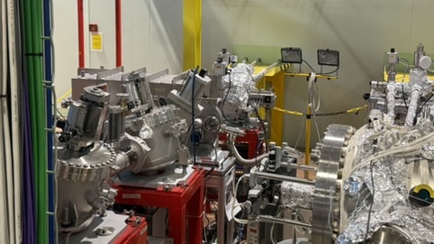
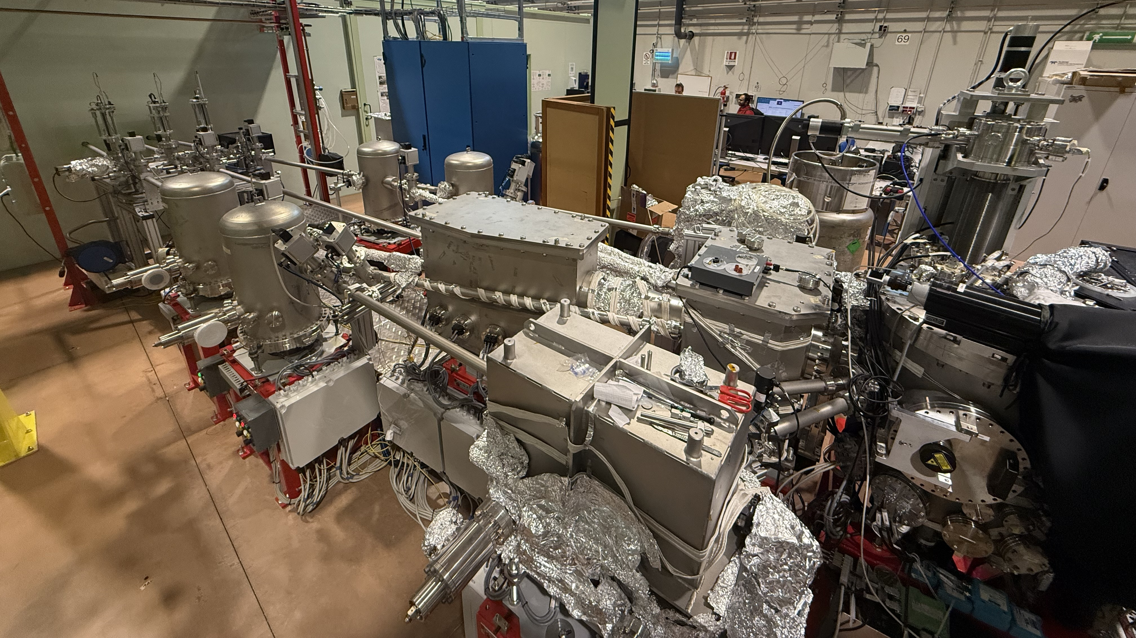
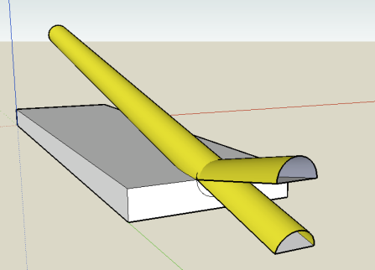

The EIS-TIMER instrument
Introduction Transient Grating Polarization Grating Outlook
●●●●○ ○○○○○○ ○○○○○○ ○○○
The time delay (Δt₁₁) between the two ω₁ beams the can be varied in the -3 +7 ps range
2θ
Sample
Delay line: 4 ML mirrors tuned at the 3rd harmonic, time delay (Δt₁₃) up to ns
θ_{B}
Toroidal mirrors
Two plane mirrors (not shown)
3rd harmonic (ω₃=3ω₁)
beam splitters
k-values (nm⁻¹)
 | 20.8 nm | 16.6 nm | 13.3 nm | 8.34 nm
18.4º | 0.04 | 0.05 | 0.1 | 0.2
27.6º | 0.06 | 0.08 | 0.15 | 0.3
85º | 0.15 | 0.2 | 0.4 | 0.9
105.4º | 0.2 | 0.3 | 0.5 | 1.1
2θ
λ
fundamental harmonic (ω₁)
~ 20 m long interferometer!

Slide 6
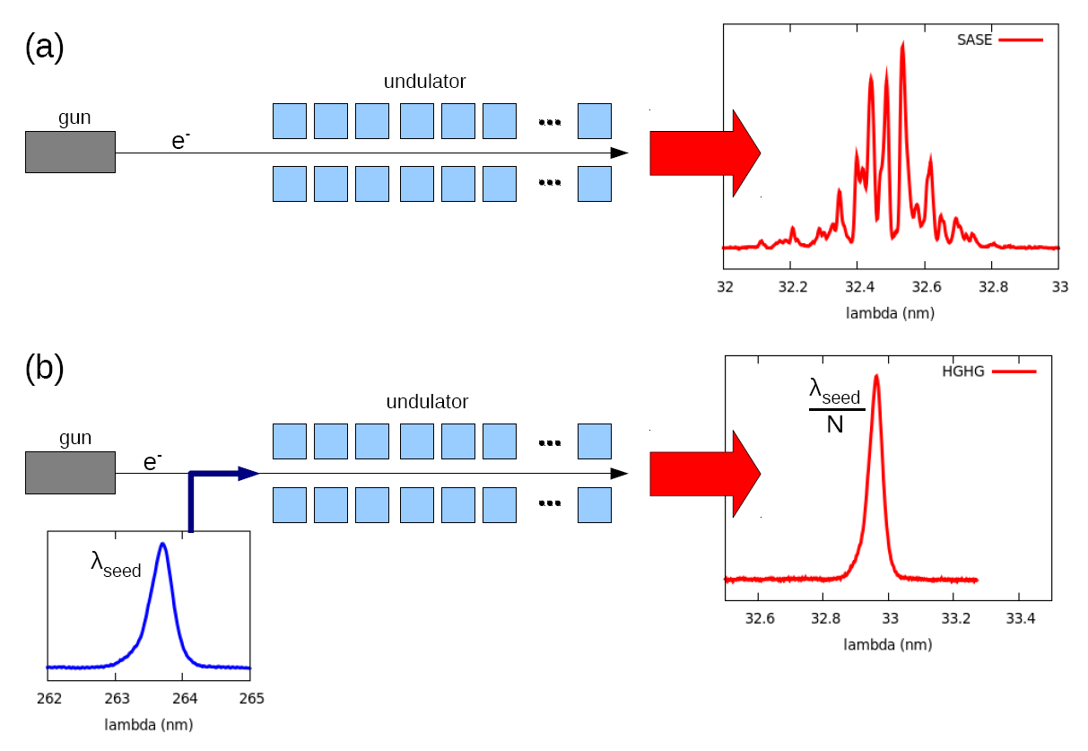
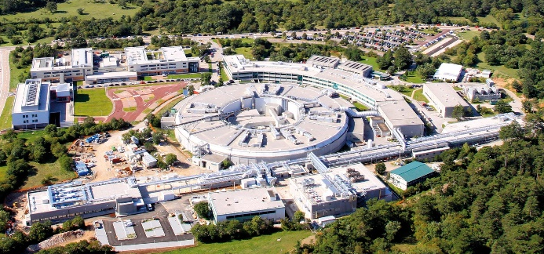

My FEL is (still) special 😝
Introduction Transient Grating Polarization Grating Outlook
●●●●● ○○○○○○ ○○○○○○ ○○○
SASE (LCLS, XFEL, etc.)
FERMI @ Elettra
microbunching (growing from noise)
Undulators
LINAC
•••
e⁻ bunch
•••
simpler, higher brightness (similar to optical lasers), shorter wavelengths (up to hard x-rays), shorter time duration (a few fs)
Polarization:
Variable linear and circular
Spectral purity:
close to transform-limited
Tunable wavelength:
100 - 4 nm, 12 - 310 eV
High peak flux pulses:
50 - 100 fs, 10¹³ photons
FEL-optical jitter:
< 10 fs (r.m.s.)
Seeded FEL emission
controlled microbunching
Modulator
Undulators
LINAC
•••
e⁻ bunch
Dispersive section
•••
Seed laser
(λ_{seed}; δt_{seed})
single longitudinal mode (high coherence), higher shot-to-shot stability, seed controls the output λ_{FEL}=λ_{seed}/N ; δt_{FEL}=δt_{seed}/N^{1/3}

Slide 7
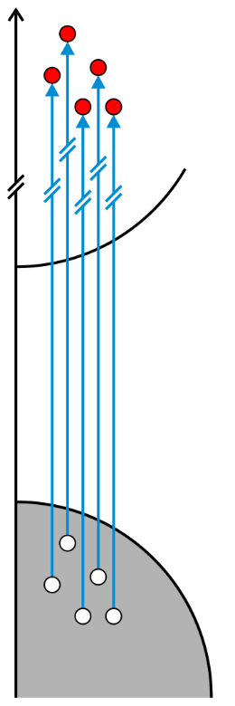
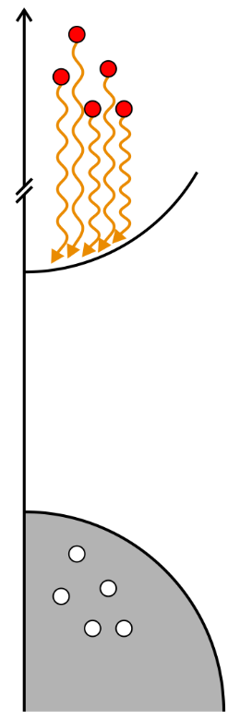
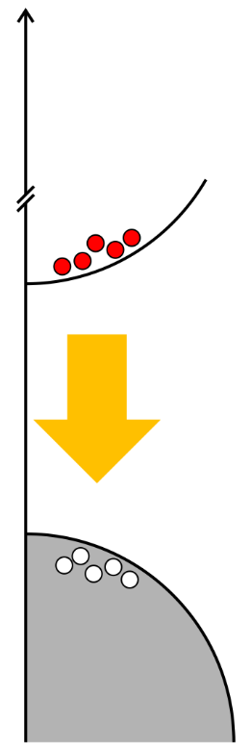
XUV-TG excitation mechanism
Introduction Transient Grating Polarization Grating Outlook
●●●●● ●○○○○○ ○○○○○○ ○○○
L_{TG}
L_{TG}
Space (x)
Space (x)
L_{TG}
L_{TG}
Space (x)
Space (x)
Time (Δt)
Hot electrons
< 1 fs
Electron-lattice relaxation
< 1 ps
e-e therm.
< 50 fs
Lattice dynamics
hundreds of ps
Mean free path of excited electrons
⇨ Fundamental periodicity limit
Review paper: L. Foglia et al., Photoacoustics 29, 100453 (2023)

Slide 8
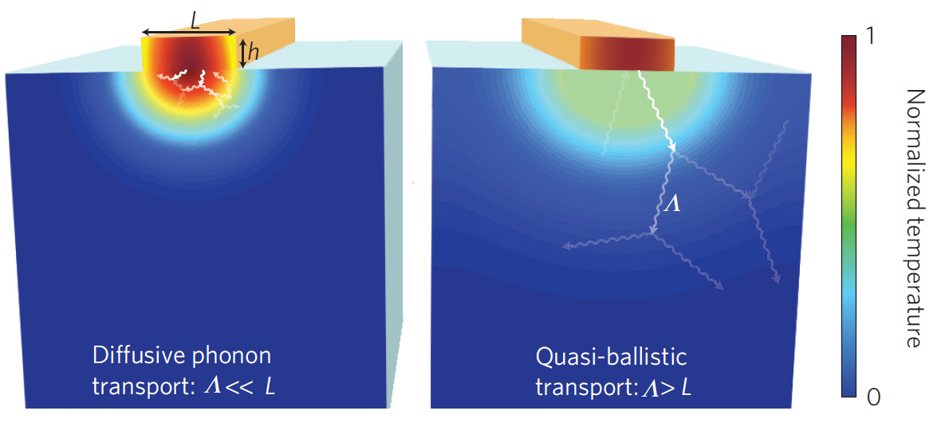
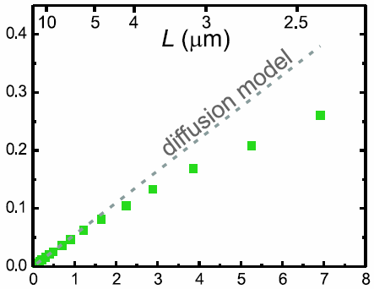
Nanoscale thermoelasticity
Introduction Transient Grating Polarization Grating Outlook
●●●●●●●● ●●○○○○ ○○○○○○ ○○○
Heat transport at the nanoscale is a hot area of research^{[1]}
➔ thermal management of nanoelectronics, thermoelectric energy conversion, etc.
~30 %
τ⁻¹ (GHz)
Characteristic dimensions of thermal gradient compare with phonon mean free path
➔ Fourier law of diffusion breaks down.
Q² (μm⁻²)
how fast is the thermal relaxation process at the nanoscale?
[1] M. Siemens et al., Nat. Materials 9, 26-30 (2010)
[2] Johnson et al., PRL 110, 025901 (2013)

Slide 9
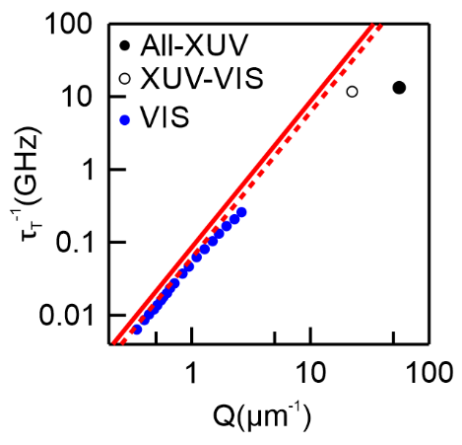
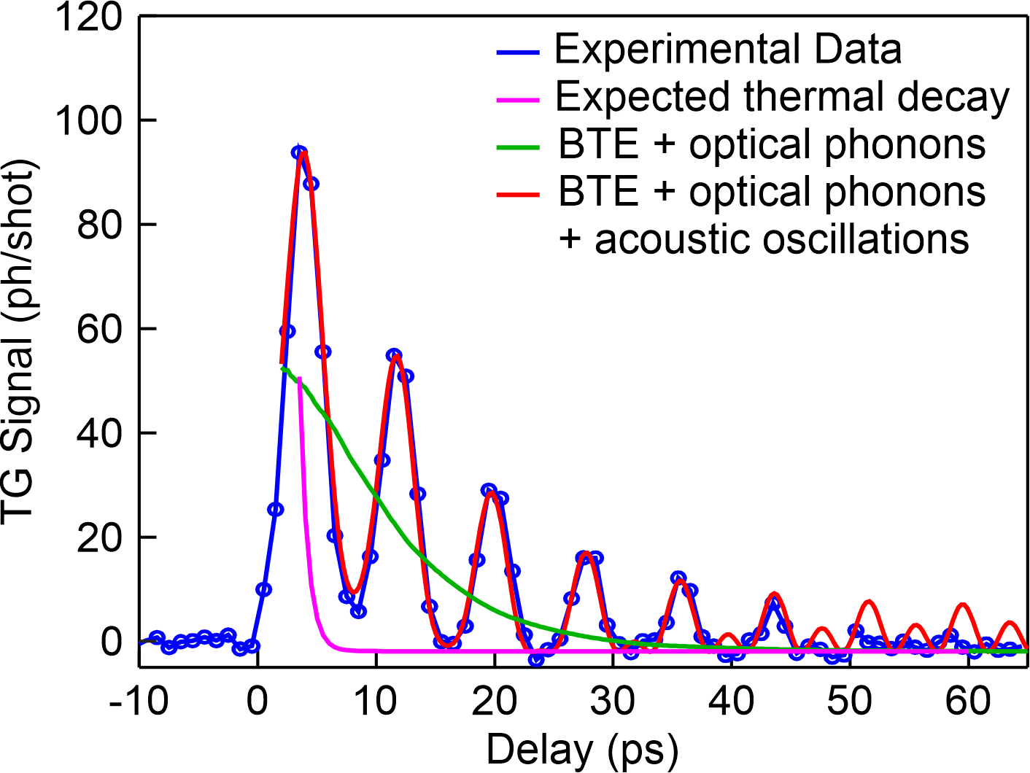
Nanoscale thermoelasticity: Si
Introduction Transient Grating Polarization Grating Outlook
●●●●●●●● ●●●○○○ ○○○○○○ ○○○
τ⁻¹ (GHz)
Si 100nm Λ_{TG}=69 nm
Q² (μm⁻²)
Heat diffusion theory: predicts too short decay time (faster than heat carrier)
Phonon decay is known to be in the ns range
➔ cannot contribute to signal decay
Parameter free thermal transport model based on the Boltzmann equation
➔ Almost ballistic (decay time similar to acoustic period)
XTG can provide an experimental answer to the question!
F. Bencivenga et al., Science Advances 5, aaw5805 (2019)
Review: L. Foglia et al., Photoacoustics 29, 100453 (2023)
Johnson et al., PRL 110, 025901 (2013)
Calculations by S. Hubermann (Mc Gill university)
Notes:
Still not ballistic: too many phonon oscillations during thermal decay

Slide 10
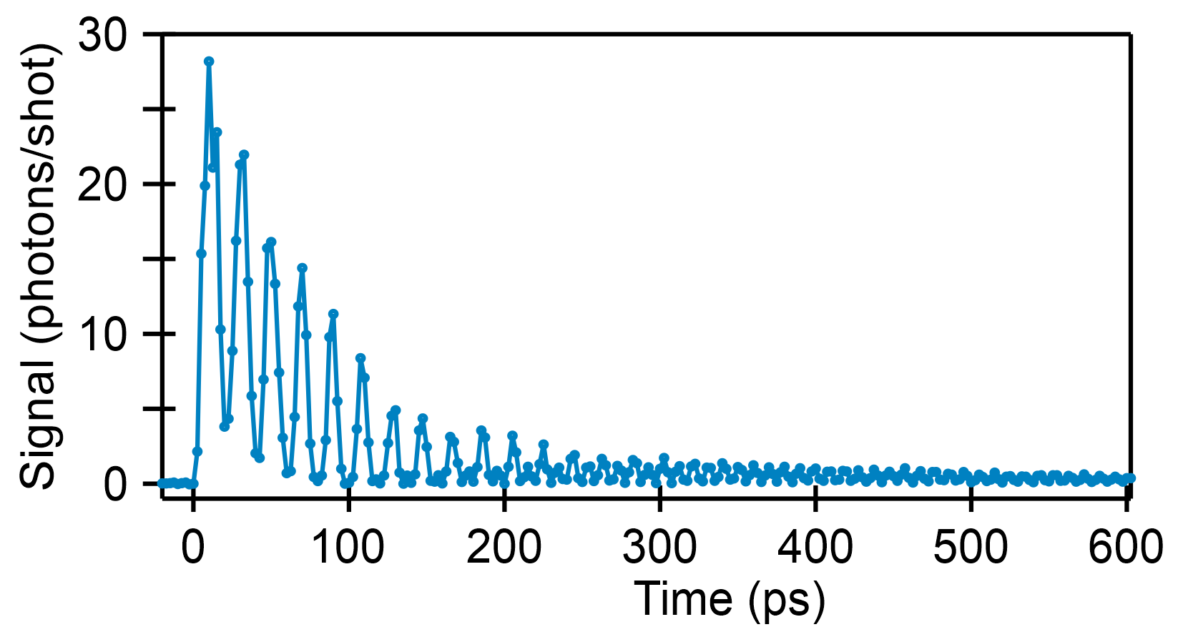
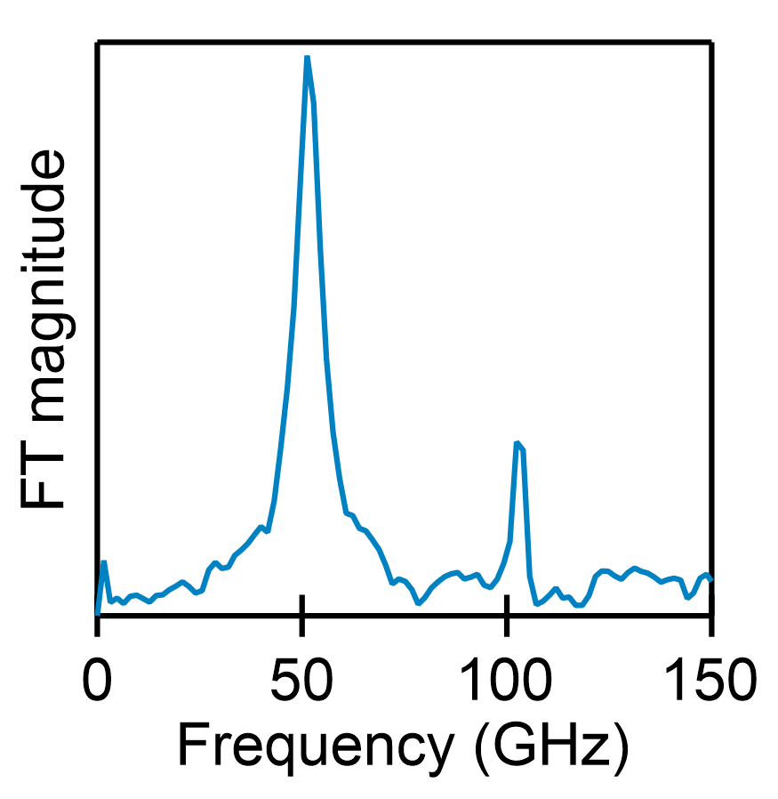
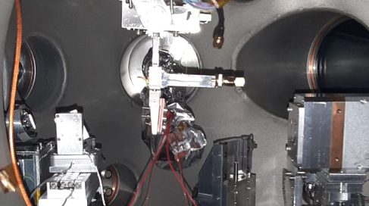
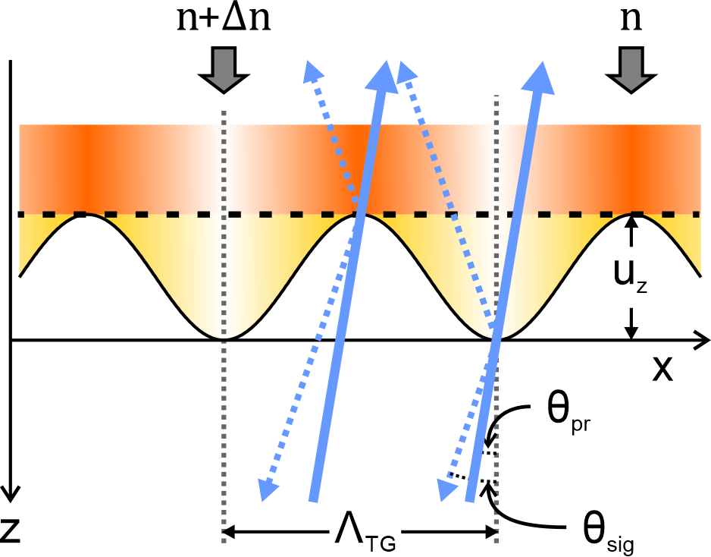
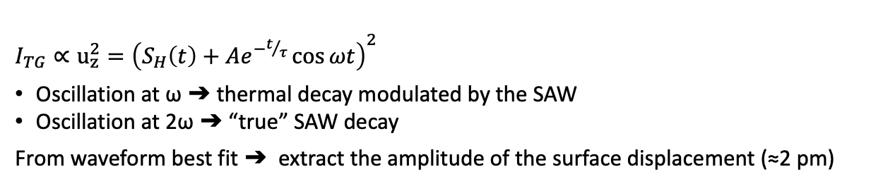
Surface elasticity
Introduction Transient Grating Polarization Grating Outlook
●●●●●●●● ●●●●○○ ○○○○○○ ○○○
Sample manipulator (tilted sample)
    bulk STO ; L_{TG} = 84 nm
ω
Scattering plane
ω
2ω
2ω
Back-diffracted EUV TG signal
Folding mirror
Detector
$I_{TG}∝u_{z}^{2}={\left(S_{H}\left(t\right)+Ae^{−t/τ}\cos{ωt}\right)}^{2}$
Oscillation at ω ➔ thermal decay modulated by the SAW
Oscillation at 2ω ➔ “true” SAW decay
From waveform best fit ➔ extract the amplitude of the surface displacement (≈2 pm)
    Highest SAW ever excited (by an order of magnitude!) in any material: 50 GHz
    Possible to carry out experiments on bulk samples
    High frequency SAW may be also used to drive other dynamics (e.g. magnetoelasticity)
A. A. Maznev et al., Appl. Phys. Lett., 119, 044102 2021

Slide 11
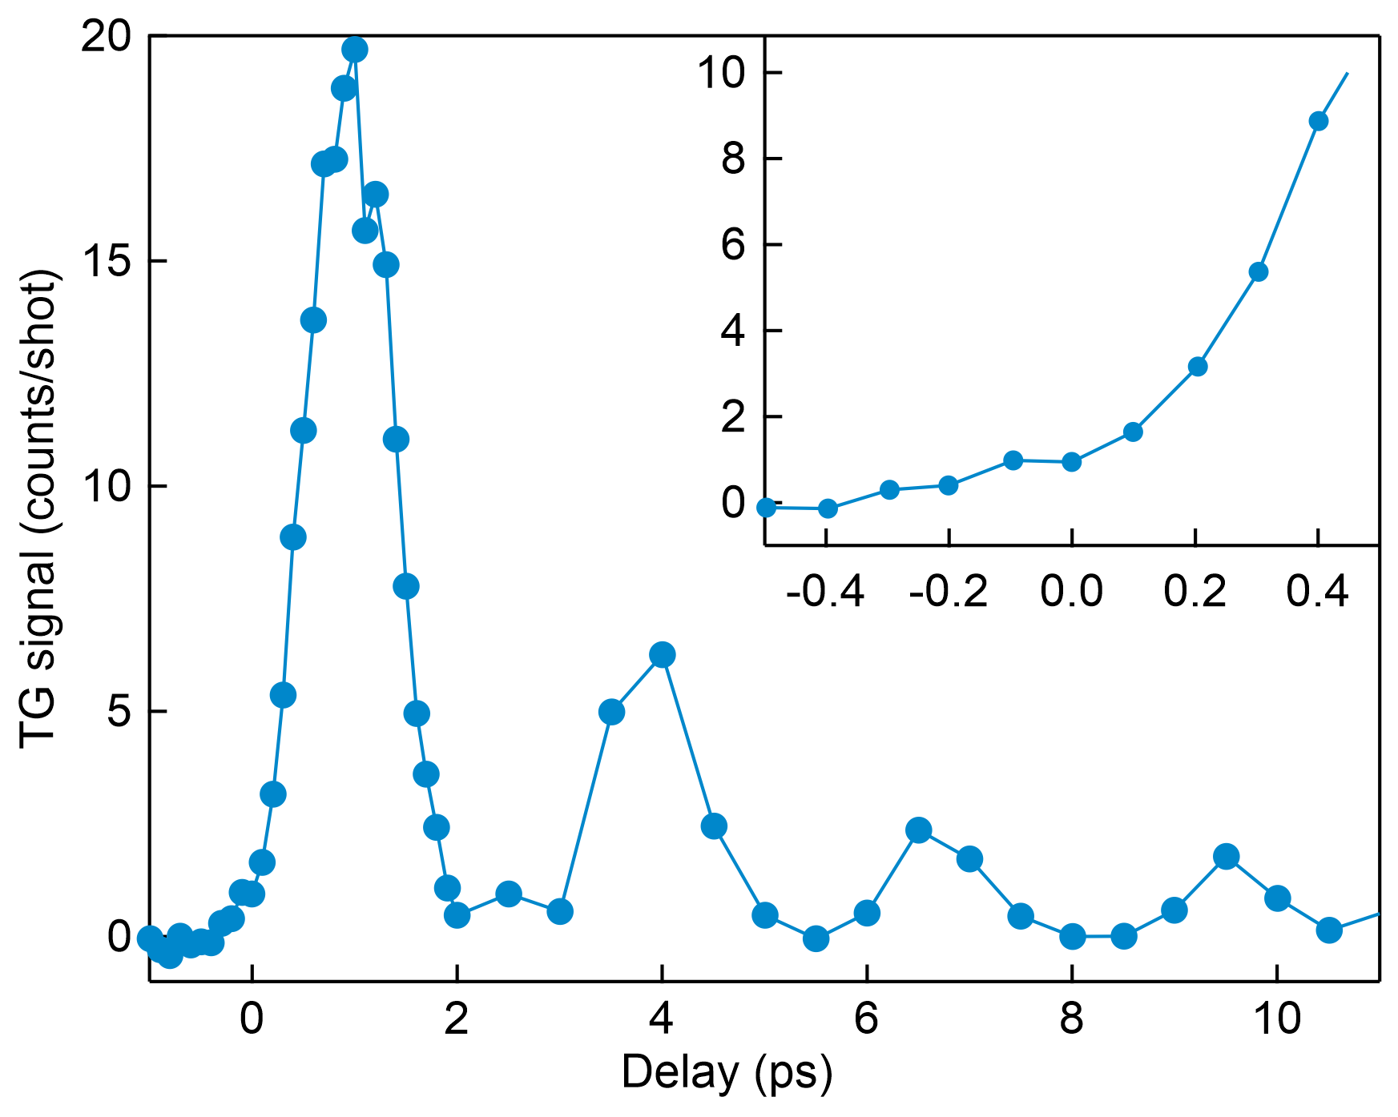
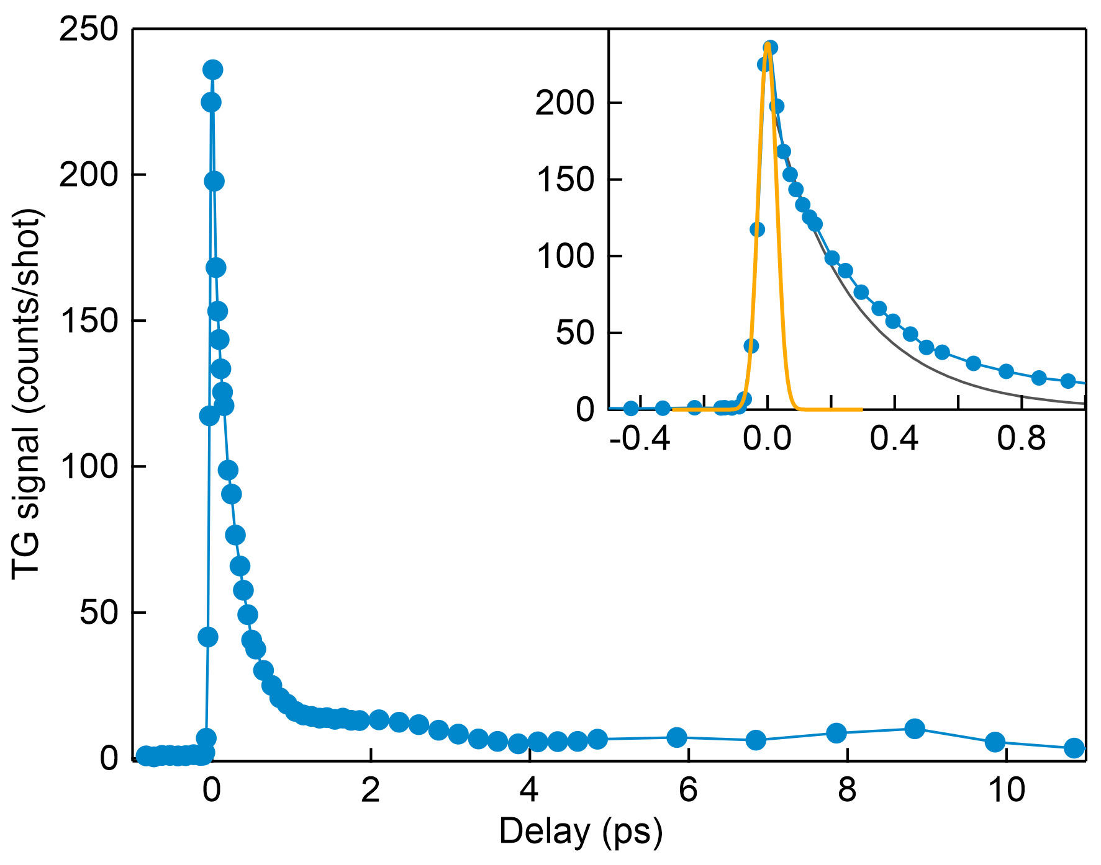
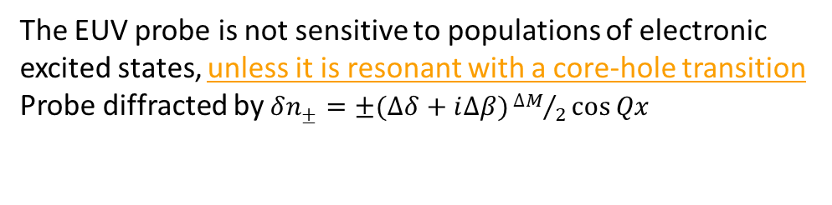
Beyond thermoelasticity
Introduction Transient Grating Polarization Grating Outlook
●●●●●●●● ●●●●●○ ○○○○○○ ○○○
    Co; Λ_{TG} = 16.7 nm
    probe photon energy: ≈ 93 eV
    Co; Λ_{TG} = 16.7 nm
    probe photon energy: ≈ 59 eV
    The TG signal is proportional to |Δn*|²
    In the EUV/X-ray regime n* is proportional to density
    Δn* ∝ Δρ/ρ ∝ ΔT (thermoelastic response)
The EUV probe is not sensitive to populations of electronic excited states, unless it is resonant with a core-hole transition
Probe diffracted by $δn_{±}=±(∆δ+i∆β){∆M}/2\cos{Qx}$

Slide 12
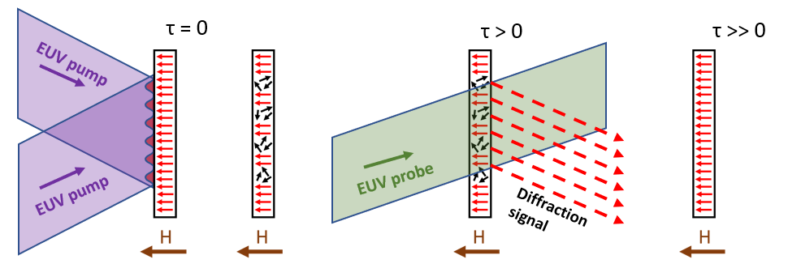
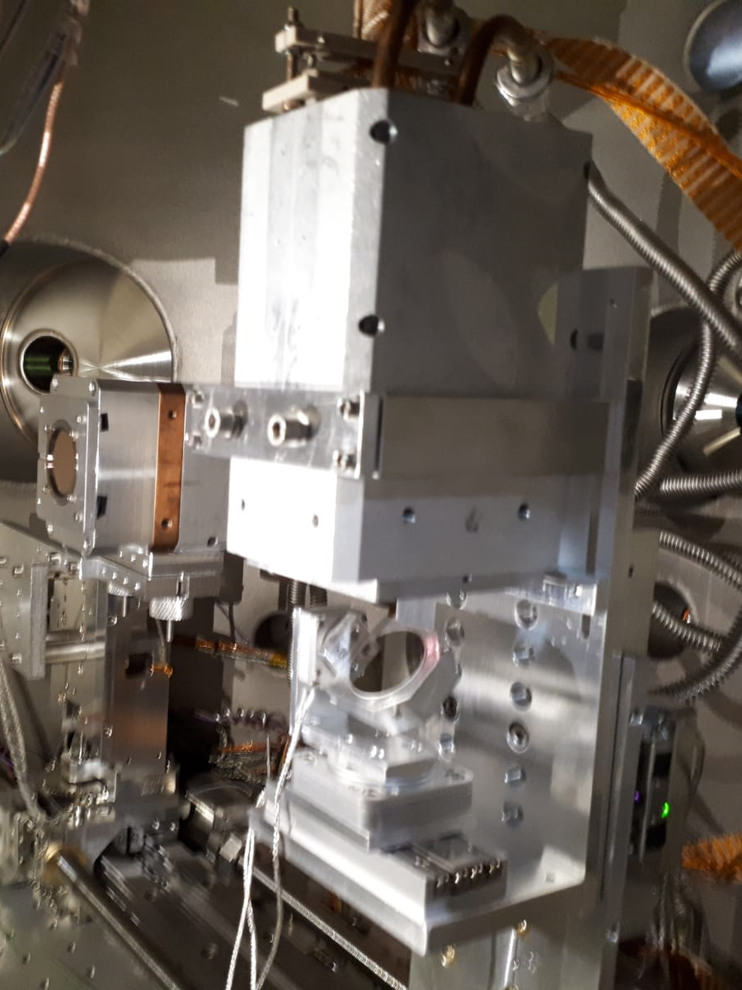
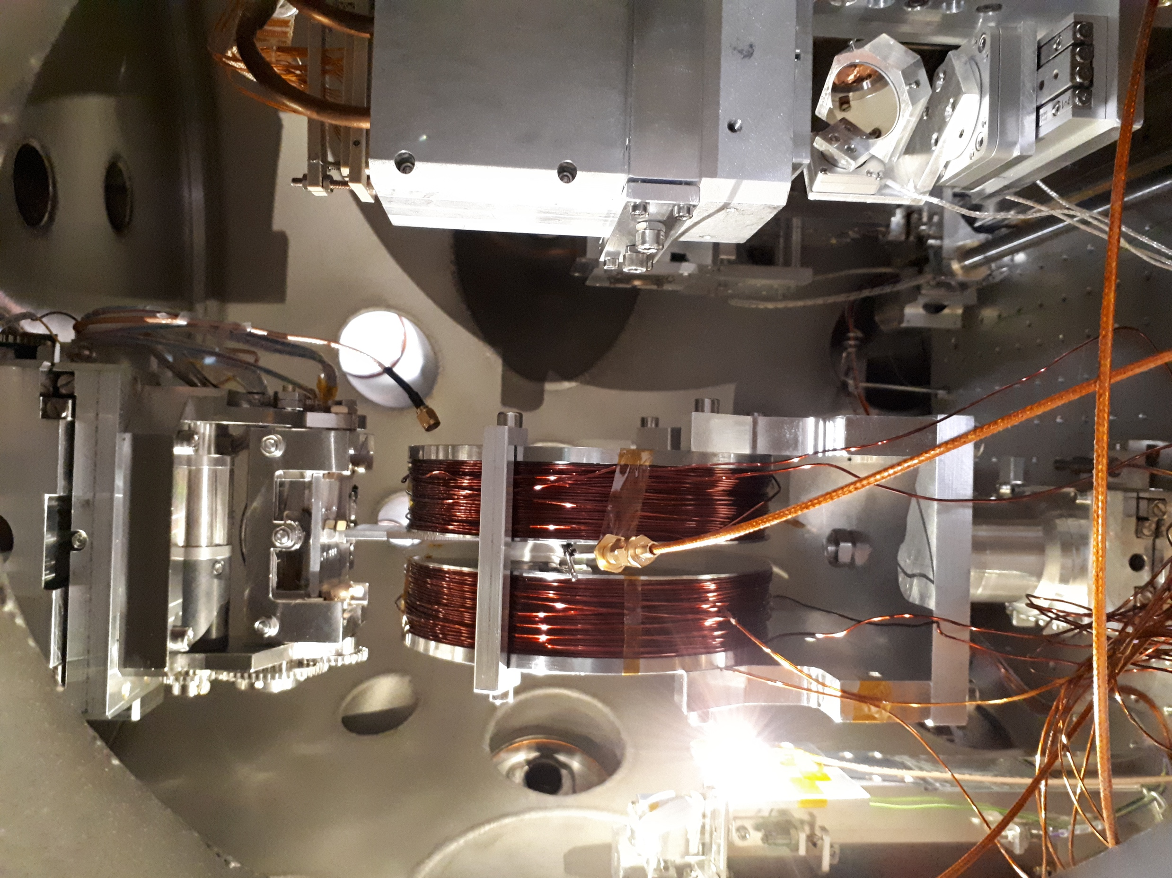
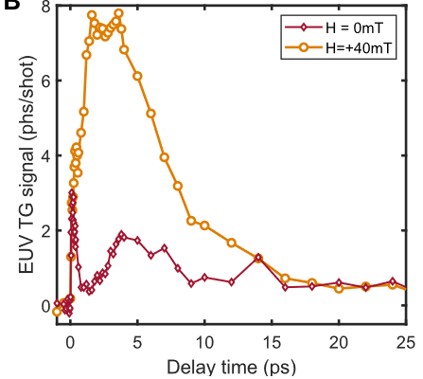
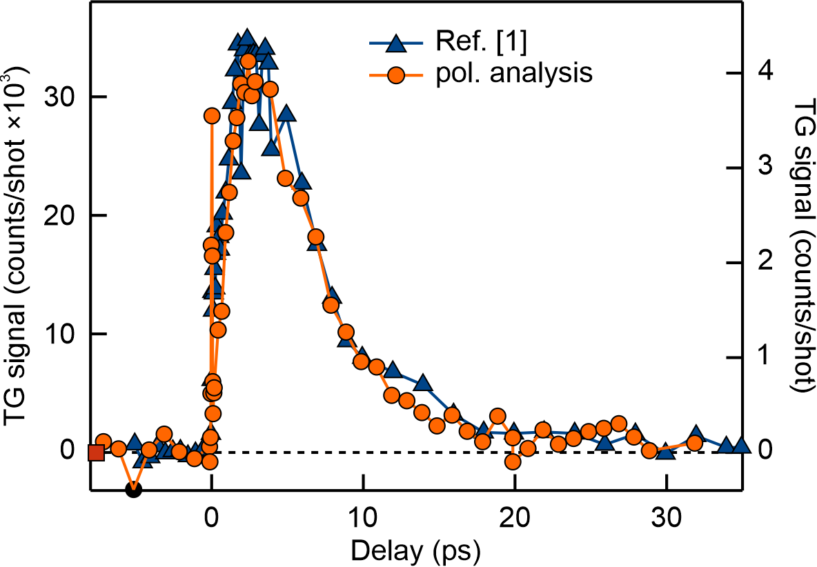
Nanoscale magnetization gratings
Introduction Transient Grating Polarization Grating Outlook
●●●●●●●● ●●●●●● ○○○○○○ ○○○
Detector for the total signal (no polarizer)
Detector for magnetic signal (only horizontal component)
Co_{0.81}Gd_{0.19},
L_{TG} = 44 nm
Magnetic response
Electronic response
Probe (vertical polarization)
Thermoelastic response
ML mirror (polarizer)
Signal at resonance is dominated by magnetic response
[1] D. Ksenzov et al., Nano Lett. 21, 7, 2905–2911 (2021)

Slide 13
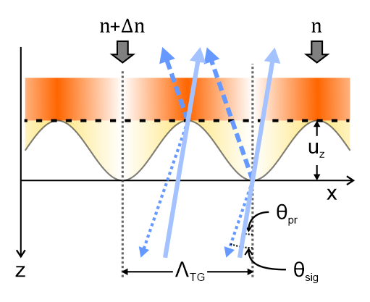
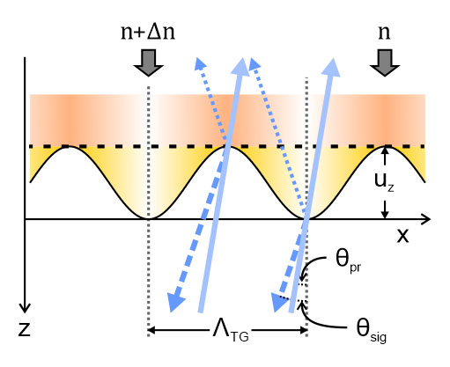
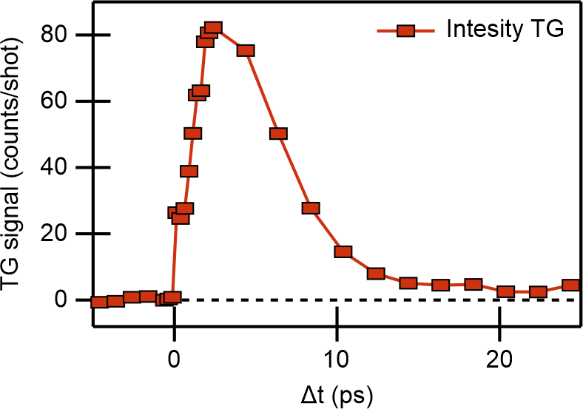
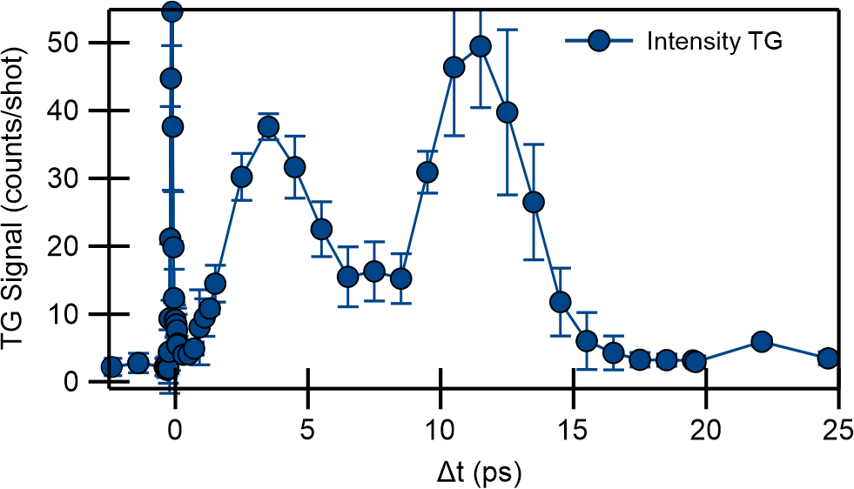
Introduction Transient Grating Polarization Grating Outlook
●●●●●●●● ●●●●●● ●○○○○○ ○○○

Slide 14
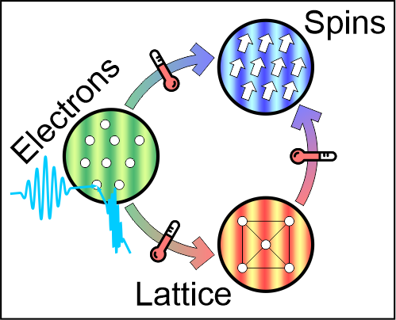
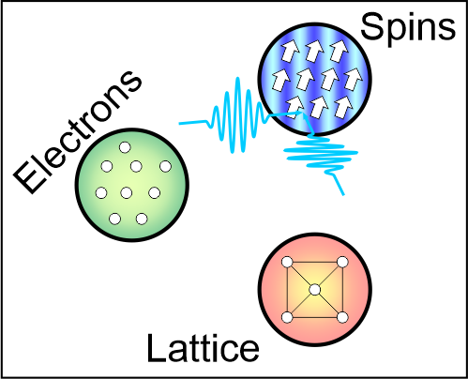
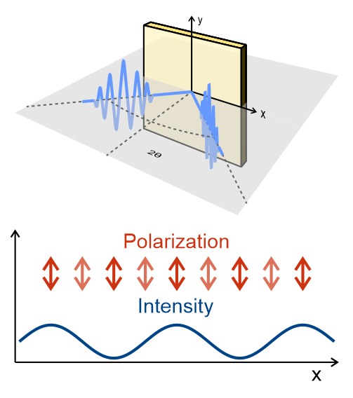
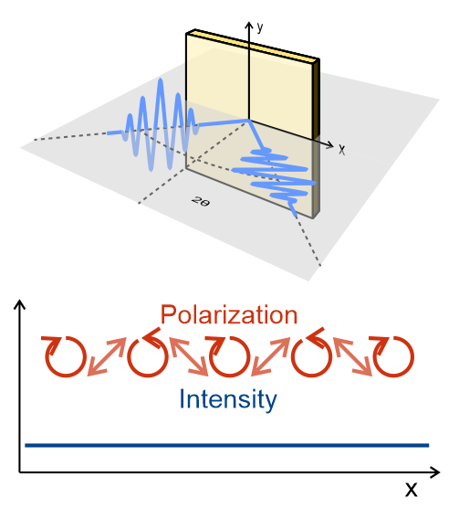
Polarization Transient Gratings
Introduction Transient Grating Polarization Grating Outlook
●●●●●●●● ●●●●●● ●●○○○○ ○○○
y
y
x
x
2θ
2θ

Slide 15
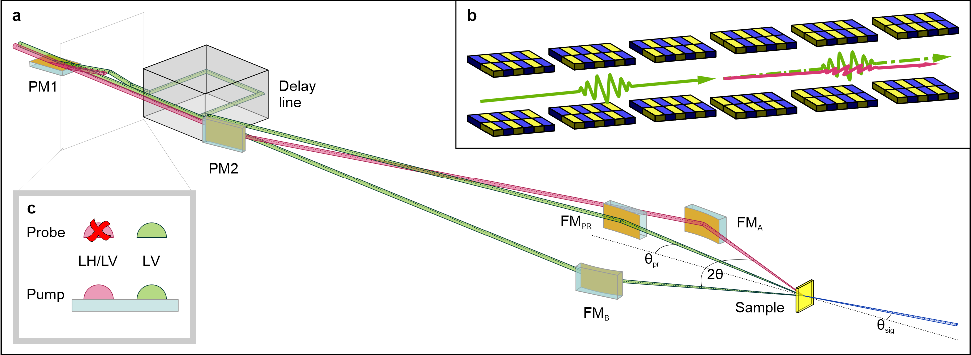
Introduction Transient Grating Polarization Grating Outlook
●●●●●●●● ●●●●●● ●●●○○○ ○○○

Slide 16


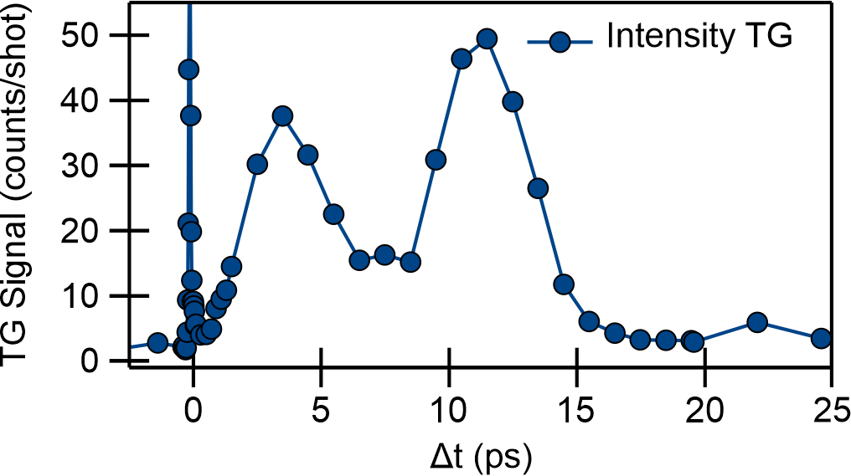
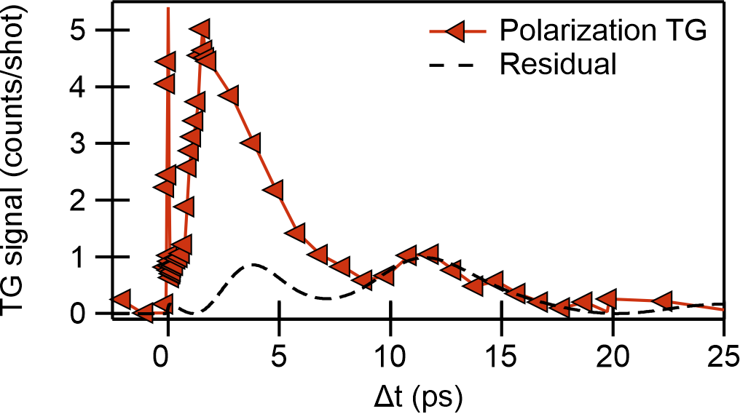
Polarization Transient Gratings
Introduction Transient Grating Polarization Grating Outlook
●●●●●●●● ●●●●●● ●●●●○○ ○○○
↕
↕
•••
λseed
•••
LV & LV
Intensity-grating: reflection signal is dominated by thermoelastic response!
↕
↕
•••
λseed
•••
LV & LH
Polarization Grating: Thermoelastic response scales &
extra response appears (or is enhanced)!
Co_{0.78}Gd_{0.22},
L_{TG} = 44 nm
L. Foglia et al., Nature Commun. 15, 10742 (2024)

Slide 17
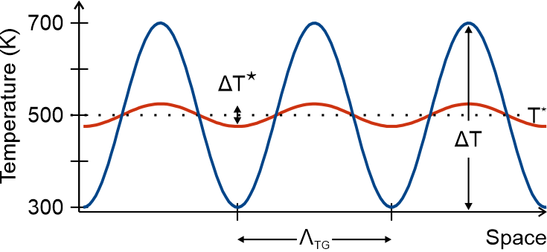
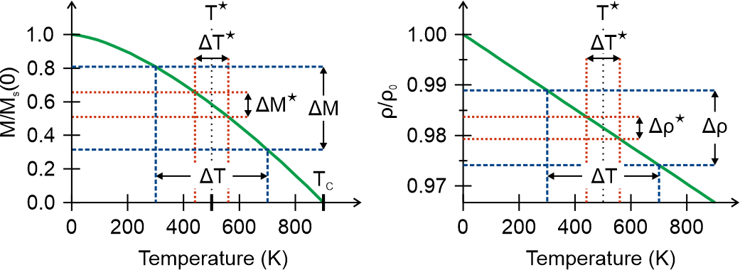
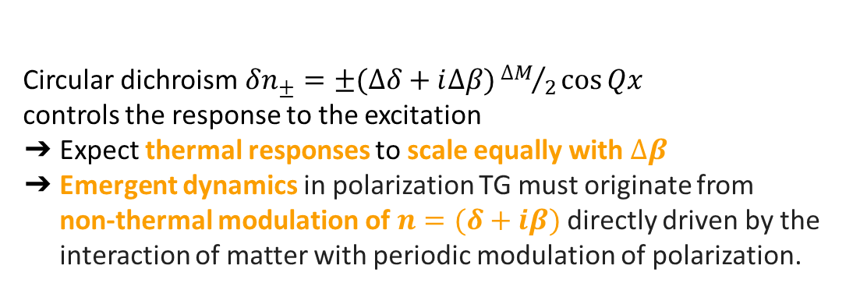
Excitation mechanism
Introduction Transient Grating Polarization Grating Outlook
●●●●●●●● ●●●●●● ●●●●●○ ○○○
Circular dichroism$δn_{±}=±(∆δ+i∆β){∆M}/2\cos{Qx}$
controls the response to the excitation
Expect thermal responses to scale equally with $∆β$
Emergent dynamics in polarization TG must originate from
non-thermal modulation of $n=(δ+iβ)$ directly driven by the interaction of matter with periodic modulation of polarization.
M. Hennecke et al., Commun Phys. 7,191 (2024)
L. Foglia et al., Nature Commun. 15, 10742

Slide 18
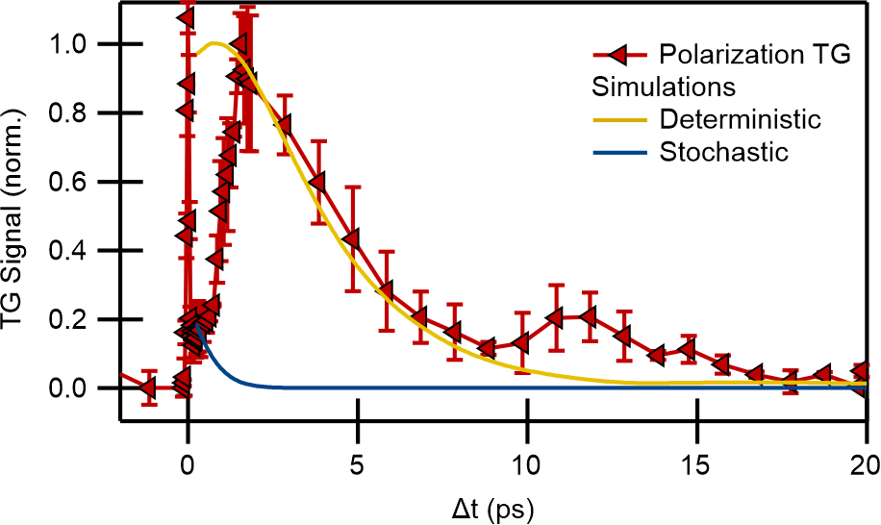
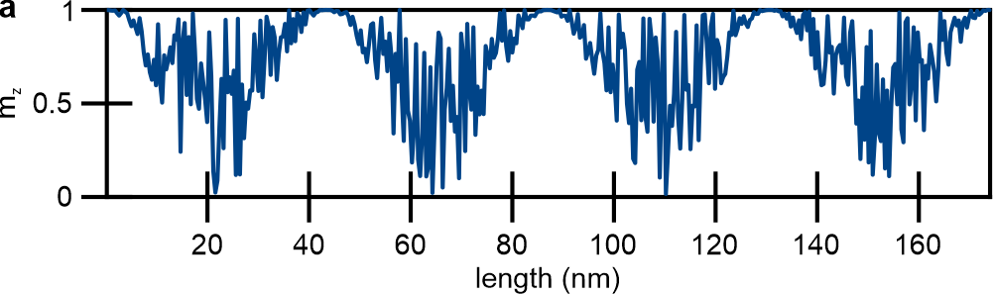
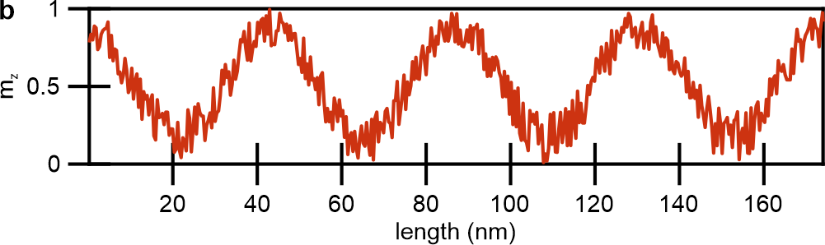
Selective excitation
Introduction Transient Grating Polarization Grating Outlook
●●●●●●●● ●●●●●● ●●●●●● ○○○
Thermal (stochastic) excitation
Deterministic excitation
Pseudospectral numerical simulations with a deterministic initial demagnetization reproduce the observed dynamics.
K. Rockwell,et al., Phys. Rev. B 109, 180404 (2024).

Slide 19
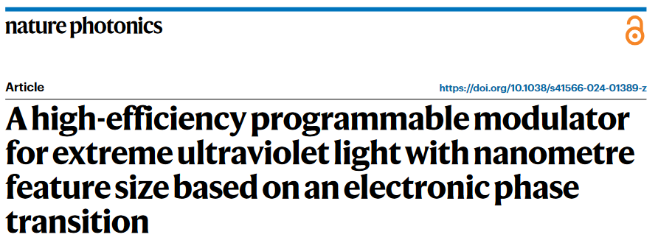
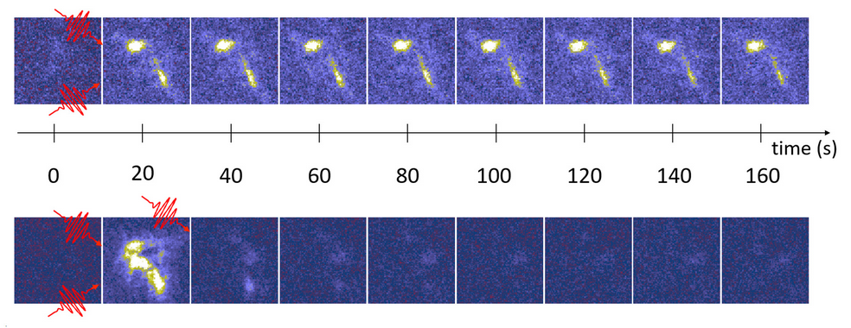
Summary and outlook of EUV-TG applications
Introduction Transient Grating Polarization Grating Outlook
●●●●●●●● ●●●●●● ●●●●●● ●○
Applications (so far) of EUV TG at TIMER
Bulk, surface and confined phonons
Nanoscale thermal transport
Nanoscale magnetic dynamics
All-optical magnetic switching
Short-wavelength magnons
Nanoscale polarization gratings (NPG)
Ultrafast electronic response (limited by time resolution & resonances)
Photoinduced phase transitions
Superconducting coherence length
Resonant self diffraction spectroscopy
Pulse metrology
Structured illumination microscopy (SIM)
I. Vaskivskyi et al., Nature Photonics 18, 458 (2024)

Slide 20
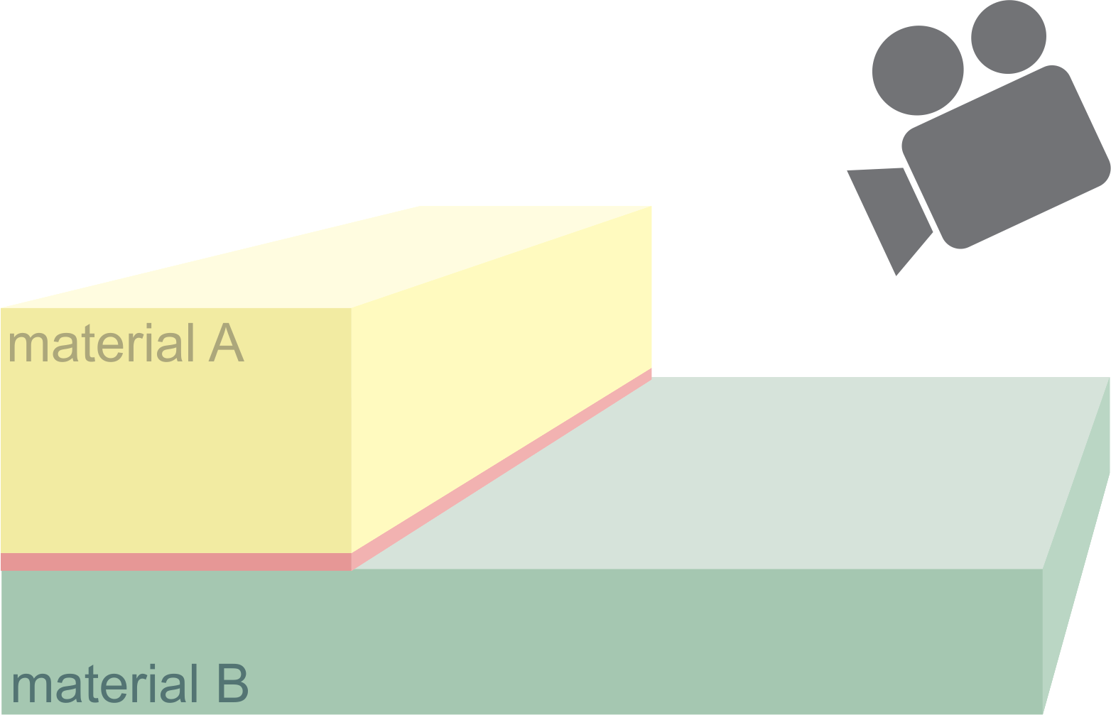
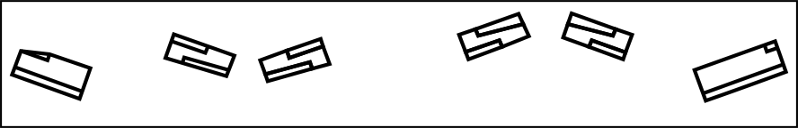

Hard X-ray TG
Introduction Transient Grating Polarization Grating Outlook
●●●●●●●● ●●●●●● ●●●●●● ●●
Top view
Lateral view
Si (111)
M2a (0.4°)
Mirror 1
Si (111)
M2b
M1 (0.1°)
G1 (1μm)
G2 (500nm)
Open questions:
Mean free path of high energy electrons allows for the excitation modulation?
Hard X-ray absorption is sparse and stochastic: Sufficiently strong Fourier component at k_{TG}?
Complementarities to XUV-TG:
Access bulk solids & buried interfaces
Reduce periodicity down to single-digit nm
    Selectively excite charge density waves, mode couplings, quantum instabilities…
  Ultrafast (maybe as) electron dynamics ?
STO; E_{FEL}=9.8 keV
H. Li et al., arXiv:2506.03428

Slide 21














Many thanks to you for the attention and to…
M. Svandrlik, C. Masciovecchio, S. Lizzit,
A. Locatelli
Experimental team (FERMI BLs):
F. Bencivenga, F. Capotondi, D. De Angelis,
R. Mincigrucci, M. Pancaldi, E. Pedersoli, A. Simoncig, I. Lopez Quintas,
and former members...
Machine physics team:
L. Giannessi, G. de Ninno, E. Allaria et al.
Laser team:
M. Danailov, G. Kurdi et al.
PADReS team:
M. Zangrando et al.
... and all the FERMI team!
B. Wehninger
C. Gutt et al.
P. Bowlan
et al.
S. Bonetti et al.
M. Fuchs et al.
C. von Korff Schmising et al.
V. Giordano
et al.
A. Maznev,
K. Nelson et al.
R. Cucini
G. Panaccione
et al.
G. Monaco et al.
G. Knopp
et al.
H. Kapteyn, M. Murnane et al.
J. Hastings, D. A. Reis, D. Zhu, M. Trigo et al.
M. Chergui
et al.

Slide 22



“highly interdisciplinary journal focusing on, but not limited to, scientific studies of chemical transformation and energy materials based on photon, electron, and neutron facilities. The word “photon” here is representative of particles in modern scientific facilities.
Photon Science also reports breakthroughs in instrumentation, methodology, and big-data research with demonstrations or potential for chemistry and material science.”
Editor-in-chief:
Wanli Yang, Lawrence Berkeley National Laboratory)
Associate Editors:
Hendrik Bluhm, Fritz Haber Institute of the Max Planck Society
Laura Foglia, Elettra Sincrotrone Trieste
Hua Zhou, Argonne National Laboratory
Submission is now open!
APCs are waived for all articles submitted by December 31, 2027 if accepted after peer review.

