Slide 1



Theoretical studies of superradiant pulse saturation and sub-wavelength effects in FELs
Brian McNeil & Pornthep Ponchalee
25th August, 2025

Slide 2

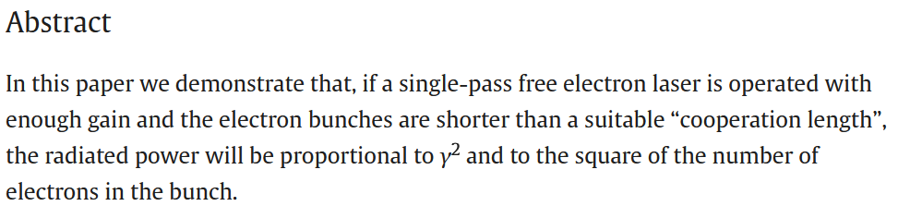
Superradiant pulses from an FEL

Slide 3
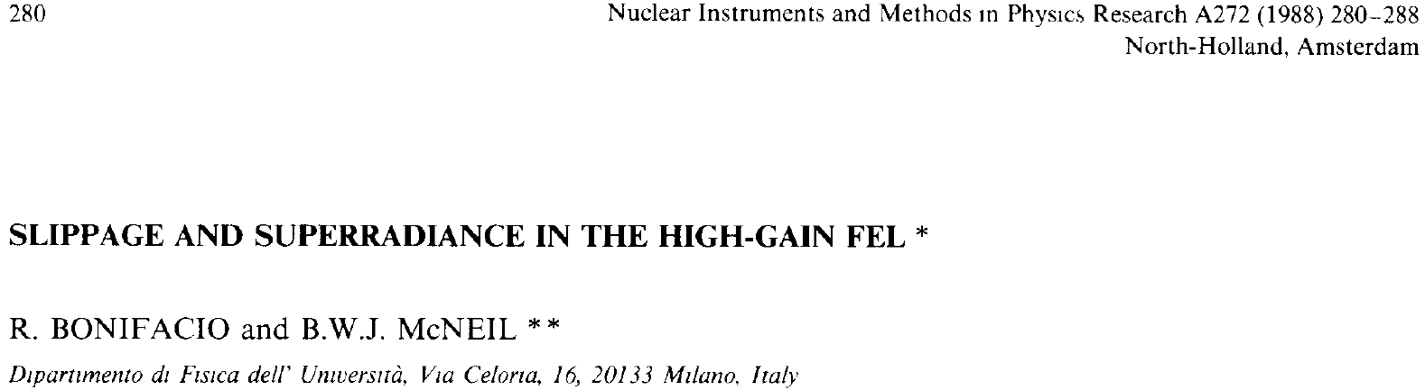
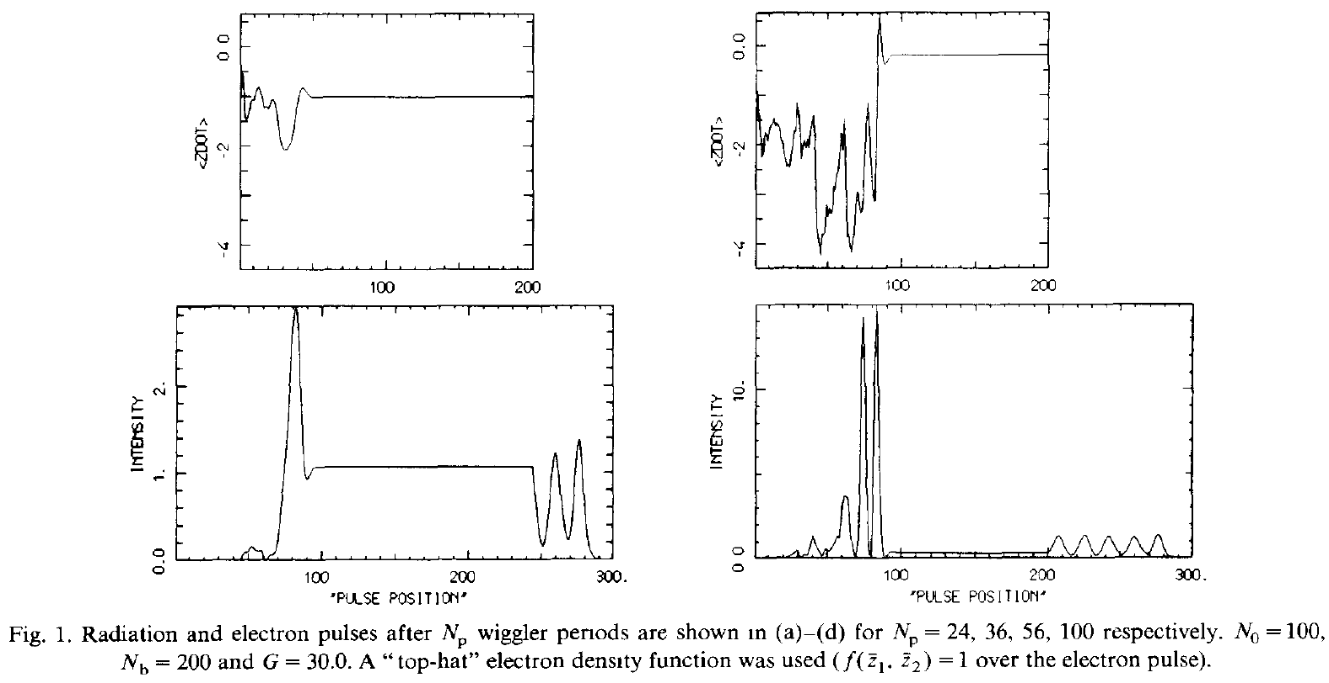
Averaged model
– no sub-wavelength information
Propagation at v_{z} < c
Superradiance
Propagation at c
z = 56 λ_{w}
z = 100 λ_{w}
It keeps growing

Slide 4
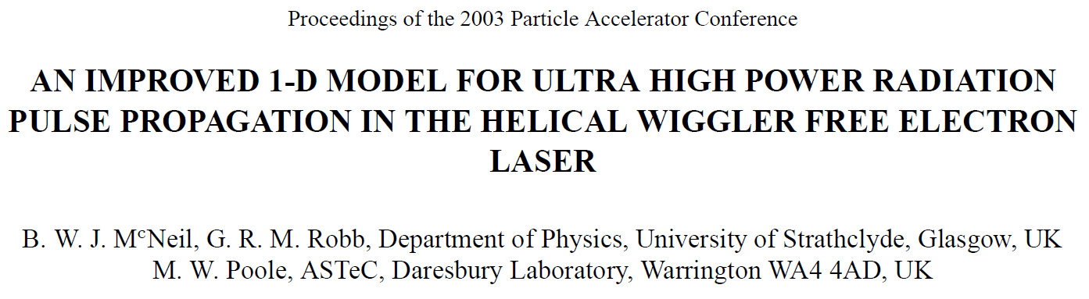
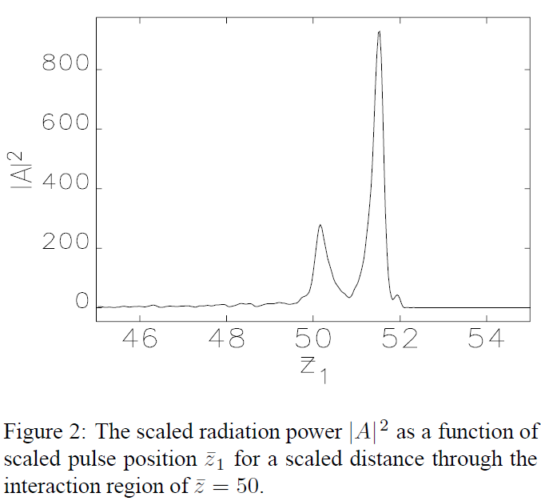
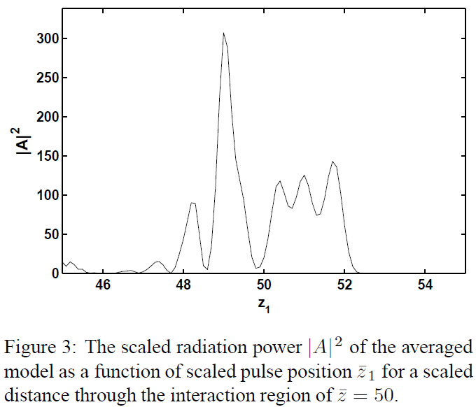
15 years later!
Un-averaged model
Averaged model
Q: Will the spike saturate?

Slide 5
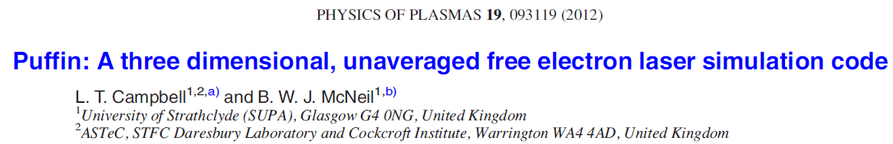
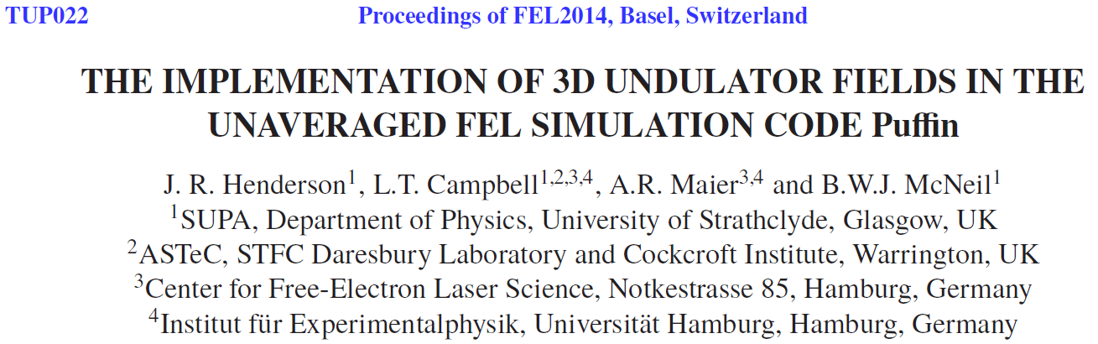
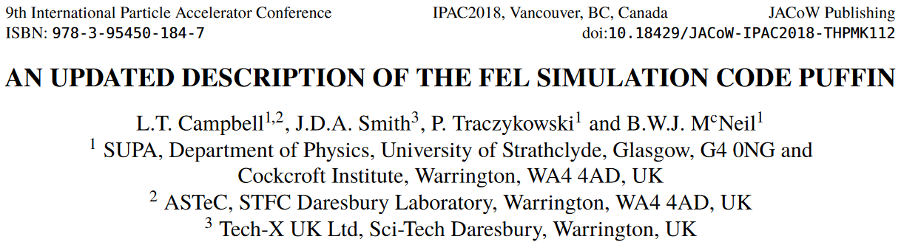
So, with further development of the un-averaged code Puffin…

Slide 6
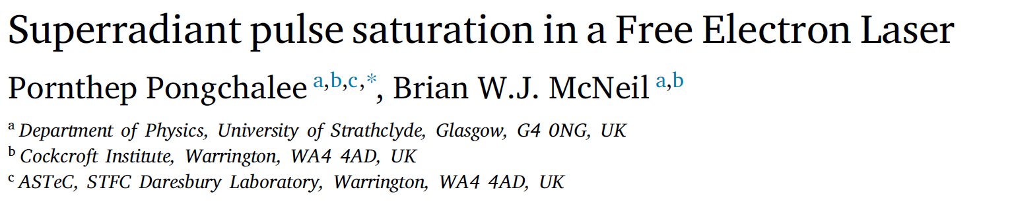
…and with the hard work of my (then) PhD student Pornthep Pongchalee…
We finally got there:
36 years later!
PS: Pornthep now at the Synchrotron Light Research Institute (SLRI), Thailand

Slide 7
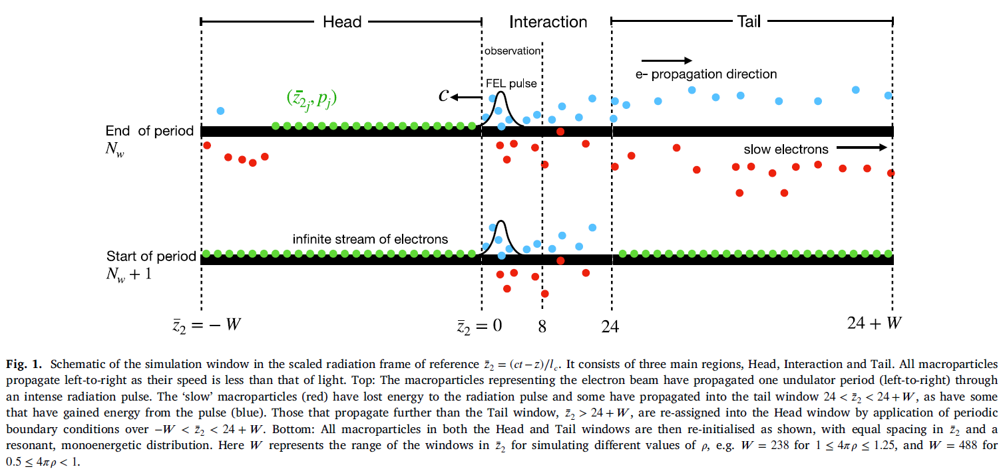

New Puffin modelling option: an infinite e⁻ beam
Window in light frame of reference and scaled to the 1D cooperation length

Slide 8
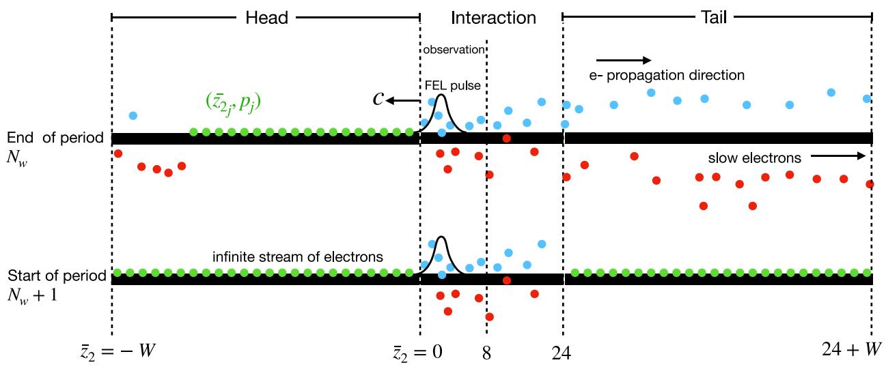
Saturation of Superradiant Pulses in Free Electron Laser (II)
New Puffin mode of operation: Modified periodic boundary condition
Window moving with the speed of light, c
Window in light frame of reference and scaled to the 1D cooperation length
Notes:
The diagram shows the schematic of the simulation window in the scaled radiation frame of reference z2 = (ct-z)/lc. It consists of three main regions, Head, Interaction and Tail. All macroparticles propagate left-to-right as their speed is less than the speed of light.
Top: The macroparticles representing the electron beam have propagated one undulator period (left-to-right) through an intense radiation pulse. The ‘slow’ macroparticles (red) have lost energy to the radiation pulse and some have propagated into the tail windows, as have some that have gain energy from the pulse (blue). Those that propagate further than the Tail window are re-assigned into the Head window by application of periodic boundary conditions used in Puffin.
The new mode of Puffin operation is now coming in as the using of the additional custom script at the end of each undulator period to re-initialise the macroparticles position and its corresponding energy as we can see from the ..
Bottom: All macroparticles in both the Head and Tail windows are then re-initialised as shown, which equal spacing in z2 and a resonant, monoenergetic distribution.

Slide 9
1D Unaveraged Puffin Simulations for: 4πρ=1

Slide 10
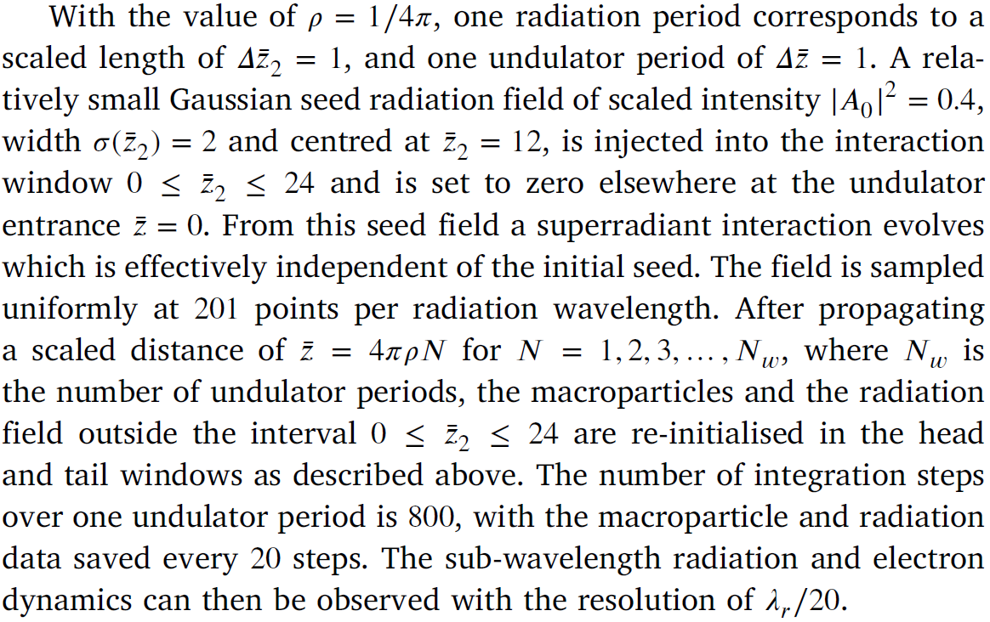
Initial & computational Parameters

Slide 11
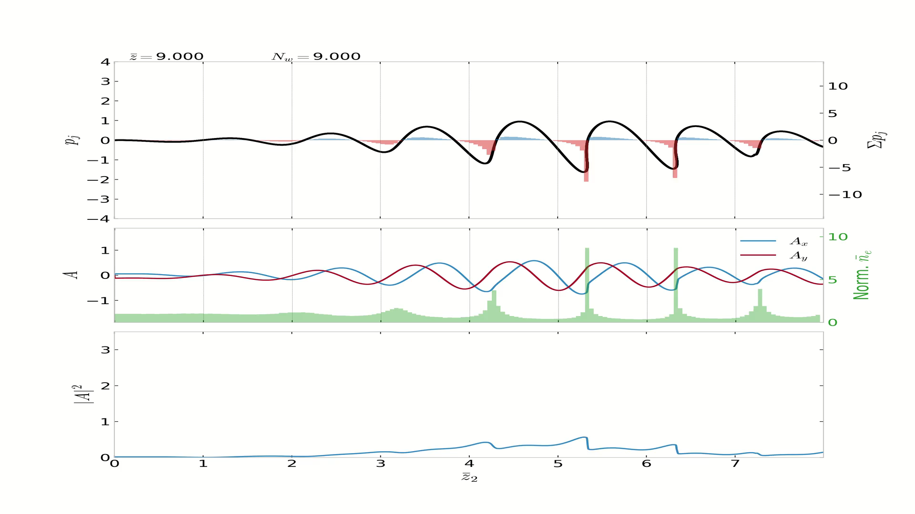

Slide 12
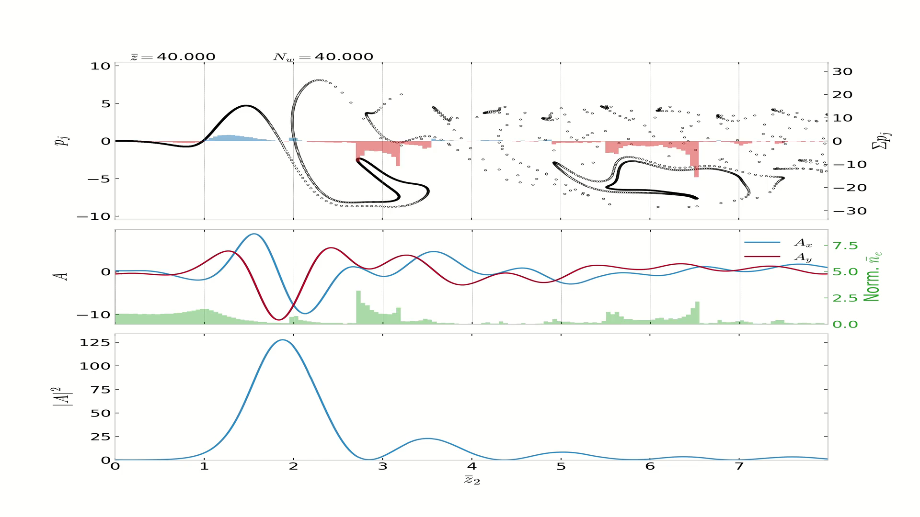

Slide 13
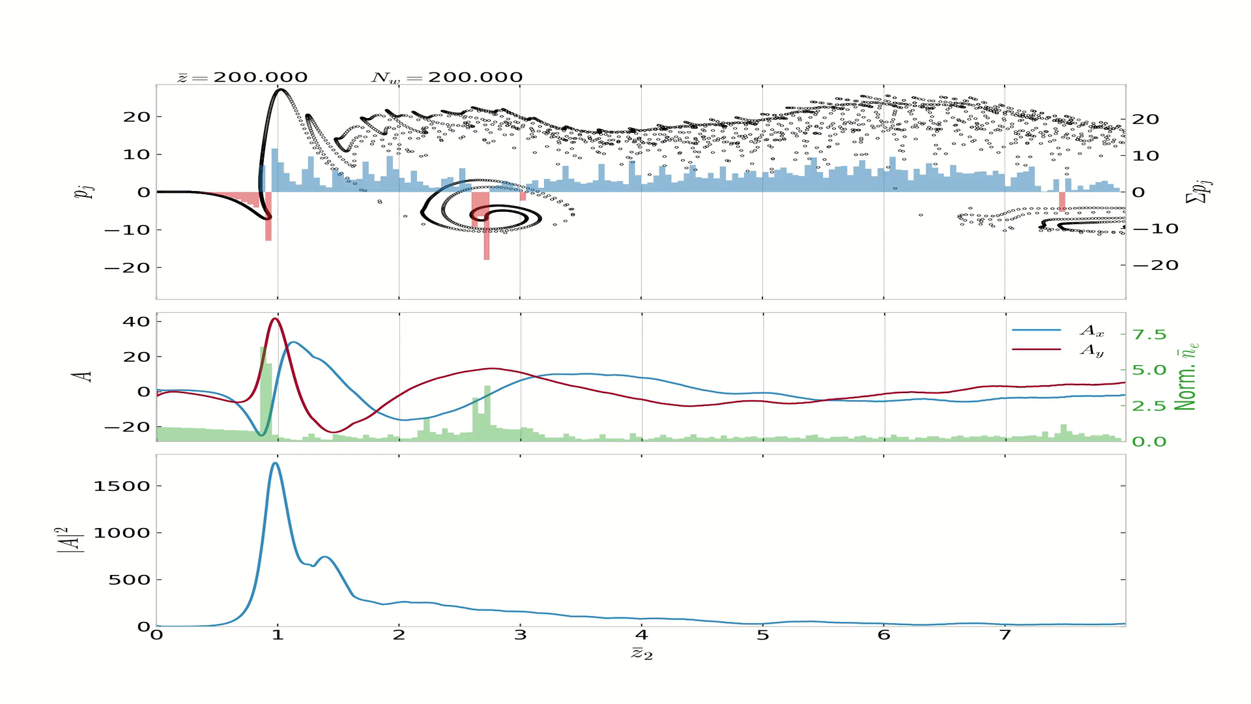

Slide 14
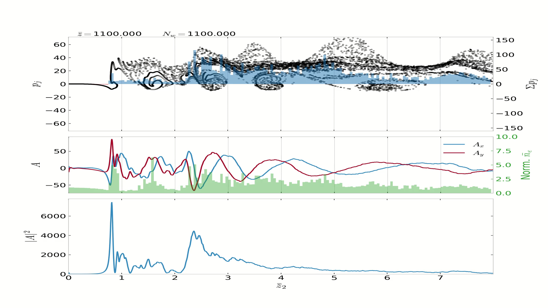

Note large energy increases:

Slide 15
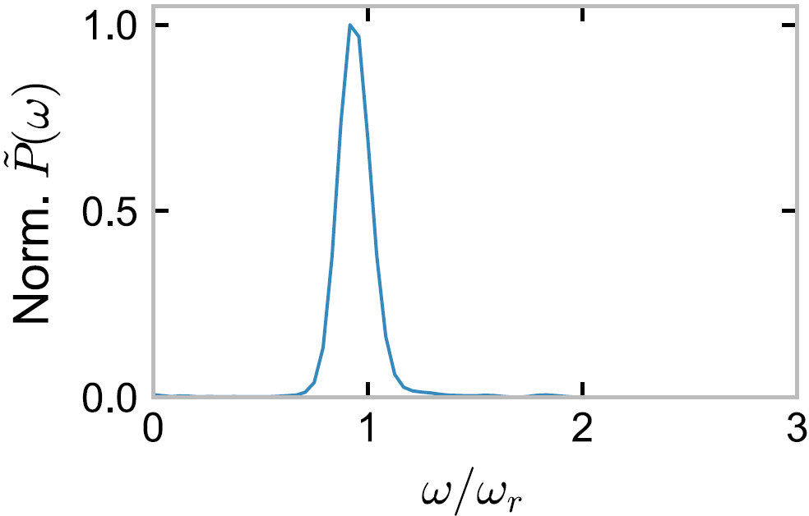
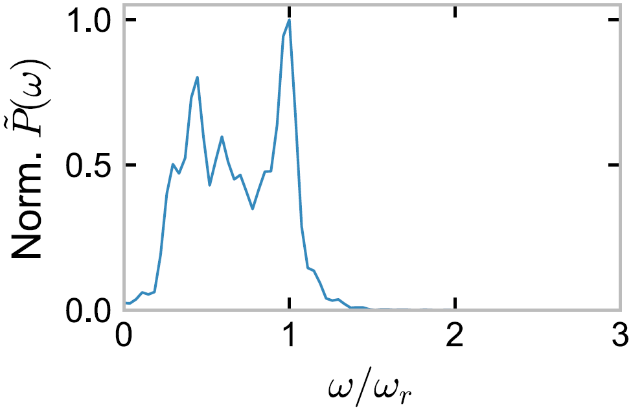
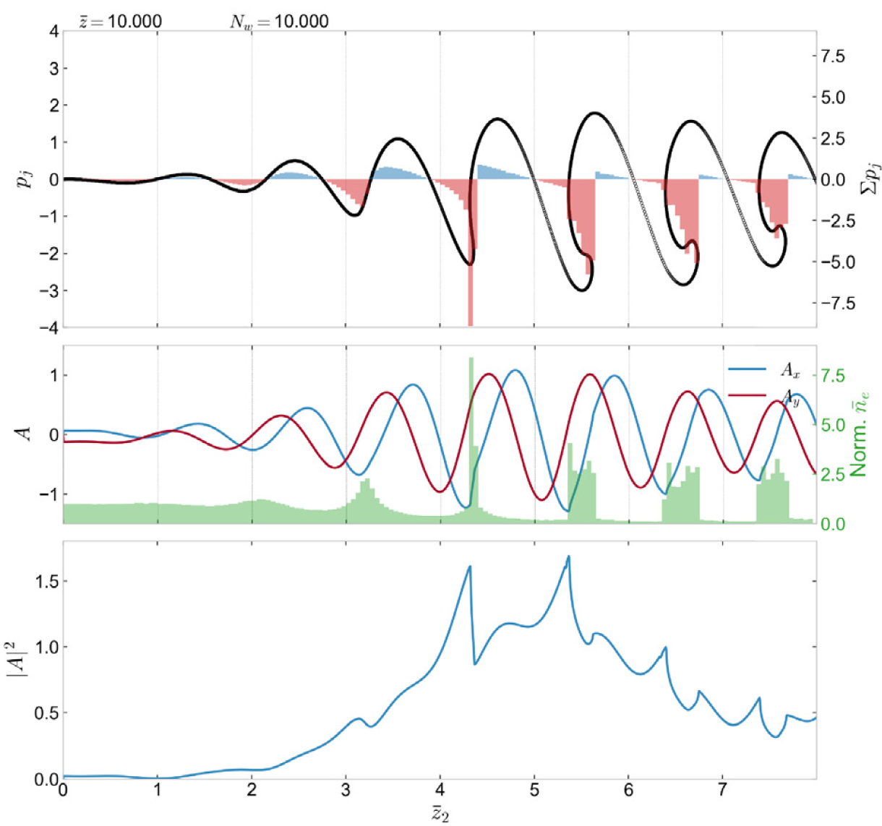
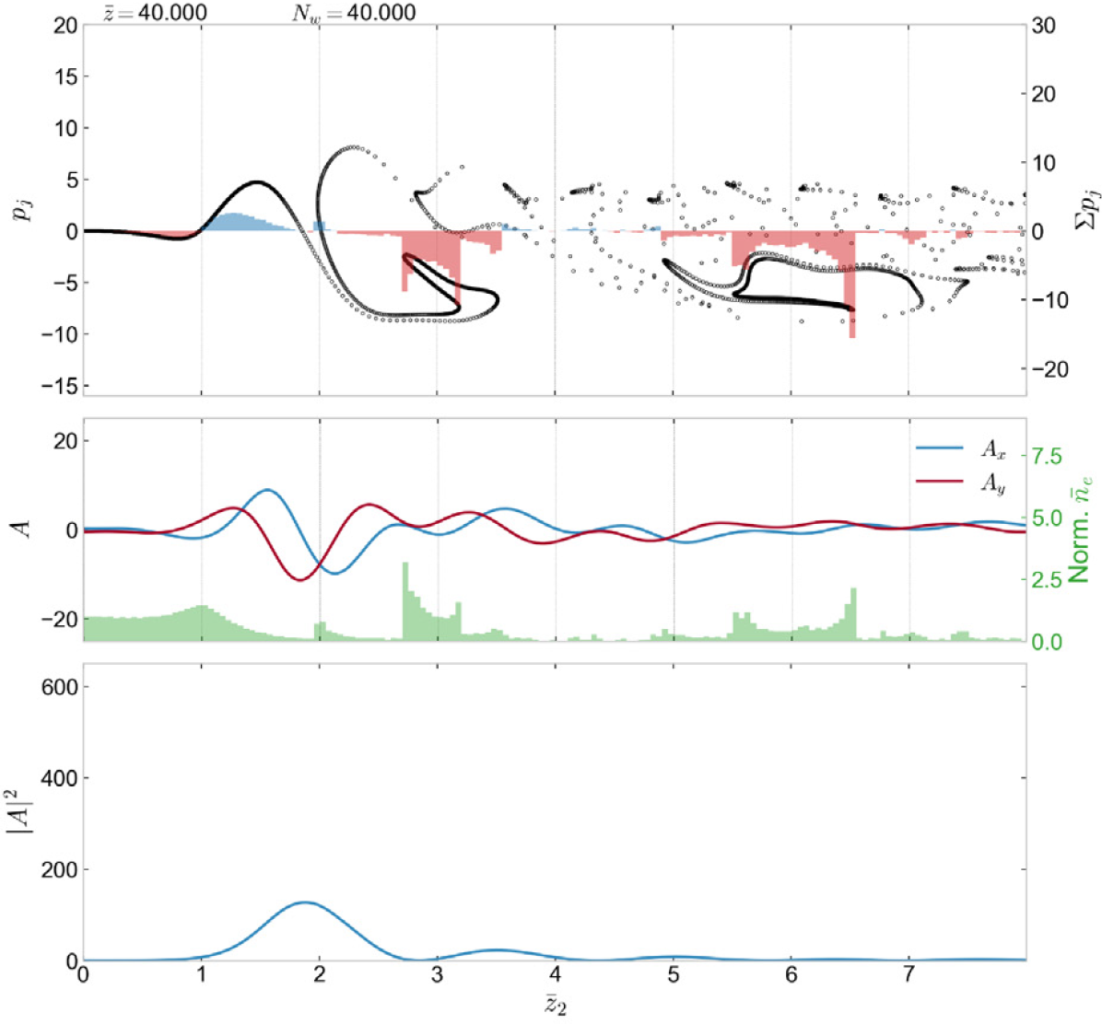
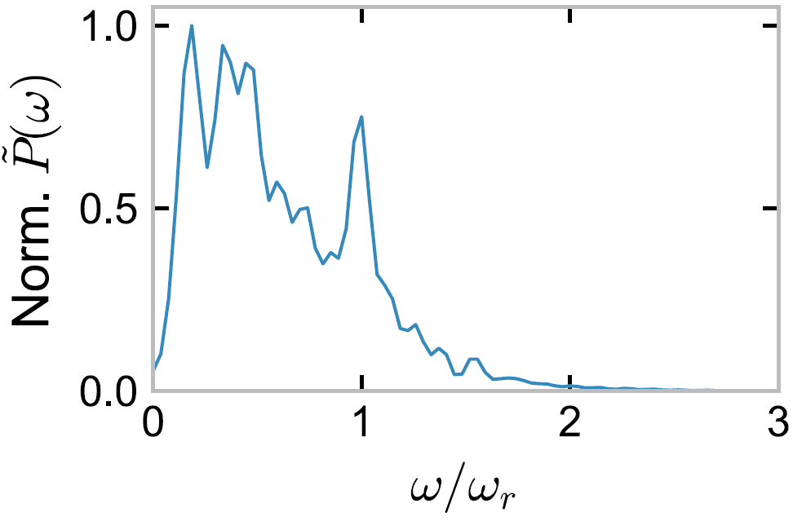
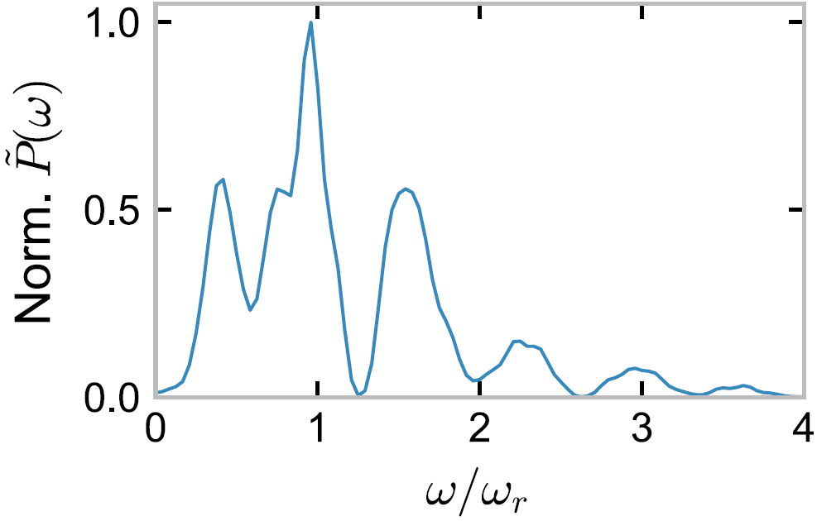
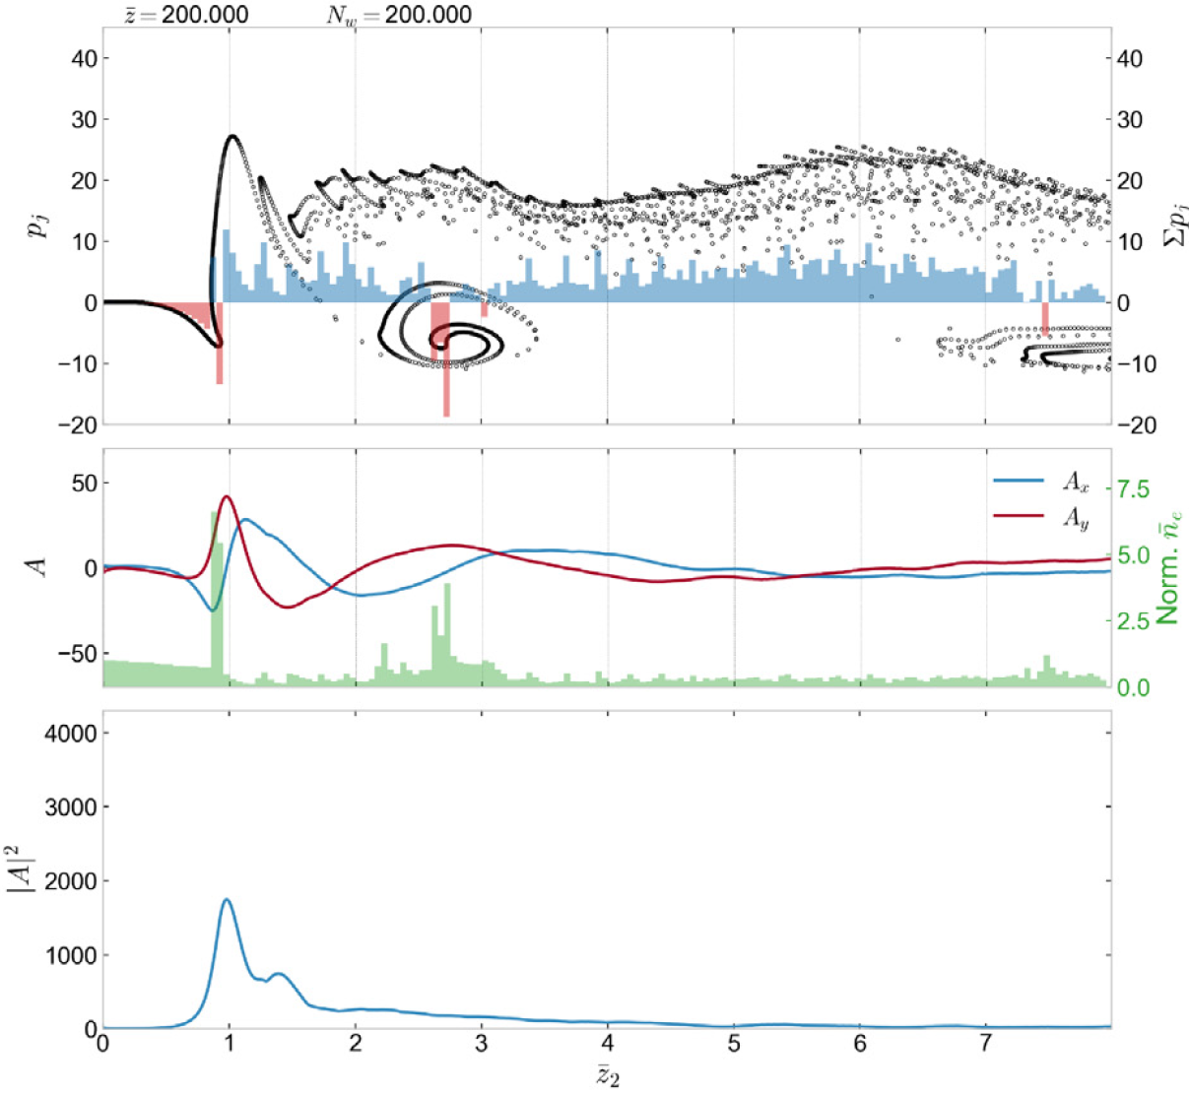
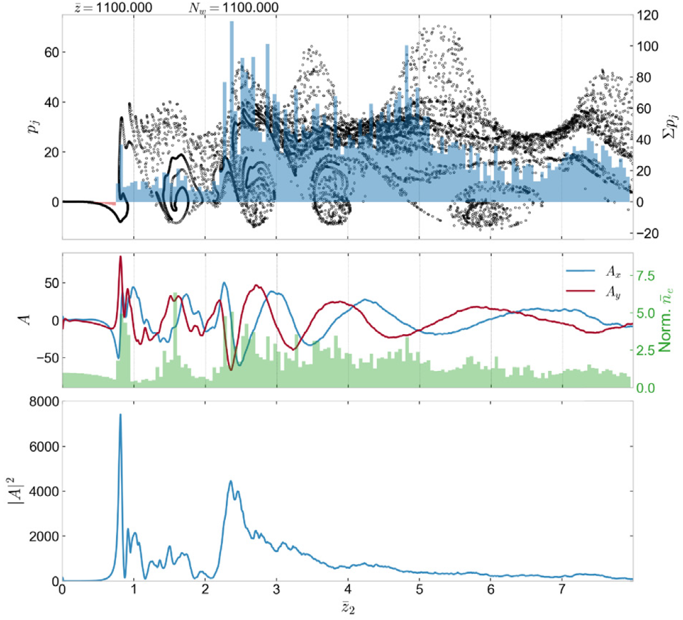
Scaled Power Spectra

Slide 16
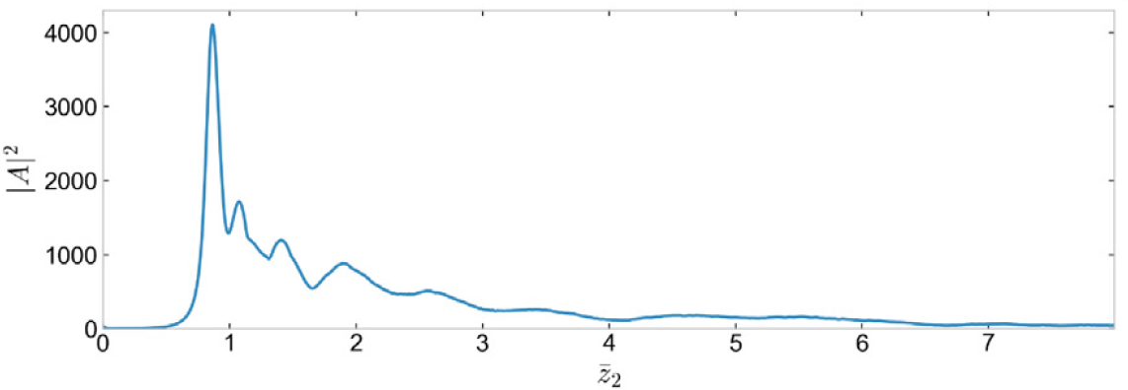
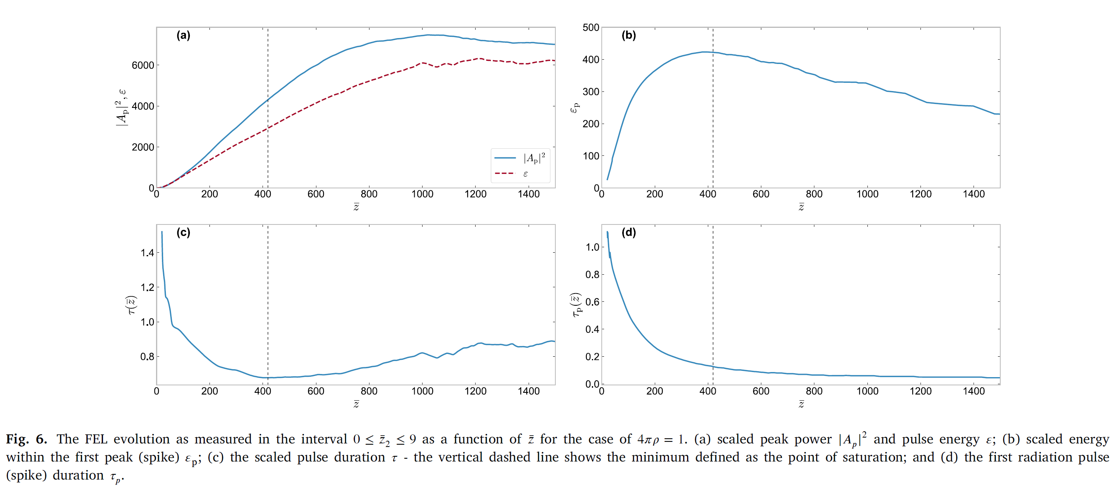
Saturation
Over whole pulse
Over spike
Peak power
Pulse Energy
Spike energy
Saturation
Pulse width
Spike width

Slide 17
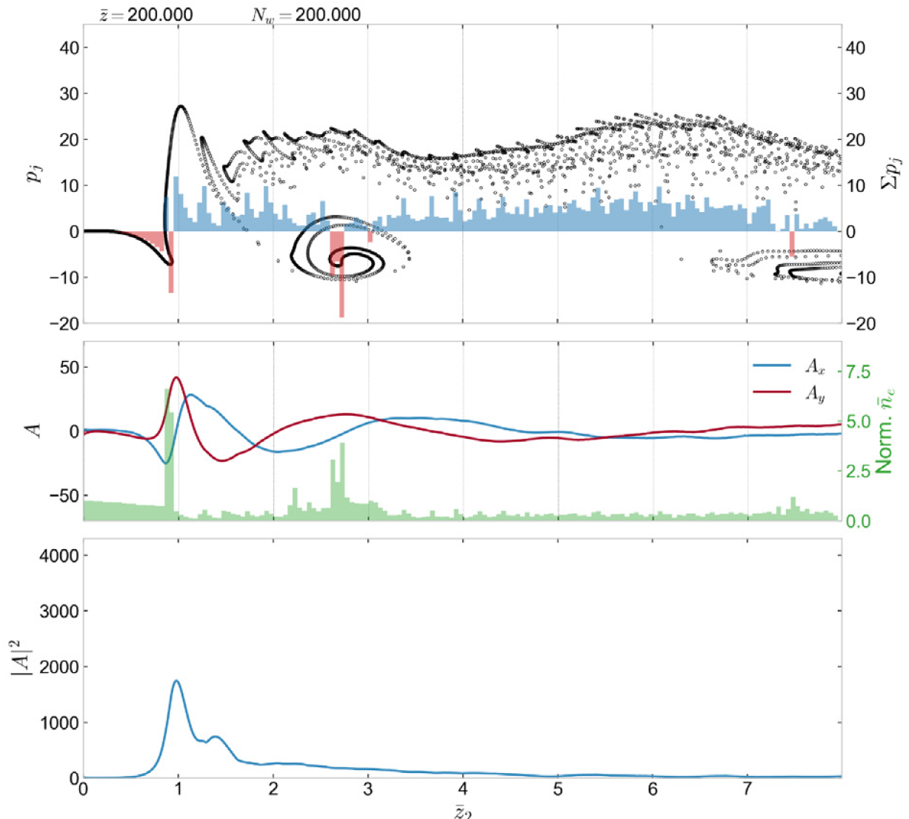
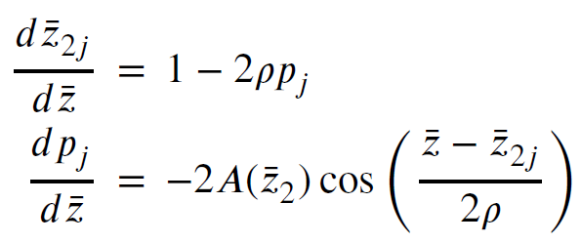

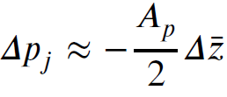

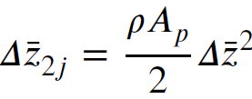
Spike saturation scaling
It is hypothesised that saturation of the first radiation spike occurs when the energy loss of electrons propagating through it means they can propagate a relatively large distance with respect to a radiation wavelength within one undulator period.
Neglecting the e⁻ drift in
Change in due to radiation spike:

Slide 18

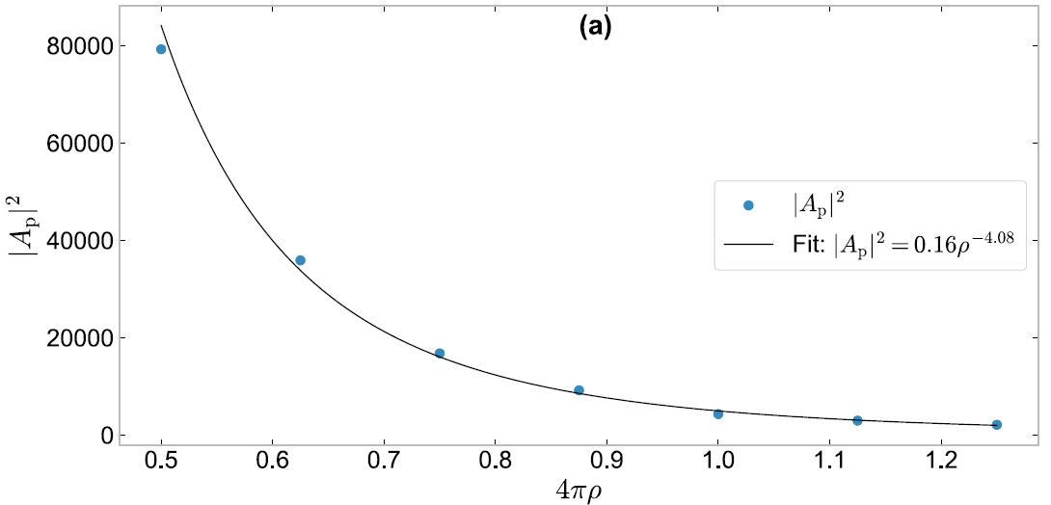
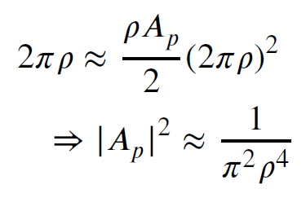
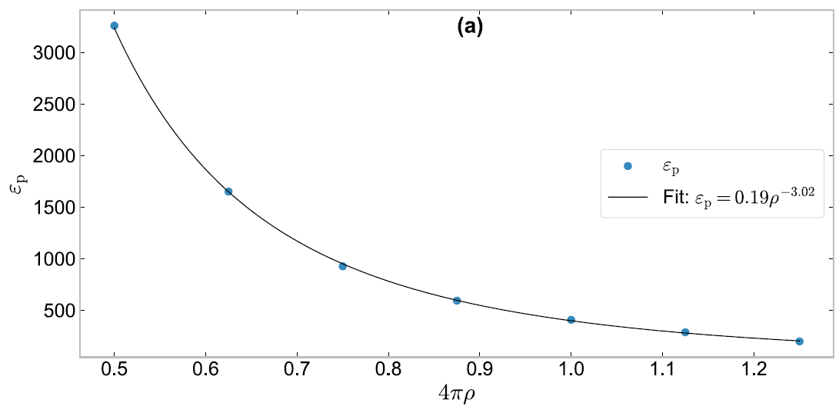
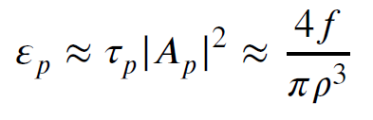
Saturation of the electron motion in the radiation spike is now defined as when the electron propagates an extra half a radiation wavelength through the radiation spike, in addition to its drift in the radiation frame of , in half of a wiggler period:
Given:
The spike duration 𝜏𝑝, is assumed to scale as the radiation wavelength, which in units of is 𝜏𝑝 = 𝑓 × 4𝜋𝜌 where 𝑓 is a fractional factor. The scaled energy in the spike at saturation 𝜀𝑝 is then:

Slide 19
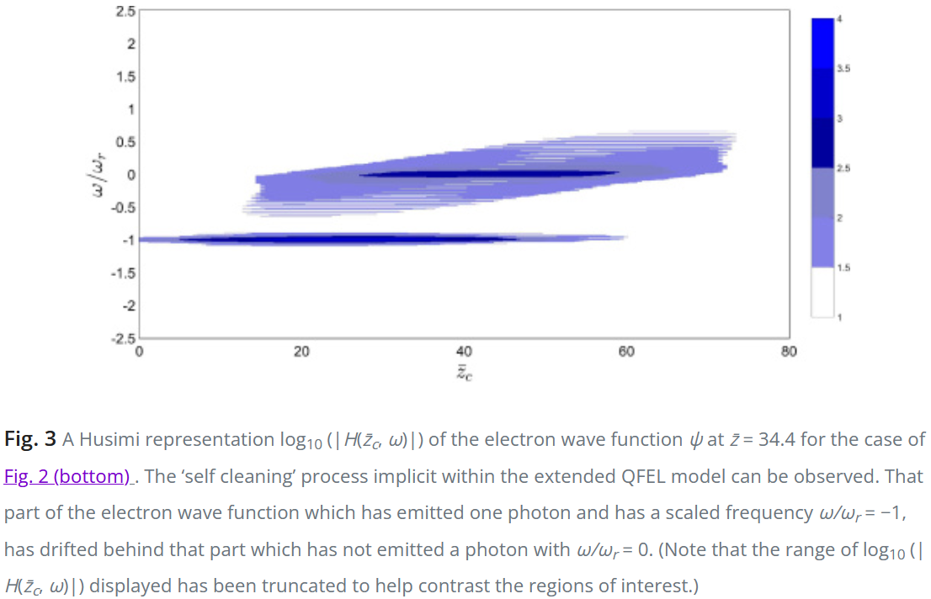
Future work
3D simulations are needed to take into account diffraction more realistically
1D model assumes only plane wave emission. What about the large acceleration of some electrons? There is a 5 x energy increase in one undulator period. Again, 3D simulations to include off-axis radiation emission needed.
Can the saturation be observed? Possible via a RAFEL set up with high cavity Q?
It would be expected this type of spike saturation behaviour would be significantly different in a Quantum-FEL set up*. Can it be utilised towards gamma emission?
Any other uses?
*MS Brown, JR Henderson, LT Campbell and BWJ McNeil, An extended model of the quantum free-electron laser, Optics Express 25, 33429-33438, 2017

Slide 20
Thank you!

