Slide 1
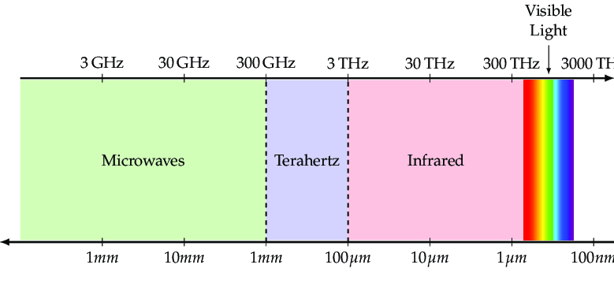
Optical klystron for IR/THz radiation
Najmeh Mirian
HZDR

Slide 2
Overview
FEL concept and THz problem
Optical Klystron and its Principle
Simulation results
Alternative Strategies for Mitigating Slippage Effects
Conclusion and Outlook

Slide 3
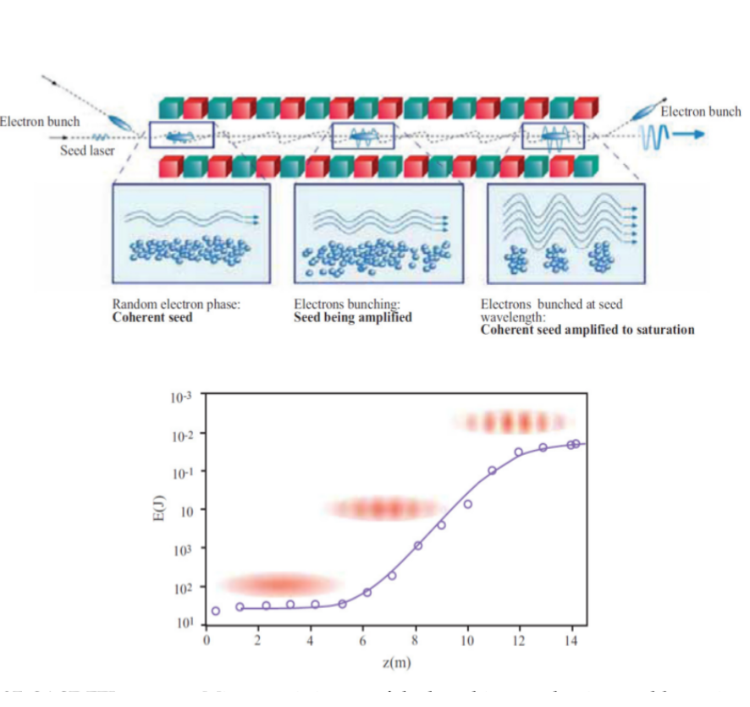
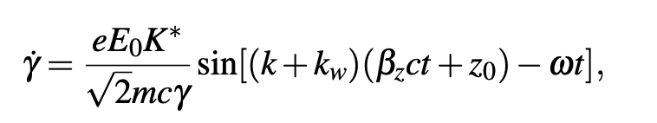
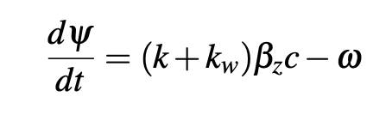
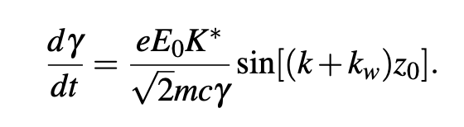
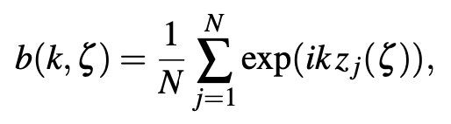
FEL concept and THz problem
The concepts of coupling, synchronism and bunching are the underlying principles of the FEL operation.
Interaction With Radiation
The energy exchange between the electron and the radiation
The Phase between the electron and radiation wave only varies very slowly with time and remains virtually constant.

Slide 4
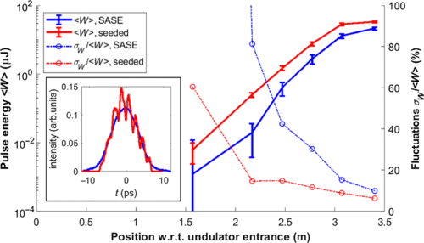
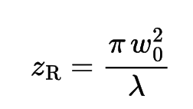
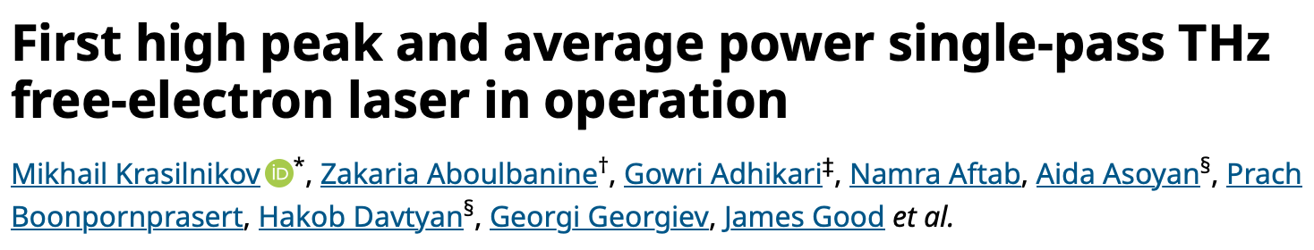
THz FELs , seeded and SASE FEL
FEL is one of the best options for radiation generation in this frequency range, but slippage effects require the use of relatively long and low-current electron bunches to drive the terahertz FEL, limiting amplification gain and output peak power.
Challenges:
Temporal and transverse overlap
(Slippage and diffraction)
Rayleigh length is short

Slide 5
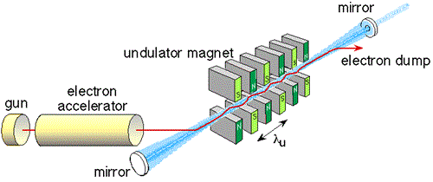
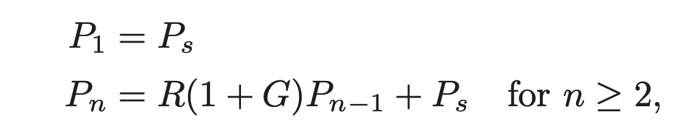
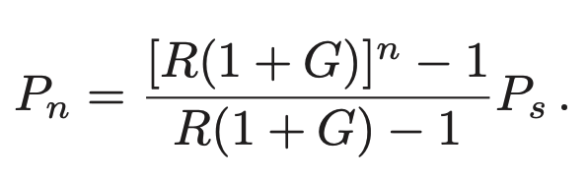
Oscillator FEL
Challenges:
Low gain, Low energy, long pulse,
Cavity tuning, Mode Competition & Spectral Purity, …
Broad gain spectrum: THz oscillators often lase on multiple longitudinal modes, making stable single-frequency operation challenging.
Cavity dispersion: Managing cavity length and slippage is tricky because radiation slippage per undulator pass can be comparable to the pulse duration.
FELBE@ELBE has been showing very good performance for over 21 years, U. Lehnert, M. J. Klopf

Slide 6
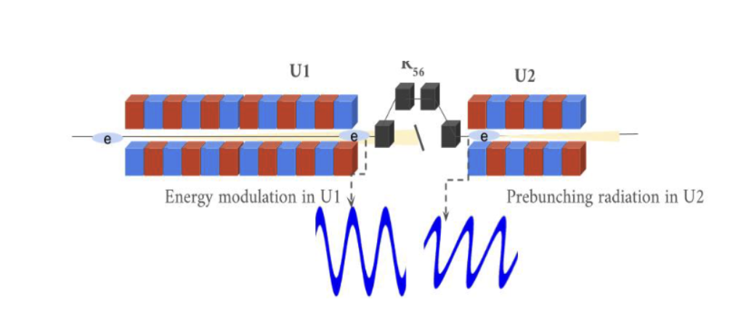

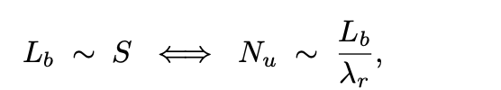
Optical Klystron
RF klystron: velocity modulation → drift → bunching → output cavity.
Optical klystron: energy modulation (1st undulator) → dispersion → bunching → radiation amplification (2nd undulator).
Seeded OK
SASE OK
Oscillator based OK
For THz range SASE-OK is good choice
In this regime, the magnetic undulator field imprints a longitudinally correlated energy modulation across the bunch, and the accumulated slippage tends to align the modulation phase of head and tail sections despite the noise start. In other words, a long modulator can partially synchronize the phase of the induced energy modulation across a THz-scale bunch.

Slide 7
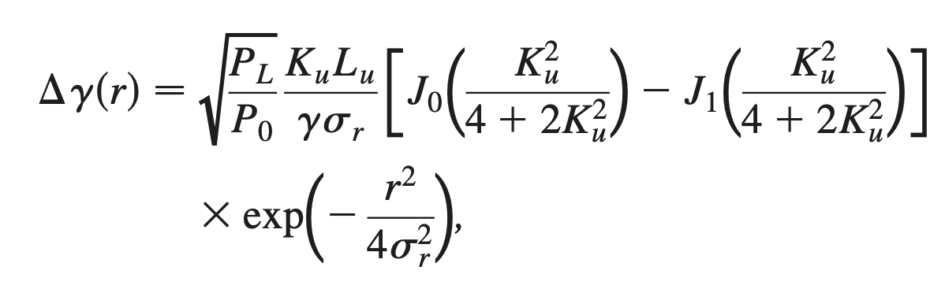
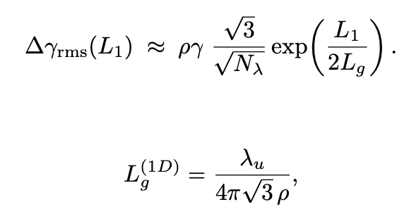
Optical Klystron
Principle OK:
1- Energy modulation in first Undulator
Seeded
SASE

Slide 8
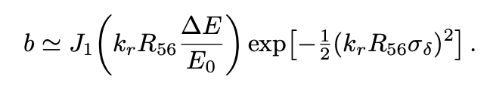
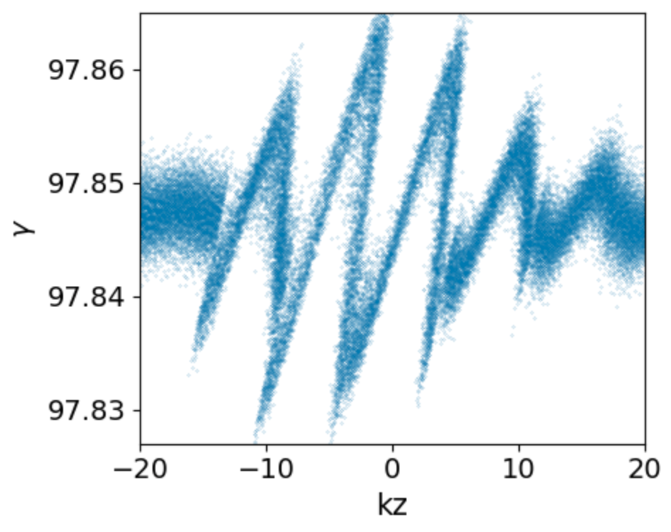
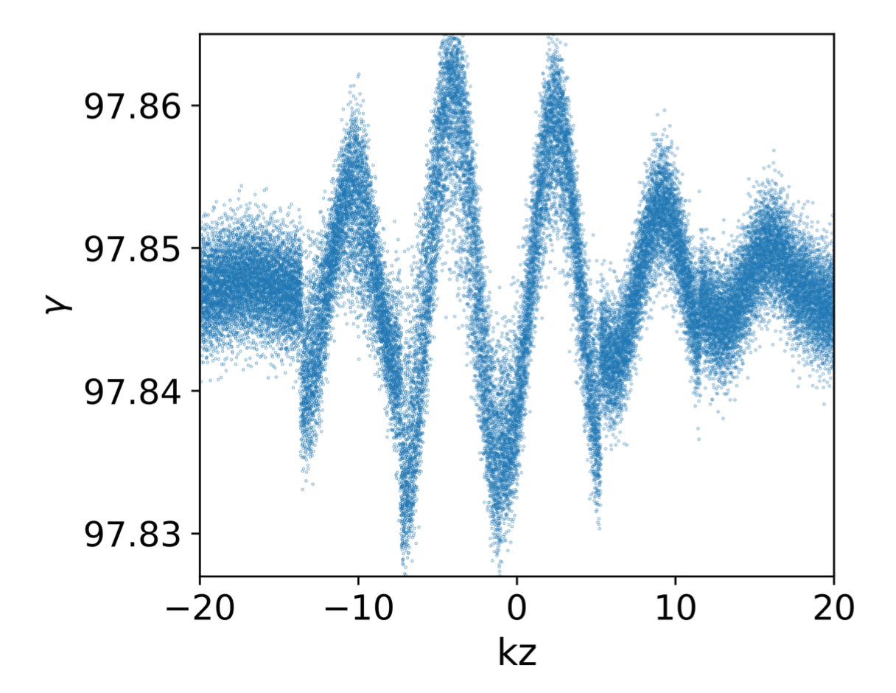
Optical Klystron
Principle OK:
2- Density modulation by Chicane
R56=2 mm

Slide 9
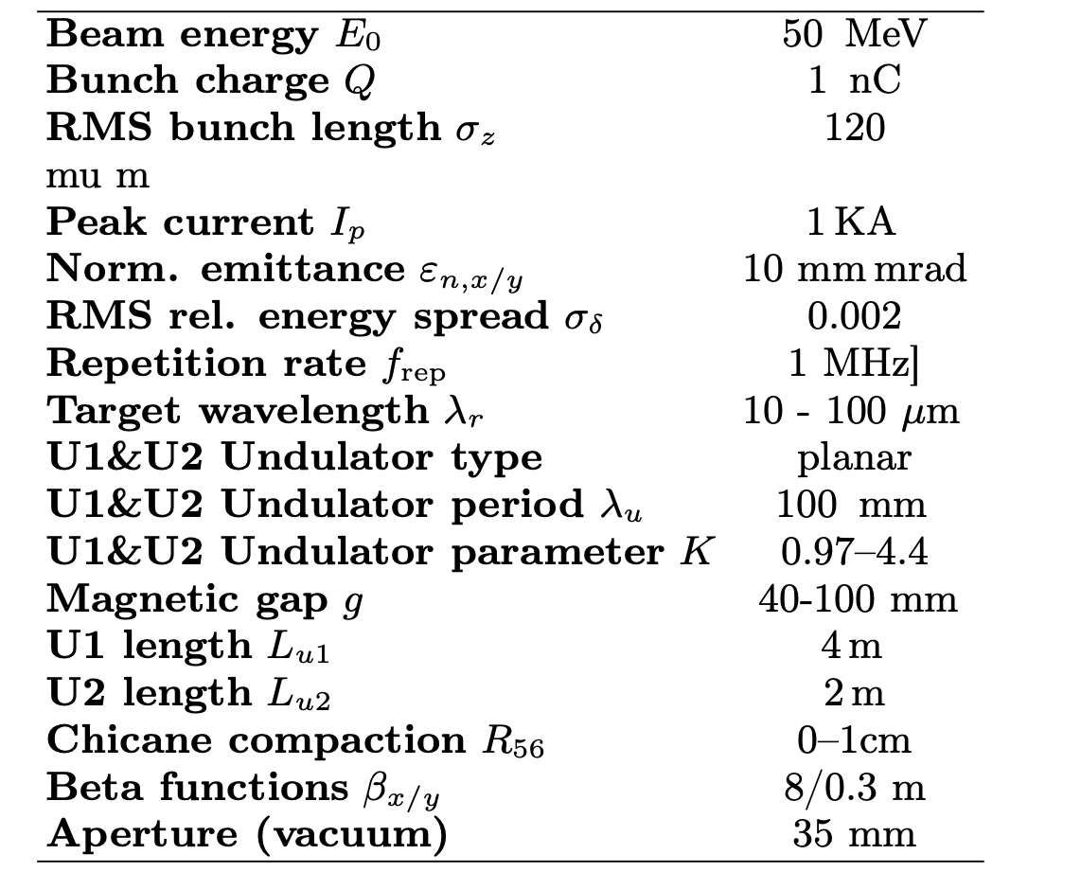
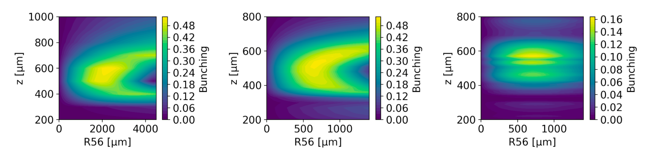
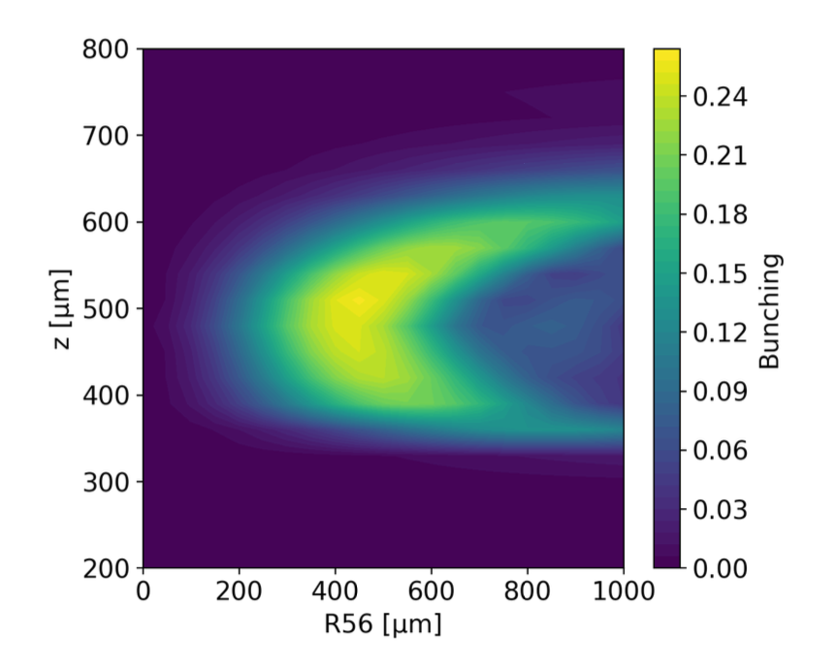
Simulation results
Scan of R56 for λr = 100 μm (left), 30 μm (middle), and 10 μm (right).
3rd Harmonic of 30 micron

Slide 10

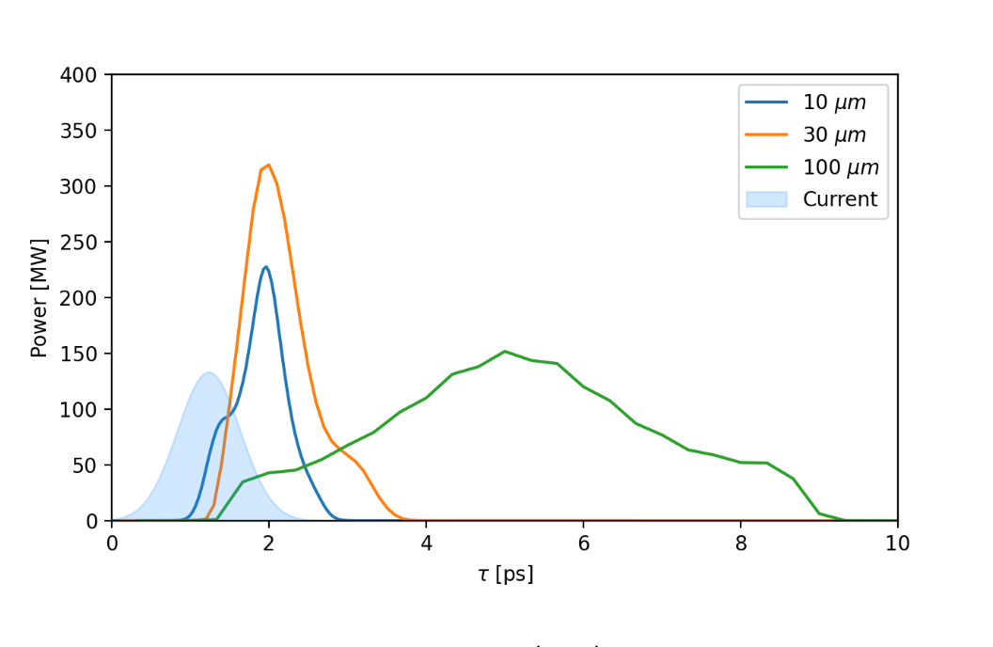
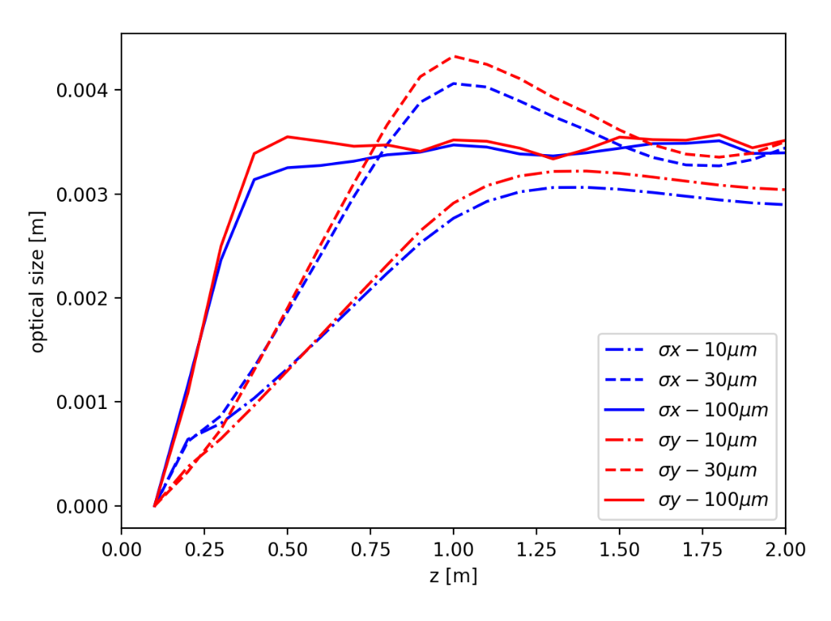
Simulation results
Simulated FEL output power after the second undulator (U2) for radiation wavelengths of 10 μm, 30 μm, and 100 μm. The blue shaded area represents the electron beam current profile. The effect of slippage is evident in the temporal structure of the FEL pulses, with longer wavelengths exhibiting broader pulse durations due to stronger slippage.
Collective effects are ignored!

Slide 11
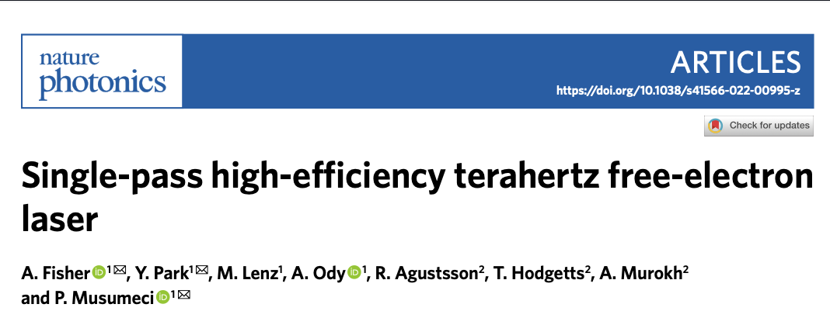
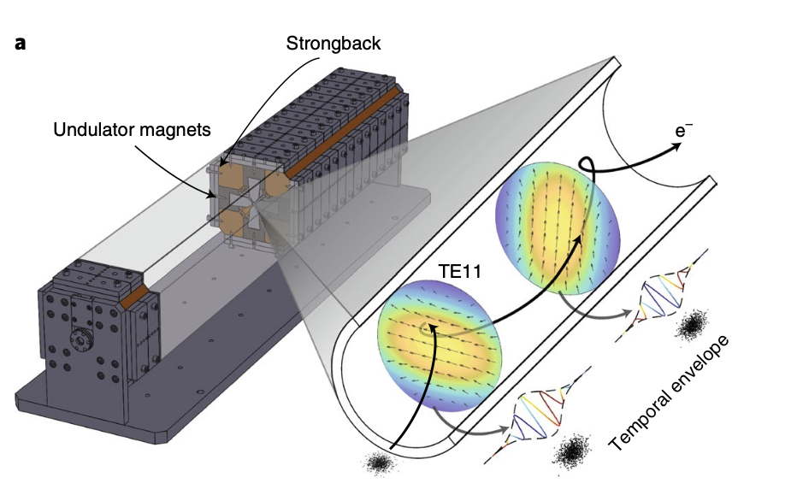
Alternative Strategies for Mitigating Slippage Effects
Waveguide-assisted propagation
The use of parallel-plate or corrugated waveguides can significantly extend the Rayleigh length of THz radiation, thereby reducing diffraction and helping to maintain overlap between the electron beam and the optical field.
A waveguided undulator section or transport line suppresses the effective slippage by confining the radiation mode and enhancing its on-axis field strength.

Slide 12
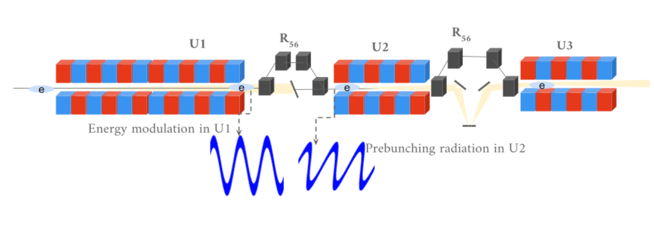
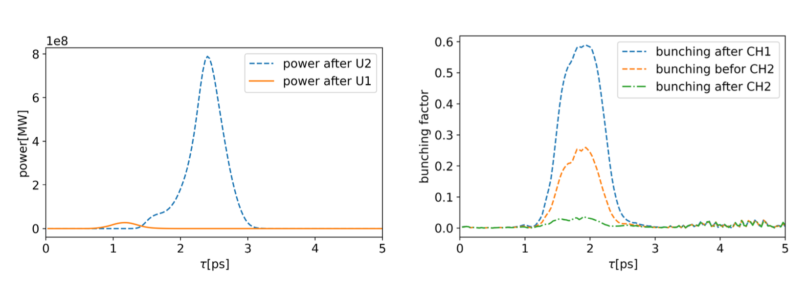
Alternative Strategies for Mitigating Slippage Effects
Simulated performance of the staged optical klystron with chicane-embedded optical delay. Left: FEL output power after U1 and U2. Right: bunching factor evolution at different positions: after first chicane (CH1), before second chicane (CH2), and after CH2. A moderate R56 in the first chicane limits energy extraction in U2 but preserves beam quality, enabling strong amplification in U3.

Slide 13
Conclusion and Outlook
The OK approach can be a promising option for THz FELs and may represent the most suitable configuration for single-pass operation. However, the challenge of slippage remains significant. Simulations indicate that the pulse power can be amplified up to a few megawatts, and further amplification of the radiation may be achieved through additional optimization strategies.

Slide 14
Thanks for your attention
I gratefully acknowledge fruitful discussions and support from colleagues at Helmholtz-Zentrum Dresden- Rossendorf (HZDR) , I thank Ulf Lehnert for valuable input and guidance throughout this work, Atoosa Meseck (HZB) and Michael Klopf (HZDR) for insightful comments on optical klystron strategies, and Andreas Wagner (head of the ELBE facility@HZDR) for continuous support of the DALI project. We also thank the accelerator physics groups at HZDR for their constructive feedback during the development of this study.

