Slide 1

5D Phase space reconstruction at DESY and PSI
FELs of Europe topical workshop on selected problems in FEL physics: from soft X-rays to THz
Sonja Jaster-Merz, Francesco Demurtas, Paolo Craivich, Philipp Dijkstal et al.
philipp.dijkstal@psi.ch, 25 September 2025

Slide 2
Content
General information on PolariX TDS project
The 5D reconstruction method
Results from FLASHForward
Preliminary results from SwissFEL

Slide 3
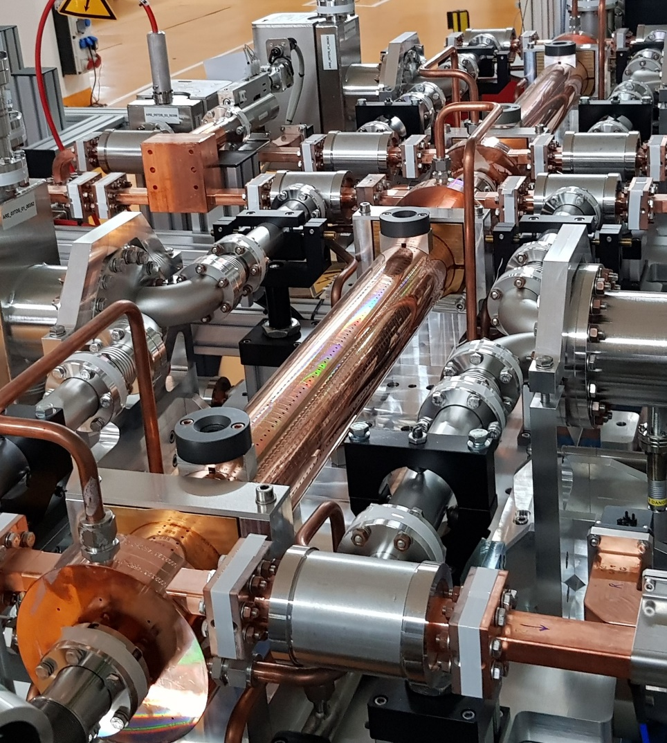


Polarizable X-band transverse deflection structure (TDS)
PolariX enables new diagnostic methods and allows for sub-fs longitudinal resolution
Designed in collaboration between CERN, PSI and DESY ^{[13-15]}.
Installed at: FLASH 2, FLASHForward, ARES, SwissFEL.
Sub-fs resolution possible.
Unique feature: Variable streaking angle.
PolariX TDS installed at the ARES linac.

Slide 4
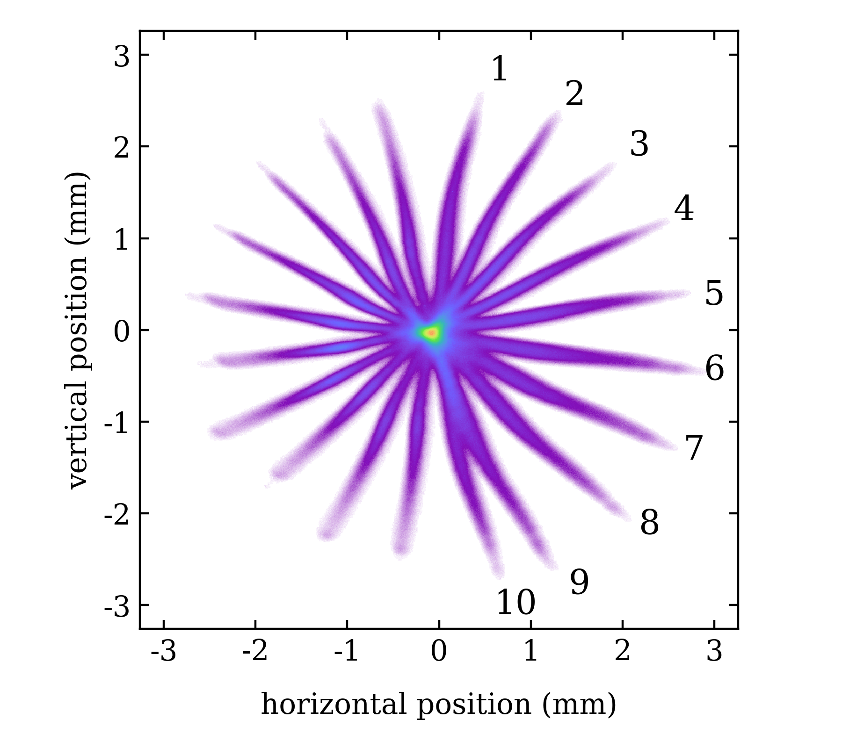
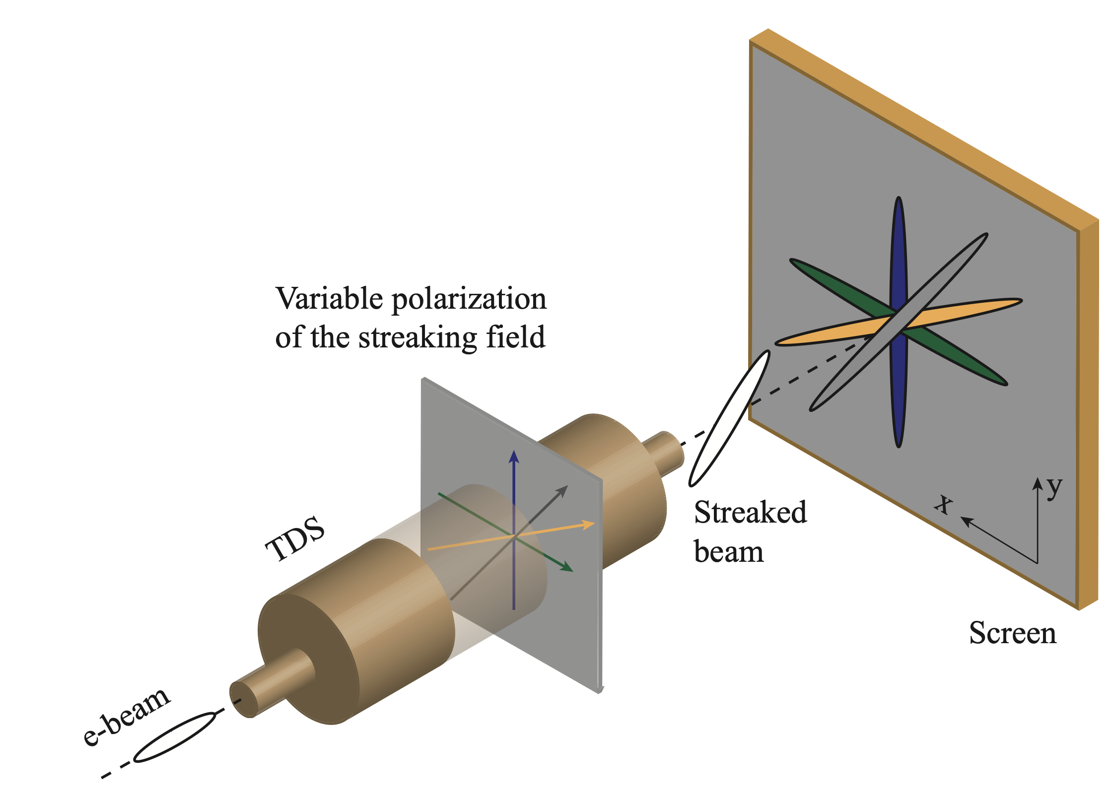
Motivation
Diagnose multidimensional phase space of electron bunches to investigate complex beam dynamics (e.g. collective effects, beam correlations, slice emittance in different planes, etc..)
  5D/6D phase-space characterization becomes possible by different streaking planes and using tomographic methods.
  Reconstruction of the 3D charge density.
References:
A. Grudiev, CLIC-Note-1067 (2016)
P. Craievich et al., Phys. Rev. Accel. Beams 23, 112001 (2020)
B. Marchetti et al., Sci Rep 11, 3560 (2021)
P. González Caminal et al., Phys. Rev. Accel. Beams 27, 032801 (2024)
POLARIzable X-band Transverse Deflection Structure – POLARIX TDS

Slide 5

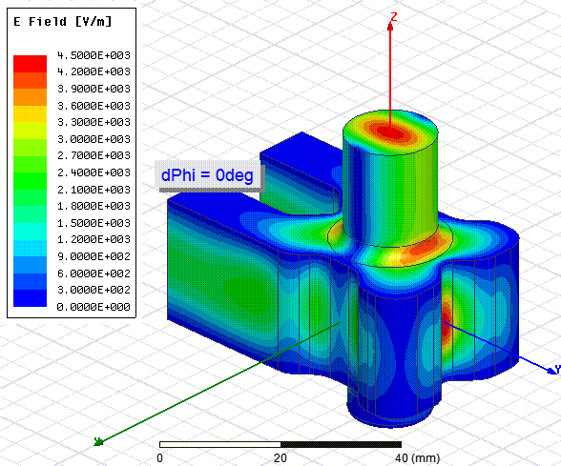
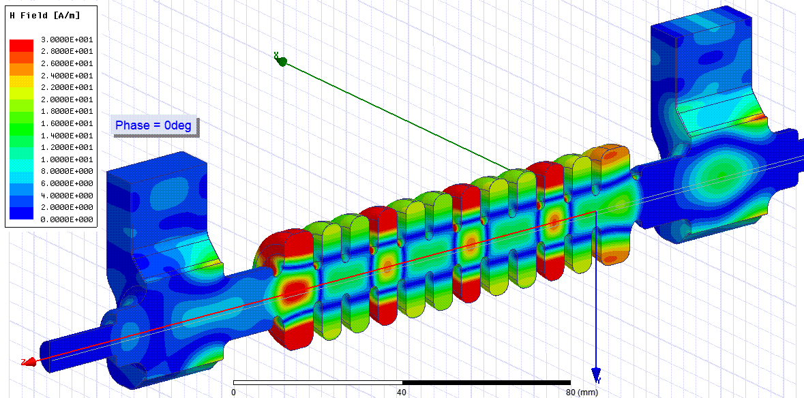
Method to achieve variable polarization
POLARIzable X-band Transverse Deflection Structure – POLARIX TDS
Variable polarization circular TE11 mode launcher: E-rotator
Phase difference between port 1 and port 2:
0 degree -> vertical polarization
180 degree -> horizontal polarization
DESY-CERN-PSI Collaboration
1x TDS FLASHForward (DESY)
2x TDS FLASH II (DESY)
2x TDS SINBAD-ARES (DESY)
2x TDS SwissFEL Athos (PSI)

Slide 6
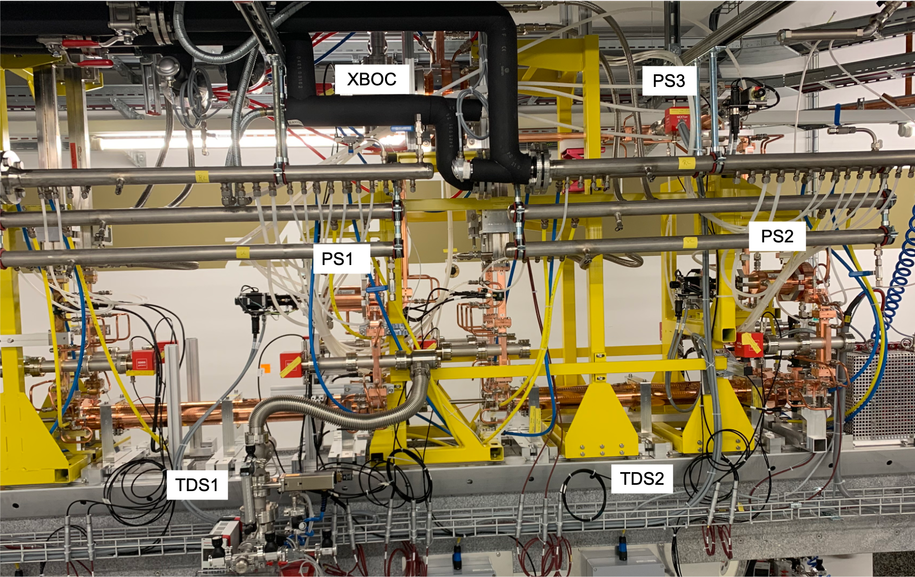
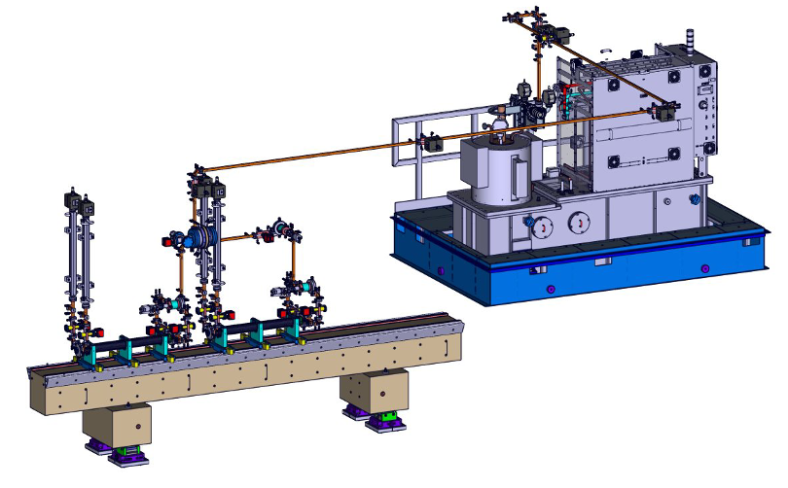
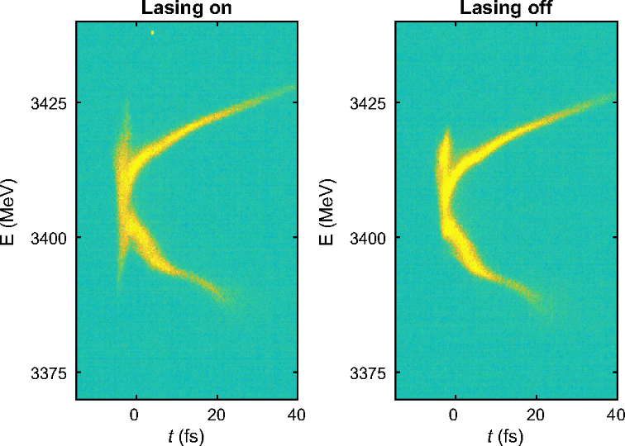
PolariX TDS and RF components at PSI
3 Phase shifter (PSI)
XBOC (PSI)
RF loads
Rms resolution down to ~300 attoseconds in low charge (i.e. low emittance) beam configuration has been demonstrated.
Main use case: measurement of current / FEL power profiles during machine setup or special mode development.
All waveguide RF components including the XBOC, and phase shifters were designed and built at PSI, X-Band Klystron is a CPI VKX-8311A, 50 MW (max used rf power 35 MW). PSI HV klystron modulator: developed and built in-house (400 kV, 3 ms). deflecting voltage ~90 MV.
E. Prat et al., Advanced Photonics 7 (2), 026002 (2025)

Slide 7
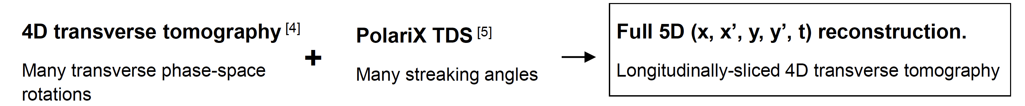
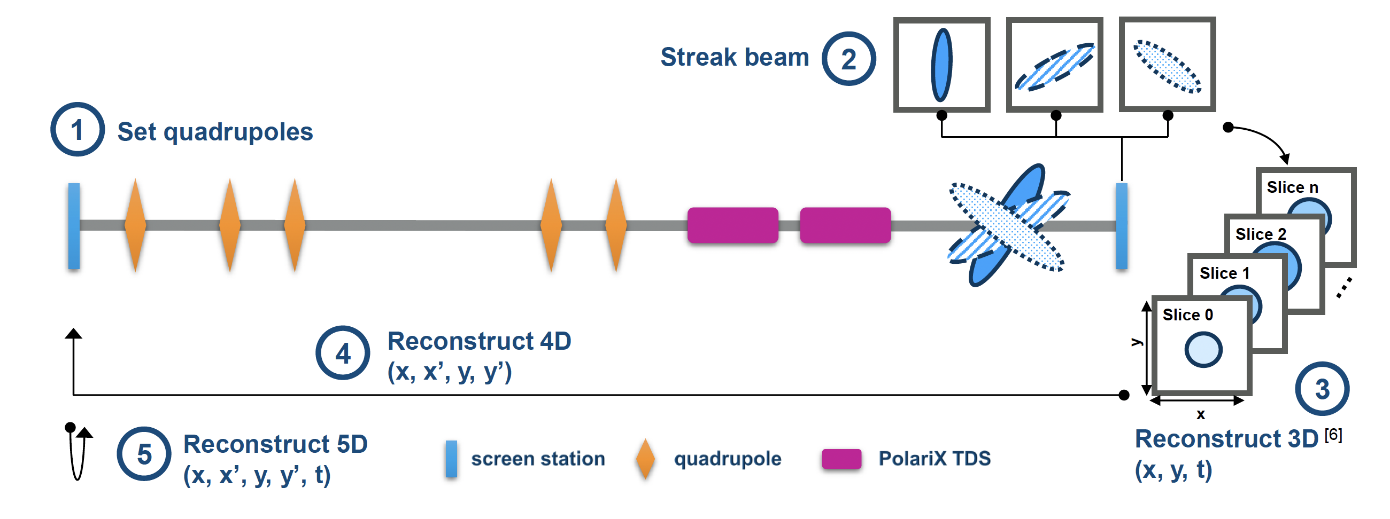
5D phase-space tomography – method^{[1-4]}
Reconstructing the full transverse phase-space of each longitudinal slice
Two independent rotations, via transverse optics (θₓ, θ_{y}) and TDS streak angles, enable mapping from 2D images to full 5D distribution.
Hierarchical reconstruction: first resolve (x, y, t), then expand each time slice into full transverse phase space.
Resolution and accuracy are tunable via beamline tuning (β-matching), TDS voltage, drift length, and number of projections.
Only drift space between TDS and screen.
[5]
[6]
[1] S. Jaster-Merz et al., Phys. Rev. Accel. Beams 27, 072801, 2024 - METHOD
[2] S. Jaster-Merz et al., https://doi.org/10.48550/arXiv.2505.13724, PROOF of PRINCIPLE
[3] S. Jaster-Merz et al ., LINAC2022, MOPORI10, 2022,
[4] S. Jaster-Merz et al ., IPAC2022, MOPOPT021, 2022
[5] K. Hock and A. Wolski, Nucl. Instrum. Methods Phys. Res. Sect. A, 2013
[6] D. Marx et al., Journal of Physics: Conference Series, vol. 874, 2017

Slide 8
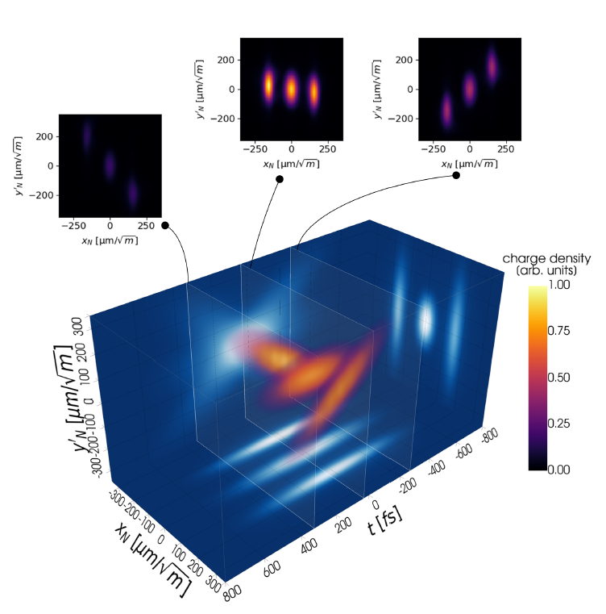
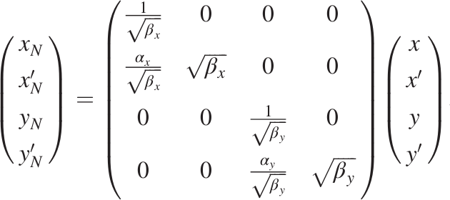
Excellent performance demonstrated in simulations
Proof-of-principle simulation studies with test distributions using the ARES beamline
Full 5D reconstruction of Gaussian and highly complex phase spaces.
Beam parameters reconstructed with
≲ 5% discrepancies.
Extraction of sliced beam parameters and the 4D slice emittance possible.
beam charge: 1 pC
beam energy: 155 MeV
S. Jaster-Merz et al., Phys. Rev. Accel. Beams 27, 072801 (2024)
Visualization done with PyVista

Slide 9
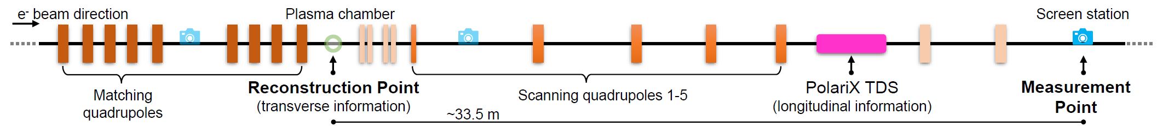
Experimental demonstration at FLASHForward
Fully commissioned PolariX TDS and flexible diagnostic beamline available
S. Jaster-Merz et al., https://doi.org/10.48550/arXiv.2505.13724
Experimental facility dedicated to beam driven plasma acceleration experiments.
Uses up to 1.3 GeV electron beams from the FLASH linac.
Measurement performed with 10 Hz single bunch operation, ~1.1 GeV energy, ~0.3 nC charge,
and ~200 fs RMS bunch duration.

Slide 10
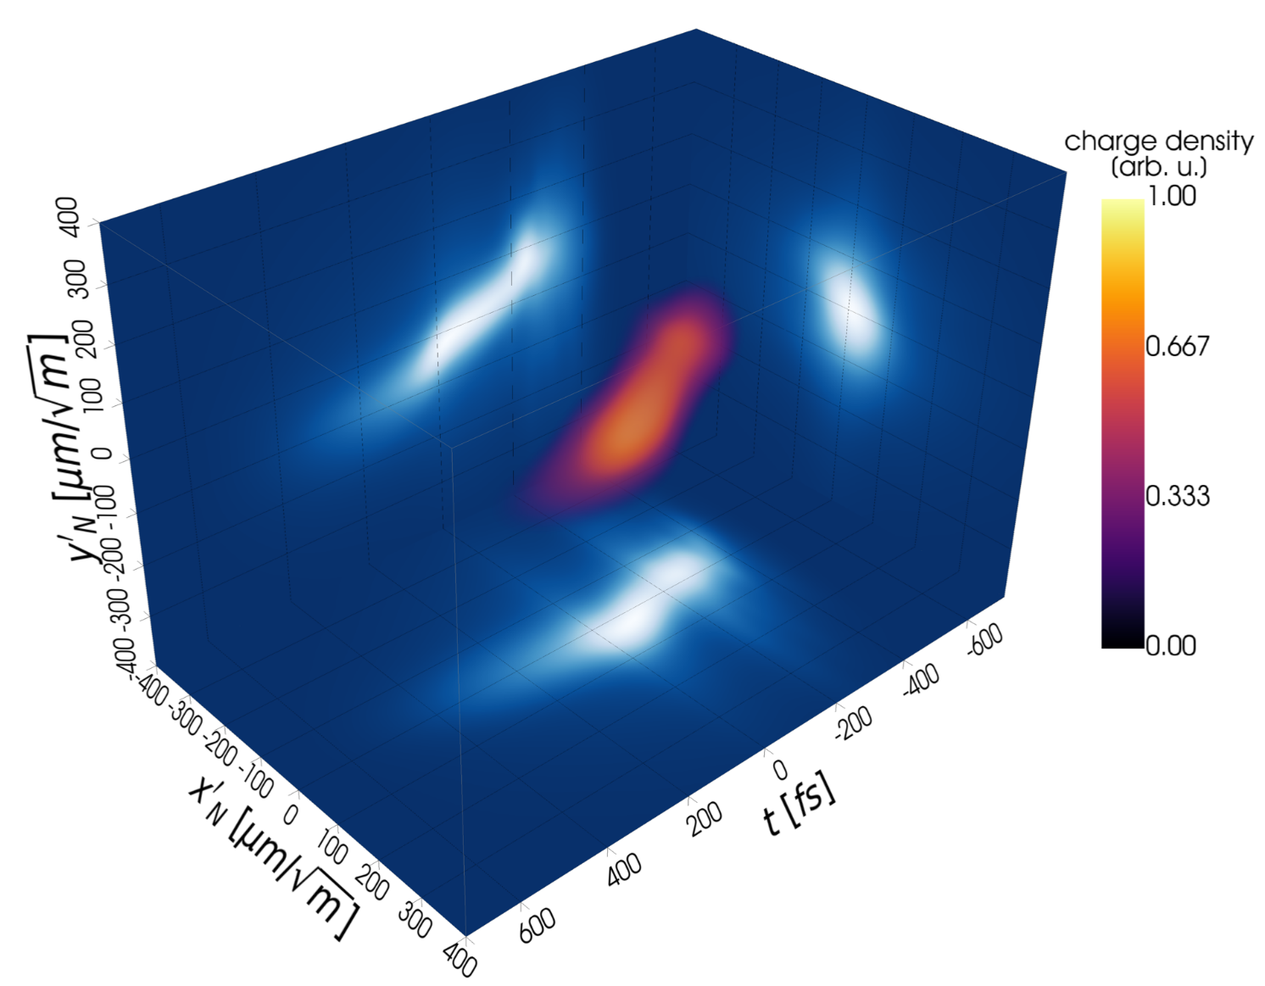



First experimental 5D reconstruction
Feasibility of conducting a 5D tomography measurement is demonstrated for the first time
960 projections recorded in
~28 hours.
head
tail
3D projection (x’_{N}, y’_{N}, t)
beam charge: 300 pC
Average longitudinal resolution of 20 fs.
Reconstruction of 72 bins in the longitudinal plane and 301 bins (3.3 µm/√m) per transverse plane.
Visualization done with PyVista
S. Jaster-Merz et al., https://doi.org/10.48550/arXiv.2505.13724

Slide 11
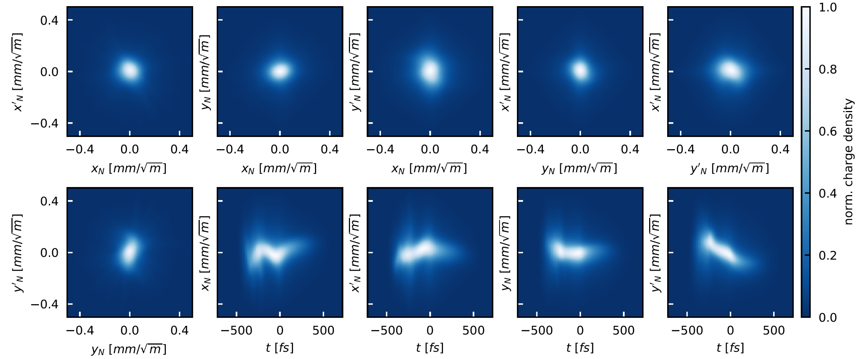
Reconstructed 5D phase space enables new insights
Previously hidden transverse-longitudinal correlations are retrieved
S. Jaster-Merz et al., https://doi.org/10.48550/arXiv.2505.13724
‌‌All 2D projections of the 5D phase space obtained from the reconstruction.
Transverse phase space reconstruction validated against dedicated 4D tomography measurement.

Slide 12
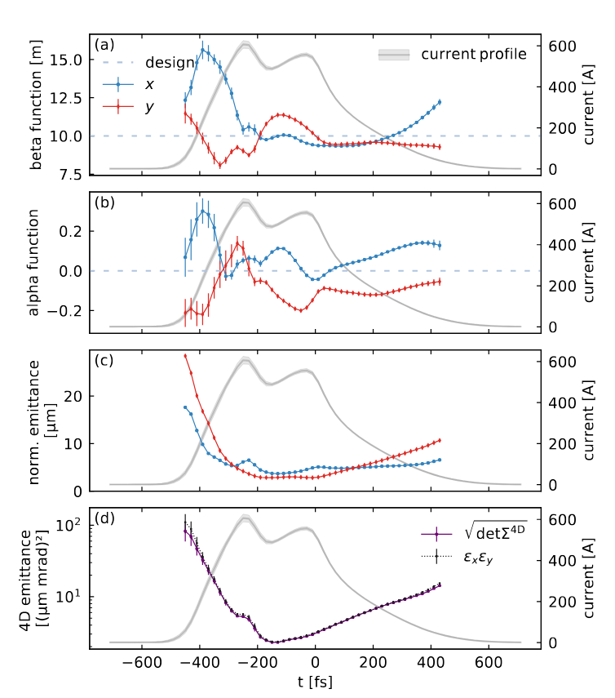
Extraction of sliced beam parameters from reconstruction
Information about both transverse planes can be obtained simultaneously
In addition to the full 5D phase space distribution the reconstruction allows to obtain:
  ‌Sliced transverse beam parameters,
  ‌Bunch duration and current profile,
  Sliced 4D emittance.
  Projected transverse beam parameters.
S. Jaster-Merz et al., https://doi.org/10.48550/arXiv.2505.13724
Projected quantities validated against multi-quadrupole scan and TDS bunch duration measurements.

Slide 13
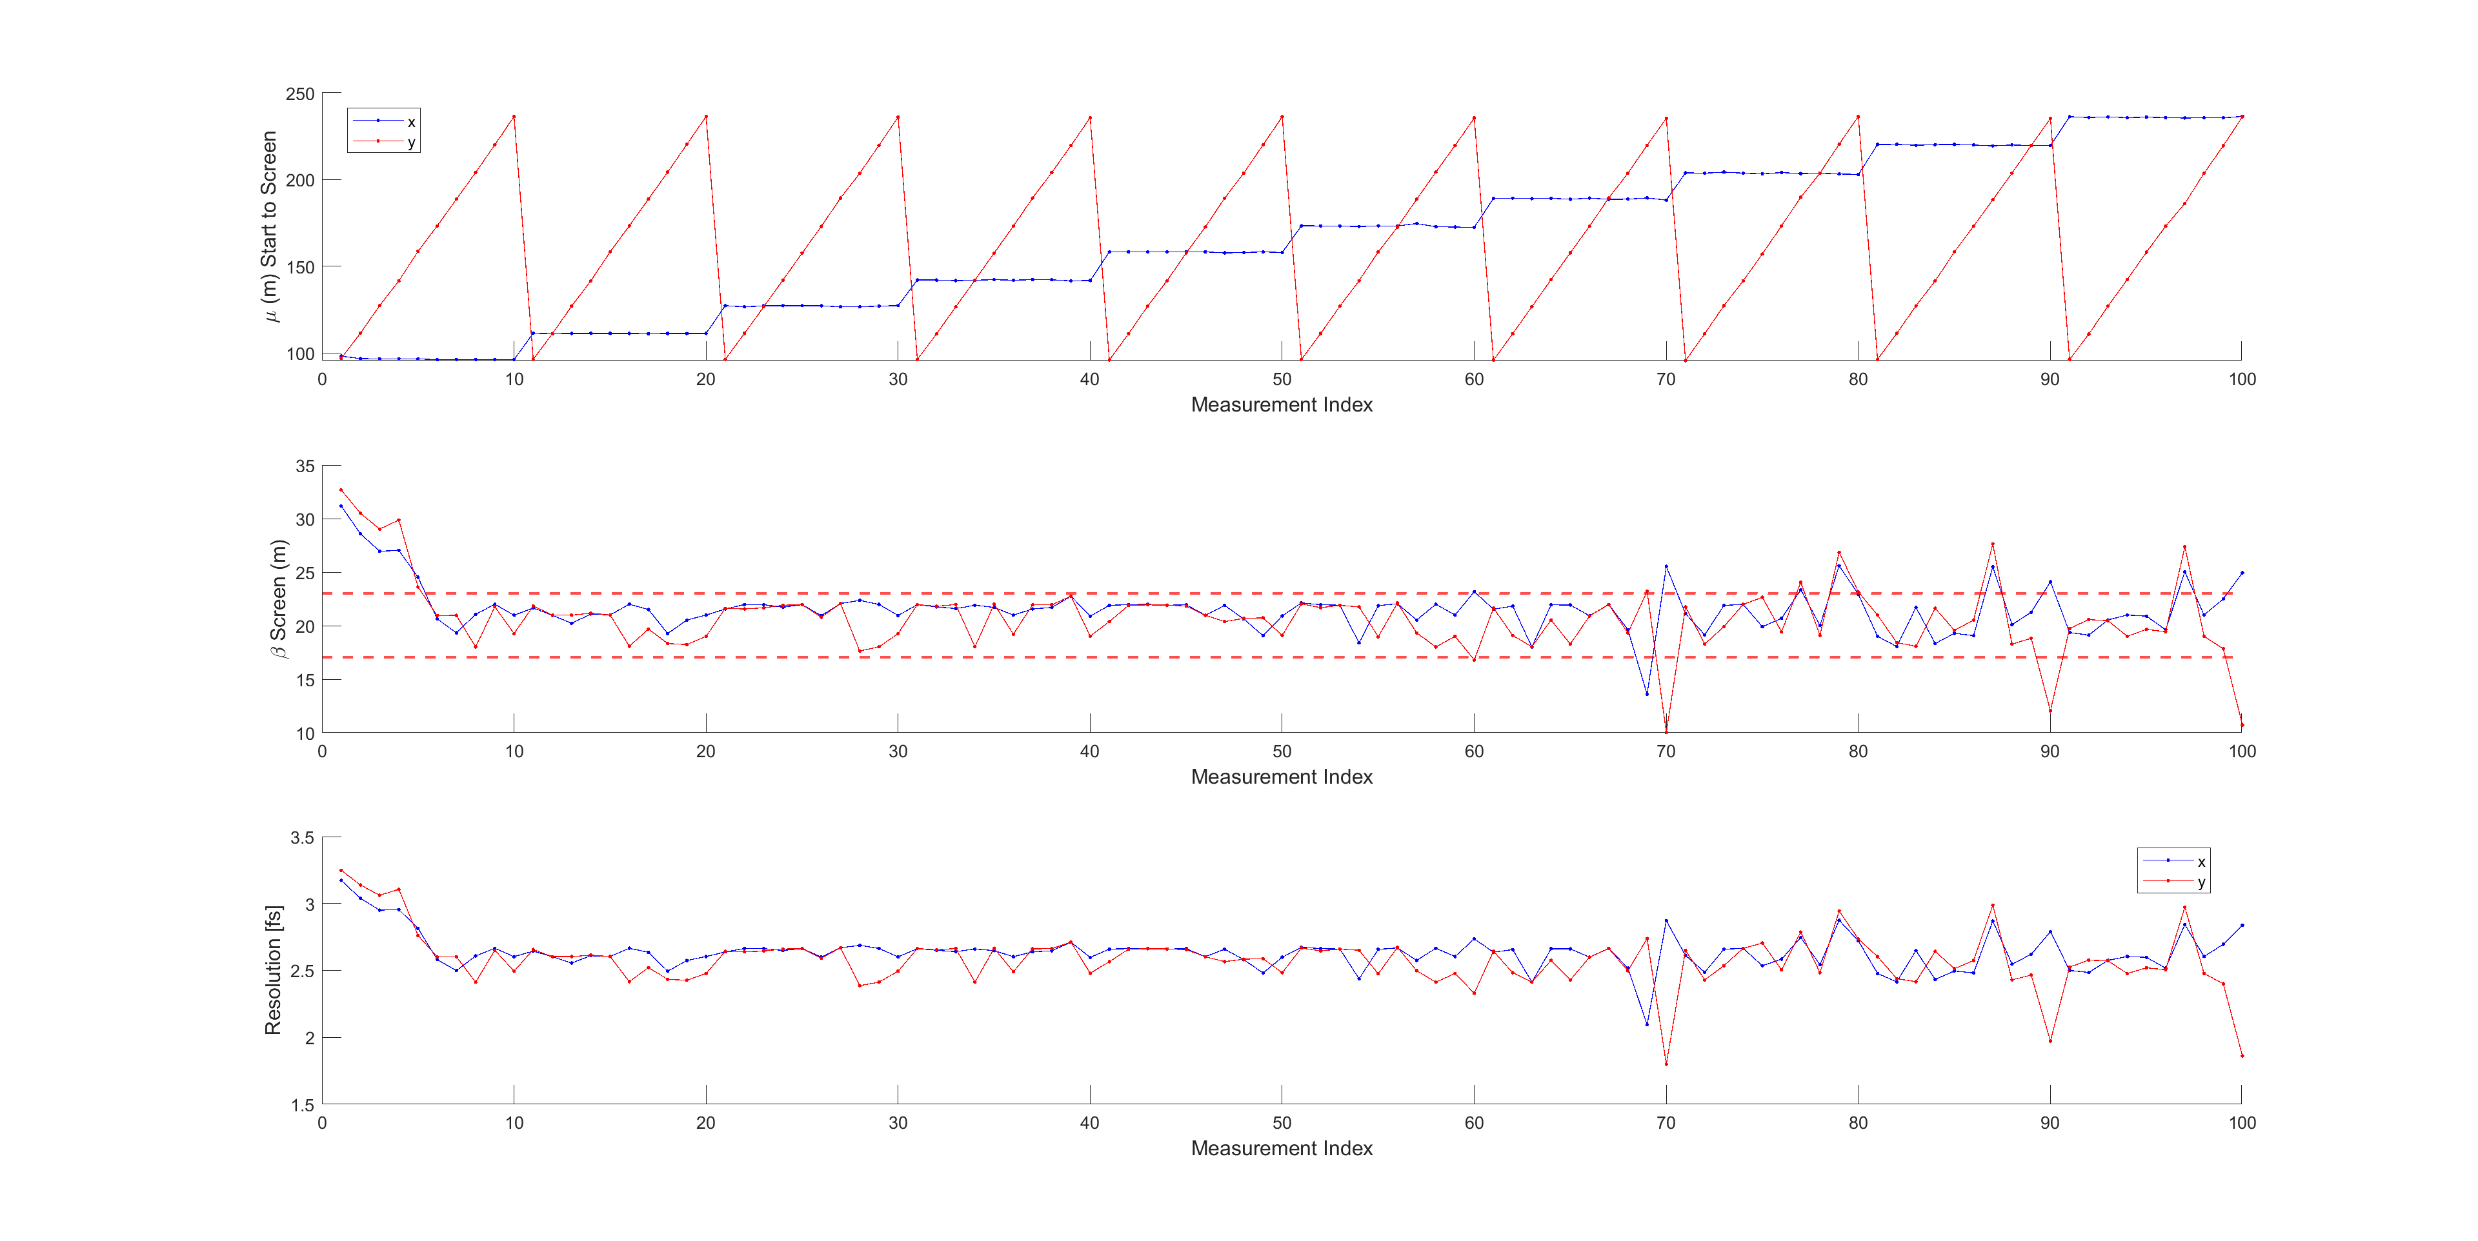
5D measurement optics preparation
To perform the 5D tomography the 3D reconstruction must be combined with a quadrupole scan in both x and y planes
Reconstruction Point
DSCR120
TDS 1
TDS 2
$μ_{x},μy$ from 96 to 236 in ten steps$→$ 100 quadrupole settings

Slide 14
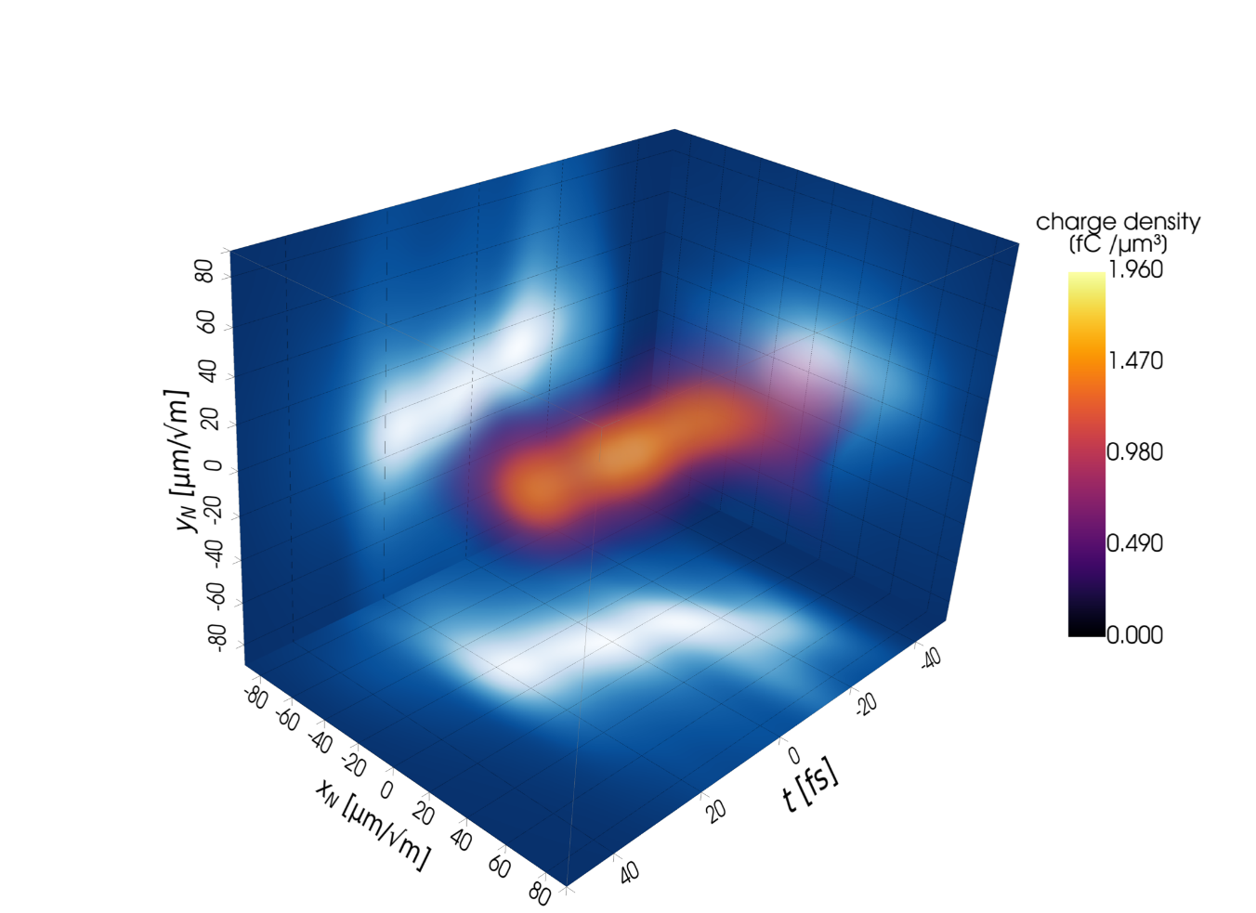
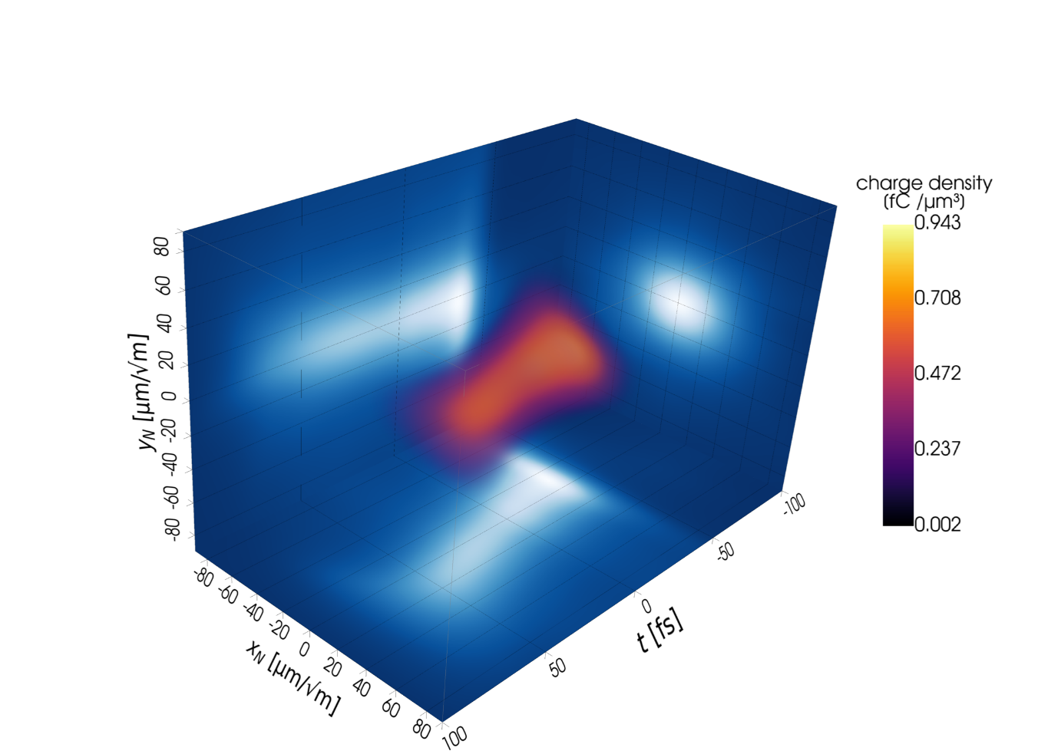
5D tomography method successfully applied at PSI
Two 5D datasets for different beam settings were recorded
Beam 1: Compressed ~56 fs short (FWHM)
Beam 2: Reduced beam tilts, ~103 fs (FWHM)
Preliminary results.
Preliminary results.
For each dataset, we acquired 5 images for each combination of 100 quadrupole settings and 10 polarizations (+unstreaked case) in about 7 hours.
Beam repetition rate: 1 Hz.

Slide 15
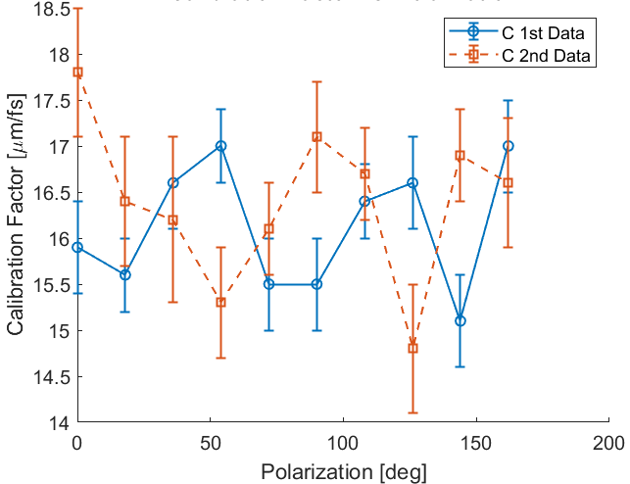
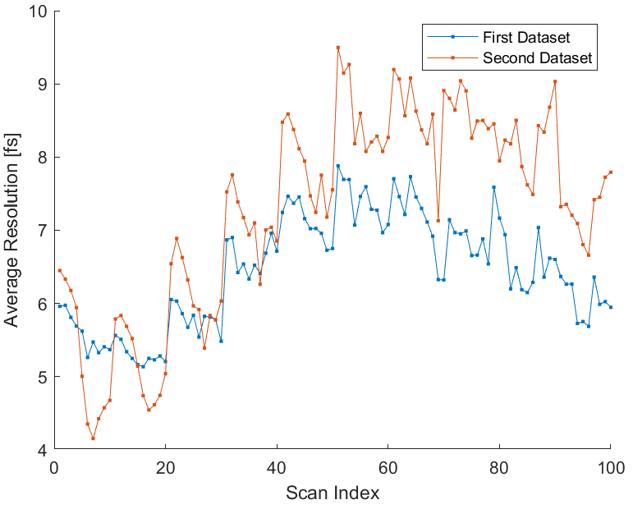


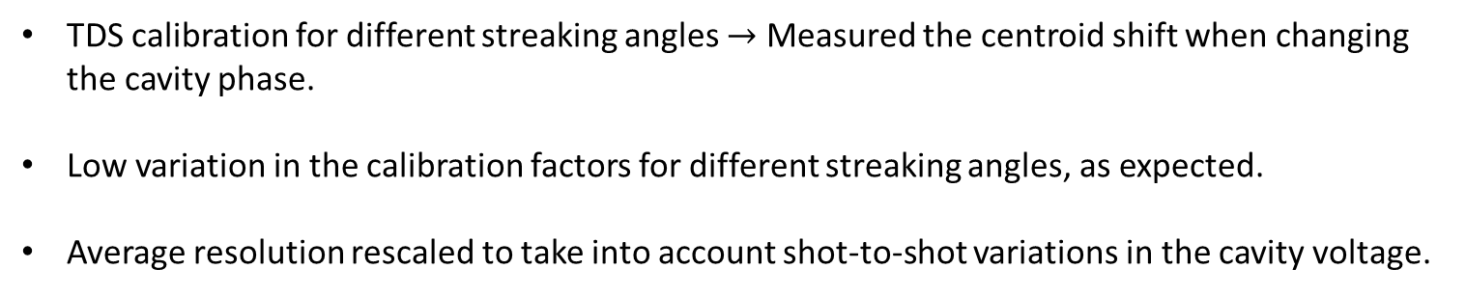
5D Reconstruction: Calibration results
TDS calibration for different streaking angles $→$ Measured the centroid shift when changing the cavity phase.
Low variation in the calibration factors for different streaking angles, as expected.
Average resolution rescaled to take into account shot-to-shot variations in the cavity voltage.
$$C=\frac{eV_{0}L}{E}2πν [μm/fs]$$
$$R_{t}=\frac{σ_{off}}{C}$$

Slide 16
2D projections of the reconstructed phase space of beam 1
Reconstructed 5D distribution reveals beam tilts
Preliminary results.

Slide 17
Reconstruction of beam 2
Relaxing the compression reduced tilts
Preliminary results.

Slide 18
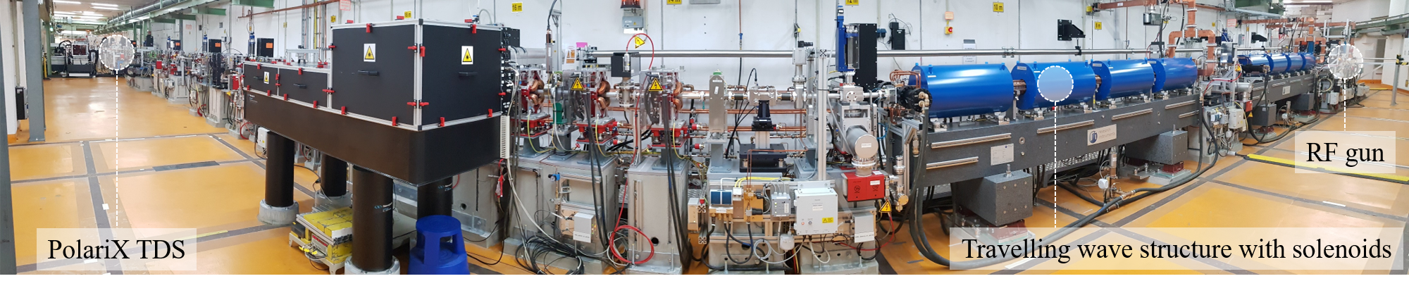
Outlook: PolariX at ARES
Accelerator test facility for novel diagnostics, advanced acceleration schemes, medical applications, …
Designed to produce and characterize bunches of high quality with sub-fs duration.
Applications using sub-pC charge beams.
Drive towards high-precision longitudinal diagnostics, detailed phase-space characterization, and highly sensitive diagnostic tools.
https://ares.desy.de/

Slide 19
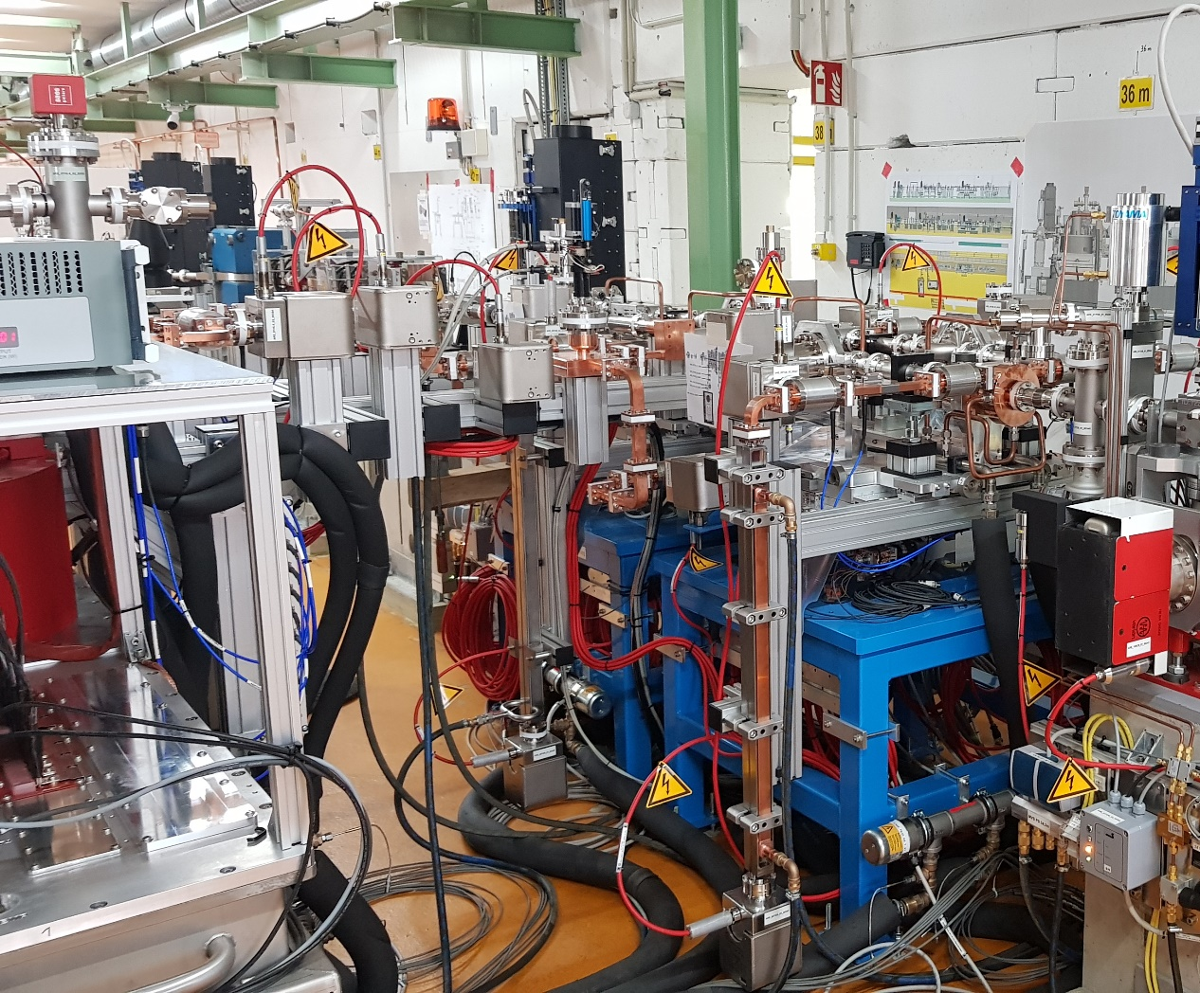
PolariX setup at ARES
Located downstream of first experimental chamber and bunch compressor.
Two PolariX TDSs with independent RF supply.
2 x 6 MW CPI klystrons + 2 BOCs.
Expected longitudinal resolution: ~0.2 fs assuming 20 MV peak voltage for each TDS.
Commissioning is ongoing, and first 3D phase space reconstructions were performed.

Slide 20
Summary and outlook
The first X-band TDS with variable polarization was designed, built, and tested in a joint project between CERN, DESY and PSI.
The variable polarization allows to directly measure various kinds of phase space correlations.
The 5D reconstruction method was successfully demonstrated at 2 facilities (SwissFEL and FLASH), with ARES results expected for 2026.
Disadvantage: long measurement times. Prohibitive for FEL user facilities (except in special machine study time)!
Measurements with the PolariX TDS should be combined with generative machine learning techniques, as demonstrated for example in R. Roussel et al., Phys. Rev. Accel. Beams 27, 094601 (2024).

Slide 21

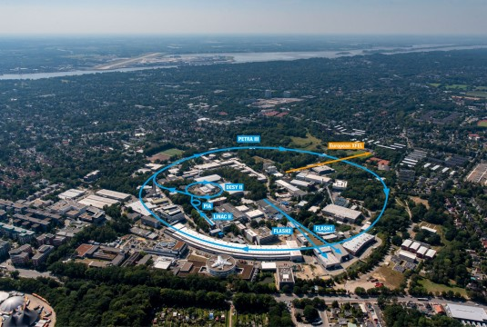
Aknowledgments
S. Jaster-Merz, B. Beutner, R. W. Assmann, J. Beinortaitė, J. Björklund Svensson, R. Brinkmann, F. Burkart, H. Dinter, P. González Caminal, W. Hillert, A. L. Kanekar, M. Kellermeier, W. Kuropka, F. Mayet, J. Osterhoff, B. Stacey, M. Stanitzki, T. Vinatier, S. Wesch, R. D’Arcy (DESY)
Francesco Demurtas, Enrica Chiadroni, Anna Giribono (INFN)
P. Craievich, F. Marcellini, E. Prat, S. Reiche, Z. Geng, E. Ericson, R. Ischebeck (PSI)
PSI , Areal view

