Slide 1
WP9:RF systems power tests and validation
S. Doebert, L. Sito, N. Catalan Lasheras, CERN SY-RF-MKS,
First Annual Meeting, 24-26.3.2026, Lisbon

Slide 2
WP9: Introduction
Goal is to integrate the Klystron (WP6), the Modulator (WP7) and the Pulse Compressor (WP8) into a High-Power RF System and Validate the Performance
Focus of the validation is on high efficiency, power consumption, high average power and repetition rate. Operational stability and reliability.
Demonstrate TRL7 for this x-band RF-system
(System test in operational/relevant environment; in our case the CERN x-band high gradient test facility)
Training of Industry on this system
Maybe we can add an accelerating structure to the final test

Slide 3
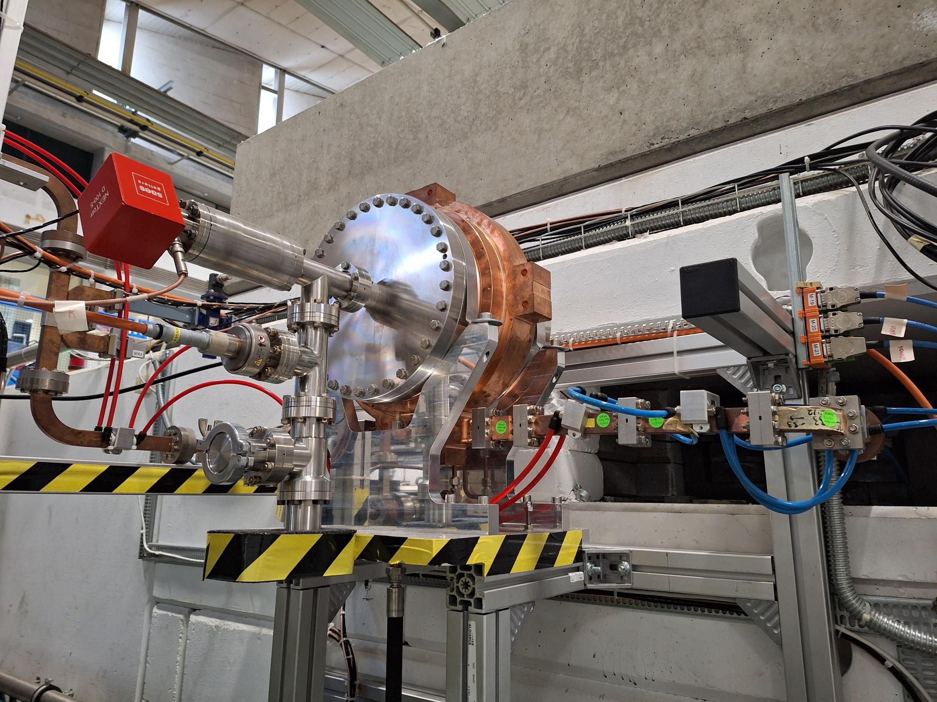
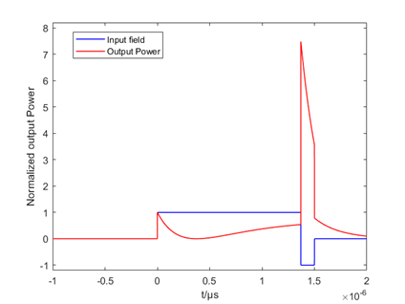
Key specifications
Tentative klystron and modulator parameters
Max. Repetition rate : 500 Hz
Electrical power: ~ 100 kW
Max average RF power: 15 KW
Stability: 24 h without trip ?
BOC-type pulse compressor with 180 deg phase flip and ~ factor 7 power gain
> 175 MW peak power

Slide 4
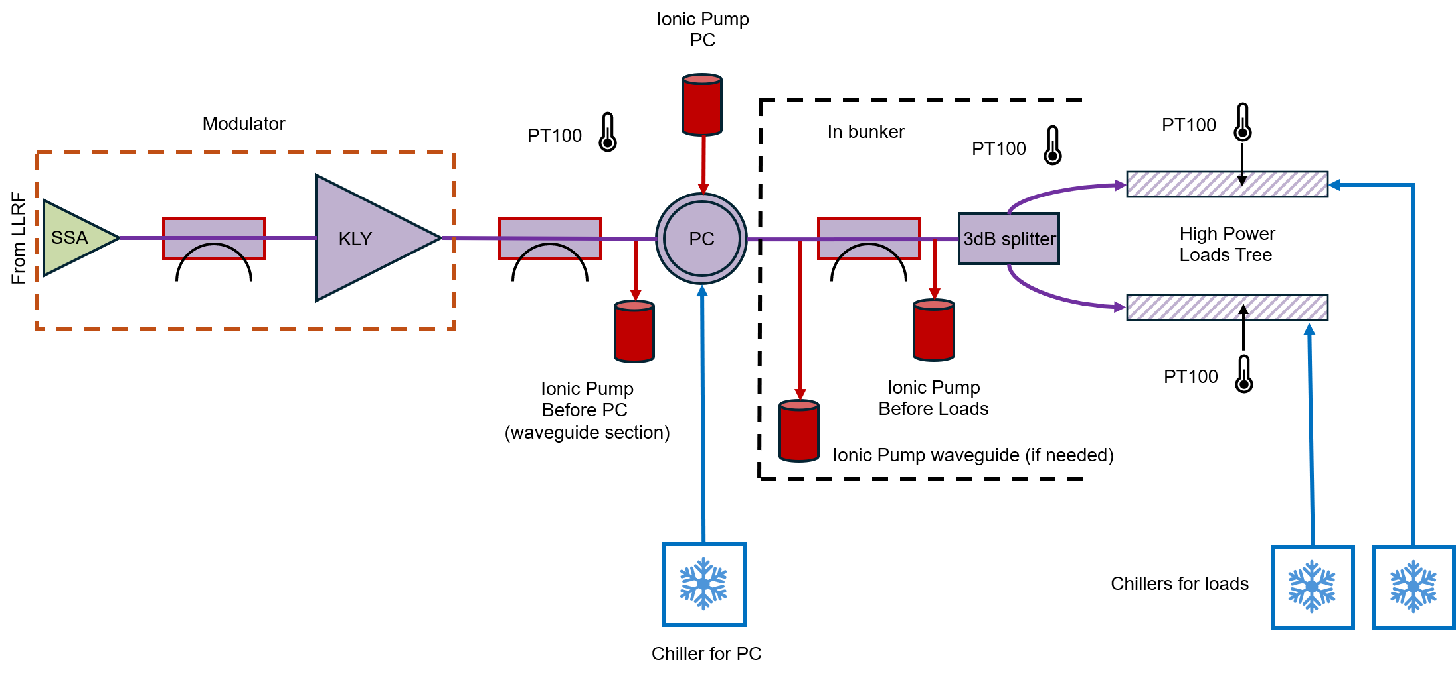
Test area preparation
Items to prepare:
Clean up space for the modulator
Cooling water
Electricity
Pulse compressor integration
Waveguides and Load tree for conditioning
Vacuum system
LLRF
Data ACQ and software:
Vacuum signals, RF signals, temperature measurements,
adapt conditioning algorithm

Slide 5
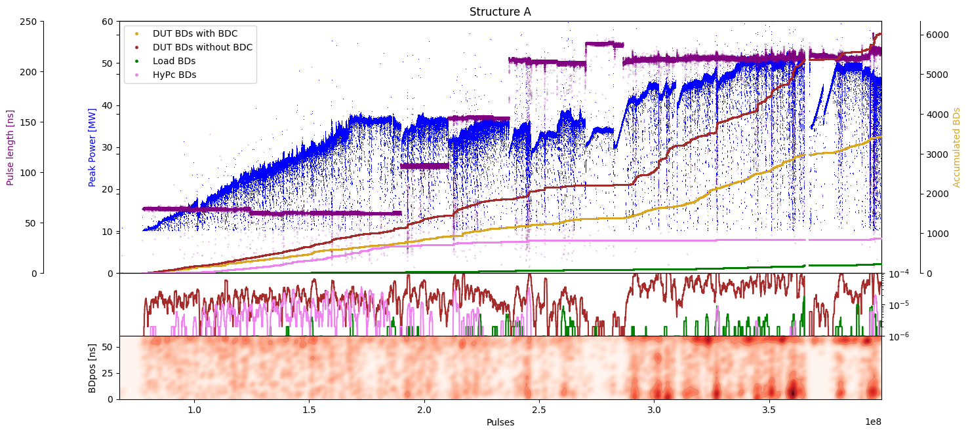
High-Gradient conditioning algorythm
Xbox 2 TD31
TD31N3 conditioning history
Structure A/B 50:50
Structure A 100:1
Achieved unloaded Peak Power 36.1MW
Max. Peak Power achieved 50MW (~80 MV/m)
Paz Alonso Arias

Slide 6
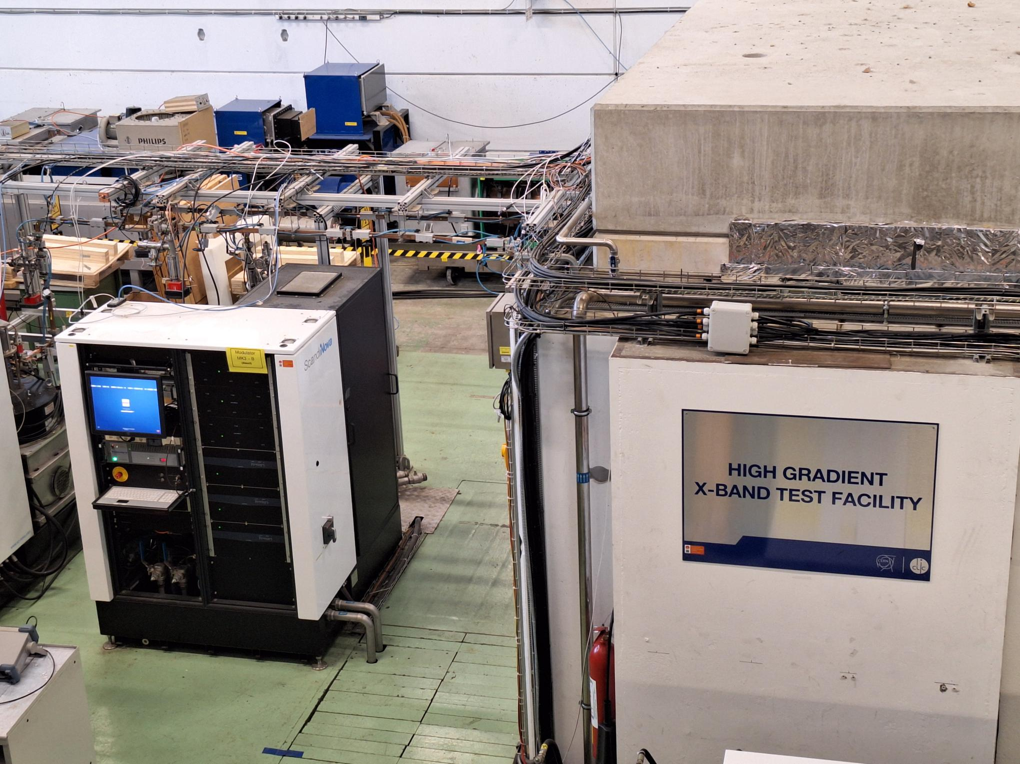
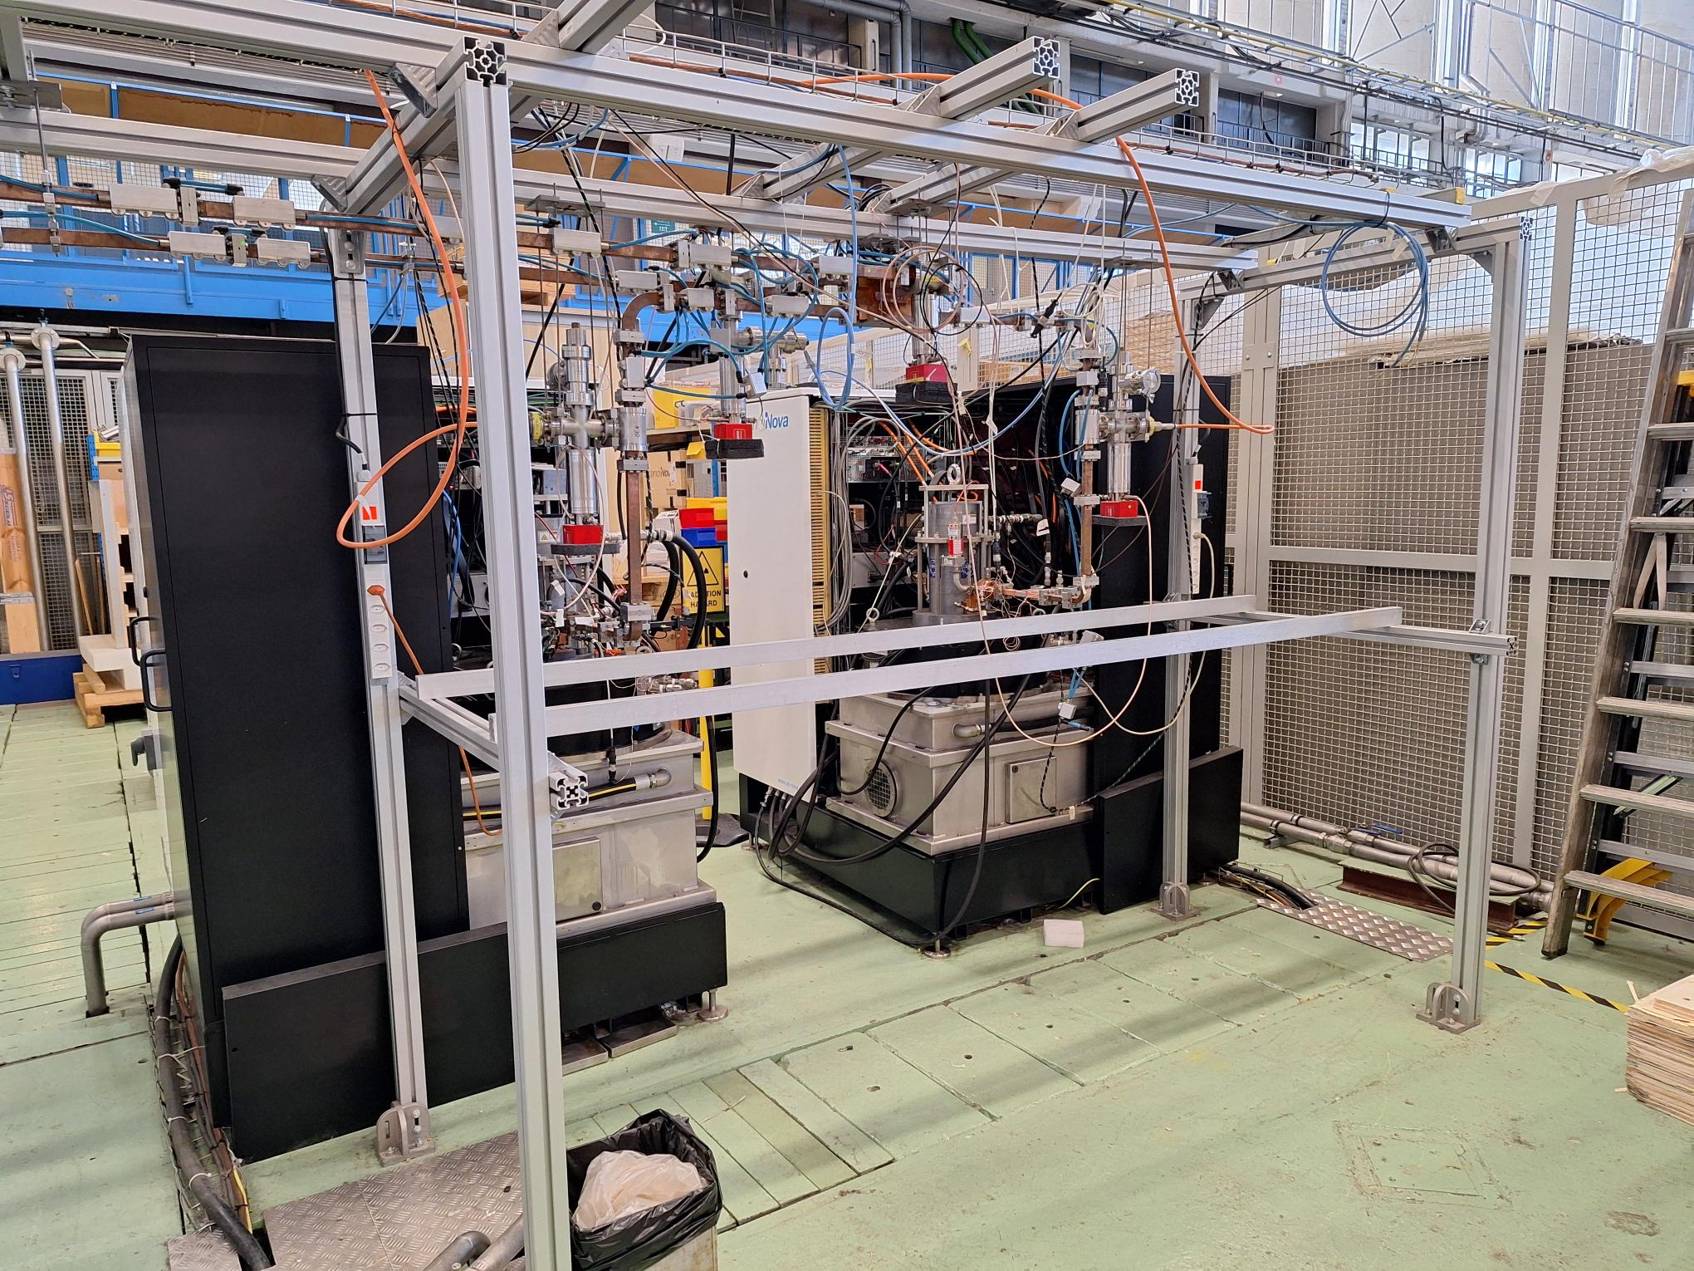
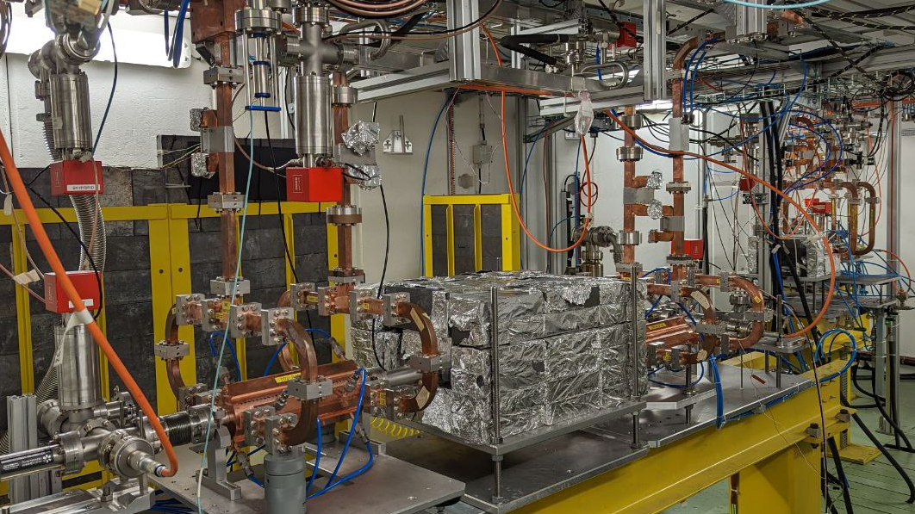
CERN High-Gradient X-band facility
Space for PACRI
Xbox 3
Inside the test bunker

Slide 7
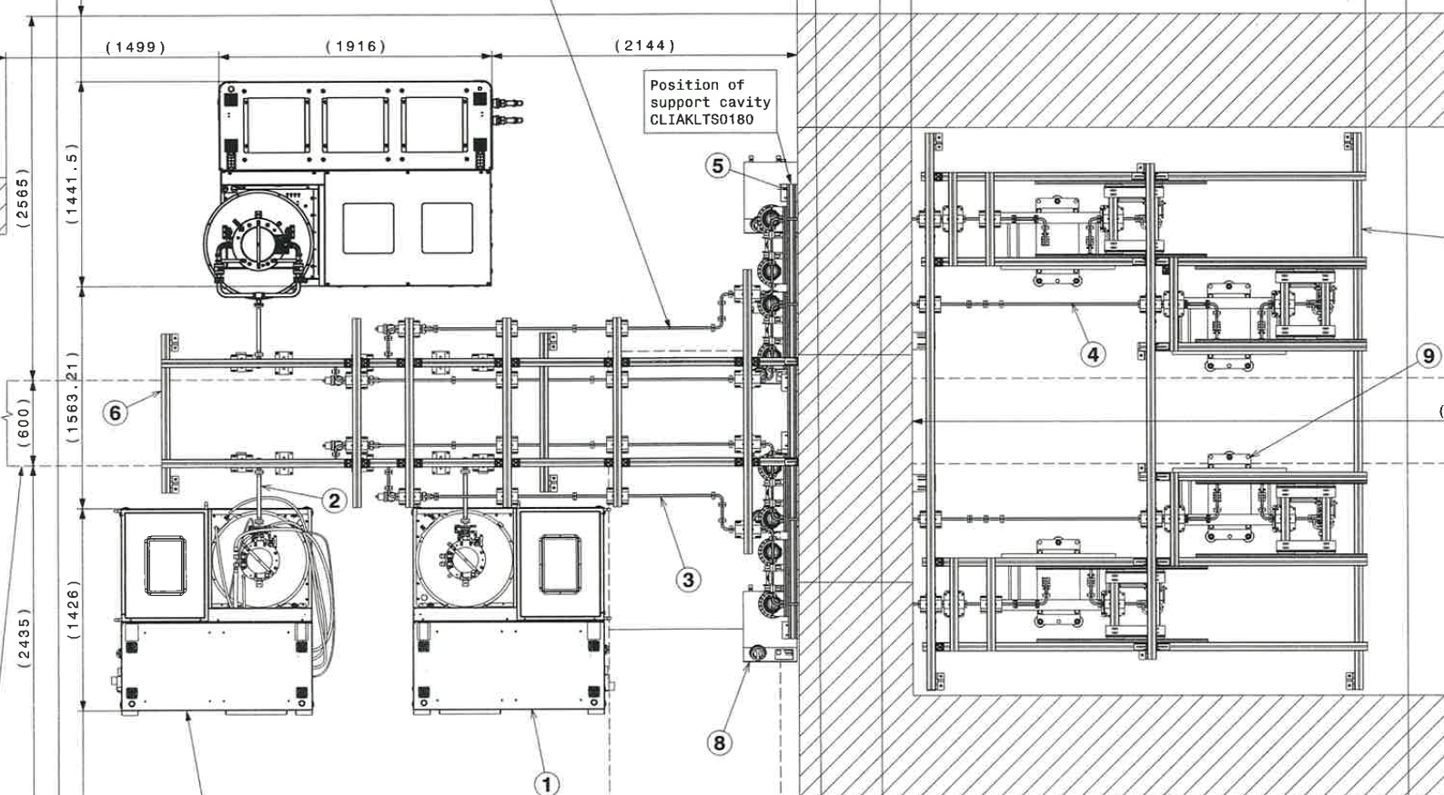
Test area preparation
New Modulator and Klystron
Bunker with loads or accelerating structure
Pulse compressor location
Very preliminary mechanical integration study

Slide 8
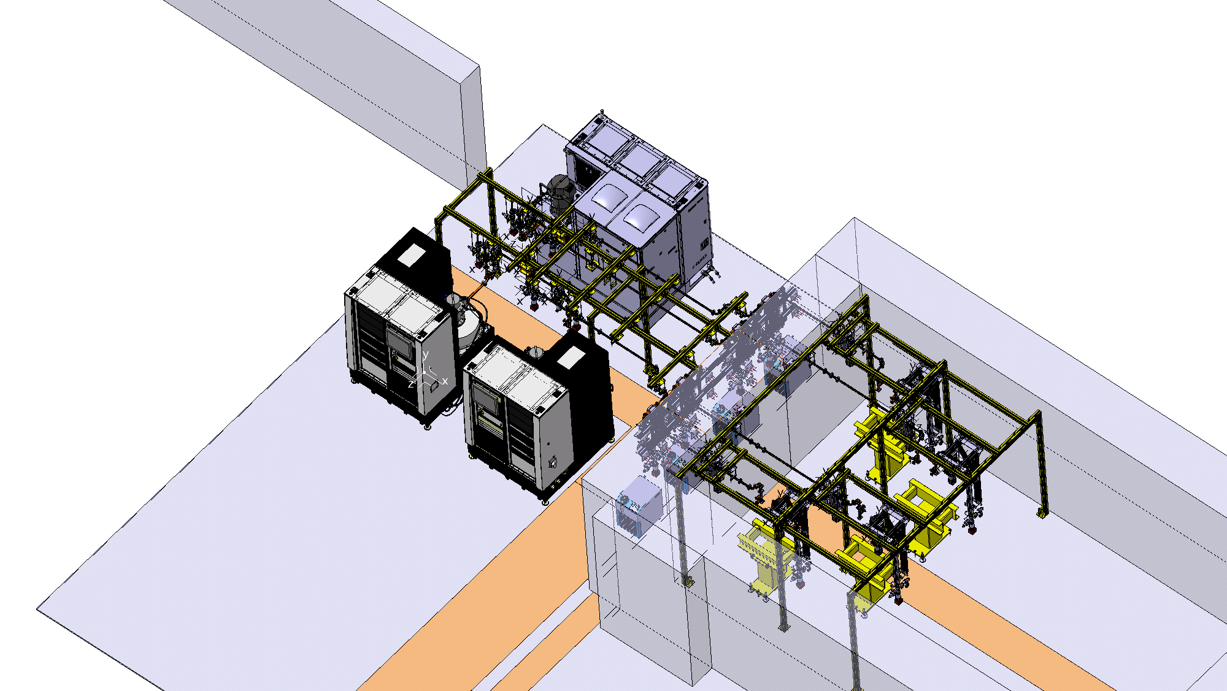
Test area preparation
Very preliminary mechanical integration study

Slide 9
Test program
Phase 1: Equipment reception and verification
Phase 2: Modulator and klystron installation and commissioning
Commission modulator and klystron up to 25 MW
and full repetition rate into a load-tree, calibrations, measure average RF power and power consumption of the whole system, determine efficiencies
Phase 3: Add pulse compressor and final tests
Condition the pulse compressor up to full power and pulse length together with the waveguide systems and the load-tree. Determine system stability and reliability
Phase 4: Bonus: If available maybe split power and add accelerating structure for final demonstration. Not foreseen in the original plan. Which structure could be used ?

Slide 10
System validation and demonstration
How or when do we declare success ?
Full peak and average power out of the klystron with the modulator
Expected efficiencies achieved
Full peak and average power in the pulse compressor
Long term stable operation of the whole system at 90% power ?
No system trips for 24h, 48h, one week ?
Monitor breakdown rates and failure rates, generate statistics
Determine limitations if any

Slide 11
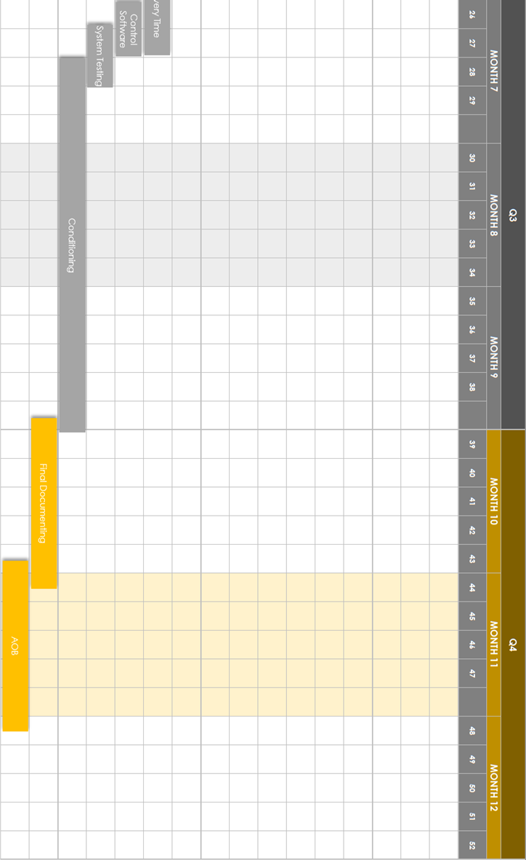
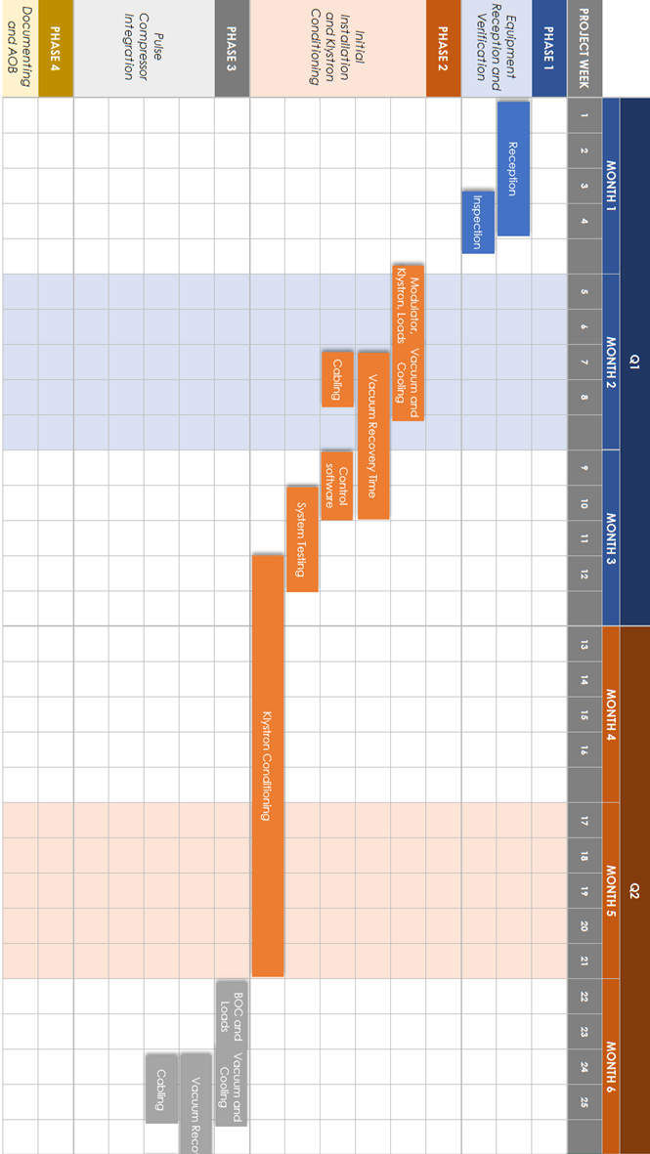
Proposed Timeline
This tentative timeline implies delivery of the equipment ~ September 2027 !
Please check with your own planning

Slide 12
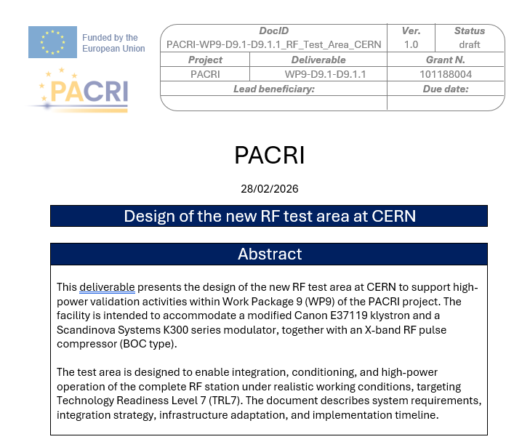
Open Questions and Design Report
Delivery dates of equipment
More detailed specifications
Frequency of the klystron and pulse compressor
Exact validation parameters, scenarios
RI personnel training, how, who, what ?
The draft version of the report can be found on the share point:
PACRI-WP9-D9.1-D9.1.1_Design_RF_test_area_CERN_Preliminary.docx

Slide 13
Conclusions
Using the existing x-band high power test stand at CERN for PACRI
is feasible
Some modifications and adaptations are needed but clearly manageable within the foreseen preparation time
Expect to be ready to receive the klystron, modulator and pulse compressor late 2027
Postdoc hired and already working on the project
Leonardo Sito !

