Slide 1
WP12 – High Repetition Rate pump sources for laser drivers
Presented by Tyler Green (ELI ERIC)
Annual meeting Lisbon 2026-03-25

Slide 2
Goal and participants of WP12
Investigate DPSSL pump lasers for pumping high average power short pulse amplifiers – Investigate requirements for DPSSL pump lasers for pumping high average power Ti:Sapphire or OPCPA- based systems
Task | Task leader
12.1 Implement improvements to DUHA pump laser for increased average power | ELI ERIC
12.2 Evaluation of optical coatings in high average power, high energy systems | ELI ERIC
12.3 Investigate an OPCPA amplifier at 100 Hz | UKRI, ELI ERIC
12.4 Diode laser pump unit design for 20…100 Hz implementation | FBH, ELI ERIC

Slide 3
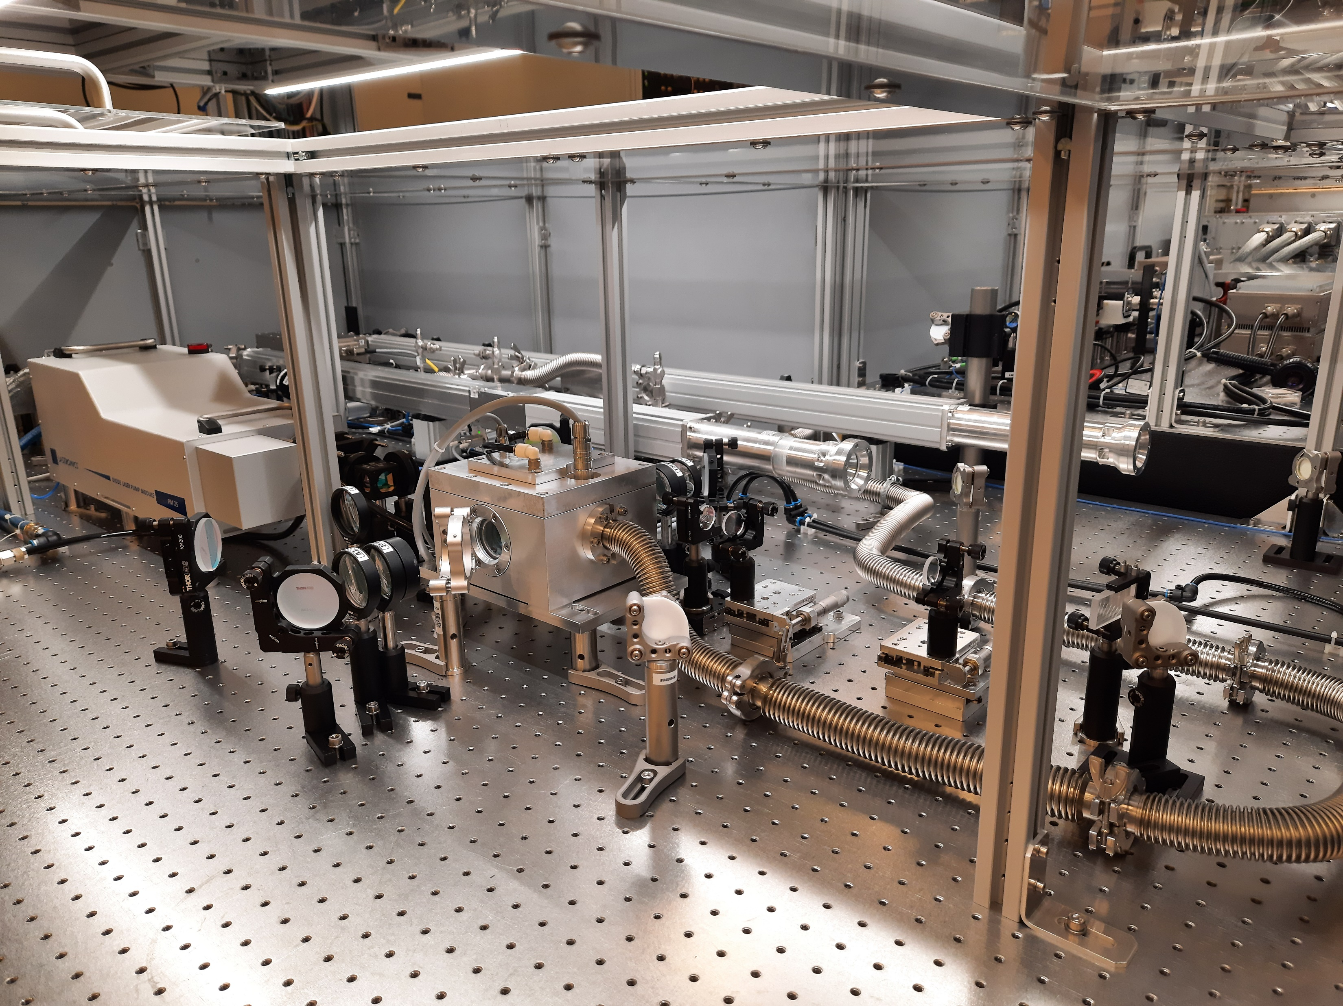
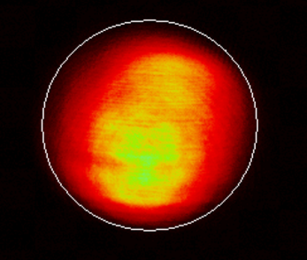

Task 12.1 – Improvements to L2-DUHA pump laser
L2 front end improvements:
Enhanced contrast with fast Pockels cells on input beam
Fiber pulse temporal shaper optimization
Booster profile improvements (100mJ, 300mJ capable):
Pi-shaper implemented on booster input
Current profile is not uniform super-Gaussian and mid-frequency modulations present
Long term solution spatial light modulator solution in progress

Slide 4
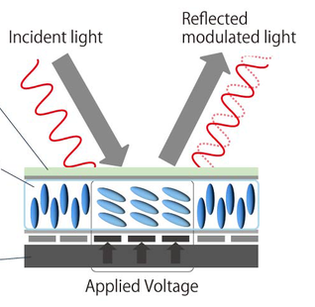
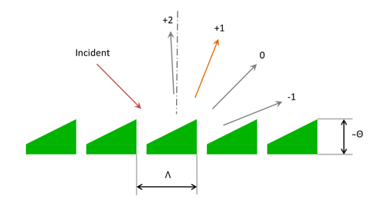
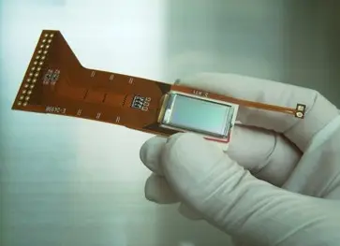

Task 12.1 – Improvements to L2-DUHA pump laser
Long term outlook for profile uniformity:
Implement spatial light modulator amplitude/wavefront modulator to compensate mid-spatial frequency modulations
Principle of modulation is a matrix of macro-pixels each of which imparts phase profile of blazed grating on the beam
T. Paliesek el al. High Power Laser Science and Engineering 11 (2023) 1-9
Pictures: https://aoc.santec.com/en/knowledge/SLMblog1/

Slide 5
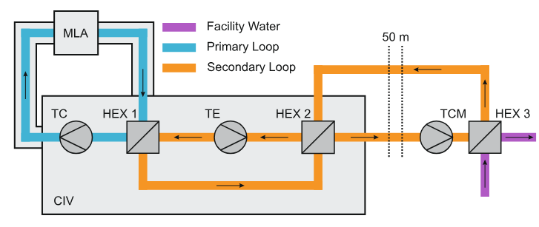
Task 12.1 – Improvements to L2-DUHA pump laser
Cryogenic cooling loop running at full pressure (high pressure was causing technical errors on the side of the cool for a significant part of 2025)
Flow currently limited to 36 g/s (target 160 g/s) addition of second TCM motor planned in May

Slide 6
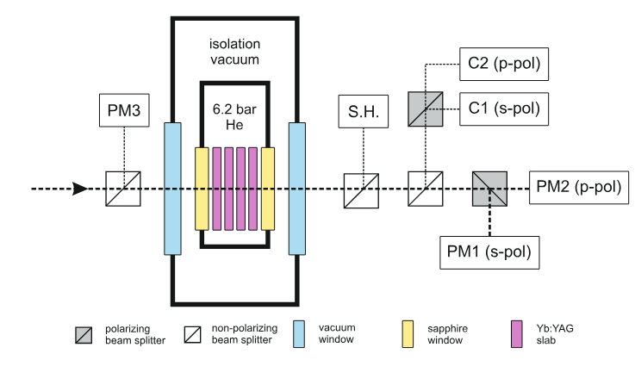
Task 12.1 – Improvements to L2-DUHA pump laser
Tests carried out at current status of cryogenic cooler.
Transmission
Depolarization
Wavefront deformation
SSG

Slide 7
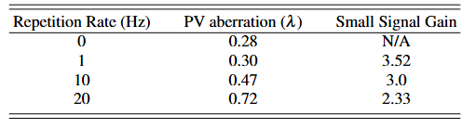
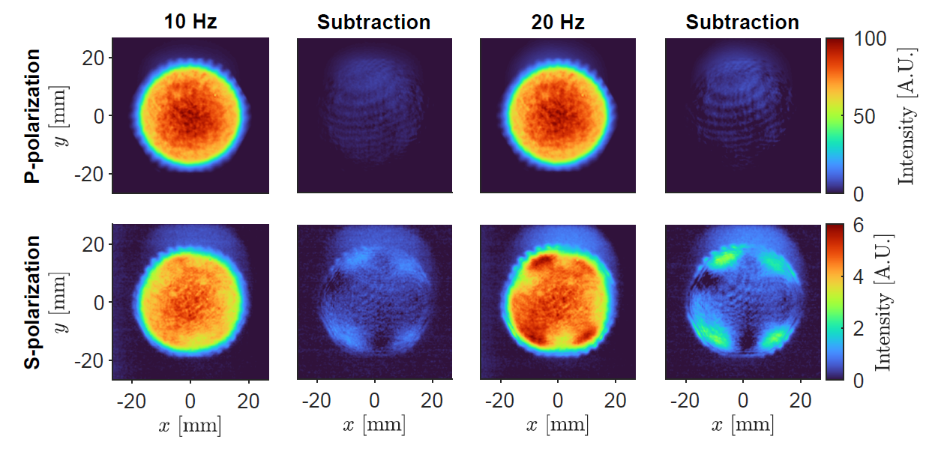
Task 12.1 – Improvements to L2-DUHA pump laser
Cryogenic cooler is running since December. Current mass flow rate 36 g/s, installation of second turbo-compressor scheduled for May will increase to 160 g/s. At current flow, depolarization visible at 10-20 Hz repetition rate.

Slide 8
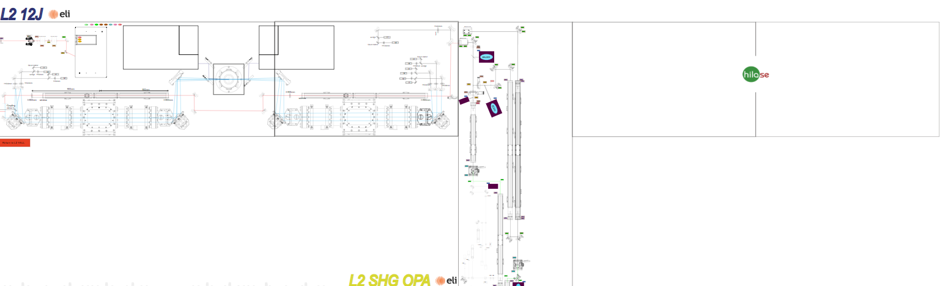
Task 12.2 – Evaluation of optical coatings for pump lasers
LIDT setup installed in L2 for evaluation pump laser coatings (first WP12 milestone)
LIDT testing station

Slide 9
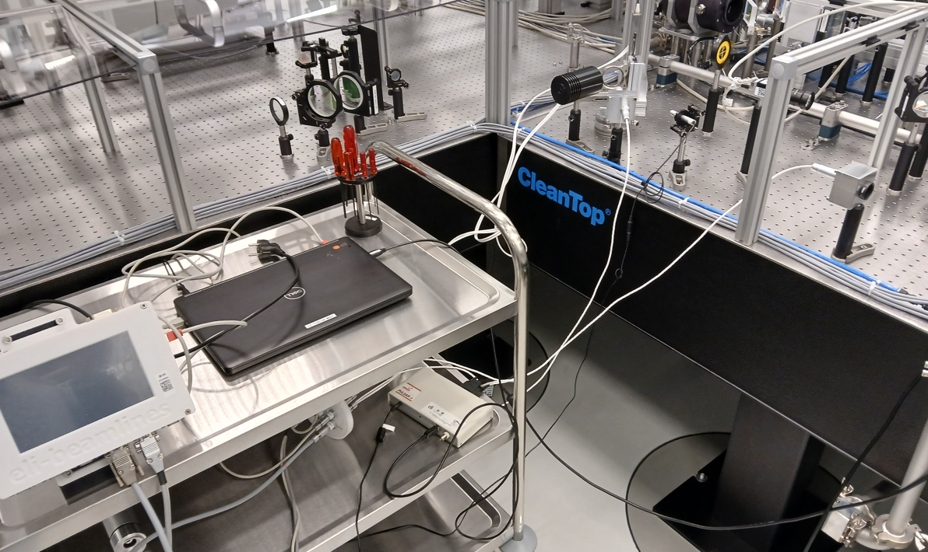
Task 12.2 – Evaluation of optical coatings for pump lasers
LIDT setup installed in L2 for evaluation pump laser coatings (first WP12 milestone)
LIDT station installed between L2-DUHA pump laser and KAZI laser (DiPOLE100)
First tests expected to be using the L2 front end (100mJ-level testing) follow up tests can use KAZI.
Milestone 11, Month 12: High power, high energy LIDT station constructed and test plan prepared.

Slide 10
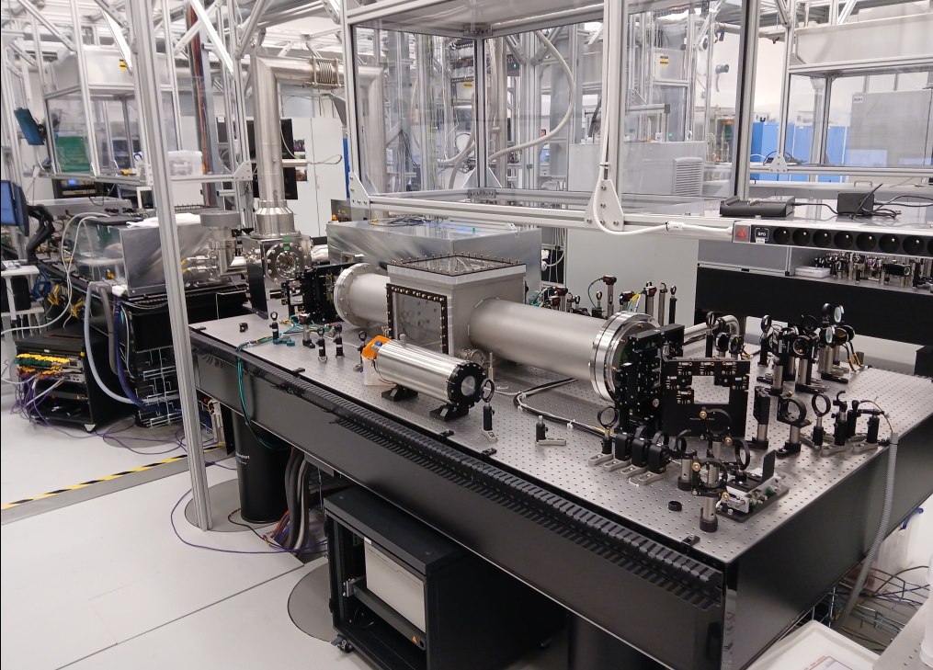
Task 12.2 – Evaluation of optical coatings for pump lasers
KAZI Laser (DiPOLE100)
Long term goals to be integrated into the driver laser for EuPRAXIA as a pump laser.
Current plans to support EuPRAXIA-related R&D
High performance coating characterization
High Power pumping of short pulse lasers R&D

Slide 11
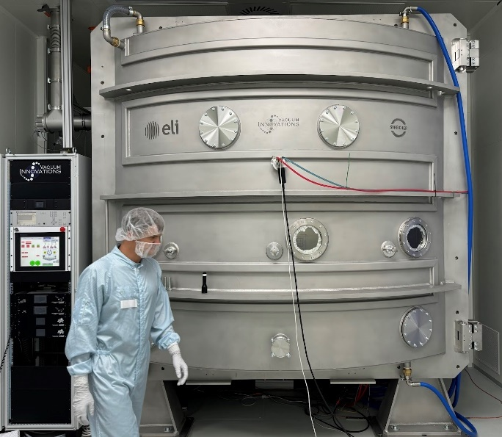
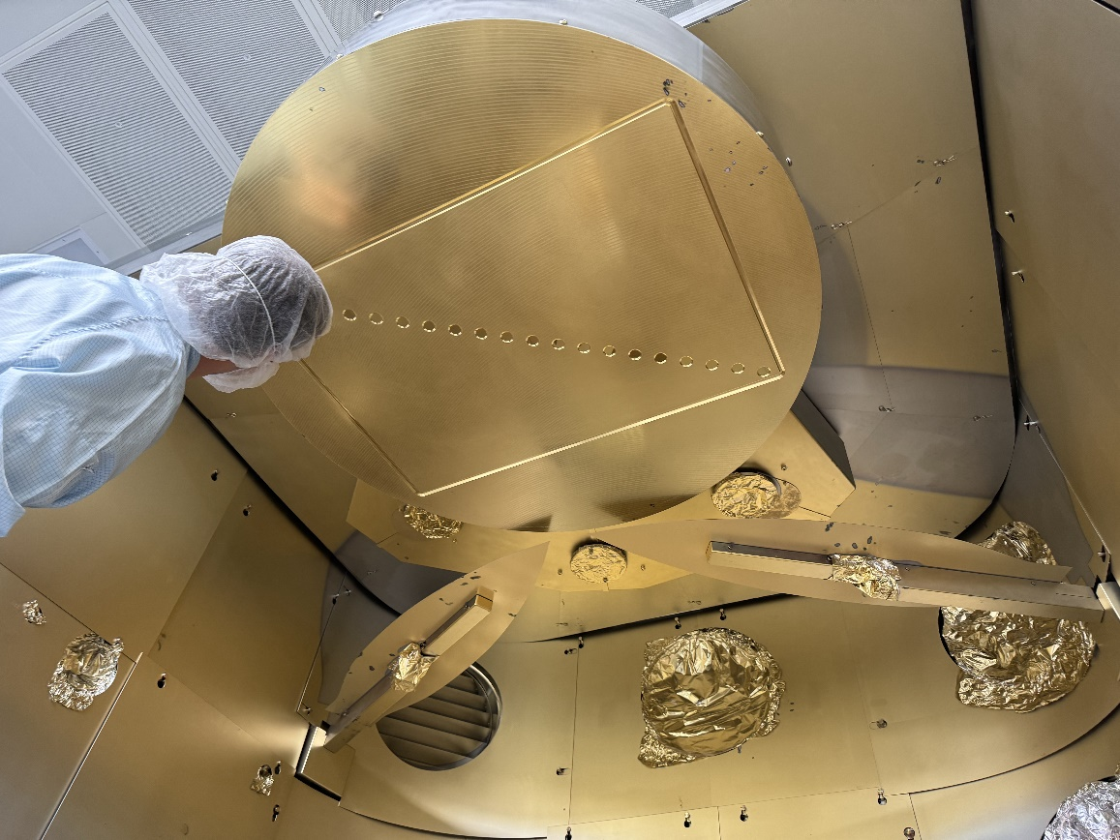
Task 12.2 – Evaluation of optical coatings for pump lasers
High energy optical coatings to be produced at 1030nm, 515nm, and low GDD 820nm-centered
To be tested in L2 hall
Coating development (THRILL)
Metallic HR – first samples OK
Low GDD dielectric HR 1060nm, 800nm
MLD “grating” HR 1060nm
AR and GLAD coatings (~500mm)
LIDT fs testing in ELI-BL (upgraded)
10g of Au
1200mm

Slide 12
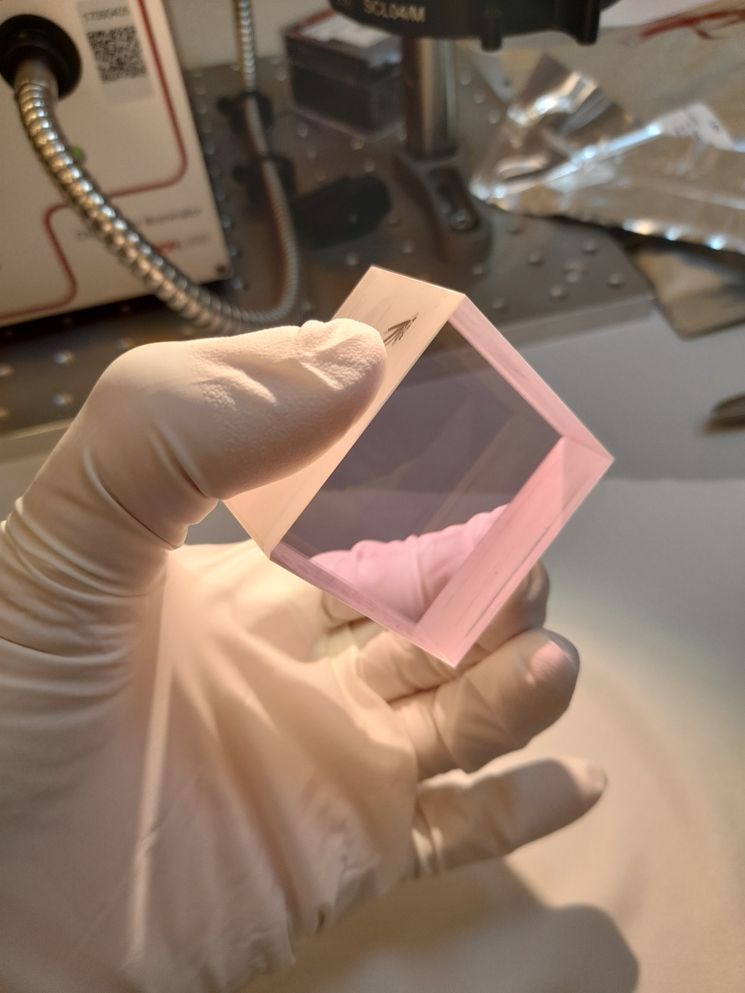
Task 12.3 – 100 Hz OPCPA
Summary: Investigate an OPCPA amplifier at 100 Hz. Model the feasibility of using the DPSSL technology for pumping an OPCPA architecture as a driver for high energy pulses for LWFA.
UKRI leading this and currently waiting for input from ELI ERIC.
(Milestone 16, Month 18: Analysis of pump performance requirements
for pumping OPCPA completed)

Slide 13
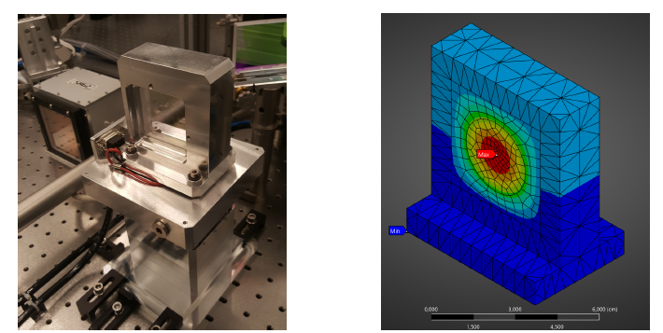
Task 12.3 – 100 Hz OPCPA
Modelling work underway to evaluate performance of OPCPA crystals under kW-level pumping conditions. Goal is to have OPCPA model and tolerances for pump laser to pass to UKRI this summer

Slide 14
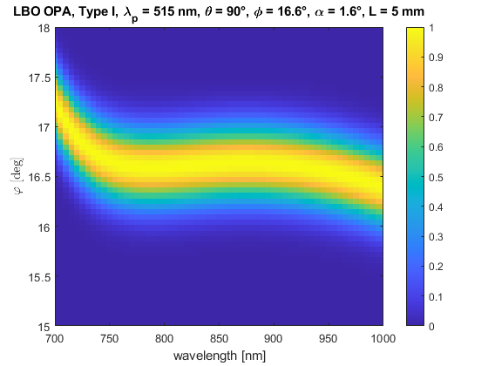
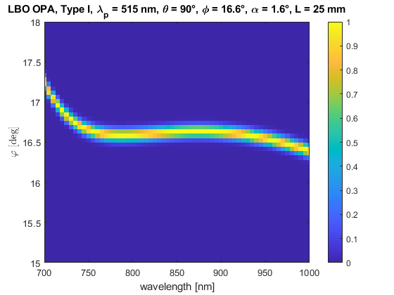
Task 12.3 – 100 Hz OPCPA
Phase matching becomes more sensitive for longer crystals (like those needed for ns amplification)
Length: 5 mm
Length: 25 mm

Slide 15
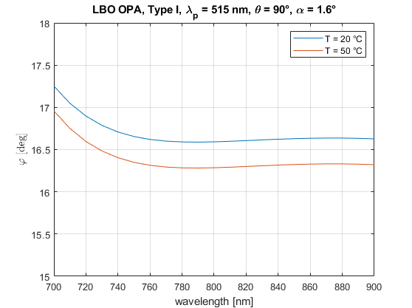
Task 12.3 – 100 Hz OPCPA
Temperature dependence from heating under high power conditions may impact spatial uniformity of amplification and amplified spectrum

Slide 16
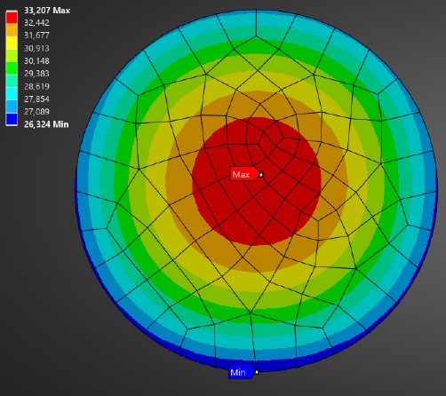
Task 12.3 – 100 Hz OPCPA
Reported values of absorption in LBO at 515nm vary widely (often over an order of magnitude) which can have a significant impact on the amplification simulations and the temperature gradients in the crystal.
We would like to perform measurements of amplifier performance and also direct measurements of the crystals we currently have using photothermal common path interferometer (PCI)

Slide 17
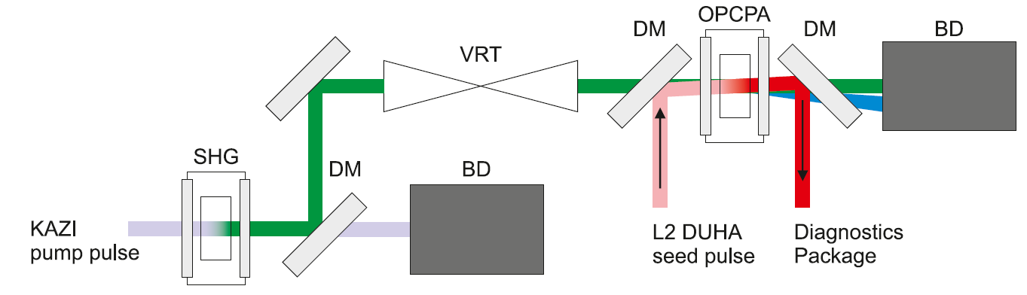
Task 12.3 – 100 Hz OPCPA
Verify with experiment
Verify coatings with PCI to measure absorption
Produce (in house) and characterize DMs which is relevant for Ti:Sapphire and OPCPA and part of Task 12.2

Slide 18
Task 12.4 – Laser Diode pump design
Summary: Diode laser pump unit design for 20…100Hz implementation for EuPRAXIA second site.
Consider Diode requirements for Phase II EuPRAXIA goals (800 TW, 100 Hz)
Goal: from perspective of current diode technology, compare what pumping requirements for various DPSSL materials. Considered DPSSL materials Nd:glass, Yb:YAG, and Tm:YLF.
Other factors such as suitability of gain crystals, target considerations etc aren’t considered here.

Slide 19
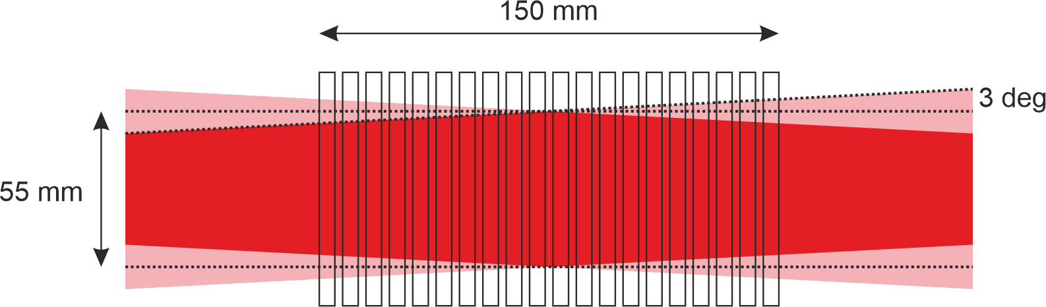
Task 12.4 – Laser Diode pump design
Diode pumping requirements for EuPRAXIA Phase II (800 TW, 100 Hz)
Consider diode pumped solid state laser in following dual head configuration for all gain media

Slide 20
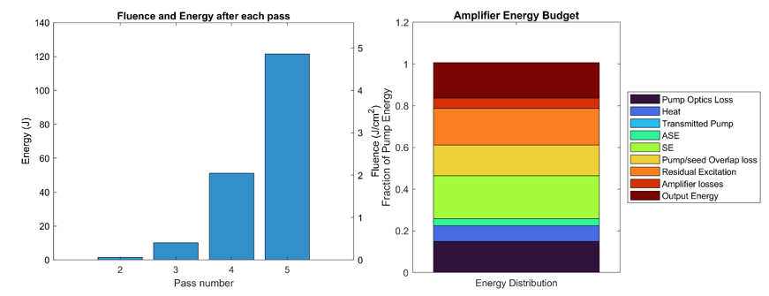
Task 12.4 – Laser Diode pump design
Initial Multipass model (for Nd:glass and Yb:YAG) included ASE, SE, Pump/seed overlap losses, optical transport losses
Maximum of 4 passes through the dual head amplifier and input energy of 200mJ
Example output for Yb:YAG
Tm:YLF not modelled due to different pumping dynamics, but parameters taken from SPIE proceeding based on analysis from Livermore (Galvin et al).
Galvin, et al, Proc. SPIE 11033 (2019)

Slide 21
Task 12.4 – Laser Diode pump design
Parameter (Yb:YAG specific) | Desired value (description)
Nominal Pulsed Peak Power at final image plane (kW) | ≥ 230
Pulse Duration (ms) | 0.66 nominal
Diode requirements provided to FBH by ELI to initiate TDR process.
Milestone 27, Month 24, Diode pump requirements clarified with selected EuPRAXIA second site (FBH/second site host)
Paramter (Nd:glass specific) | Desired value (description)
Nominal Pulsed Peak Power at final image plane (kW) | ≥ 610
Pulse Duration (ms) | 0.3 nominal
Parameter (Yb:YAG specific) | Desired value (description)
Nominal Pulsed Peak Power at final image plane (kW) | ≥ 139
Pulse Duration (ms) | CW
Galvin, et al, Proc. SPIE 11033 (2019)

Slide 22
Conclusion
Task 12.1 - Amplification at high energies underway for pump laser and troubleshooting of profile deformations ongoing. Long term plan of implementing spatial light modulator amplitude modulator in process for spatial, and potentially wavefront corrections.
Task 12.2 - LIDT station installed in L2 hall which can utilized L2 pump laser or KAZI laser for testing. Cooperating with optical coatings team to produce and characterize in-house optics optimized for high average power nanosecond pulse trains and dichroic low GDD elements. 1 Milestone Complete
Task 12.3 - UKRI awaiting input from ELI regarding pump laser requirements for OPCPA. ELI is currently preparing these requirements and developing model for this task. ELI also intends to proceed in using KAZI for measurements of high average power, Joule-class OPCPA head. 1 Milestone upcoming and in process
Task 12.4 – Specifications for diode requirements for multiple laser archetypes passed from ELI to FBH. FBH preparing call for proposals for TDR preparation currently. 1 Milestone Complete

