Slide 1
WP13 – Modelling of thermal load impact on grating under vacuum and validation with existing systems
Presented by Adeline Kabacinski (THALES) and Luca Labate (CNR-INO)
Annual meeting Lisbonne 2026-03-25

Slide 2
Goal and participants of WP13
Prototype of high average power optical compressor - Develop technology for high repetition rate, high average power optical compressor for Chirped Pulse Amplification lasers using advanced grating technology and implementing control of heat load effects on compressor gratings to ensure beam quality at the laser focus
Participant | Contact | Person-Months
THALES LAS (WP leader) | Christophe Simon-Boisson Olivier Chalus Adeline Kabacinski | 12
CNR (WP deputy leader) | Luca Labate Mohamed Ezzat | 12
UKRI | Mariastefania De Vido | 8
CLPU | Mauricio Rico Cruz Mendez | 5
Amplitude | Antoine Courjaud | 3
Total |  | 40

Slide 3
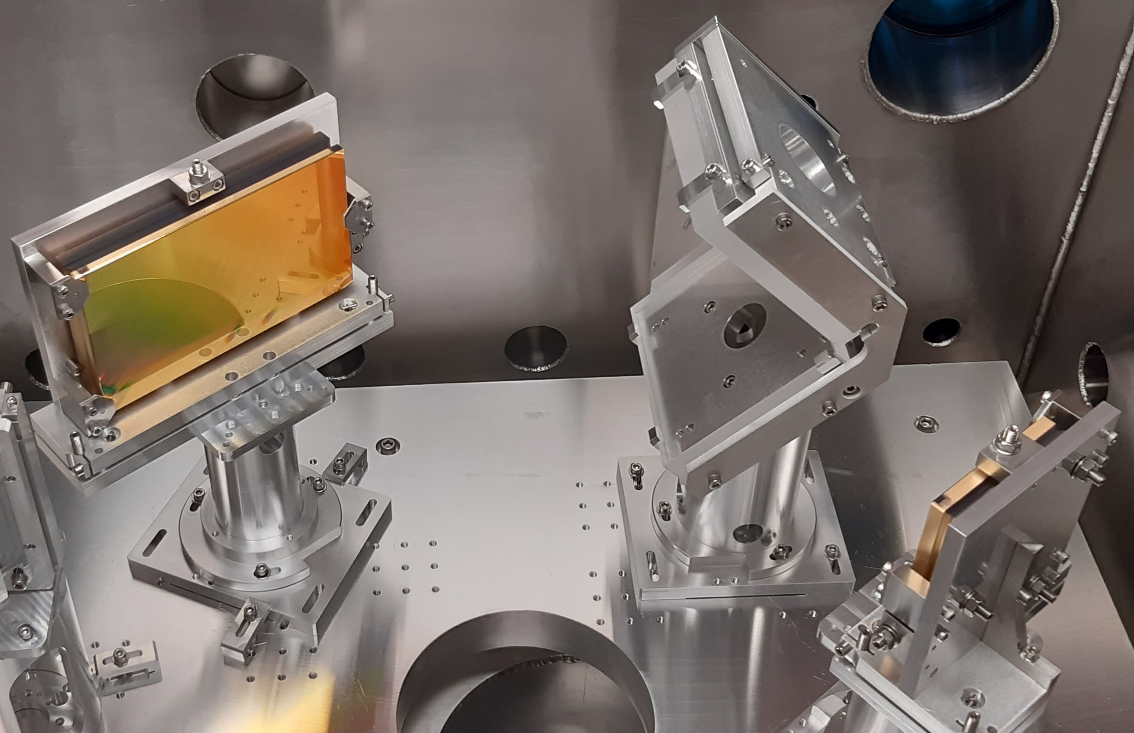

Thermal load in the compressor
Ultrashort pulses (< 25 fs) are needed to reach the on-target intensities required for LWFA
Ti:Sa based CPA exploit the broad amplification of Ti:Sa to produce those pulses
All elements in the laser chain must preserve this wide bandwidth
Current technology for the compressor : gold coated reflective gratings exhibiting wide bandwidth (Δλ > 100 nm)
Unfortunately, gold layer absorbs 4 % of radiation at 800 nm : at high average power, important heat load of grating surface
Compression performed under vacuum : no natural heat removal
2 major risks :
Wavefront deformation
Temperature of the gratings > damage threshold

Slide 4
Strategies to manage thermal load in the compressor
Active cooling of gratings
Can efficiently remove heat and stabilize temperature
Still high heat load and potential surface deformation due to high absorption (4%)
Complex implementation
MLD gratings
Low absorption (<0.5%) i.e. low heat load of the grating
Better diffraction efficiency than gold gratings : up to 99%
Limited bandwidth (≈ 90 nm)
Complex implementation : out of plane configuration
In the end, the choice of the strategy to manage thermal load in the compressor mainly depends on the input average power and on the targeted pulse duration.

Slide 5
Laser requirements for Eupraxia
Phase 1 : 1 GeV electrons
Pulse energy on target : > 5J i.e. 6.1 J to 7.3 J at compressor input (depending on considered diffraction efficiency)
Pulse duration : > 25 fs to 40 – 50 fs
Repetition rate : 20 → 50 → 100 Hz
Phase 2 : 5 GeV electrons
Pulse energy on target : 10 – 30 J i.e. 36.8 J to 43.7 J at compressor input (depending on considered diffraction efficiency)
Pulse duration : 50 – 100 fs
Repetition rate : 20 → 50 → 100 Hz
 | Phase 1 On target : 5 J / 100 Hz | Phase 2 On target : 30 J / 100 Hz
Incident power on P1 (gold gratings, diff eff = 91%) | 7.3 J at 100 Hz 730 W | 43.7 J at 100 Hz 4370 W
Absorbed power on P1 (gold gratings, abs = 4%) | 29 W | 175 W
Incident power on P1 (dielectric gratings, diff eff = 95%) | 6.1 J at 100 Hz 610 W | 36.8 J at 100 Hz 3680 W
Absorbed power on P1 (dielectric gratings, abs = 0.5%) | 3 W | 18 W

Slide 6
Tasks and deliverables
Task 13.1 : Modelling of thermal load impact on grating under vacuum and validation with existing systems. The goal of this task is to develop a robust modelling tool for compressor design under vacuum
Task 13.2 : Experimental characterization of dielectric grating samples with density power compatible with kW beamline. The goal of this task is to measure diffraction efficiency on 750 – 850 nm bandwidth, grating distortion and temperature increase under vacuum with density power compatible with kW beamline and LIDT in ps and fs regime for dielectric grating designed for 800 nm system
Task 13.3 : Compressor design based on dielectric grating technology for kW beamline. The goal of this task is to propose a full compressor design, using dielectric gratings, suitable to compress kW beamline envisaged for EuPRAXIA infrastructure
Task | Due Date | Deliverable
13.1 | 24 months (February 2027) | Sensitive report : report on modelling and validation
13.2 | 36 months (February 2028) | Sensitive report : report on characterization of dielectric grating at kW power level
13.3 | 48 months (February 2029) | Public report : report on design of dielectric gratings based compressor for kW beamline

Slide 7
Task 13.1
Task 13.1 : Modelling of thermal load impact on grating under vacuum and validation with existing systems
24 months
Simulations :
Develop a numerical model to simulate thermal load impact on a grating under vacuum (different codes / approaches to confront results) : CNR : academic free access code / CLPU : ANSYS code
Available simulations performed by THALES for 300 mJ and 1.5 J / 100 Hz systems, can be used to cross validate numerical models
Perform simulations for PACRI parameters : CNR / CLPU
Experiments :
Perform temperature and wavefront deformation measurements at 1.5 J / 100 Hz, gold coated gratings with low expansion substrate and active cooling : CNR and THALES
Perform temperature and deformation measurements of a MLD grating under vacuum + low thermal load : THALES / Amplitude (see task 13.2)
Perform temperature and deformation measurements of a grating under vacuum + high thermal load : UKRI
Compare experimental and numerical results : ALL

Slide 8

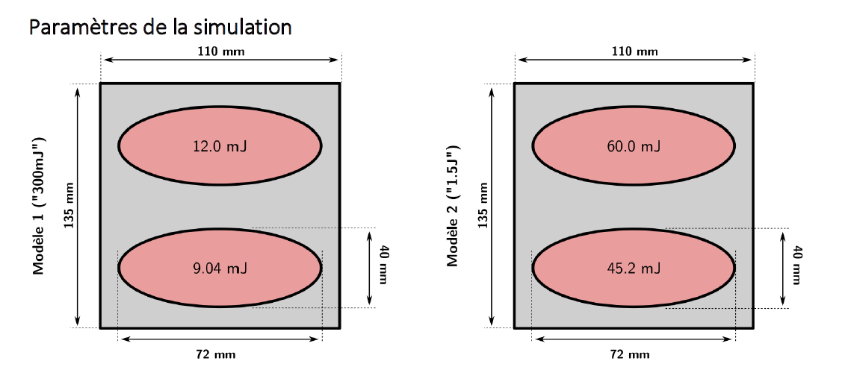

THALES numerical results
ANSYS simulations
Compressor with 2 gratings, 2 passes per grating (grating 1 : P1 and P4, grating 2 : P2 and P3)
Simulations performed for grating 1 only (limiting in terms of average power)
Grating parameters :
Substrate material : low expansion substrate
Coating : gold, considered absorption @ 800 nm = 4%
Considered diffraction efficiency : 91%
Size : 135 mm x 110 mm x 20 mm
Beam parameters :
Energy at the compressor input : 2 levels, 300 mJ / 1.5 J
Repetition rate : 100 Hz → 30 W / 150 W in input
Beam size : determined to limit fluence < 0.1 J/cm² for 1.5 J level, 40 mm in height, 72 mm in width (projection of 40 mm at AOI)
E_{abs_P1}= energy absorbed on P1
E_{abs_P4} = E_{abs_P1} * diff_eff^3

Slide 9
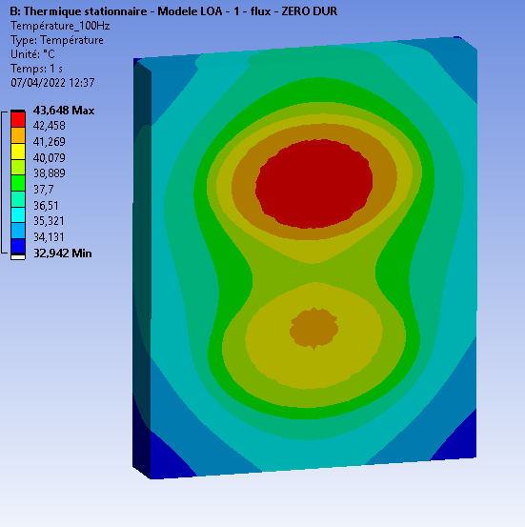
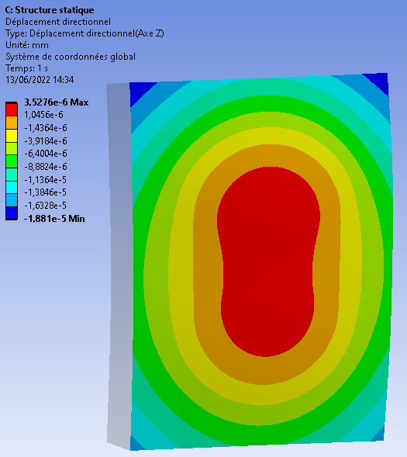
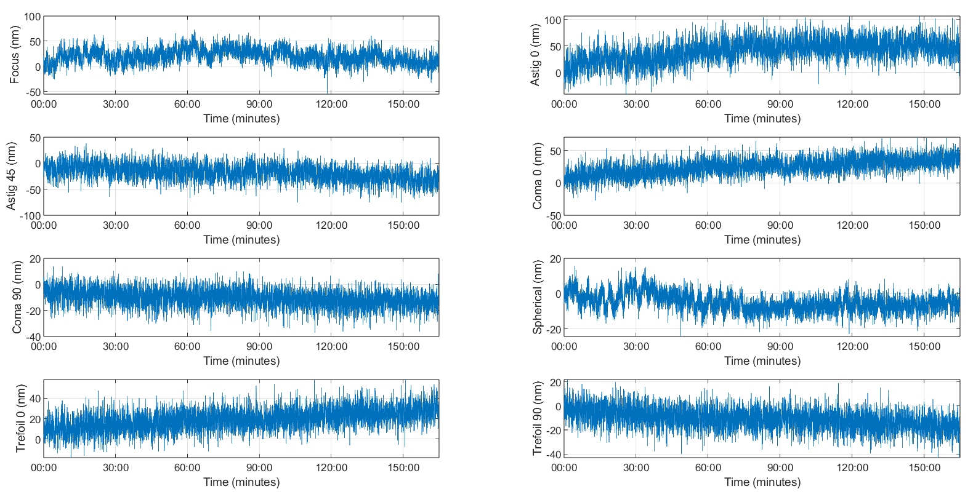
THALES results : 300 mJ / 100 Hz
Simulations at 300 mJ / 100 Hz
30 W incident i.e. 1 W absorbed on P1, ≈ 2 W absorbed on G1
Our systems are already being operated by customers at this average power level, with low expansion substrate and no active cooling
Strehl ratio > 0.85 at full energy in the compressor
No wavefront deformation introduced by thermal effects
No active cooling
Temperature
Deformation
Simulation results :
Max. temperature : 44°C
Max. amplitude deformation : 0,02 µm PV

Slide 10
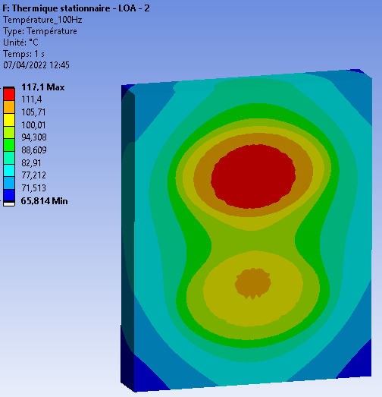
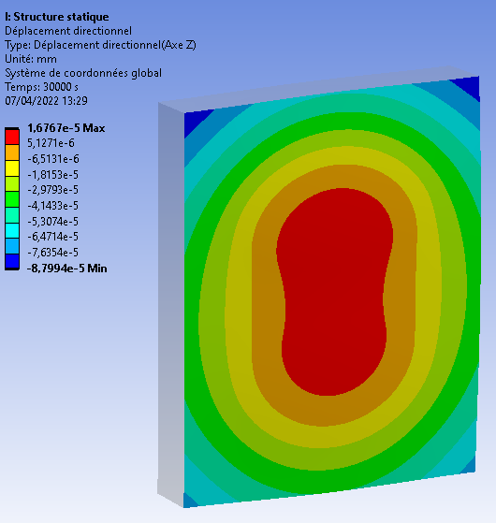
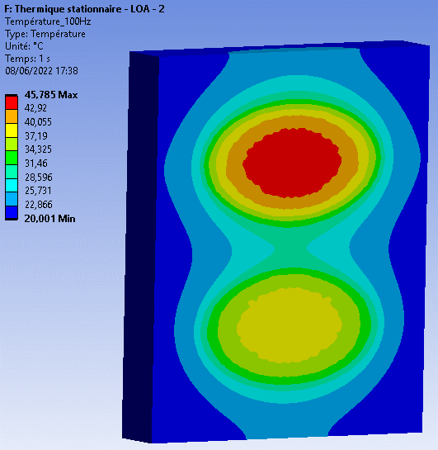
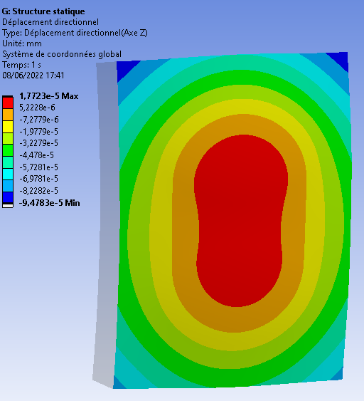
THALES results : 1.5 J / 100 Hz
With active cooling :
Back side maintained uniformely at 20°C
No active cooling
Temperature
Deformation
Temperature
Deformation
Simulation results :
Max. temperature : 117°C
Max. amplitude deformation : 0,11 µm PV
Simulation results :
Max. temperature : 46°C
Max. amplitude deformation : 0,11 µm PV
150 W incident i.e. 6 W absorbed on P1, ≈ 12 W absorbed on G1
Deformation is limited thanks to the use of a low thermal expansion substrate
Active cooling is required at this average power to limit temperature below degradation threshold

Slide 11
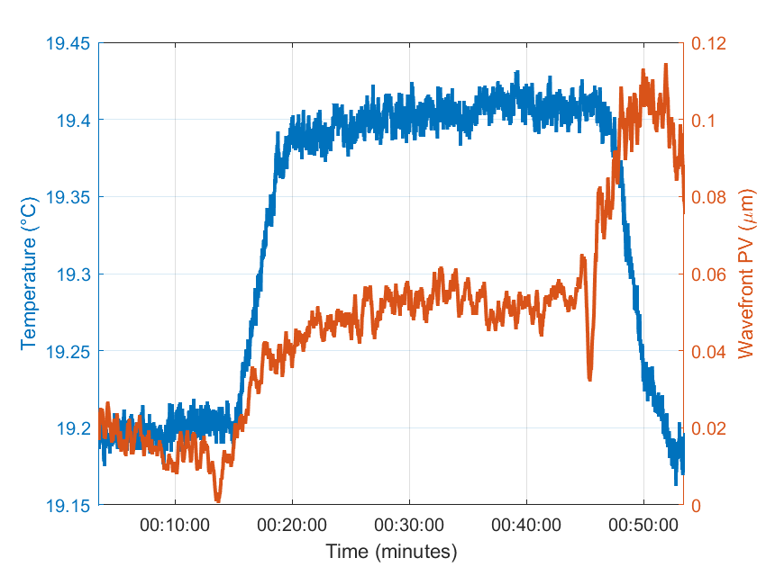
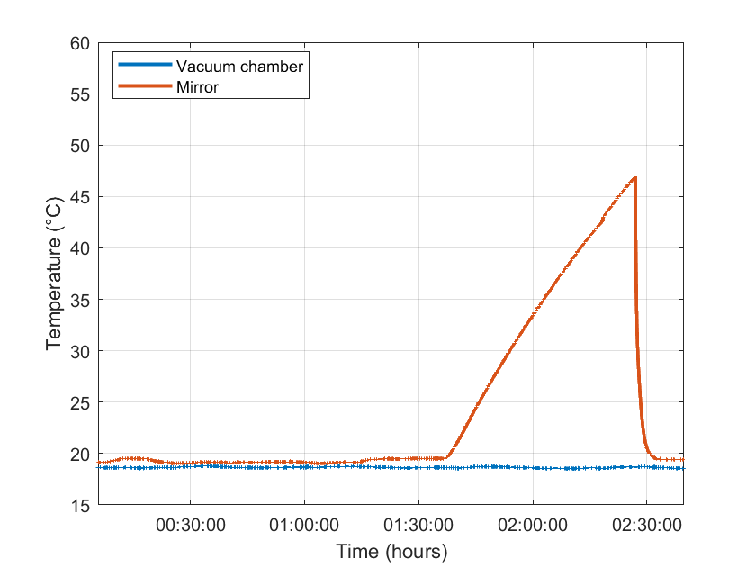
THALES results : 1.5 J / 100 Hz
Experimental tests of active cooling
Performed on a real size gold coated Zerodur mirror under vacuum heated by laser
Absorbed power measured at 15 W (> 12 W absorbed by G1)
Measurement of temperature with thermocouples
Measurement of wavefront deformation with an infrared diode + HASO
Different cooling strategies tested
Laser ON
Efficient active cooling with a water cooled plate, with 15 W absorbed :
Warm up < 0.3°C
Wavefront deformation < 200 nm PV
Validation of our cooling strategy on real size optics, to be implemented on gratings in a high average power compressor in 2026 (1.5 J, 100 Hz, CNR/INO Pisa)
Chiller OFF
Laser ON

Slide 12

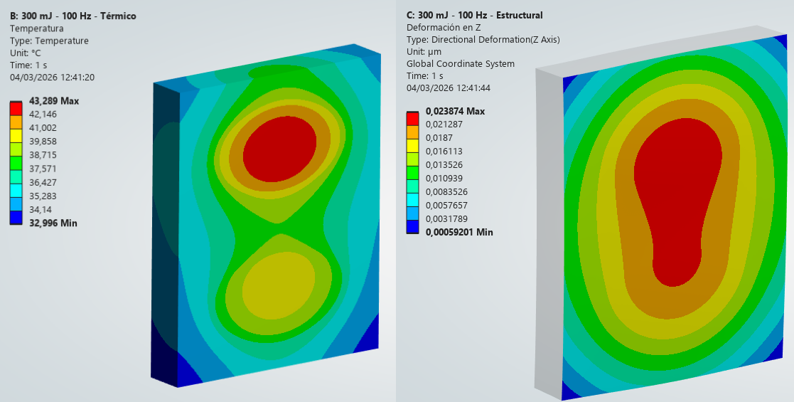
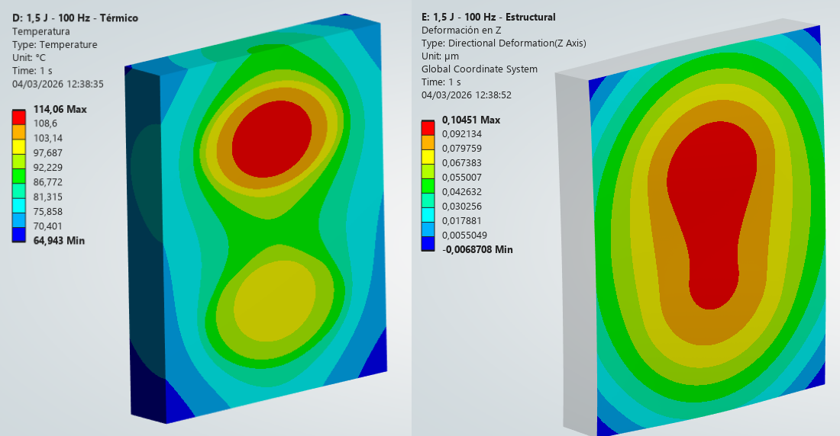
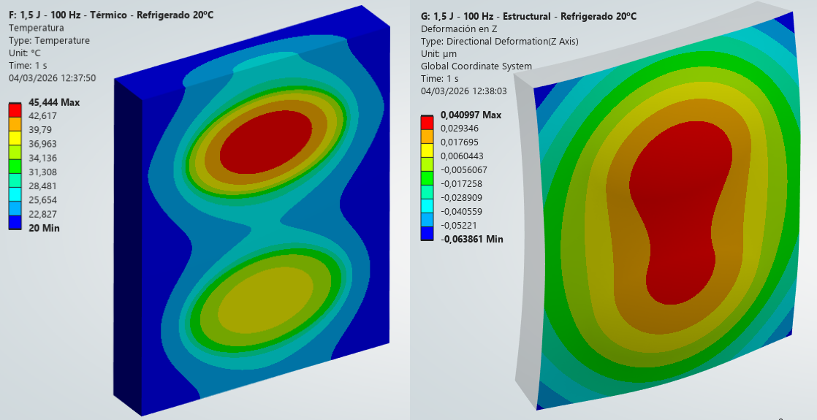
CLPU simulations with THALES parameters
300 mJ / 100 Hz
1,5 J / 100 Hz
Max. Temperature:
43,3 °C
Max. Deformation:
0,023 µm PV
Max. Temperature:
114,0°C
Max. Deformation:
0,111 µm PV
1,5 J / 100 Hz – Active Cooling 20 °C
 | THALES | CLPU
300 mJ / 100 Hz | 44°C 0.02 µm PV | 43°C 0.02 µm PV
1.5 J / 100 Hz, no cooling | 117°C 0. 11 µm PV | 114°C 0. 11 µm PV
1.5 J / 100 Hz, active cooling | 46°C 0.11 µm PV | 45°C 0. 11 µm PV
Max. Temperature:
45,4 °C
Max. Deformation:
0,105 µm PV
CLPU simulations (ANSYS model) produce results very similar to those from THALES. Also good agreement with CNR/INO results (presented by Luca Labate). Cross validation of models.

Slide 13
CLPU simulations – PACRI hypothesis
Beam parameters
Energy : calculated depending on phase 1 / phase 2 and coating technology
Repetition rate : 20 Hz / 50 Hz / 100 Hz
Beam size : calculated considering AOI, such that fluence < 0.1 J /cm²
Gratings parameters
Substrate material : Zerodur (emissivity = 0.96) in all simulations
Coating material : Gold or MLD, thickness = 300 nm
Grating size : adapted to beam size and configuration (1 or 2 passes)
Only the first grating (P1 or P1 + P4) is modelled
Thermal analysis
Radiation is the only heat transfer mode : no convection (vacuum), no conduction through gratings supports
Ultrashort laser pulses modelled as an equivalent continuous heat source using average power (energy x repetition rate)
Results: Temperature distribution throughout the entire body
Structural analysis
One central node as a reference to allow free thermal expansion in all directions
Results: Directional deformation perpendicular to the grating plane (Z Axis)
 | Gold coating | MLD coating
Absorption at 800 nm | 4 % | 0.5 %
Diffraction efficiency (1 pass) | 91 % | 95 %
Diffraction efficiency (4 passes) | 69 % | 81 %
AOI | 52° | 36°
Emissivity | 0.02 | 0.85
 | 5 J on target | 30 J on target
Energy on P1 (gold gratings) | 7.3 J | 43.7 J
Energy on P1 (dielectric gratings) | 6.1 J | 36.8 J

Slide 14
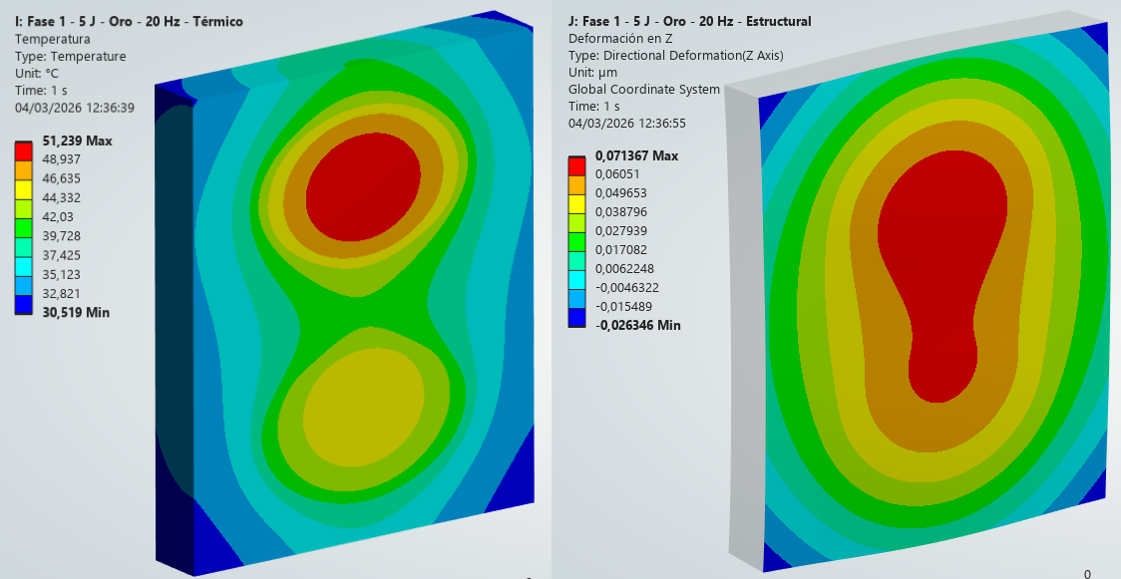
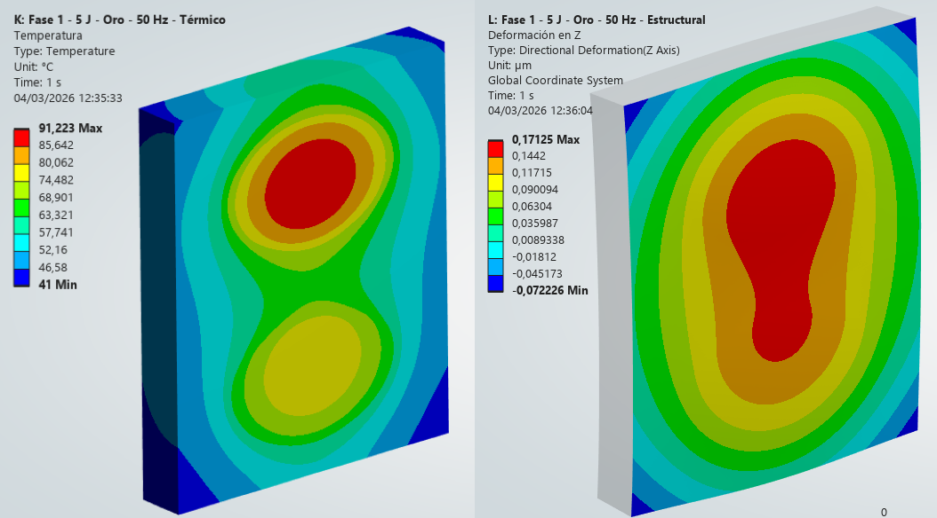
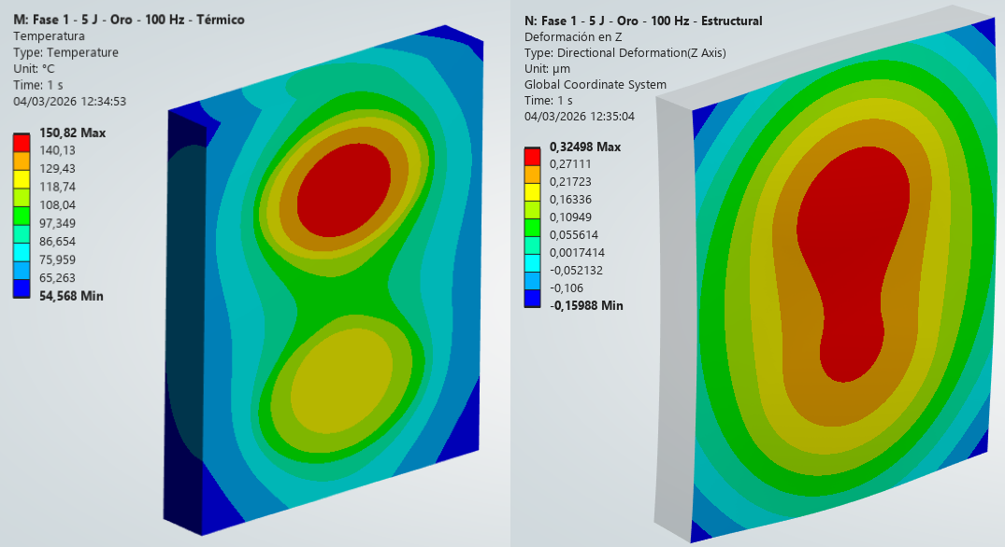
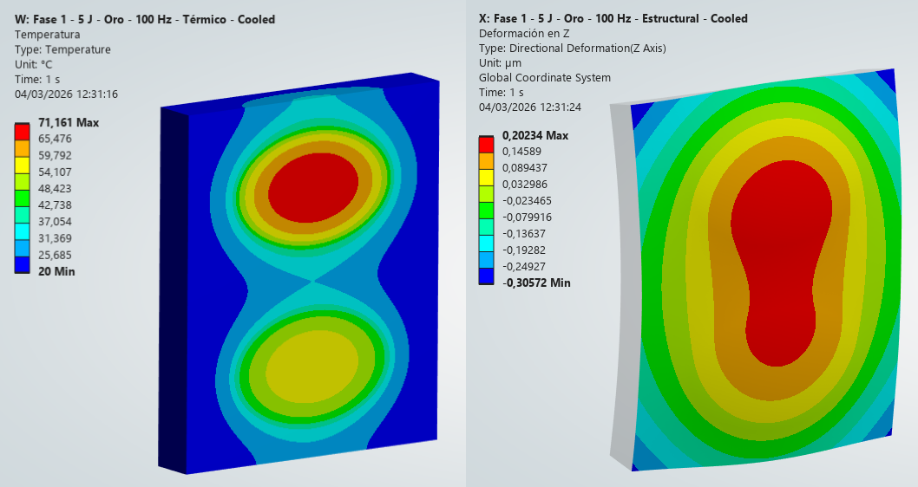
CLPU simulations – Phase 1: Gold Gratings
Grating size: 300 mm x 250 mm x 40 mm
 | Phase 1: 1 GeV electrons
Incident power on P1 (Gold) | 7,3 J / 20 Hz | 7,3 J / 50 Hz | 7,3 J / 100 Hz
Absorbed power on P1 (Gold) | 5,8 W | 14,6 W | 29,2 W
Absorbed power on P4 (Gold) | 4,4 W | 11 W | 22 W
5 J / 20 Hz
5 J / 50 Hz
Max. Temperature:
51,2 °C
Max. Deformation:
0,098 µm PV
Max. Temperature:
91,2°C
Max. Deformation:
0,423 µm PV
Max. Temperature:
150,8 °C
Max. Deformation:
0,485 µm PV
Max. Temperature:
71,1 °C
Max. Deformation:
0,508 µm PV
5 J / 100 Hz
5 J / 100 Hz – Act. Cooling 20 ºC

Slide 15
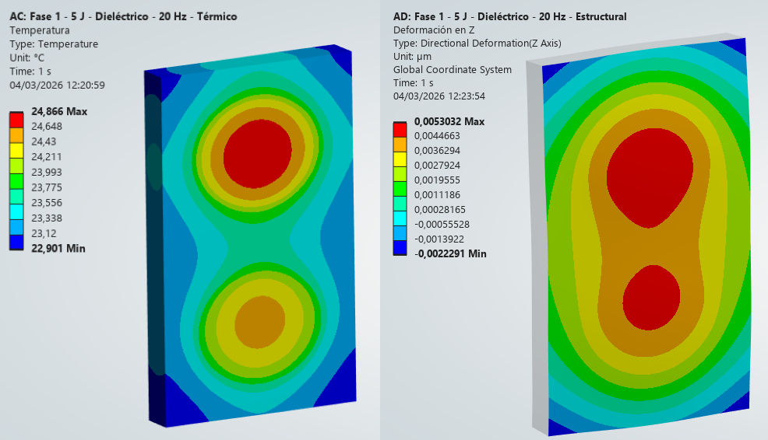
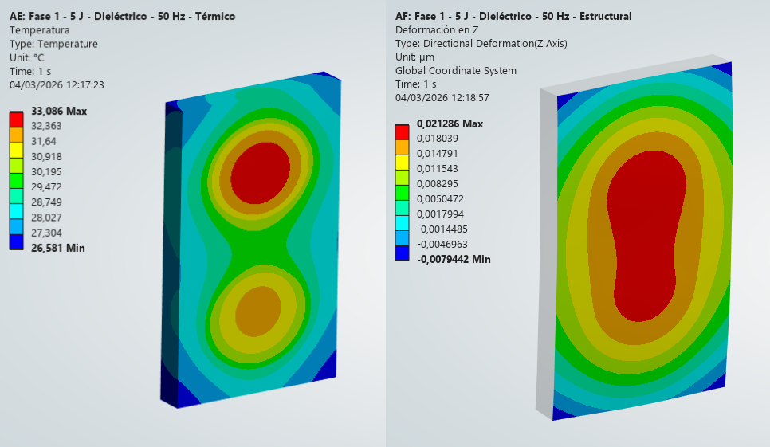
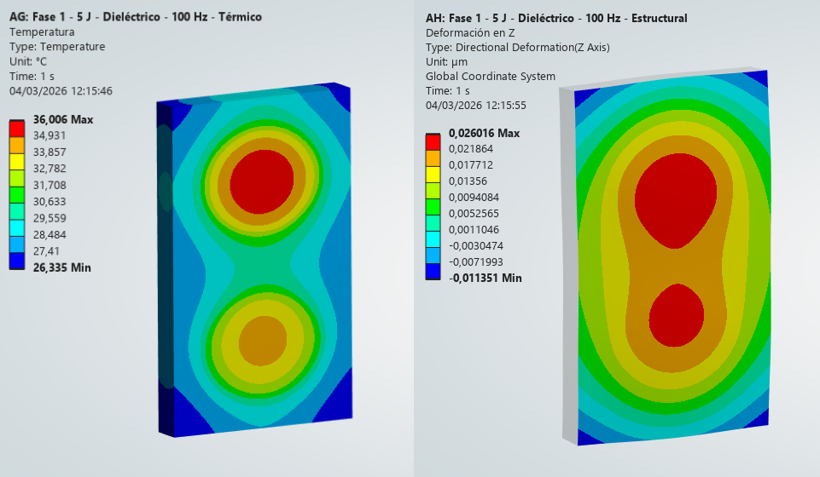
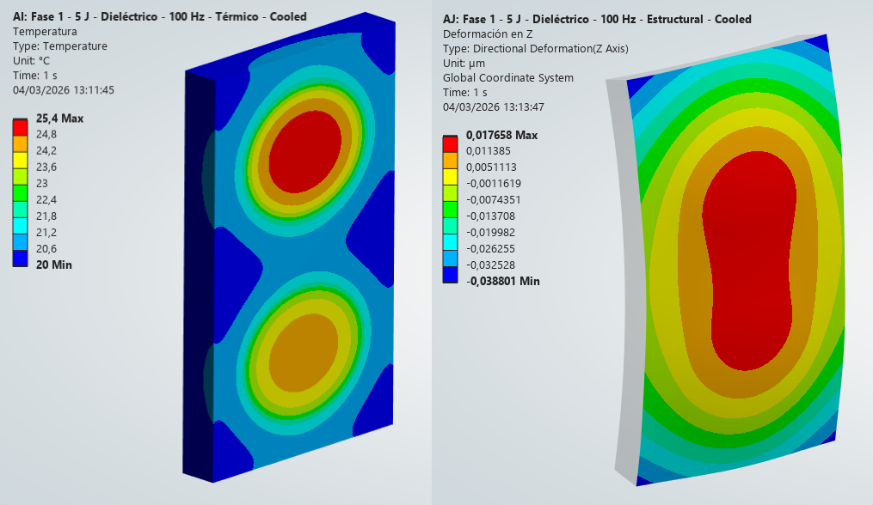
CLPU simulations –Phase 1: Dielectric Gratings
Grating size: 300 mm x 180 mm x 30 mm
 | Phase 1: 1 GeV electrons
Incident power on P1 (Dielectric) | 6,1 J / 20 Hz | 6,1 J / 50 Hz | 6,1 J / 100 Hz
Absorbed power on P1 (Dielectric) | 0,6 W | 1,5 W | 3 W
Absorbed power on P4 (Dielectric) | 0,5 W | 1,3 W | 2,6 W
5 J / 20 Hz
5 J / 50 Hz
Max. Temperature:
24,9 °C
Max. Deformation:
0,029 µm PV
Max. Temperature:
33,1°C
Max. Deformation:
0,008 µm PV
Max. Temperature:
36,0 °C
Max. Deformation:
0,037 µm PV
Max. Temperature:
25,4 °C
Max. Deformation:
0,056 µm PV
5 J / 100 Hz
5 J / 100 Hz – Act. Cooling 20 ºC

Slide 16
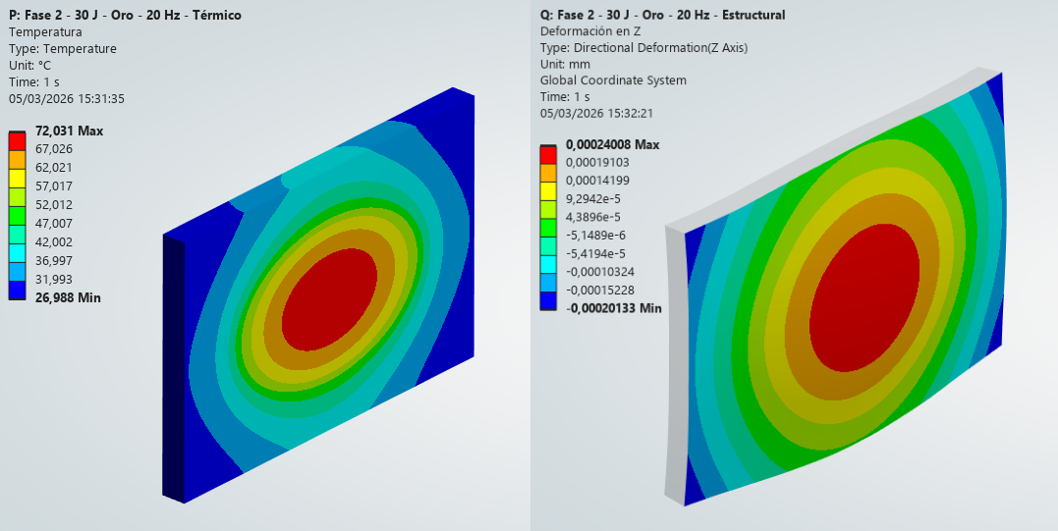
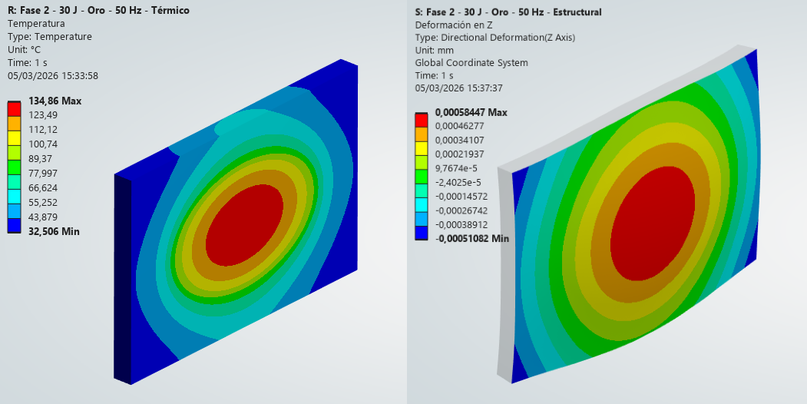
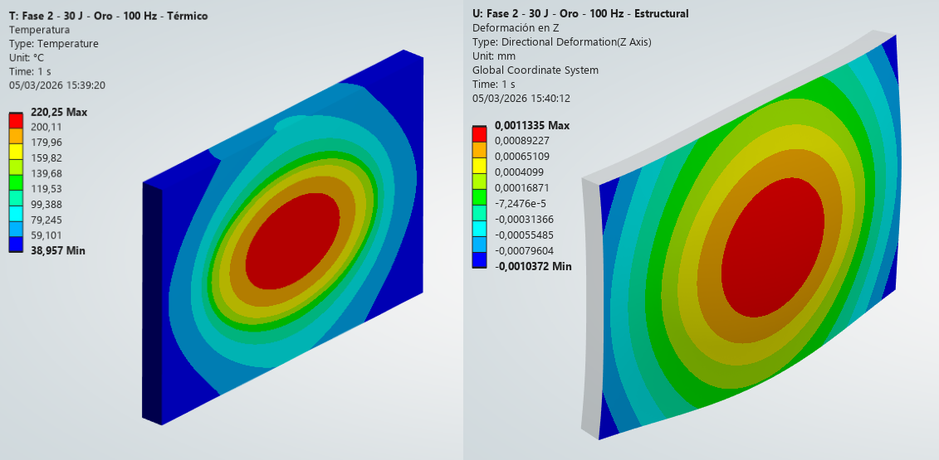
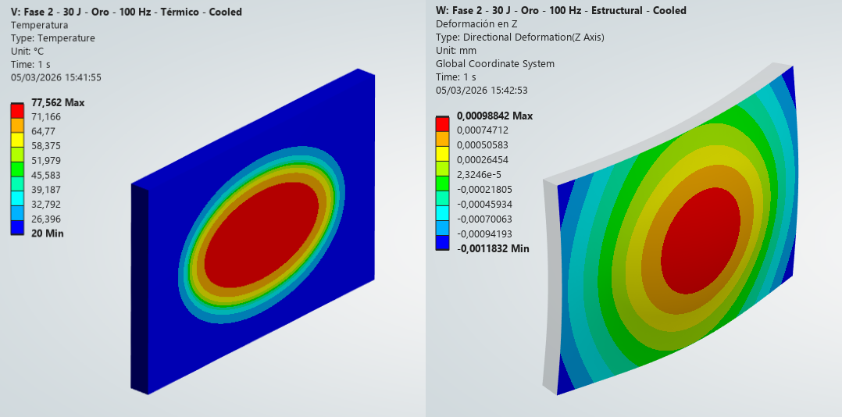
CLPU simulations –Phase 2: Gold Gratings
Grating size: 600 mm x 400 mm x 40 mm
 | Phase 2: 5 GeV electrons
Incident power on P1 (Gold) | 47,3 J / 20 Hz | 47,3 J / 50 Hz | 47,3 J / 100 Hz
Absorbed power on P1 (Gold) | 34,9 W | 87,4 W | 174,8 W
30 J / 20 Hz
30 J / 50 Hz
Max. Temperature:
72,0 °C
Max. Deformation:
0,441 µm PV
Max. Temperature:
134,9°C
Max. Deformation:
1,095 µm PV
Max. Temperature:
220,25 °C
Max. Deformation:
2,171 µm PV
Max. Temperature:
77,56 °C
Max. Deformation:
2,171 µm PV
30 J / 100 Hz
30 J / 100 Hz – Act. Cooling 20 ºC

Slide 17
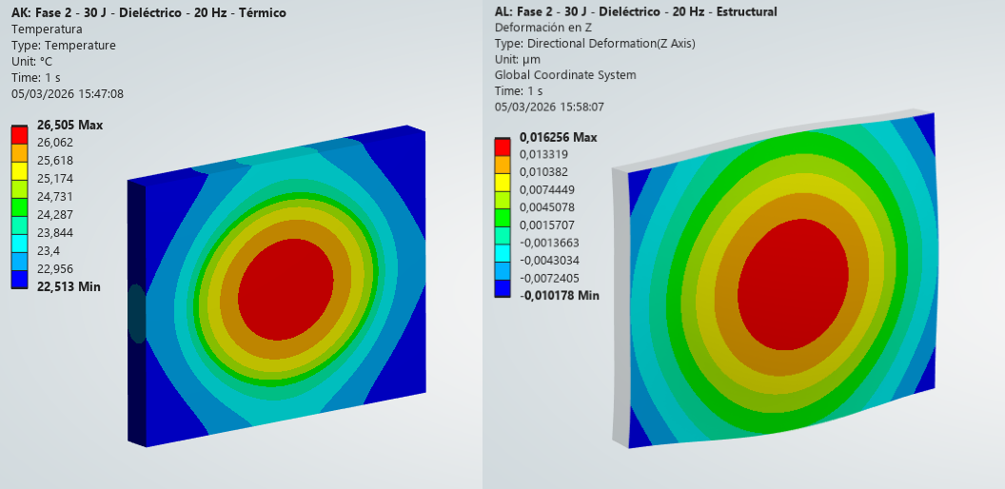
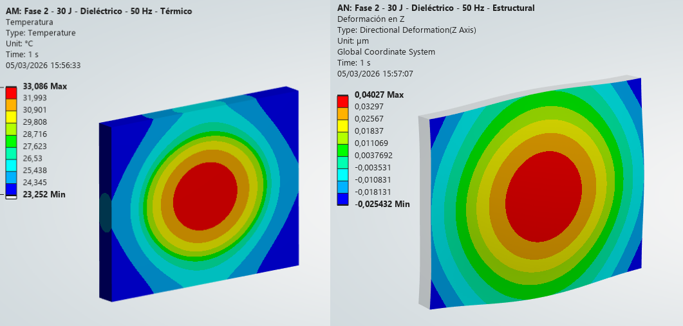
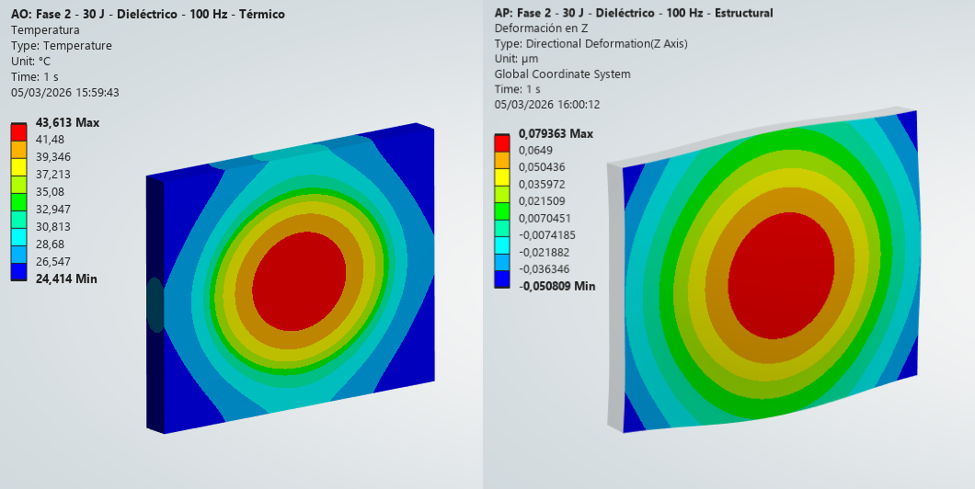
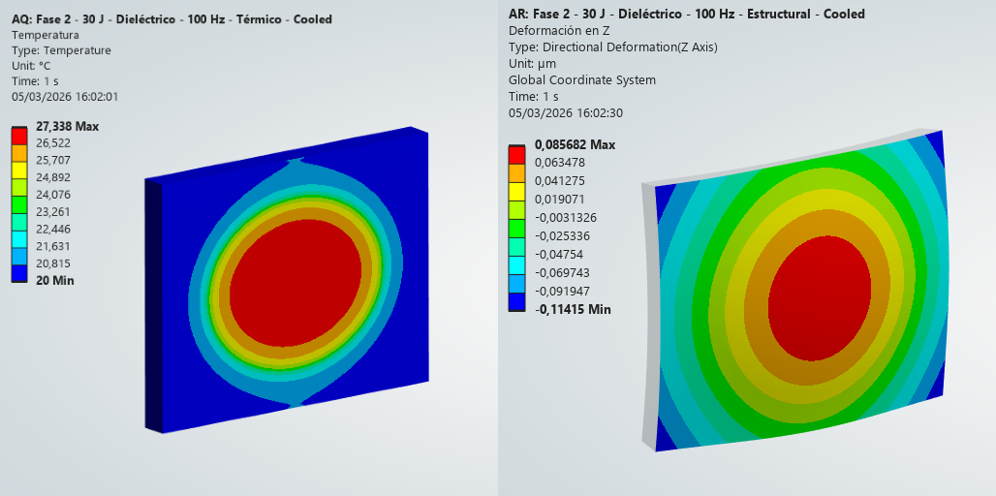
CLPU simulations –Phase 2: Dielectric Gratings
Grating size: 450 mm x 350 mm x 40 mm
 | Phase 2: 5 GeV electrons
Incident power on P1 (Dielectric) | 36,8 J / 20 Hz | 36,8 J / 50 Hz | 36,8 J / 100 Hz
Absorbed power on P1 (Dielectric) | 3,7 W | 9,2 W | 18,4 W
30 J / 20 Hz
30 J / 50 Hz
Max. Temperature:
26,5 °C
Max. Deformation:
0,026 µm PV
Max. Temperature:
33,1°C
Max. Deformation:
0,065 µm PV
Max. Temperature:
43,6 °C
Max. Deformation:
0,130 µm PV
Max. Temperature:
27,3 °C
Max. Deformation:
0,200 µm PV
30 J / 100 Hz
30 J / 100 Hz – Act. Cooling 20 ºC

Slide 18

Using the FEniCS library for grating thermal management
FEniCS project: started around 20yrs ago, driven at that time mainly by universities/research centres in Sweden/Norway
Open-source platform for solving PDEs using FEM.
Transforms weak-form equations into efficient code (C++ code, python wrapper).
Acts as an FEA engine: define mesh, BCs, variational form
Thermal analysis
Radiation is the only heat transfer mode : no convection (vacuum),
no conduction through gratings supports
Ultrashort laser pulses modelled as an equivalent continuous heat source
using average power (energy x repetition rate)
- Output: Temperature distribution throughout the entire body
Structural analysis
- Thermal expansion from this temperature field is coupled to linear elasticity to compute stress and deformation in the grating
Central point at the back surface fixed
Output: Deformation (displacement) of the front surface
Wavefront aberrations analysis (started, ongoing)
Local deformation is used to retrieve the optical path
Output: Wavefront aberrations in terms of Zernike coefficients (and expected Strehl ratio)
M. S. Alnaes, J. Blechta, J. Hake, A. Johansson, B. Kehlet, A. Logg, C. Richardson, J. Ring, M. E. Rognes and G. N. Wells. The FEniCS Project Version 1.5, Archive of Numerical Software 3 (2015)
A. Logg and G. N. Wells. DOLFIN: Automated Finite Element Computing, ACM Transactions on Mathematical Software 37 (2010)
Consolidated base of users worldwide
>600 peer-review paper on google scholar and Clarivate Web of Science databases

Slide 19

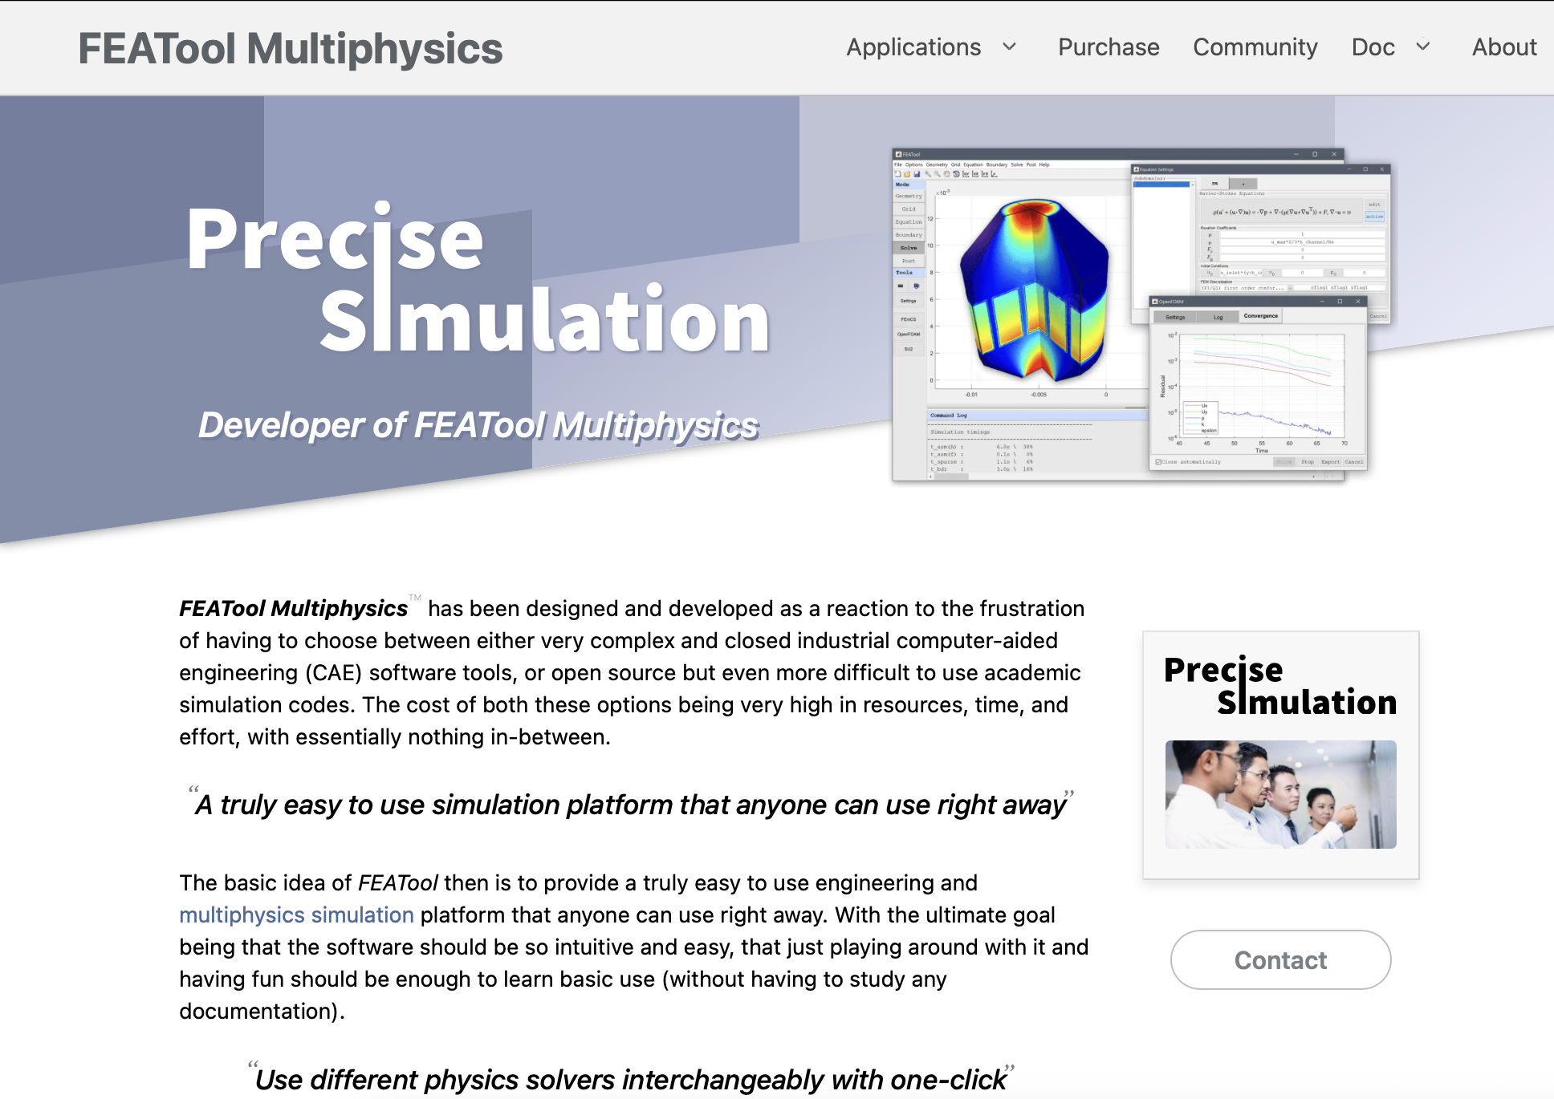
User-friendly settings using FEATool Multiphysics
FEATool is a software aimed at providing a unified simulation platform to access different open-source solver engines in CFD, FEA, etc. (including, among others, FEniCS, OpenFOAM, …)
Typical workflow for grating thermal management simulations
Step 1 – Prepare the model in FEATool
Define geometry (grating substrate + coatings, …)
Set material properties (heat conduction, elasticity, …), heat source and boundary conditions, clamping conditions
Step 2 – Export to FEniCS
→ mesh and equations exported as:
featool-fenics.h5 (mesh and subdomains),
featool-fenics.py (FEniCS Python script).
Step 3 – Solve in FEniCS
Run the Python script (optionally in parallel, e.g., on a cluster).
Step 4 – Import back to FEATool
Interactive analysis/visualization (using plotly or paraview)

Slide 20
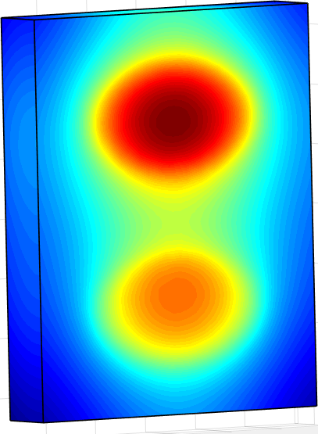
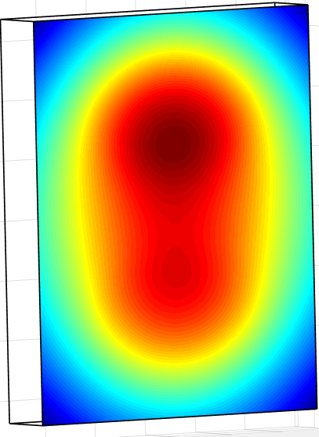
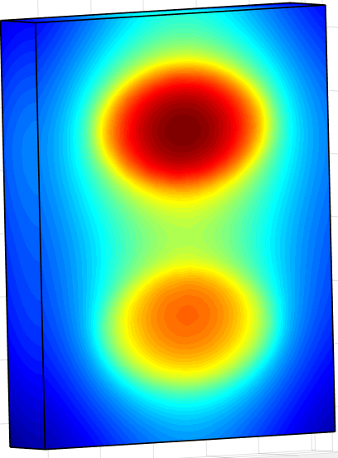
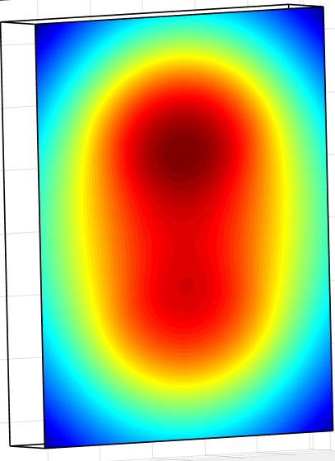

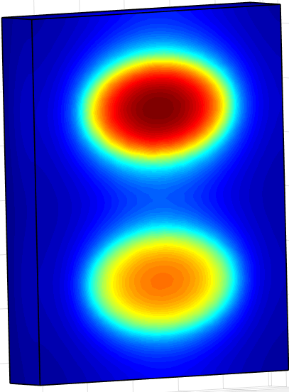
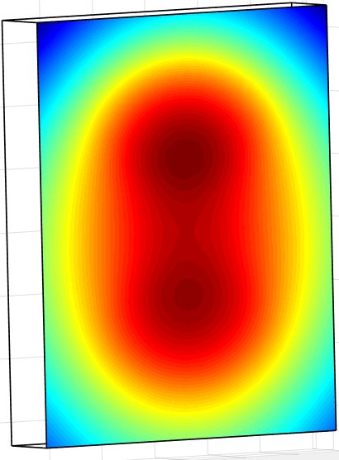
Case 0: Thales 100Hz system
Grating size: 135 mm x 100 mm x 20 mm
300 mJ / 100 Hz
1.5 J / 100 Hz
Max. Temperature:
42.6 °C
Max. Deformation:
0.018 µm PV
Max. Temperature:
116.8°C
Max. Deformation:
0.116 µm PV
 | THALES | CLPU | CNR-INO
300 mJ / 100 Hz | 44°C 0.02 µm PV | 43°C 0.02 µm PV | 42.6°C 0.018 µm PV
1.5 J / 100 Hz, no cooling | 117°C 0. 11 µm PV | 114°C 0. 11 µm PV | 116.8°C 0. 116 µm PV
1.5 J / 100 Hz, active cooling | 46°C 0.11 µm PV | 45°C 0. 11 µm PV | 45.7°C 0. 105 µm PV
Max. Temperature:
45.7 °C
Max. Deformation:
0.105 µm PV
The ILIL simulations produced results very similar to those from THALES simulations.

Slide 21
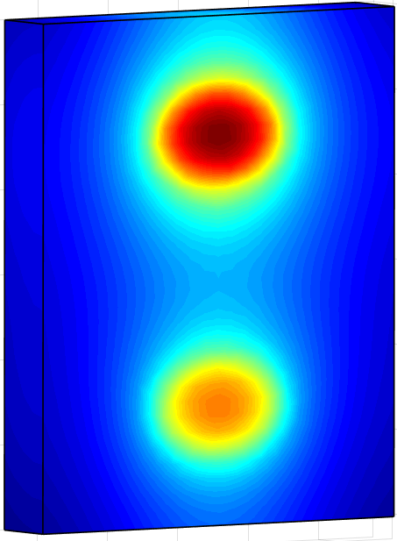
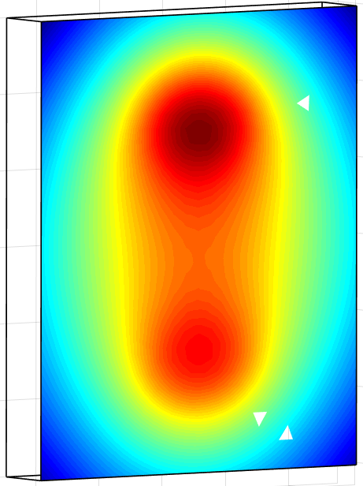
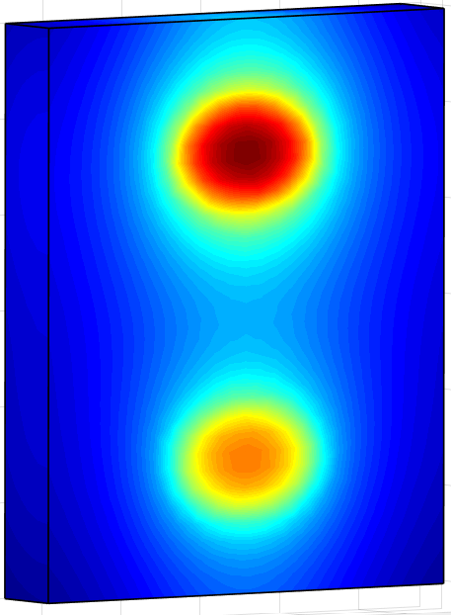
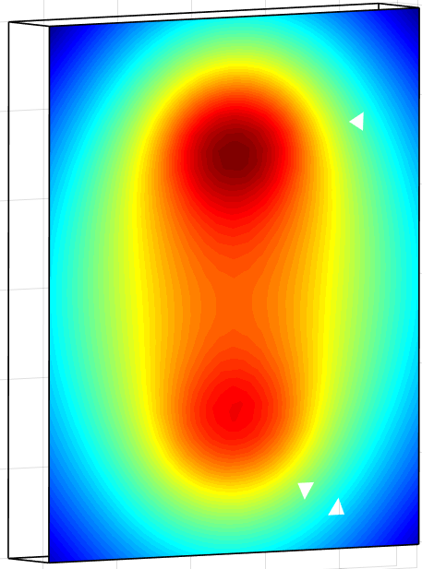
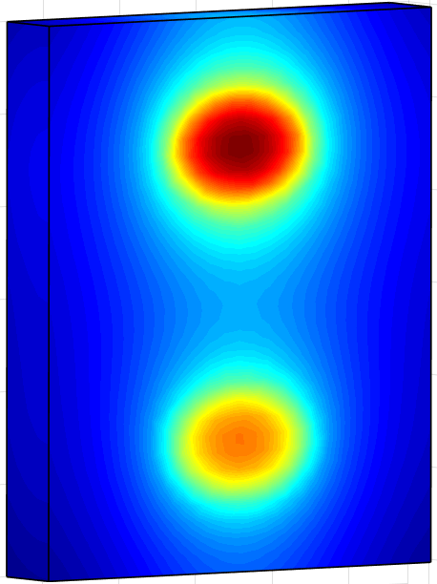

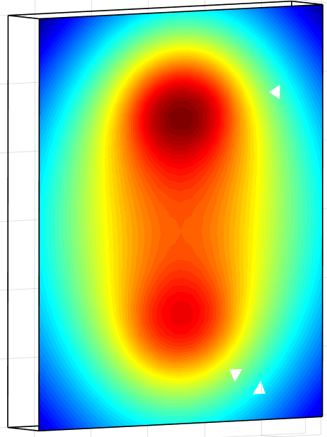
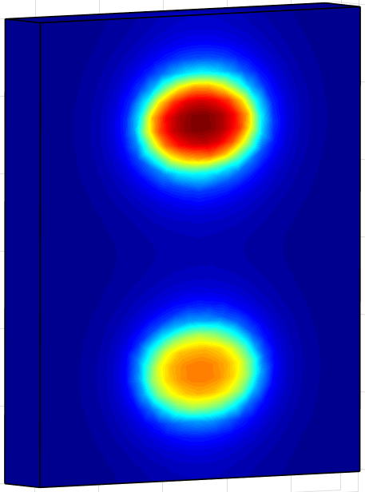
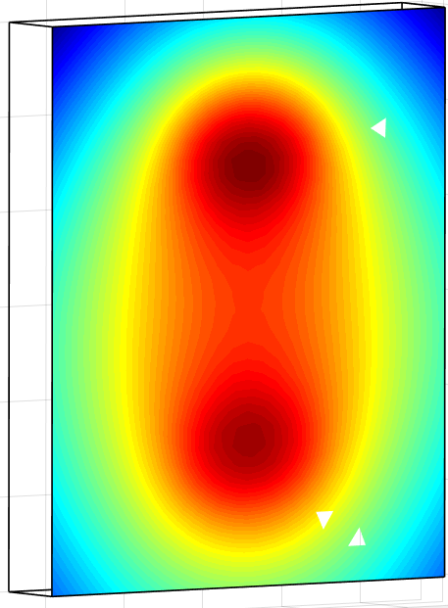
Case 1: EuPRAXIA phase 1, gold gratings
Grating size: 300 mm x 250 mm x 40 mm
 | Phase 1: 1 GeV electrons
Incident power on P1 (Gold) | 7,3 J / 20 Hz | 7,3 J / 50 Hz | 7,3 J / 100 Hz
Absorbed power on P1 (Gold) | 5,8 W | 14,6 W | 29,2 W
Absorbed power on P4 (Gold) | 4,4 W | 11 W | 22 W
5 J / 20 Hz
5 J / 50 Hz
Max. Temperature:
48.8 °C
Max. Deformation:
0.093 µm PV
Max. Temperature:
90.4°C
Max. Deformation:
0.391 µm PV
Max. Temperature:
154.8 °C
Max. Deformation:
0.472 µm PV
Max. Temperature:
75.5 °C
Max. Deformation:
0.420 µm PV
5 J / 100 Hz
5 J / 100 Hz – Act. Cooling 20 ºC

Slide 22
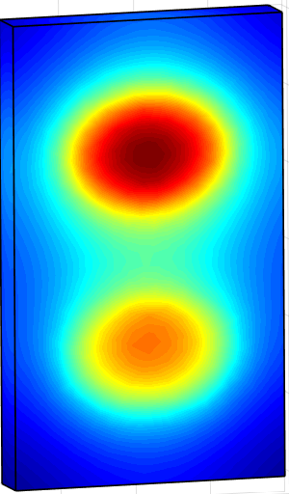

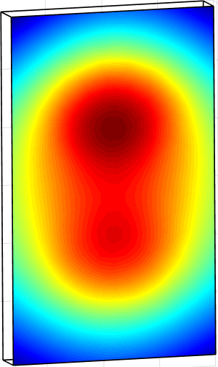
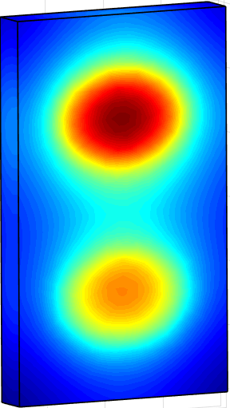
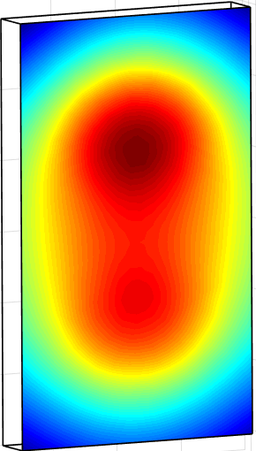
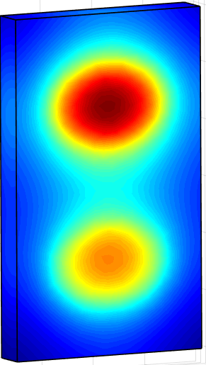



Case 1: EuPRAXIA phase 1, dielectric gratings
Grating size: 300 mm x 180 mm x 30 mm
 | Phase 1: 1 GeV electrons
Incident power on P1 (Dielectric) | 6,1 J / 20 Hz | 6,1 J / 50 Hz | 6,1 J / 100 Hz
Absorbed power on P1 (Dielectric) | 0,6 W | 1,5 W | 3 W
Absorbed power on P4 (Dielectric) | 0,5 W | 1,3 W | 2,6 W
5 J / 20 Hz
5 J / 50 Hz
Max. Temperature:
23.9 °C
Max. Deformation:
0.031 µm PV
Max. Temperature:
29.5 °C
Max. Deformation:
0.007 µm PV
Max. Temperature:
38.6 °C
Max. Deformation:
0.035 µm PV
Max. Temperature:
26.2 °C
Max. Deformation:
0.051 µm PV
5 J / 100 Hz
5 J / 100 Hz – Act. Cooling 20 ºC

Slide 23
Comparison of results obtained with ANSYS and FEniCS
EuPRAXIA phase 1 laser, 5J on target
 | ANSYS | FEniCS/FEATool | Difference
Gold gratings, 20Hz | 51.2°C 0.098 µm PV | 48.8°C 0.093 µm PV | 5% 5%
Gold gratings, 50Hz | 91.2°C 0. 423 µm PV | 90.4°C 0. 391 µm PV | 1% 7%
Gold gratings, 100Hz | 150.8°C 0.485 µm PV | 154.8°C 0. 472 µm PV | 2.5% 3%
Gold gratings, 100Hz, active cooling on the back | 71.1°C 0.508 µm PV | 75.5°C 0.420 µm PV | 6% 17%
Dielectric gratings, 20Hz | 24.9°C 0.029 µm PV | 23.9°C 0.031 µm PV | 4% 6%
Dielectric gratings, 50Hz | 33.1°C 0.008 µm PV | 29.5°C 0.007 µm PV | 11%
Dielectric gratings, 100Hz | 36°C 0.037 µm PV | 38.6°C 0.035 µm PV | 12% 5%
Dielectric gratings, 100Hz active cooling on the back | 25.4°C 0.056 µm PV | 26.2°C 0.051 µm PV | 3% 9%

Slide 24








Case 2: EuPRAXIA phase 2, dielectric gratings
Grating size: 450 mm x 350 mm x 40 mm
 | Phase 2: 5 GeV electrons
Incident power on P1 (Dielectric) | 36,8 J / 20 Hz | 36,8 J / 50 Hz | 36,8 J / 100 Hz
Absorbed power on P4 (Dielectric) | 3,7 W | 9,2 W | 18,4 W
Absorbed power on P4 (Dielectric) | 3,1 W | 7,8 W | 15,7 W
30 J / 20 Hz
30 J / 50 Hz
Max. Temperature:
26 °C
Max. Deformation:
0.024 µm PV
Max. Temperature:
34.8°C
Max. Deformation:
0.060 µm PV
Max. Temperature:
48.8 °C
Max. Deformation:
0.120 µm PV
Max. Temperature:
26.8 °C
Max. Deformation:
0.198 µm PV
30 J / 100 Hz
30 J / 100 Hz – Act. Cooling 20 ºC

Slide 25



Deformation-induced wavefront aberrations
Analysis of impact of thermal induced surface deformation on the wavefront (preliminary results, work still ongoing) via a home-made code
EuPRAXIA phase 1, gold gratings, no cooling
Analysis performed on a “single-pass” base (i.e., account is made for each pass) -> need for a more realistic model
Surface deformation -> optical path differences -> phase map
Expansion into Zernike polynomials base
$$a_{nk}=\frac{1}{\left\langle Z_{n}^{k} | Z_{n}^{k}\right\rangle }\int{φ\left(ρ,θ\right)Z_{n}^{k}\left(ρ,θ\right)ρdρdθ}$$
Strehl ratio calculation
Main aberrations: vertical tilt, vertical astigmatism
$$\frac{I}{I_{0}}=1−\frac{k^{2}}{2}\sum_{n=1}{\sum_{k}{\frac{a_{nk}^{2}}{n+1}}}$$
Strehl ratio: 0.86

Slide 26


Deformation-induced wavefront aberrations
EuPRAXIA phase 1, dielectric gratings, no cooling
Main aberrations: vertical tilt, vertical astigmatism, vertical coma
Strehl ratio: 0.93
Main aberrations: vertical tilt, vertical astigmatism
Strehl ratio: 0.88

Slide 27


Deformation-induced wavefront aberrations
EuPRAXIA phase 1, dielectric gratings, with cooling
Main aberrations: vertical tilt, vertical astigmatism, vertical coma
Strehl ratio: 0.98
Main aberrations: vertical tilt, vertical astigmatism
Strehl ratio: 0.98

Slide 28
Task 13.2
Task 13.2 : Experimental characterization of dielectric grating samples with density power compatible with kW beamline
36 months
THALES : MLD gratings from PGL already available (50 x 50 mm² and 100 x 50 mm²)
Perform measurement of the diffraction efficiency of a MLD grating : THALES
Perform measurement of the LIDT of a MLD grating in ps regime and in fs regime : THALES
Implement a MLD compressor, characterization without thermal load : THALES
Perform measurement of temperature and surface deformation of a MLD grating with thermal load under vacuum (available average power to be determined) : THALES / Amplitude
Procurement of larger gratings according to compressor design
Possibility to perform tests on other platforms at high average power : CNR / UKRI

Slide 29
Task 13.3
Task 13.3 : Compressor design based on dielectric grating technology for kW beamline
48 months
Write a state of the art synthesis on dielectric compressor
Thanks to results obtained in the previous tasks, design the compressor for kW beamline : UKRI / THALES
Design verification : Amplitude

Slide 30
Conclusion
Significant heat load on gratings at high average power, no natural heat removal (compression performed under vacuum)
Depending on the average power level, 2 strategies can be considered :
Active cooling of the gratings
Use of MLD gratings instead of gold coated gratings (lower absorption)
For PACRI, up to 4 kW incident on the first grating (phase 2, 30 J / 100 Hz on target)
Task 13.1 (24 months) : numerical work well underway
Good agreement between THALES / CLPU / CNR results : cross validation of the models
Simulations with PACRI parameters performed by CLPU and CNR : thermal load manageable with MLD gratings and without active cooling, even for phase 2 apparently
To be compared to experimental results
Task 13.2 (36 months) : characterization of MLD gratings / compressor (without thermal load) to be performed soon by Thales
Task 13.3 (48 months) : design of the compressor to be performed according to 13.1 and 13.2 results

