Slide 1
Mastering Gerchberg-Saxton Phase Retrieval: Toward Low-Latency Spatio-Spectral Metrology for High-Stability Lasers (WP14)
Slava Smartsev
CLPU, CNR (INO Pisa), CNRS (IJClab, LULI), ELI-BL , UKRI
with Amplitude and Thales

Slide 2
Introduction
2

Slide 3
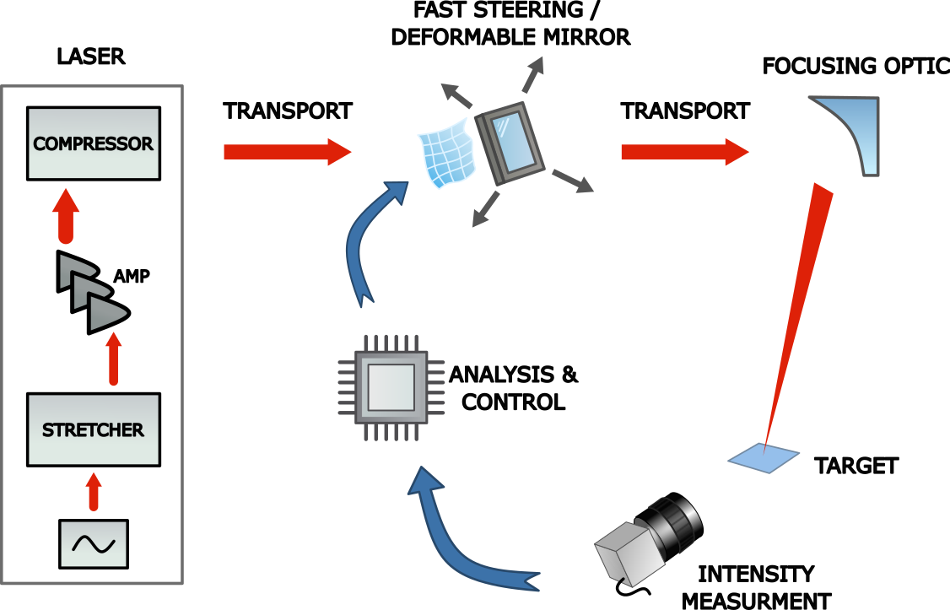
Introduction
PACRI WP14 Objective: Achieving extreme focal spot stability (pointing: 0.1 µrad, Strehl ratio: 3%)
The Ideal Measurement: Simple, single shot, reliable, in-situ, and real-time
The Stability Roadmap: Bridging passive design and active high-speed feedback loops
Facility Implementation: Current diagnostics, Gershberg-Saxton, challenges, and future directions
S. Smartsev for WP14 | 25 03 2026 | CNRS - IJClab

Slide 4
Our facility: LaseriX - IJClab

Slide 5
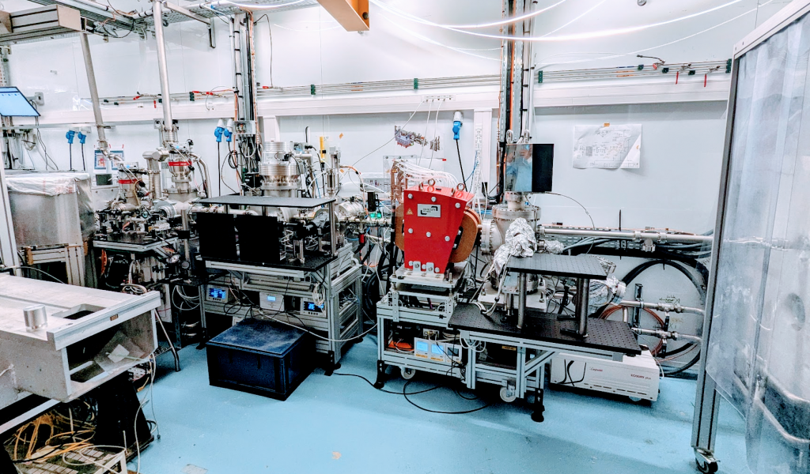
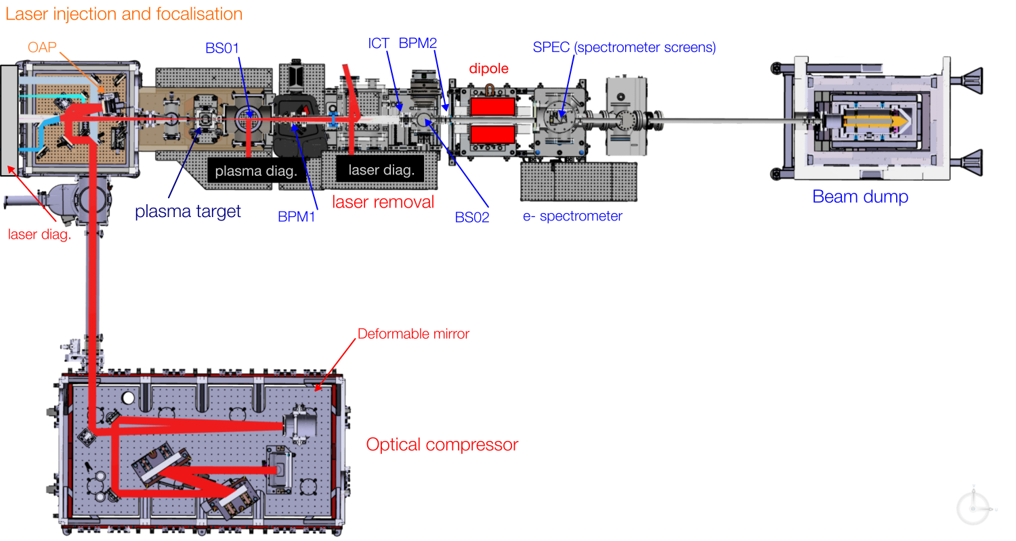


Laser injection focalisation module (LIF)
Electrons: ~150 Mev ~50 pC
laser diags
60 mm
Laser on target: ~1J (-> 1.5J) ~40 fs @ 1Hz (-> 10 Hz)

Slide 6
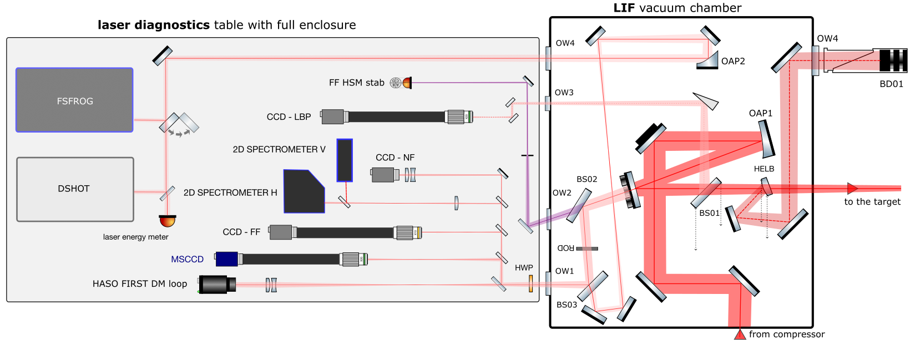
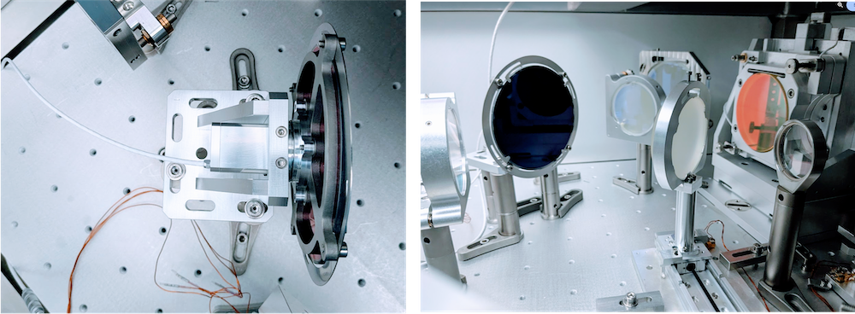
Laser diagnostics
LSM

Slide 7
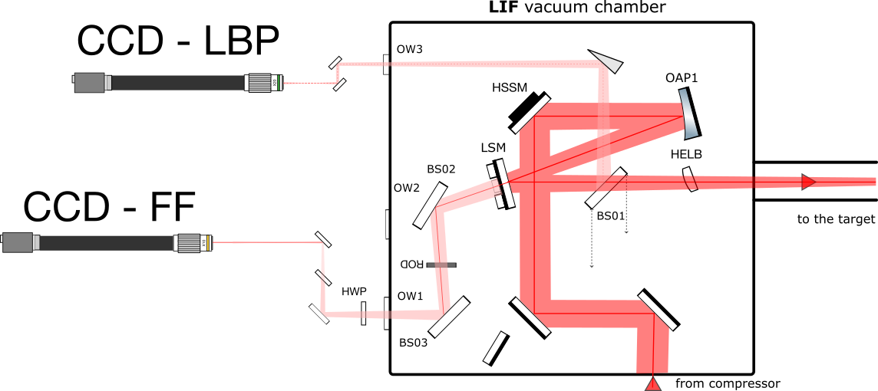
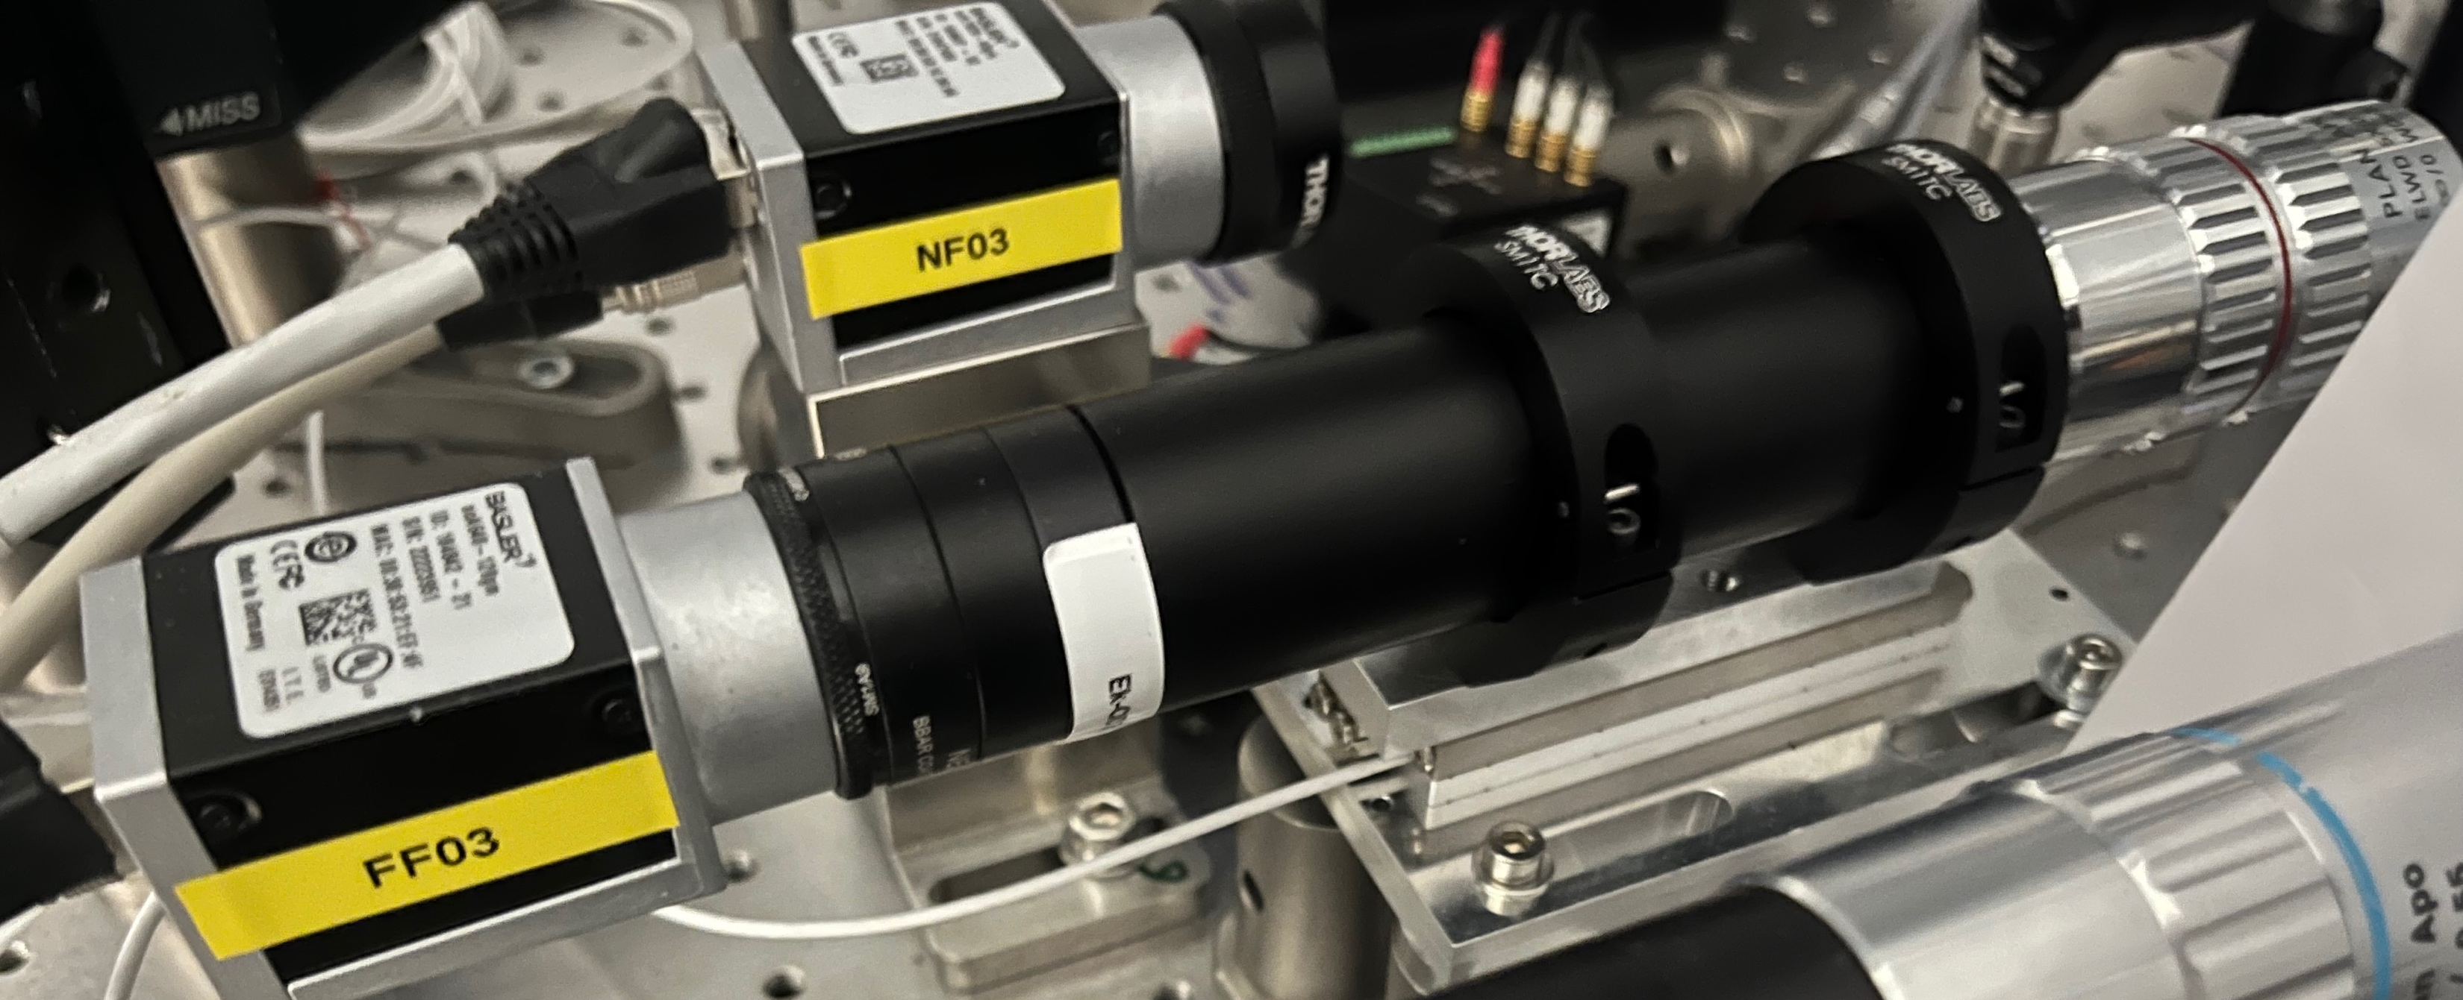
Laser diagnostics – focal spot

Slide 8
Gerchberg-Saxton phase retrieval

Slide 9
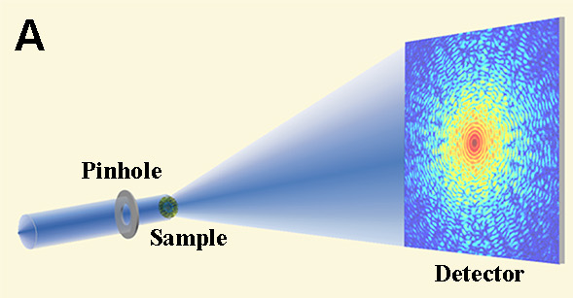
Few words about Gerchberg-Saxton
Originally for crystallography
Ideal for Fourier relation: FF-NF
Image: https://www.physics.ucla.edu/research/imaging/research_CDI.html
Gerchberg, R. W., Saxton, W. O. Optik. 35: 237–246 (1972)
J. R. Fienup, "Phase retrieval algorithms: a comparison," Appl. Opt. 21, 2758-2769 (1982)

Slide 10
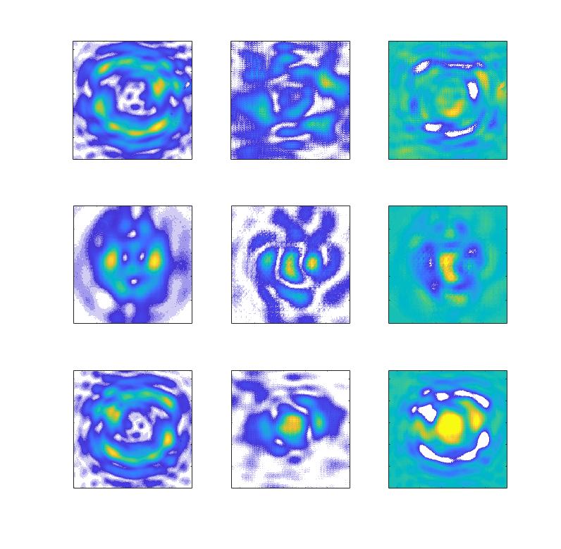
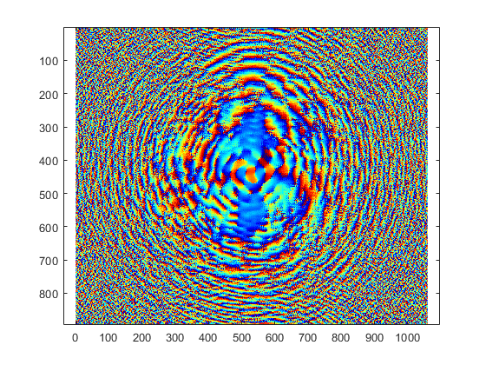
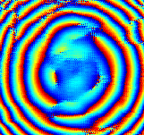
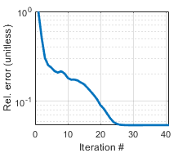
Works also for Fractional FFT or Fresnel regime
Start at z=-z0 and some phase guess
measured intensities
force the measured intensity
keep the phase
propagate to z=0
z=-z0
z=0
force the measured intensity
keep the phase
propagate to z=-z0

Slide 11
Experimental results: LBP

Slide 12
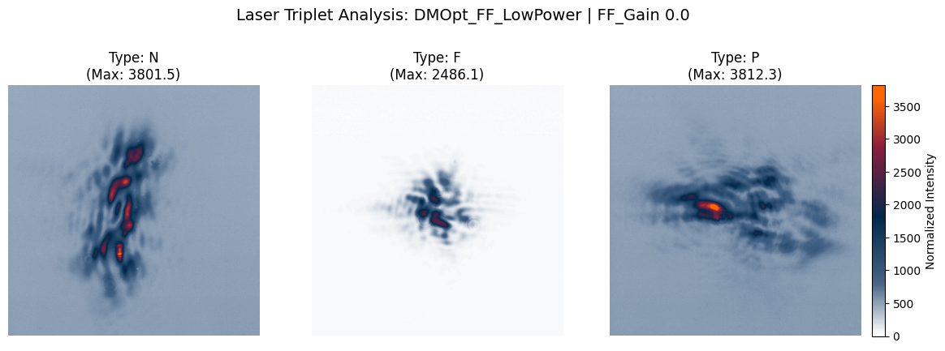
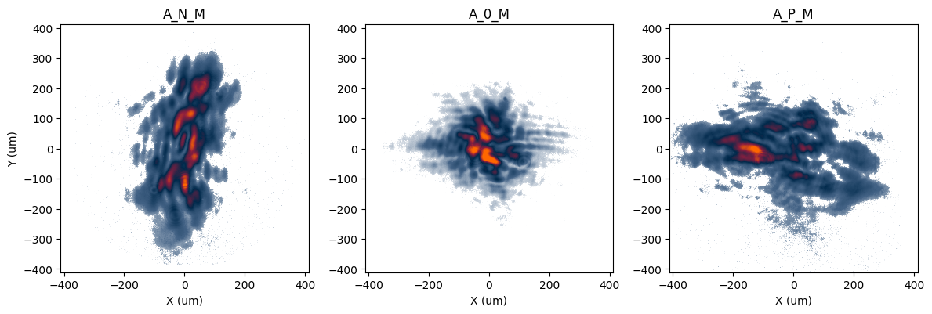
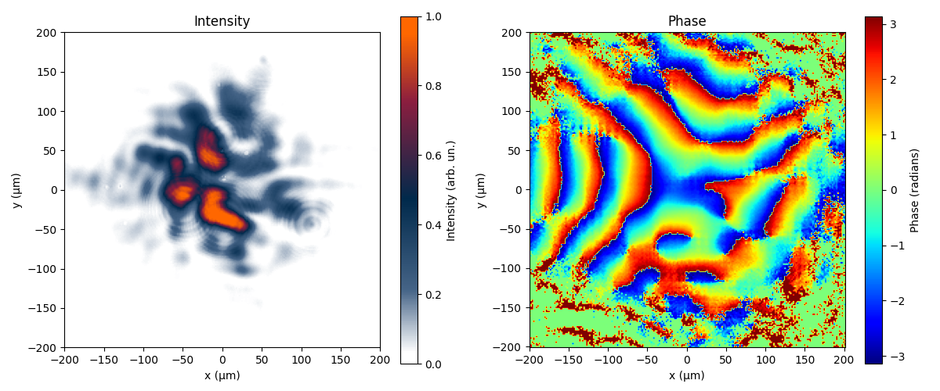
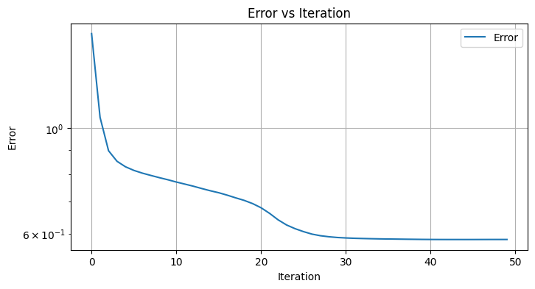
Experimental GS phase retrieval LBP
Raw images
processed amplitudes: ready for GS
Retrieved phase
Error vs iterations

Slide 13
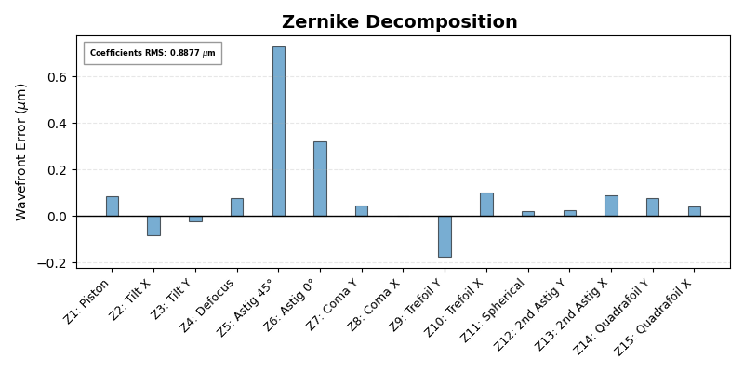
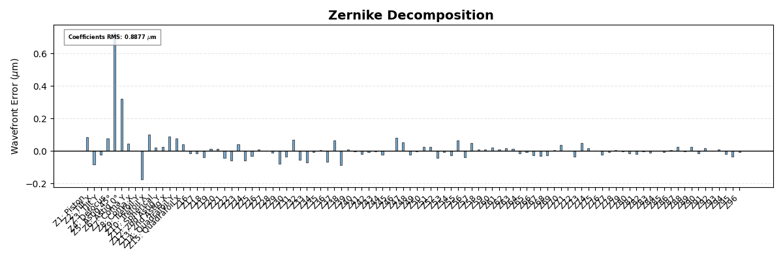
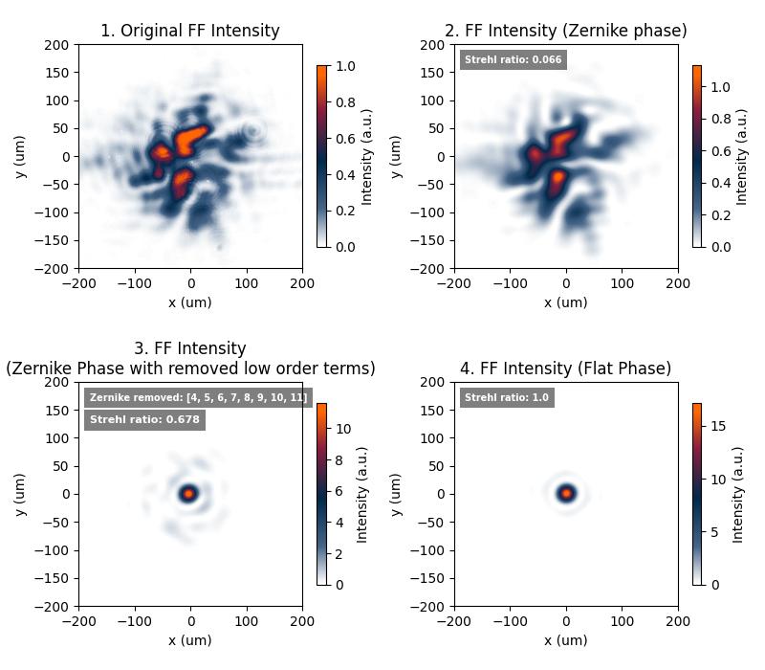
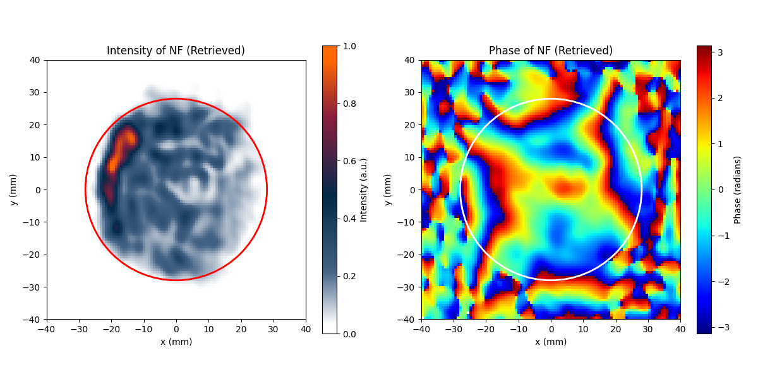
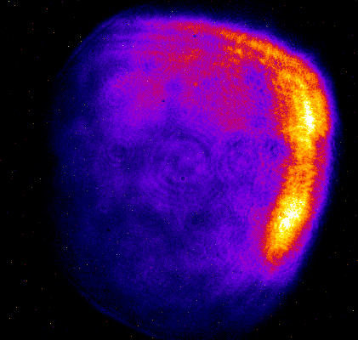
Experimental GS phase retrieval LBP
Far Field (FF)
Near Field (NF)
Measured NF
retrieved from GS FF

Slide 14
Experimental results: FF

Slide 15
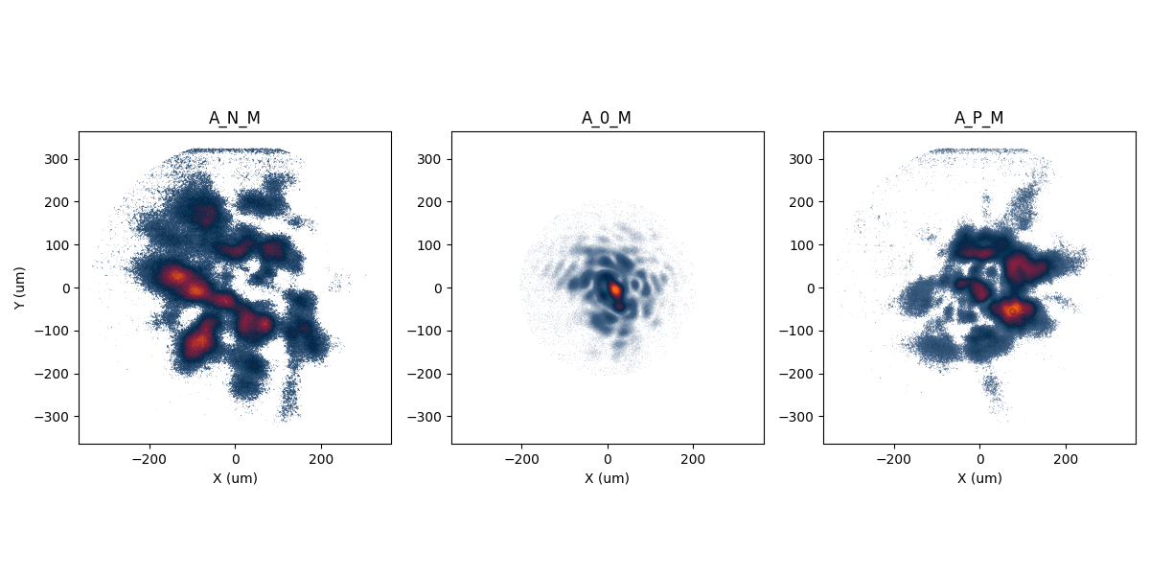
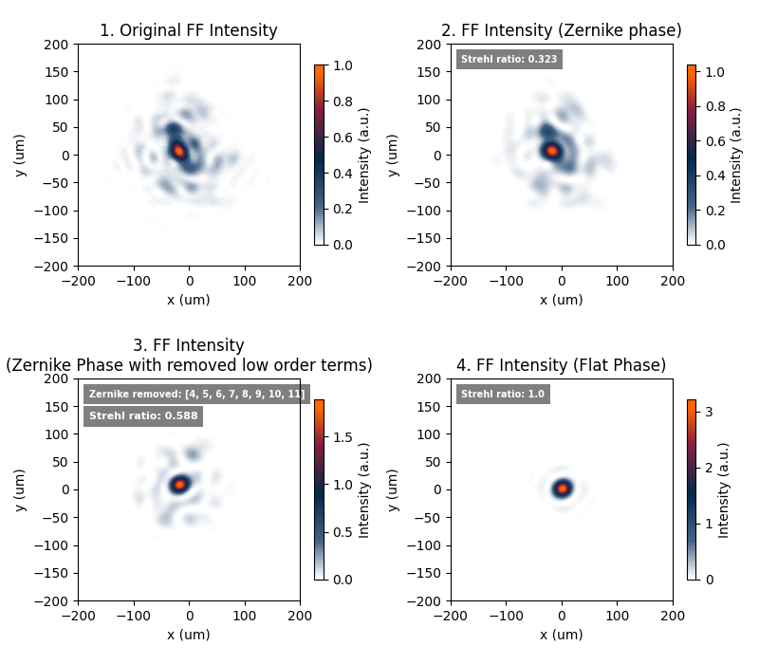
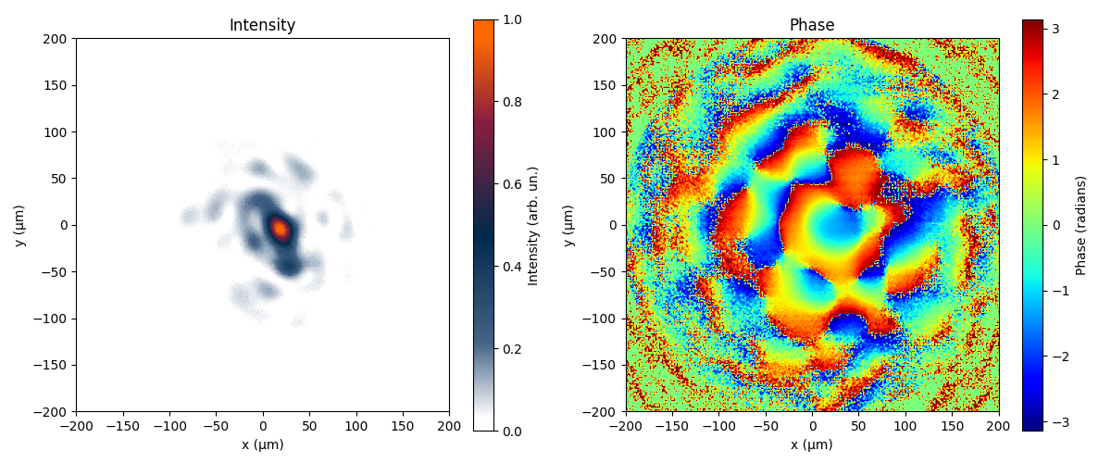
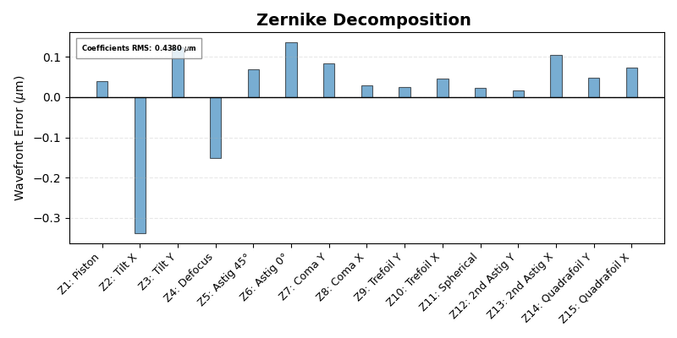
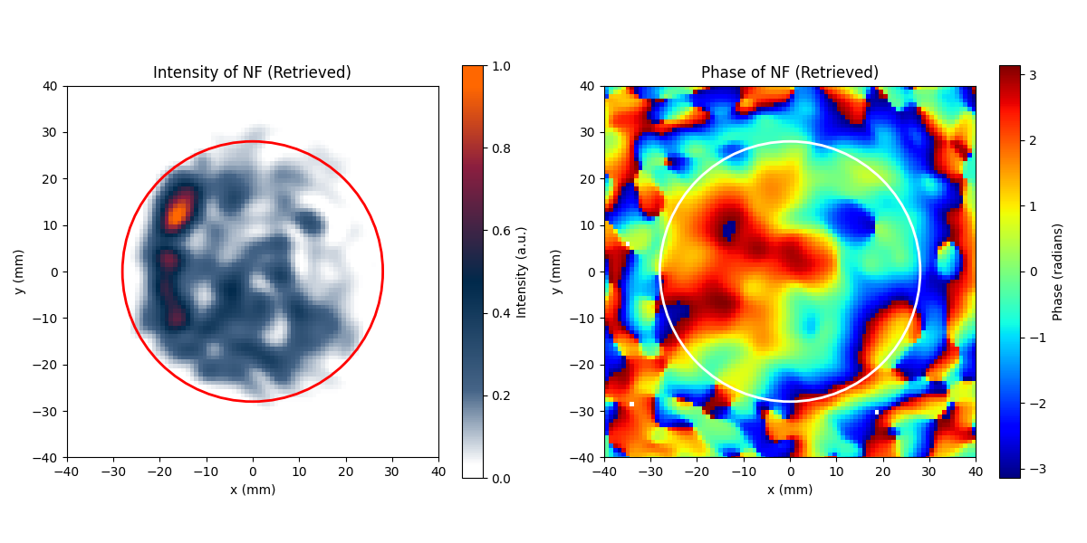
Experimental GS phase retrieval FF
Processed Amplitudes Triplet
Far Field (FF)
Measured NF
Retrieved LBP NF
Retrieved NF

Slide 16
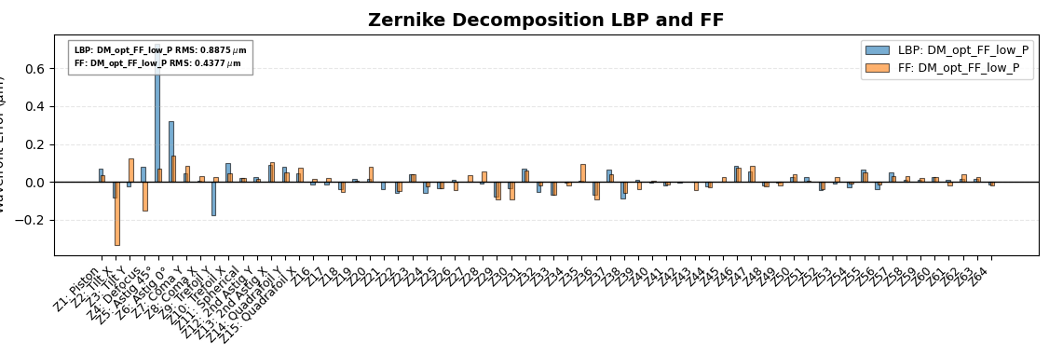
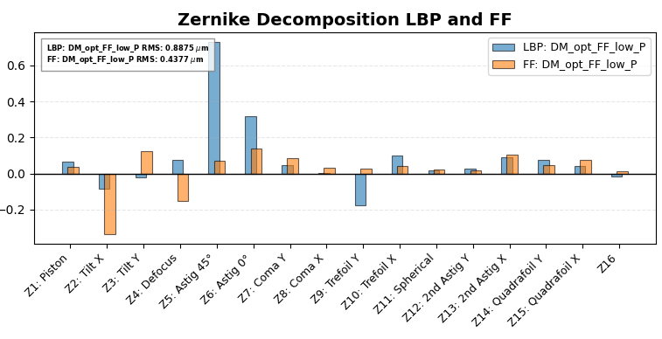
Compare Zernike for two cases
As expected, low order Zernike are different, surprisingly high order Zernike are similar!

Slide 17
Future research directions

Slide 18
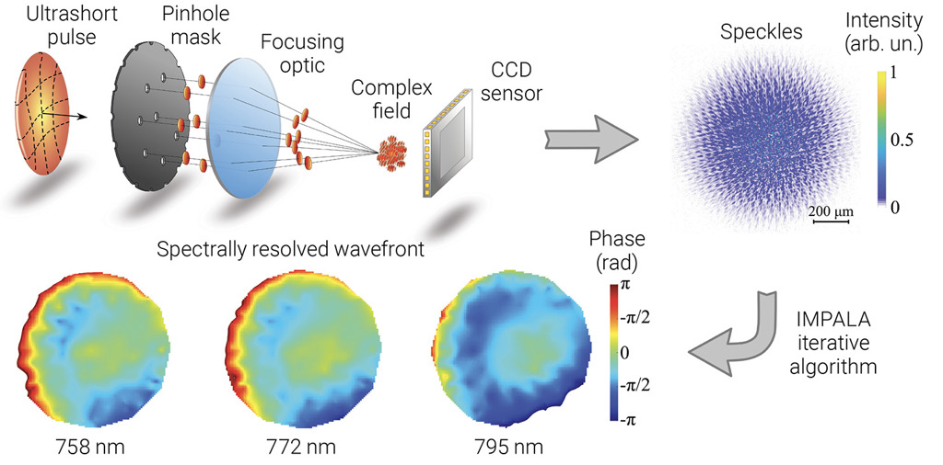
Advanced GS - IMPALA
3 planes GS is not ideal: how to improve?
Special aperiodic mask allows phase (and amplitude) using only 1 plane intensity measurement
S. Smartsev et al, Opt. Lett. 49, 1900-1903 (2024)
J. Esslinger et al, Spatio-temporal characterization of a petawatt laser using deterministic speckle patterns (2026 – in review)

Slide 19
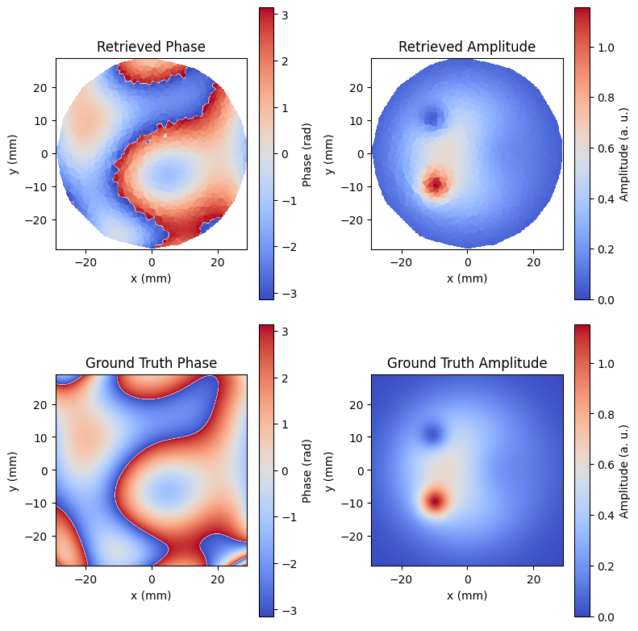
Toward real-time wavefront measurement device
Simulation: low bandwidth beam
Research of hardware and algorithm implementation for single shot, low-latency prototype (aiming to 10-50 Hz)
Challenges toward first prototype:
  Mask alignment / calibration
  Finite dynamic range (10-12 bit)
Advantages:
  in-situ
  scalable
  access to spectrally resolved phase (STC)
  attenuation without aberrations
Work in progress!

Slide 20
Summary

Slide 21
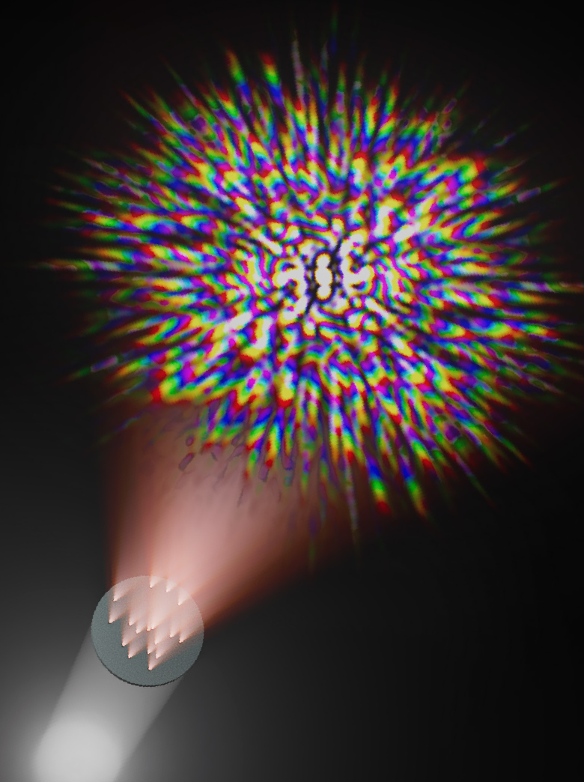
Summary
  Our spatial phase diagnostics (in a hurry)
  Basics of Gerchberg-Saxton phase retrieval
  Experimental retrievals (too much aberrations)
  Future research direction toward single shot, low-latency phase retrieval device
  If works: active wavefront correction
Obrigado!

Slide 22
Extra

Slide 23
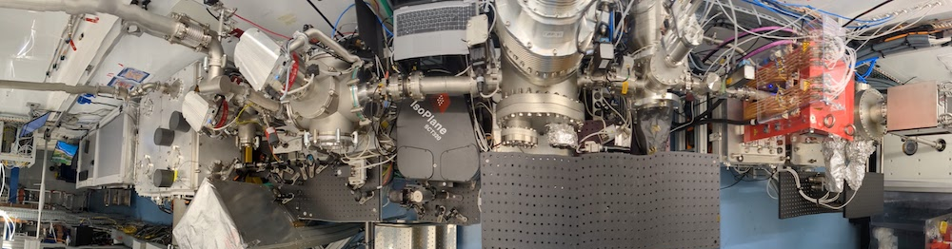
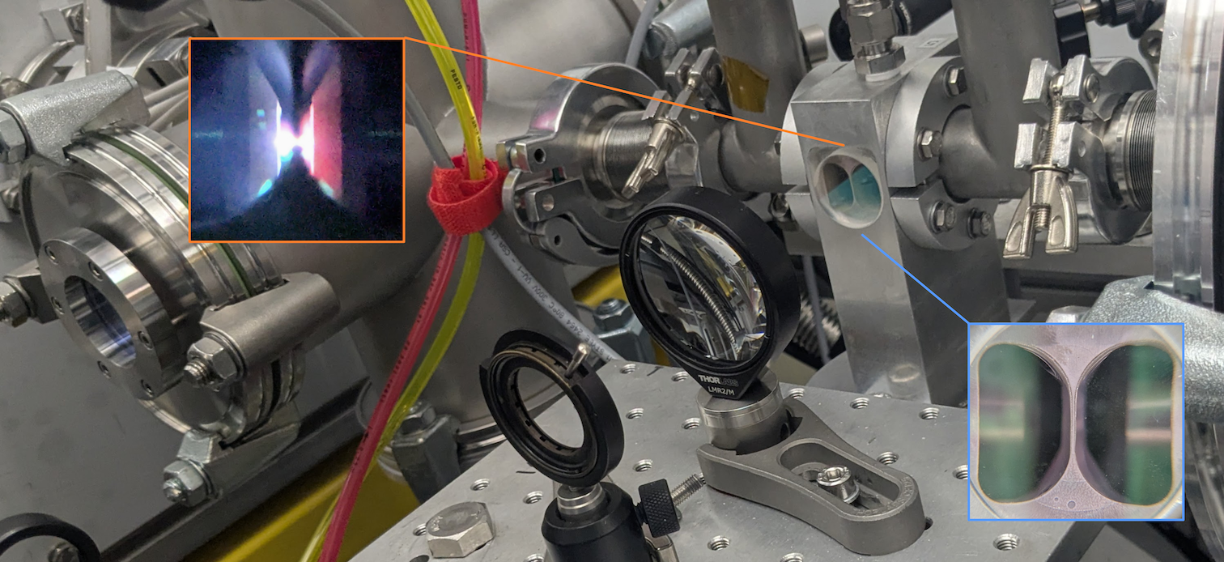
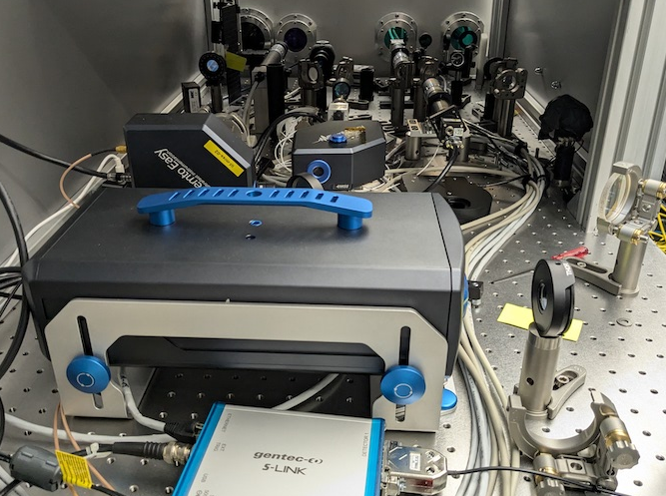
CNRS : Focal spot stabilisation
electron characterisation beamline
PALLAS LPA injector line as a test facility for technological bricks for EuPRAXIA
top view of PALLAS LPA beamline
laser diagnostics all operating at high energy (except direct focus)
spatial: WFS, beamprofile (NF, FF), direct focus (up to 200mJ) , MSCCD
temporal: FrogFS, D-Shot
Spatio-spectral: MSCCD 2x2D spectrometers
plasma module
laser focalisation module
OAP
last mirror / diags leak
active steering mirror

