Slide 1
WP1: Coordination and project management
G. D’Auria
Elettra - Sincrotrone Trieste

Slide 2
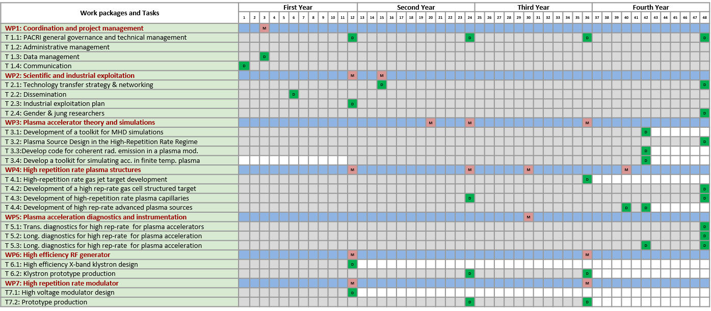

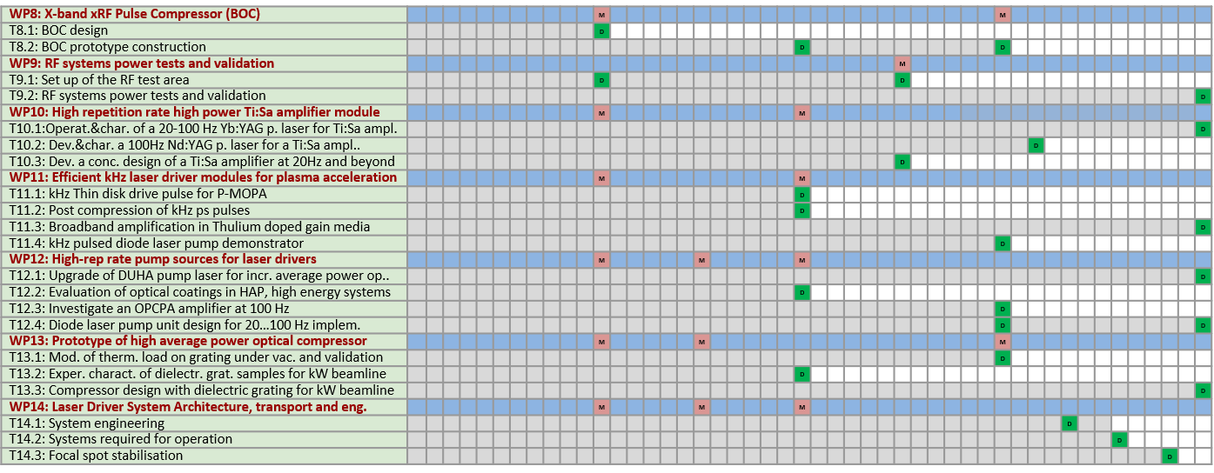
Gantt chart
D
64 Deliverables
M
40 Milestones

Slide 3
WPs list
Instit.
Plasma
RF_X-band
Lasers
Total 1.000 person months

Slide 4
Deliverables status
No | List of Deliverables due in the first year | WP | Type | Diss. | Due date | Status
D1 | PACRI first progress report: R&D and components under development. | 1 | R | PU | 28-feb-26 | In progress
D5 | Data Management Plan as a "living document“. | 1 | R | PU | 31-mag-25 | Submitted
D6 | Project Website with project information for different stakeholder groups. | 1 | DEC | PU | 31-mar-25 | Submitted
D8 | Report on cumulative expenditure. | 1 | R | SEN | 30-nov-25 | Submitted
D16 | PACRI Dissemination and Exploitation Plan. | 2 | R | PU | 31-ago-25 | Submitted
D17 | PACRI Industrial Outreach & Exploitation Plan. | 2 | R | PU | 28-feb-26 | Submitted
D36 | Revised high efficiency klystron parameters. | 1 | R | SEN | 28-feb-26 | Posponed (AMD) 31-may-26
D39 | High Voltage modulator design. | 7 | R | SEN | 28-feb-26 | Delayed (No AMD) 31-may-26
D42 | X-band RF pulse compressor design. | 8 | R | SEN | 28-feb-26 | Submitted
D45 | Design of the new RF test area at CERN. | 9 | R | PU | 28-feb-26 | Delayed (No AMD) 31-may-26

Slide 5
Milestones status

Slide 6
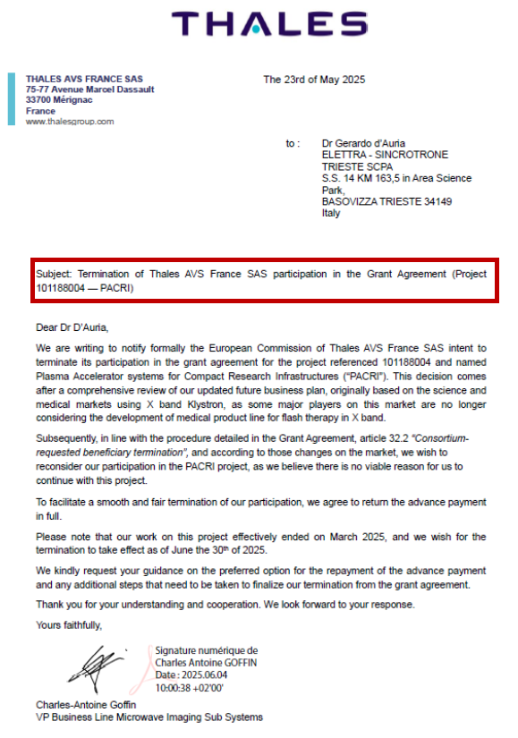
THALES -MIS leaving the project
Mid of April 2025 we have been informed that THALES-MIS France (former BE5) intended to leave the PACRI project.
This decision was driven by a thorough review of THALES-MIS future business plan, which originally relied on the X-band Klystron for use in the scientific and medical markets. The planned changes led THALES-MIS to reconsider their participation in the PACRI project.
As their decision appeared to be not-negotiable, we asked THALES-MIS to send an official communication confirming that they were returning the full amount of the project pre-financing.
We immediately informed our EU Project Officer and began preparing a “recovery plan”.
THALES declaration received on June 04th, 2025

Slide 7
Alternative klystron suppliers and possible solution
In order to solve the issue we considered:
Manufacturers of X-band power klystrons in Europe and worldwide
Tasks assigned to THALES
the entities to which these tasks could be transferred
Currently, worldwide, there are only two possible suppliers of X-band hi-power klystrons, with the characteristics required by PACRI:
Canon Electron Tubes and Devices, in Japan, https://etd.canon/en/ (use of E37119 klystron)
Communications & Power Industries (CPI), in USA, https://www.cpii.com
After a thorough analysis of the possible solutions, Elettra took over the coordination of WP6, supported by SCANDINOVA and other members of the PACRI RF pillar.
A contingency plan was submitted to the European Commission as part of a General Amendment.

Slide 8
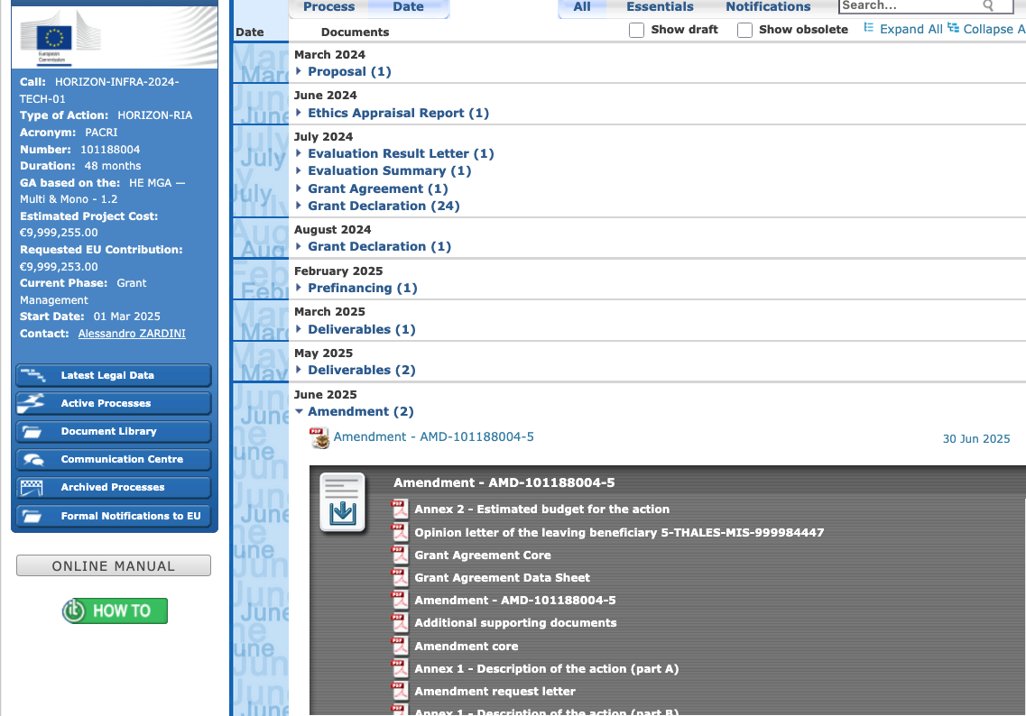
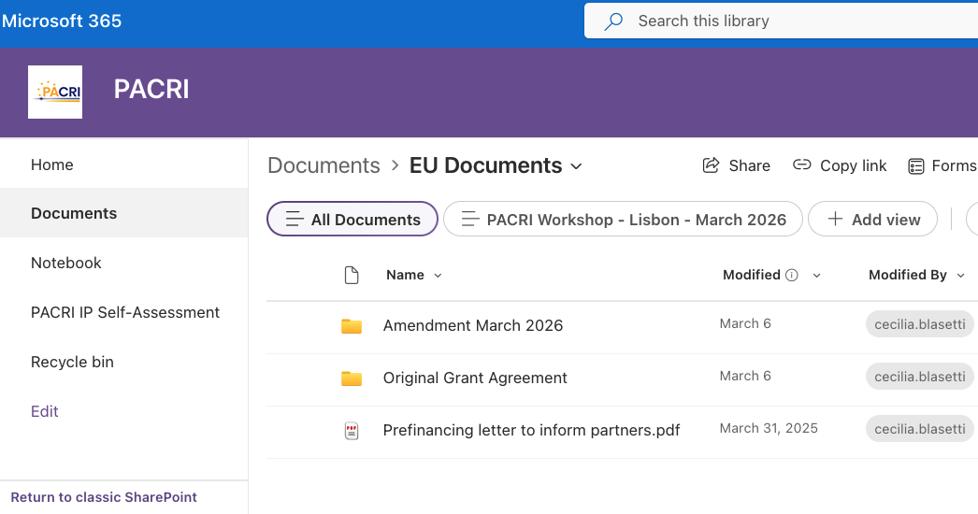
Amendment status - 1
Amendment approved by the EC on 05/03/2026:
Exit of THALES-MIS from the Consortium
Addition of UPSACLAY as Affiliated Entity to CNRS
All information available
- on Sharepoint
on EC Participant Portal

Slide 9
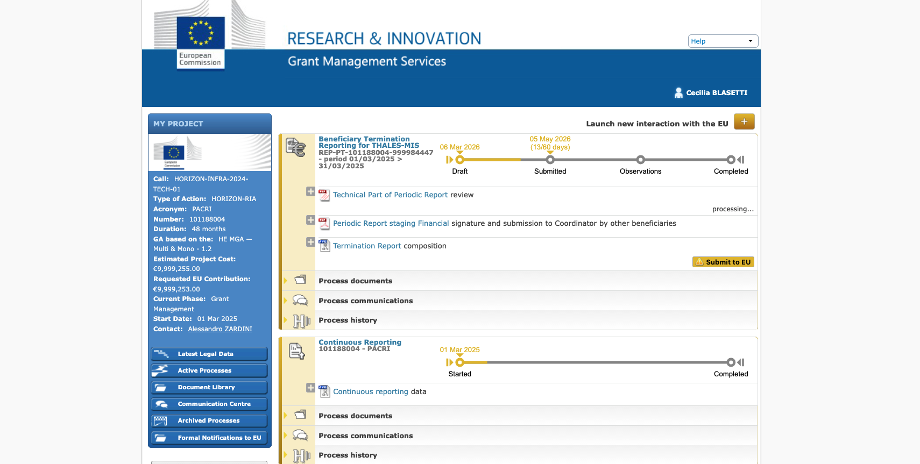
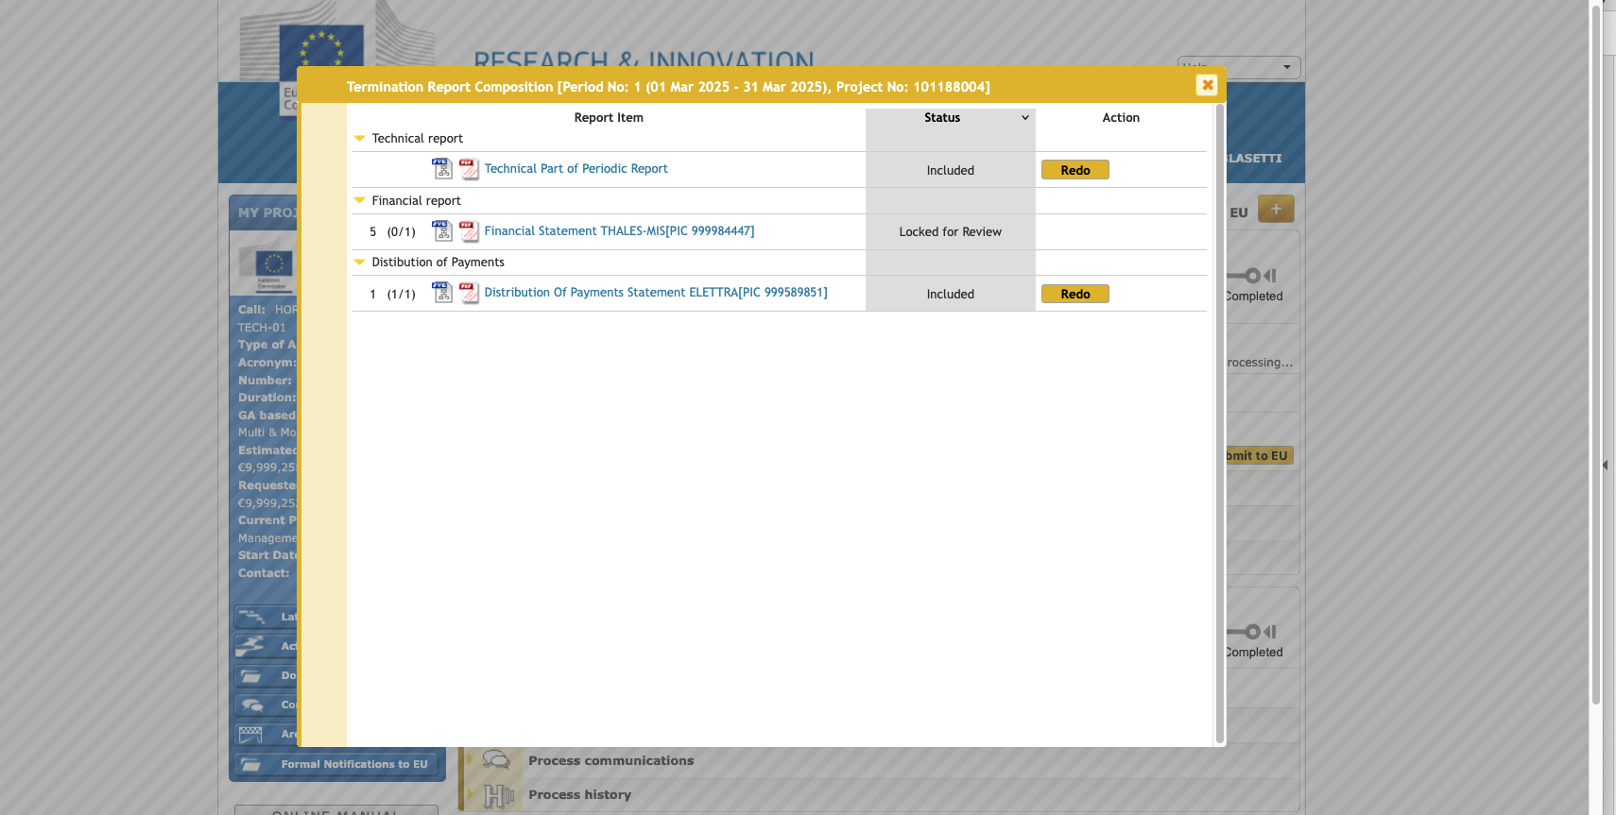
Amendment status - 2
Formally still missing: Termination report
Technical part done
Financial form THALES-MIS to be signed
…we hope to close it in the upcoming days

Slide 10
Collaboration platforms and Institutional Constraints
Currently, PACRI uses MS SharePoint and Zoom for online meetings, document management, data storage, chat and collaboration activities
However, one of our French partners informed us of recent Institutional Restrictions for using US-owned software (linked to a potential data access by US authorities)
To discuss and solve the problem we asked all partners to fill a survey, for gathering information on the use of non-EU platforms and to collect suggestions for possible compliant alternatives.
Carsten Welsch will present this issue in more detail in his WP2 talk and it will be discussed on Thursday in the next GA

Slide 11
PACRI mailing lists update
Active PACRI mailing lists:
PACRI management - pacri.management@elettra.eu
PACRI coordinator - pacri.coordinator@elettra.eu
PACRI executive - pacri.executive@elettra.eu
PACRI ga - pacri.ga@elettra.eu
PACRI WP leaders - pacri.wpleaders@elettra.eu
PACRI sac - pacri.sac@elettra.eu
PACRI laser pillars - pacri.laser@elettra.eu
PACRI RF pillar - pacri.rf@elettra.eu
PACRI plasma pillar - pacri.plasma@elettra.eu
PACRI scientific contacts - pacri.science@elettra.eu
PACRI administrative contacts - pacri.office@elettra.eu
Upcoming mailing lists:
PACRI technology transfer point of contact - (TBD)
-
__
All information available on:
PACRI Sharepoint → Documents → WP1→ Mailing lists →PACRI contact persons_2026-03-13.xls

Slide 12
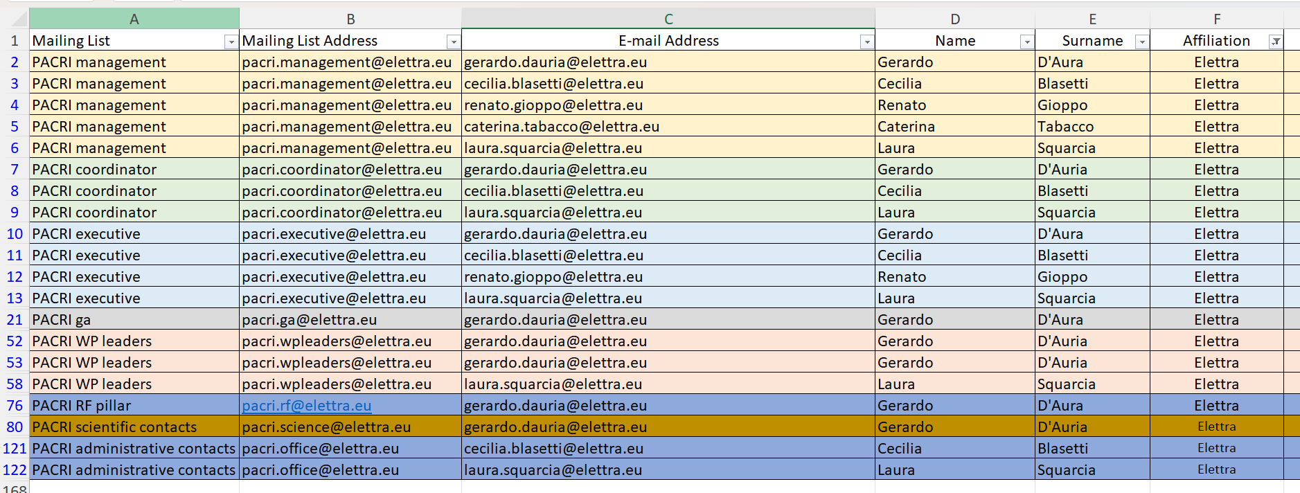
PACRI mailing lists update
By filtering by affiliation, you can see all mailing lists involving your institution and check the names included in each list.
Please let us know any additions or addresses to remove or replace (do not edit the file!)

Slide 13
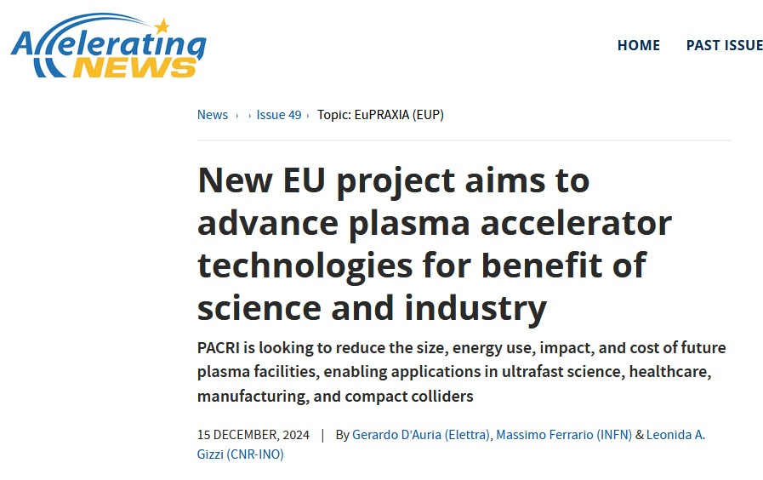


Articles and Events
https://acceleratingnews.eu/news/issue-49/
We are also considering PACRI's participation in Trieste Next 2026,
the Festival of Scientific Research, whose 15th edition titled:
“The Shape of Thought. Interactions Between Brains and Intelligences” will take place from Friday 25th to Sunday 27th September 2026.

Slide 14

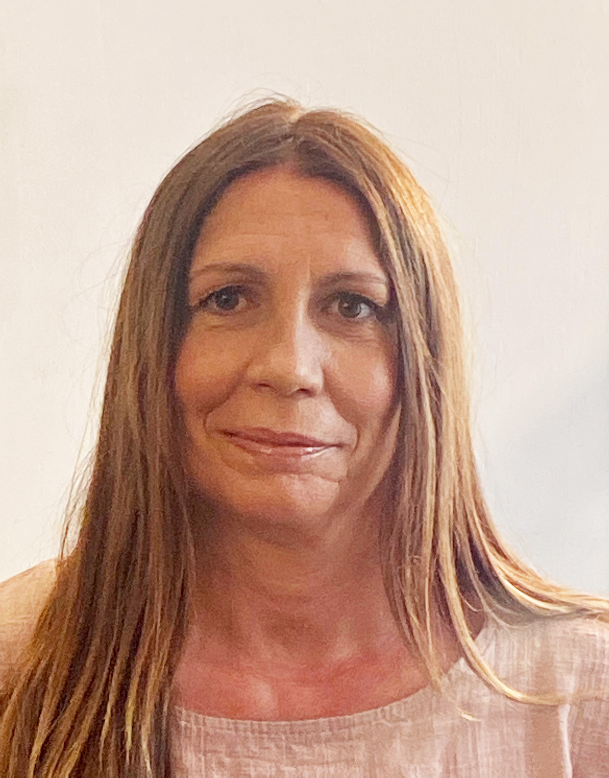
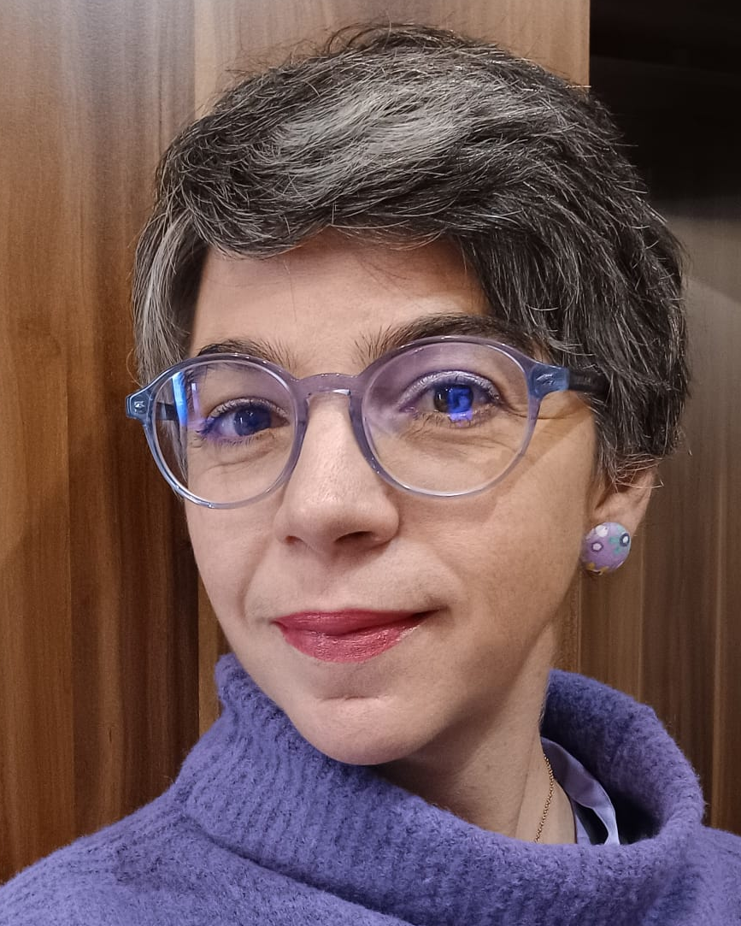
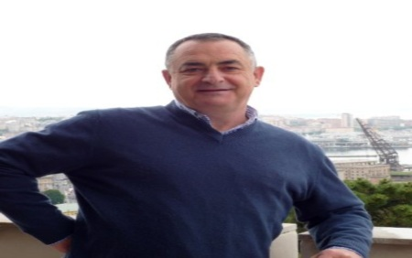

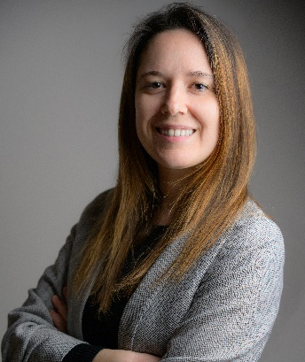
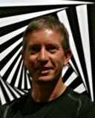
PACRI Elettra team
Renato Gioppo
Project accounting
Caterina Tabacco
Project assistant
Cecilia Blasetti
Project Officer
Gerardo D’Auria
Project Leader
Nuaman Shafqat
RF Engineer
Laura Squarcia
Project Officer
Stefano Deiuri
IT support
The PACRI team at Elettra is now complete,
with Laura joining us full-time for the project.

Slide 15
Conclusions
Thanks to all the Partners, PACRI is running well.
The Grant Agreement and the Consortium Agreement have been finalised.
The 2nd pre-payment tranche will be distributed after approval by the General Assembly.
The amendment submitted to the EC for the exit of Thales-MIS from the Consortium and the addition of UPSACLAY, as Affiliated Entity to CNRS, has been approved on 05/03/2026.
The proposed solution for THALES-MIS's exit from the project ensures that the overall objectives and ambitions of PACRI remain essentially the same.
We are facing a very intense and stimulating period with PACRI…….!

Slide 16

























Acknowledgements
Thanks all PACRI members for the work they have done and for the huge amount of work that lies ahead.
A special thank to Elettra’s working group, which supports all the project activities on a daily basis.
Special thanks also to all colleagues at IST-ID Lisbon for their assistance in organising this event.
Thank you!

Slide 17
Spare slide

Slide 18
Thank you!

