Slide 1
WP2: Scientific + Industrial Exploitation
Debdeep Ghosal, Joseph Wolfenden and Carsten P Welsch
Annual Meeting, Lisbon, 24 March 2026

Slide 2

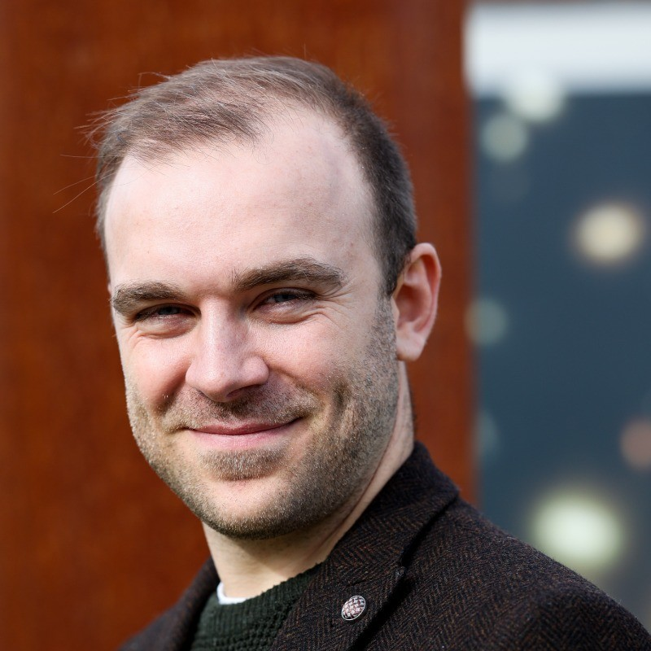


Key Contacts in WP2
Work Package Lead: Prof Carsten P Welsch
c.p.welsch@liverpool.ac.uk
Dr Debdeep Ghosal Communication & Dissemination dghosal@liverpool.ac.uk
Dr Joseph Wolfenden Knowledge Transfer joewolf@liverpool.ac.uk

Slide 3
Milestones and Deliverables
# | Deliverable Name | Status | Due Date
D2.3 | D2.2.1: Initial dissemination and exploitation plan including communication activities | COMPLETED | M06 | Aug-25
D2.4 | D2.3.1: PACRI industrial outreach & exploitation plan. | COMPLETED | M12 | Feb-26
D2.1 | D2.1.1: Evaluation of PACRI technology transfer strategy. | IN PROCESS | M15 | May-26
D2.6 | D2.2.3: Policy briefing report 1. | DUE | M16 | Jun-26
D5.3 | D5.3.1: Report on virtual diagnostics suite for plasma accelerators. | DUE | M42 | Aug-28
D2.7 | D2.2.5: Policy briefing report 2. | DUE | M46 | Dec-28
D2.2 | D2.1.2: PACRI technology transfer report. | DUE | M48 | Feb-29
D2.5 | D2.4.1: Young researchers & gender report. | DUE | M48 | Feb-29
D5.4 | D5.3.2: Report on predictive algorithm, benchmarked through experiments. | DUE | M48 | Feb-29
# | Milestone Name | Status | Due Date
2 | PACRI dissemination plan | COMPLETED | M12 | Feb-26
15 | PACRI technology transfer strategy ready | DUE | M15 | May-26
40 | PACRI technology transfer plan ready | DUE | M48 | Feb-29

Slide 4
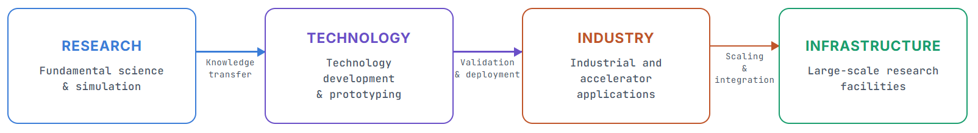
WP2 Overview & Objectives
Ensure visibility of PACRI technologies
Structure industrial engagement
Identify and manage Key Exploitable Results
Maximize visibility and impact of PACRI outputs

Slide 5
Communication
PACRI now has a clear brand consistency with visual coherence.
EU and Swiss funding acknowledged.
Communication leads at all partner organizations identified.
Various templates are available to partners on PACRI SharePoint site including talks, posters, roll-up banners, etc.
PACRI website and LinkedIn page also established – please follow!

Slide 6
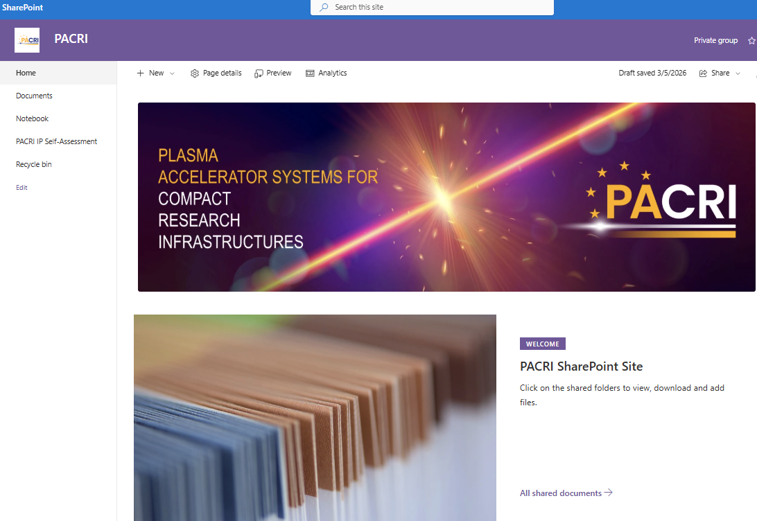
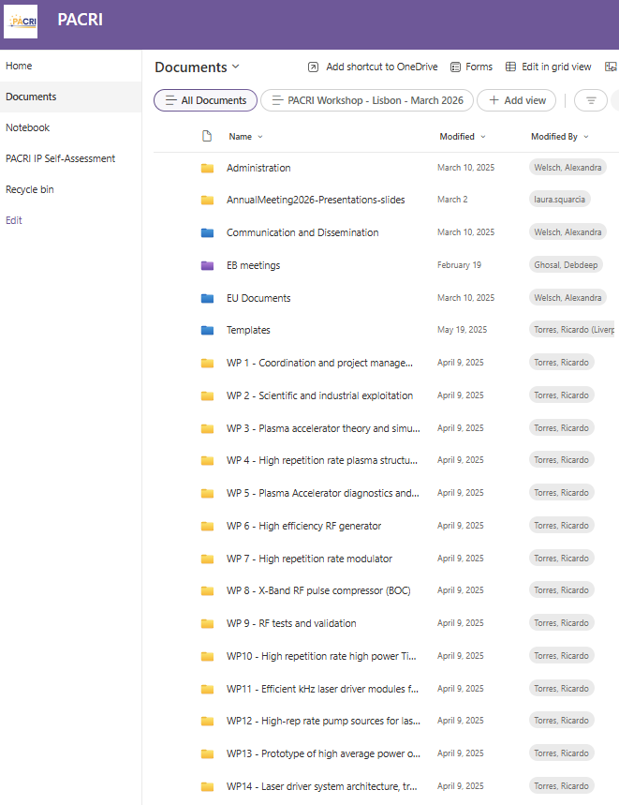

SharePoint
A secure SharePoint platform at ULIV currently acts as central repository for sharing information and archiving project materials safely.
Requires:
Microsoft email account
Two-factor authentication
Please send an email to Debdeep to get access and further instructions
https://theuniversityofliverpool.sharepoint.com/sites/PACRI/

Slide 7
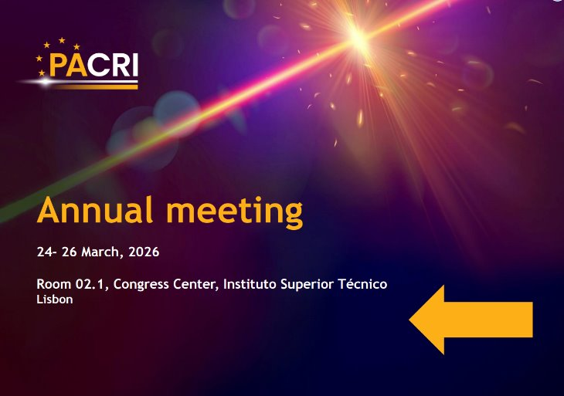
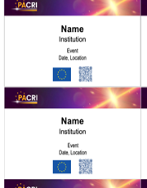

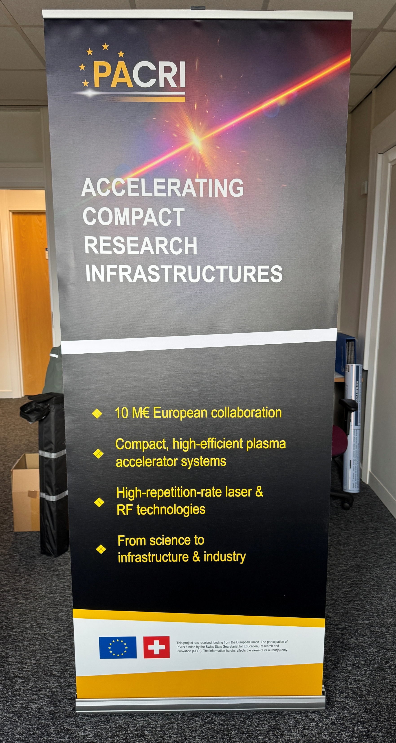

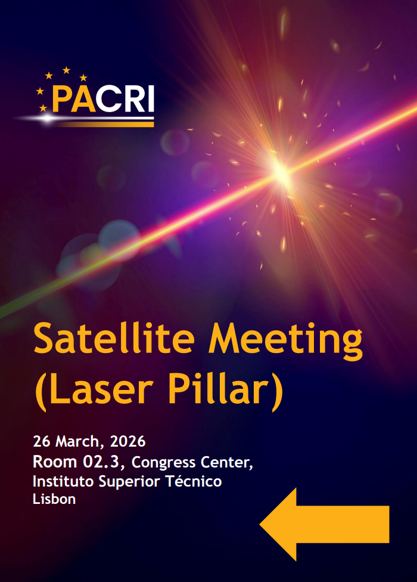
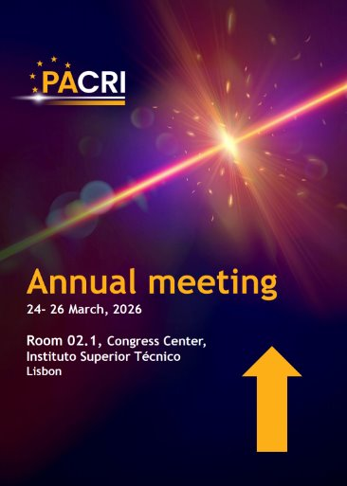
PACRI “look & feel”
Branded materials produced

Slide 8
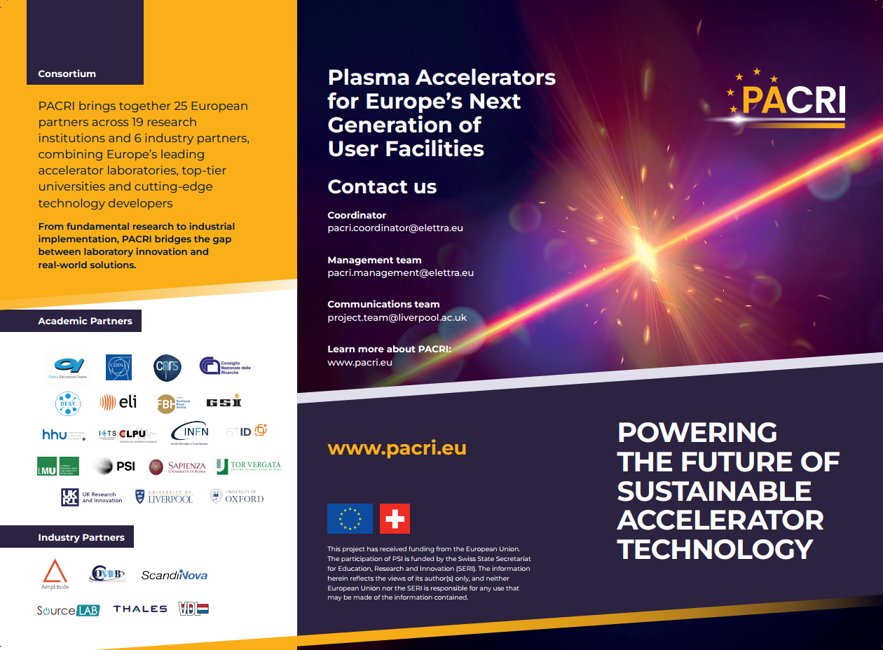
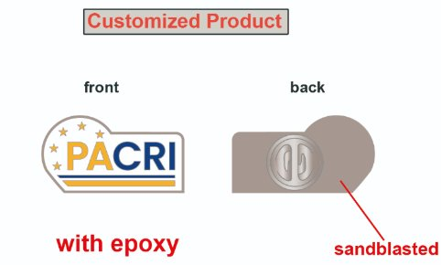
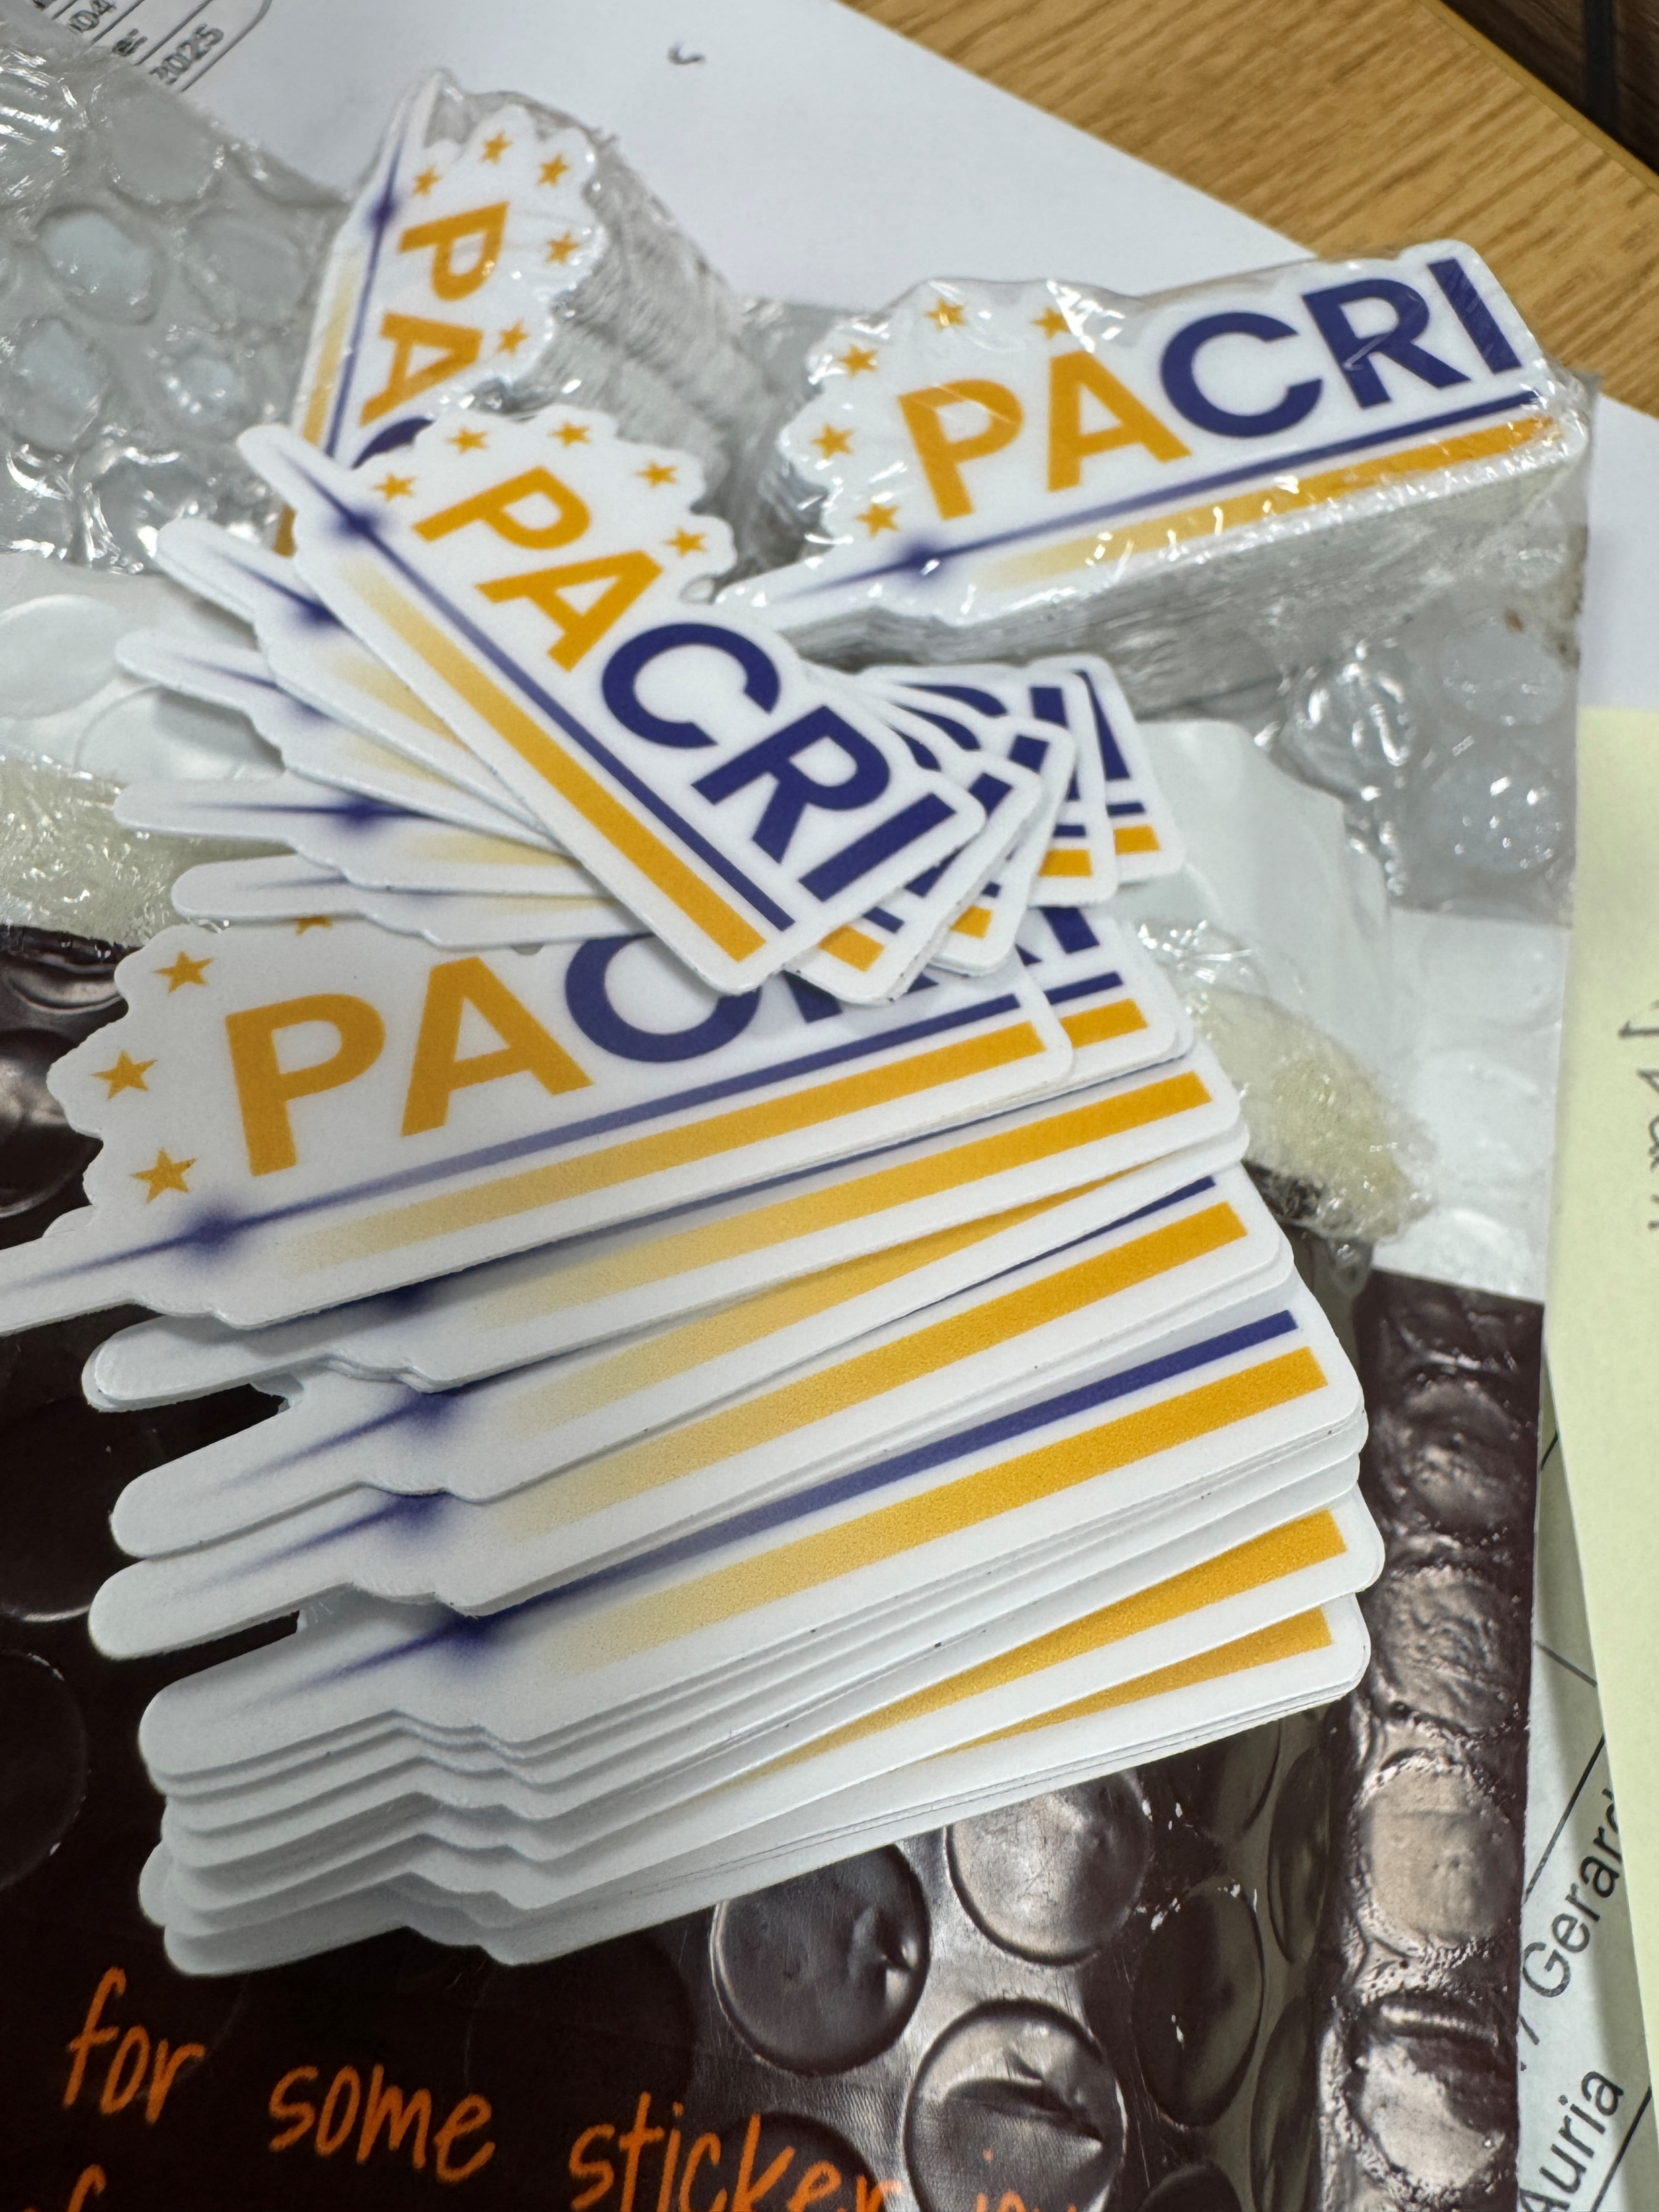
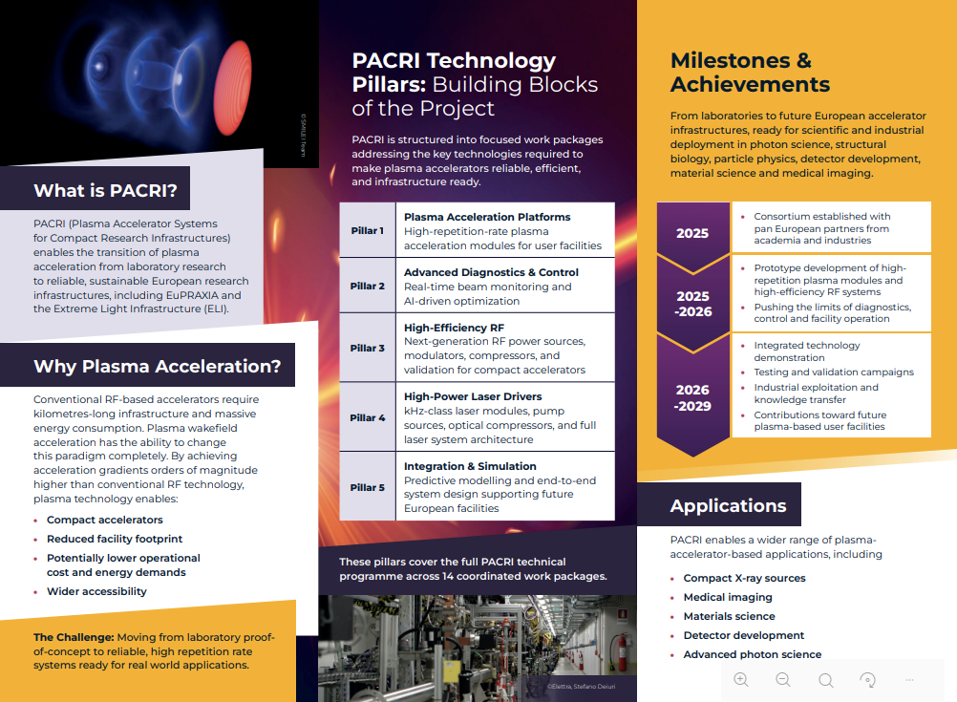
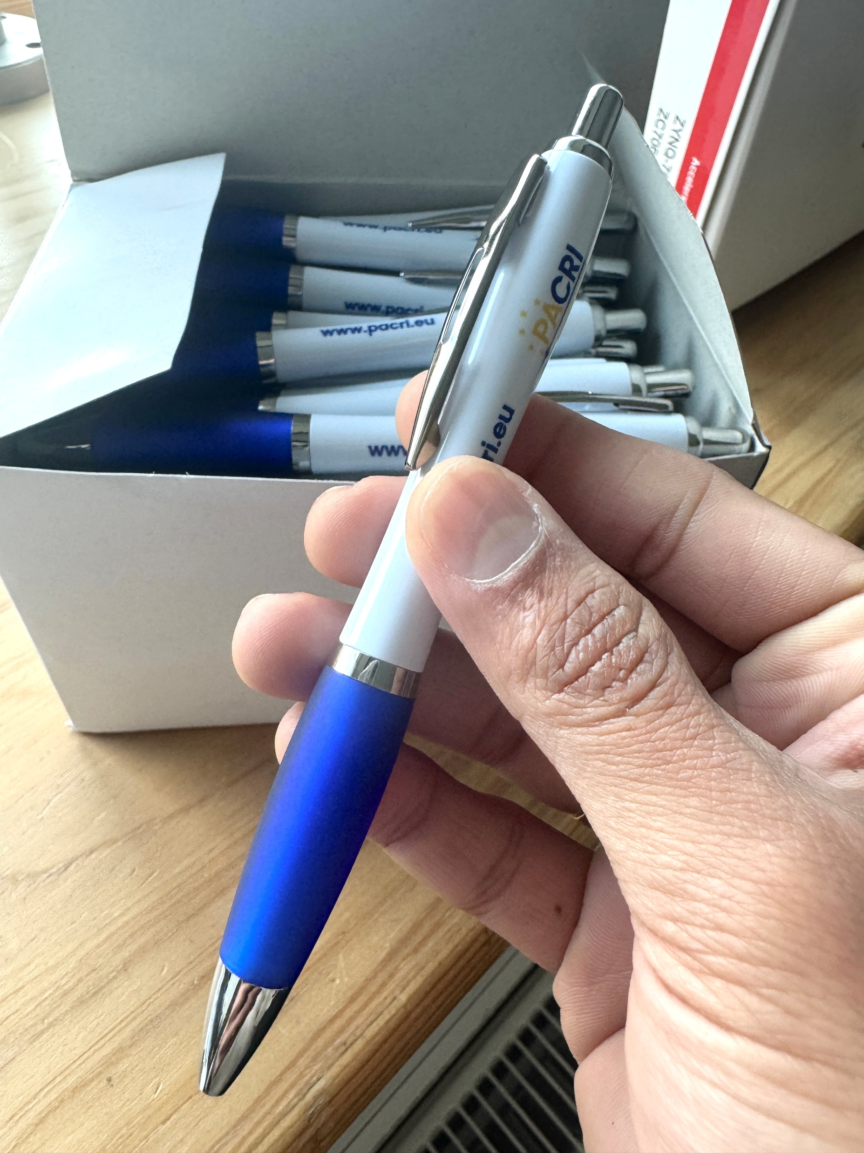
PACRI “look & feel”

Slide 9
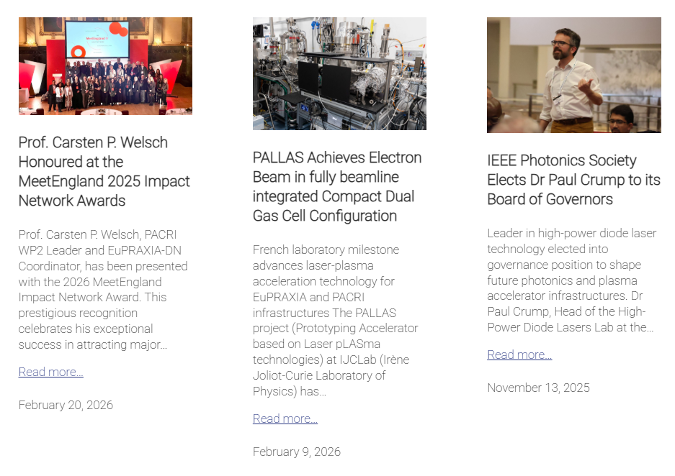
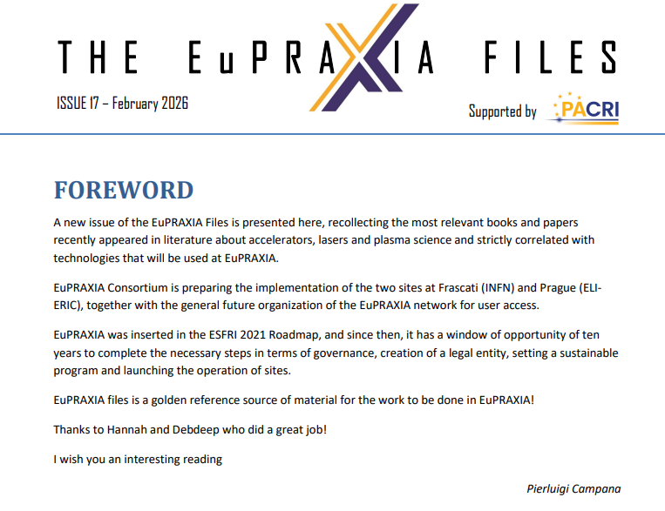
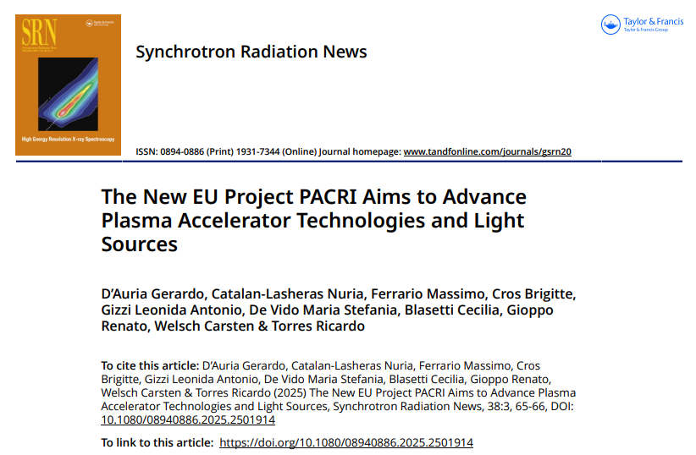
PACRI Communication
PACRI dissemination and exploitation plan (D2.3) developed and submitted.
PACRI publishes regular news about:
Scientific results
Events
Wider project news
Partner news
ULIV can help with:
Drafting press release
Posting on online outlets
Promotion through social media
Please continue to send us (regularly):
R&D highlights, events, prizes etc
1-2 images (with caption, credits and permissions)

Slide 10

Highlighting PACRI ECRs
PACRI | Early Career Feature
Meet the PACRI
Early Career Researchers
Group photo
venue · date
“quote from a PACRI ECR”
ECR name · Institution · Research focus
Profiles
Feature article
Goals
Short bio/research highlights, published on the PACRI website
Published on pacri.eu, showcasing research journeys and training impact
Showcase the next generation of accelerator scientists
Promote PACRI training impact externally

Slide 11


PACRI Events
Annual Meeting organization and delivery with host and coordinator.
Conference presence: IBIC 2025, IPAC’26, Elba conference, etc.
Industry-facing dissemination: target for 2026.

Slide 12


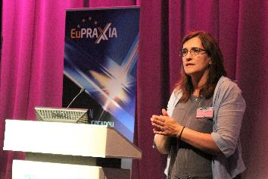
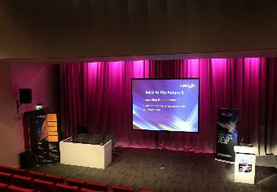
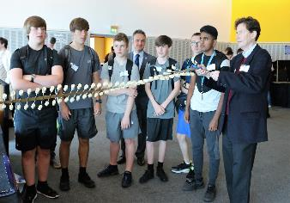
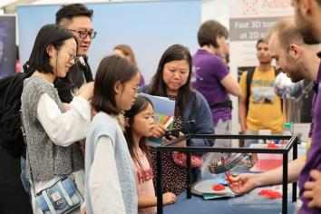
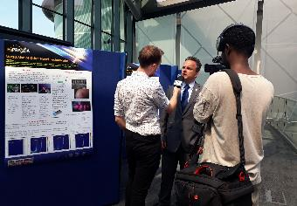
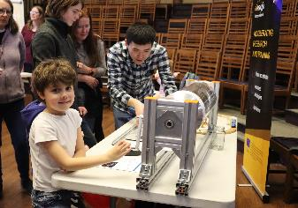
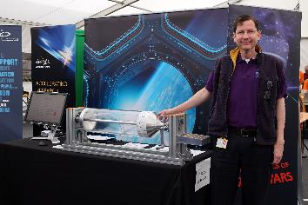
Outreach and Public Engagement
ULIV is a recognized leader in the communication of accelerator science R&D to public audiences through innovative activities, events, and media coverage:
Physics of Star Wars
EuPRAXIA Symposium
Shining a light on particle accelerators
Pint of Science
Daresbury Open Week
Surfatron
Online games
etc.

Slide 13
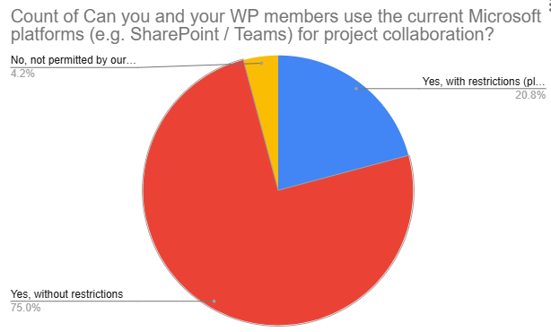
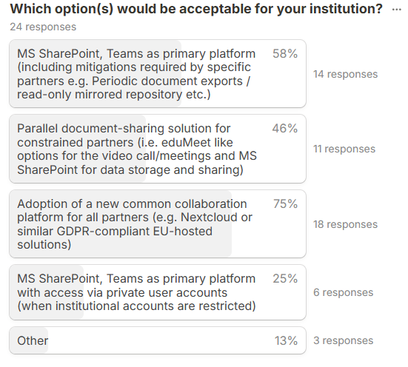
PACRI Collaborative Platform
Poll results
Microsoft SharePoint & Teams were our agreed standard for document management, online meetings and collaboration.
ULIV IT confirmed that data is stored in EU-based data centers, compliant with GDPR​
However, French partners report significant institutional restrictions: Use of US-owned software platforms no longer permitted due to US CLOUD Act
Poll was distributed to WP leaders to identify constraints and acceptable options

Slide 14
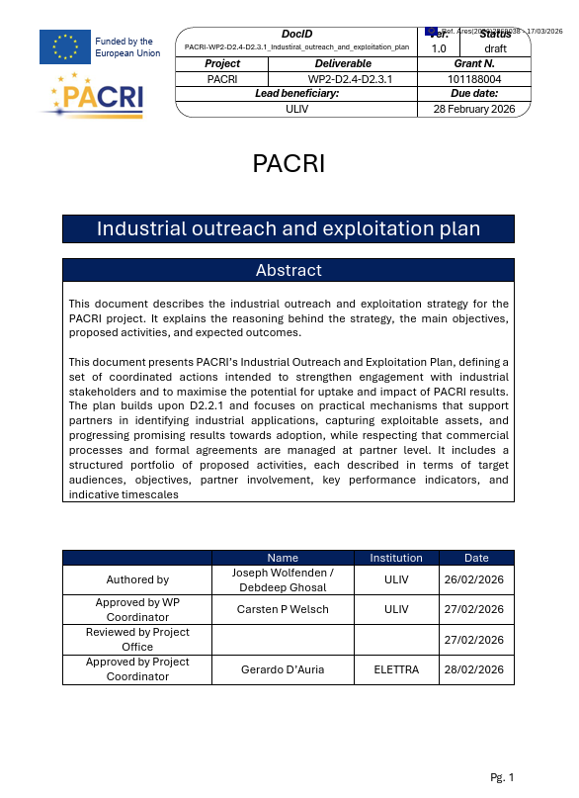
Why a Flexible KT framework is Needed
PACRI is a large and diverse consortium, with universities, labs, and industrial partners contributing in different ways.
Exploitation cannot follow a narrow central route.
Rather than a central hub, we need shared tools and processes.
We need to promote and facilitate existing channels as early as possible.
Detailed exploitation plan developed, D2.4.

Slide 15

Knowledge Transfer Framework
Exploitation leads in each WP to monitor outputs and flag emerging opportunities
IP self-assessment tool to support early identification of exploitable results
Internal PACRI IP register to catalogue inventions, designs, and TRL levels
Annual exploitation review to track progress, priorities, and next actions
Engagement with partner TTOs to support early IP evaluation
Follow-on tools for use-case and market mapping to clarify routes toward uptake

Slide 16
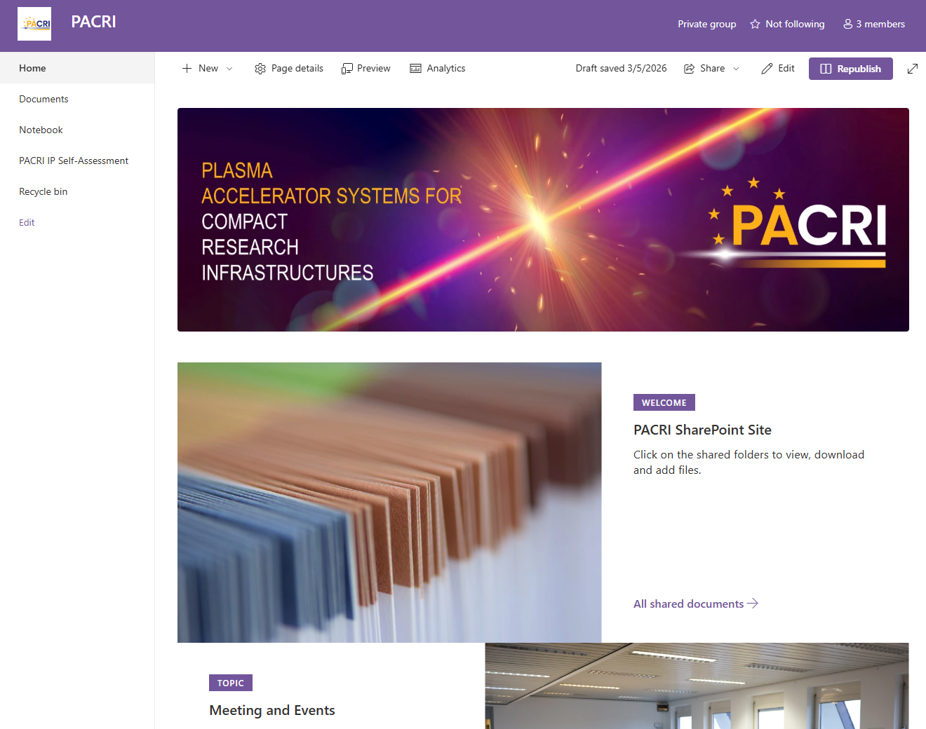
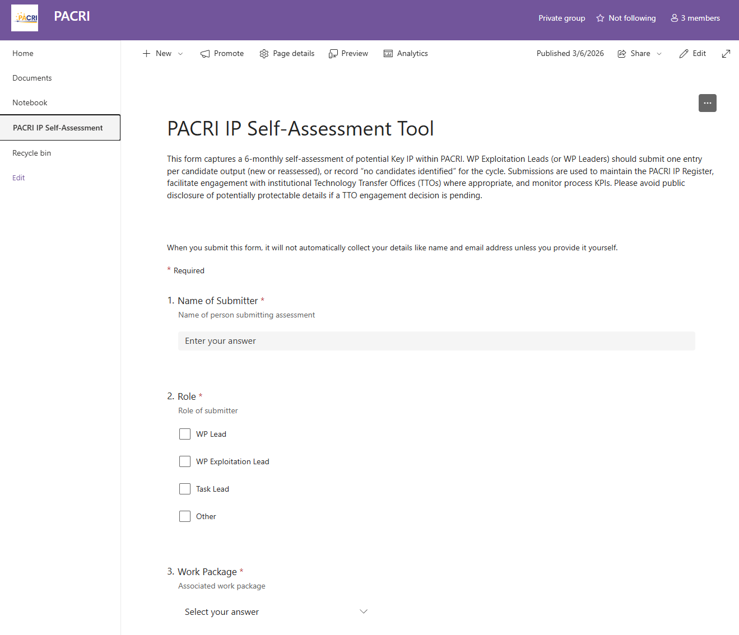
IP Self-assessment Tool

Slide 17


How the Framework Supports Translation
Internal
External
Identify promising PACRI outputs early
Document technical results and ownership
Assess exploitation potential and maturity
Align partners on next steps and support
Define relevant use cases and applications
Understand market needs and user demand
Clarify the value proposition of outputs
Engage industry and external stakeholders

Slide 18






KT: Next Steps
Framework now needs to be implemented…
Monitor KPIs
Measure progress and refine priorities
WP2
Assess Opportunities
Impact
Ongoing evaluation of developments
Engage TTOs
Connect with support and potential users
Identify Outputs
Spot promising results early

Slide 19

Join Informal WP2 Discussions
Topics | Aims
Communication activities Dissemination opportunities Outreach initiatives Impact and exploitation | Exchange ideas Identify collaboration opportunities Collect feedback
Supporting handouts
PACRI dissemination & outreach overview
Collecting ideas for joint dissemination and engagement activities

Slide 20
Summary
By working together closely, we will continue to maximize PACRI’s impact across several parallel pathways.
The new IP self assessment tool will help ensure the translation of innovations into applications that deliver economic and societal value.
The PACRI communication plan ensures effective communication of all project results across multiple channels.
Next steps: Agree on collaboration tools, use PACRI templates to maximize visibility, engage in communication activities and join informal discussions.
Thank you!

Slide 21

www.pacri.eu

