Slide 1
WP6: High efficiency RF generator WP7: High repetition rate modulator
Mikael Lindholm, Kévin Pepitone / ScandiNova Systems

Slide 2
OUTLINE
Modulator
Operating modes
Klystron design
Specifications
Timeline

Slide 3
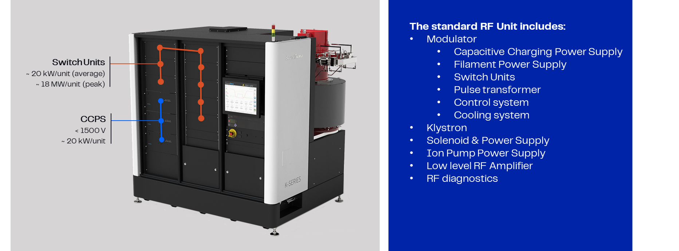
MODULATOR

Slide 4
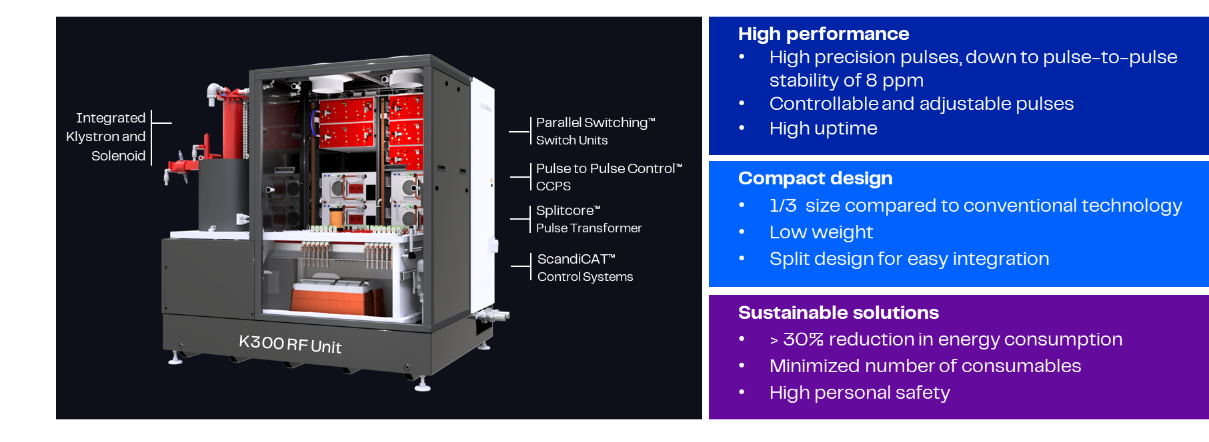
MODULATOR

Slide 5


OPERATING MODES
Long pulse duration
25 MW RF peak power at 11994 MHz
1.5 us RF pulse
High repetition rate
25 MW RF peak power at 11994 MHz
400 Hz repetition rate
Up to 307 kV and 195 A
1.2 us RF pulse
500 Hz repetition rate
Up to 307 kV and 195 A
RF average power is calculated to be 15 kW, and the klystron’s collector dissipation in diode mode is 87 kW (based on the design).
RF average power is calculated to be 15 kW, and the klystron’s collector dissipation in diode mode is 70 kW (based on the design)

Slide 6
KLYSTRON DESIGN
Existing klystron
Standard design
New klystron
Performances
Gain for future projects
Risks of oscillations with HE klystron
Efficiency
E37119 with VT-68970
25 MW
40% efficiency
48 dB gain
E37126,PRT with VT-68970
25 MW
50% efficiency TARGET
50 dB gain TARGET

Slide 7

KLYSTRON DESIGN
The High Efficiency prototype klystron has
Same dimensions as the E37119
Full compatibility with the existing solenoid, power combiner and X-ray shield
Based on the acquired knowledge by Canon on the collaboration with CERN
Alternatives:
Option 1: Using the existing klystron
Option 2: Using a new developed klystron with no guarantee of results (as initial concept)
Option 1.5: Improve existing klystron without high risk

Slide 8
SPECIFICATIONS
Parameter | Unit | Range/Value
Modulator peak power (max) | MW | 59.9
Modulator Average power (max) | kW | 81.3
Klystron Voltage (min/max) | kV | 0-307
Klystron Current (min/max) | A | 0-195
PRF range (min/max) | Hz | 0-400/500
Pulse Length FWHM (min/max) | µs | 0-3.02/2.72
Pulse Length TOP (min/max) | µs | 0-1.5/1.2
Top flatness (dV) | ⁺/₋% | 0.5
Pulse to Pulse stability rms (max) | ppm | 20
Rate of rise | kV/µs | > 276
Rate of fall | kV/µs | > 273
Klystron Current
Klystron Voltage
50%
Pulse Length (FWHM)
Pulse Length (top)
Pulse Length (TOP)
dV
Rate of Rise

Slide 9
TIMELINE
Klystron: Estimated deliver time from the order
Task | 1 | 2 | 3 | 4 | 5 | 6 | 7 | 8 | 9 | 10 | 11
Design
Procurement
Assembly and test
Shipment
Modulator
Task | March 2026 | April 2026 | May 2026 | June 2026 | July 2026 | August 2026 | September 2026 | October 2026 | November 2026 | December 2026 | January 2027 | February 2027 | March 2027 | April 2027 | May 2027 | June 2027 | July 2027 | August 207 | September 2027
Design
Procurement
Assembly and test
Shipment

Slide 10

Thank you from your attention

