Slide 1
WP6: X-band generator
G. D’Auria
Elettra - Sincrotrone Trieste

Slide 2
RF X-band
WP6: High efficiency RF generator (Elettra)
Task 6.1: X-band klystron parameters review
Task 6.2: Klystron acquisition
WP7: High repetition rate modulator (Scandinova)
Task 7.1: Modulator design
Task 7.2: Prototype production
WP8: RF pulse compressor (INFN)
Task 8.1: BOC design
Task 8.2: BOC prototype construction
Task 8.3: BOC low power RF characterization
WP9: High power RF tests and validation (CERN)
Task 9.1: Set up of the RF testing area
Task 9.2: RF systems power tests

Slide 3
Klystron contingency plan
Following THALES-MIS's exit from PACRI, Elettra took over the coordination of WP6, with the support of SCANDINOVA and the other members of the PACRI RF pillar.
We have contacted Canon for purchasing an X-band klystron that meets most of PACRI’s requirements, to be installed on the SCANDINAVA modulator.
Canon has agreed to provide us a slightly modified version of their 25 MW tube (mod. E37119) with the aim to increase its efficiency from 42% to 50%.
We are carefully evaluating this option, trying to minimize risks and unexpected problems.

Slide 4
Reallocation of THALES Tasks/Deliverables
Work Package | Tasks | Thales AVS p/m | Reallocated to
WP2: Scientific and industrial exploitation | Task 2.1: Tecnology transfer strategy & networking Task 2.2: Dissemination. Task 2.3: Industrial Exploitation. | 1 | Elettra
WP6: High efficiency RF generator (WP Leader) | Task 6.1: CANON X-band klystron specs review Task 6.2: Purchase of the X-band klystron from CANON | 19 | Elettra (15) Scandinova (4)
WP7: High repetition rate modulator | Task 7.1: High voltage modulator design Task 7.2: Prototype production. | 1 | Scandinova
WP9: RF tests and validation | Task 9.1: Set up of the RF test area. Task 9.2: RF systems power tests and validation. | 3 | Elettra (2) Scandinova (1)
Deliverables
Deliverable Name | Short description | WP | Short name of NEW lead participant | Type | Dissemination level | Delivery month
D 6.1 | Revised high efficiency klystron parameters | 6 | Elettra | Report | SEN | 15
D 6.2 | Report on klystron purchasing | 6 | Scandinova | Report | P | 27
D 6.3 | Klystron delivery report | 6 | Scandinova | Report | P | 36

Slide 5
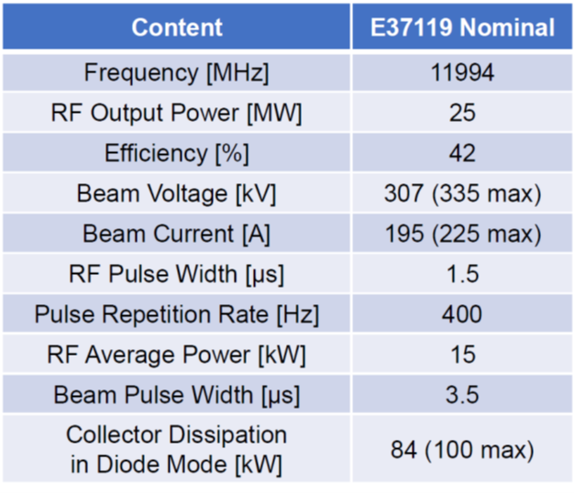

CANON E37119 operating parameters
High efficiency E37119 klystron
(as proposed by CANON)
Existing E37119 klystron
50
With modification
of RF circuit
RF window unchanged
Collector unchanged

Slide 6
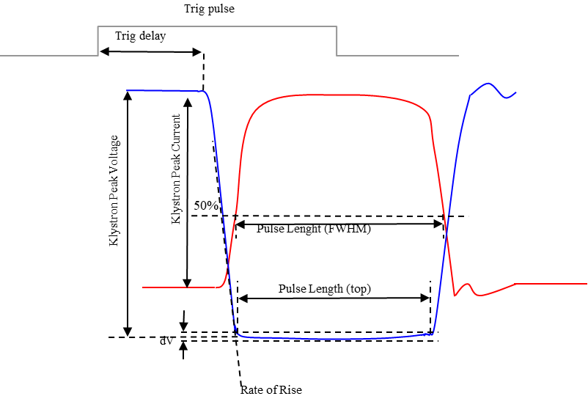

HV modulator operating parameters
Modulatror voltage and current pulses

Slide 7
High efficiency E37119 CANON timeline
Less than 1 year!

Slide 8
Conclusions
The contingency plan to address THALES' exit from the project has been finalized and approved by the European Commission.
The proposed solution ensures that PACRI's overall objectives and ambitions remain essentially the same.
We will purchase a Canon klystron to be installed on the modulator under development at SCANDINOVA.
Over the next few months, we will decide whether to opt for a high-efficiency klystron, as proposed by CANON, or to minimize risks, by selecting a klystron that can only operate at a higher repetition rate.

Slide 9
Thank you!

