Slide 1
WP08: X-band RF pulse compressor
F. Cardelli, INFN-LNF
PACRI Annual Meeting, Lisbon, 24-26 March 2026

Slide 2
WP08 Objectives
Objectives:
The objective of WP8 is to design and fabricate an innovative X-band pulse compressor system based on a single high-order-mode RF cavity, employing a clamped configuration (brazing free). The system shall achieve a power multiplication factor ≥ 3 when operated in conjunction with the klystron and modulator developed within WP6 and WP7.
Task 8.1:
The electromagnetic (EM) design and thermal analysis of the pulse compressor will be carried out by INFN (BE3) and subsequently translated into final manufacturing drawings by COMEB (BE8). Innovative mechanical solutions will be adopted for the BOC cavity structure, enabling a fully clamped assembly without brazing.
Task 8.2:
The BOC prototype will be manufactured by VDL (BE7). The fabrication process will target extremely high precision and accuracy, at the micron level, which will be verified through dedicated metrology measurements. Following the manufacturing phase, the RF compressor will be assembled and characterized on a microwave test bench in order to validate its performance.

Slide 3
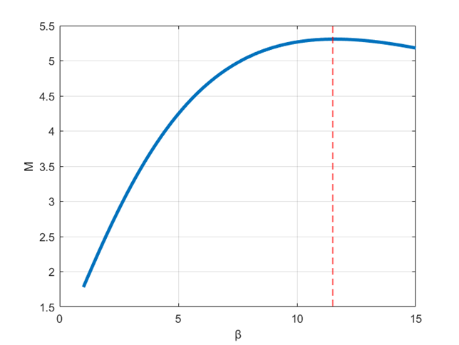
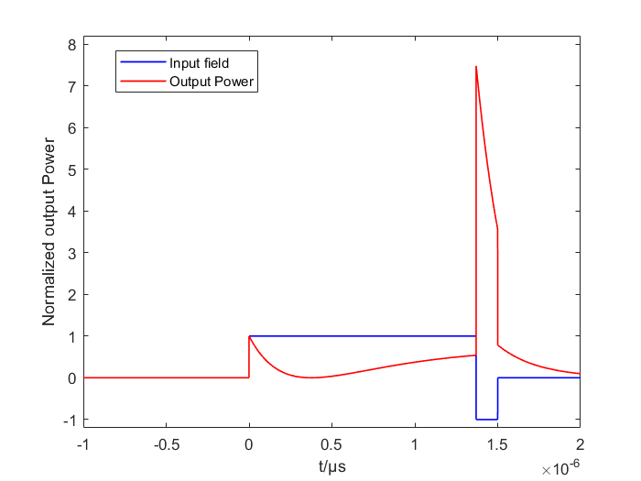
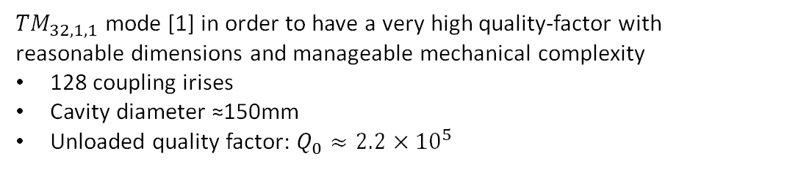
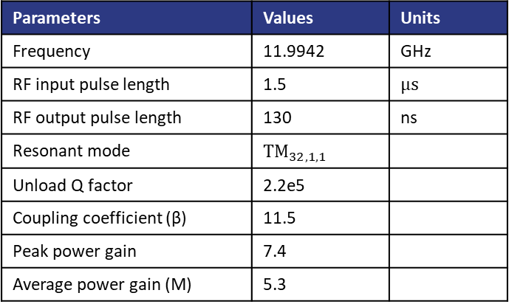
BOC type pulse compressor
BOC type pulse compressors:
large unloaded quality factor,
lower surface fields
large mode seperations
Reference value | unit | High rep. rate | Very high rep. rate
Operating frequency | GHz | 11.9942 | 11.9942
Repetition rate | Hz | ≥400 | ≥500
Target average power multiplication M |  | ≥3 | ≥3
Target compressed RF pulse length | ns | 130 | 100
RF input pulse length | ns | 1500 | 1000
${TM}_{32,1,1}$ mode [1] in order to have a very high quality-factor with reasonable dimensions and manageable mechanical complexity
128 coupling irises
Cavity diameter ≈150mm
Unloaded quality factor: $Q_{0}≈2.2×{10}^{5}$
Parameters | Values | Units
Frequency | 11.9942 | GHz
RF input pulse length | 1.5 | $$μs$$
RF output pulse length | 130 | ns
Resonant mode | $${TM}_{32,1,1}$$
Unload Q factor | 2.2e5
Coupling coefficient (β) | 11.5
Peak power gain | 7.4
Average power gain (M) | 5.3
(11.5,5.3)
[1] P. Wang, et al., Design, fabrication and RF measurements of the storage and correction cavity prototypes of the RF pulse compression system for the klystron-based CLIC main linac, in Nuclear Instruments and Methods in Physics Research Section A: Accelerators, Spectrometers, Detectors and Associated Equipment, Volume 1084 (2026)

Slide 4
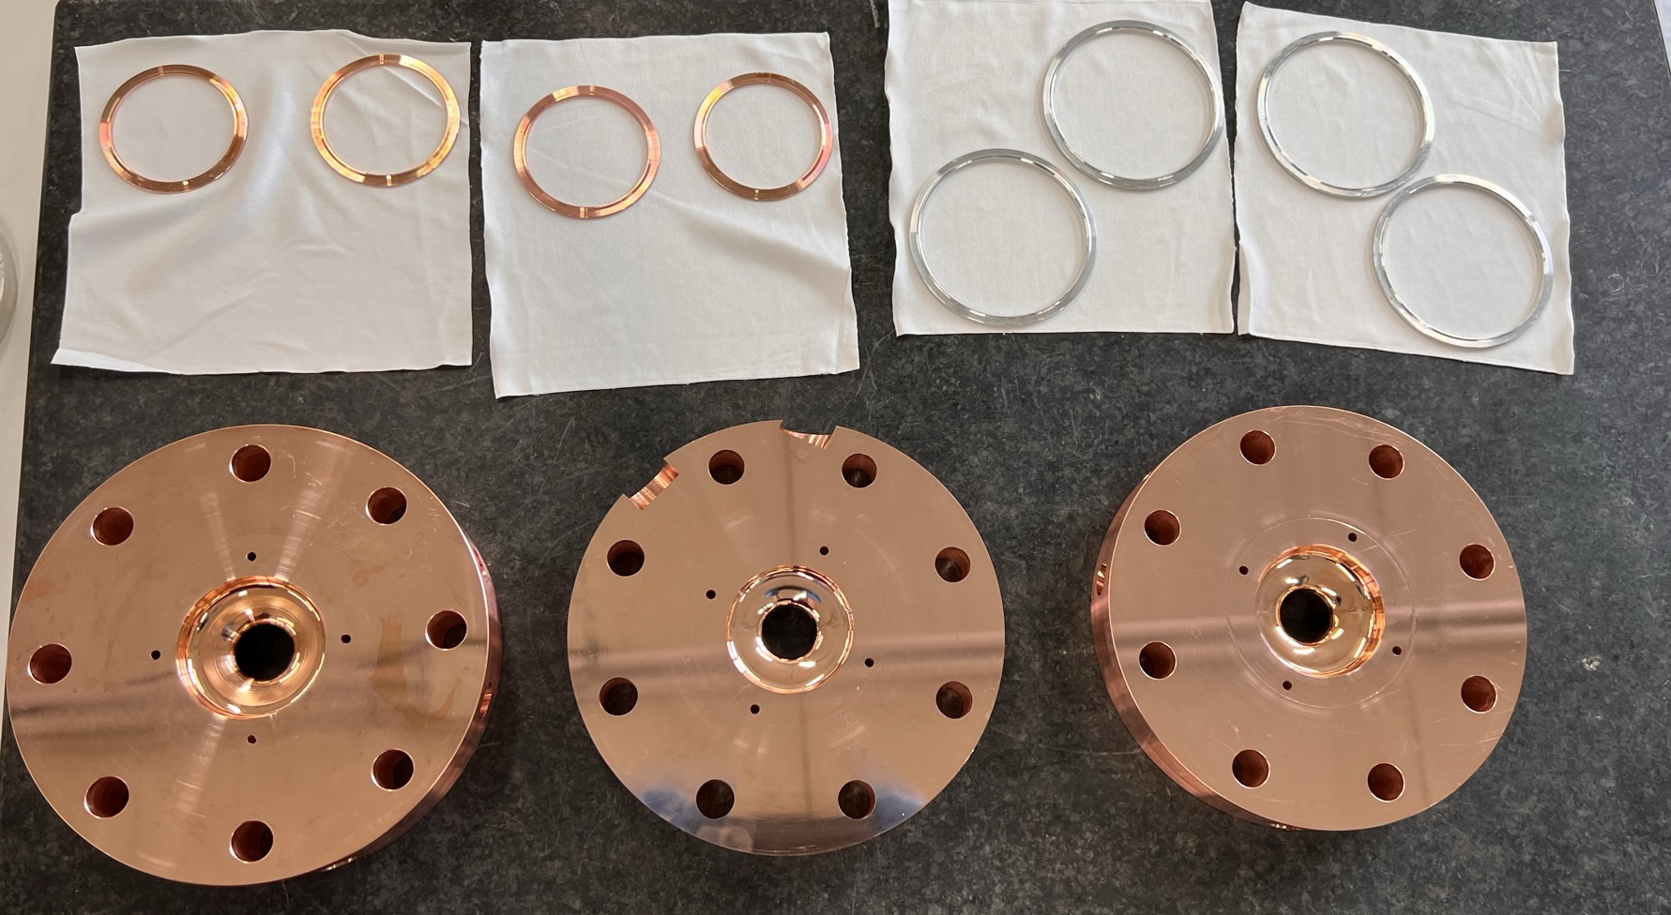
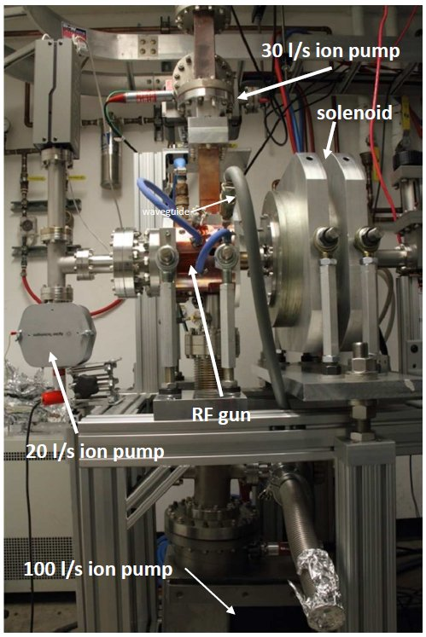
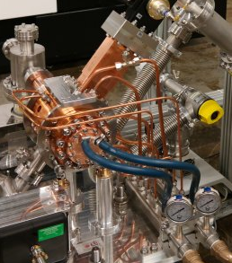
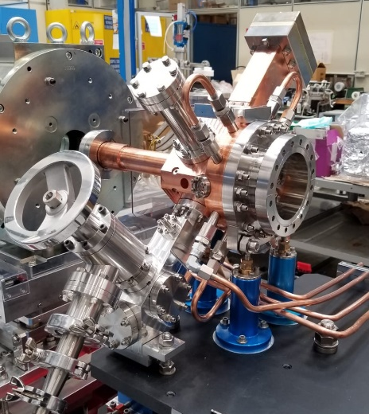
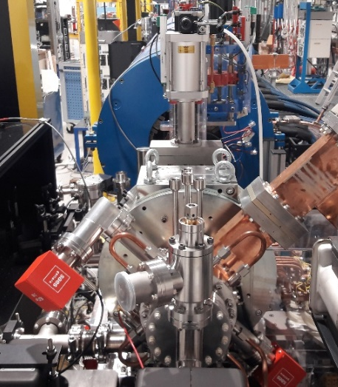
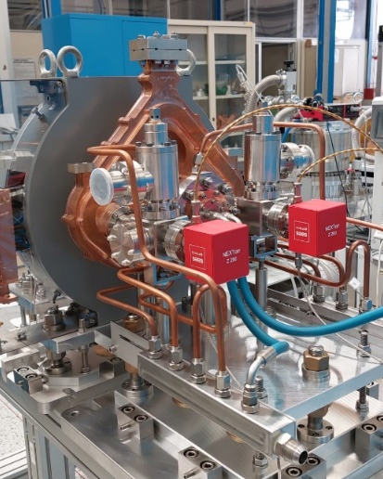
INFN Brazing free technology
INFN clamping-gasket technology and allow to avoid brazing process
Use simple screws to assemble the different machined parts, and the vacuum seal and RF contact are achieved through the use of metal gaskets or bite-edge seals.
Reduction of costs and production time.
Reduction of conditioning time and operation at higher surface fields by using hard copper.
In the last ∼10 years different RF photo-injectors have been realized based on this technology:
NEW SPARC_LAB
C BAND (I.FAST/TUAREG)
SPARC
ELI-NP
CLEAR (CERN)
D. Alesini et al., Phys. Rev. ST Accel. Beams 18, 092001 (2015)
D. Alesini et al., PHYS. REV. ACCEL. BEAMS 21, 112001 (2018)
In operation @ CERN (2020)
V. Shpakov et al., et al 2022 JINST 17 P12022 (2022)
Successfully tested @ PSI
In operation
@SPARC_LAB
A. Giribono PRAB 26, 083402, 2023
In operation @UCLA
Tested at high power
S Band (2856 GHz and 2998 GHz)
C Band (5.712 GHz)

Slide 5
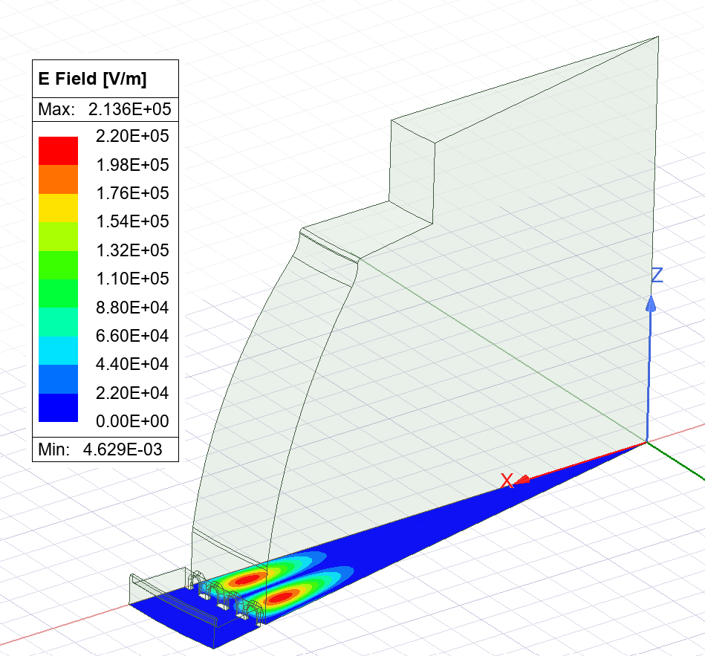
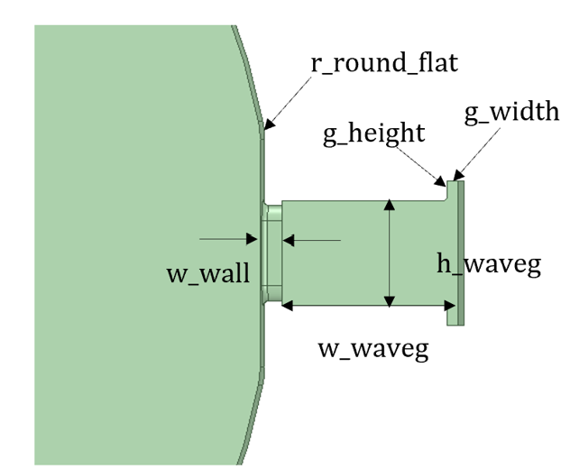
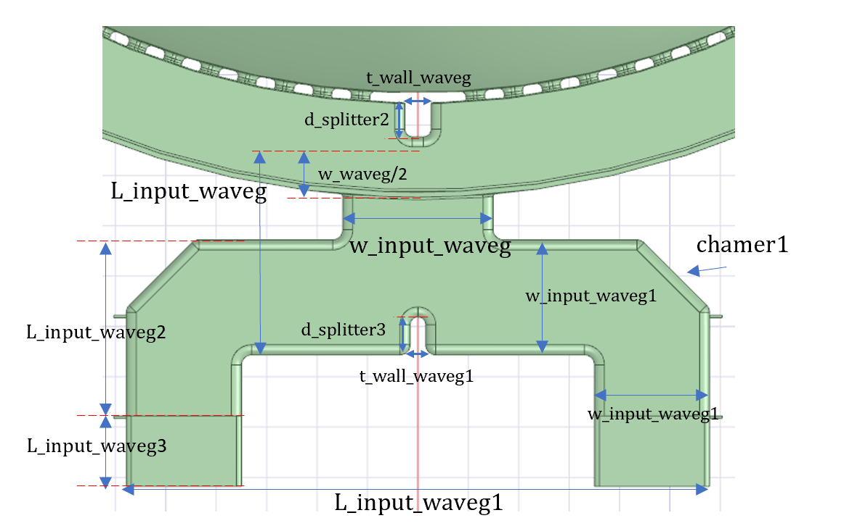
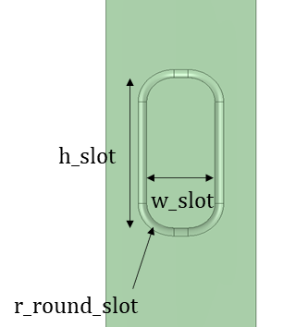
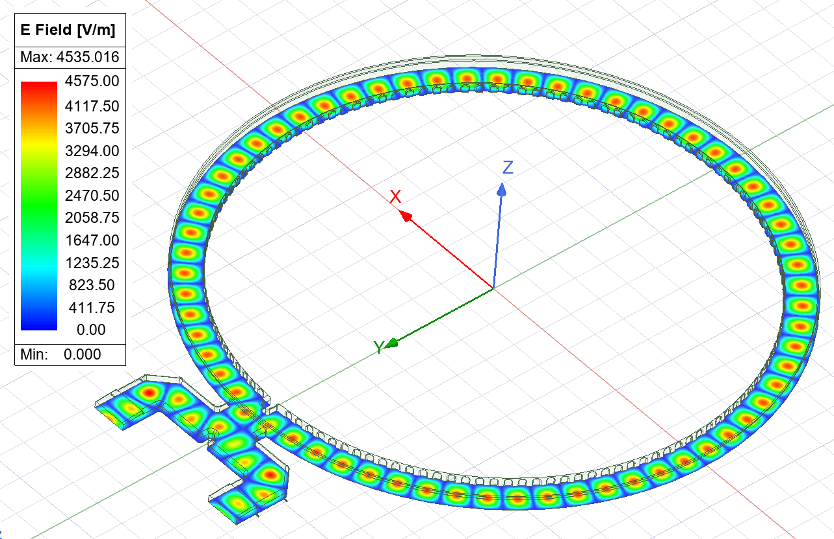
Electromagnetic design
Shape and diameter of the cavity tuned to resonate at the working frequency and mode separation
Gap introduced for brazing-free assembly with a width ≈ 1 mm and rounded edges to reduce field enhancement
  No significant degradation of TE₀₁ mode
Tuning of the width of the waveguide around the cavity and of the coupling holes
4-port RF input coupler minimizes reflections and allow the presence of the gap
Bite-edge contact
g_width
Bite-edge contact

Slide 6
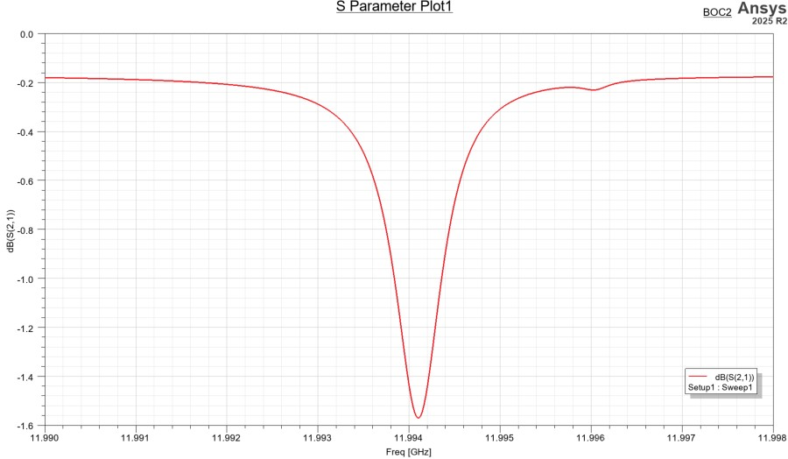
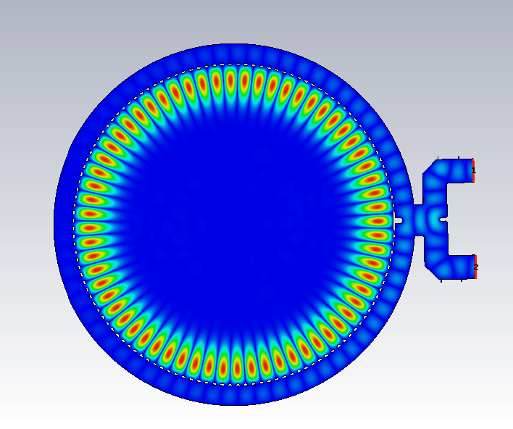
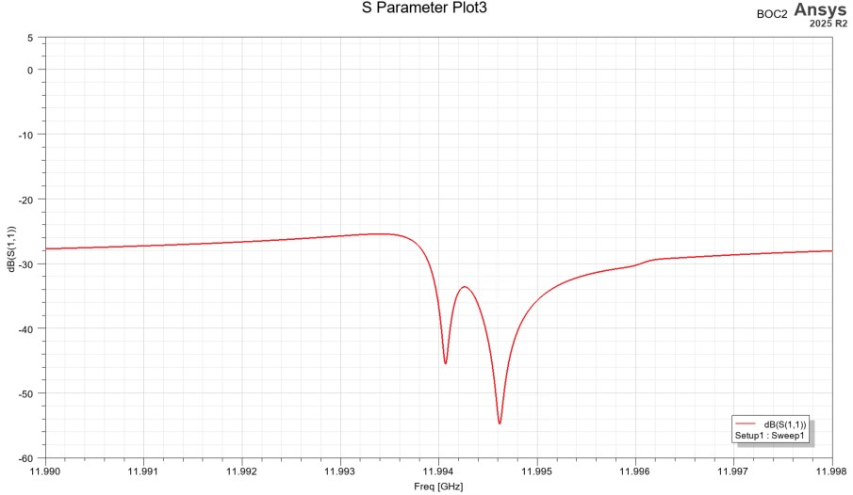
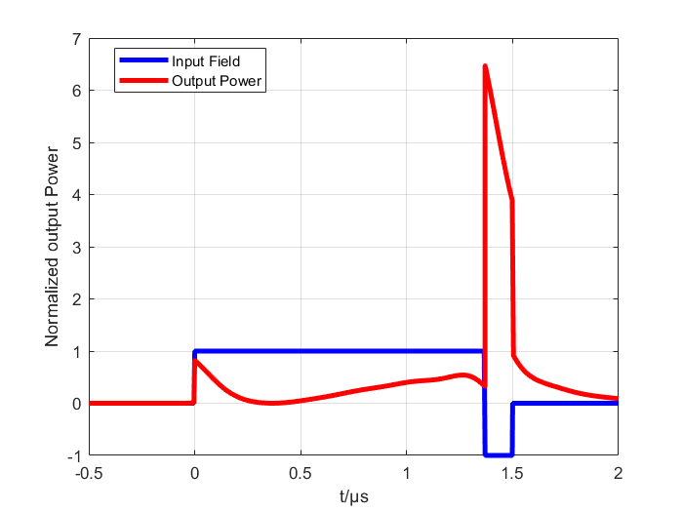
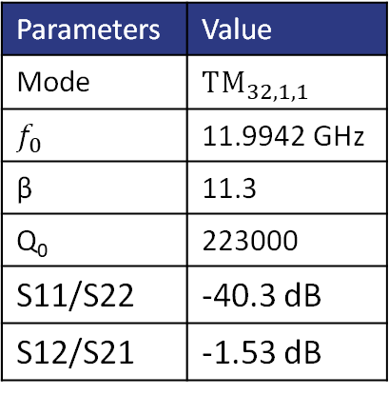
Simulation results
Simulation performed both with Ansys HFSS and CST
Parameters | Value
Mode | $${TM}_{32,1,1}$$
$$f_{0}$$ | 11.9942 GHz
β | 11.3
Q₀ | 223000
S11/S22 | -40.3 dB
S12/S21 | -1.53 dB
The waveforms calculated from the simulated S21

Slide 7
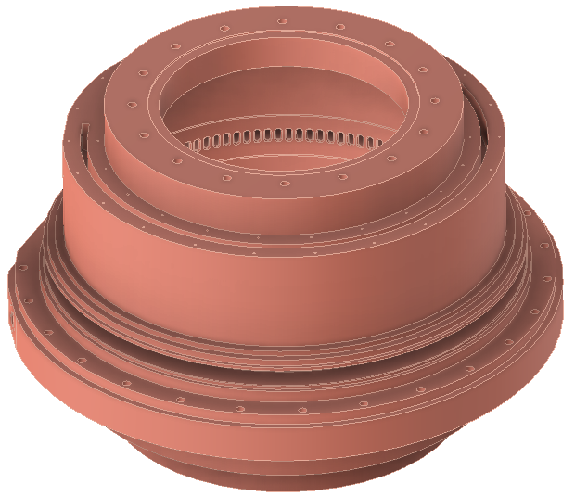
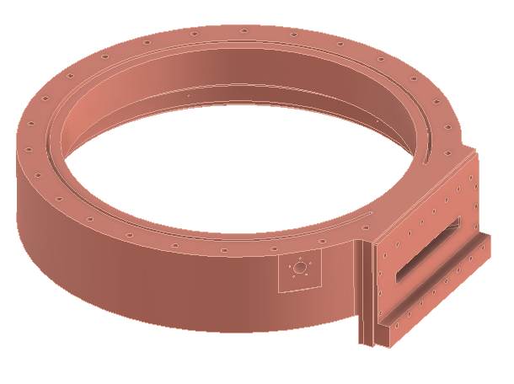
Mechanical design
Continuous feedback between the electromagnetic design and the mechanical model has been required to ensure consistency between RF performance and mechanical constraints for the clamping gasket technique.
The machining capabilities of the manufacturer (VDL) have been taken into account to guarantee the required tolerances for all critical components.
The main cavity is machined from a single bulk OFHC copper piece, including the coupling slots and part of the surrounding waveguide.
The surrounding waveguide is then completed with an outer machined ring, coaxially inserted onto the main body.
  Vacuum sealing ensured by 2 custom aluminum gaskets.
  RF electrical contact is achieved through 2 dedicated bite-edge contacts.
The input RF coupler is realized clamping two parts to the outer ring, using 2 dedicated aluminum gaskets.
A preliminary cooling system has been implemented, consisting of four cooling channels with a flow rate of approximately 20 L/min of demineralized water.
The cooling channels are sealed by stainless steel rings, which also provide mechanical reinforcement of the structure and serve as the interface for the support system.

Slide 8
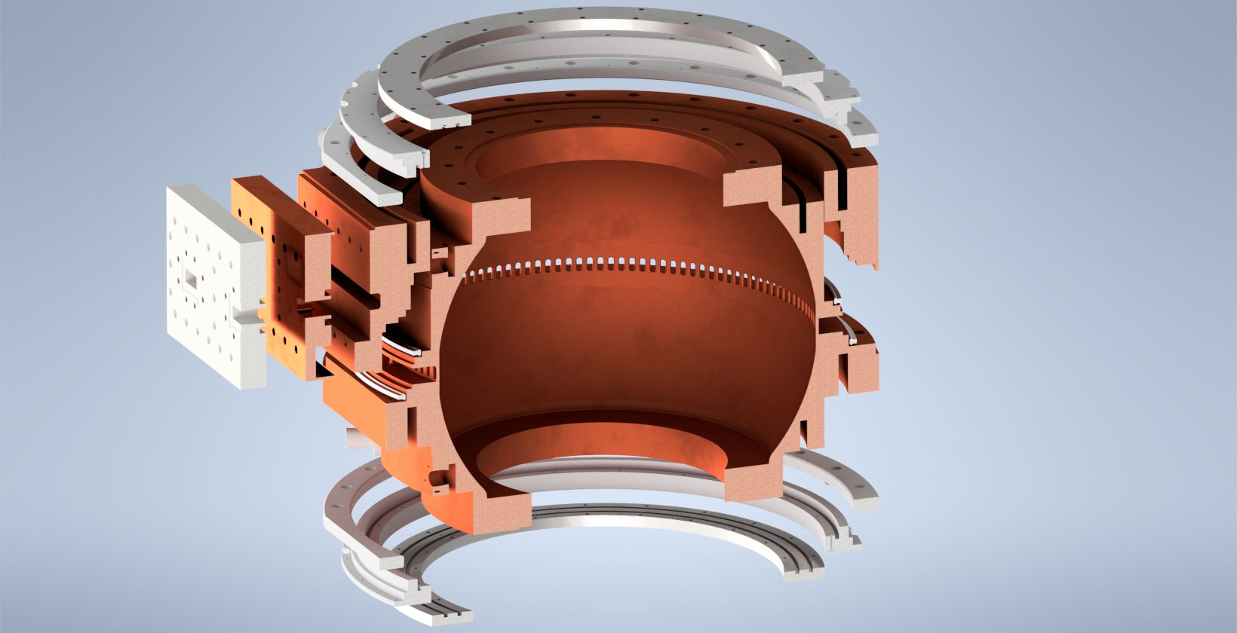
Mechanical design
Input hybrid
Gasket seat
Cooling channels lid
Waveguide wall
Input flange
1.
1.
Aluminum gasket
2.
2.
Cooling channels
Cavity
Cooling channels lid

Slide 9
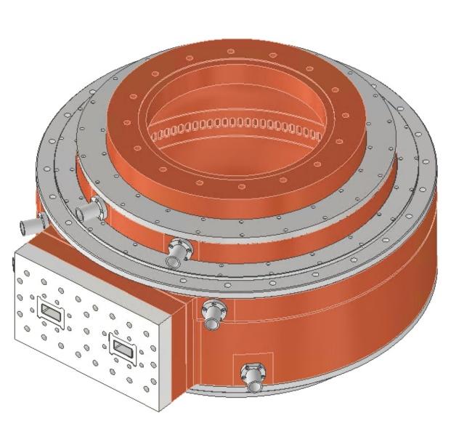
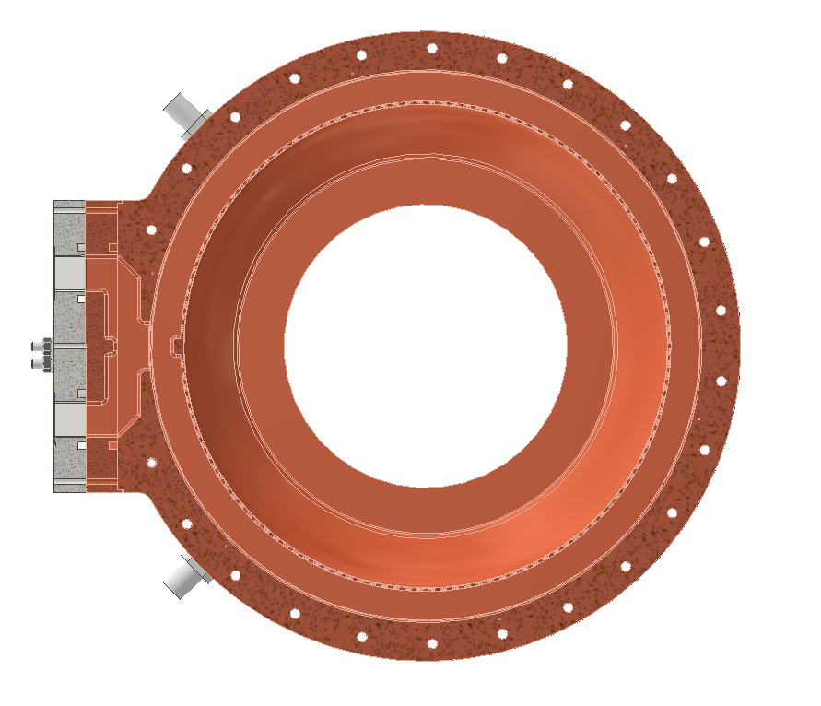
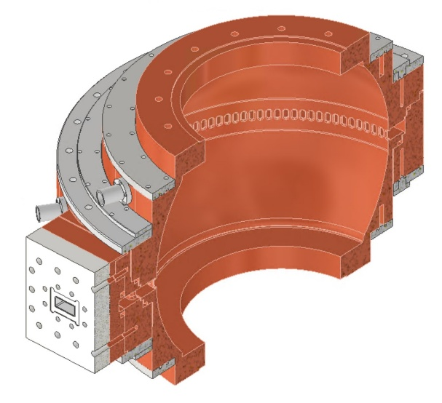
Mechanical design
Final configuration
Cap with 55l Starcell ion pump
WR90 flanges
4x Cooling channels

Slide 10
Next steps
Thermo-mechanical simulations and tolerances studies (ongoing)
Final mechanical design optimization and supports design (ongoing)
Test of the custom gaskets sealing and of the assembly procedure on a simplified sample prototype (low internal finishing requirements and low tolerances of the cavity wall and slots.).
Final 2D constructive drawings by COMEB
Purchase order for OFHC copper material and machining of the different parts by VDL
Final assembly and vacuum test @VDL
RF characterization at low power @INFN-LNF
Integration in the final setup @CERN for high power testing
Tentative schedule
TASK | 2026 |  |  |  |  |  |  |  |  |  | 2027
 | Mar. | Apr. | May | Jun. | Jul. | Aug. | Sept. | Oct. | Nov. | Dec. | Jan. | Feb. | Mar. | Apr. | May | Jun. | Jul. | Aug. | Sept. | Oct. | Nov. | Dec.
Test gasket prototype (INFN)
Final 2D Drawings (COMEB)
Ordering Cu material (VDL)
Production BOC prototype parts (VDL)
Assembly and testing (INFN and VDL)

Slide 11
Conclusions
The BOC electromagnetic (EM) and preliminary mechanical designs have been completed.
The mechanical design will be finalized following thermal analysis performed with Ansys.
Preliminary tests has to be carried out on a simplified prototype.
The Deliverable PACRI-WP8-D8.1 has been submitted in March 2026.
Thank you for the attention
Acknowledgement:
  D. Alesini, G. Di Raddo, L. Pellegrino, INFN-LNF (Italy)
  Y. Zhang, Y. Wei, Z. Huang, Z. Cao, USTC Hefei (China)
  A. Grudiev, CERN (Switzerland)
  M. Jansen, R. Jongen, VDL (Netherland)
  R. Bonifazi, COMEB (Italy)

