Slide 1
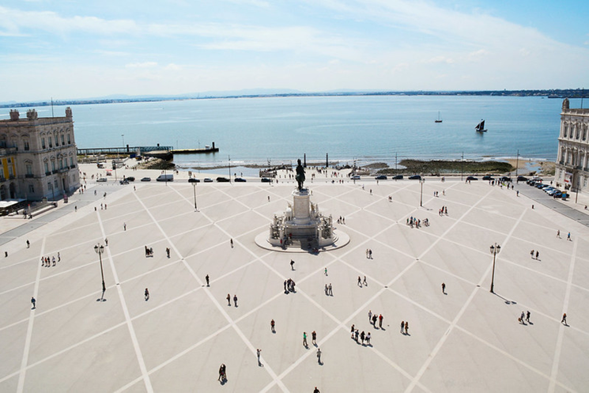
Welcome to the first PACRI annual meeting
24–26 mar 2026
Instituto Superior Técnico, Lisbon, Congress Center

Slide 2
Meeting agenda

Slide 3
Meeting agenda

Slide 4
Meeting agenda

Slide 5
Thank you!

