Slide 1

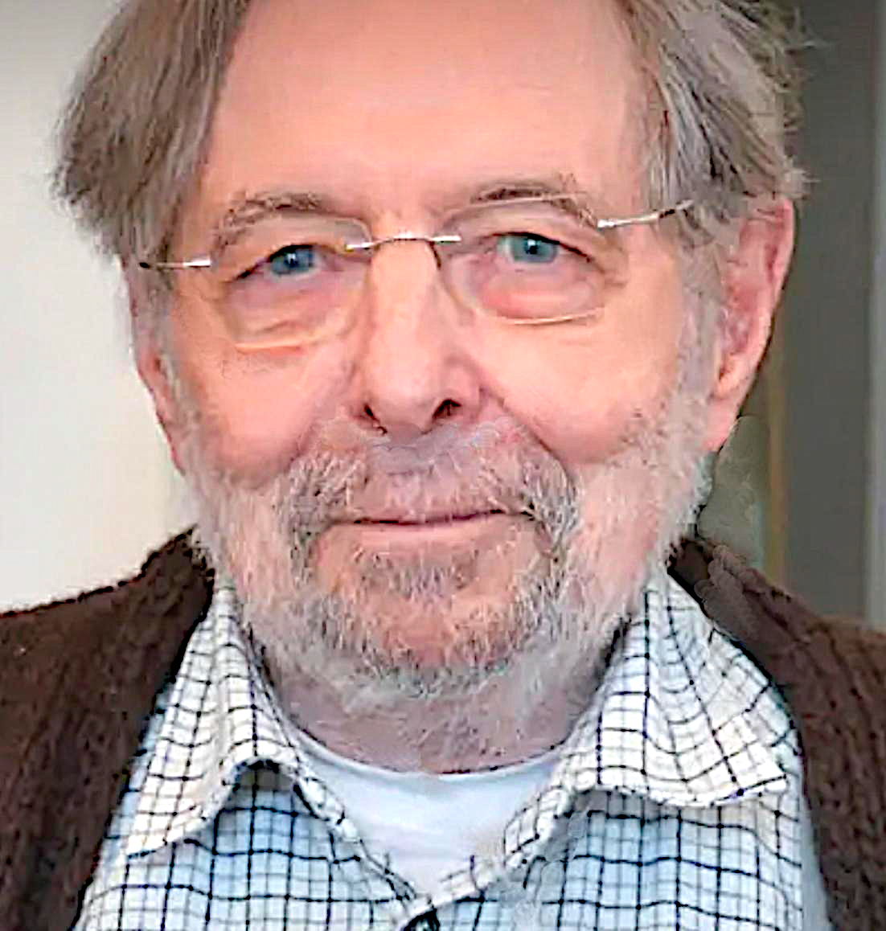



SCHOOL ON SYNCHROTRON RADIATION
2026 “Gilberto Vlaic” School on
Synchrotron Radiation
"Characteristics and Properties
of Synchrotron Radiation"
Giorgio Margaritondo
Ecole Polytechnique Fédérale de Lausanne (EPFL),
and Istituto Italiano di Tecnologia (IIT)

Slide 2

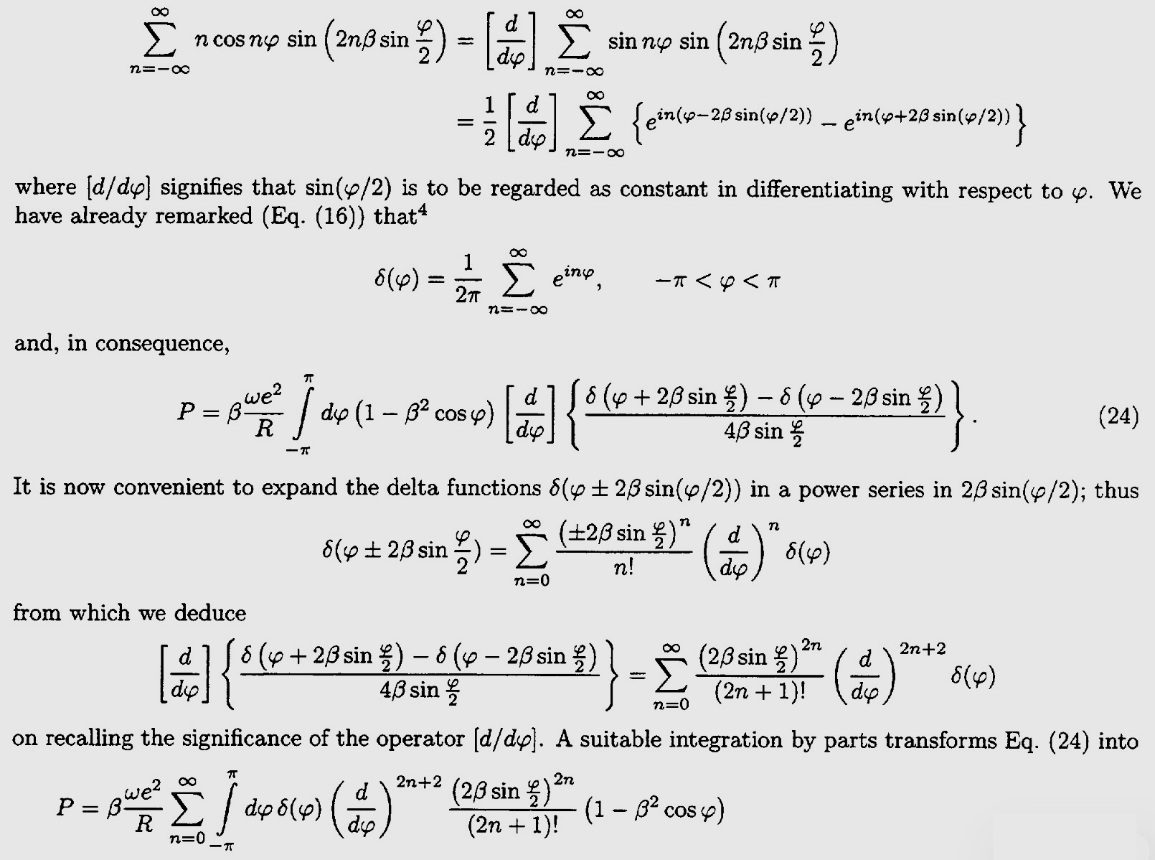
First, my pledge to you today:
NO complicated formalism,
just simple concepts!
    …We do not need this!!!
L
2γ ²
λ_{L} ≈

Slide 3



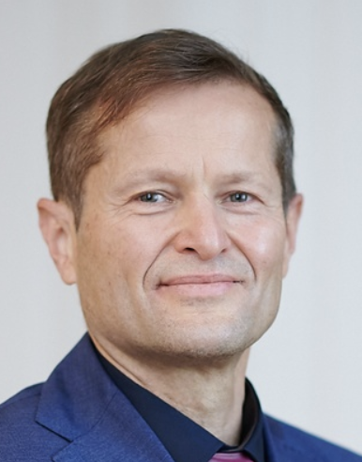


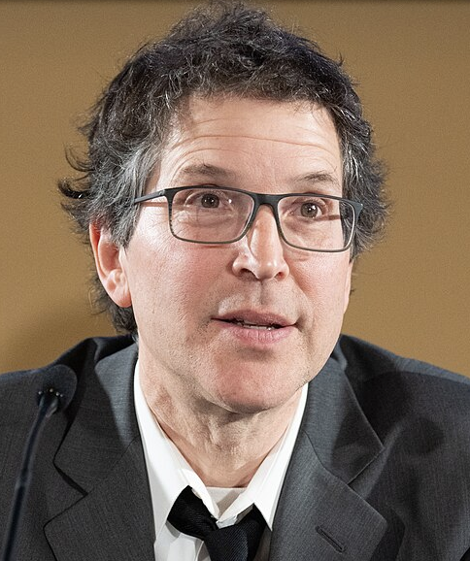
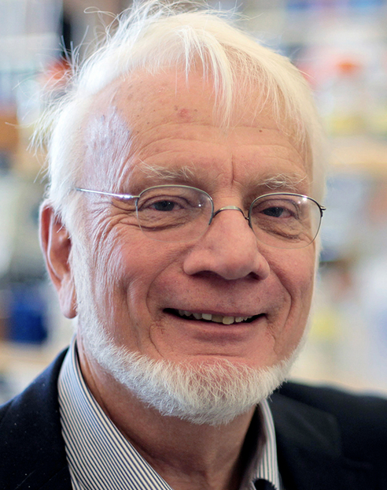

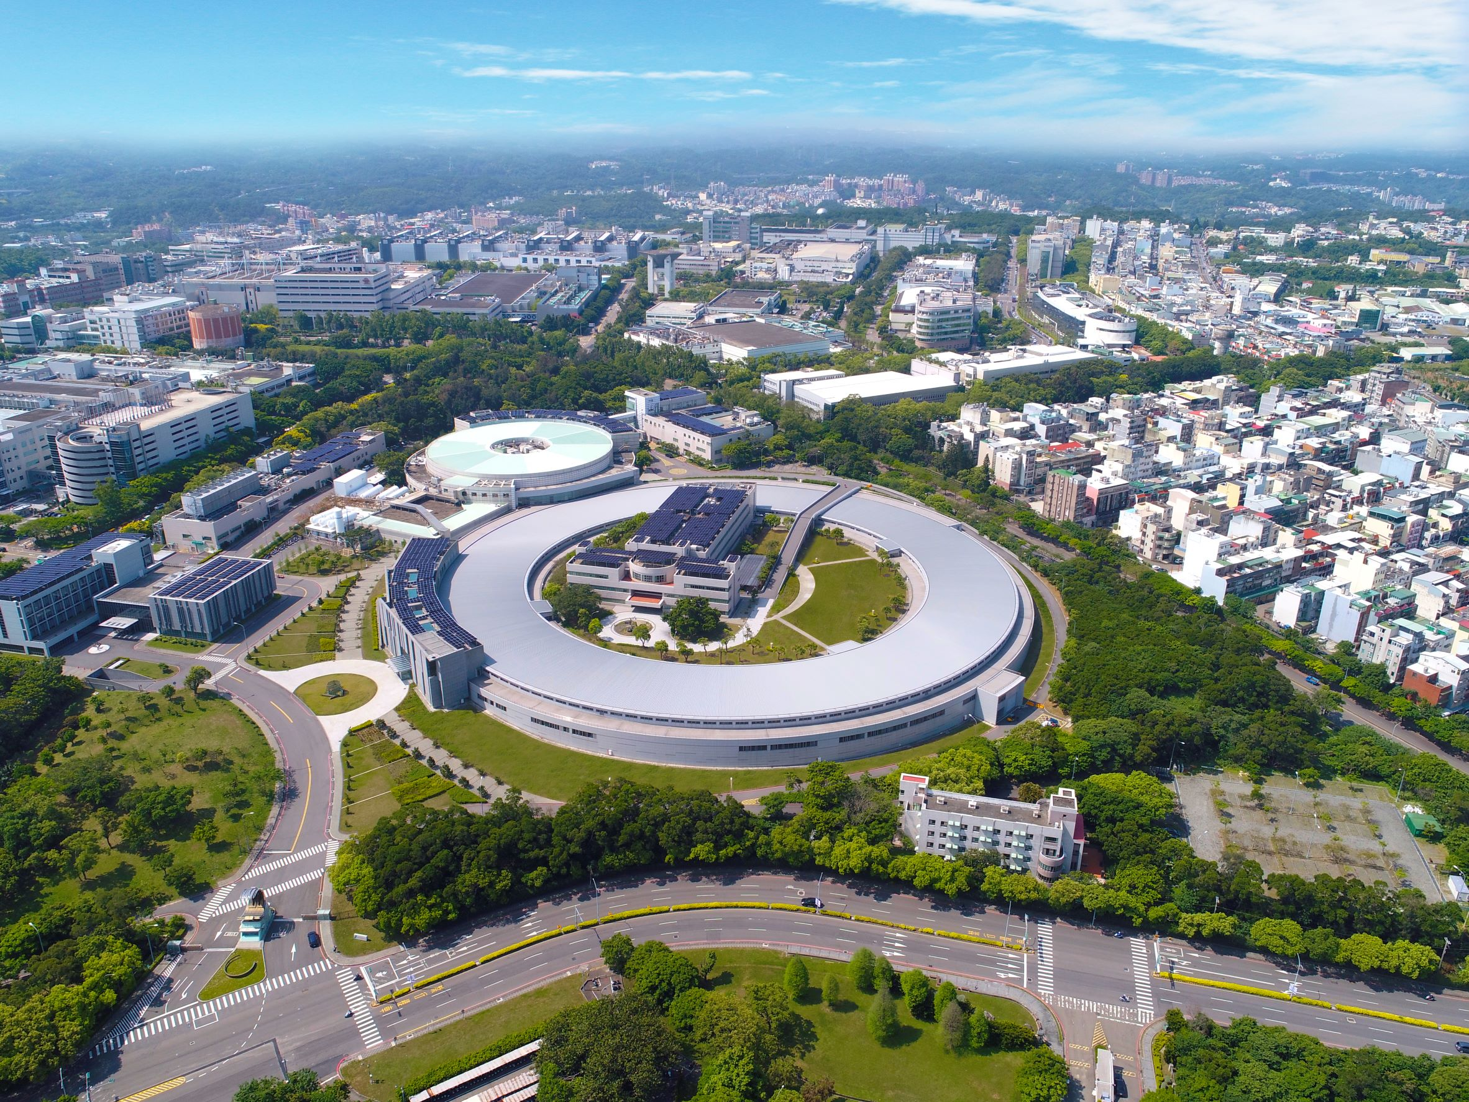
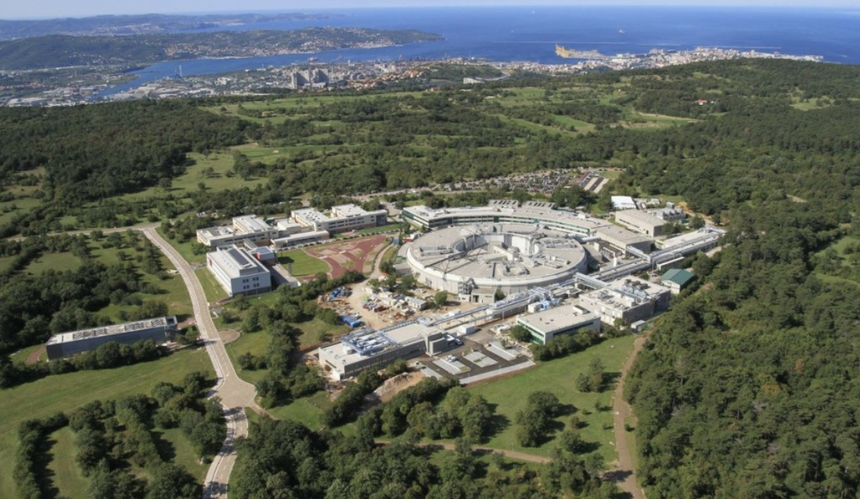
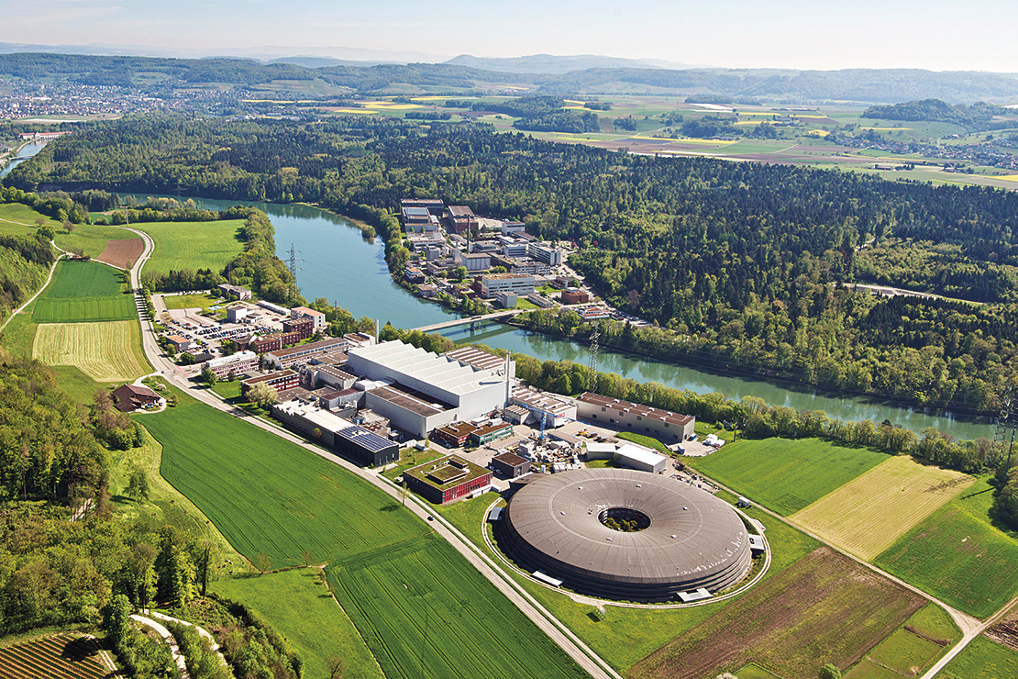
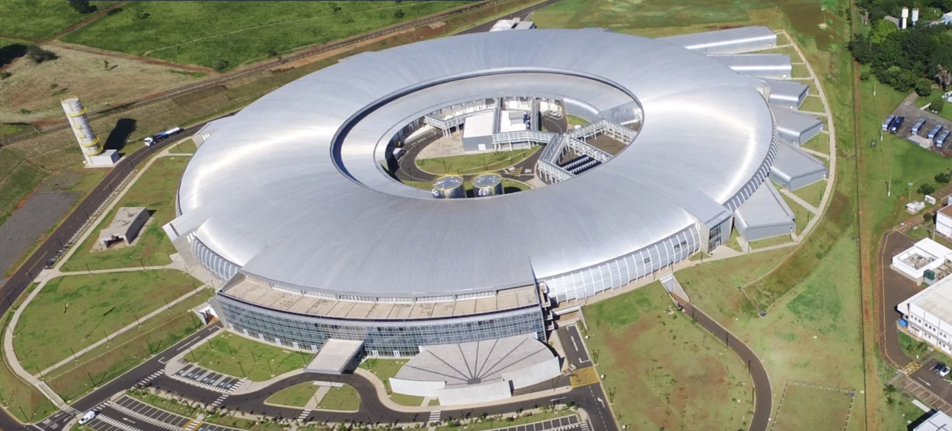


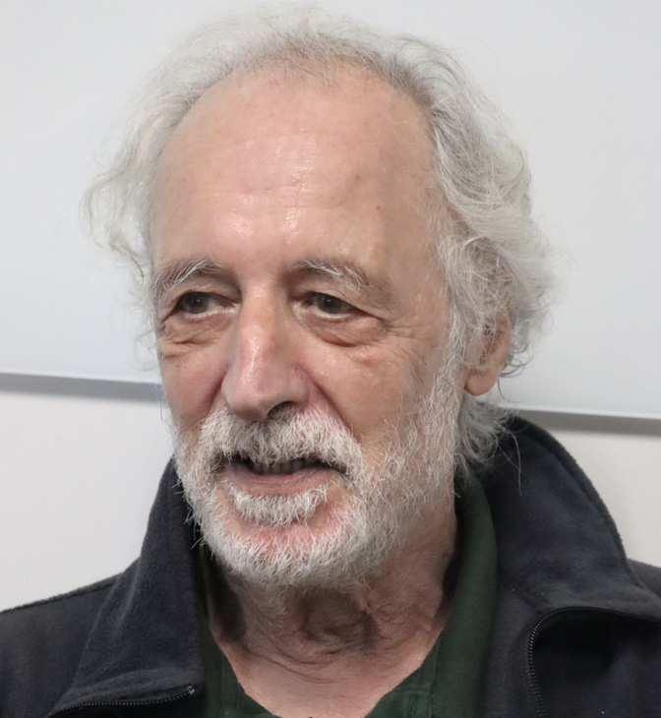



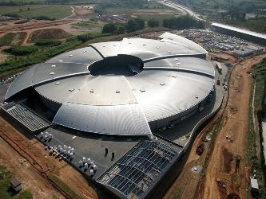
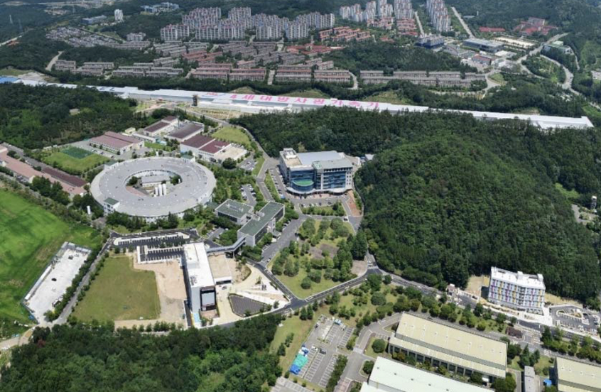
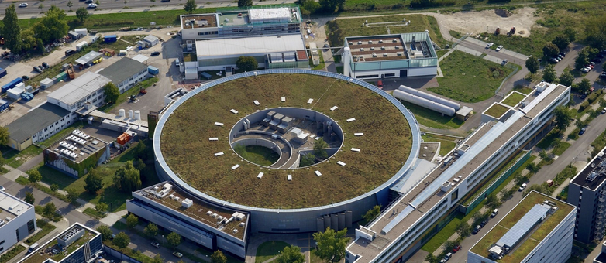
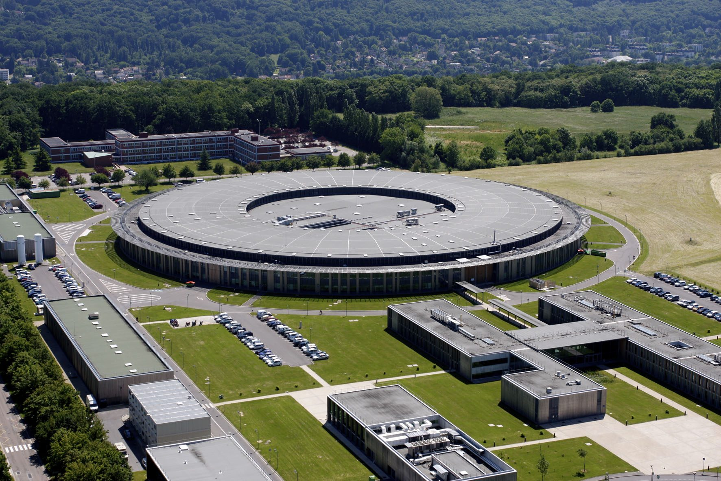
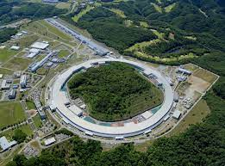
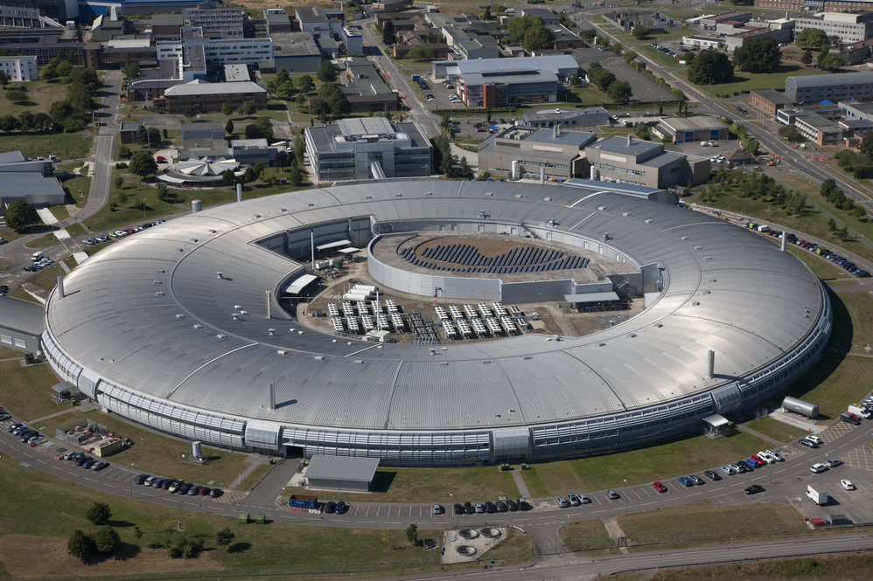
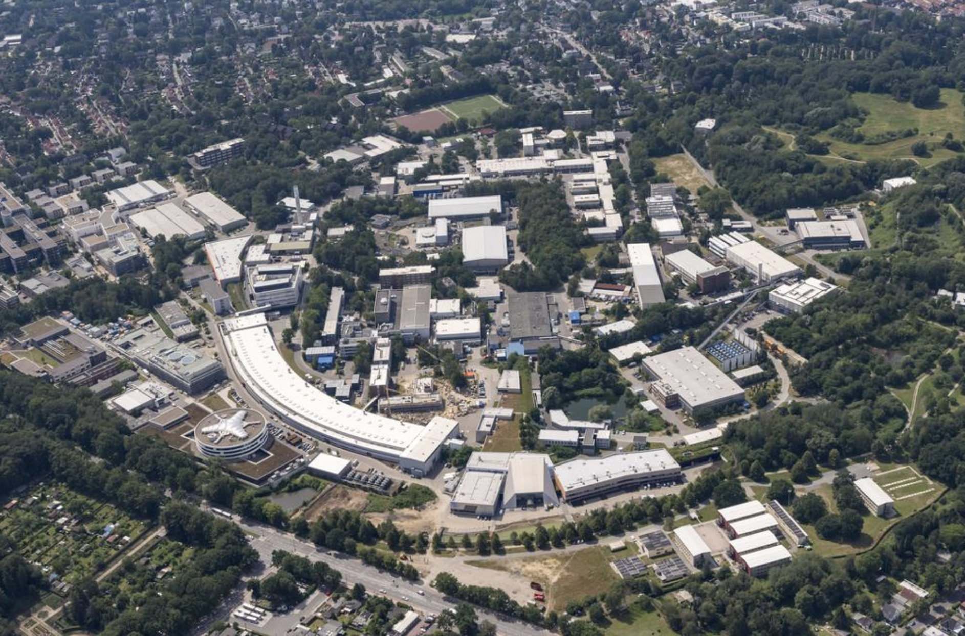
BUT, before we start: why should you be interested in synchrotron radiation?
First, it is a giant enterprise at the forefront of science and technology!
NSRRC Taiwan
Elettra, Italy
SLS, Switzerland
Hundreds of thousands of users
> 60 active facilities, more underway
Literature: >1,250,000 Google Scholar citations
SIRIUS, Campinas
SSRF, Shanghai
A factory of Nobel prizes: Agostini, Agre, Baker, Boyer, Kobilka, Kornberg, Krausz, L'Huillier, Mackinnon, Ramakrishnan, Steitz, Yonath, Walker
SESAME, Jordan
PAL, Korea
BESSY II, Berlin
BESSY II, Berlin
Alba, Spain
    …the biggest scientific network in the world, but also a fantastically profitable enterprise: it was recently found that, COVID-related synchrotron activities produced by themselves benefits surprisingly exceeding 7 trillions dollars!!!
Soleil, France
Spring-8, Japan
DESY, Hamburg
DIAMOND, UK

Slide 4
How did synchrotrons impact the COVID pandemics?
Compare COVID and the Spanish Flu of 1918-21, for which there were no vaccines and many more deaths! The ultrafast identification of the COVID virus microstructure by synchrotron x-ray crystallography was crucial for the rapid development of vaccines
The vaccines did not shorten the COVID pandemics, which was similar to the Spanish Flu. But they did reduce premature deaths, by 50-70%, or up to 20 millions lives
The USA costs of 18 months of COVID in 2020-21 were 16 trillions dollars; 4.4 were due to premature deaths (D. M. Cutlers, L. H. Summers , Journal American Medical Association (JAMA),https://jamanetwork.com/journals/jama/fullarticle/2771764)
Without synchrotrons and vaccines, these costs would have continued in the last ≈16 months of COVID, causing an additional USA loss of 4.4 x (16/18) ≈ $3.9 trillions
So, the (minimum) 50% premature death mitigation for COVID by synchrotrons and vaccines corresponded to a benefit of 0.5 x 3.9 ≈ $1.9 trillions for the USA
...projected to the world using the gross domestic products ratio (≈3.9 ), the benefit was ≈ $3.9 x 1.9
≈ 7.4 trillions dollars!

Slide 5

$ 7.4 trillions over 16 months give
7.4 x 12/16 = $ 5.6 trillions per year,
a shockingly huge benefit!!! For comparison:
    It is ≈5% of the world gross domestic product per year, ≈50% of all US govertnment expenditures
    and about 15 times all the research costs
    per year of the European Union
I want a synchrotron!!!
It beats by a factor >40 the yearly benefits of the most profitable company in the world, Apple
The evaluated benefits/cost ratio is also huge, between 60 and 175

Slide 6
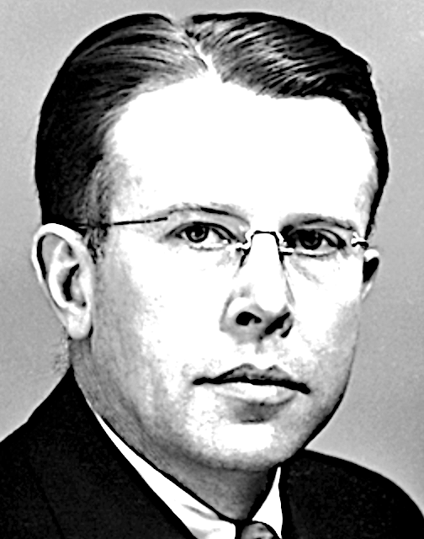
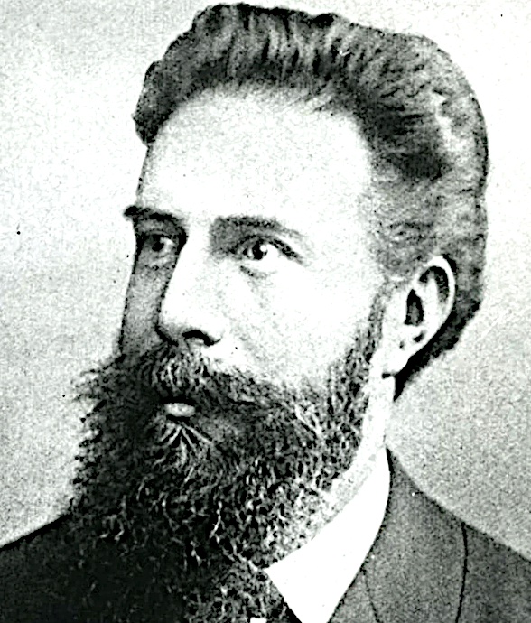
Now, the key question: what is synchrotron radiation? Here is a simple narration:
In parallel (1920's): particle
research still uses cosmic rays.
Whose flux is becoming too low
1929-30: Lawrence solves the
problem with an accelerator, the cyclotron
1895: Roentgen discovers x-rays
Medical applications trigger the
immediate birth and the strong
expansion of radiological industry
...which also emits electromagnetic waves, raising two questions: do they influence the cyclotron operation? And could they find practical applications?
The answers come very slowly: why?
1912-13: von Laue and the Braggs (father and son) discover x-ray diffraction and its applications. However, for decades such applications are negatively affected by the very bad performances of x-ray sources
... relativity sharply reduces the emitted wavelengths, possibly reaching x-rays for high-energy accelerators!!!
Cyclotron electrons have almost the speed of light, thgus require relativistic theories.
Which arrive only in the 1940's from Russia (Ivanenko, Pomeranchuk) and the USA (Schwinger), with a key discovery

Slide 7
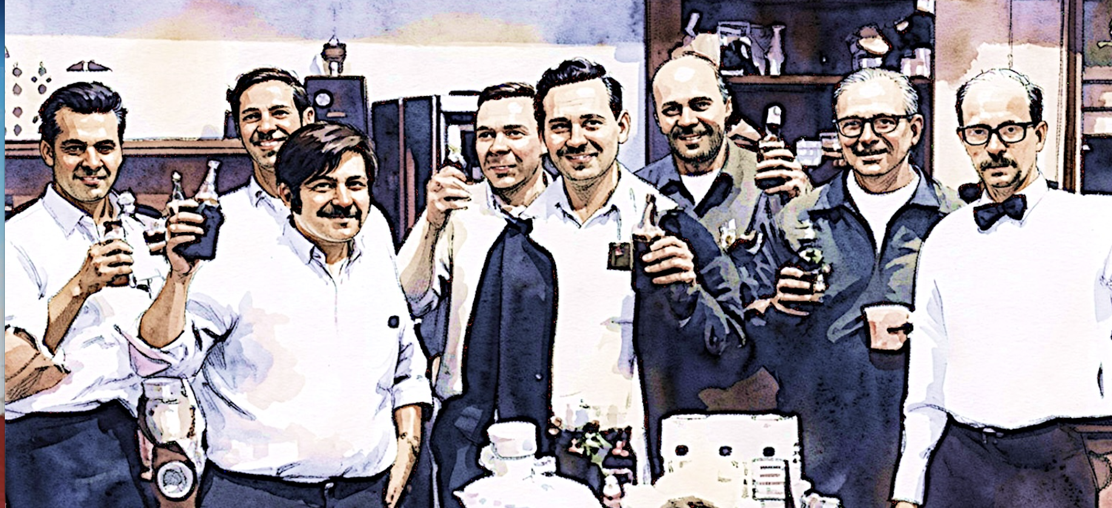
1950's, 1960's: successful tests of using the radiation from "synchrotrons", the accelerators of that time (NBS, Cornell, Frascati)
however, such tests do not lead to steady experimental programs, due to the severe technical problems caused by the pulsed operation of synchrotrons...
1960's: a new class of non-pulsed accelerators, the "storage rings" solves the technical problems
but there is a huge managerial problem: their use is shared with particle research, which always gets the priority heavily penalizing syncrotron radiation projects
...until (August 7 1968) successful tests are conducted in Stoughton (Wisconsin), under the leadership of Ed Rowe, on the use of the storage ring Tantalus as a fully dedicated to synchrotron radiation research
...after a prehistory of 73
years, synchrotron radiation
research is born! But why is this so very important?

Slide 8
A common denominator makes x-rays very important for research: the things they investigate with their wavelengths and photon energies!
0.1
10
1000
x-rays
100000
10000
1000
100
10
core electrons
chemical
bond lengths
energies of electrons affected by chemical bonds
wavelength
wavelength (Å)
photon
energy
(eV)
photon
energy
valence electrons
Spectrum of electromagnetic waves
…x-rays are the best probes of
chemical bonds, which are the foundation of most of technology and science: this is why they are so very important!

Slide 9
Let us broaden the OVERALL PICTURE:
many different interactions of x-rays with matter
lead to many different experimental techniques
atom or
molecule
scattered photons, fluorescence
small-angle scattering
fluorescence spectroscopy
X-rays
Synchrotrons sources are NOT narrowly specialized tools, but versatile facilities symultaneously serving many different applications and many users
photoelectrons, Auger electrons
photoelectron and Auger spectroscopy
molecular
fragments
transmitted photons
absorption spectroscopy, EXAFS
fragmentation spectroscopy
scattered photons
X-ray scattering
solid
X-rays
fluorescence
fluorescence spectroscopy
diffracted photons
crystallography
photoelectrons, Auger electrons
transmitted photons
imaging, absorption spectroscopy, EXAFS
photoelectron and Auger spectroscopy
atoms,
molecules
desorption spectroscopy

Slide 10
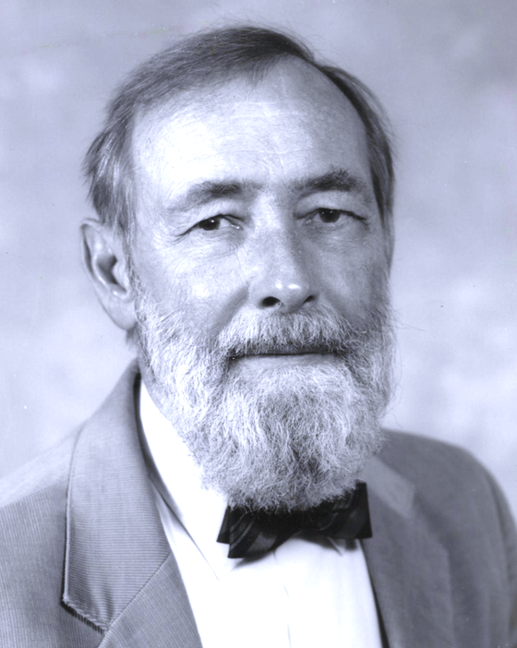
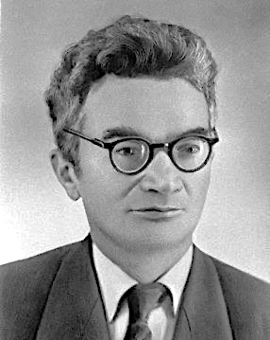
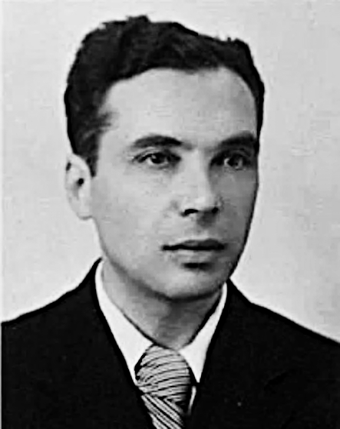
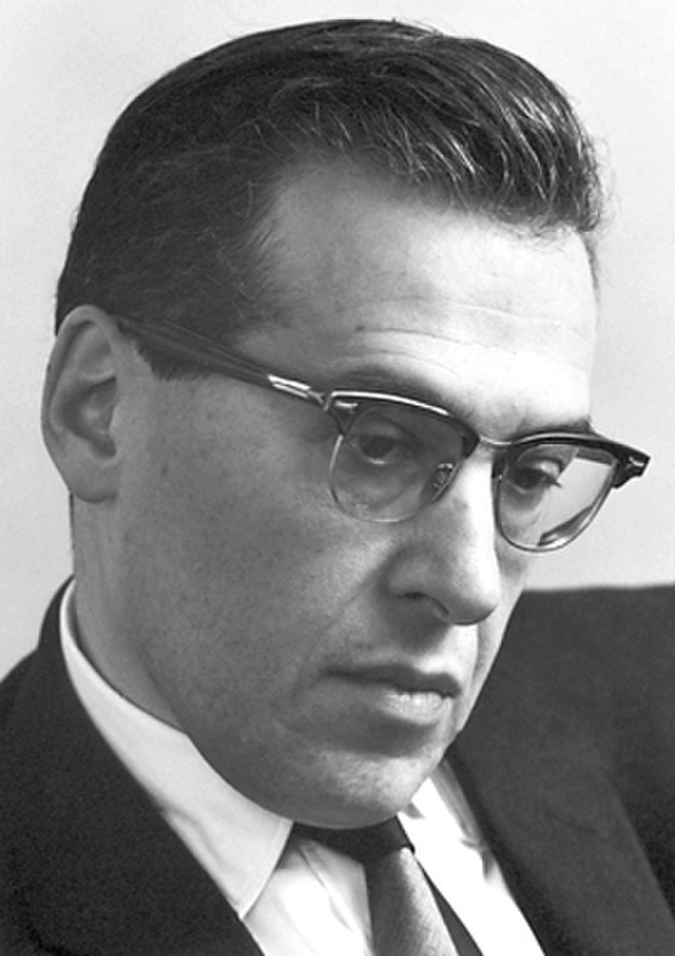
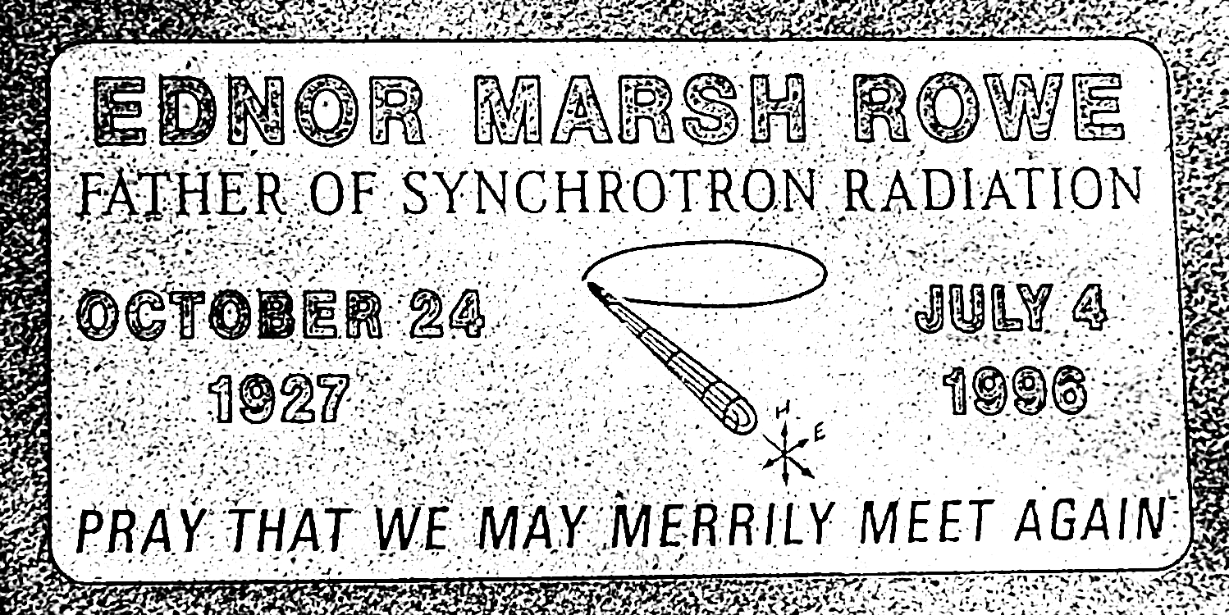
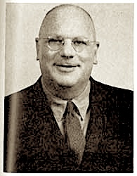
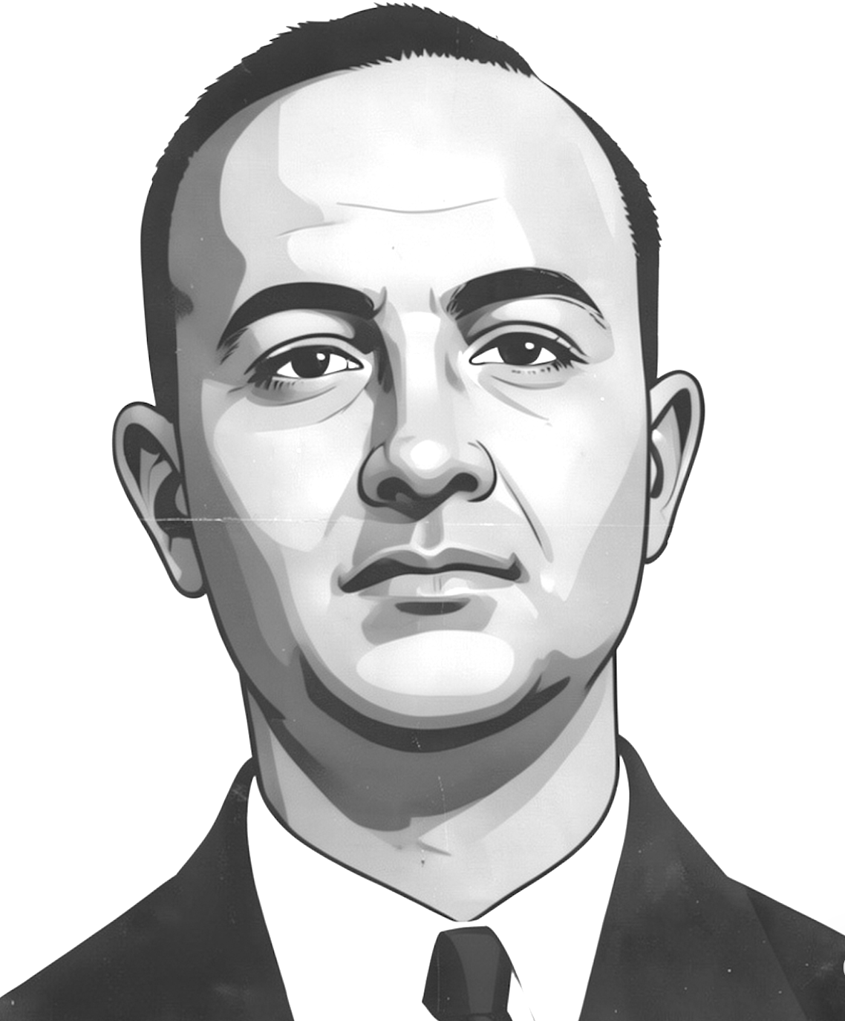
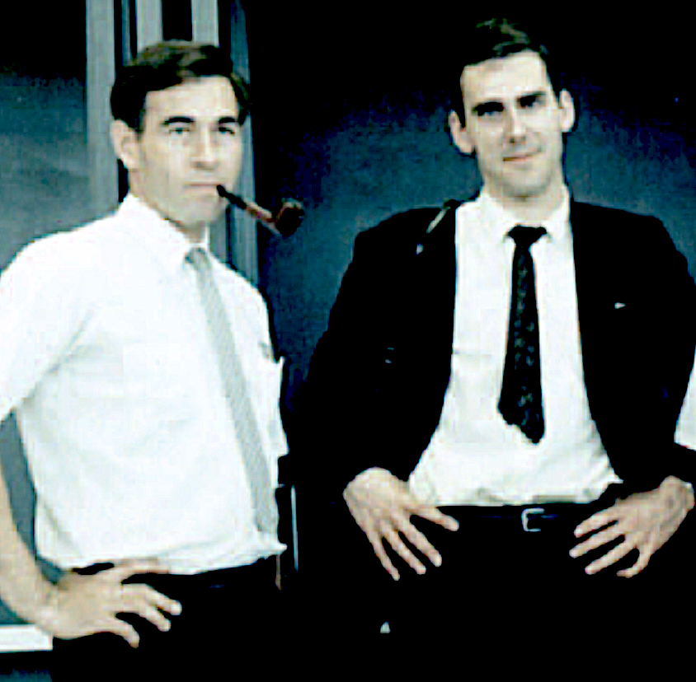
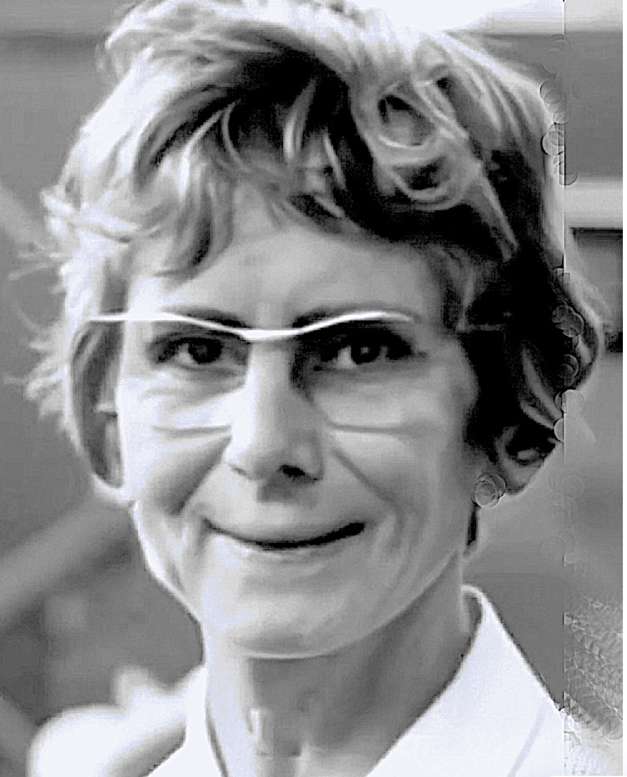
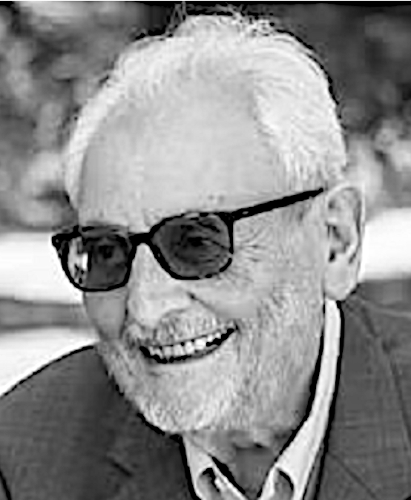
Before continuing, let us honor our top historical figures:
The relativistic theorists
Ednor Rowe
Ivanenko
The pioneer of dedicated storage ring sources
Pomeranchuk
Schwinger
The heads of the first tests
The leader of the first
x-FEL
Diran
Tomboulian
Lyman Parrat
Robert Madden, Keith Codling
Yvette Cauchois
Claudio Pellegrini

Slide 11
...How do we use relativity to get x-rays?
Wh do not we try instead to produce x-rays like radio waves, with electrons oscillating in an (inexpensive) antenna?
oscillating electrons are accelerated charges, so according to classical physics (Larmor's law) they do emit radiation. And their mass is small, enhancing the acceleration and the emission
waves
BUT: antennas are good
for producing long-wavelength radio waves,
not short-wavelength (high-frequency) x-rays!
WHY NOT? Because the
electronic devices inducing
the oscillations cannot reach the required high frequencies (say, 10¹⁸ hertz)
For x-rays, we need a different strategy:
indeed, relativity and synchrotron radiation!

Slide 12
Key point - relativity explains all synchrotron radiation properties with 2 reference frames and 3 effects:
(1) Lorentz contraction
(2) Doppler effect
(3) time dilation
We shall discuss the first two effects right away
and deal with time dilation a bit later
Reference frames:
“Electron” frame R_{e} , speed = v
“Laboratory” frame, R_{L}
R_{L}
R_{e}
v
v

Slide 13

First relativistic effect: Lorentz contraction - Measured by a motionless observer, the intrinsic length L of an object moving at speed v decreases to ≈L /γ
“gamma factor”:
1
γ =
1–v ²/c ²
v
NOTE: in relativity, γ is proportional to m_{L}c ², the electron energy
R_{L}
L
≈ L /γ

Slide 14
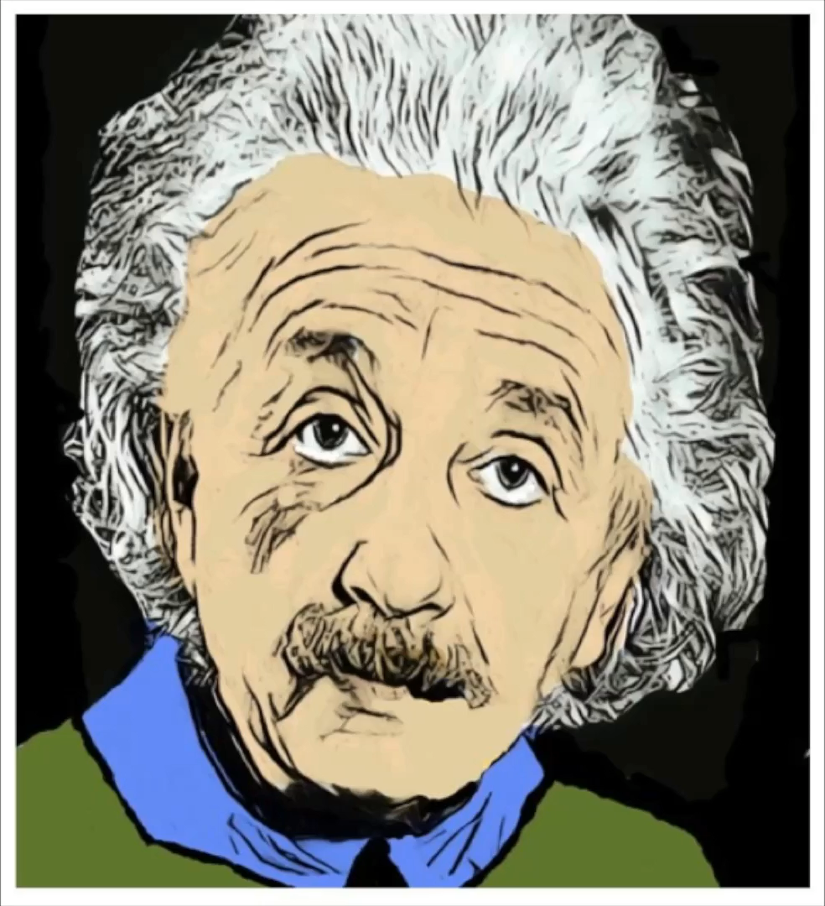
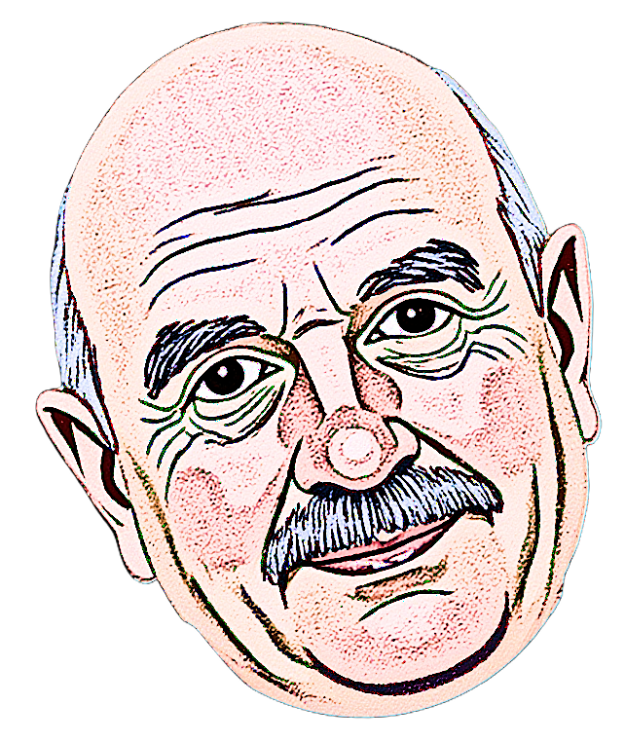
This is the second phenomenon, directly decreasing the wavelengths:
my relativistic Doppler effect reduces those from oscillating electrons …like sound from a moving train!
Wooooooof!
Moving train – high pitch
Wiiiiiiiiiiiiif!
v
The Doppler effect
(1) shifts the sound to higher frequencies (shorter wavelengths);
Train not moving – low-pitch sound
(2) “projects ahead” the sound causing angular collimation
Likewise, for waves from relativistic oscillating electrons one can show that the Doppler effect shrinks the wavelength (by ≈1/(2γ )) and the angular spread

Slide 15
This is the second phenomenon, directly decreasing the wavelengths:
my relativistic Doppler effect shortens those of oscillating electrons …like the sound from a moving train!
Wooooooof!
Moving train – high pitch
Wiiiiiiiiiiiiif!
v
The Doppler effect
(1) shifts the sound to higher frequencies (shorter wavelengths);
Train not moving – low-pitch sound
(2) “projects ahead” the sound causing angular collimation
Likewise, for waves from relativistic oscillating electrons one can show that the Doppler effect shrinks the wavelength (by ≈1/(2γ )) and the angular spread

Slide 16
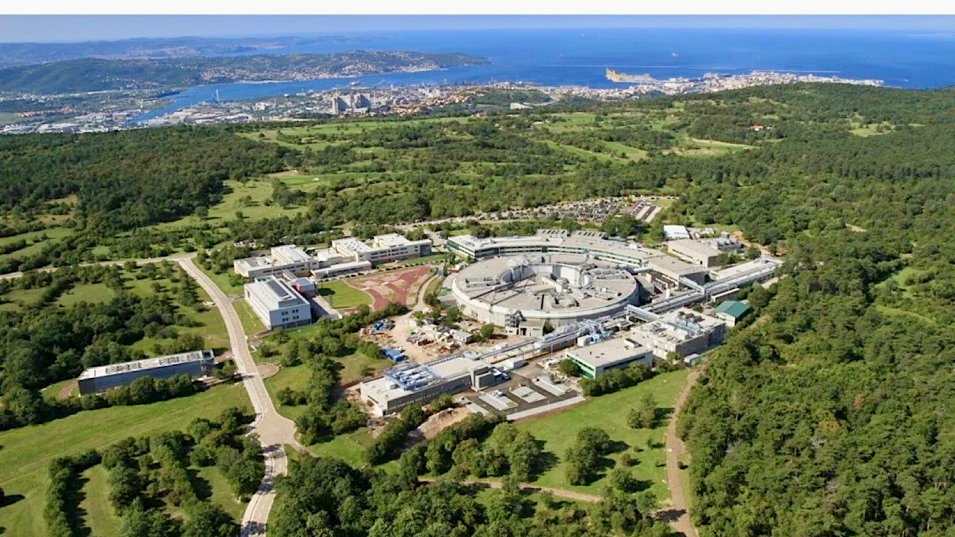

…where electrons circulating at almost the speed of light in a “storage ring” emit radiation – most notably x-rays
IDEA!!! Let us try to get x-rays with relativity by adding to a transverse electron oscillation a longitudinal motion with speed v ≈ c
To see how this can be done in practice,
let us visit a top facility: Elettra in Trieste

Slide 17
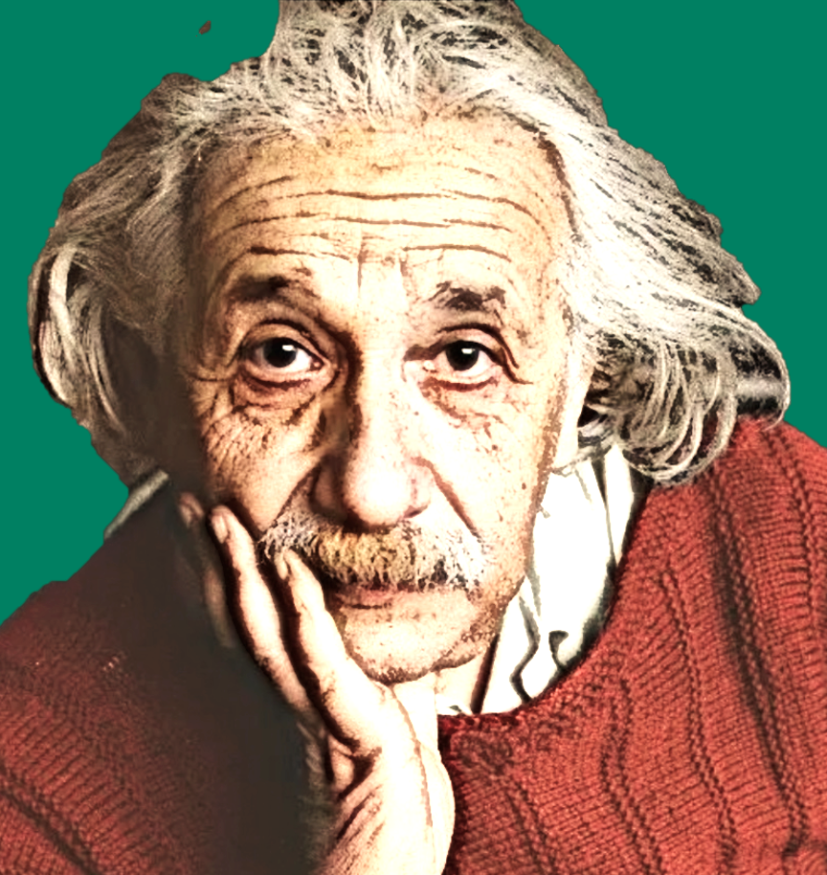
OK, let us see now how we get x-rays from Elettra by combining indeed transverse electron oscillations with a longitudinal speed v ≈ c !
the undulator causes oscillations with transverse acceleration, so the electrons emit synchrotron radiation
L
Add an “undulator”: a periodic series of magnets, period L
…whose wavelength λ_{L} (in the laboratory frame R_{L}) is related to the period L -- but is not simply equal to L
relativistic
electron,
v ≈ c
…the electrons are forced to circulate at v ≈ c in a storage ring under vacuum by a system (not shown) of magnets and electric fields

Slide 18
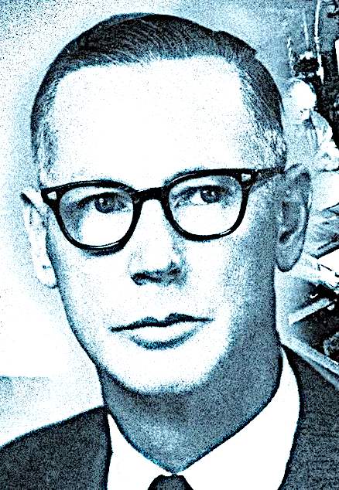
Why not? To answer, you must
think like an electron [Don Kerst]!
In its own frame R_{e} , the electron “sees” the undulator arriving with velocity -v ≈ -c
-v ≈ -c
L
…and, as all moving objects, it is subject to the “Lorentz contraction”: its length decreases by the factor ≈γ
…so, the electron “sees” the undulator period shrunk to ≈L /γ ;
R_{e}
this equals the
wavelength emitted in R_{e}: λ_{e} ≈ L /γ
-v ≈ -c
L /γ

Slide 19
…but λ_{e} is not the wavelength λ_{L} seen in the laboratory frame R_{L}: why?
Because of the (relativistic) Doppler effect due to the source (electron) motion:
λ_{L} ≈ λ_{e} /(2γ )
Combination of Lorentz contraction + Doppler shift: λ_{L} ≈ λ_{e} /(2γ ) = (L /γ ) /(2γ )
λ_{L} ≈ L /(2γ ²)
High energy → large γ → short λ_{L}
Example: γ = 5000 (a typical storage ring),
L = 1 cm → λ _{L}≈ 2 Å: we do get x-rays!!!

Slide 20
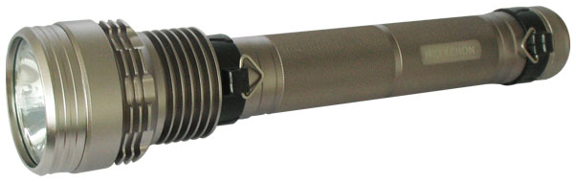
OK, we get x-rays... but are we reaching our real goal: not generic x-ray sources but very good ones?
First, what is a “good source”?
To quantify this notion,
consider these source parameters:
a flashlight is
“good” not only because of its flux but also because its emission is geometrically concentrated
Area,
A ≈ ξ ²
ξ
Flux, F
Angular divergence
(solid angle Ω )
F
…and define the
“Brightness” = constant
A Ω
A source is “good” if it has high brightness:
large flux, small area, small divergence

Slide 21
Do synchrotron sources reach high brightness?
YOU BET! Over one million billion times more than conventional x-ray sources!
How? Thanks to four factors:
Relativity, as we shall see, sharply reduces the angular divergence
And we shall also find that that relativity boosts the emitted power
Electrons in a storage ring under vacuum can handle more emitted power than those in a solid, since the solid can be damaged
The electrons travel in the ring in bunches
(we shall see why), along slightly different
paths; the source size is the transverse
cross section of the bunch, determined by all the
paths and kept small by very effective controls

Slide 22

Relativity at work: extreme angular collimation
…but in R_{L} it shrinks to a very small forward cone, as the sound of a moving train but much narrower
R_{e}
v ≈ c
R_{L}
…in the electron frame R_{e} ,
the angular range of the emission is broad, like radio waves from an antenna
wave velocity in R_{e}: magnitude c, zero longitudinal component
Why? Take the extreme case of an x-ray wave emitted in a transverse direction in R_{e}
so, from R_{e} to R_{L} the velocity vector rotates
θ
c
In R_{L} , the electron motion with relativistic speed v “projects ahead” the emission:
v
My relativity requires the magnitude c to be invariant
the forward wave velocity is ≈v and the angle θ is small, so:
θ ≈ sinθ = c ² - v ² /c = 1-v ²/c ²
θ ≈ 1/γ
Very small angular
spread ≈1/γ : milliradians!!!

Slide 23

Relativity at work
again: emitted
power
We need now the third relativistic effect mentioned above, time dilation: an interval Δt_{e} in R_{e} becomes Δt_{L} = γ Δt_{e} in R_{L}
R_{L}
12
9
3
v
6
oscillating electron
“Larmor law”: the emitted power is proportional to a_{e}², the square of the transverse acceleration in R_{e}
v
a_{e}
If v = zero, a_{e} = a_{L}, the transverse acceleration in R_{L} – and the power is proportional to a_{L}²
emission
but, if v ≠ zero: going from R_{e} to R_{L} the relativistic dilation multiplies the time by γ while the transverse coordinate is invariant; the acceleration
= coordinate/time² is divided by γ ²: a_{L} = a_{e}/γ ², and a_{e} = γ ²a_{L}
The power is proportional to a_{e}² = (γ ²a_{L})²,
thus to γ ⁴ = (energy)⁴/(m_{o}c ²)⁴
the emission decreases as 1/m_{o}⁴: electrons emit a lot, protons much less
The emission increases as the 4th power of the electron energy, reaching extremely high levels
The heat flux beats
the sun surface!

Slide 24
Let us now have a closer look at undulators: their emitted wavelength spectrum is caused by the relativistic electrons acting like super-collimated flashlights!
weak magnetic field →
small transverse undulations
L
detector
continuously illuminated
[ TOP VIEW ]
(small) detector
N periods
long signal pulse
narrow band
Fourier theorem
Δλ or Δν
time
wavelength (λ) or frequency (ν )
Going through the N undulator periods, the electron emits a wave with N wavelengths, of total length Nλ_{Lare}
Evaluation of the bandwidth…
Pulse duration: Δt = Nλ_{L}c. Fourier: the frequency spread is Δν = 1/Δt = c/(Nλ_{L}) = (c/λ_{L})/N = ν /N. Relative wavelength bandwidth: Δλ_{L}/λ_{L} = Δν/ν = 1/N

Slide 25
The undulator bandwidth formula, Δλ_{L}/λ_{L} = 1/N, is like that of a diffraction grating, and this is not surprising:
The waves emitted during different electron oscillations interfere with each other, producing the total emission and its bandwidth Δλ_{L}
So, we can simply borrow from elementary optics the theory of the diffraction grating, which gives indeed:
This is reminiscent of the waves from the slits of a diffraction grating…
Δλ_{L}/λ_{L} = 1/N
in the limit of grazing incidence

Slide 26
Other wonderful properties of undulators:
(1) They can emit different wavelengths; (2) their angular spread is very small; (3) they have very high brightness --
all such properties can be explained with simple approaches; for example:
what happens if we increase the magnetic field strength B by decreasing the magnet gaps?
the wavelength changes: why?
A stronger magnetic field B increases the transverse electron oscillations and their transverse speed, proportional to B
The magnetic (Lorentz) force of the undulator B-field on the electrons does not do any work and cannot change the kinetic energy, so the longitudinal speed v decreases
This changes the γ -factor in the Doppler shift, modifying λ_{L} from L /(2γ ²) to
λ_{L} = [L /(2γ ²)](1+ constant x B ²)
Wow! We can tune the wavelength by changing B!

Slide 27
At a synchrotron facility, around the ring we find other sources besides undulators: bending magnets and wigglers
experimental chamber
beamline
undulator
bending magnet
wiggler
wiggler
bending magnet
What are these other sources?

Slide 28
A wiggler, like an undulator, is a periodic magnet array -- but its magnetic field is stronger and causes larger transverse oscillations of the electrons:
[ TOP VIEW ]
series of short pulses
broad band
Fourier theorem
time
frequency (ν ) or wavelength (λ)
Multiple pulses → stronger emission

Slide 29
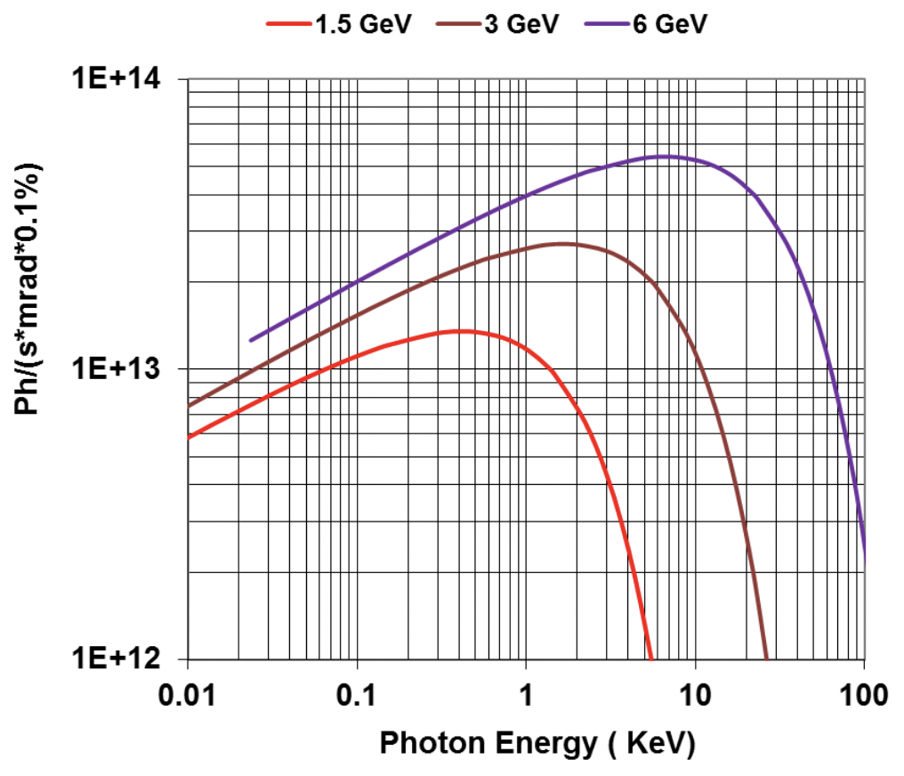
The third type of synchrotron sources:
bending magnets, the dipoles that also force the electrons to circulate in the storage ring
short
signal pulse
broadband
YES! With a log-log plot
Fourier theorem
...but is this really the famous bending magnet
spectrum?
time
frequency (ν ) or
wavelength (λ)
So, the "famous synchrotron spectrum" is just the log-log plot of a peak!

Slide 30
Why do bending magnets
emit very short x-ray wavelengths?
…because of the same effects active for undulators (and wigglers): Lorentz contraction and Doppler shift
Intuitively, the emitted wavelengths are related to the longitudinal size D of the magnet
-v ≈ -c
D /γ
D
…which in the electron
frame R_{e} is Lorentz-contracted to ≈D /γ
And in the laboratory frame R_{L} the wavelengths are Doppler-shifted by a factor ≈2γ, so they are determined by
≈(D/γ )/(2γ ) = D/(2γ ²)
The magic 2γ ² factor again!

Slide 31
The time structure of radiation from storage rings:
The cause: electrons travel around the ring in bunches -- why?
An electron keeps circulating in the ring if the energy it loses by emitting synchrotron radiation is periodically restored by the electric force of an “RF cavity”.
But this only works for bunched
electrons passing through the cavity
in synchrony with the periodic force
radiofrequency (RF) cavity
Consequence: at
every turn, each bunch
sends a short (nanoseconds
to picoseconds) pulse of radiation in each
beamline
...a time structure with nice practical applications!
source
time
detector

Slide 32
Polarization, a key synchrotron radiation property:
Consider an electron traveling through an undulator or a wiggler:
[ SIDE VIEW ]
[ FRONT VIEW ]
The waves emitted along the
undulator axis correspond to electric field perturbations in the horizontal plane: they are linearly polarized
…likewise, on-axis waves from bending magnets are linearly polarized in the horizontal plane
and special (elliptical) wigglers/undulators can produce intense elliptically polarized radiation

Slide 33
Synchrotron radiation properties explained with relativity:
Short emitted wavelengths
Very high emitted power
Angular collimation and brightness
✔︎DONE
✔︎DONE
✔︎DONE
✔︎DONE
✔︎DONE
✔︎DONE
Undulators, wigglers, bending magnets
Pulsed time structure
Polarization
Coherence, spatal and time
Free electron lasers

Slide 34
Another, very important feature of synchrotron sources:
COHERENCE =
“the property that allows radiation to cause visible wave effects like diffraction or interference”
no diffraction
radiation from non-coherent
source
example: screen with pinhole and fluorescent screen
coherent
laser radiation
diffraction!
Limit case: a point source emitting only one wavelength λ always produces a visible diffraction pattern -- it has full coherence
More realistic sources, emitting multiple wavelengths and/or having a finite size, reveal TWO kinds of coherence: “time” and “spatial”
point source
λ

Slide 35
Multiple wavelengths: longitudinal (time) coherence
different wavelengths produce different patterns…
…whose
superposition blurs the fringes
when is a fringe pattern still visible?
Spacing of adjacent fringes (from elementary optics):
x ≈ (H/δ )λ ;
if λ is replaced by a band Δλ, x is “blurred” to:
Δx ≈ (H/δ )Δλ
Condition to see the pattern:
Δx < x → Δλ/λ < 1 (time coherence)
defining the “coherence length” as L_{c} = λ²/Δλ , time coherence requires L_{c} > λ
δ
H

Slide 36
Finite-size sources: spatial
coherence
Each point of an extended source produces a diffraction pattern:
superposition → blurring
when is a pattern still visible?
Maximum distance between centers of patterns produced by different source points: M ≈ ξ H/D
D
H
Fringe spacing x ≈ (H/δ )λ
Fringes can be seen if M ≤ x :
ξ H/D ≤ (H/δ )λ → δ ≤ λD/ξ
ξ
solid angle Ω
δ
condition for spatial coherence
Another way to look at this condition: the radiation contributing to diffraction is the portion that reaches the pinhole, emitted in the solid angle ≈δ ²/D ²
≤ (λD/ξ )²/D ² = λ ²/ξ ² – which corresponds to a fraction of the total emission
≈(λ ²/ξ ²)/Ω = λ² /(ξ ²Ω )
“coherent power factor”: large if the source has spatial coherence

Slide 37
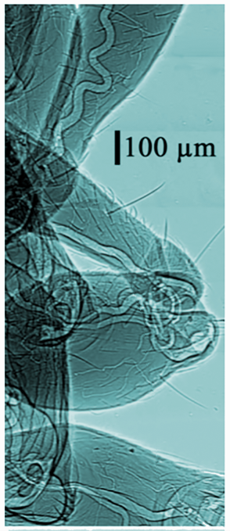
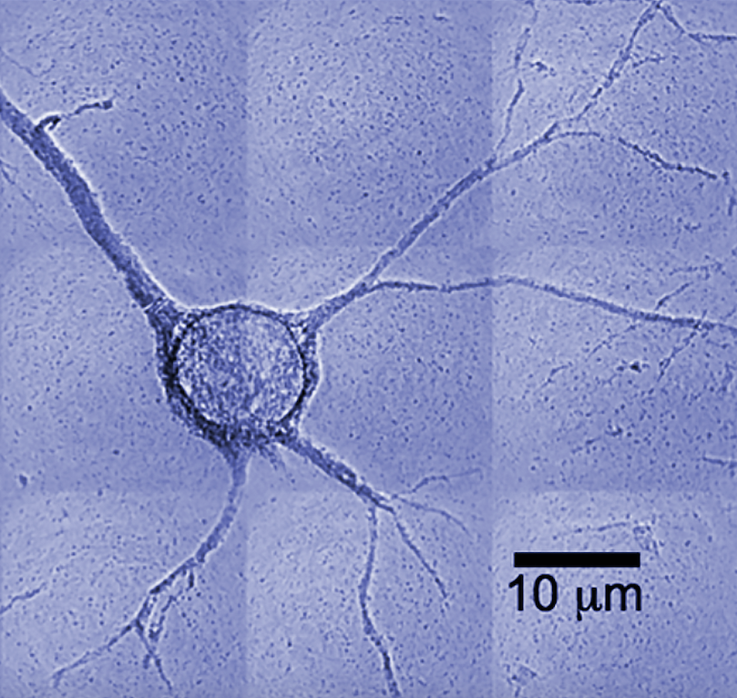
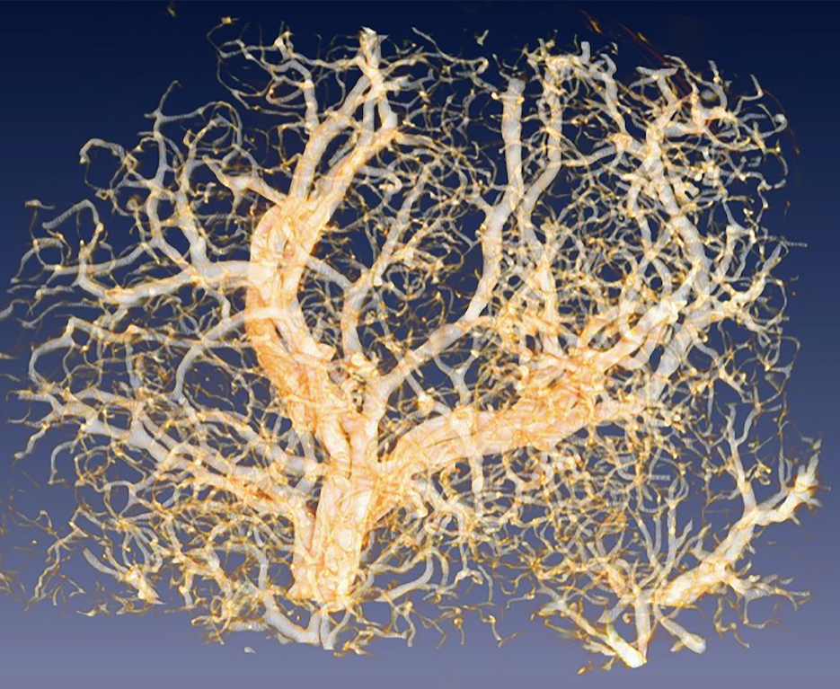
Are synchrotron sources spatially coherent?
YES! Their small size ξ and small angular spread Ω give a large coherent power factor λ²/ (ξ ²Ω )
Note, however: the λ² term in this factor makes spatial coherence very difficult to obtain for the short λ’s of x-rays: synchrotron sources are required
…and λ² is also present in the (time) coherence length causing a similar problem!
Also note: the brightness is proportional to 1/ (ξ ²Ω )
thus, the historical efforts to enhance the brightness by decreasing
ξ and Ω also boosted the spatial coherence
Coherence is specifically very beneficial for imaging techniques: synchrotron x-rays with high spatial coherence notably produce phase-contrast images, with sharp features and very small details
radiograph of a single neuron: world record of spatial resolution
cancer
microvasculature
body of an ant

Slide 38
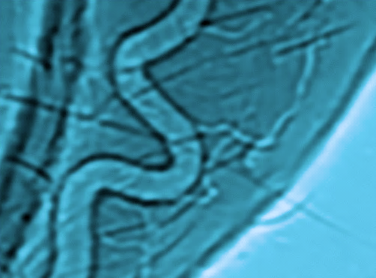
Phase-contrast imaging with spatially coherent x-rays -- the phenomenon is complex, but we can grasp key features with a simple analogy: “seeing” a glass of wine
we see the wine because it absorbs and/or scatters certain wavelengths and looks colored
but we also see the edges of the (transparent) glass because they deviate the light by refraction/scattering
likewise, phase contrast (refraction/scattering of x-rays) can cause sharp, highly visible edges in synchrotron radiographs
…however, to produce such edges x-rays must
have a well-defined direction: this is guaranteed
by the spatial coherence of synchrotron radiation,
which also corresponds to angular collimation

Slide 39

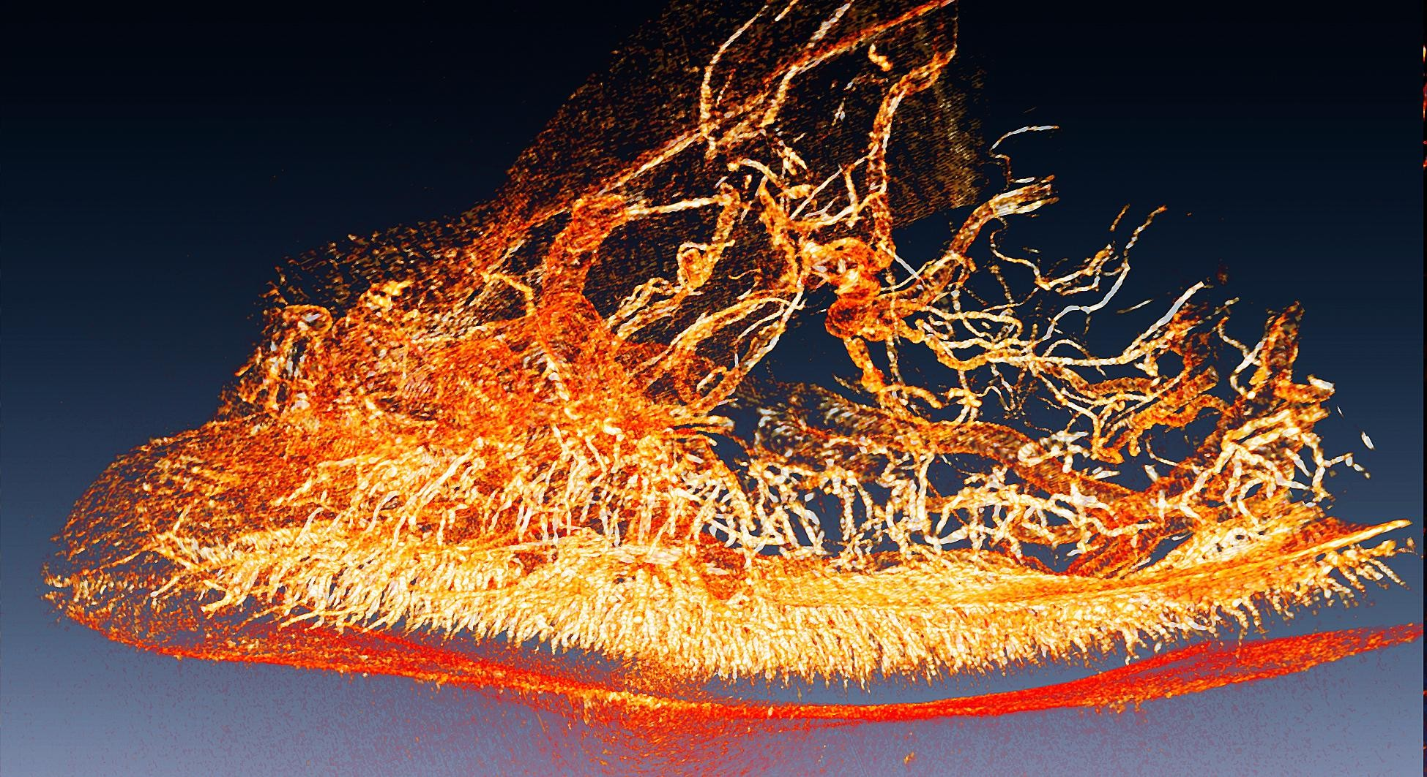
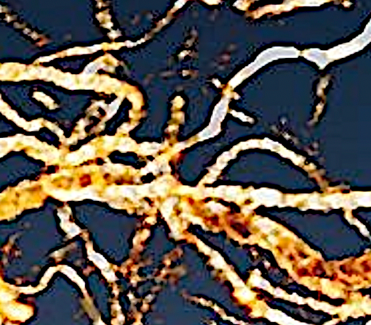
Example of the research that can be done with phase contrast imaging: the miracle of fireflies
Synchrotron microtomography of a firefly “lantern”
[Y. L. Tsai, Y. Hwu et al, Phys. Rev. Letters 113, 258103 (2014)]
…being able to detect even the smallest vessels, we could clarify key aspects of the incredibly effective light emission mechanism

Slide 40
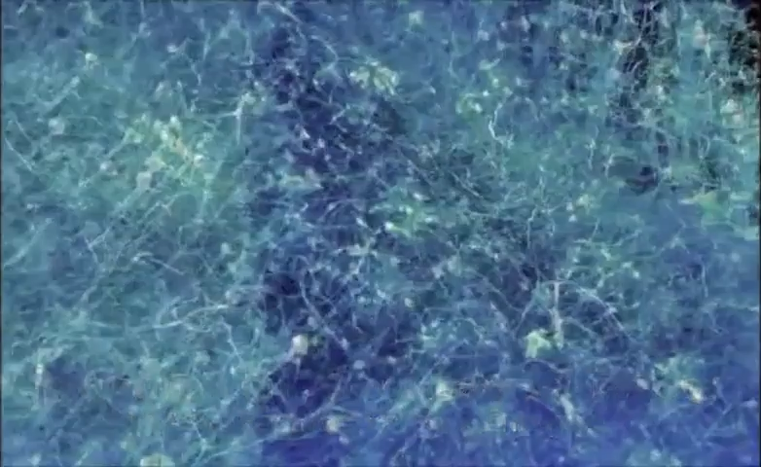
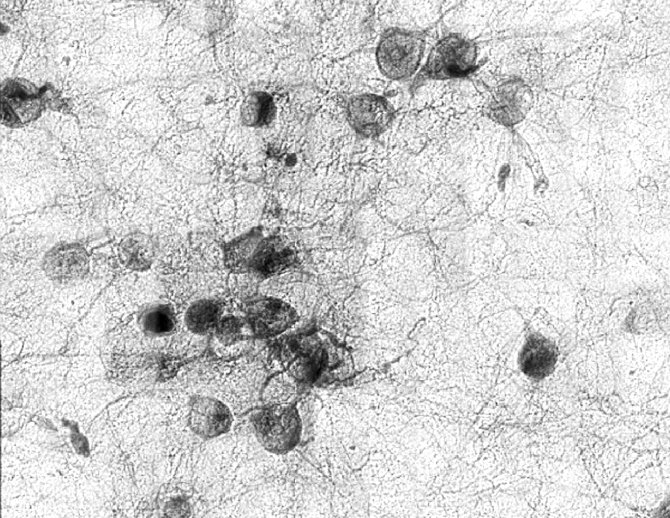
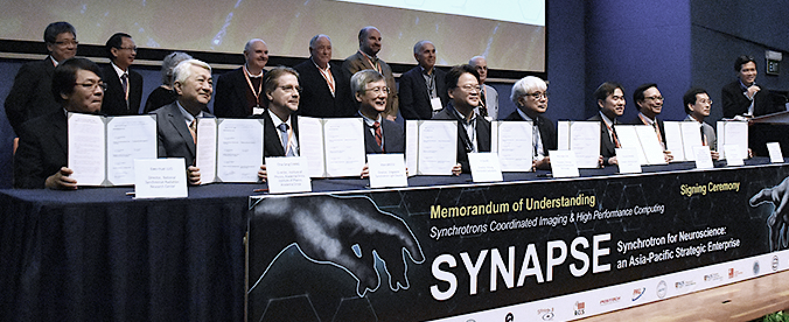

Microscopy with coherent x-rays: exploring the brain, neuron by neuron
SYnchrotrons for Neuroscience – an Asia-Pacific Strategic Enterprise
(SARI/SSRF-China, PAL-Korea, AS-Taiwan, RIKEN/Spring8-Japan, NUS/SSLS-Singapore, ANSTO-Australia, SLRI-Thailand, SESAME-Jordan)
Goal: mapping a human brain

Slide 41
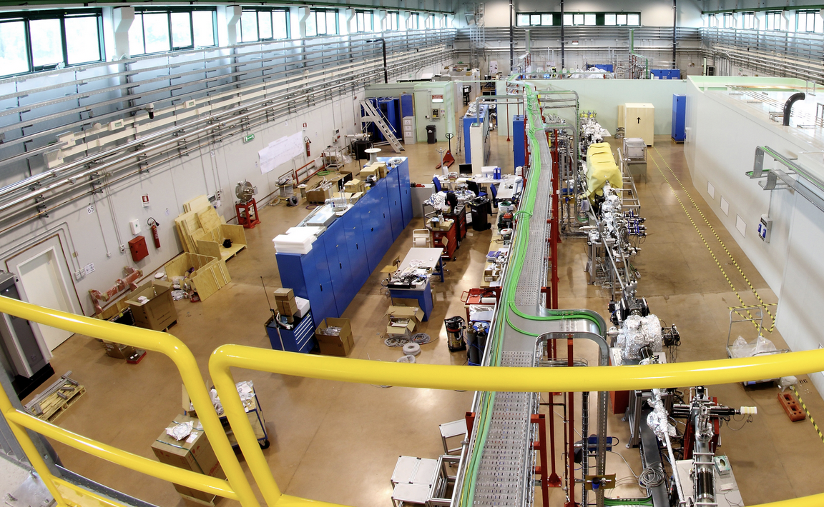
A New Generation of
Synchrotron Radiation Sources:
X-ray Free Electron Lasers (X-FELs)
Question: storage-ring synchrotron sources have high intensity and brightness and excellent coherence: they look like lasers, but ARE THEY, indeed, lasers?
A visible/infrared laser:
Active medium giving optical amplification
Storage-ring synchrotron sources:
NO optical amplification
NO good mirrors for x-rays, thus NO optical cavities
They are NOT lasers
Two-mirror optical cavity, increasing the photon path and the optical amplification

Slide 42
But there is now a new class of x-ray sources, the x-FELs, which are based on an optical amplification process -- caused by the interaction of electrons with their emitted waves
very long undulator
λ_{L}
One electron emits a wave
A bunch of electrons enters the x-FEL undulator
Traveling with the bunch, the wave acts on the electrons confining them to thin periodic slices (microbunches) with period equal to the wavelength λ_{L}
The emissions of
microbunched electrons are coordinated and amplify the wave

Slide 43
What pushes the electrons towards the “slices”?
…the so-called “ponderomotive forces”, due to the interaction of the electrons with the wave and the undulator: complicated, but their basic features can be easily grasped
emitted wave
The wave is zero at the nodes and so are the ponderomotive forces: the nodes are where the electrons could accumulate
But accumulation does not occur at all nodes since the wave field has two directions that cause forces with opposite orientations:
no accumulation
electron accumulation
…so, electrons accumulate at
every other node: the microbunch period is one wavelength
λ_{L}
λ_{L}

Slide 44
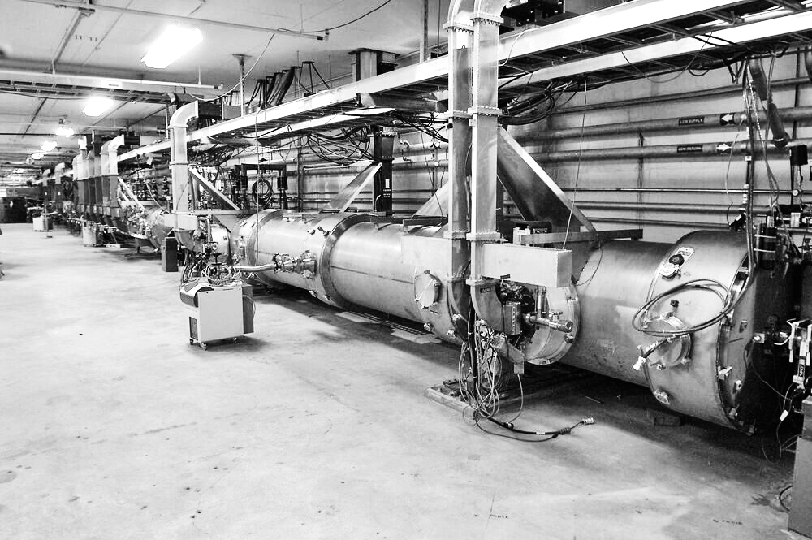
Why most undulators do not behave like x-FELs?
…the relativistic “longitudinal mass” γ ³m_{o} is very heavy for high-energy electrons with large γ -values, required to emit x-rays: it takes a (relatively) long time to shift them to the “slices”, so a very long undulator is required for microbunching
…plus, the microbunching period is very short (x-ray wavelengths) -- the bunch structure is delicate, easily destroyed:
very high accuracy is required for
the undulator and the electron beam
λ_{L}
NOTE - for infrared FELs γ is smaller, the longitudinal mass much
lighter and the wavelength much longer: the above problems do not
exist. That is why infrared FELs arrived several decades before the x-FELs

Slide 45
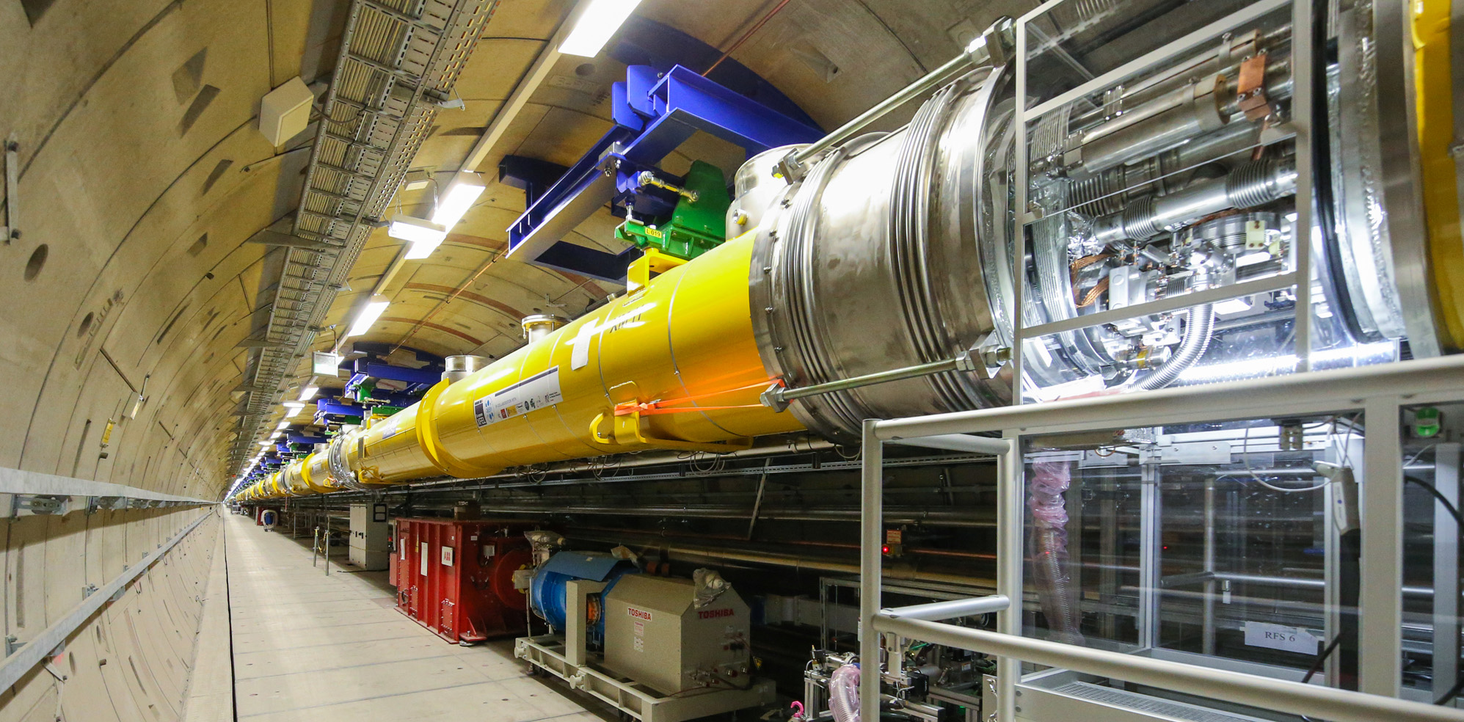
General scheme of an x-FEL:
Ultrabright x-ray beam
Electron beam
Very long undulator
Note again – unlike
a visible laser, no two-mirror optical cavity: there are no efficient mirrors for x-rays
Thus, strong optical amplification
is needed to produce lasing in a single pass: this causes additional, tough technical requirements
LINAC (linear accelerator of electrons)

Slide 46
The x-FEL photon pulse duration is very short
and the cross section very small:
H
The strong optical amplification required for one-pass lasing demands a high electron density, thus a very short electron bunch length H
A
v ≈ c
Microbunched electron bunch
…which corresponds to a very short photon pulse duration H/v ≈ H/c (femtoseconds or less, shorter than the pulses from storage rings)
Plus, high electron density requires a very small cross section A of the electron bunch and therefore of the photon pulse, producing ultrahigh brightness
[Note: most x-FELs are not based on storage rings but on LINACs, which can produce smaller cross sections A]

Slide 47
COHERENCE of x-FELs
spatial: excellent; time: problematic
Why problematic? Because the waves that are amplified are emitted at random when the electron bunch enters the undulator (SASE = Self-Amplified Spontaneous Emission)
Thus, the time structure is different for different photon pulses: this broadens the wavelength spectrum Δλ and limits the time coherence
time
Possible solution: “seeding” -- i.e., using the x-FEL undulator to amplify waves with high time coherence produced by an external source
External source
A complicated technology, recently realized

Slide 48
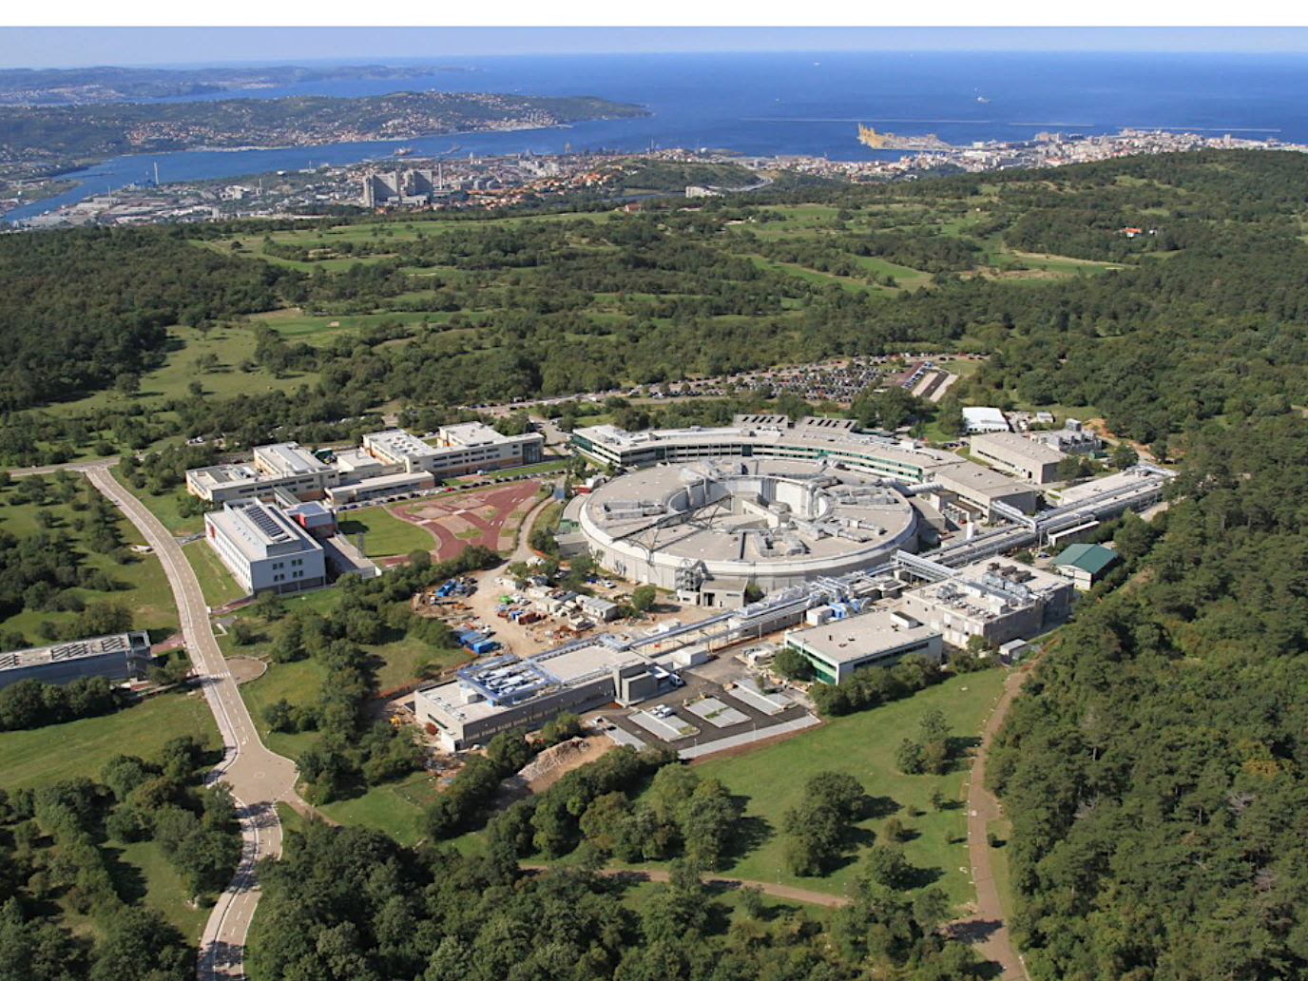

Claudio Pellegrini (UCLA and Stanford), father of the x-FELs
FELs are now a fantastic reality, notably at ELETTRA
...with the seeded x-FEL
“FERMI” (Free Electron
Radiation for Multidisciplinary Investigations)

Slide 49
PROBLEM: x-FELs emit femtosecond pulses
of tens of gigawatts -- how can we handle this tremendous concentrated power, and use it?
…sent into a molecule or a nanoparticle, causes its explosion:
computer reconstruction
boom!
…but, with the ultrafast x-ray FEL pulses one can analyze the structure during the explosion and try to retrieve from the data the initial structure

Slide 50
Some examples of what happens at the femtosecond time scale of an x-FEL pulse:
Fast chemical reactions
In 100 femtoseconds shock and sound waves travel in solids over atomic distances
X-FEL experiments on these and many other ultrafast features open very exciting new opportunities in science and technology!
A water molecule dissociates in 10 femtoseconds
Photons propagate over hundreds of nanometers
Typical periods of molecular vibrations: 10-100 femtoseconds
Laser surgery without collateral damage
Novel micromachining techniques, etc…

Slide 51

To end our lecture, a fascinating aspect: x-ray FELs and the quantum foundations of physics
What causes the interference and diffraction of photons?
First-order Quantum Electrodynamics (QED):
Wave effects such as interference and diffraction are caused by
interactions of each photon only with itself (indeed, they also
happen when there is, on the average, only one photon in the
apparatus). So, as Dirac realized, multiple-photon effects are negligible
BUT: with ultrabright “seeded” x-FELs, multi-photon higher-order QED effects are detected, leading to new techniques! [J. Stöhr, Synchrotron Radiation News 32 , 48 (2019)]

Slide 52


Many thanks to the school organizers for inviting me!
FOR FURTHER READING:
Y. Hwu and G. Margaritondo: “Synchrotron Radiation and X-ray Free Electron Lasers (X-FELs) Explained to all Users, Active and Potential ”, J. Synchrotron Radiation 28, 1014 (2021)
G. Margaritondo: “An Enlightening Procedure to Explain the Extreme Power of Synchrotron Radiation”, J. Synchrotron Radiation 26, 2094 (2019)
G. Margaritondo: “The Simple Physics of the Bending Magnet Spectrum”, J. Synchrotron Radiation 25, 1271 (2018)
G. Margaritondo: “Synchrotron Light: a Success Story over Six Decades”, Rivista Nuovo Cimento 40, 411 (2017)
G. Margaritondo and J. Rafelski: “The Relativistic Fundations of Synchrotron Radiation”, J. Synchrotron Radiation 24, 898 (2017)
G. Margaritondo: “Who Were the Founders of Synchrotron Radiation? Historical Facts and Misconceptions”, J. Vacuum Sci. Technol. A40, 033204 (2022)
G. Margaritondo: “Teaching about the Birth of Synchrotron Light: the Role of Frascati and a Missed Opportunity”, J. Synchrotron Radiation 31, 987 (2024)
G. Margaritondo : “Teaching about the Relativistic Background of Synchrotron Radiation: Some Intriguing Aspects with Strong Didactic Implications”, J. Synchrotron Radiation (accepted)
…and thank you for yourattention: your future, young folks, is
brighter than ever!

Slide 53
Supplemental Material

Slide 54
Demonstrating time dilation and Lorentz contraction:
time from “emission” to “detection” measured in the train
(R_{e} frame):
Δt_{e} = L_{e} /c
source of light flashes
time measured by a motionless observer (R_{L} frame):
Δt_{L} = L_{e}² + (vΔt_{L})² /c ;
c ²Δt_{L}² = 4L_{e}² + v ²Δt_{L}² ;
c ²Δt_{L}² (1-v ²/c ²) = c ²Δt_{e} ²
Δt_{L} = γ Δt_{e}
(time dilation)
vΔt_{L}
L_{e}
L_{e}
detector
v
Lorentz contraction:
total time: Δt_{L} = D_{L}/(c –v ) + D_{L}/(c +v ) = 2cD_{L}/(c ² -v ²)
= γ ²(2D_{L}/c)
v
D_{L}<D_{e}
mirror
…must equal the time dilation: γ ²(2D_{L}/c) = γΔt_{e} = γ (2D_{e}/c)
source + detector
D_{e}
backward path: time = D_{L}/(c +v )
D_{L} = D_{e}/γ
(Lorentz contraction)
time from “emission” to “detection” measured in the train: Δt_{e} = 2D_{e} /c
travel time along forward path in the R_{L} frame: time = D_{L}/c + (time x v )/c
→ time = D_{L}/(c – v )

Slide 55
An alternate, intriguing picture of how an undulator produces synchrotron radiation:
L
In R_{L ,} the undulator corresponds to a transverse
B -field with period L ; seen in R_{e ,} the B -field
travels with speed ≈ -c and its period is ≈L /γ
R_{L}
B
≈-c
…and, going from R_{L} to R_{e} , relativity also adds a
periodic electric field E perpendicular to the B-field
R_{e}
E
so, the undulator looks to the electron in R_{e} like
an “electromagnetic wave” of wavelength λ_{e} ≈ L /γ , which
L /γ
…backscattered by the electron, becomes synchrotron radiation:
R_{L}
electron
synchrotron radiation
λ_{L}≈L /(2γ ²)
…and the backscattered wavelength seen in R_{L} is Doppler-shifted becoming λ_{L} ≈ λ_{e}/(2γ ) ≈ (L /γ )/(2γ ) = L /(2γ ²)

Slide 56

A simple model of x-ray imaging by phase contrast
[G. Margaritondo and G. Tromba, J. Appl. Phys. 85, 3406 (1999); Y. Hwu et al.,
J. Appl. Phys. 86, 4613 (1999)]
detector
predicted image: edge with
dark-clear fringes
refraction
x-rays
object with a slanted edge between regions with different refractive index
a real radiograph
detected intensity
Note: high lateral coherence is required for phase contrast, but high longitudinal (time) coherence is not needed

Slide 57





Synchrotron radiology can read ancient manuscripts
visible-light picture
x-ray image
…even under seal:
“In nome a Deo”
so, Lady Cataruçia Savonario of Venice could speak to us after seven centuries [results of Dr. Fauzia Albertin]

Slide 58
Photoemission, another fundamental class of synchrotron techniques
photoelectric effect:
photon (hν )
photoelectron
…photoemission explores the energies of electrons forming chemical bonds:
solid
electrons
solid
atom
vacuum
The effect adds hν to the electron energy: by subtracting hν from electron energies measured in vacuum, one can derive the electron energies in the solid
Electron energy
hν
Creation of chemical bonds
Photoelectric effect

Slide 59
Solid-state photoemission detects valence electrons and core electrons:
photoelectron energy, corrected for the photon energy
valence electrons
electron energy
photoemission spectrum
core electrons
captured photoelectrons
…synchrotron photoemission transformed my bookish quantum notions like core levels into tangible realities!

Slide 60

Photoemission reveals the gap of a
high-temperature superconductor
superconducting state
electrons
Superconducting gap
normal state
…which became visible instead in high-resolution spectra taken with ultrabright synchrotron radiation
energy
Conventional photoemission had limited energy resolution and could not detect the gap
-0.2 -0.1 0
Energy (eV)

Slide 61

The x-FEL microbunching: a subtle “miracle”
Two factors act on the electrons and cause the “ponderomotive forces” ( and ): (1) the emitted wave and (2) the undulator magnetic field, of period L
But, as the electrons travel over L /2, the
direction of the undulator magnetic field is reversed: one could imagine that the “ponderomotive forces” are inverted and the “slices” are depleted…
Wow!!!
But this does not happen! Why?
…because of the small difference between the electron and wave speeds, v and c :
the electron travels over L /2 in a time L /(2v), during which the wave propagates over [L /(2v)]c ;
path difference: L /2 - [L /(2v)]c = (L /2)(1–v/c) = (L /2)(1–v/c)(1+v/c)/(1+v/c)
= (L /2)(1–v ²/c ²)/(1+v/c) ≈ [L /(2γ ²)]/2 =
λ / 2
…and, over λ/2 the wave field is also reversed, so the ponderomotive force directions are not changed: this “miracle” saves the x-FEL mechanism!

Slide 62
Another nice case of very simple theory:
optical amplification of FELs
Assume: I = wave intensity,
E = wave electric field, proportional to I
The electron → wave energy transfer rate dI /dt is determined by the combination of two factors:
(1) the transfer rate from one electron, given by the (negative) work made by the wave, proportional to E
(2) the degree of microbunching, determined by the “ponderomotive forces” on the electrons, also proportional to E
Overall, dI /dt is proportional to E x E, thus to I x I = I : dI /dt = constant x I
The solution I (t ) = I_{o}exp(αt ) of this equation grows with t , thus with the distance = v t
I
Indeed, the wave intensity increases with the distance along the undulator…
eventually, however, the increase saturates
distance = v t

Slide 63
Why does the intensity increase saturate?
Electron bunch entering the x-FEL undulator:
…when the microbunching is complete, the amplification slows down
emitted wave
furthermore, as the electrons lose energy to the wave, their γ and emitted wavelength L /(2γ ²) change: they no longer increase the intensity at the original λ
These factors and others cause the saturation of the amplification – which anyway could not continue forever since the energy supply is not infinite…

