Slide 1
Swift Heavy Ion Irradiation of Layered Amorphous Oxide–Metal Thin Films
Ion-track formation, structural modification and nanoscale ripples
Muhammad Alamgeer
Affiliation:
Laboratory for Thin Films, Ruđer Bošković Institute, Zagreb
Joined: March 2026
Mentor: Dr. Krešimir Salamon
Project Lead: Dr. Marko Karlušić
Project: HRZZ IP-2022-10 (SHIILAOM)

Slide 2
Motivations and Impact
Swift heavy ion (SHI) irradiation enables controlled modification of materials
Important for nanoscale structuring and interface engineering
Helps understand energy dissipation mechanisms in materials
Applications in:
Nuclear materials
Electronics
Advanced nanotechnology

Slide 3
Objectives and Rationale
Study effects of SHI irradiation on oxide–metal multilayers
Investigate influence of:
  Ion fluence
  Grazing incidence angle
Analyze:
  Ion-track formation
  Nanoparticle formation
  Interface modifications

Slide 4
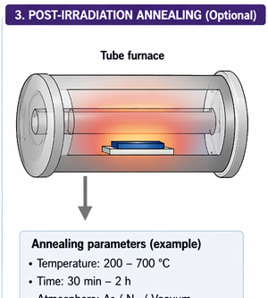
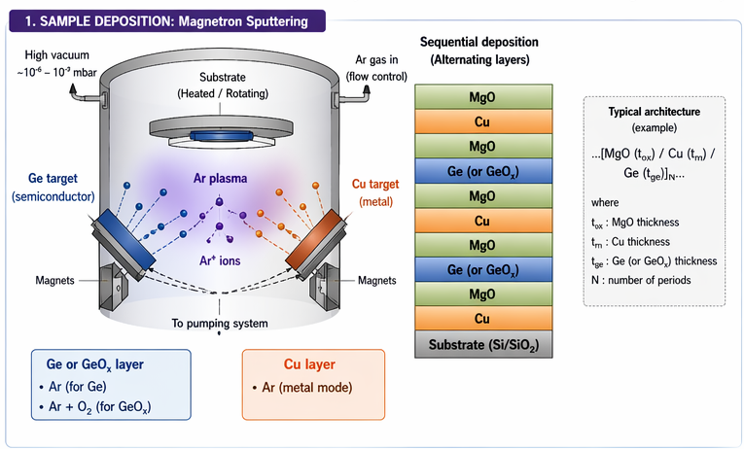
Materials and Structure
Multilayer systems:
  Ge / MgO
  Cu / MgO
Fabrication:
  Magnetron sputtering
Structure:
  Alternating amorphous oxide and metal layers
Goal:
  Controlled interface mixing
  Development of nanoscale ripples
  Formation of nanoparticles

Slide 5
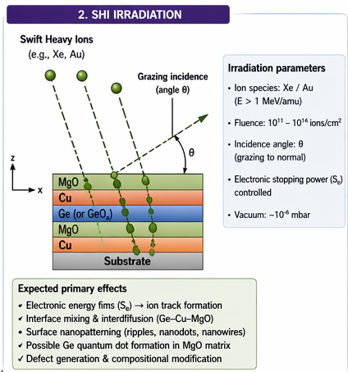
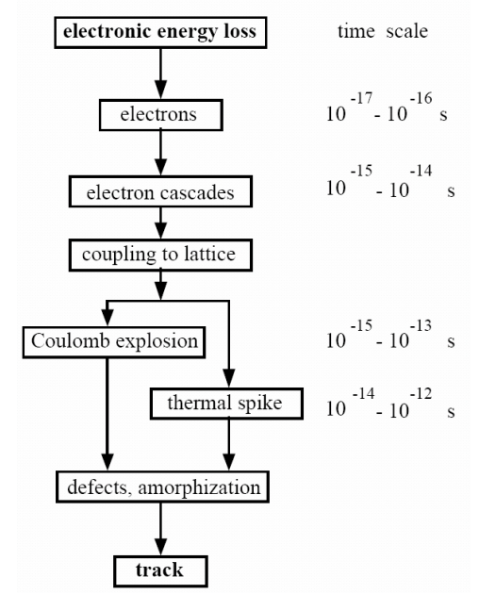
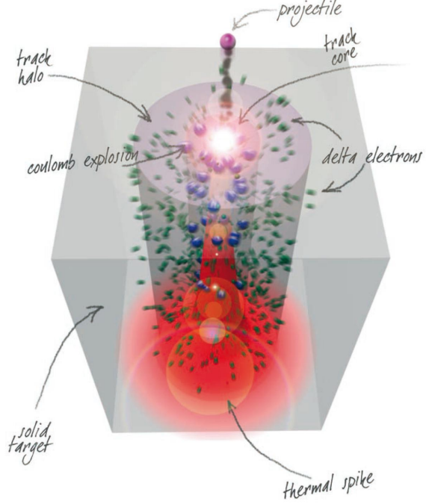
What is SHI?
Swift Heavy Ions:
  Mass > 20 amu
  Energy > 1 MeV/amu
High-energy ions penetrate material and:
  Deposit energy along their path
  Create ion tracks
Key Parameters:
Fluence
Incidence angle

Slide 6
Physical Effects of SHI
Intense electronic energy deposition
Formation of:
  Ion tracks
  Localized heating (thermal spike)
Leads to:
  Structural modification
  Defect formation
  Interface mixing

Slide 7
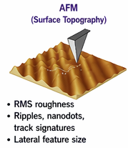
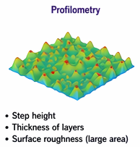
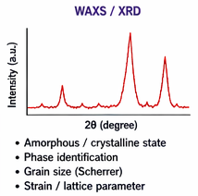
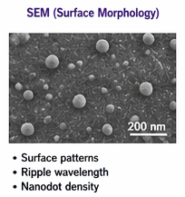
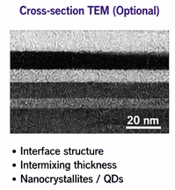
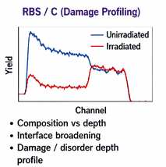
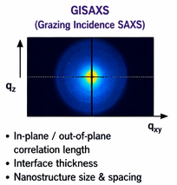
Characterization Techniques
AFM → Surface morphology
GISAXS → Nanoscale structure
RBS/C → Damage profiling
SEM → Surface imaging
TEM → Internal structure

Slide 8
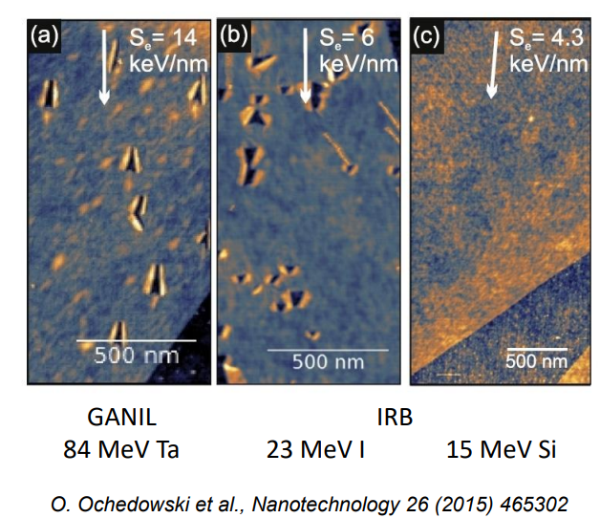
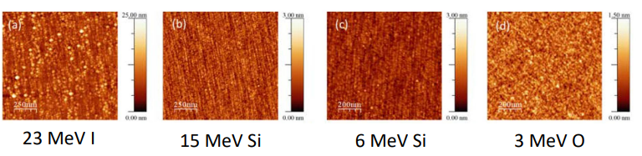
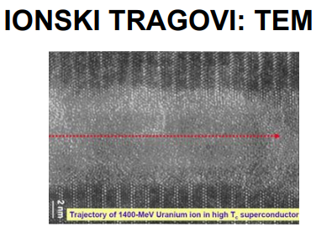
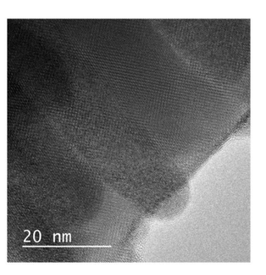
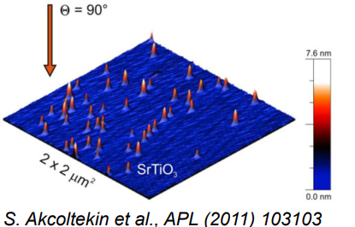
Expected Results
Formation of ion tracks
Development of nanoscale ripples
Nanoparticle formation within layers
Interface mixing between oxide and metal layers

Slide 9
Research Plan (Year 1)
Fabrication of multilayer samples
Post-deposition annealing
SHI irradiation (grazing incidence)
Initial characterization:
  AFM
  RBS/C
  SEM

Slide 10
Research Plan (Year 2)
Second series of samples
Advanced characterization:
  GISAXS
  XRD / WAXS
Data analysis
Publication and conference presentations

Slide 11
Research Plan (Year 3+)
Third series fabrication
Comprehensive data analysis
Synchrotron experiments
Final publications and PhD thesis

Slide 12
Impact & Applications
Controlled nanostructuring of materials
Development of radiation-tolerant materials
Applications in:
  Nuclear environments
  Aerospace systems
  Nanoelectronics

Slide 13
Future Work & Collaboration
Optimize multilayer design
Explore different irradiation conditions
Expand characterization techniques
Collaborate with experimental facilities

Slide 14
Acknowledgments
Mentor: Dr. Krešimir Salamon
Lab Head: Dr. Maja Mičetić
Project Lead: Dr. Marko Karlušić
Project: HRZZ IP-2022-10 (SHIILAOM)

