Slide 1



Tuning Metal–Support Interactions in a Ru Single Atom Catalyst Anchored on NiCo₂O₄ for Overall Water Splitting: Insights from XAS and XPS
Astha Gupta
PhD Research Scholar
Department of Chemistry
BITS-Pilani, Pilani, India
Gilberto Vlaic XVIII School on Synchrotron Radiation: Fundamentals, Methods and Applications

Slide 2
Content
Introduction: Single-Atom Catalysts and Metal–Support Interactions
Ru-SAC NiCo₂O₄: Synthesis and Structural Characterization
Local Coordination Structure: Insights from XAS/EXAFS
Electronic Metal–Support Interaction: XANES and XPS Insights
Electrocatalytic Performance: HER, OER and Overall Water Splitting
Conclusions and Outlook: Toward Operando Understanding

Slide 3

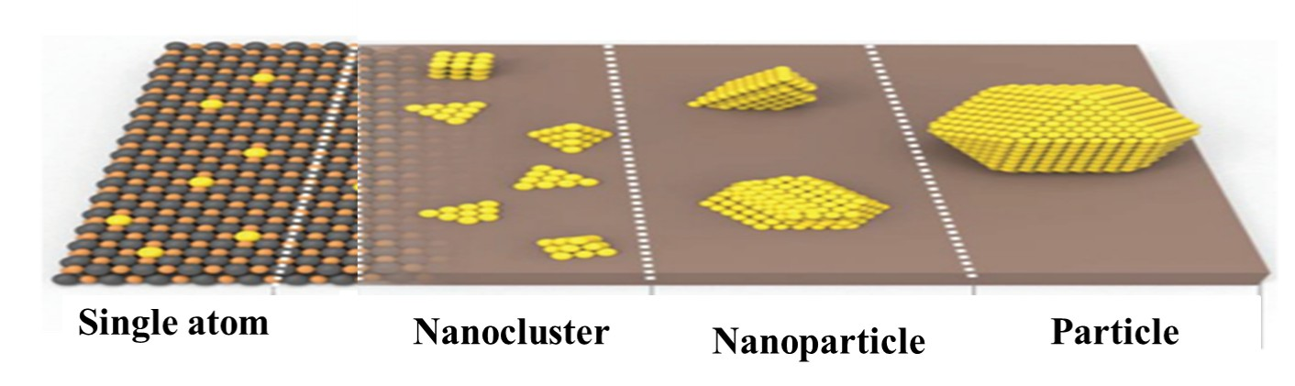
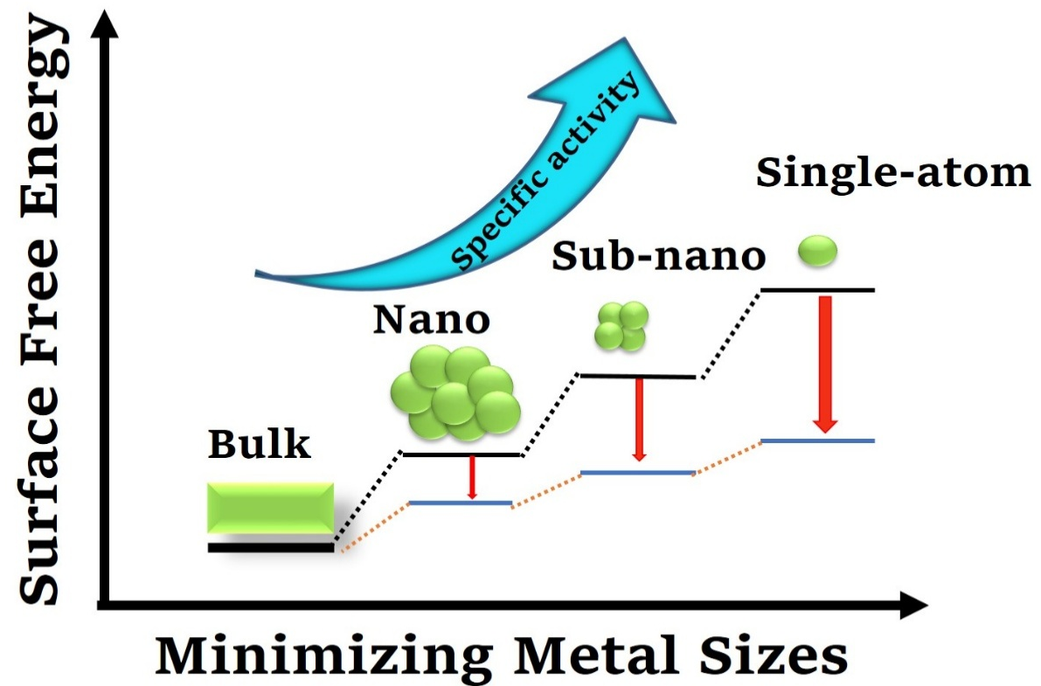
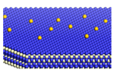
Research Goal: Stabilizing Single Atoms for Efficient Electrocatalysis
Why Single Atoms?
Challenges with Single Atoms?
Every metal atom is accessible
Atomic efficiency reaches to 100 %
Strategy to stabilize single atoms by trapping them on metal oxide supports
Poor stability, metal centers susceptible to aggregation.
Single atoms bond to surface O, forming M_{SA}–O–M bonds that anchor them and prevent aggregation.
Enables charge transfer between single atom and support.
Provides: Stability: strong binding suppresses sintering.
Huang et al., Small Methods, 2020, 4(2), 1900540

Slide 4
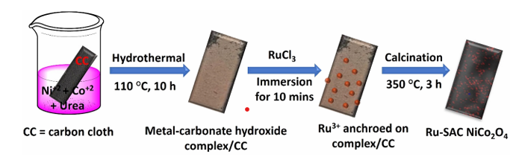
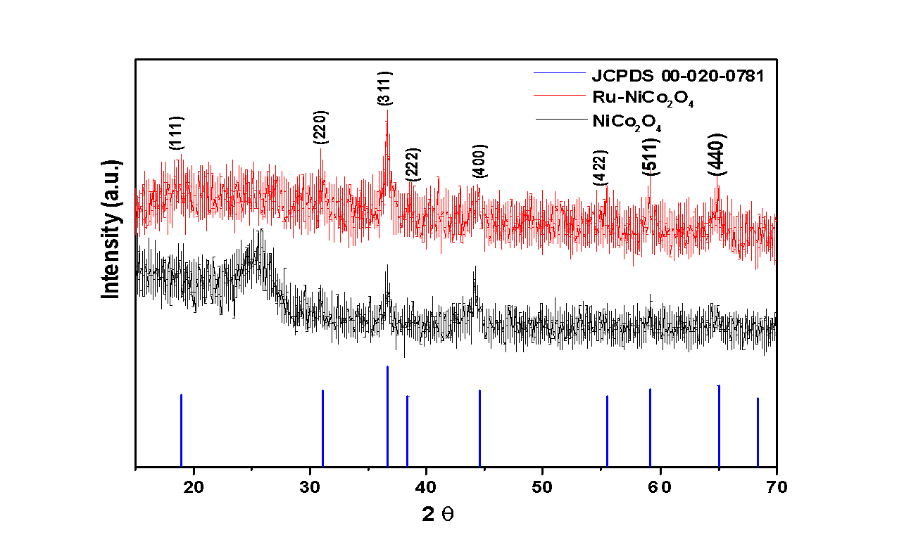
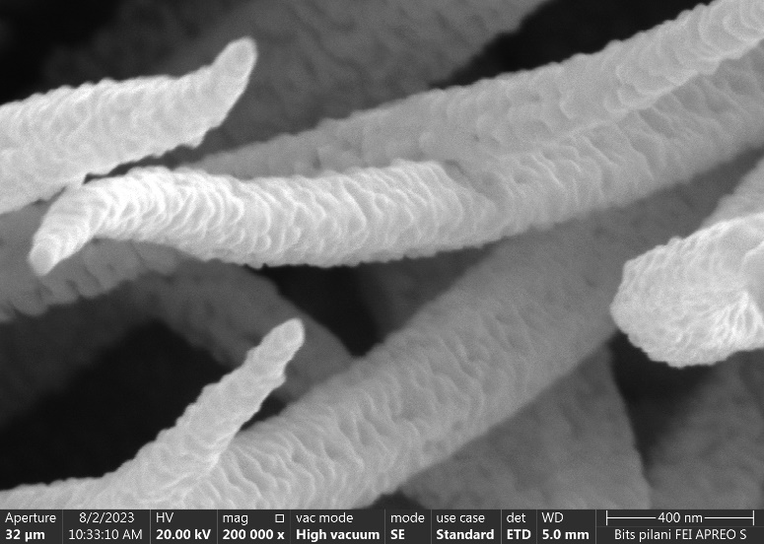
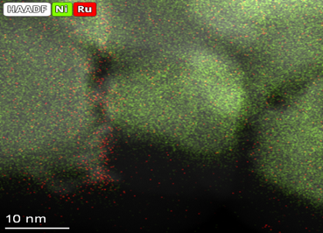

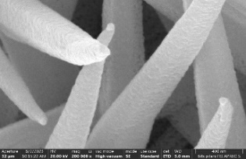
Specific System: Ru Single Atoms on NiCo₂O₄
Design and Structural Characterization of Ru-SAC NiCo₂O₄
2.03 wt % loading of Ru atoms on NiCo₂O₄ support
Cubic crystal structure
No significant change in the crystal structure
10 nm
10 nm
400 nm

Slide 5
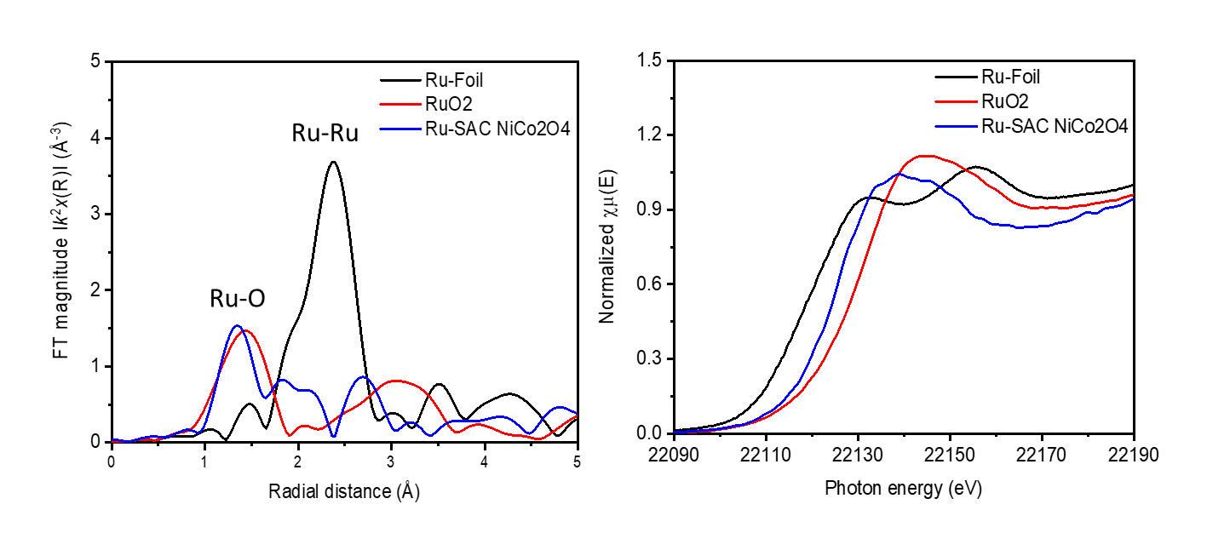
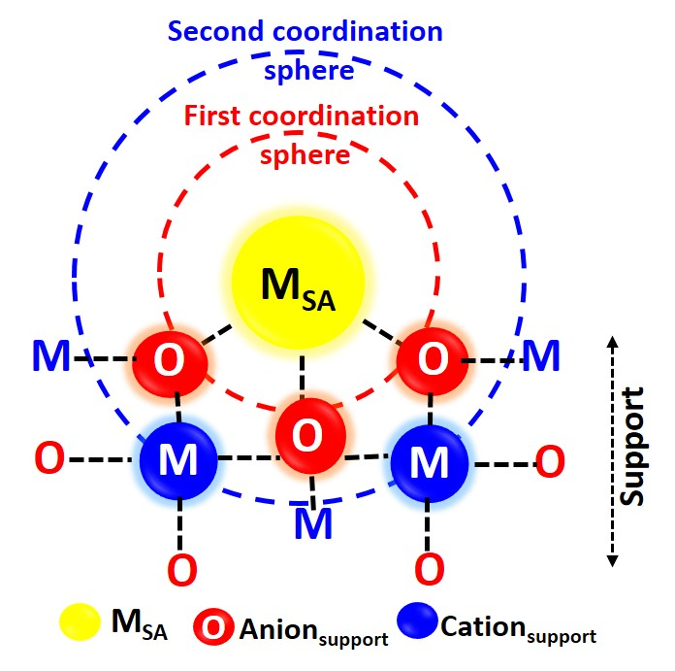
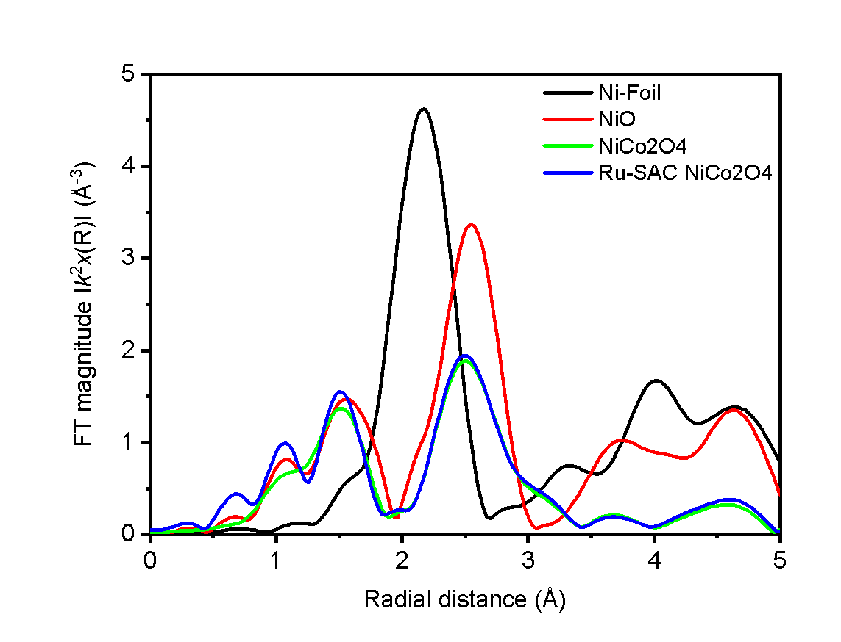
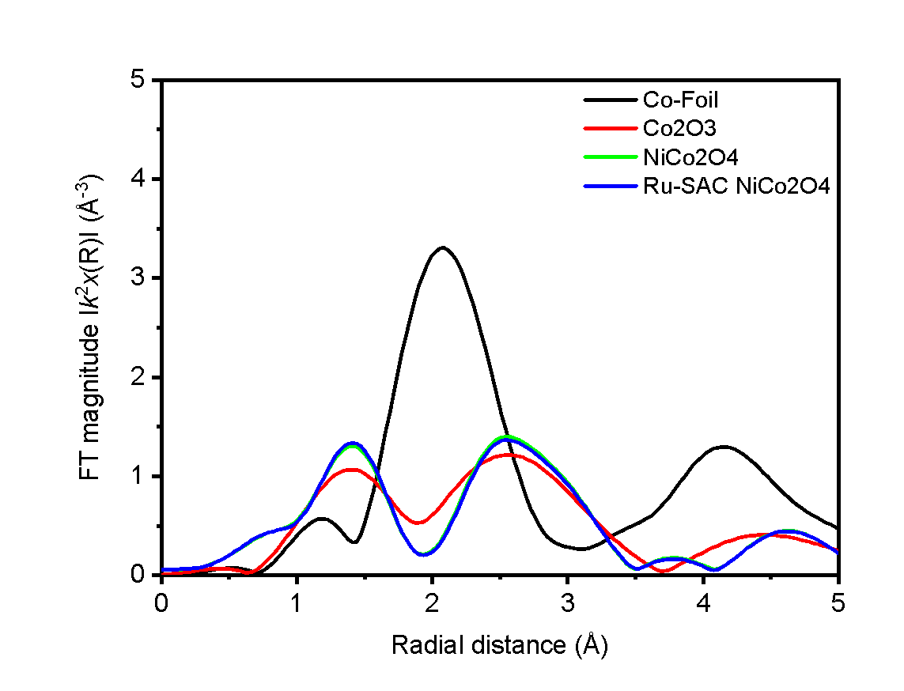
Resolving the Local Coordination Environment of Ru and it’s Oxidation state: EXAFS, and XANES analysis
Ru k-edge
Ru k-edge
Ru-Ni/Co
b
a
Ru–O–Ni/Co interactions
Ni k-edge
EXAFS
Co k-edge
EXAFS
Ru–Co and Ru–Ni bond pairs with a CN Ru–O=2.10, CN Ru–Co=5.26 and CN Ru–Ni=6.83
Atomically dispersed Ru atoms anchored to the NiCo₂O₄ surface through Ru–O–Ni/Co interactions, without significant disruption of the host lattice.

Slide 6
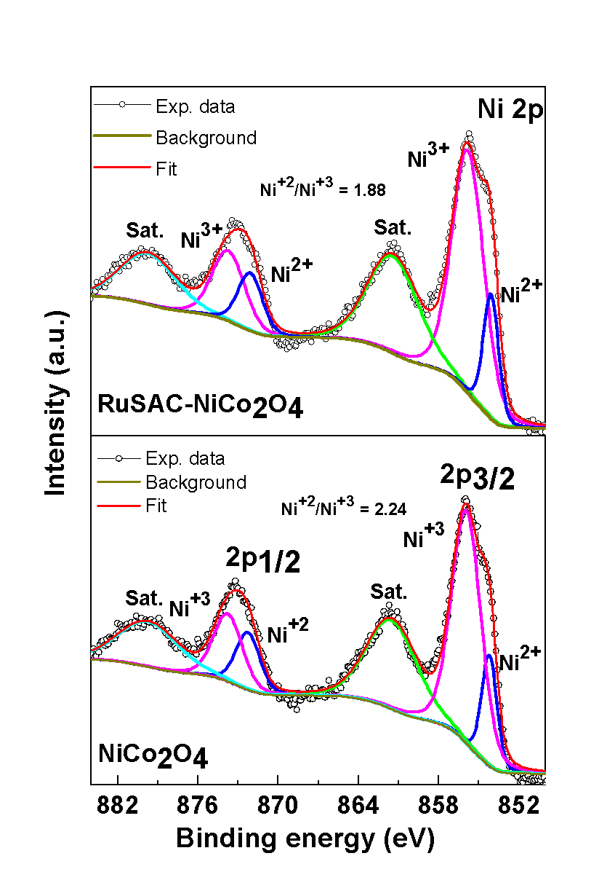
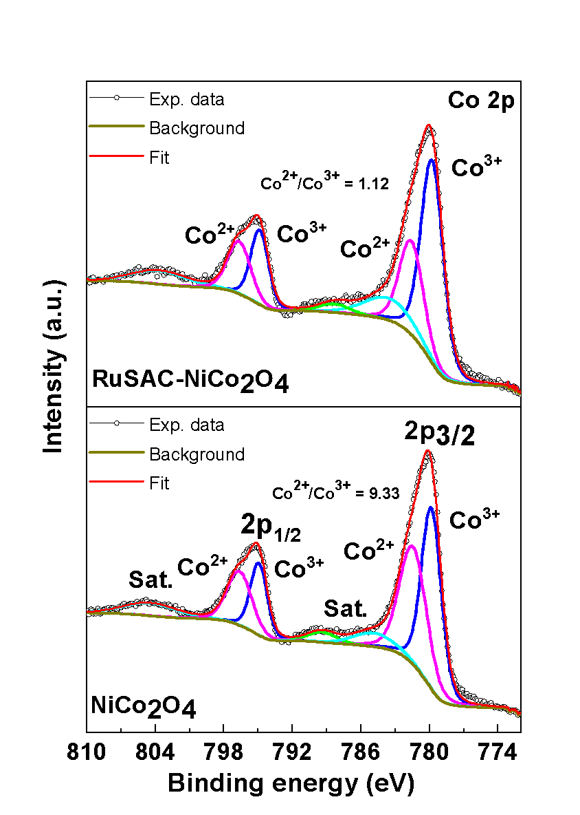
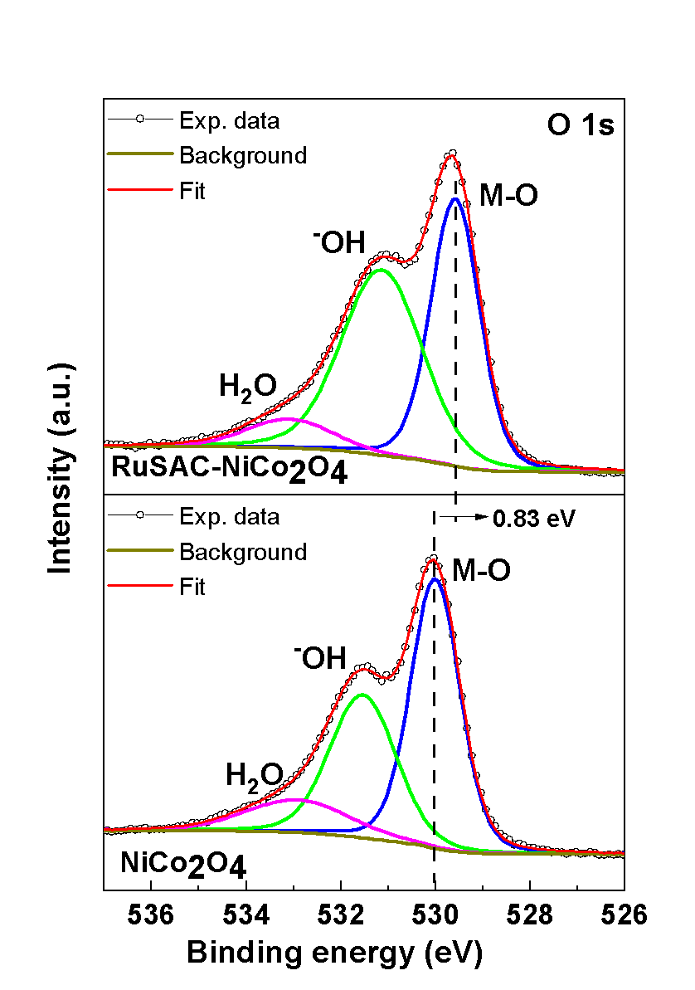
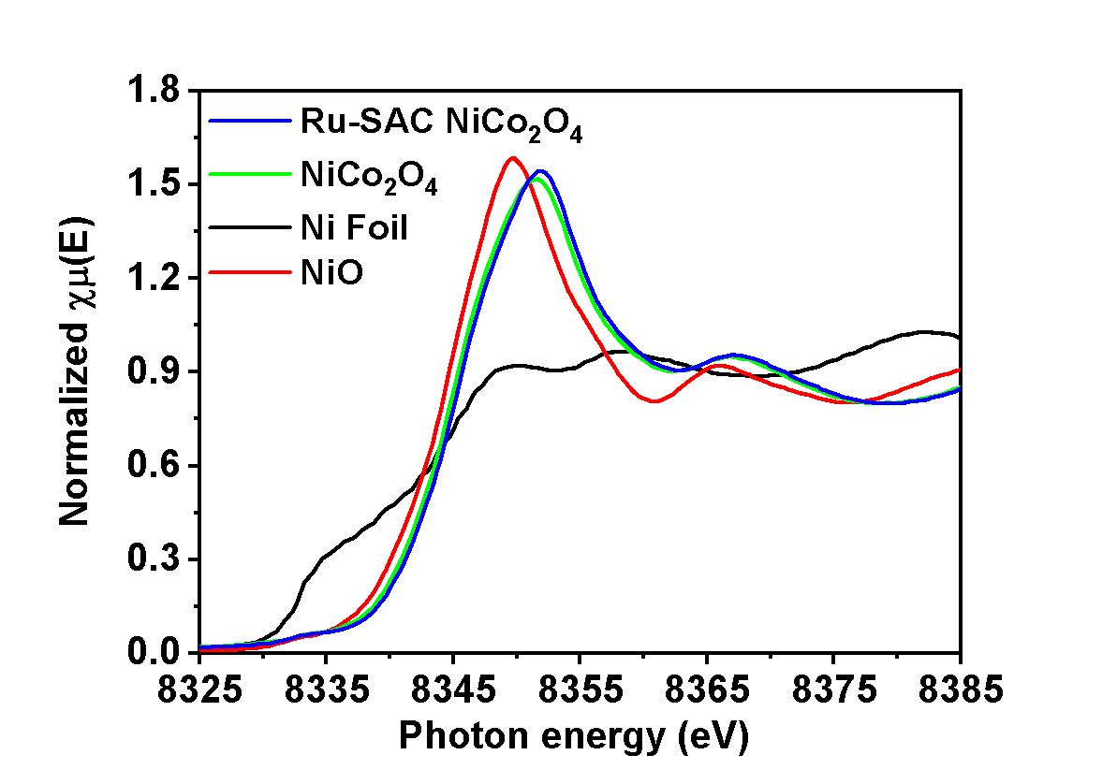
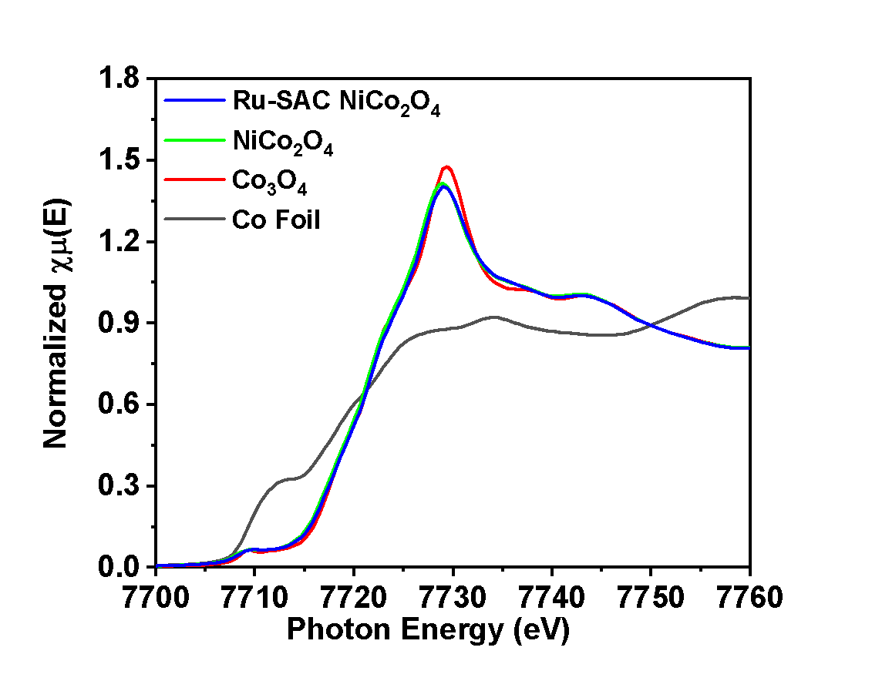
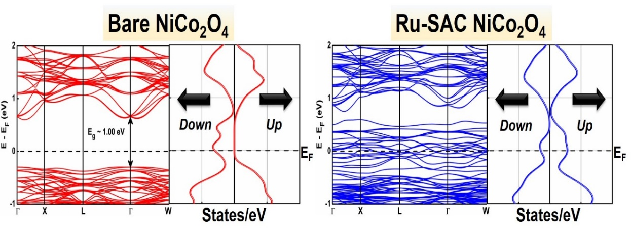
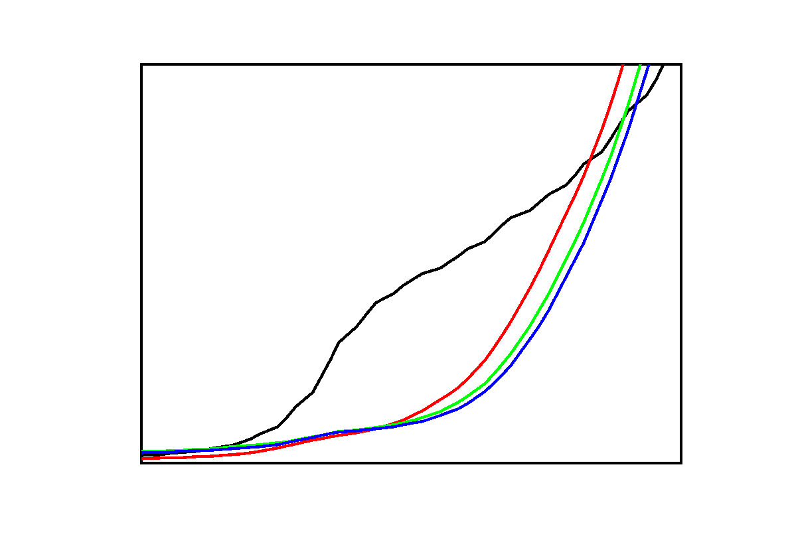
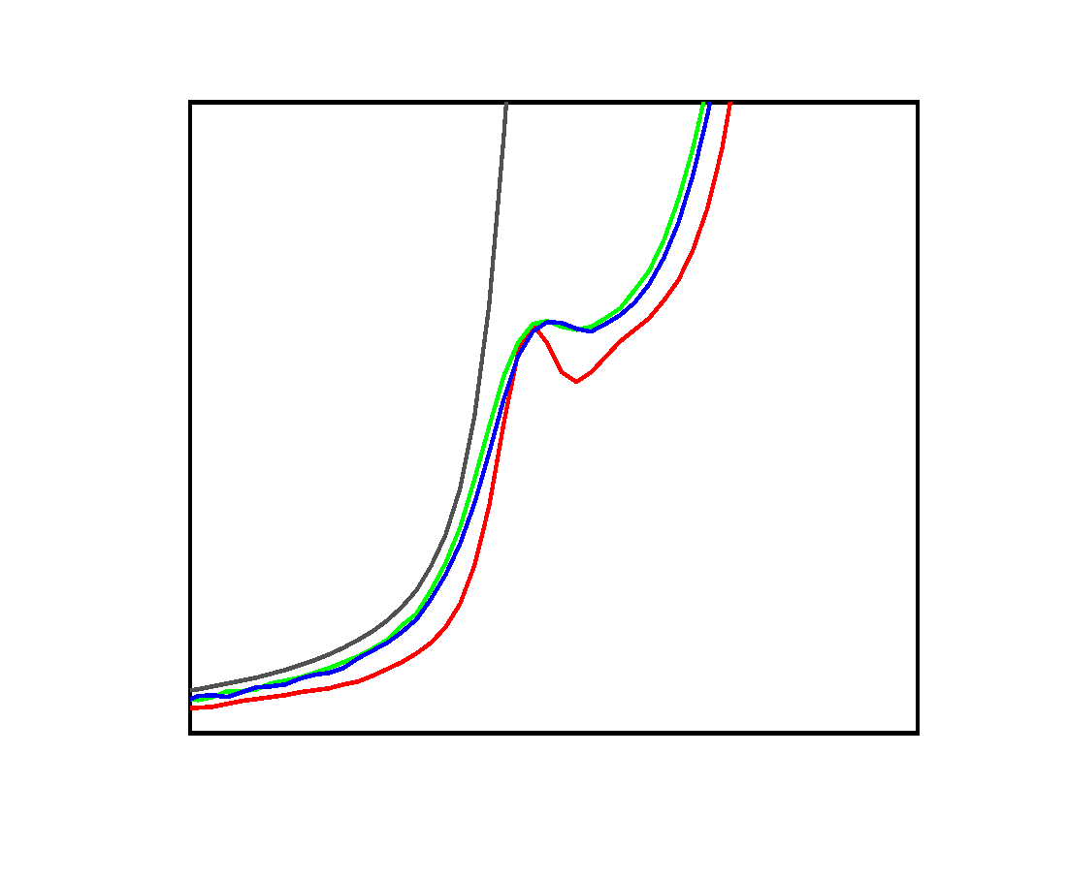
How Does Ru Modify the Electronic Structure
of NiCo₂O₄
Ni k-edge
XANES
Co k-edge
XANES
Zero band gap for Ru SAC-NiCo₂O₄
Increased conductivity of Ru-SAC NiCo₂O₄
Increased valence state of Ni and Co after the anchoring of Ru atoms.
Ni²⁺/Ni³⁺: 2.24 → 1.88, Co²⁺/Co³⁺: 9.33 → 1.12, lattice-O binding-energy shift: 0.83 eV
This charge redistribution establishes a strong electronic metal–support interaction (EMSI).

Slide 7
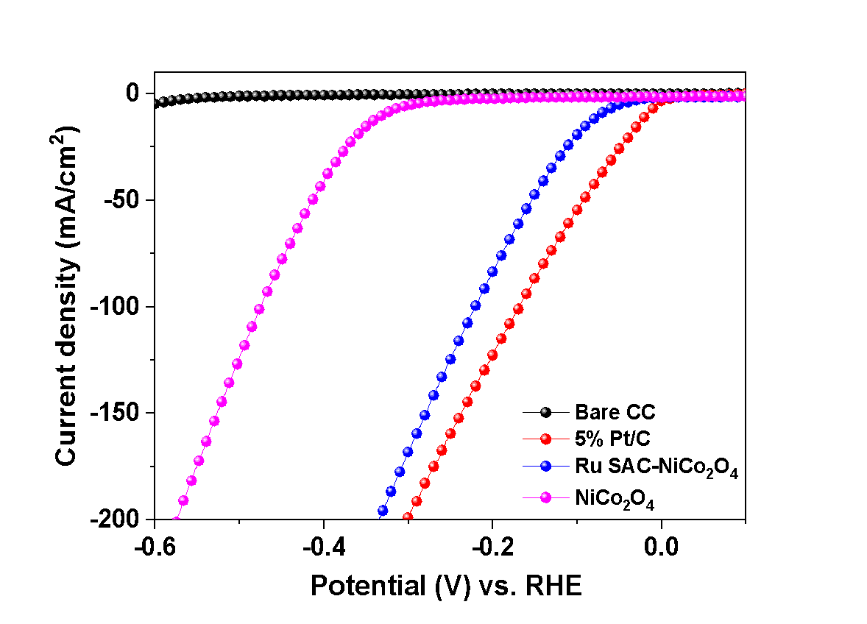
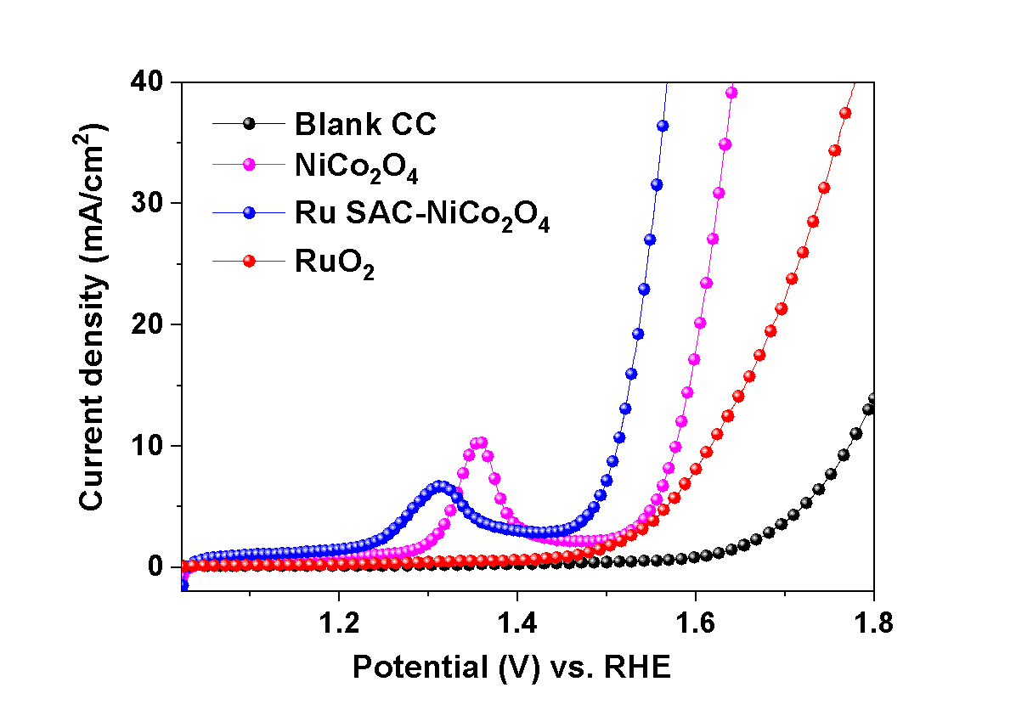
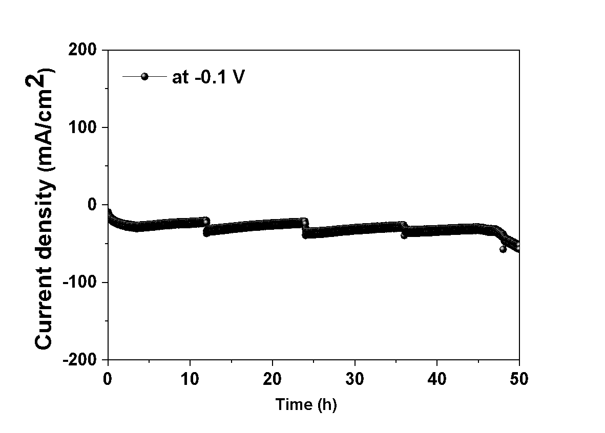
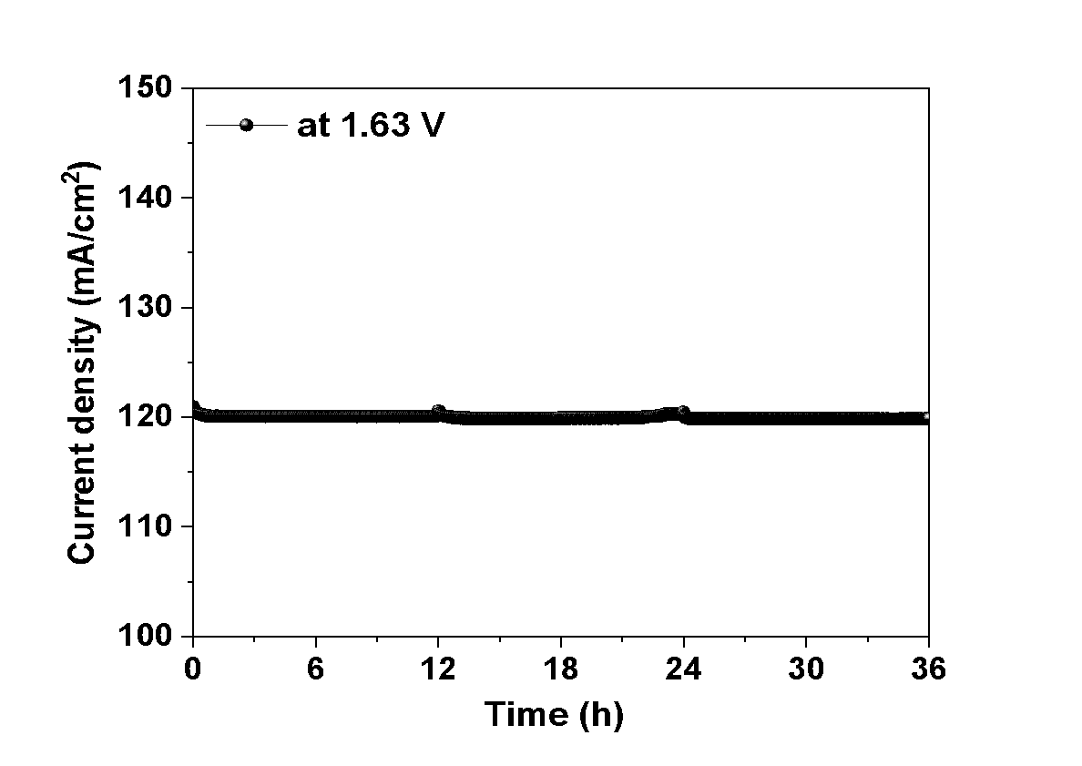
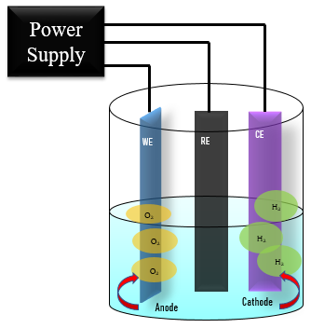
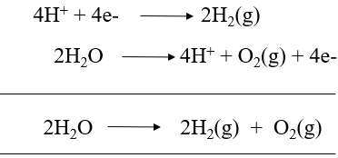
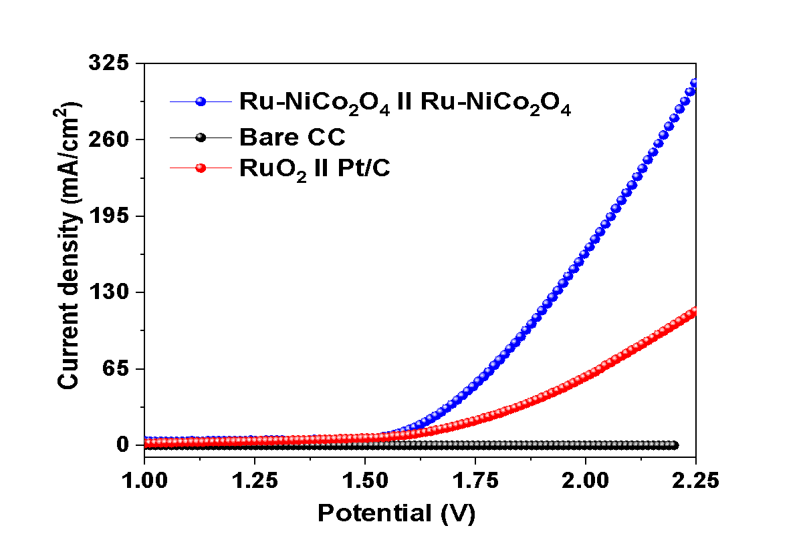
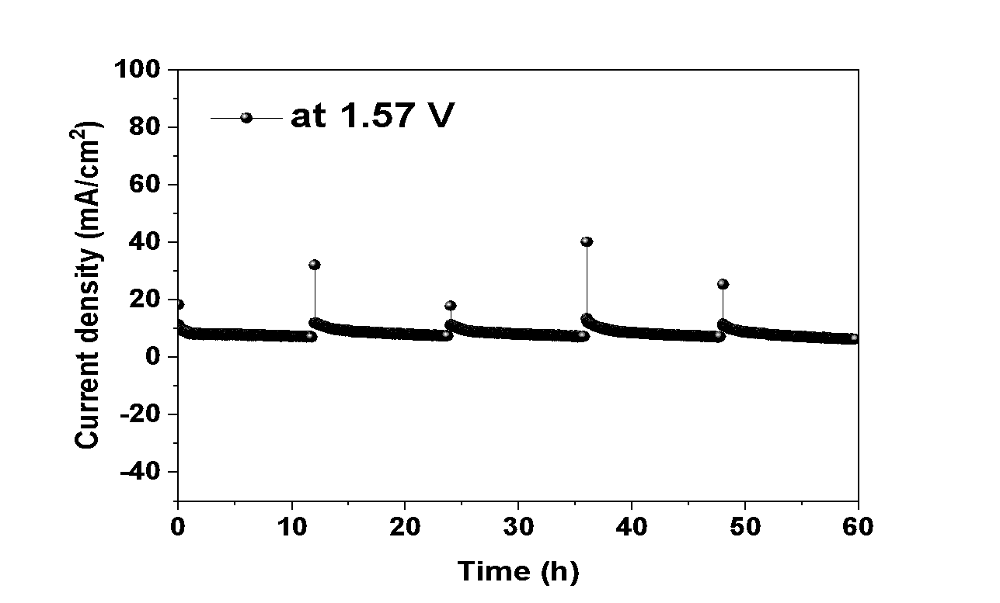
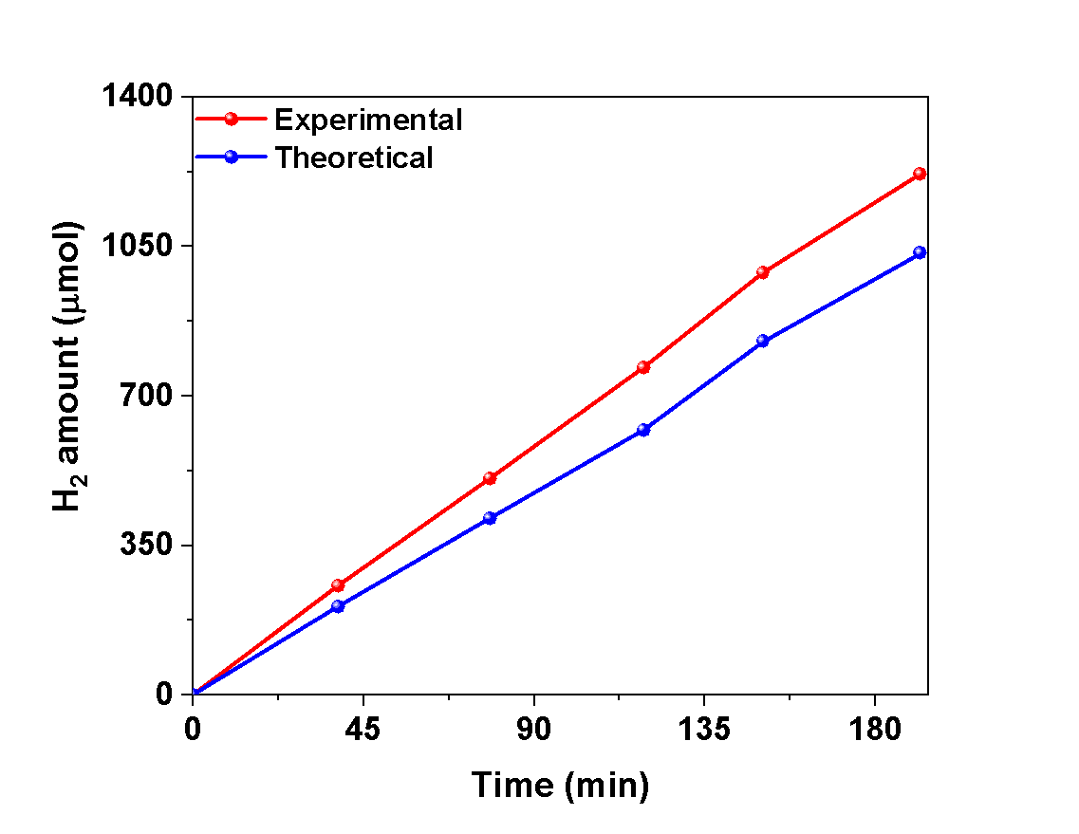
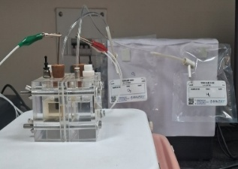
Does the Ru–Support Interaction Translate into Catalytic Performance?
Highest chemical energy density (150 MJ/Kg)
Zero carbon emission
Combustion product is water.
b
Why Hydrogen?
a
c
Eº_{(red)} = 0 V vs. RHE
d
Eº_{(ox)} = 1.23V vs. RHE
E_{ap} = 1.23 V + η
Faradic efficiency is 82.4 %, amount of H₂ produced is 0.0147 kg by 1 kWh of energy.

Slide 8
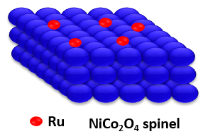
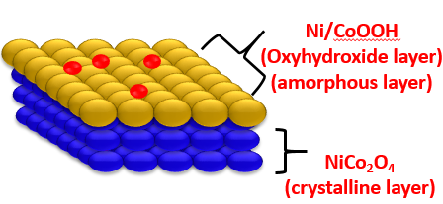
Conclusion
Ru single atoms are successfully anchored on NiCo₂O₄ through Ru–O–Ni/Co interactions.
XAS and XPS reveal significant electronic redistribution at the Ru–oxide interface.
The preserved host-lattice structure confirms effective stabilization of isolated Ru sites without significant structural disruption.
Ru-SAC/NiCo₂O₄ exhibits enhanced bifunctional HER/OER activity compared with bare NiCo₂O₄.
The catalyst enables stable overall water splitting at 1.57 V @ 10 mA cm⁻² for 60 h.
Future Scope: Operando Spectroscopic Probing of Ru Coordination Dynamics and Support Phase Transformation
During OER
(OH⁻ adsorption & oxidation
After OER
Before OER
Reconstructed surface
How single atoms and support interaction evolve during catalysis?
How the coordination of single atoms changes during catalysis and how it affect their activity and stability?

Slide 9
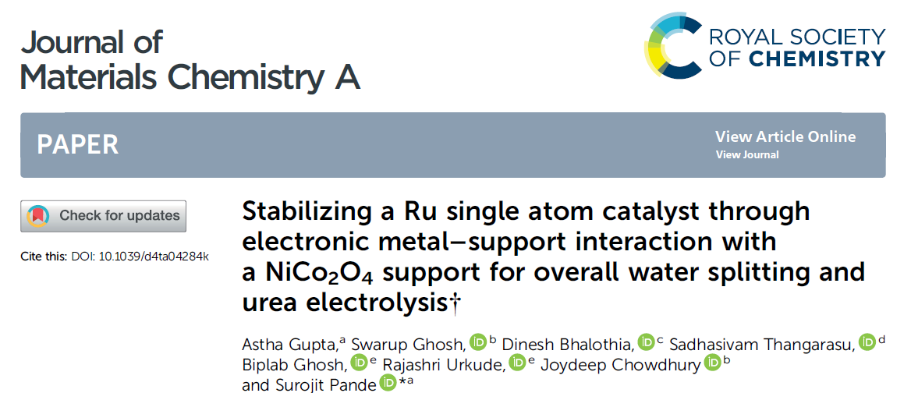




Acknowledgment
Prof. Surojit Pande (PhD Supervisor)
Department of Chemistry, BITS Pilani, Pilani, India
Central instrument facility, BITS Pilani, Pilani, India
Indus Synchrotron Radiation facility (BL-9), RRCAT, Indore, India
BITS Pilani, Pilani Campus

Slide 10










Thank you!

Slide 11
The beamline optics are made up of a collimating meridional cylindrical mirror coated in Rh/Pt, and the collimated beam reflected by the mirror is monochromatized by a Si (111) based double crystal monochromator (DCM) for energy selection.
The DCM's second crystal is a sagittal cylindrical crystal that is used for horizontal beam focusing, while another Rh/Pt coated bendable post mirror facing downward is used for vertical beam focusing at the sample position.
To get a significant edge jump at the absorption edge of the element to be analysed, calculations were done. Calculated amount of sample then mixed with cellulose powder in proper amount and pressed (2 Ton) into a 1 mm diameter disc to made pellets. These pellets were used for recording absorption spectra. The data was 2 collected when the synchrotron source 2.5 GeV ring was operated at 120 mA injection current.
XAFS (XANES and EXAFS) measurements were carried out in transmission and fluorescence mode. The ion chambers were filled with N2, He, and Ar for Ru, Ni and Co foils and for the samples. The second crystal of the monochromator was 60% detuned during the data collection to suppress the higher harmonic components. The energy calibration was performed using the Ru, Ni and Co metal foils as a reference

Slide 12
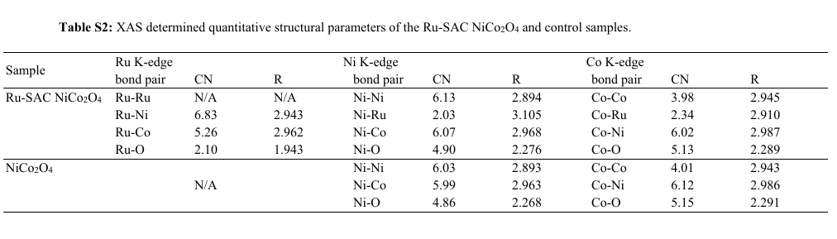
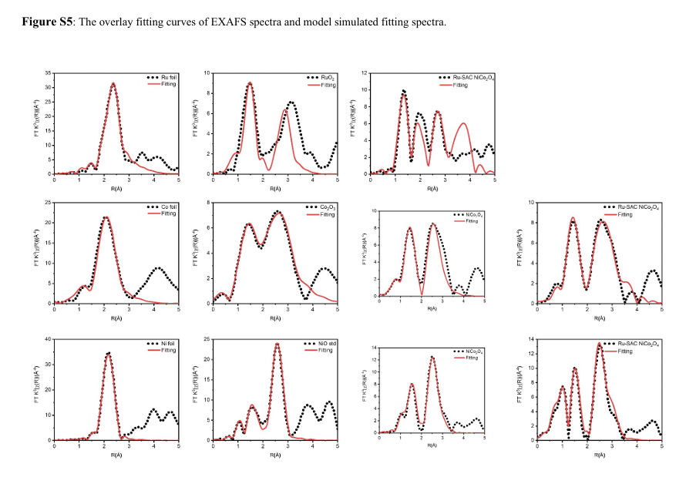
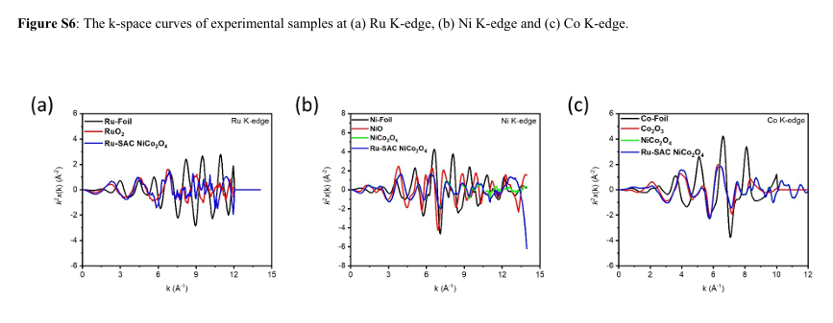

Slide 13
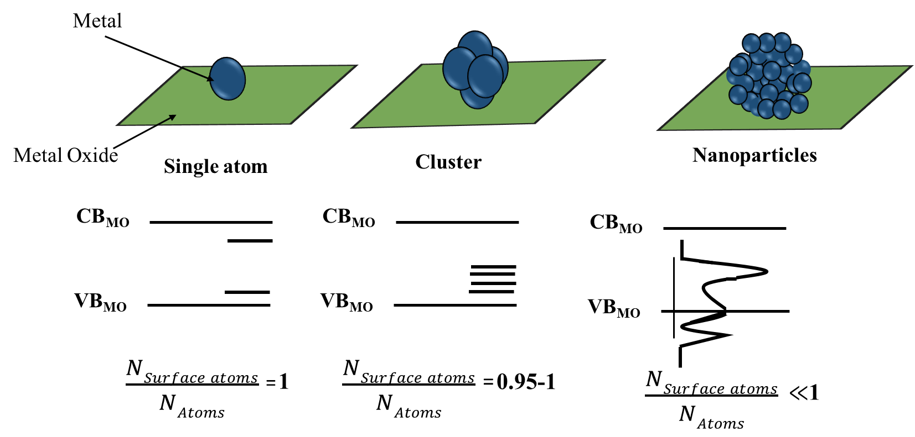
Single Atom Catalysts (SACs)
Schematic overview of geometric and electronic effects in supported metal single atoms, clusters, and nanoparticles
13/24
D. Leybo et. al., Chem. Soc. Rev., 2024, 53, 10450.
BITSPilani, Pilani Campus

Slide 14
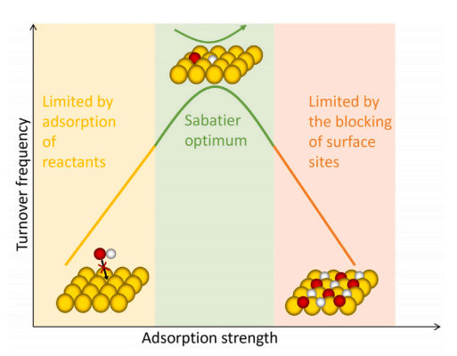
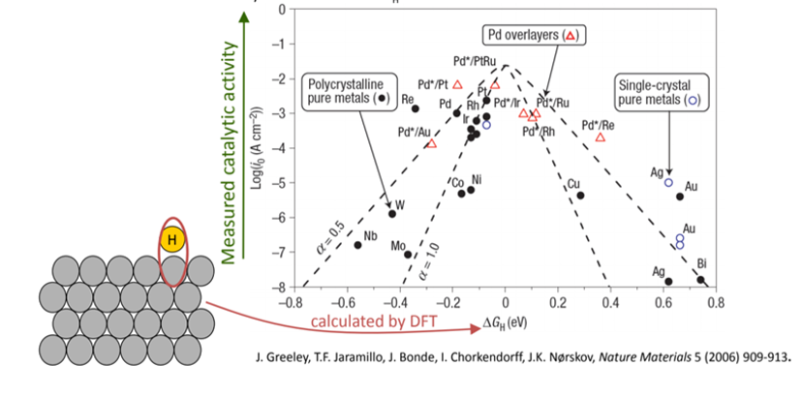
Why Ruthenium?
For weak-binding materials, the reaction is limited by slow adsorption or activation of reactants.
For strong-binding materials, the reaction is limited by slow desorption or formation of products.
The optimal catalyst features an intermediate binding strength.
Volcano-shaped curves were derived for the exchange current as a function of the hydrogen adsorption energy.
Kinetics of electrolytic H₂ evolution depends on the strength by which the intermediately-produced hydrogen atoms are bound to the electrode surface.
Norskov et.al., Nat. Mater., 2006, 5, 909-913.

