Slide 1
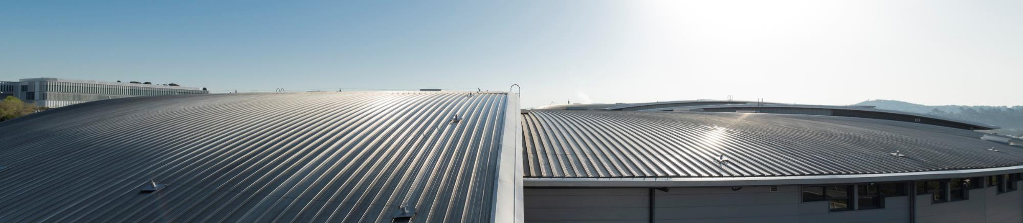
Ex situ and in situ synchrotron studies of CeO₂ thin films grown by Atomic Layer Deposition
Andrea Braga – abraga@cells.es

Slide 2



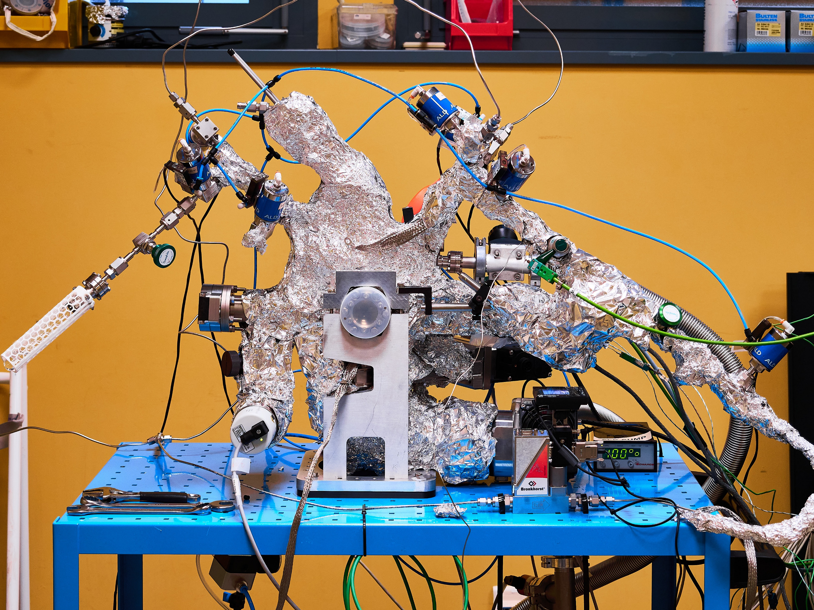
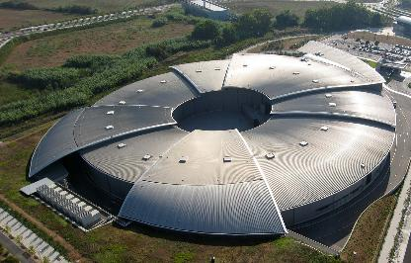
Introduction
BSc + MSc in
Materials Science
University of Padua, Italy
Atomic Layer Deposition project at ALBA synchrotron
Development of ALD2, an in-house modular reactor for in situ and operando characterisation of ALD processes
Research focused on fundamental aspects of ALD growth, especially during the first ALD cycles
Growth of Al₂O₃, TiO₂, CeO₂, template-assisted ALD etc.
Final goal: preparation of model catalytic surface for hydrogen applications
PhD in Chemical Engineering
University of Catalonia, Barcelona, Spain
Research on catalysis for hydrogen and syngas production with synchrotron characterisation
Postdoctoral researcher at the University of Udine, Italy
Bifunctional nanomaterials for CO₂ capture and conversion
Postdoctoral researcher at ALBA synchrotron, Barcelona, Spain
Development of in situ Atomic Layer Deposition characterisation and processes

Slide 3
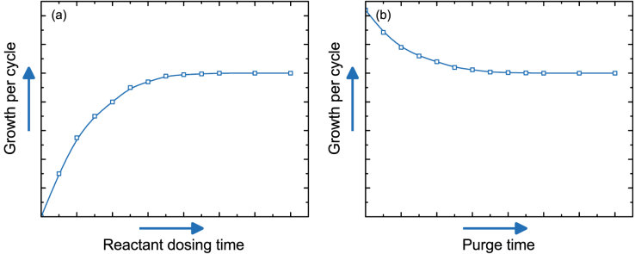
Atomic Layer Deposition
Thin film synthesis technique, derived from chemical vapour deposition (CVD)
The chemical reaction is split in steps with self-limiting reactions
Sub-nanometre thickness control, conformal coverage of complex geometries, high purity and uniformity, doping control
Used in semiconductor industry for high-k dielectrics, being developed for solar cells and other thin film technologies
Self-limiting reactions, surface saturation
Surface sites available
ALD cycle
CVD regime, precursor residues
A – Precursor, t_{A}
B – N₂ purge, t_{B}
(t_{A})
(t_{B})
Saturation curves of ALD: growth per cycle rises with precursor dose and lowers with purge time until reaching a plateau, beyond which further exposure adds no additional growth.
C – co-reactant, t_{C}
D – N₂ purge, t_{D}

Slide 4
CeO₂ thin films by ALD
Motivations and aims
Model catalysts for H₂ production: CeO₂ is a fundamental support for many catalytic reactions
Interest for high-k dielectric
CeO₂ ALD processes lack characterisation
Al₂O₃ and TiO₂ are mature, CeO₂ needs more development
As of today, no thin film regime has been obtained reliably using Ce(dpdmg)₃, only island growth and inhomogeneous films, no clear trend with process parameters
Track thickness with in situ XANES, mapping with ex situ XAS
Characterise the deposited Ce
Methods
CeO₂ thin films are being grown on Si substrates with 2-3 nm native SiO₂ layer, recipe development offline in the lab
ALD cycle consisting of a A) Ce(dpdmg)₃ pulse, B) N₂ purge,
C) the co-reactant pulse (H₂O or O₂), and D) N₂ purge; the timing for each step are [13, 20, 3.5, 60] seconds
Film thickness tracked at NOTOS beamline, ALBA, measuring the XANES edge jump μ of Ce L₃-edge at 5700 eV every 5-10 cycles
XAS maps measured with fluorescence detection at 5800 eV of Ce signal and resolution of 10 μm at NOTOS
XPS measurements conducted in UHV in a commercial SPECS XPS

Slide 5
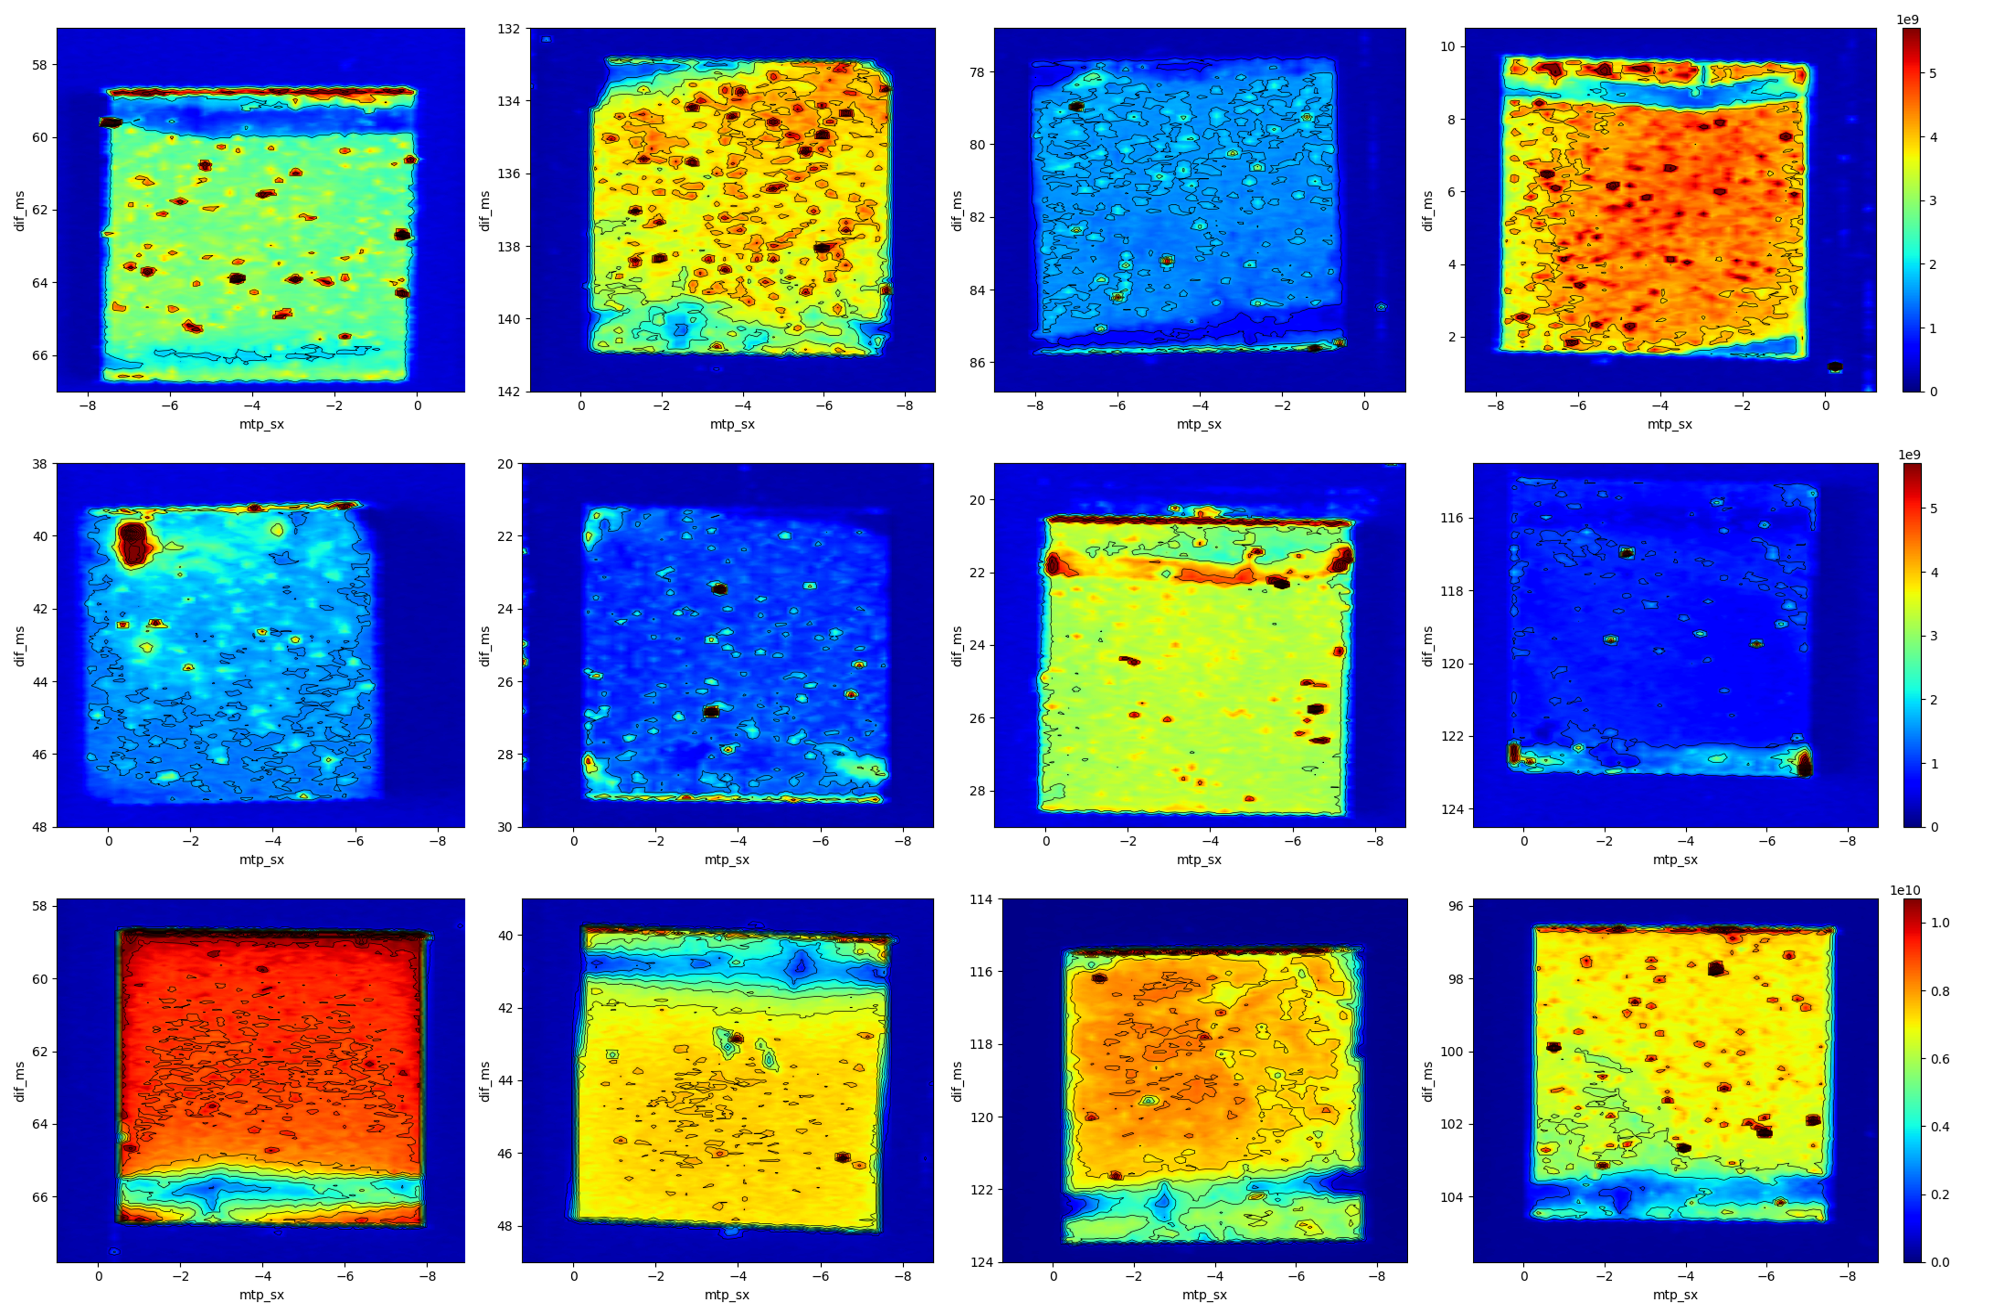
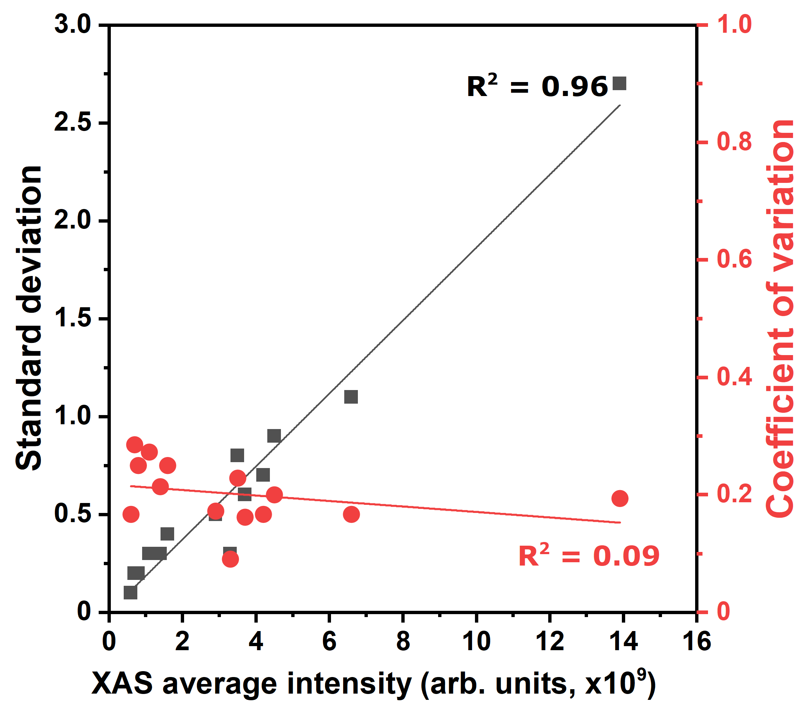

XAS mapps: Ce deposition and homogeneity
$$CV= \frac{σ}{I_{XAS}}$$
Standard deviation scaled linearly with XAS median intensity, coefficient of variation is constant, island growth regime.
Ex situ Ce L₃-edge XAS maps at 5800 eV of various samples prepared in the lab with different process parameters (cycle number, substrate temperature, co-reactant, Ce precursor flow)

Slide 6
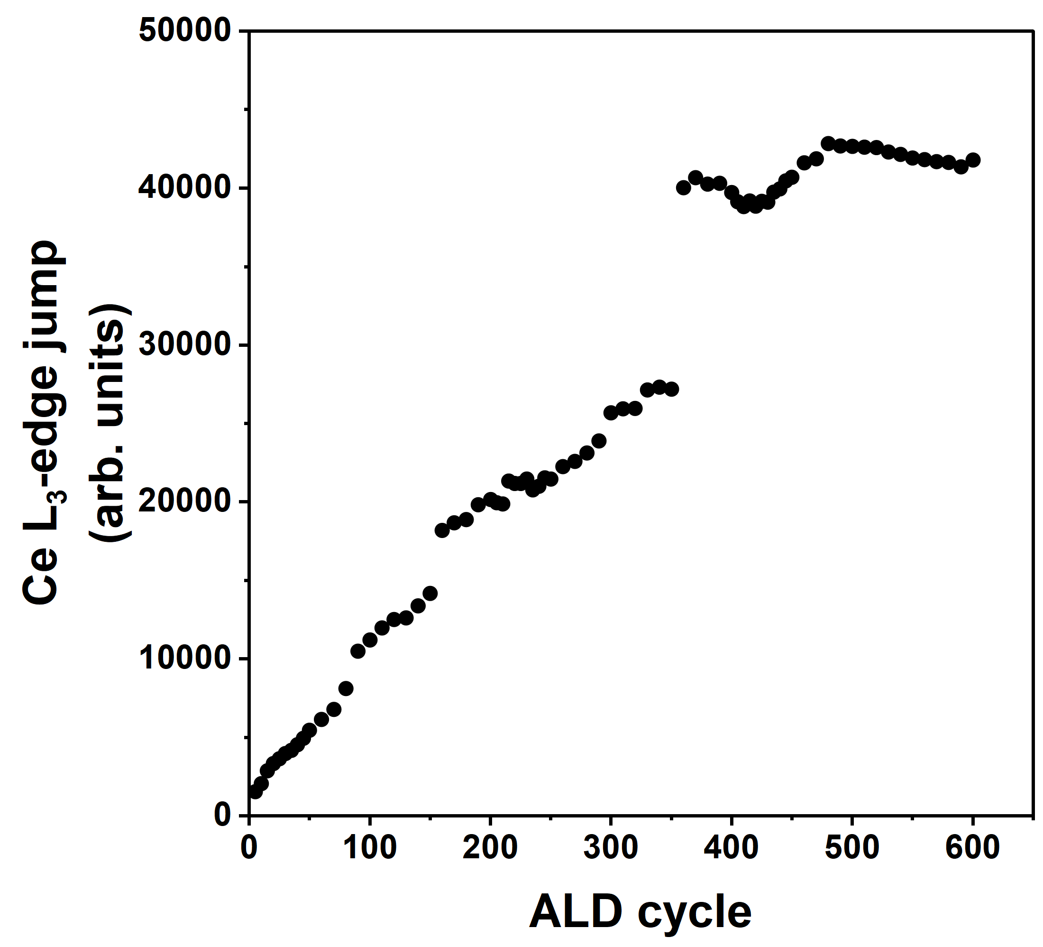
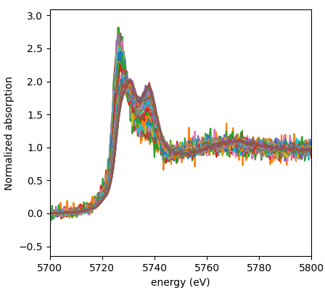
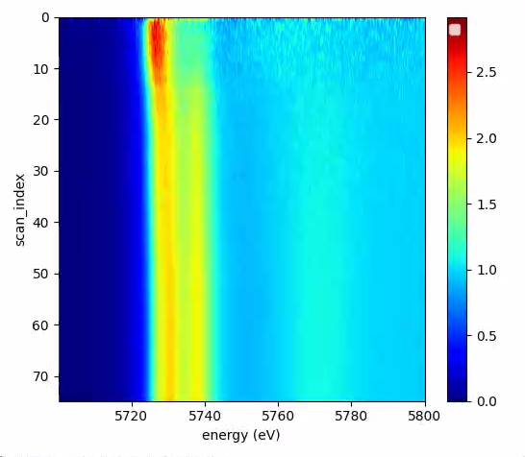
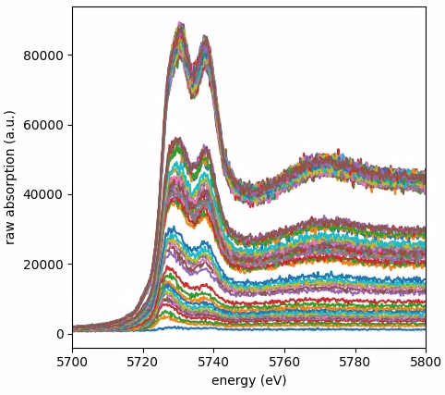
In situ XANES: tracking film thickness and chemical information
Ce³⁺
Ce³⁺
Ce⁴⁺
Ce⁴⁺
ALD Cycle
Ce L₃-edge jump, direct thickness track
Raw XANES spectra collected every 5 cycles
Normalised XANES spectra
2D XANES map, normalised spectra
Ce³⁺ is formed during the first cycles when the film is ultrathin (or islands are very small), later CeO₂ is formed.
The jump show linear ALD growth only for limited number of ALD cycles, inconsistent growth.

Slide 7
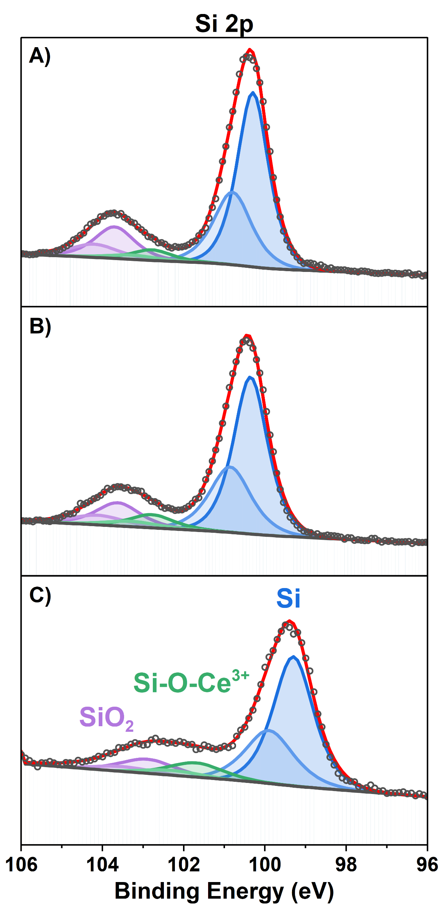
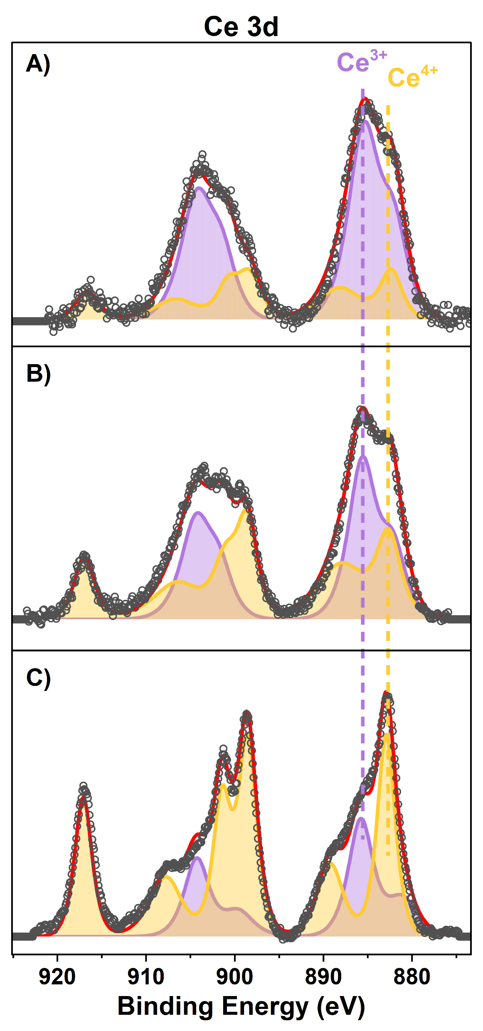
XPS analysis: chemical information and interfaces
Sample | A | B | C
Cycles | 70 | 70 | 140
N₂ flow (mL/min) | 20 | 160 | 160
Si-O-Ce³⁺ (%) | 5.9 | 8.4 | 13.2
Ce³⁺ (%) | 69.2 | 48.1 | 29.5
Total Ce (%) | 3.6 | 6.3 | 27.4
Total Ce/Si-O-Ce³⁺ | 0.6 | 0.7 | 2.1
Si 2p region showing Si⁰, SiO₂, Si⁴⁺-O-Ce³⁺ with -1 eV shift, increasing with Ce loading.
Ce³⁺ is present in low-coverage films; oxidised to Ce⁴⁺
with higher loadings.
Ce³⁺ peaks needs to be shifted 1 eV higher compared to standard CeO_{2-x}, probably rising from Si⁴⁺-O-Ce³⁺.
Total Ce/Si-O-Ce ratio indicative of island vs film or coalescence regimes.

Slide 8
Take home message
CeO₂ thin films are not obtained, and the process needs further development
XAS mapping show inhomogeneous growth and low match with process parameters
In situ XANEs showed formation of defective Ce structures and inhomogeneous growth-per-cycle regimes
XPS can track the Si-O-Ce interface and infer on the island-film regimes
Further steps: in situ XANES beamtime, operando GISAXS beamtime, systematic process optimisation, surface treatments, integration of in situ probes like quartz crystal microbalance, ellipsometry and mass spec.

