Slide 1
ReCAllTubes - Recycling Aluminium from Municipal Waste Slag for New Tube Production
Florian Brandstetter
24th September, 2026

Slide 2
Agenda
Academic Background
Project ReCAllTubes
Current status & first results
Outlook

Slide 3
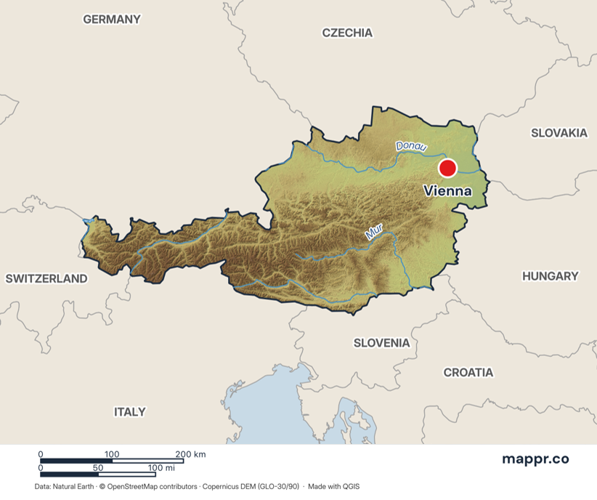
Academic Background
PhD student since 07/2026 @ Department of Materials Science of Montanuniversität Leoben
Neutron and X-ray Team (NEXT)
Master`s degree in Materials Science in 06/2026
  Thesis: “Effect of Co and W on the Phase Transformations and Mechanical High-Temperature Properties of β-Solidifying γ-TiAl Alloys”
Project ReCAllTubes (Start 04/2026)
Leoben
Muggia
Map adapted from mappr.co, https://www.mappr.co/maps/austria/

Slide 4
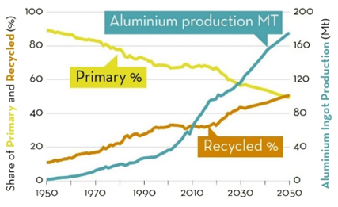
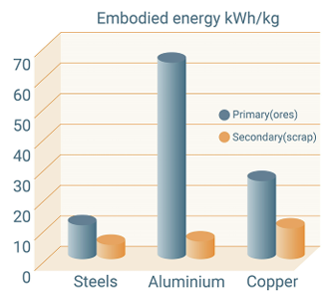
ReCAllTubes – Motivation
Primary Al production → 15 t CO₂ per t Al
Al as a critical raw material for the EU economy [1]
[1] European Union, Regulation (EU) 2024/1252 establishing a framework for ensuring a secure and sustainable supply of critical raw materials, Official Journal of the European Union, (2024)
95%
fewer CO₂ emissions
By recycling, compared to the production of packaging systems made from primary aluminum.
D. Raabe et al., Making sustainable aluminum by recycling scrap: The science of “dirty” alloys, Prog. Mater. Sci. 128, 2022, 100947
European Aluminium, Circular Aluminium Action Plan: A Strategy for Achieving Aluminium's Full Potential for Circular Economy by 2030, (2020)

Slide 5
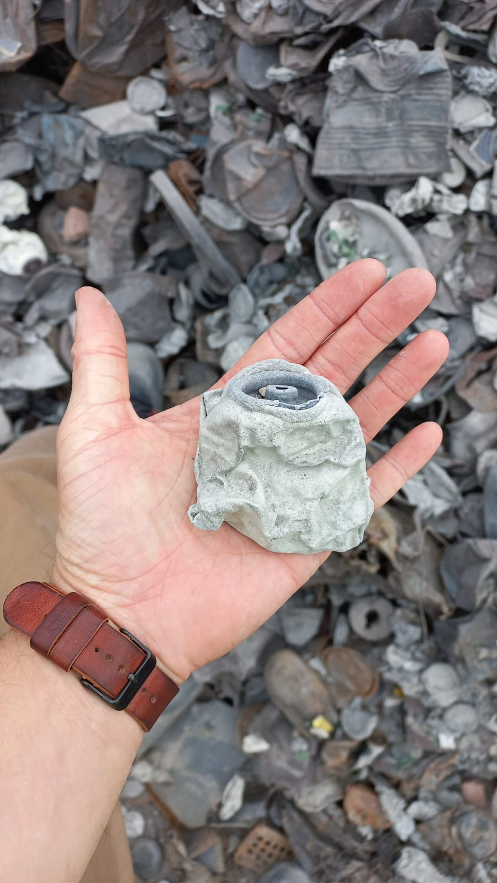
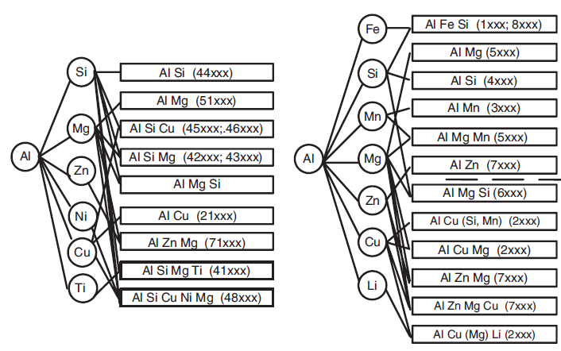
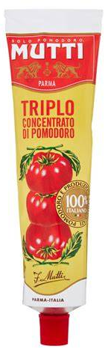
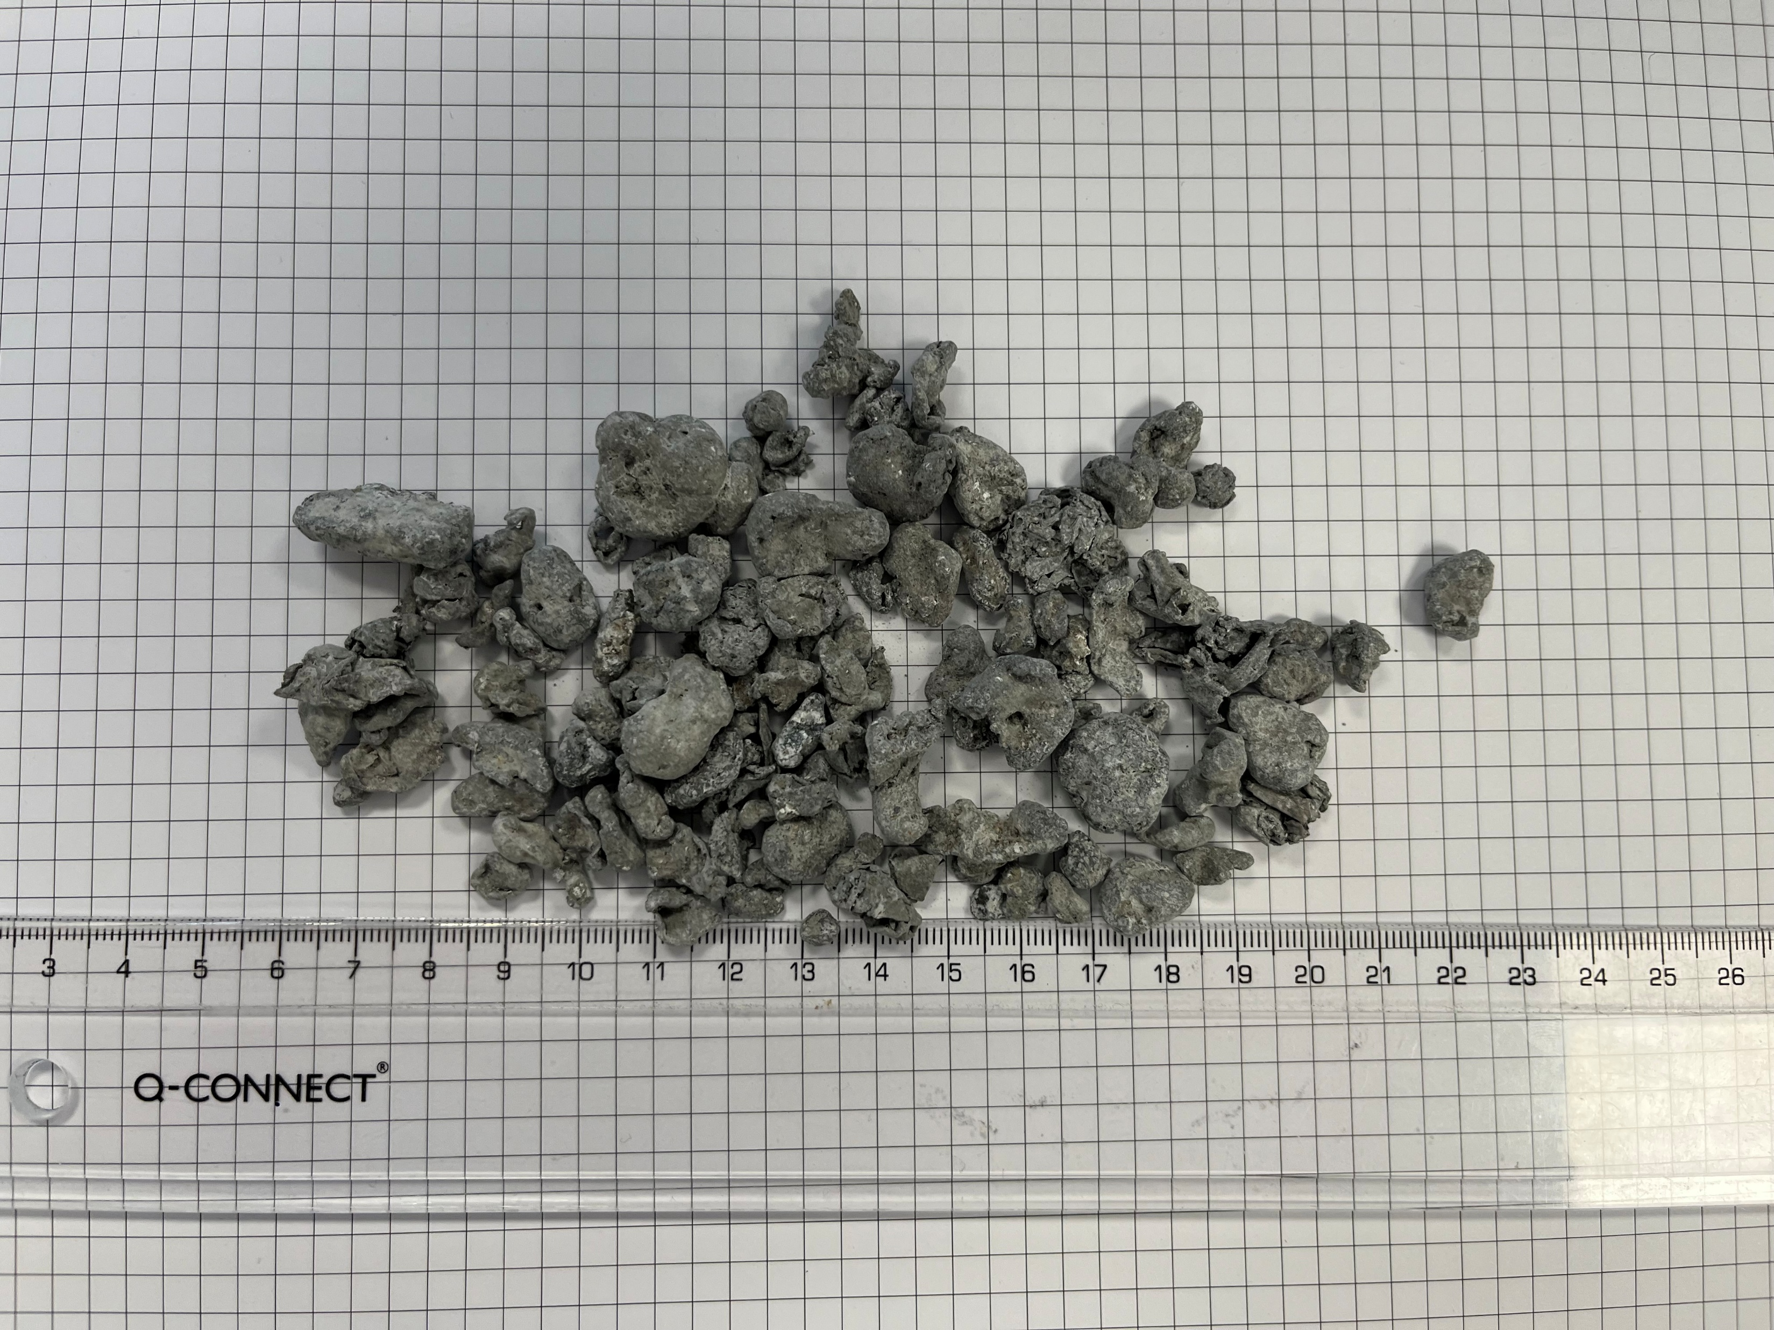
ReCAllTubes – Challenges
Municipal waste incineration (MWI) slag
Cast Alloys (AC)
Wrought Alloys (AW)
1xxx Al
>99% Al
C. Krammer, Aluminium Taschenbuch 1, 16th Edition, ISBN 978-3-410-22028-2
1
AI-assisted sorting by product type (cans, tubes, coffee capsules,…) followed by alloy-class separation using X-ray fluorescence analysis (XFA).

Slide 6





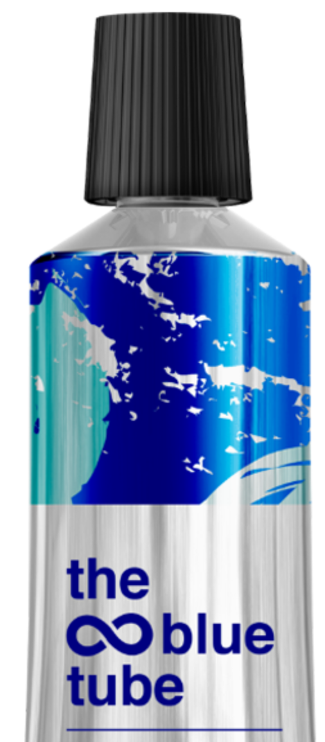
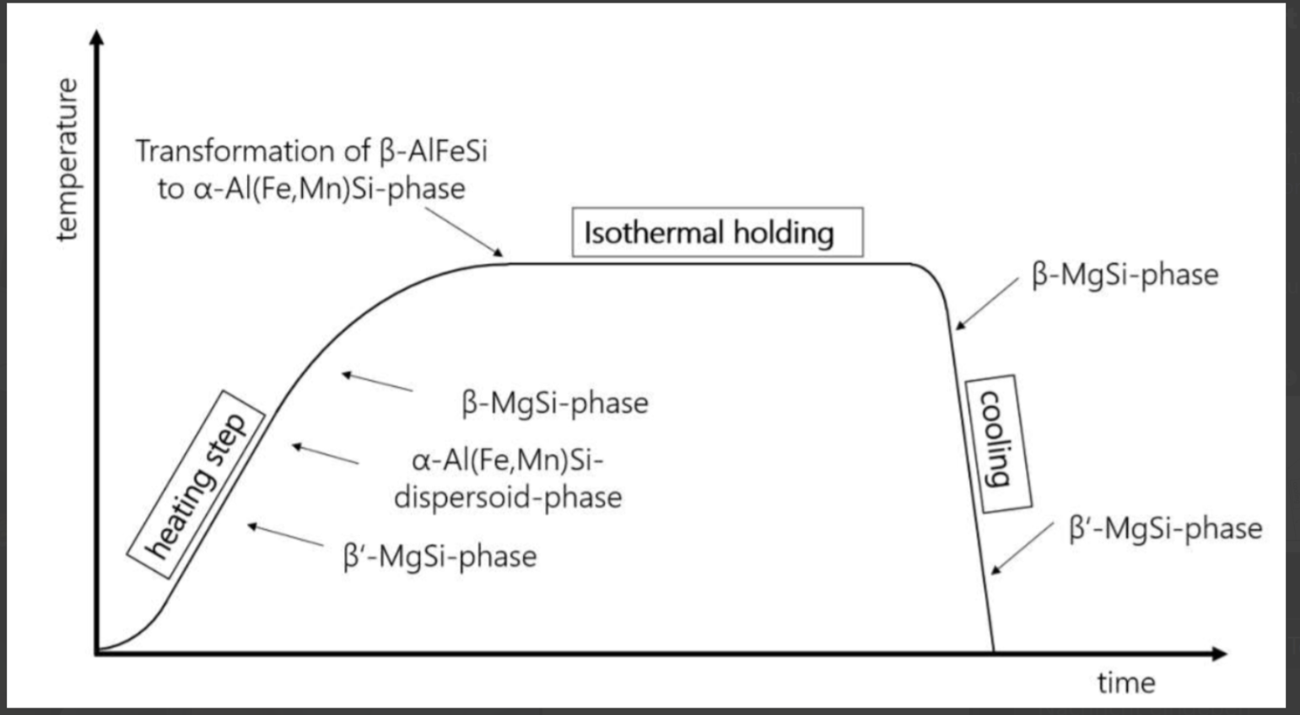

ReCAllTubes – Challenges
Extrusion, annealing and expansion
Casting, rolling and billet production
T
30s
t
1
2
3

Slide 7
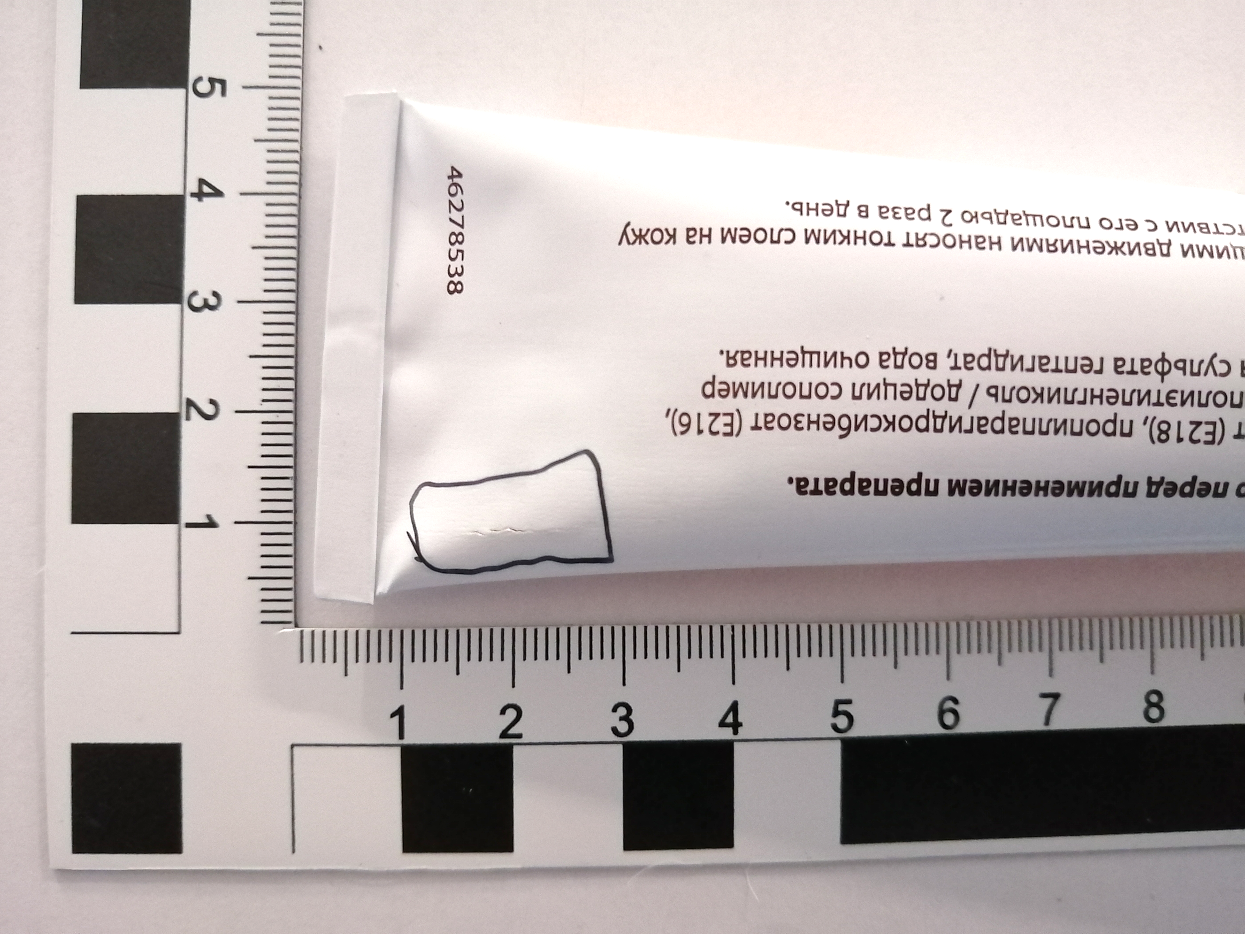
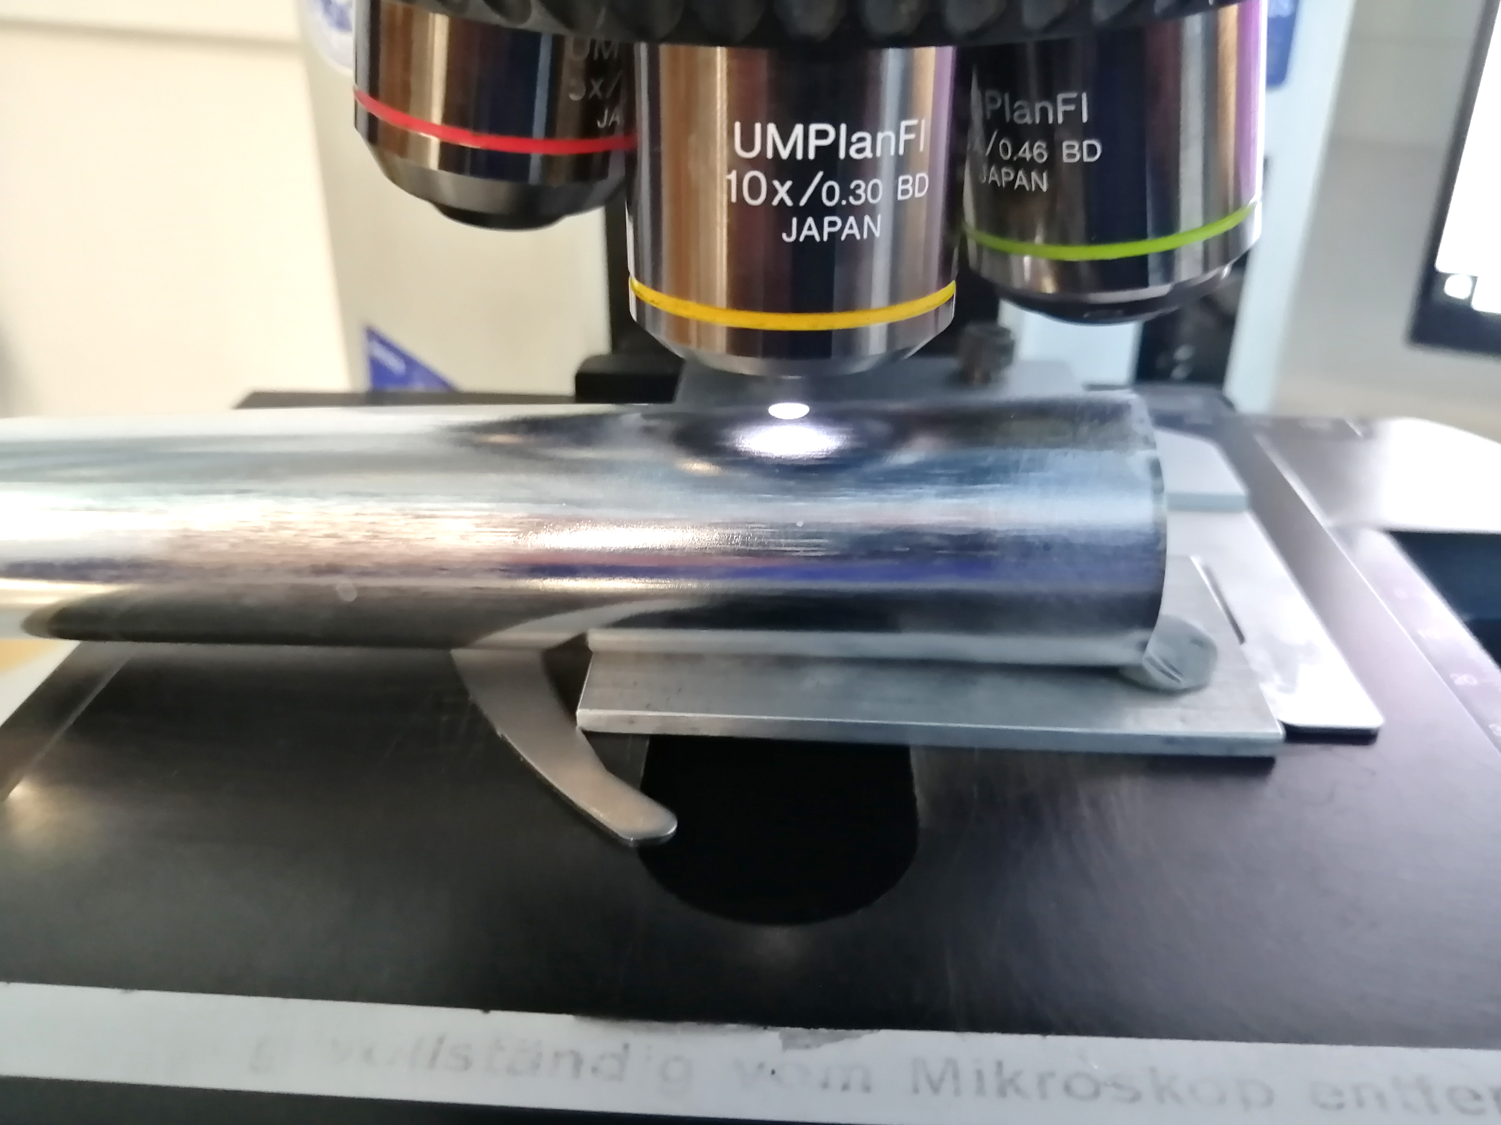
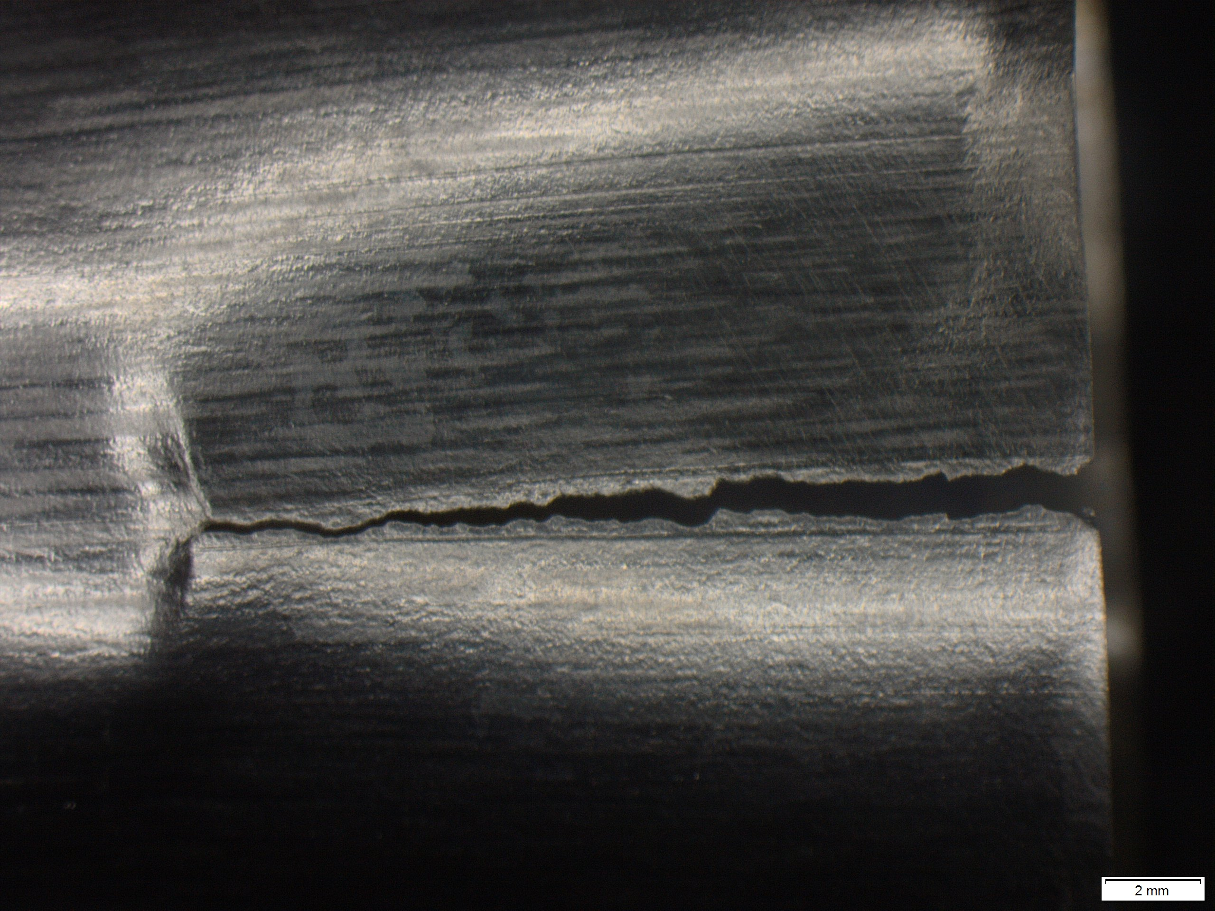
ReCAllTubes – Challenges
rolling and
billet production
extrusion
annealing
expansion
casting
cracking

Slide 8
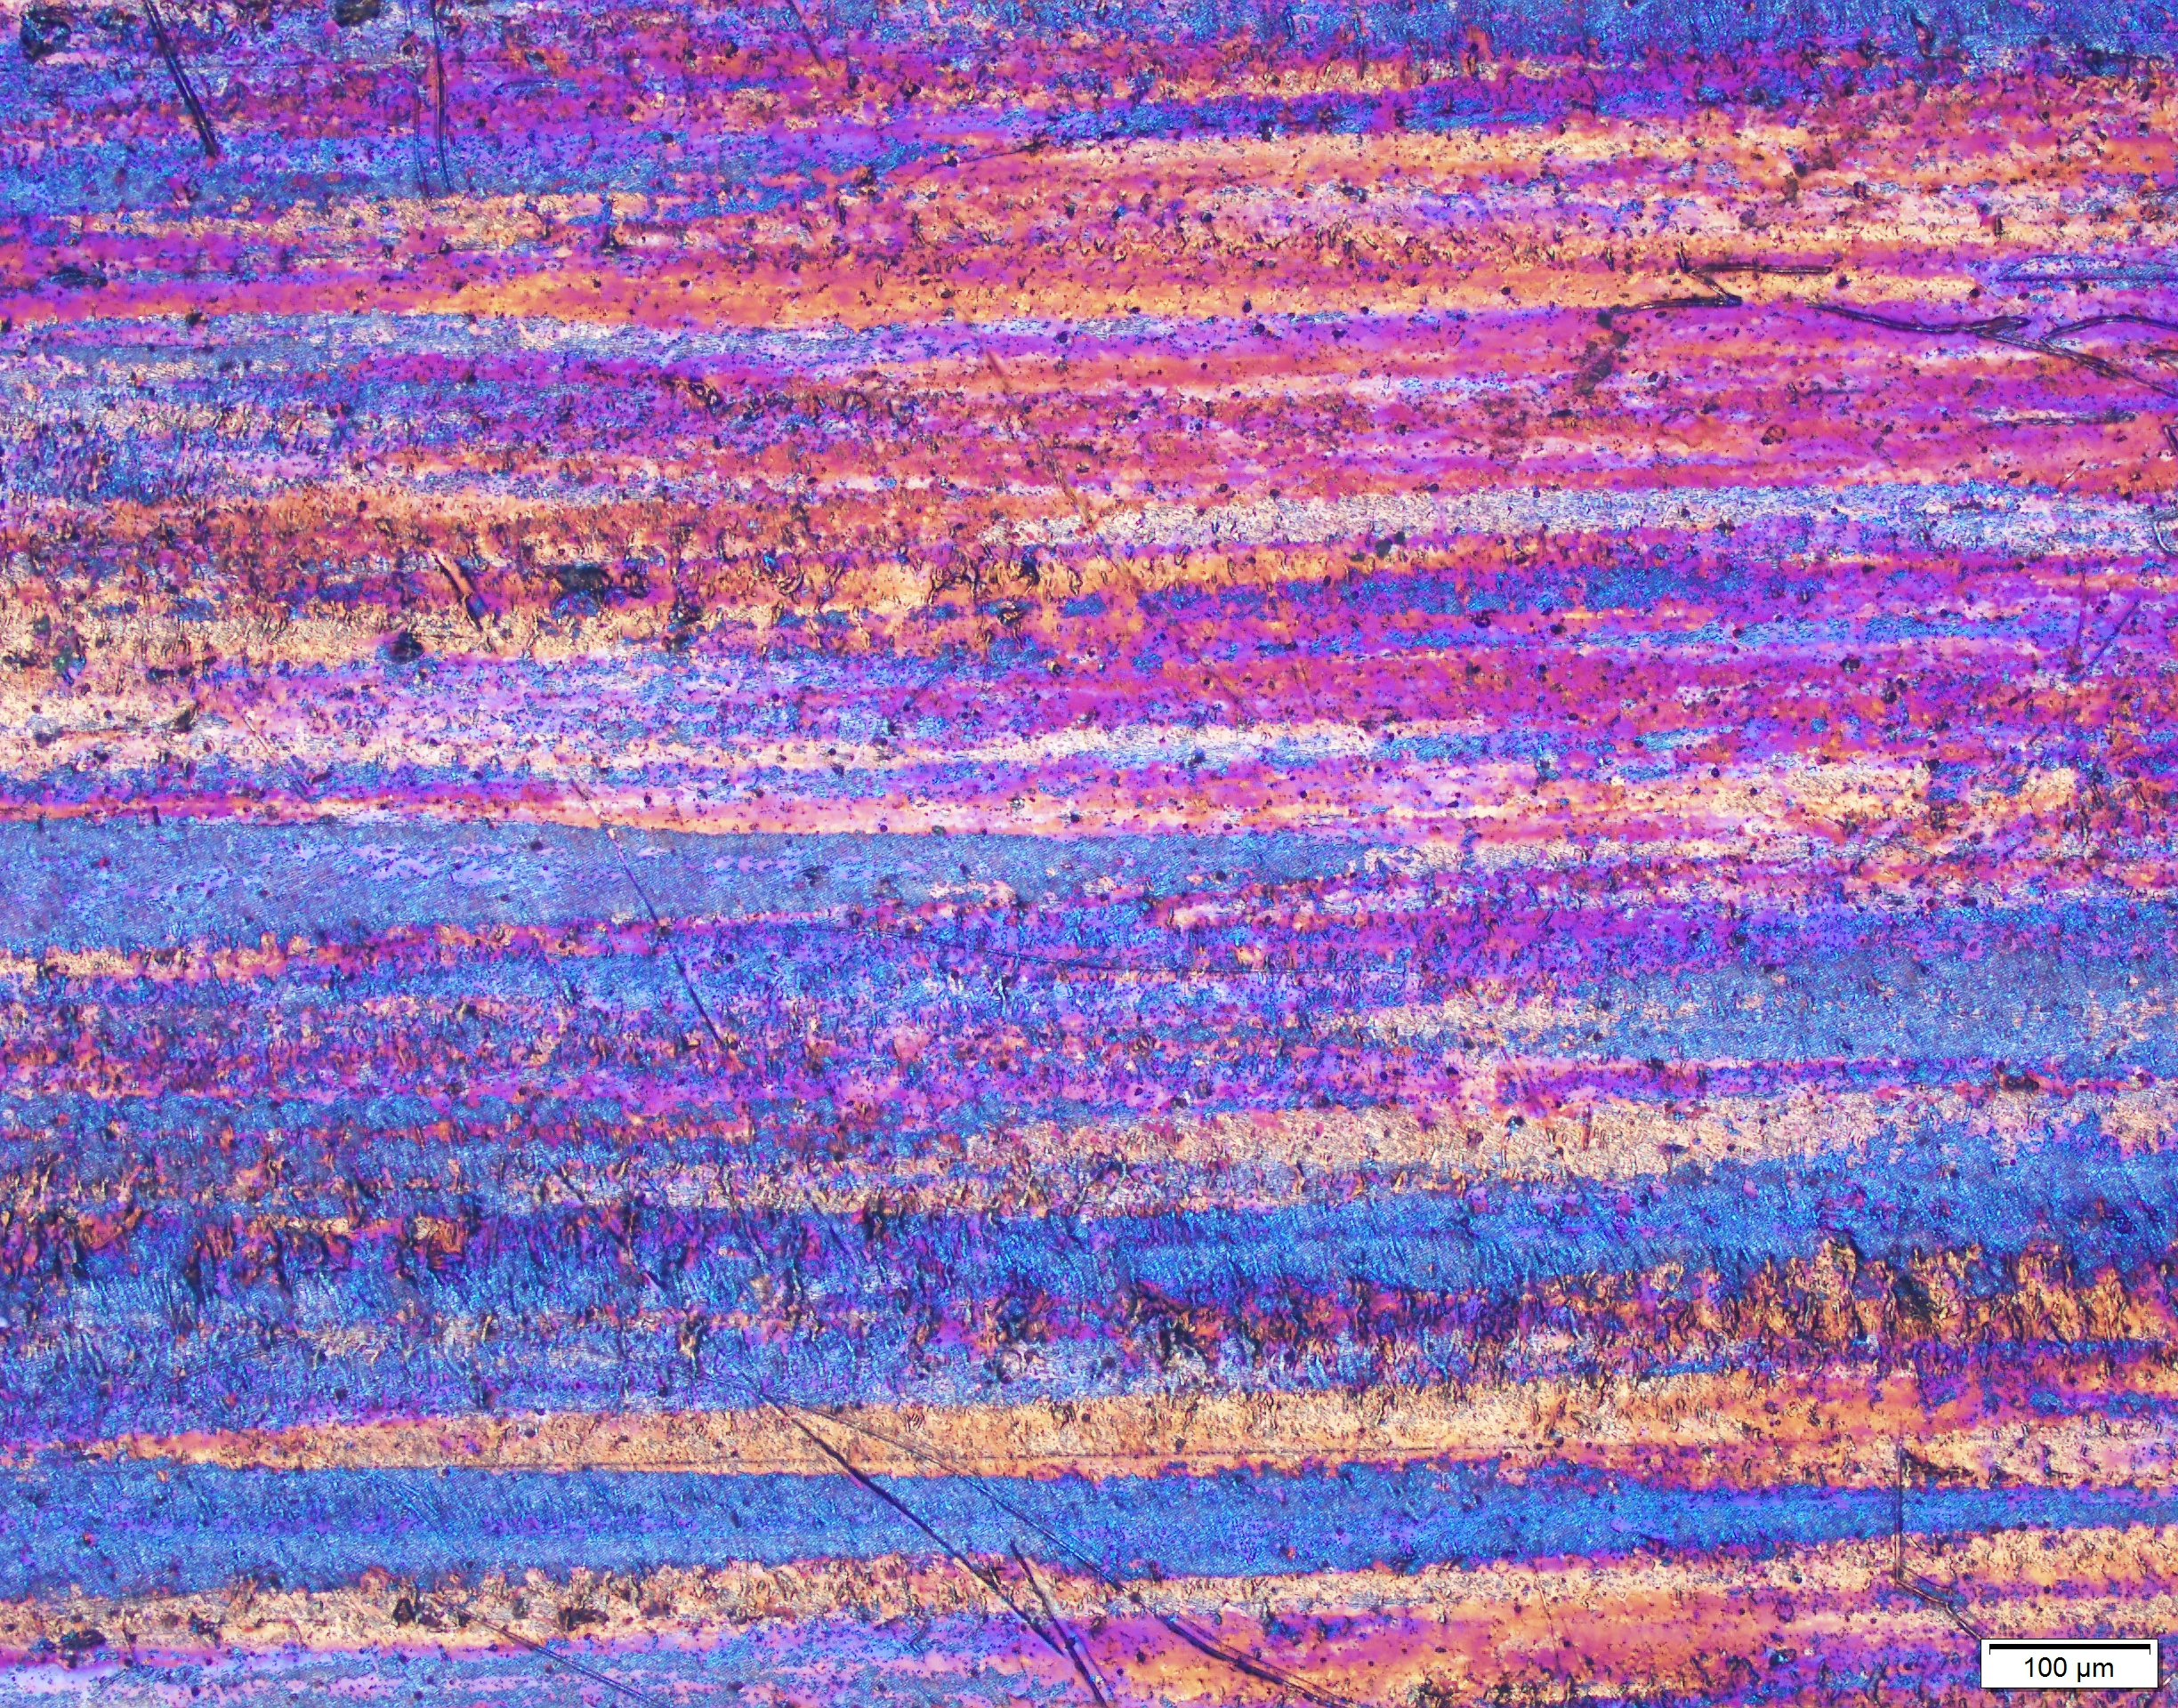
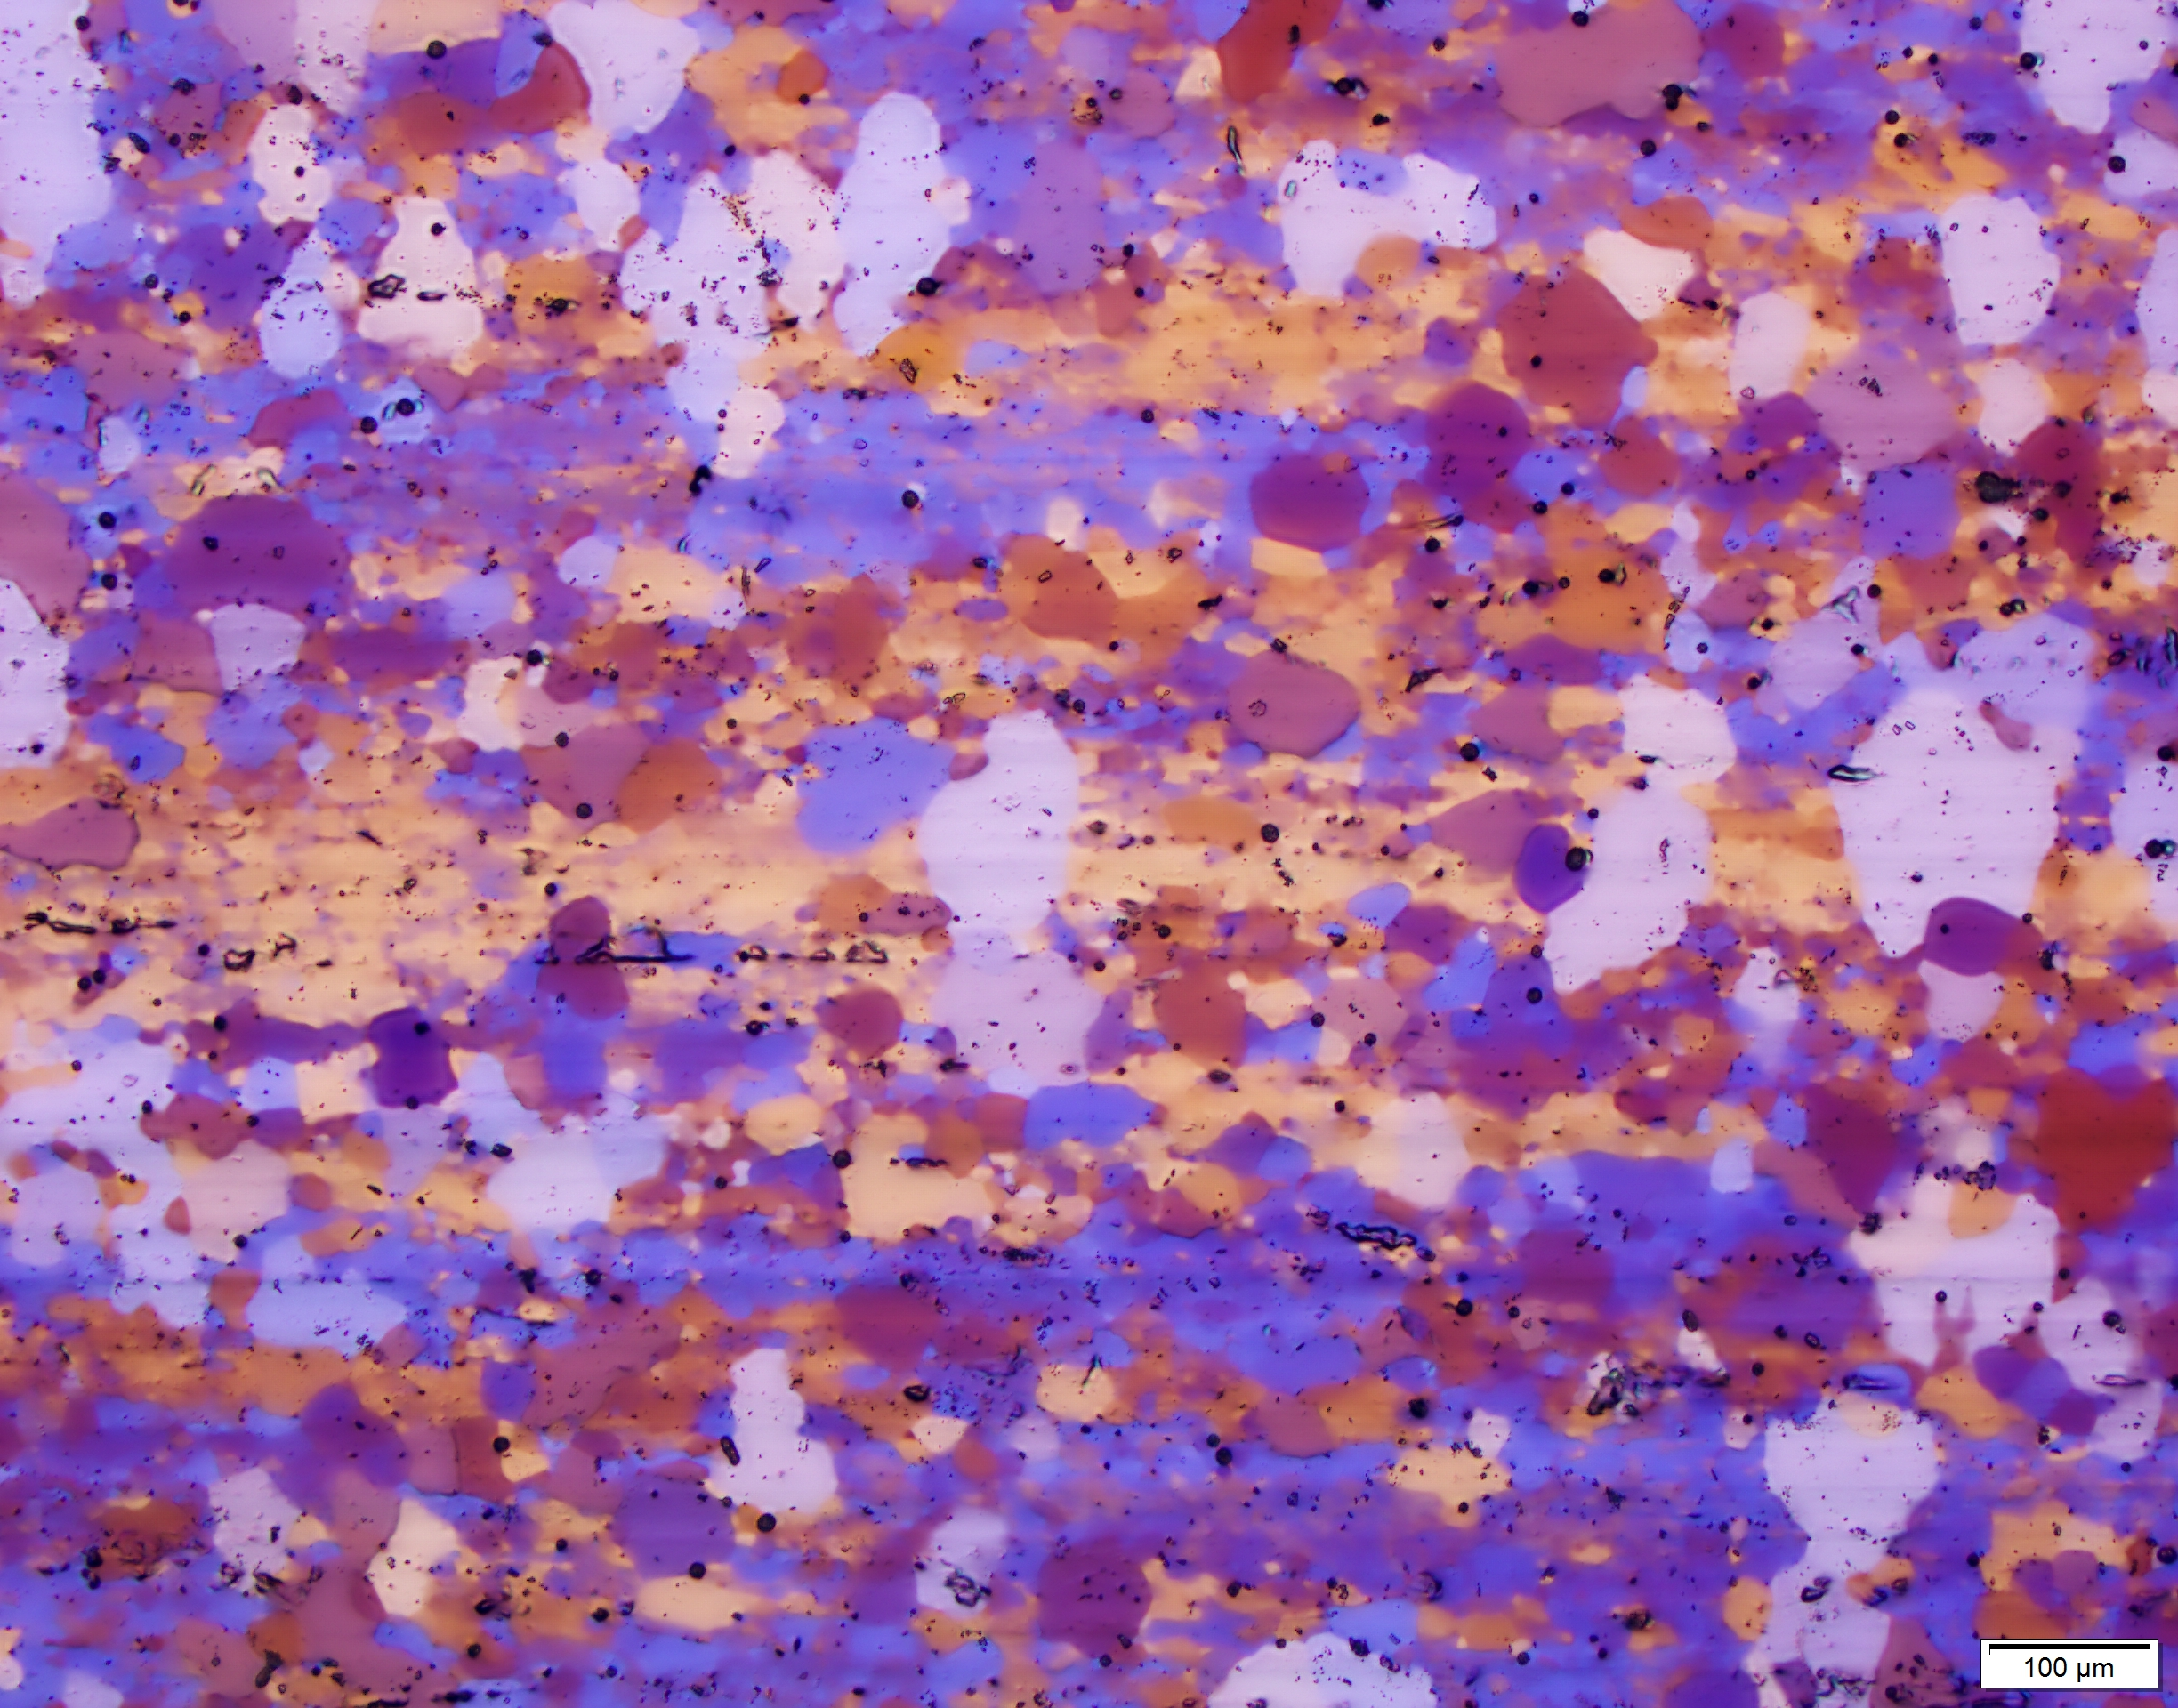
Results – Rexx lab experiments
AW-1070A – 90s at 340°C
AW-1070A – 180s at 340°C

Slide 9
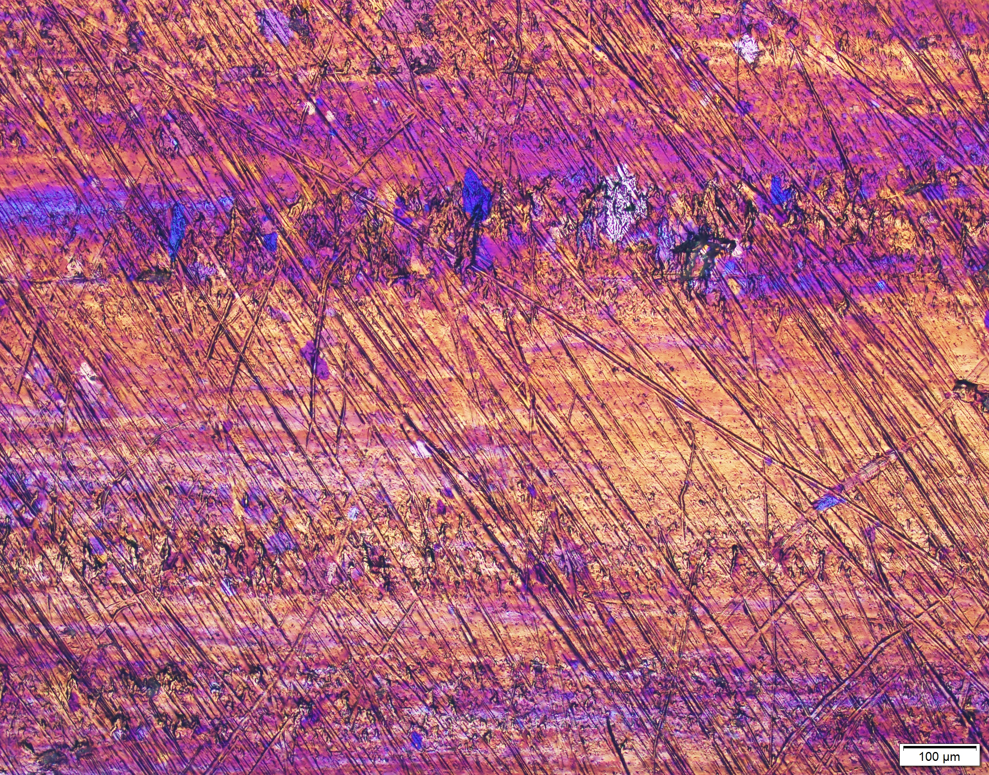
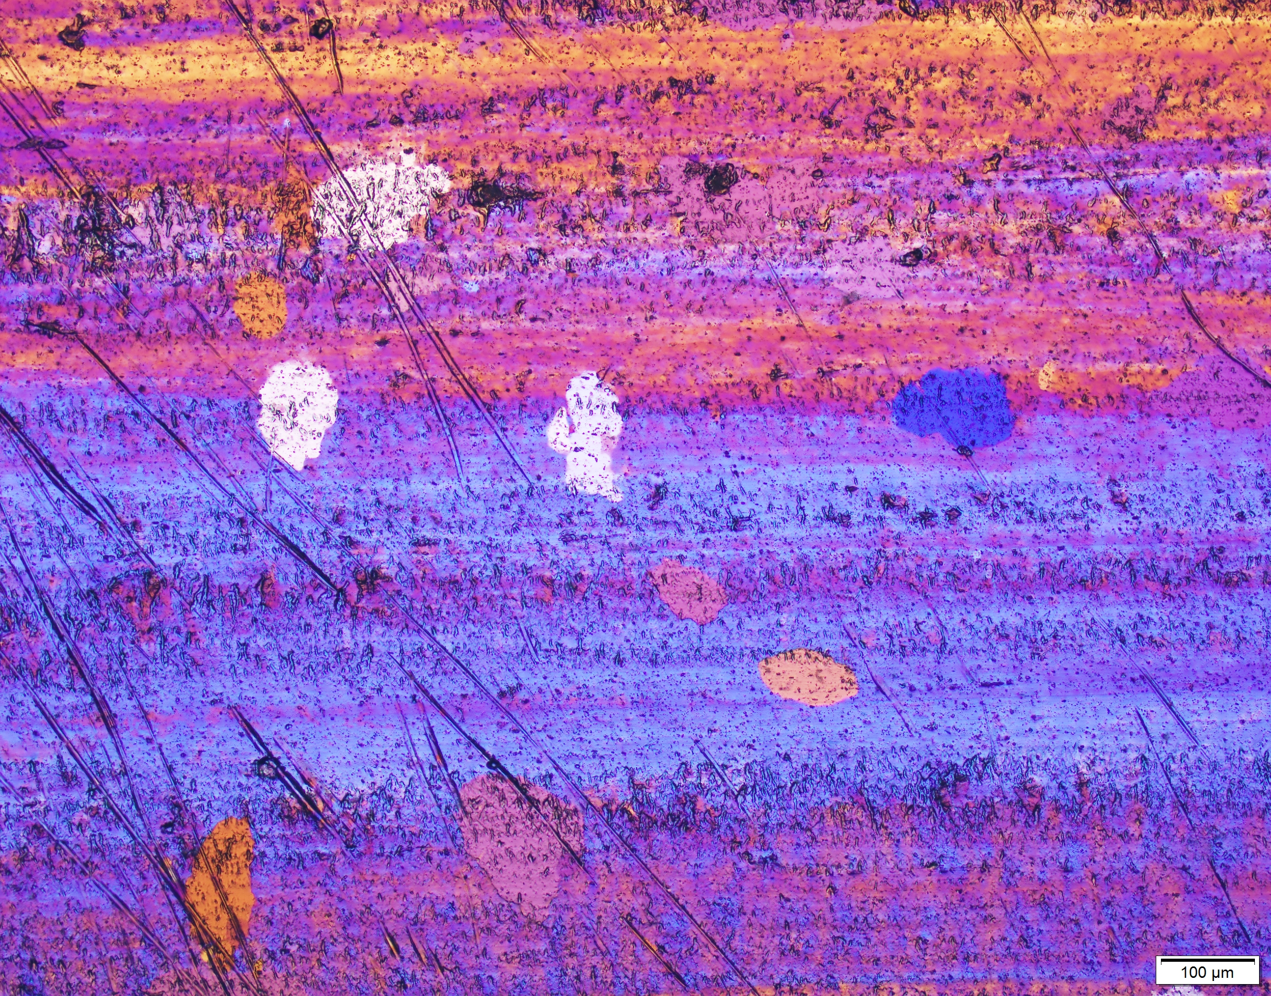
Results – Rexx lab experiments
PCR BT2.0 – 45s at 350°C
PCR BT2.0 – 90s at 350°C

Slide 10
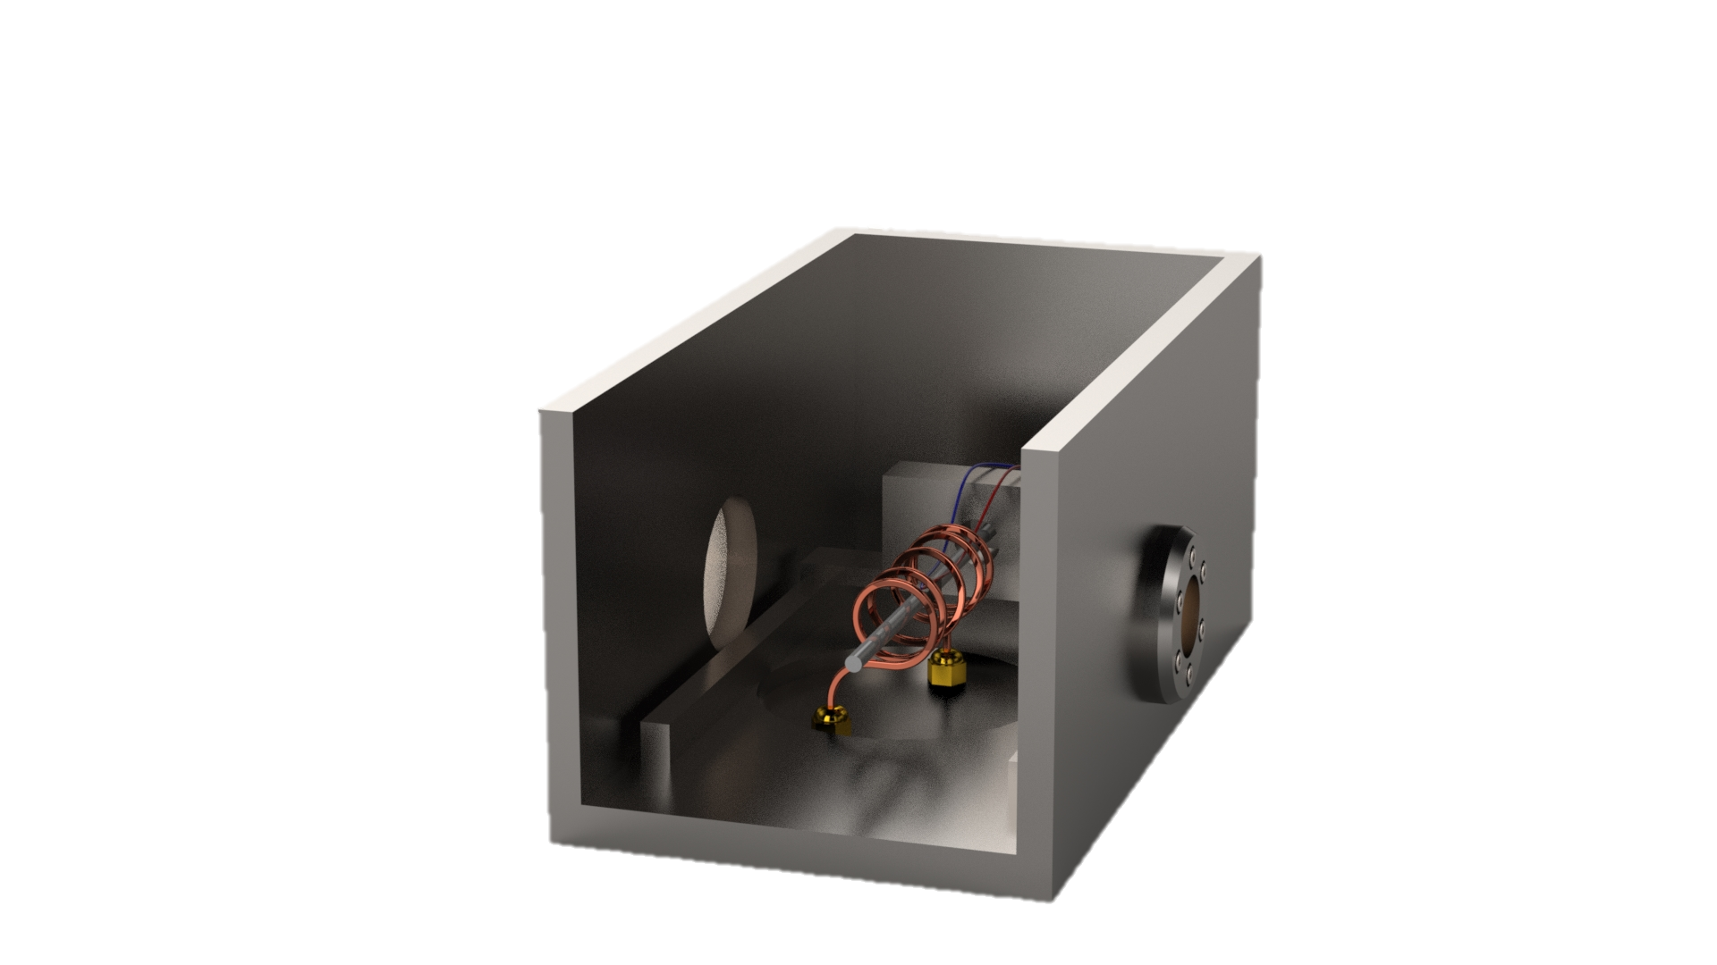

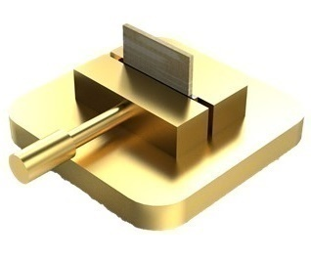
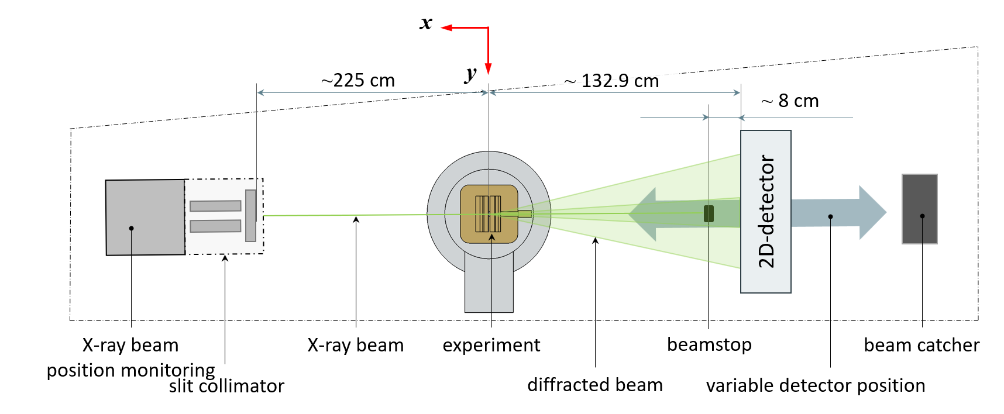

Results - High-Energy X-Ray Diffraction (HEXRD)
in-situ
ex-situ
E = 102.63 keV
λ = 0.01208 nm
high energy materials science beamline P07

Slide 11
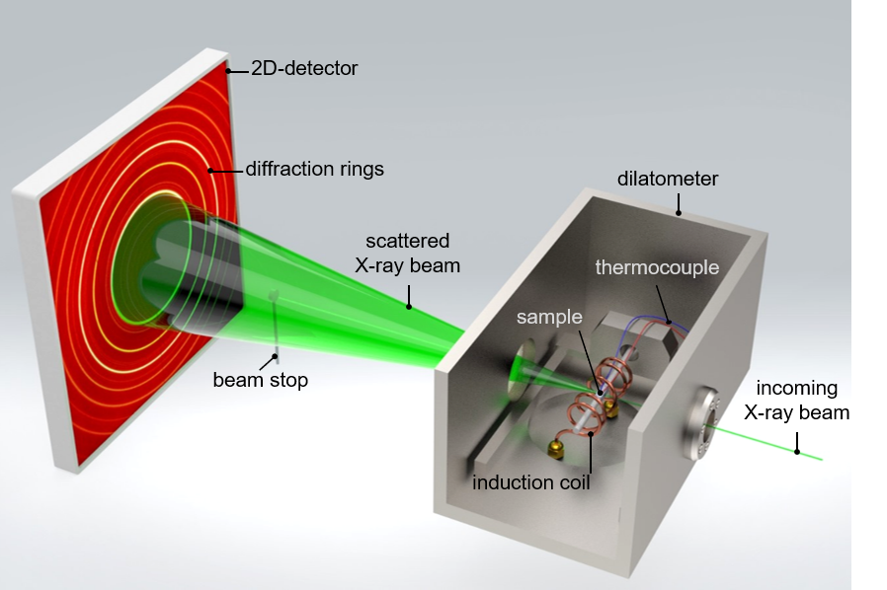
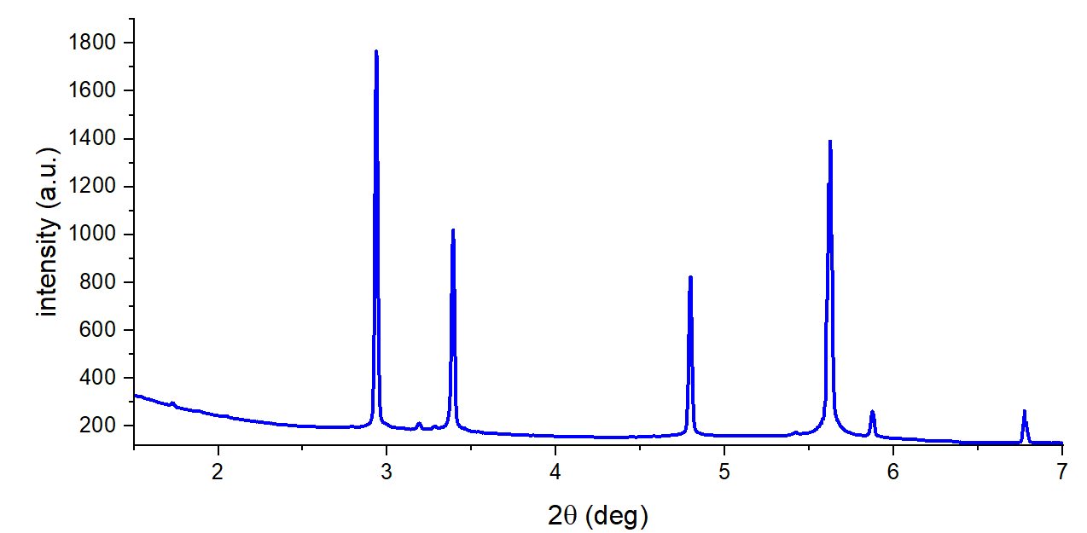
Results – HEXRD
phases
position and distribution of Debye-Scherrer rings
(residual) stresses
ellipticity (peak positions), peak‘s widths
microstructure, (defects)
spotty pattern, peak‘s widths
Al-311
Al-200
Al-111
Al-220
➔ -530
➔ -321
➔ -600
Al-222
Al-400
➔ -413
➔-835

Slide 12
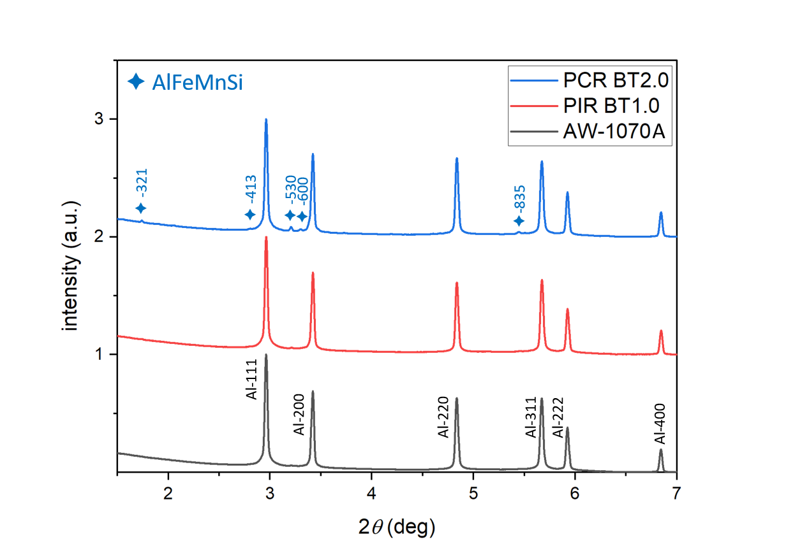
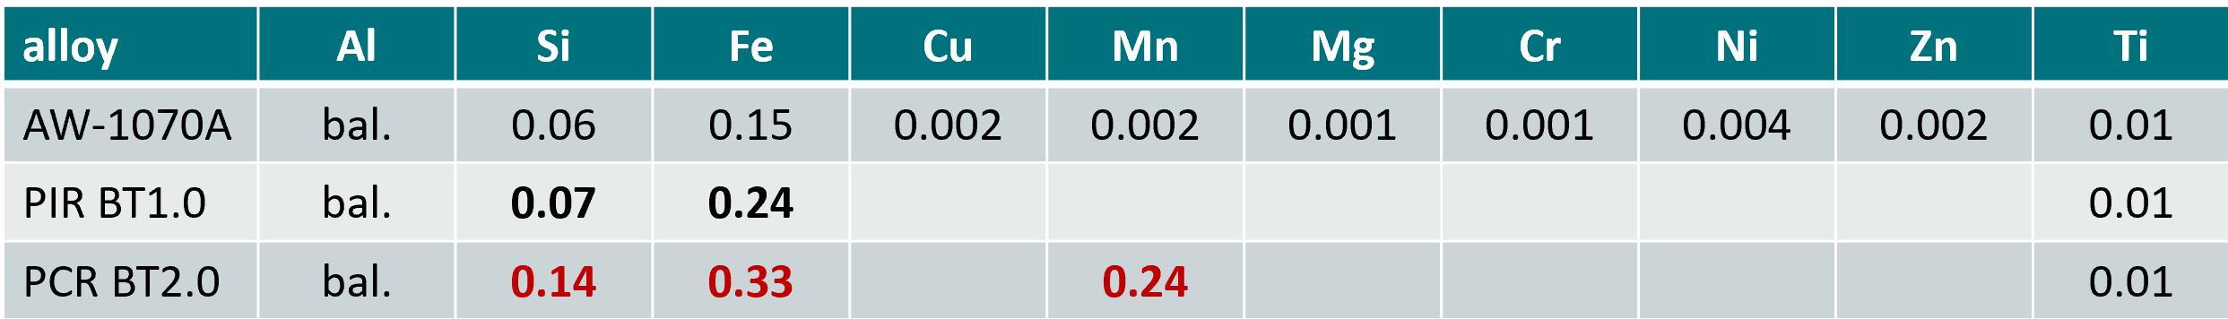
Results – HEXRD – Phases in AW-1xxx
E = 102.63 keV
λ = 0.01208 nm

Slide 13
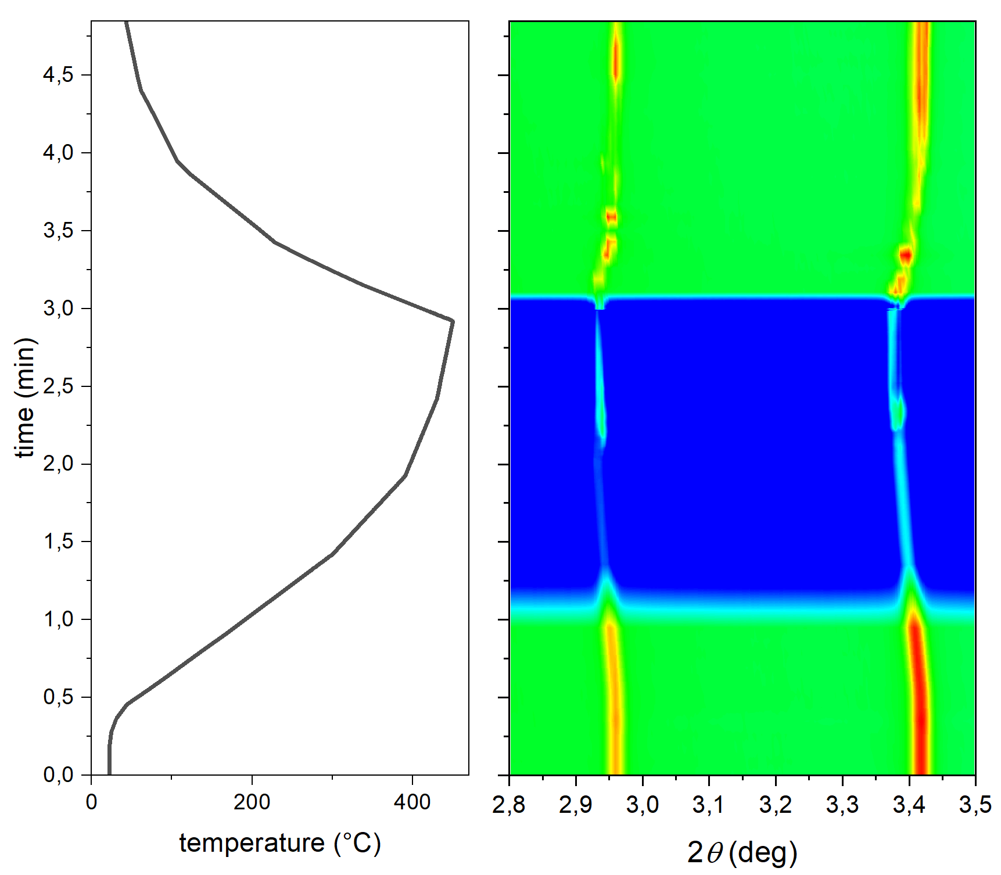
Results – In-situ Rexx of AW-1070A, PIR and PCR
AW-1070A
slow mode – time resolution 1 s
fast mode – time resolution 0.15 s
slow mode – time resolution 1 s
Al-111
Al-200

Slide 14
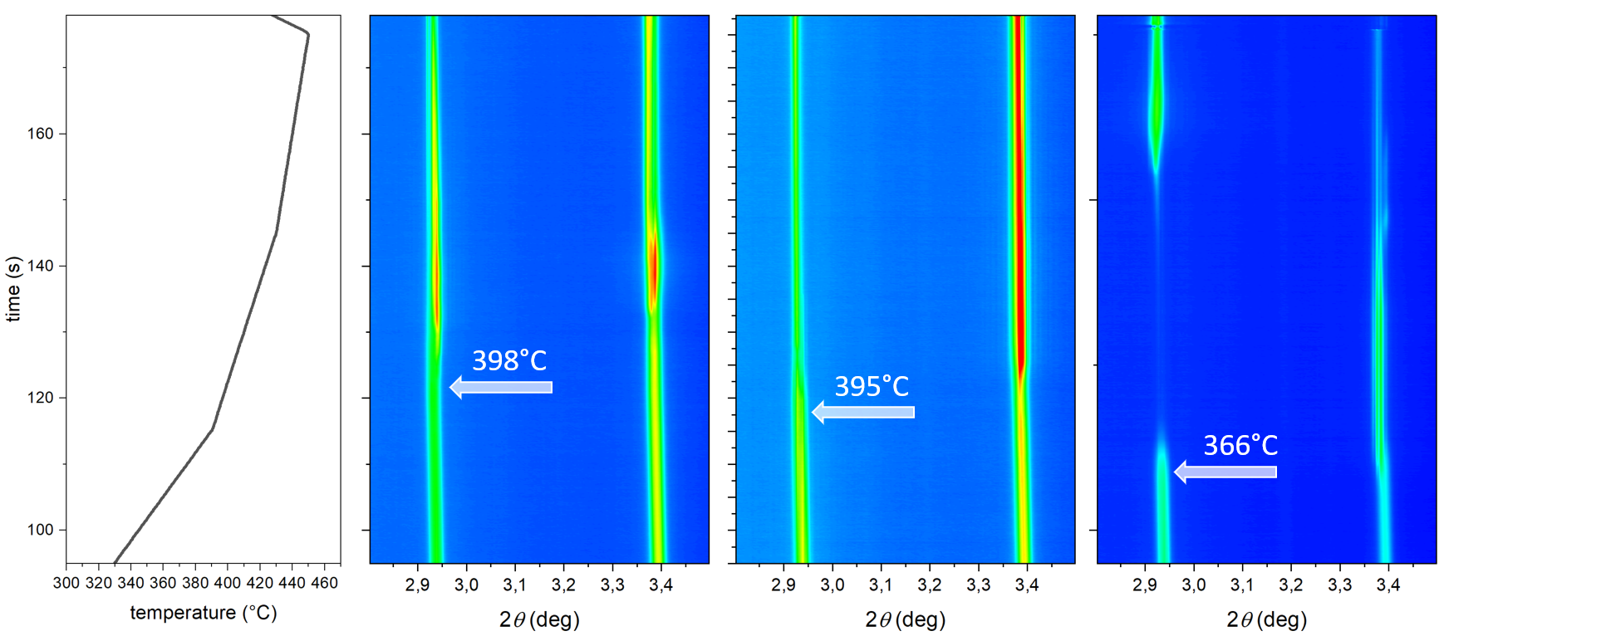
Results – In-situ Rexx of AW-1070A, PIR and PCR
AW-1070A
PIR BT1.0
PCR BT2.0
stacking fault energy decreased by tramp and trace elements
  impurities and intermetallic phases as Rexx nucleation sites
  Over-annealing → Cracking
398°C
366°C
Al-111
Al-200

Slide 15
Outlook – Future HEXRD experiments
Proposal for beamtime @ DESY Petra III P07 for the period of 04/2027 to 08/2027
modified dilatometer setup → rotating graphite / glassy carbon capsule as a container for melted Al samples
for in-situ investigation of
(i) nucleation sequence,
(ii) phase evolution
(iii) microstructure evolution
during an industrially relevant heat treatment straight from the melt

Slide 16




project „ReCAllTubes“ funded by FFG, KLWPT 24/26, FTI-Initiativen 2025, Ressourcenwende 2025

Slide 17
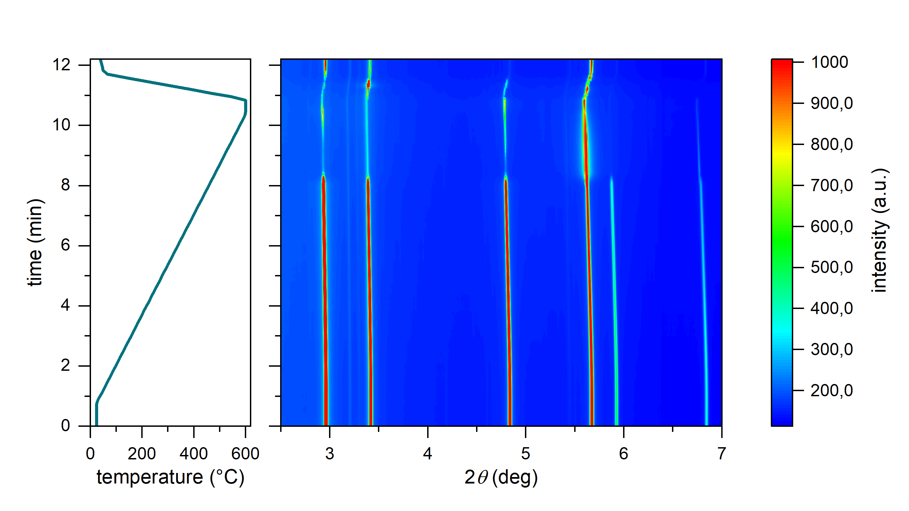
Rexx during continous heating
IV
493°C
stacked PCR-BT2.0 sheets
IV
III
479°C
III
II
II
464°C
I
Al-111
Al-200
Al-220
Al-311
Al-222
Al-400
I
start

Slide 18
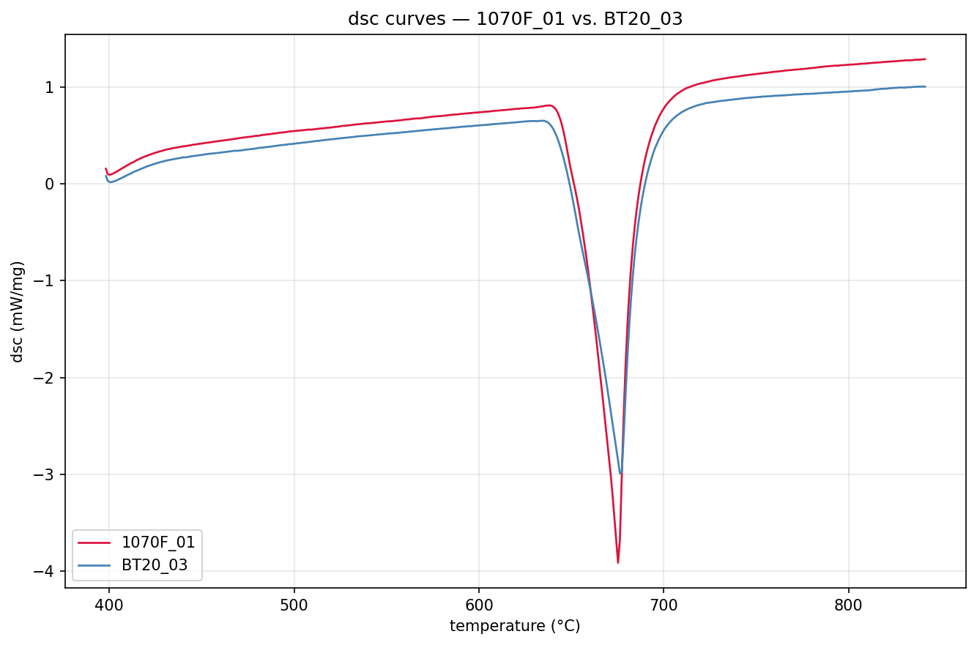
Melting temperatures by DSC
AW-1070 – 655.4°C
PCR BT2.0 – 648.2°C

