Slide 1
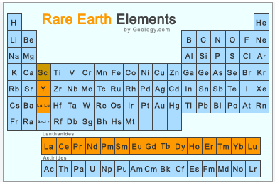
Rare earth elements: What are and how to recycle it
Name: Francesco Dian
1° year PhD student in Udine
PhD in Environmental and Energy Engineering Science

Slide 2
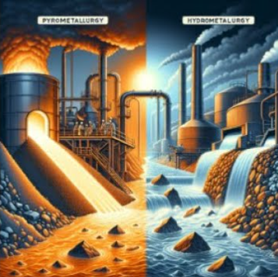
Hydrometallurgy and Pyrometallurgy

Slide 3
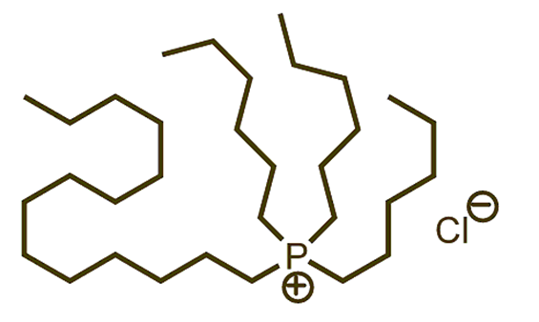
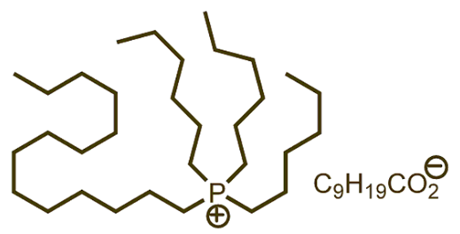
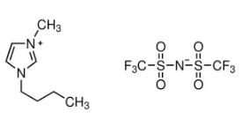
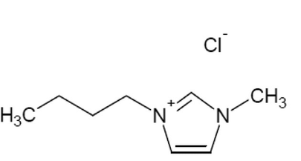
Ionic Liquids

Slide 4
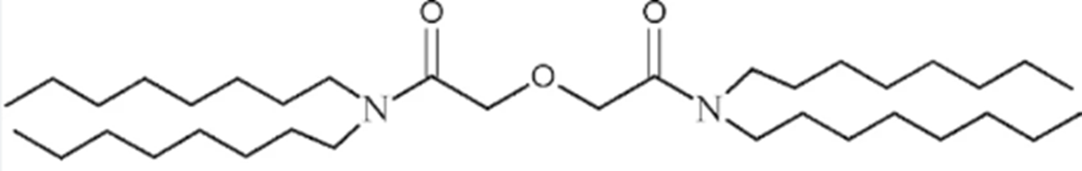
TODGA
N,N,N',N'-tetraoctyl diglycolamide

Slide 5
Future prospects
Explore alternative extractants, such as D2EHPA, which is widely used for REE extraction.
Extend preliminary data on the ILs embedded in Polymer inclusion membranes (PIMs)

Slide 6
THANKS FOR YOUR ATTENTION

